Slide 1
Unlocking the Secrets of Progress Developer Studio for OpenEdge
Name Srinivas Kantipudi
Title Sr Manager
Date 7th June, 2015

Slide 2
Focus of the session
Introduction to PDS for OE
Tips for different User personas

Slide 3

Introduction to PDS for OE
Configure
Develop
Build
Publish
Test
PDS OE

Slide 4
Tips – Categorized based on different User personas
Vivid keyboard User
Large projects
Response time
Customizations
Keep things clean

Slide 5
Tips – Categorized based on different User personas
Keep things clean
Large projects
Response time
Customizations
Vivid keyboard User

Slide 6
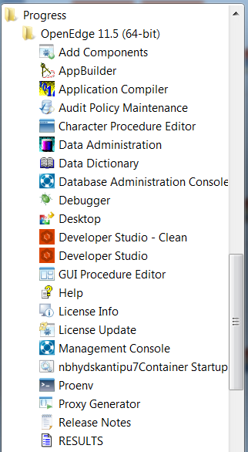
All about –clean option: When to and when not to use
Keep things clean
Developer Studio
2x to 3x times faster
Developer Studio -clean
Keeps PDS OE clean
Clear stale cache information
For daily use
When you update plugins

Slide 7
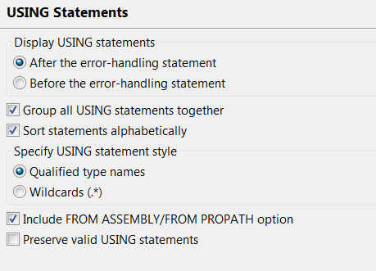
Organize your code
Keep things clean
Organize USING Statements
  Eliminates duplicate and removes unused USING statements
  Expands USING Statements to fully qualified type
  Sort and group USING statements
  Preferences to suite your styles
Preferences: Progress OpenEdge → Advanced → USING Statements
Menu: Source → Organize USING Statements (Ctrl+Shift+O)

Slide 8
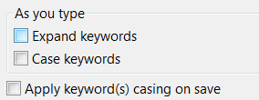
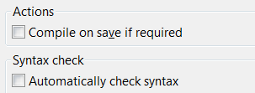
Code manageability
Keep things clean
Applying casing on save
  Alternative is to use shortcut: Ctrl+Shift+F
Expand keywords
Compile on save
Preferences: Progress OpenEdge → Editor
Menu: Source → Expand Keywords (Ctrl+Shift+1)
Preferences: Progress OpenEdge → Editor → Build

Slide 9
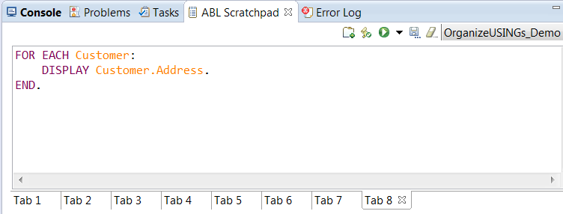
Writing trial code – Use a Scratchpad
Keep things clean
ABL Scratchpad
  Experiment your new logic without creating any new ABL file
  Keeps your project clean
Menu: Window→ Show View→ ABL Scratchpad

Slide 10
Tips – Categorized based on different User personas
Keep things clean
Large projects
Vivid keyboard User
Response time
Customizations

Slide 11
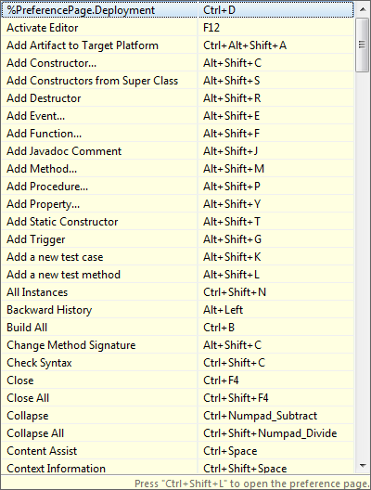
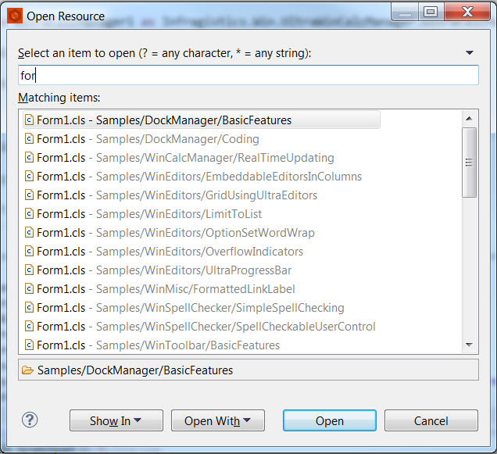
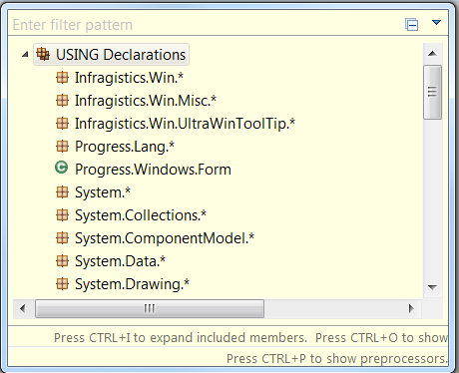
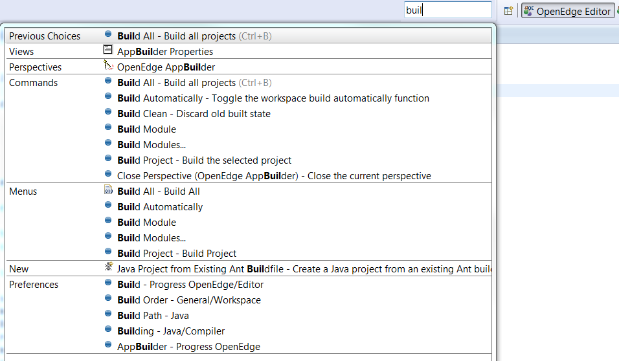
Top keyboard Shortcuts
Vivid keyboard User
Mother of all Shortcuts
Access/Open anything from one place
Find any resource
Quick Outline view in the Editor
Ctrl + Shift + L: List all Shortcuts
Ctrl + 3: Quick access
Ctrl + Shift + R: Open resource
Ctrl + O: Opens Quick Outline view

Slide 12
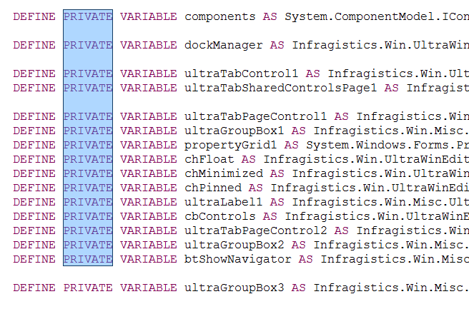
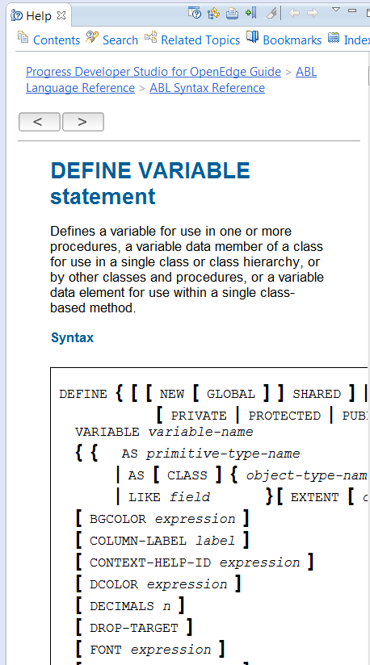
Other useful shortcuts
Vivid keyboard User
Jump to lines with errors
Keyword Help
Block selection mode
Ctrl + . (dot): Goes to first error
Shift + F2: Syntax reference
Alt + Shift + A: Toggle block selection on and off

Slide 13
Tips – Categorized based on different User personas
Vivid keyboard User
Large projects
Response time
Customizations
Keep things clean

Slide 14
32 Vs 64 bit PDS OE
Response time
The more is not always the merrier
  Consumes more memory
  Performance hit at places
Large heap size available
  Advantage for memory intensive operations
Time in secs
Configuration:
Machine: Windows 7, 64 bit OS with 8 GB RAM
Project (s): One project with 10,000 files

Slide 15
Heap Memory settings
Response time
Default heap setting is mostly not sufficient
  -Xms40m
  -Xmx384m
Time in secs
Eclipse.ini file:
<DLC>/oeide/eclipse/eclipse.ini

Slide 16
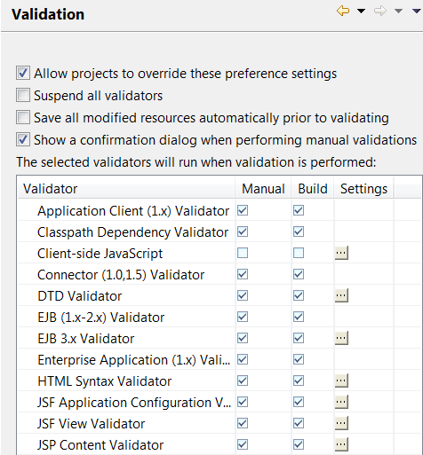
Validations
Response time
Checks certain files in the project for errors
Takes nearly 30 secs for validations during REST project creation
By default takes Workspace level settings
  Can enable project level settings
Validations happen during Build, project creation
Rules can be created to exclude certain folders/files
Preferences: Validation
Project properties: Validation

Slide 17
Tips – Categorized based on different User personas
Vivid keyboard User
Large projects
Response time
Customizations
Keep things clean

Slide 18
Build settings
Large projects
Auto build mode
Time consuming for large projects
Keeps your project up to date
Manual build mode
Control on builds
Can’t see errors unless you build
Other options
Exclude from build
Default for PDS OE
Build kicks in after every change
Restricting the errors per build
Other options like compile on save will help
Working Sets

Slide 19
Working Sets
Large projects
Work on subset of projects
Reduces time and noise for many operations
Limit the search to working set(s)
Working set 1
Project 1
Project 2
Project 3
Working Set 2
Working Set 3
Menu: Project → Select Working Set
Project → Build Working Set -> Select Working Set

Slide 20
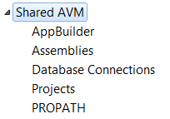
Shared AVM
Large projects
Common AVM
  Use Shared AVM when multiple projects share same settings
Project1
AVM 1
Project2
Shared
AVM
DB1
Projectn
Preference: Progress OpenEdge → Shared AVM

Slide 21
Tips – Categorized based on different User personas
Vivid keyboard User
Large projects
Response time
Customizations
Keep things clean

Slide 22
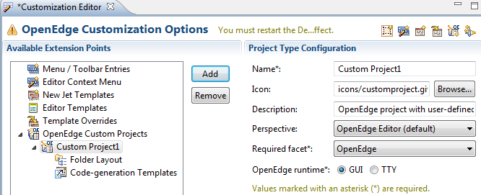
Customization Editor
Customizations
Customize projects, menu, toolbar & context menu items
  Create custom projects
  Create custom menu & toolbar items
  Add new templates or override existing templates
Menu: OpenEdge → Tools → Customization Editor

Slide 23
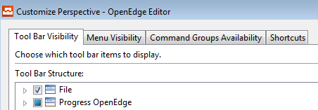
Customization of Perspectives and startup
Customizations
Customize Perspective
  Customize Toolbar, Menu
Project startup customization
  Run a file during start of AVM
  Subscribe to Events or perform specific operation
Menu: Window → Customize Perspective
Project: _idestartup.p

Slide 24
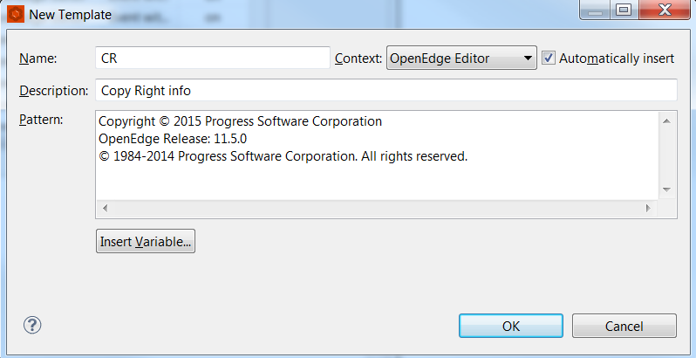
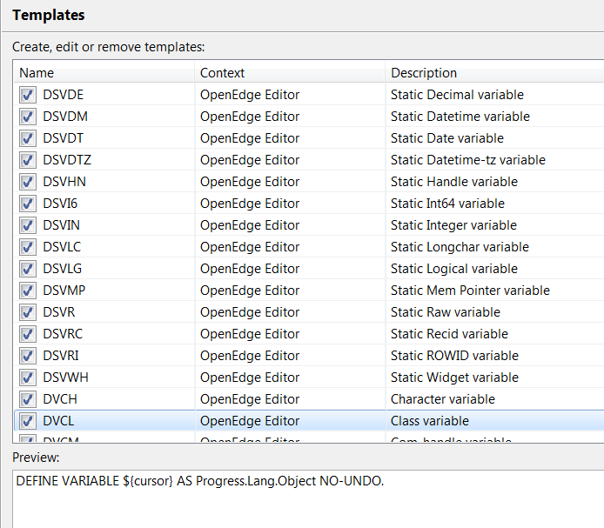
Macros
Customizations
Macros
  Use predefined macros
  Customize to fit your style
  Add your own macros
  Export and Import
Preferences: Progress OpenEdge → Editor → Templates(macros)

