Slide 1
Continuous Integration for OpenEdge Applications
Name DivyaTheja Pachipula
Title Senior Engineer
Date 8th June, 2015

Slide 2
Focus of the session
Development environments and challenges
What is Continuous Integration
Continuous Integration flow
Tools Involved
Demo

Slide 3
Need for CI – Today’s development environments
Distributed teams
Agile Development
Multiple teams
Multiple countries
Cloud Platforms
Short end cycles
Daily/Weekly releases
Multiple technologies

Slide 4
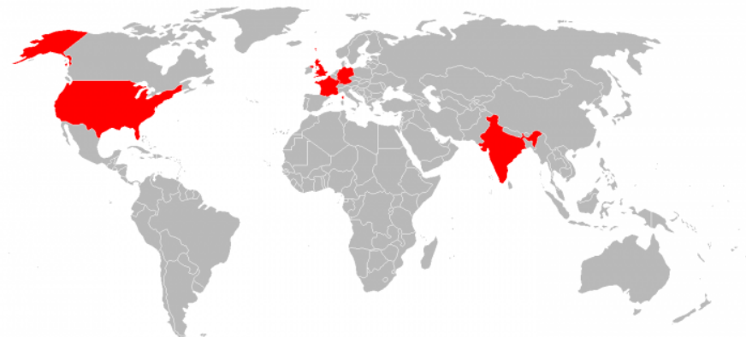
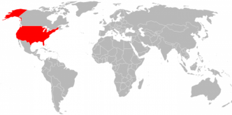





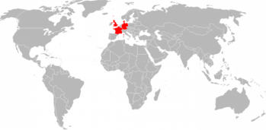


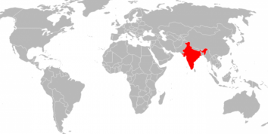
Need for CI - Application Development Challenges
Infrequent
commits
OE Developer 1
Lots of bugs
OE Developer 2
Source code
repository
Testing
happens late
Infrequent
builds
Difficult
integration
OE Developer 3

Slide 5
Need for CI - Application Development Challenges
Infrequent
commits
Slow release process
Poor project visibility
Insufficient testing
Issues raised are harder to fix
OE Developer 1
Lots of bugs
OE Developer 2
Source code
repository
Testing
happens late
Infrequent
builds
Difficult
Integration
OE Developer 3

Slide 6
What is Continuous Integration?
“Continuous Integration is a software development practice where members of a team integrate their work frequently; usually each person integrates at least daily - leading to multiple integrations per day. Each integration is verified by an automated build (including test) to detect integration errors as quickly as possible.”
- Martin Fowler

Slide 7



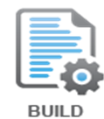

Continuous integration flow
COMMIT
INITIATE CI
PROCESS
REPORT
TEST

Slide 8
Tools involved

Slide 9
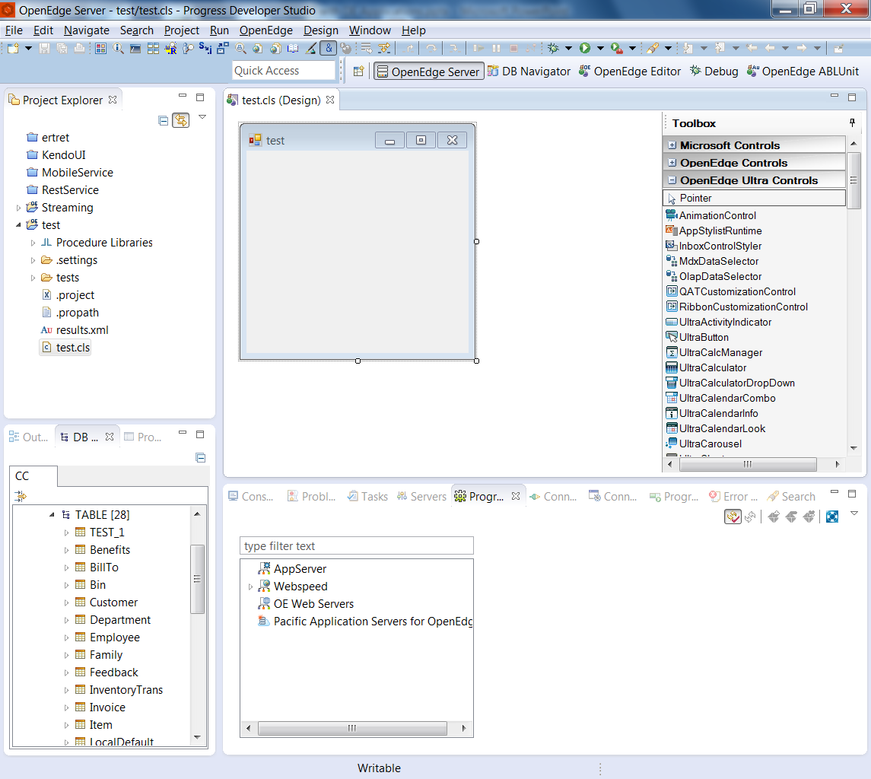
Tools Involved
Development
Check-in
Build
Generate
artifacts
Test
Publish
results
Developing OpenEdge Applications
  Procedure Editor
  Progress Developer Studio for OpenEdge
Unlocking Secrets of Progress Developer Studio for OpenEdge

Slide 10
Tools Involved
Development
Check-in
Build
Generate
artifacts
Test
Publish
results
Tool | Availability | Eclipse Plug-in | Vendor
GIT | Open Source | Yes
SVN | Open Source | Yes | Apache
CVS | Open Source | Yes (As part of normal eclipse) | GNU
Mercurial | Open Source | Yes | GNU
Team Foundation Server | Commercial | Yes (Teamprise) | Microsoft
Round Table | Commercial | Yes | TugBoat
AccuRev | Commercial | Yes | AccuRev
PerForce | Commercial | Yes | PerForce
Clearcase | Commercial | Yes | IBM

Slide 11
Tools Involved
Development
Check-in
Build
Generate
artifacts
Test
Publish
results
Source Control Components
  Server
    Repository
  Client
    Command-line client
    Windows client
    Eclipse client

Slide 12
Tools Involved
Development
Check-in
Build
Generate
artifacts
Test
Publish
results
Artifacts to be shared with team
  Database artifacts
  Property files
  Third party libraries
  Test Scripts
  Install Scripts
  PDS OE specific
    Workspace preferences
    Projects
    Project properties

Slide 13
Tools Involved
Development
Check-in
Build
Generate
artifacts
Test
Publish
results
Progress Compilation Tool (PCT)
  ANT Task
  From Riverside Software
Libraries
Compile
Database
<property environment="env" />
<taskdef resource="PCT.properties"/>
<DlcHome value="${DLC}"/>
<target name="build" description="Builds source files">
<mkdir dir="build"/>
<PCTCompile destDir="build">
<fileset dir="src">
<include name="**/*.cls" />
<include name="*.p" />
</fileset>
</PCTCompile>
</target>

Slide 14
Tools Involved
Development
Check-in
Build
Generate
artifacts
Test
Publish
results
Generate Procedure Libraries
Generate Documentation for ABL Code
  ABLDoc
    Progress proprietary
  Class Documentation
    Consulting werk
Experience enhanced PDSOE with powerful features

Slide 15
Tools Involved
Development
Check-in
Build
Generate
artifacts
Test
Publish
results
Tool | Supported test cases (Files Types) | Availability
ProUnit | Procedures | Open Source
OEUnit | Classes | Open Source
ABLUnit | Procedures and Classes | PDS OE

Slide 16
Tools Involved
Development
Check-in
Build
Generate
artifacts
Test
Publish
results
Publish results to team
  Artifacts generated
  Test results
  ABL Documentation

Slide 17
Components Involved - Tools : CI Server
Source Control
Publish results
Build
CI Server
Test
Generate artifacts

Slide 18
Tools Involved : CI Server
Tool | Vendor | Availability | SCM Support | Build Tools | Plug-in availability
Jenkins | - | Open Source | Yes | Ant, Maven | Eclipse
Hudson | Oracle |  |  | Ant, Maven | Eclipse
Cruise Control | GNU | Open Source | Yes | Ant, MS Build | Eclipse
Go | Thought Works | Commercial | Yes
Team Foundation Server | Microsoft | Commercial | Built-in | MS Build | Visual Studio, Eclipse
Bamboo | Atlassian | Open Source / Commercial | Yes | Maven, Ant, MS Build | Eclipse, Visual Studio and IntelliJ
Electric Commander | Electric Cloud | Commercial | Yes |  | Eclipse and Visual Studio
Team City | JetBrains | Free / Commercial | Yes | Ant | Eclipse, Visual Studio and IntelliJ

Slide 19

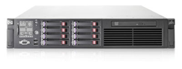
Development Process with CI
Sends
feedback
Regular
commits
OE Developer 1
Testing
happens early
Source
Control
CI Server
OE Developer 2
Automated
Builds, tests, ..
Fewer bugs
OE Developer 3

Slide 20
Development Process with CI: Benefits
Sends
feedback
Regular
commits
OE Developer 1
Testing
happens early
Smoother integration process
Automated regression tests
Regular working releases
Better visibility
Find and fix issues faster and more easily
Source code
repository
CI Server
OE Developer 2
Automated
Builds, tests, ..
Fewer bugs
OE Developer 3

Slide 21
Continuous Integration Best Practices
Always run all tests locally before committing
Wait for committed tests to pass before moving on
Never go home on a broken build
Always be prepared to revert to the previous revision
Don’t comment out failing tests
Don’t check-in on a broken build
Make builds fast

Slide 22

Continuous integration for OpenEdge Applications

Slide 23
Continuous Integration - Summary
Continuous Integration can help us build better
quality software faster,
with more confidence

