Slide 1
Progress Developer Studio for OpenEdge WebSpeed Development
Ramadevi Dhavala
Senior QA Engineer
June 9th, 2015

Slide 2
Focus of the Session
Introduction To Progress Developer Studio For OpenEdge(PDS OE)
WebSpeed support in PDS OE
Integrating Kendo UI With OpenEdge WebSpeed
Demo

Slide 3
Introduction To Progress Developer Studio for OpenEdge (PDSOE)
AppServer
Rest
Mobile
GUI
WebSpeed
ABLUnit
Dynamics
StaticWeb
Progress Developer Studio for OpenEdge
Eclipse Plug-in Platform
Eclipse based IDE
Highly customizable and easily navigable user interface
Extensive plug-ins available for extending the functionality
Notes:
Progress developer Studio for OpenEdge (PDS OE) is the eclipse based IDE.
As Eclipse is an open-source, plug-in based framework, we can integrate a wide variety of software tools into the Eclipse installation, that is what we did in Progress Developer Studio for OpenEdge. In PDSOE, Every feature is a plug-in. In future If I want to develop another new feature I can simply create and plug in and can easily incorporate it.
PDSOE used to develop OpenEdge applications from a simple ABL application to mobile applications.
It helps you to :
•Quickly build user-interface and business logic
•Incorporate and manage application data sources
•Run, debug and deploy code
Progress Developer Studio for OpenEdge consists of a set of editors, views, dialogs, and wizards that run in the Eclipse framework.
Apart from the functionalities like rest, mobile, appserver, GUI for .net, CHUI and static web, PDSOE also allows us to develop an OpenEdge project with ‘Webspeed’ functionality.

Slide 4
Introduction To WebSpeed in PDSOE
PDSOE
App Builder
Web
Speed
Mobile
GUI for .Net
Rest
CHUI
WebSpeed development support completely revamped in 11.0 – All capabilities brought into PDS OE
Progress Developer Studio for OpenEdge
Notes:
Progress developer Studio for OpenEdge (PDS OE) is the eclipse based IDE.
As Eclipse is an open-source, plug-in based framework, we can integrate a wide variety of software tools into the Eclipse installation, that is what we did in Progress Developer Studio for OpenEdge. In PDSOE, Every feature is a plug-in. In future If I want to develop another new feature I can simply create and plug in and can easily incorporate it.
PDSOE used to develop OpenEdge applications from a simple ABL application to mobile applications.
It helps you to :
•Quickly build user-interface and business logic
•Incorporate and manage application data sources
•Run, debug and deploy code
Progress Developer Studio for OpenEdge consists of a set of editors, views, dialogs, and wizards that run in the Eclipse framework.
Apart from the functionalities like rest, mobile, appserver, GUI for .net, CHUI and static web, PDSOE also allows us to develop an OpenEdge project with ‘Webspeed’ functionality.

Slide 5
WebSpeed Development
Support for Static and Dynamic content
WebSpeed Project Type
Two different programming models
CGI Wrapper
SpeedScript
Run & Debug Support
WebSpeed
Programming
Models
Remote publish and Debug supported
WebSpeed
Development
WebSpeed Server
Speed Script
Editor
Multi Page Editor
with three tabs
SpeedScript
Generated ABL
Preview
Support for both local and remote WebSpeed brokers

Slide 6
WebSpeed Web Request Round-Trip
Client Browser
Messenger
WebSpeed
Broker
WebSpeed
Agent
WebServer
Business Logic
Internet
Database
Notes:
Now we will discuss how a web transaction happens for a webspeed project. In general, the client, running in a Web browser, generates a connection request in the form of a URL, which is sent to a Web server to the resource and back again through the Web server to the browser and then terminating.
Webspeed also follows the same mechanism.
The HTML client, running in a Web browser, generates a connection request in the form of a URL, which is sent to a Web server, which forwards it to webspeed broker, the business logic gets executed there and the output will send back to the webserver. Finally the response will send back to the Client browser.
In order to build a WebSpeed application, it is important to understand how data pass between web components when they process a request.

Slide 7
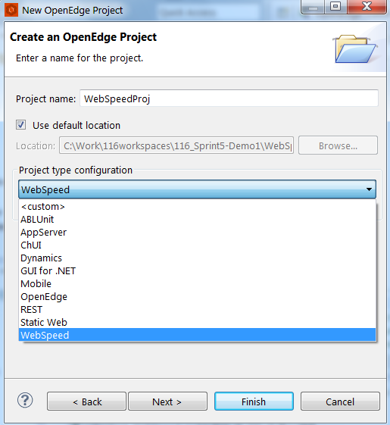
OpenEdge WebSpeed Project Type
WebSpeed Project Type
Programming
Models
Speed Script
Editor
WebSpeed Server
Run & Debug Support
WebSpeed project type
AppServer Perspective
  Easy access to related context menu options
  Servers view
WebSpeed facet
  OpenEdge, WebSpeed and JavaScript
Notes:
Once we are done with the basic pre requisites, we have to define/configure a websped project.
For this PDSOE provides a separate facet for ‘webspeed’ project type.
As soon as the project is created all the required facets OpenEdge, javascript and webspeed will be automatically added.
To provide the better organization of the code different kind of folders (HTML content, speedScript and webspeed )will also get added.
In general, whenever an OpenEdge project is created, PDSOE gives the user an option to open the associated perspective which contains all the required views and wizards of that particular project type.
Webspeed also has its own perspective to access the related context menu options quickly and the required views easily.
Enables JavaScript development using multiple source files in a configurable Include Path.

Slide 8
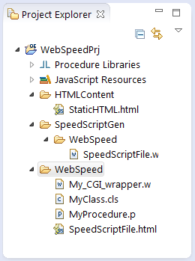
OpenEdge WebSpeed Project Artifacts
WebSpeed Project Type
Programming
Models
Speed Script
Editor
WebSpeed Server
Run & Debug Support
JavaScript Resources
  Contains JavaScript library
HTMLContent
  Contains static html files
WebSpeed
  Contains SpeedScript files and CGIWrappers
SpeedScriptGen
  Contains the auto generated .w files

Slide 9
Programming Techniques
WebSpeed Project Type
Programming
Models
Speed Script
Editor
WebSpeed Server
Run & Debug Support
<html>
<head> </head>
<body></body>
</html>
WebSpeed Application
Standard HTML
CGI Wrapper
Speed
Script
<html>
<script language="SpeedScript">
</script>
</html>
.W file
{&out} (html markup inside)
process-web-request
Notes:
There are primarily three types of files that can be used when developing WebSpeed applications:
HTML files with embedded SpeedScript (a subset of the ABL)
CGI wrappers (dynamically generate HTML, so no standalone HTML file is required)
Each of these file types includes WebSpeed-specific methods and procedures.
The different types of Web objects provide different approaches to Web development, but they also provide different WebSpeed capabilities. Your choice of Web object depends both on your
development approach and on what you want your application to do. If you feel most comfortable working directly in HTML, you probably want to use embedded SpeedScript Web objects. If you want to separate user interface from internal logic , you might want to use CGI Wrapper or HTML Mapped Web objects. To build state-persistent applications, you must use CGI Wrapper or HTML Mapped Web objects.
Each type of Web object uses different mechanisms for merging HTML and program logic. Embedded SpeedScript and CGI Wrapper Web objects merge the HTML with program logic at compile time. HTML Mapped Web objects merge the HTML almost completely at run time

Slide 10
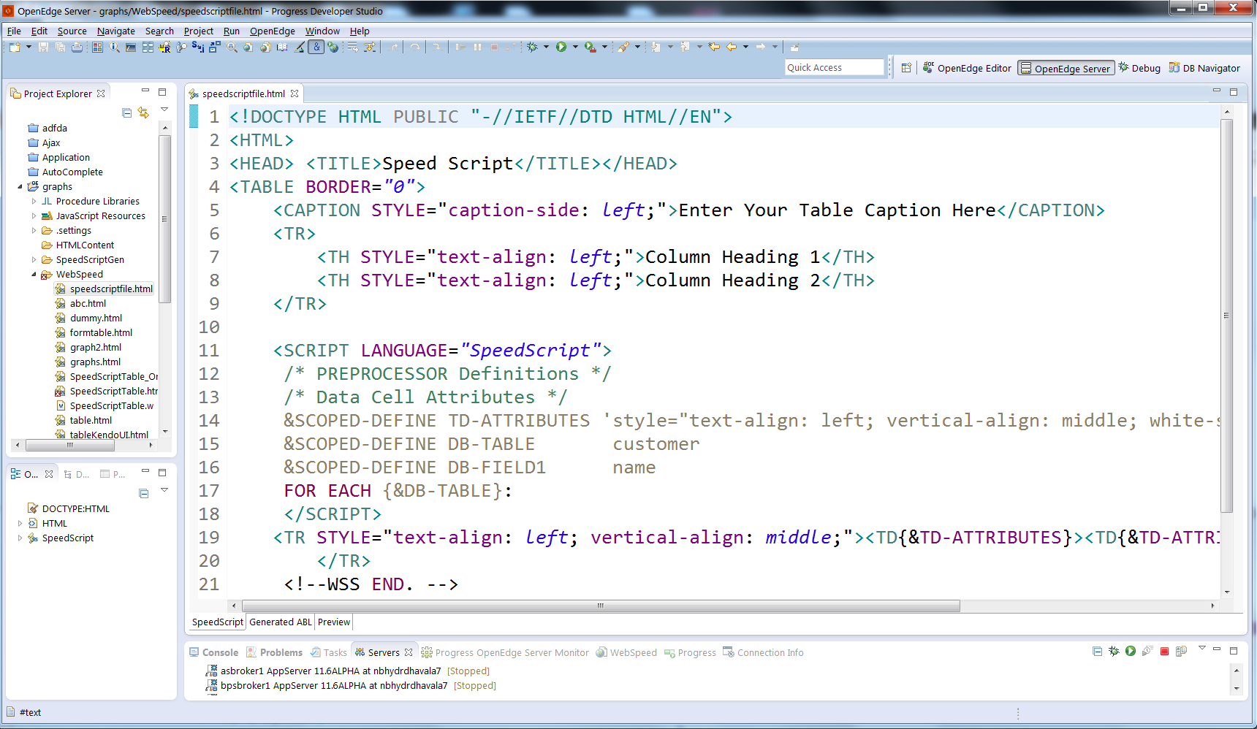

SpeedScript Editor
WebSpeed Project Type
Programming
Models
Speed Script
Editor
WebSpeed Server
Run & Debug Support
Supported Actions:
ABL colour coding
Correct case
Expand keywords
Compile/ Syntax check
Hover/ Keyword help
Content Assist / Open declarations
Surround with Catch/ finally block
Add Procedure/ Add Function
Multi Page Editor with three tabs
SpeedScript
Generated ABL
Preview
HTML section
SpeedScript section
Notes:
All new SpeedScript Editor. As I mentioned, it has three tabs, SpeedScript tab for writing SpeedScript, Preview tab to preview and Generated ABL tab which shows the generated ABL content.
By default, all .html/.htm files will be associated with this editor as the default editor in OpenEdge Architect.
The editor supports most of the ABL Editor actions like color coding, correct case etc
You can write your speedscript and you don’t have to run it to check, we have preview tab which shows how it looks.
While creating SpeedScript file, to make it even more easier, we have provided default webspeed templates which you can chose. You can also create your own template and that shows up in the list. We all like templates, right. I never want to code catch block or a variable, its always dvcl or CATCH.
How does AVM get to know about our speedscript file. The transformation is through the .w file which acts like intermediate file for .html and the AVM ...
So that’s Web development. We have taken old capabilities and made them better, now everything from within PDS OE.

Slide 11
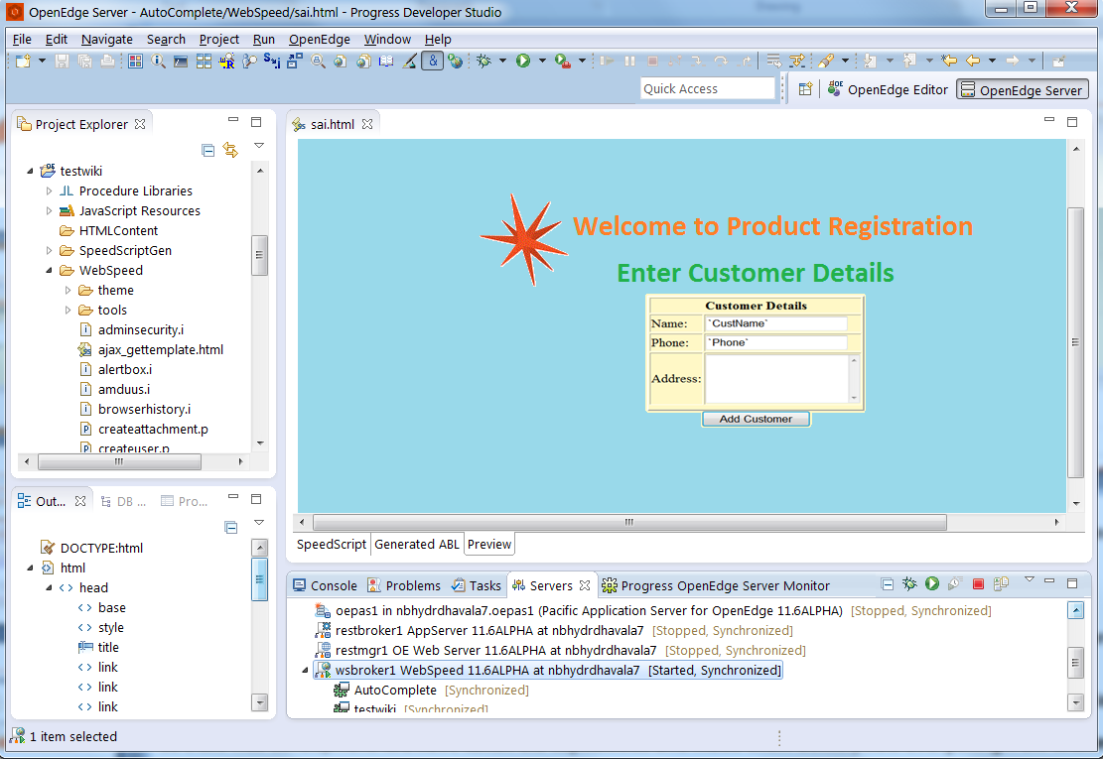
SpeedScript Editor- Preview Tab
WebSpeed Project Type
Programming
Models
Speed Script
Editor
WebSpeed Server
Run & Debug Support`
Notes:
HTML files with the <script Language="SpeedScript"> tag. ABL code can be written insdie this tag
All new SpeedScript Editor. As I mentioned, it has three tabs, SpeedScript tab for writing SpeedScript, Preview tab to preview and Generated ABL tab which shows the generated ABL content.
By default, all .html/.htm files will be associated with this editor as the default editor in OpenEdge Architect.
You can write your speedscript and you don’t have to run it to check, we have preview tab which shows how it looks.
While creating SpeedScript file, to make it even more easier, we have provided default webspeed templates which you can chose. You can also create your own template and that shows up in the list. We all like templates, right. I never want to code catch block or a variable, its always dvcl or CATCH.
How does AVM get to know about our speedscript file. The transformation is through the .w file which acts like intermediate file for .html and the AVM ...
So that’s Web development. We have taken old capabilities and made them better, now everything from within PDS OE.

Slide 12
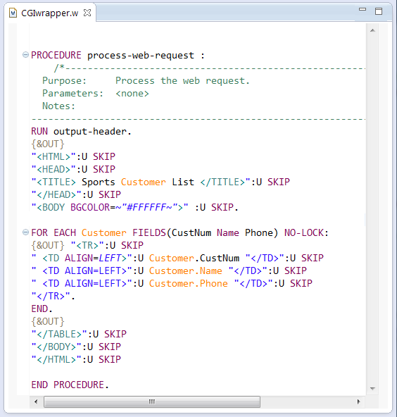
Programming Considerations - CGI Wrapper
A CGI Wrapper file is a .w file
The {&OUT} preprocessor combines with a sub-procedure “process-web-request” to generate a valid HTML page
It contains HTML markup that is wrapped by a SpeedScript {&OUT} preprocessor statement
Notes:
File-> New-> CGI wrapper wizard
Opens in ABL editor
HTML color coding for {&OUT} statements
Uses Appbuilder CGI wrapper template
Add appbuilder markup for adding appbuilder annotations
There is no HTML source file associated with a CGI Wrapper Web object. Compilation of a .w source file produces a .r file that is executed by a WebSpeed agent. When executed, CGI Wrapper Web objects dynamically create HTML content that is returned to the client browser.
CGI wrapper — A Web object that dynamically generates HTML within the context of
SpeedScript.

Slide 13
Programming Techniques
WebSpeed Project Type
Programming
Models
Speed Script
Editor
WebSpeed Server
Run & Debug Support
WebSpeed Application
Standard HTML
CGI Wrapper
Speed
Script
Notes:
There are primarily three types of files that can be used when developing WebSpeed applications:
HTML files with embedded SpeedScript (a subset of the ABL)
CGI wrappers (dynamically generate HTML, so no standalone HTML file is required)
Each of these file types includes WebSpeed-specific methods and procedures.
The different types of Web objects provide different approaches to Web development, but they also provide different WebSpeed capabilities. Your choice of Web object depends both on your
development approach and on what you want your application to do. If you feel most comfortable working directly in HTML, you probably want to use embedded SpeedScript Web objects. If you want to separate user interface from internal logic , you might want to use CGI Wrapper or HTML Mapped Web objects. To build state-persistent applications, you must use CGI Wrapper or HTML Mapped Web objects.
Each type of Web object uses different mechanisms for merging HTML and program logic. Embedded SpeedScript and CGI Wrapper Web objects merge the HTML with program logic at compile time. HTML Mapped Web objects merge the HTML almost completely at run time

Slide 14
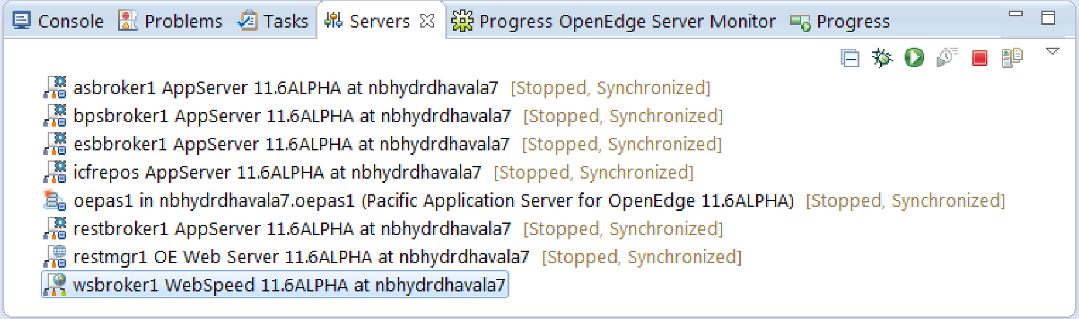
OpenEdge WebSpeed Server
WebSpeed Project Type
Programming
Models
Speed Script
Editor
WebSpeed Server
Run & Debug Support`
Debug/Start/Stop
/Restart/Publish
WebSpeed server
Notes:
Once we are done with programming, all the source files have to be compiled and published to a server.
PDSOE allows you to compile standard HTML, HTML with Embedded SpeedScript, or CGI Wrapper files to create executable Web objects.
To publish the (executable) Web objects, PDSOE offers a dedicated server called 'WebSpeed server' for the OpenEdge webSpeed projects. PDSOE knows everything about where to publish or when to publish.

Slide 15
OpenEdge Explorer
Progress Developer Studio for OpenEdge
OpenEdge Explorer
http://localhost:9090
Admin Server
HTTP/HTTPS
WebSpeed Broker
Connection Profile
Notes:
OpenEdge Architect now has a capability to create WebSpeed Server inside the Servers View
Now the question is how does a WebSpeed server instance inside OEA is able to talk to the actual WebSpeed broker (maybe on local machine as well as remote machine) and control it
There is a web app known as OpenEdge Explorer which comes installed along with OpenEdge Architect. This web application offers a lot of functionality in itself and it also knows how to talk to AdminServer running on local as well as remote machine.
OEA 110 offers users to define connection profiles to talk to OpenEdge Explorer either local or remote.
So each WebSpeed Server instance has a OpenEdge Explorer Connection profile reference through which it talks to OpenEdge Explorer and controls the WebSpeed broker

Slide 16
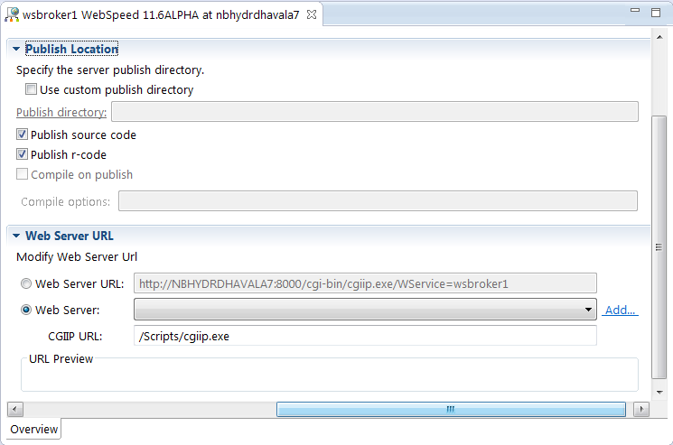
WebSpeed Server Editor
WebSpeed Project Type
Programming
Models
Speed Script
Editor
WebSpeed Server
Run & Debug Support
  Server Editor to customize Server properties
  Publishing Intervals
  Publish location
  Web Server URL

Slide 17
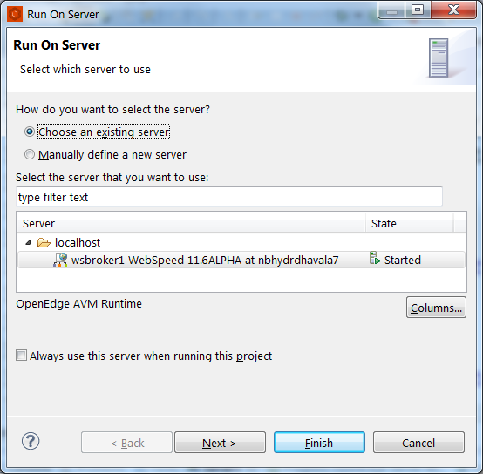
Run On Server
WebSpeed Project Type
Programming
Models
Speed Script
Editor
WebSpeed Server
Run & Debug Support
  Utility to run the dynamic html file on selected WebSpeed server
  Displays existing servers
  Provision to create a new server
Notes:
Once the code is published, the very next thing we do is test application and debug.
For this requirement, PDSOE offers debug functionality for 'WebSpeed server'. User can add breakpoints and debug their webspeed applications either locally or remotely.
Explain about run configurations and run on server options
We can use Launch configuration to Run and debug programs. We have provided several different launch configurations. Launch configuration will define the characteristics of AVM, there are several parameters that you can configure like propath, db, startup parameters etc.
Associating a project is mandatory
New launch configuration always uses separate AVM. You can change this to use project AVM. You can do this from Launch configuration main tab or you can set this in preference which will be applicable to all new launch configurations.
There are 10 tabs for openedge launch configuration.

Slide 18
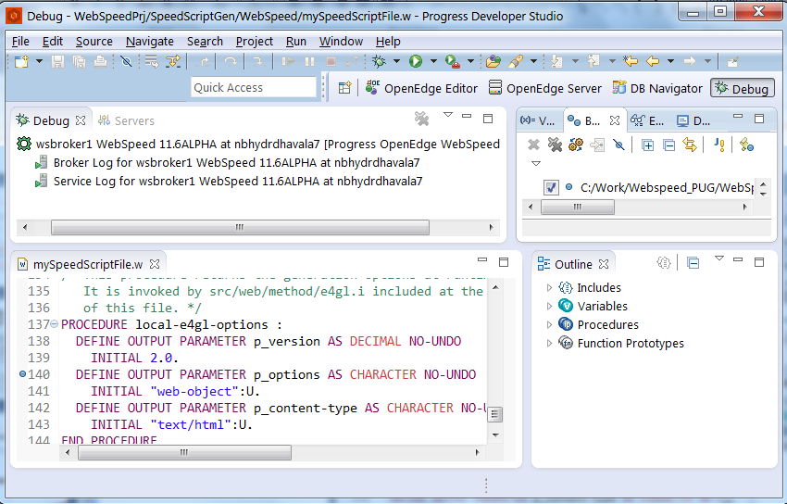
OpenEdge WebSpeed- Debug
WebSpeed Project Type
Programming
Models
Speed Script
Editor
WebSpeed Server
Run & Debug Support
Support for both Local and Remote Debugger
Operates on compiled r-code
Break points
Notes:
Once you run your application using launch configurations, if there are errors, you can debug them from PDS OE.
Similar to launch configuration, we have debug configuration. Using debug configurations, you can debug local or remote abl files. If you are debugging a local file, you can specify this file in debug configuration and set a breakpoint in the file and run the debug configuration and it opens a debug perspective and stops at the line where you have the breakpoint.
You can view expressions by adding watchpoints
This is local debugging. PDS OE also supports remote debugging. From debug configurations, we have an option to configure your external avm or an AppServer broker or an remote broker where you want to debug your code.

Slide 19
WebSpeed Development
Support for Static and Dynamic content
WebSpeed Project Type
Two different programming models
CGI Wrapper
SpeedScript
Run & Debug Support
WebSpeed
Programming
Models
Remote publish and Debug supported
WebSpeed
Development
WebSpeed Server
Speed Script
Editor
Multi Page Editor
with three tabs
SpeedScript
Generated ABL
Preview
Support for both local and remote WebSpeed brokers

Slide 20
Introduction to Kendo UI Framework
HTML5
jQuery
Kendo UI
CSS3
A JavaScript framework for building modern and interactive web applications
Notes:
Kendo UI is a frame work created by Telerik composed of different technologies which are helpful in UI development.
Kendo UI= CSS3+ JQuery+HTML5
Kendo UI is a comprehensive HTML 5, JavaScript framework for modern web and mobile application development. Kendo UI uses the power of HTML5, CSS3, and jQuery to deliver a powerful set of widgets that makes the day to day development activity much simpler.
In this presentation, I will introduce you to Kendo UI and how it can be used in your daily development using webspeed.

Slide 21
Kendo UI Framework Elements
Web
UI Widgets
Framework Features
DataViz
Charts & Graphs
DataViz Widgets
Mobile
Mobile Widgets
Mobile Features
Notes:
The set of widgets provided by Kendo UI include web, mobile, and data visualization.
Kendo UI Web- for touch-enabled desktop development
Kendo UI DataViz- for desktop and mobile data visualizations
Kendo UI Mobile- for mobile app development, including Phone Gap deployment

Slide 22
Integrating Kendo UI components into PDS OE
Go to http://www.telerik.com/kendo-ui
Download the trail version (.zip).
Unzip the file and copy required .js and.css files to your project .
Start using the Kendo UI
OR
Directly use it from CDN

Slide 23
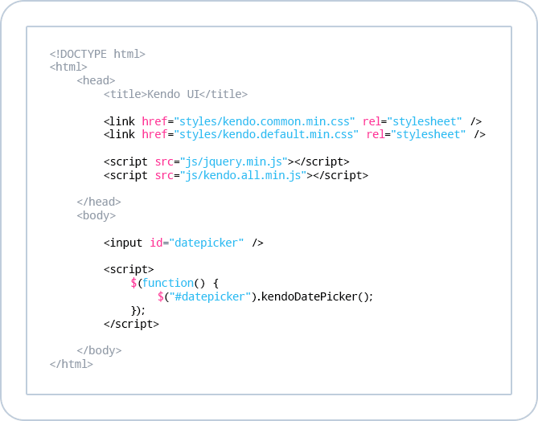
Sample Kendo UI code

Slide 24
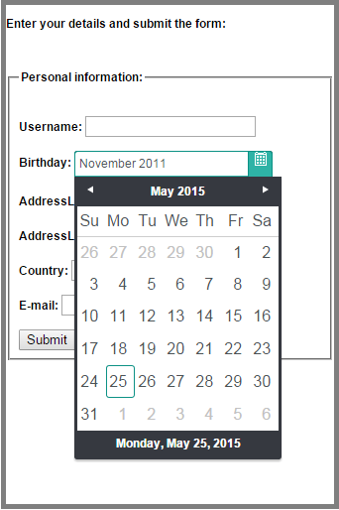
Sample Kendo UI Calendar- Result

Slide 25
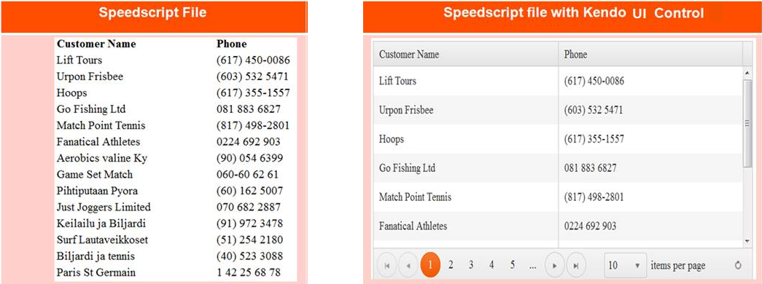
Integrating Kendo UI with WebSpeed Objects
Changes the look and feel to a modern web application with minimal coding effort.
Notes:
How the applications will be with Kendo UI
How we can use the webspeed as backend for Kendo UI

Slide 26
Demo

