Slide 1
Progress Developer Studio
Productivity features added in 11.4 and 11.5
Suresh Inavolu
Principal Software Engineer
9th June, 2015

Slide 2
Quick introduction to Progress Developer Studio
Notes:
Progress Developer Studio for OpenEdge is an integrated development environment that helps you develop various OpenEdge applications like ???

Slide 3



Progress Developer Studio
Rules & Process
Corticon Business Rules
OpenEdge BPM
Advanced ABL editor
Compile, Run, Debug
Unit testing, Documentation
ABL language
GUI development
ChUI
AppBuilder
Dyanmics
GUI for .Net
Services – REST, Mobile
Server - OpenEdge WebServer, AppServer, WebSpeed, PASOE
Server Side
Database
Design – schema, add/alter tables
Run SQL queries
Eclipse
+2000 plugins
Notes:
Mobile App?

Slide 4
Productivity features added in 11.4 and 11.5

Slide 5
Agenda
Unit testing using ABL Unit
ABL Doc
Organize USING Statement
Find References

Slide 6
Why Unit testing
Why Unit testing
  Change code confidently!
  Reduce bugs
  Improves design
  Defend against other programmers/interfaces
  Forces the developer to think
Imperfect tests, run frequently, are much better than perfect tests that are never written at all – Martin Fowler
  Integrate with build system

Slide 7
ABL Unit
Unit testing framework for ABL
  ABLUnit
Features
  Annotation based
    Test Suite procedure and Test Suite class - @TestSuite
    Test method, Test procedure - @Test
    Within the Test class/procedure
      @Setup, @TearDown, @Before, @After
  Assert API
    OpenEdge.Core.Assert:equals
      Supports Objects, INTEGER, CHARACTER, .. (all ABL datatypes)
  Support command line and ant task
    Useful for integrating with build system

Slide 8
ABL Code
ABL Class
ABL Test class
CLASS ConversionTestCase:
@Test.
METHOD PUBLIC VOID testFahrenheit2Celsius( ):
DEFINE VARIABLE conversion AS TemparatureConversion NO-UNDO.
DEFINE VARIABLE c AS DECIMAL NO-UNDO.
conversion = NEW TemparatureConversion().
c = conversion:Fahrenheit2Celsius(100).
Assert:equals(37.77, c).
RETURN.
END METHOD.
END CLASS.
CLASS TemparatureConversion:
METHOD PUBLIC DECIMAL Fahrenheit2Celsius (INPUT f AS DECIMAL):
DEFINE VARIABLE c AS DECIMAL NO-UNDO.
c = (f - 32) * 5 / 9.
RETURN TRUNCATE(c, 2).
END METHOD.
END CLASS.
Notes:
FC GVSW `

Slide 9
ABL Unit Lifecycle
TemparatureConversion.cls
@Before ConnectDB
@Setup OpenFile
@Test testFahrenheit2Celsius
@TearDown CloseFile
@Setup OpenFile
@Test testCelsius2Fahrenheit
@TearDown CloseFile
@After DisconnectDB

Slide 10
Demo - ABL Unit

Slide 11
Agenda
Unit testing using ABL Unit
ABL Doc
Organize USIGN Statement
Find References

Slide 12
ABL Doc
What is ABL doc
  Tool for generating API documentation in HTML format from doc comments in source code.
Why ABL doc
  Manual API documentation is very time consuming and will become outdated very quickly
What information should be there in API documentation
  Targeted user – developer using API either for extending the product, or using product
  Useful information like when the API returns undefined, vs throws an exception, any edge cases, what caller has to do – like clean methods (after opening a file, user should call close file once the processing is done).

Slide 13
ABL doc features
Annotation in comments
  Parse the code for author, date of creation, information about input/output
Generates HTML output
  Change the template - footer, header information, css to suite your branding
Ant support
  Generate documentation as part of your build process
Extensibility
  Write code to support for custom formats
  Extend for other output format like PDF

Slide 14
/*---------------------------------------------------
Purpose: Temparature Conversion Application
Description: Convert temparature from celsius to fahrenheit and fahrenheit to celsius
Author(s) : sinavolu
Created : Mon Jun 01 12:54:15 IST 2015
*/
CLASS TemparatureConversion:
/*---------------------------------------------------
Description: Fahrenheit2Celsius method converts the given fahrenheit to celsius
@param f The fahrenheit value in decimal
@return Celsius value with 2 decimal points.
-----------------------------------------------------------------------------*/
METHOD PUBLIC DECIMAL Fahrenheit2Celsius (INPUT f AS DECIMAL):
DEFINE VARIABLE c AS DECIMAL NO-UNDO.
c = (f - 32) * 5 / 9.
RETURN TRUNCATE(c, 2).
END METHOD.
END CLASS.

Slide 15
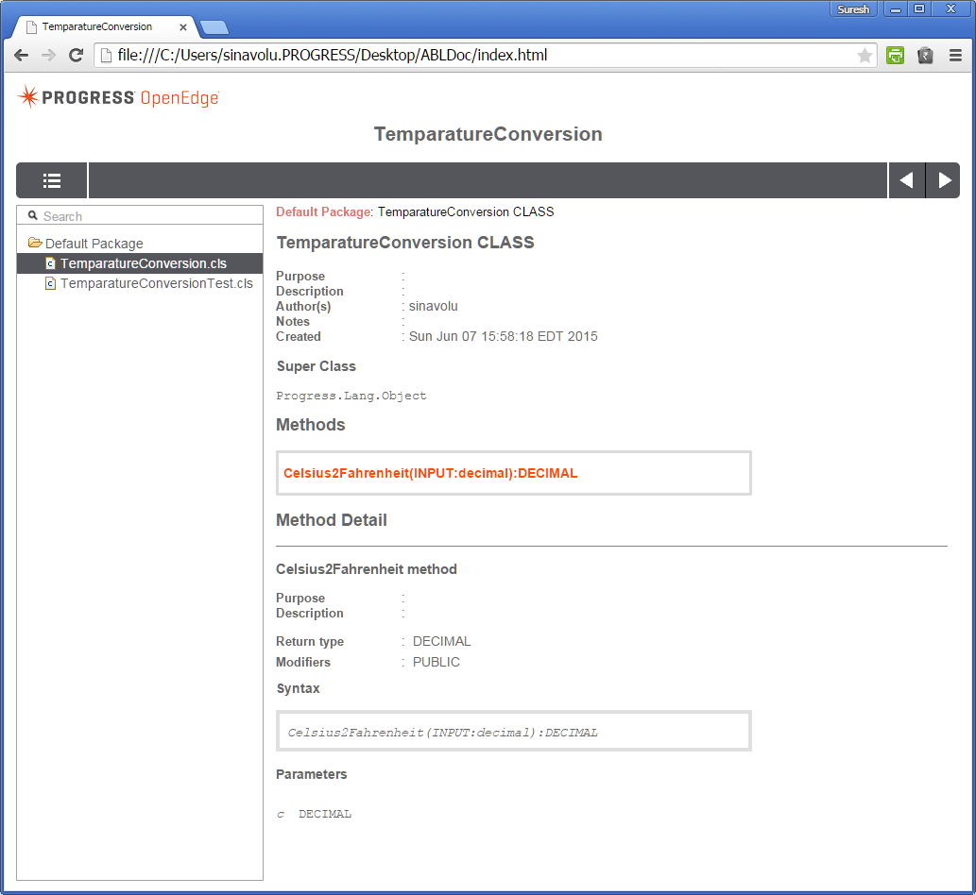
Notes:
TBD – fix use 11.5.1

Slide 16
Demo – ABL Doc

Slide 17
Agenda
Unit testing using ABL Unit
ABL Doc
Organize USIGN Statement
Find References

Slide 18
Organize USING Statements
Organize USING statement from PDSOE
Expand wild card to fully qualified name
Remove unused USING statement
Group/Sort USING statement based on package names
Resolve conflicts

Slide 19
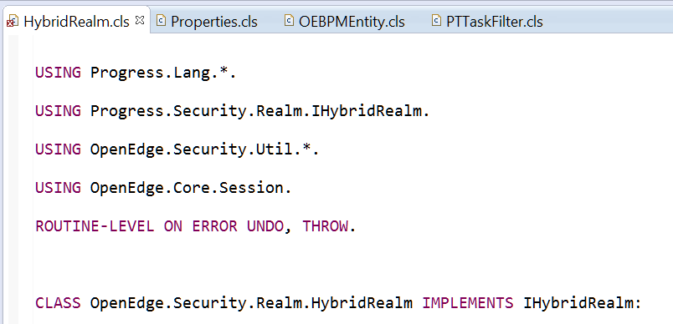
Example: Before invoking Organize USING statements
Not sorted
Using .*. pattern
Unused USING statement
USING statement before error handling statement

Slide 20
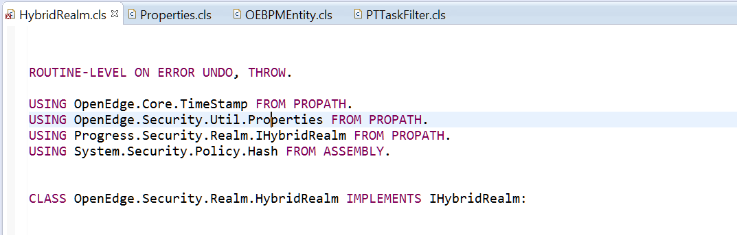
Example: After invoking ‘Organize USING’
Unused USING removed
Expanded *.* USING statement
Sorted
Moved the ERROR handling statement to the top
Added FROM PROPATH to the USING statement

Slide 21
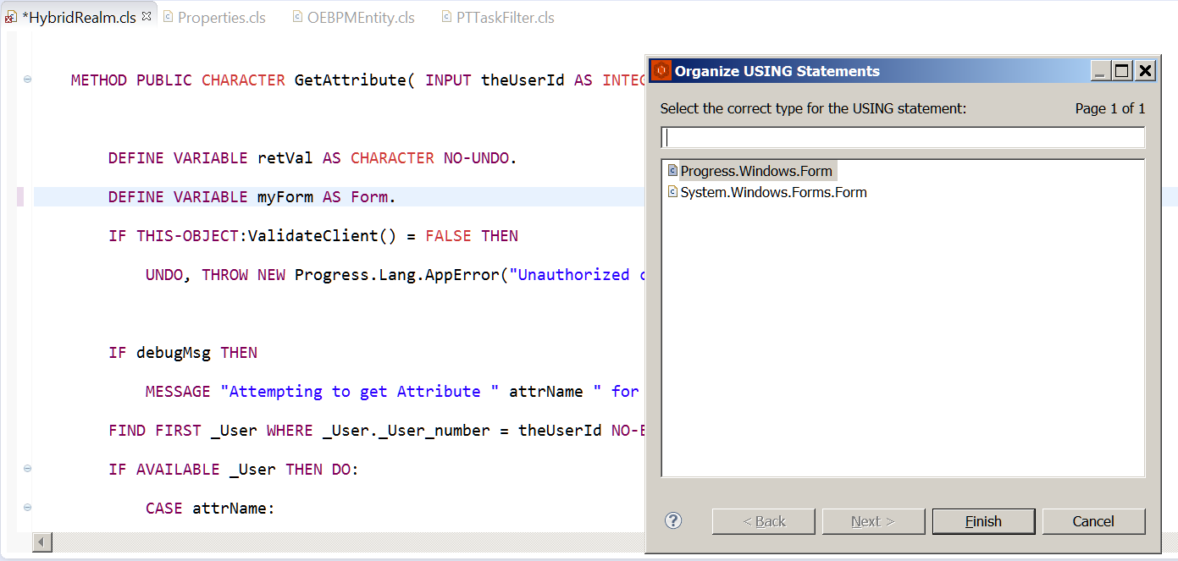
Resolving conflicting types
Notes:
Reference inside the code
Progress.Lang.*
System.*
System.Object.

Slide 22
Demo - Organize USIGN Statement

Slide 23
Agenda
Unit testing using ABL Unit
ABL Doc
Organize USIGN Statement
Find References

Slide 24
Find References
Find the usages/references of that element inside your workspace or project
Support elements
  Include files
  Internal and External Procedures
  Variable references
  Temp-table, Prodataset, Buffer usage
  Class Instance members, Class level members
  Class methods
Notes:
Text search vs Find References
Demo at each topic.

Slide 25
Demo - Find References

Slide 26
Summary
1
ABL Unit
2
ABL Doc
3
Organize USING
4
Find references

Slide 27
Questions?

