Slide 1
abstract
To paraphrase Benjamin Disraeli, there are lies, damned lies and benchmarks.
Your intrepid band of benchmarkers returns once more, with the results of testing a recent release of the OpenEdge RDBMS on Linux.
This time, the focus of our efforts has been on
Table partitioning an existing and large database.
Come to this talk to find out what they discovered. Get some hints and tips you can use to optimize your OpenEdge on Linux setup.
Notes:
GUS

Slide 2


Tales of the secret bunker !
2015 edition
Gus Björklund, Lackey
Chris Ruprecht, Lackey
Mike Furgal, MFWIC

Slide 3

We are

Slide 4
Notices
Please ask questions as we go
We have cheated a little,
leaving out some details here and there
to save time

Slide 5
Some things we will talk about
Our test environment
OpenEdge 11.5 table partitioning
ATM results
Our production database
How we partition our existing data
Pre and post-partition results.
Dumping and loading
Notes:
GUS

Slide 6
where is the bunker ?
Notes:
CHRIS

Slide 7

find directions where location-name = "secret bunker"

Slide 8
chris

Slide 9
the test machine

Slide 10
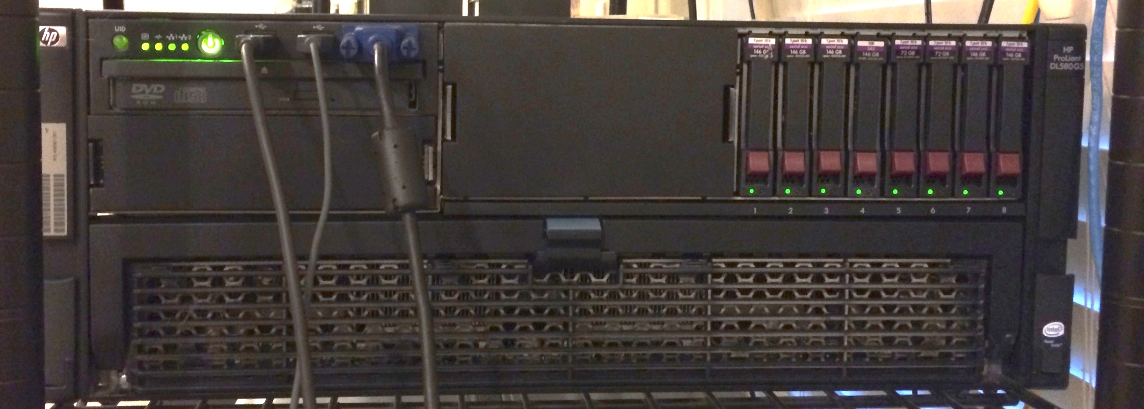
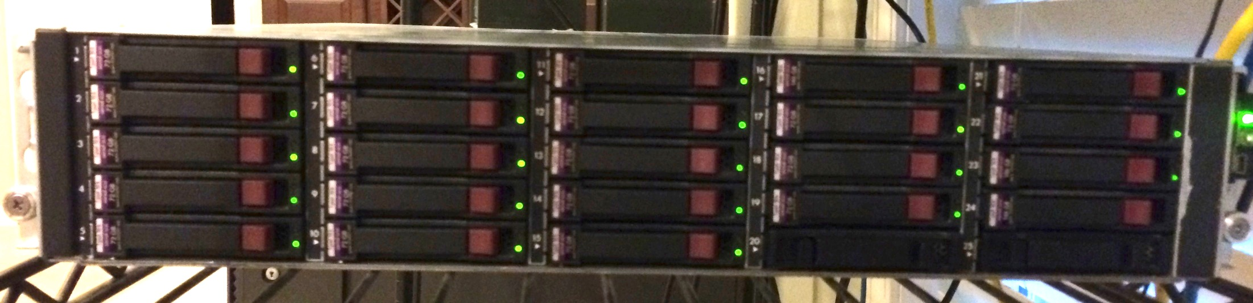
bunker15

Slide 11
bunker15 machine
4 quad-core 2.4 GHz Intel processors
  4800.25 bogomips
64 GB memory
8 x 146 GB 10,000 rpm sas drives
  4 RAID 10
  4 RAID 0 for /opt/tmp
16 x 300 GB 10,000 rpm drives
  RAID 10 for /home
Centos Linux
  2.6.32-504.12.2.el6.x86_64
OpenEdge 11.5
OpenEdge 10.2B08
New this machine costs
$35,000 USD.
Used we found it for
$3,500 USD

Slide 12
gus

Slide 13
OpenEdge RDBMS
table partitioning overview

Slide 14
OpenEdge Table Partitioning
The OpenEdge RDBMS Table Partitioning feature allows you to organize the rows of a table into multiple physical storage objects (i.e. partitions), based on one or more column values, in an application-transparent manner.
By using this feature you can achieve increased data availability and make maintenance operations easier, quicker, and more efficient.
You can partition data of existing tables quickly and gradually move data into the new storage objects. When all are moved, truncate previous areas to recover disk space.
Notes:
GUS

Slide 15
Table partitioning features
partition types
  list partitions
  range partitions
  list-range partitions
  list-list partitions
read-write and read-only partitions
existing unpartitioned data can be easily migrated into partitions
partition merge utility
partition split utility
index rebuild / index compact of indvidual partitions
binary dump / binary load of individual partitions

Slide 16
ATM results

Slide 17
ATM
database expanded to 240,000,000 rows
unpartitioned versus partitioned by branch id
Notes:
GUS

Slide 18
About ATM ...
Standard Secret Bunker Benchmark
  baseline config always the same since Bunker#2
  Not today, though – 3x larger database
Simulates ATM withdrawal transaction
150 concurrent users
  execute as many transactions as possible in given time
Highly update intensive
  fetch 3 rows
  update 3 rows
  create 1 row with 1 index entry

Slide 19
About ATM ... the database
account rows | 240,000,000
teller rows | 240,000
branch rows | 24,000
data block size | 4 k
database size | ~ 35 GB
maximum rows per block | 64
allocation cluster size | 512
data extents | 11 variable, + 2 x 10 partitions
bi blocksize | 16 kb
bi cluster size | 16384
build time | 146 min
the expanded database setup

Slide 20
About ATM ... baseline config
-n 250 # maximum number of connections
-S 5108 # broker's connection port
-Ma 2 # max clients per server
-Mi 2 # min clients per server
-Mn 100 # max servers
-L 10240 # lock able entries
-Mm 16384 # max TCP message size
-maxAreas 90 # maximum storage areas
-B 64000 # primary buffer pool number of buffers
-spin 10000 # spinlock retries
-bibufs 32 # before image log buffers

Slide 21
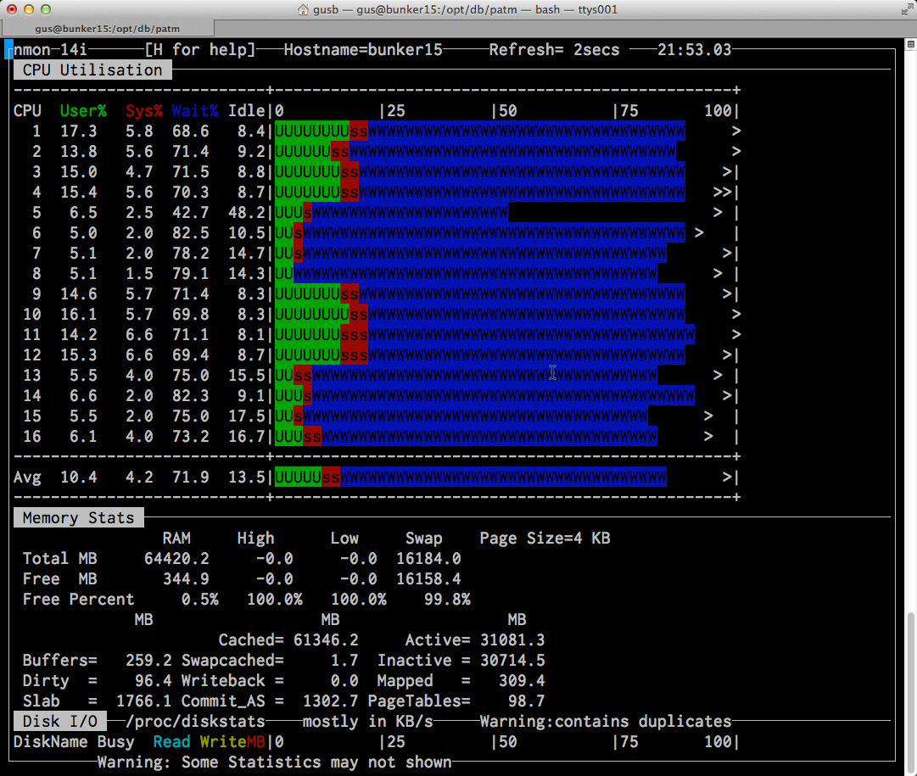

Slide 22
PATM results this machine is stout !

Slide 23

nearly there
Notes:
MIKE

Slide 24
mike

Slide 25
the bravepoint mdba backend production database
Notes:
Mike

Slide 26
Total Customers | 100
Total Databases | 1,363
Total DB Size (GB) | 63,113
Total Users | 96,520
Collecting and Analyzing VST performance metrics every 15 minutes across all customers databases

Slide 27
promonitor database numbers
attribute | value
Total size | 863 G
Number of tables | 56
Number of indexes | 76
Record blocks* | 84,431,569
Index blocks* | 18,267,504
* 8k blocks, after dump and load

Slide 28
tables to be partitioned
table name | number of rows | table size | row size min / avg / max
areastats | 1,276,802,814 | 93.7 G | 59 / 78 / 112
stats | 76,601,749 | 28.4 G | 231 / 398 / 550
There are many other tables in the database, but these are the 2 primary tables that are used to generate the dashboard

Slide 29
partitioning the database

Slide 30
Partitioning procedure for existing data, part 1
Generate dbanalys report
Backup ?
Enable table partitioning and partition index build
Add areas and extents for partitions
Designate tables as partitioned
Define partitions
Split data into partitions
Rebuild or compress indexes

Slide 31
Partitioning procedure for existing data, part 2
Generate partitionmanage view table status reports
Drop now empty initial partitions
Truncate empty areas
Remove extents of empty areas
Generate dbanalys report
Compare before and after reports
Mark some partitions read-only ?

Slide 32
gus

Slide 33
partition setup
Notes:
GUS

Slide 34
partition setup: 4 possible ways
0) OpenEdge Explorer
1) OpenEdge Management
2) program to call 4GL API
3) scripts with SQL DDL !!!
Notes:
GUS

Slide 35
enable table partitioning
proutil pm -C enabletablepartitioning
Adding Table Partitioning file _Partition-Policy
Adding Table Partitioning file _Partition-Policy-Detail
Enable Table Partitioning successful.
Table Partitioning has been successfully enabled
proutil pm -C enabletpidxbuild
TP Index Rebuild has been enabled for \
database pm. (12479)

Slide 36
define partitions for a table with existing data, part 1
set schema 'pub';
alter table pub.stats
partition by range "s-mdba-site-id"
using table area "Data-stats"
using index area "Index-stats"
(
partition stats_p0 values <= ( 'zzzz' )
)
using index "date-sample",
"stats-date",
"db-date-sample",
"s-sample#" ;
commit;
quit;

Slide 37
define partitions for a table with existing data, part 2
set schema 'pub';
alter table pub.stats prepare for split pro_initial
(
partition stats_p1 values <= ( '107' )
using table area "stats_tb_p1"
using index area "stats_ix_p1"
);
. . . . repeat for the other partitions . . . .
alter table pub.stats prepare for split pro_initial
(
partition stats_p9 values <= ( 'zzzz' )
using table area "stats_tb_p9"
using index area "stats_ix_p9"
);
commit;
quit;

Slide 38
split partitions for tables with existing data
proutil pm –C partitionmanage \
split table areastats composite initial \
useindex date-sample
proutil pm –C partitionmanage \
split table stats composite initial \
useindex date-sample

Slide 39
split utility output
BEGIN: Split Operation For Table areastats (17384)
Source Partition initial[0]
Target Partition AREASTATS_P1[1]
. . .
Target Partition AREASTATS_P9[9]
Index date-sample has been identified as the scanning index (useIndex).
A non-unique index has been selected as the useindex index.
Additional locking is required with the use of this index date-sample.
Number of Records per Transaction (recs): 100
Do you want to continue (y/n)?
1000000 records processed. (15165)
2000000 records processed. (15165)
. . .
Total records processed: 1276802814.
END: Split Operation For Table areastats[0]
Split Operation finished successfully. (17359)

Slide 40
mike

Slide 41
areastats table partitions
partition | range | nr. of rows | extent size
areastats_tb_p1 | → 107 | 54,652,873 | 6.5 G
areastats_tb_p2 | 107 → 118 | 28,465,470 | 3.4 G
areastats_tb_p3 | 118 →18 | 56,881,593 | 6.8 G
areastats_tb_p4 | 18 → 33 | 207,241,438 | 24.7 G
areastats_tb_p5 | 33 → 50 | 159,970,866 | 19.0 G
areastats_tb_p6 | 50 → 66 | 217,269,832 | 25.9 G
areastats_tb_p7 | 66 →81 | 390,946,904 | 46.6 G
areastats_tb_p8 | 81 → 90 | 104,965,394 | 12.5 G
areastats_tb_p9 | 90 → zzzz | 56,408,444 | 6.72 G
Notes:
MIKE

Slide 42
stats table partitions
partition | range | nr. of rows | extent size
stats_tb_p1 | → 107 | 3,787,225 | 1.42 G
stats_tb_p2 | 107 → 118 | 3,205,987 | 1.27 G
stats_tb_p3 | 118 →18 | 3,902,095 | 1.07 G
stats_tb_p4 | 18 → 33 | 7,117,216 | 2.9 G
stats_tb_p5 | 33 → 50 | 9,275,534 | 1.42 G
stats_tb_p6 | 50 → 66 | 15,613,030 | 6.31 G
stats_tb_p7 | 66 →81 | 23,953,761 | 9.25 G
stats_tb_p8 | 81 → 90 | 6,400,826 | 2.51 G
stats_tb_p9 | 90 → zzzz | 3,346,075 | 1.31 G

Slide 43

here
the bunker
www.opte.org/maps

Slide 44
another way:
dump and load

Slide 45
Dump and load partitioning procedure
Generate source dbanalys report – before
Backup
Binary dump tables from source database
Create new target database from empty
Enable table partitioning and partition index build
Load .df file (or use create table statements)
Define partitions
Binary load the data
Build the indexes
  1 partition at a time, or 1 table at a time
Generate partitionmanage view table nnnn status reports
Generate dbanalys report - after
Compare before and after reports

Slide 46
gus

Slide 47
don't forget to load the tables you didn't partition !

Slide 48
define partitions for a table with no data, part 1
set schema 'pub';
alter table pub.stats
set partition using index
"date-sample",
"stats-date",
"db-date-sample",
"s-sample#" ;
commit;
quit;

Slide 49
define partitions for a table with no data, part 2
set schema 'pub';
alter table pub.stats
partition by range "s-mdba-site-id"
using table area "Data-stats"
using index area "Index-stats"
(
partition "stats_p1" values <= ( '107' )
using table area "stats_tb_p1"
using index area "stats_ix_p1",
. . . . for the other partitions . . . .
partition "stats_p9" values <= ( 'zzzz' )
using table area "stats_tb_p9"
using index area "stats_ix_p9"
) ;
commit;
quit;

Slide 50
load areastats table
stime=`date +"%s"`
proutil pm -C load /opt/tmp/dump/AreaStats.bd \
-i -B 81920 >>asbload.log
etime=`date +"%s"`
elapsed=$((etime - stime))
echo "areastats binary load time: $elapsed seconds."

Slide 51
build stats table indexes – 4 indexes, 9 partitions
stime=`date +"%s"`
echo `date +"%H:%M:%S"` "bulding indexes for stats table"
for IX_NAME in "stats-date" "db-date-sample" \
"date-sample" "s-sample#"
do
for P_NUM in {1..9}
do
echo "building index ${IX_NAME}, partition ${P_NUM}"
echo y | \
proutil pm -C tpidxbuild table stats \
index ${IX_NAME} partition STATS_P${P_NUM} \
-i -TB 64 -TM 32 -TMB 32 -B 1000
done
done
etime=`date +"%s"`
elapsed=$((etime - stime))
echo `date +"%H:%M:%S"` "elapsed time $elapsed seconds."

Slide 52
4gl code to show partition objects for a table
find _file where _file-name ="stats".
for each _storageObject
where _object-number = _file-num and
_object-type = 1:
display _object-number
_partitionid
_Object-attrib
_object-state
.
end.

Slide 53
areastats table partitions
partition | range | nr. of rows | extent size
areastats_tb_p1 | → 107 | 54,652,873 | 6.5 G
areastats_tb_p2 | 107 → 118 | 28,465,470 | 3.4 G
areastats_tb_p3 | 118 →18 | 56,881,593 | 6.8 G
areastats_tb_p4 | 18 → 33 | 207,241,438 | 24.7 G
areastats_tb_p5 | 33 → 50 | 159,970,866 | 19.0 G
areastats_tb_p6 | 50 → 66 | 217,269,832 | 25.9 G
areastats_tb_p7 | 66 →81 | 390,946,904 | 46.6 G
areastats_tb_p8 | 81 → 90 | 104,965,394 | 12.5 G
areastats_tb_p9 | 90 → zzzz | 56,408,444 | 6.72 G
Notes:
MIKE

Slide 54
stats table partitions
partition | range | nr. of rows | extent size
stats_tb_p1 | → 107 | 3,787,225 | 1.42 G
stats_tb_p2 | 107 → 118 | 3,205,987 | 1.27 G
stats_tb_p3 | 118 →18 | 3,902,095 | 1.07 G
stats_tb_p4 | 18 → 33 | 7,117,216 | 2.9 G
stats_tb_p5 | 33 → 50 | 9,275,534 | 1.42 G
stats_tb_p6 | 50 → 66 | 15,613,030 | 6.31 G
stats_tb_p7 | 66 →81 | 23,953,761 | 9.25 G
stats_tb_p8 | 81 → 90 | 6,400,826 | 2.51 G
stats_tb_p9 | 90 → zzzz | 3,346,075 | 1.31 G

Slide 55
partition setup times *
operation | areastats | stats
table size | 93.7 G | 28.4 G
nr of rows | 1,276,802,814 | 76,601,749
define partitions & areas | 1 minute | 1 minute
split into 9 parts | 77 hours | 9.2 hours
table.bd file size | 110.4 G | 29.5 G
binary dump | ~ 1.25 hours | ~ 0.4 hours
binary load | 2.66 hours | 0.31 hours
index rebuild table | 3.2 hours | 0.22 hours
index rebuild 9 partitions | 4.3 hours | 0.30 hours
pm view table status | 956 seconds | 35 seconds
* YMMV, mistakes, transportation, meals, and accomodations not included
Notes:
MIKE AND GUS

Slide 56
mike

Slide 57
promonitor dashboard generation times
 | tables partitioned | tables not partitioned
generate ~100 dashboards | 2.3 mins | 2.3 mins
Number of DB Requests to retrieve an AreaStats row
Task | 10.2B | 11.5 No TP | 11.5 TP
Find 1 row with multi-component index | 7 | 8 | 9
Index Used was a 5 component index
10.2B – 4 Levels
11.5 NO TP – 4 Levels
11.5 TP – 3 Levels
Notes:
MIKE

Slide 58
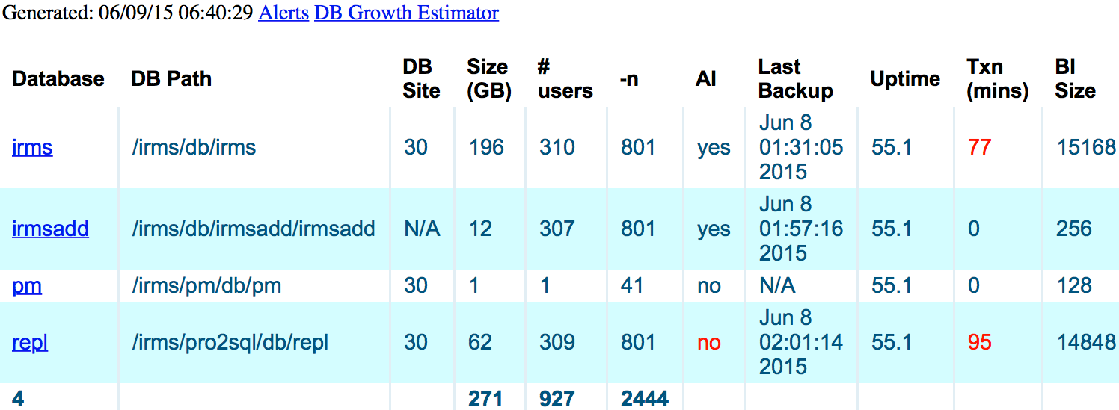

Slide 59

Secret bunker

Slide 60
Lessons learned, part 1
You think you know your data, but you don't*
  you really don't
  write programs to analyze data you think you know
112 < 98
Use SQL for partition setup
  really !
Plan.
  Do your homework !!!
Practice before doing a real database
Setup commands are different for empty and full databases
  check to be sure you will have at least 1 row in every partition
  check to be sure you will have 0 rows in every partition
* YMMV, mistakes, transportation, meals, and accomodations not included
Notes:
ALL

Slide 61
Lessons learned, part 2
Dump / load / idxbuild much faster than split
Index rebuild for table faster than for each partition of table
TB 64 TMB 32 allowed for –C tpidxbuild, not –C idxbuild
Can use partitioning to get online index rebuild
  Make 1 range partition per table for every table
Performance will be about the same*
We thought we knew our data – We were wrong!!!
Working with large databases takes time
PRACTICE
* YMMV, mistakes, transportation, meals, and accomodations not included

Slide 62
That’s all we have time for today, except

Slide 63

Gus B Mike F Dan F Chris R
Roadies: Paul Coveney, Darren Rhoads, Tom Cattigan, Joe Rozenberg
Jeff Keller, Marek Bujnarowski, Ajit Deodhar
Groupies: Dave Eddy, Humphrey Koraag, Diego Canziani, Kim Davies

Slide 64
?
Answers
Email:
mfurgal@bravepint.com
cruprech@bravepoint.com
gus@bravepoint.com

Slide 65
bonus slides

Slide 66
data extents for the areastats table
ls –l *20*.d1
-rw-rw---- 1 gus 6995705856 Jun 3 13:30 pm_201.d1
-rw-rw---- 1 gus 3643932672 Jun 3 13:30 pm_202.d1
-rw-rw---- 1 gus 7281442816 Jun 3 13:30 pm_203.d1
-rw-rw---- 1 gus 26527006720 Jun 3 13:30 pm_204.d1
-rw-rw---- 1 gus 20476723200 Jun 3 13:30 pm_205.d1
-rw-rw---- 1 gus 27810988032 Jun 3 13:30 pm_206.d1
-rw-rw---- 1 gus 50041323520 Jun 3 13:30 pm_207.d1
-rw-rw---- 1 gus 13436059648 Jun 3 13:30 pm_208.d1
-rw-rw---- 1 gus 7220625408 Jun 3 13:30 pm_209.d1

Slide 67
index extents for the areastats table
ls –l *22*.d1
-rw-rw---- 1 gus 1476001792 Jun 3 13:38 pm_221.d1
-rw-rw---- 1 gus 746192896 Jun 3 13:42 pm_222.d1
-rw-rw---- 1 gus 1577713664 Jun 3 13:50 pm_223.d1
-rw-rw---- 1 gus 6108610560 Jun 3 14:22 pm_224.d1
-rw-rw---- 1 gus 4314497024 Jun 3 13:30 pm_225.d1
-rw-rw---- 1 gus 6130630656 Jun 3 13:30 pm_226.d1
-rw-rw---- 1 gus 10482745344 Jun 3 13:30 pm_227.d1
-rw-rw---- 1 gus 2881617920 Jun 3 13:30 pm_228.d1
-rw-rw---- 1 gus 1533673472 Jun 3 13:30 pm_229.d1

Slide 68
data extents for the stats table
ls –l *24*.d1
-rw-rw---- 1 gus 1526857728 Jun 3 13:30 pm_241.d1
-rw-rw---- 1 gus 1363279872 Jun 3 13:30 pm_242.d1
-rw-rw---- 1 gus 1652162560 Jun 3 13:30 pm_243.d1
-rw-rw---- 1 gus 3123838976 Jun 3 13:30 pm_244.d1
-rw-rw---- 1 gus 3770286080 Jun 3 13:30 pm_245.d1
-rw-rw---- 1 gus 6779699200 Jun 3 13:30 pm_246.d1
-rw-rw---- 1 gus 9934340096 Jun 3 13:30 pm_247.d1
-rw-rw---- 1 gus 2694971392 Jun 3 13:30 pm_248.d1
-rw-rw---- 1 gus 1406271488 Jun 3 13:30 pm_249.d1

Slide 69
index extents for the stats table
ls –l *26*.d1
-rw-rw---- 1 gus 116523008 Jun 4 12:55 pm_261.d1
-rw-rw---- 1 gus 97124352 Jun 4 12:55 pm_262.d1
-rw-rw---- 1 gus 121241600 Jun 4 12:55 pm_263.d1
-rw-rw---- 1 gus 222429184 Jun 4 12:55 pm_264.d1
-rw-rw---- 1 gus 286916608 Jun 4 12:55 pm_265.d1
-rw-rw---- 1 gus 480903168 Jun 4 12:55 pm_266.d1
-rw-rw---- 1 gus 732561408 Jun 4 12:55 pm_267.d1
-rw-rw---- 1 gus 197787648 Jun 4 12:55 pm_268.d1
-rw-rw---- 1 gus 104464384 Jun 4 12:55 pm_269.d1

Slide 70
proutil –C partitionmanage view table stats status
PROGRESS Partition View
Database: /opt/db/gus3/pm
Date: Thu Jun 4 12:54:45 2015
PARTITION STATUS
----------------------
Table Rows
PUB.stats
initial:0 0
stats_p1:1 3787225
stats_p2:2 3205987
stats_p3:3 3902095
stats_p4:4 7117216
stats_p5:5 9275534
stats_p6:6 15613030
stats_p7:7 23953761
stats_p8:8 6400826
stats_p9:9 3346075

Slide 71
proutil –C partitionmanage view table areastats status
PROGRESS Partition View
Database: /opt/db/gus3/pm
Date: Thu Jun 4 12:55:17 2015
PARTITION STATUS
----------------------
Table Rows
PUB.AreaStats 0
areastats_p1:1 54652873
areastats_p2:2 28465470
areastats_p3:3 56881593
areastats_p4:4 207241438
areastats_p5:5 159970866
areastats_p6:6 217269832
areastats_p7:7 390946904
areastats_p8:8 104965394
areastats_p9:9 56408444

Slide 72
photo credits
the cloud
  www.opte.org/maps
secret bunker in ukraine
  by Trey Ratcliff : https://www.flickr.com/photos/stuckincustoms/374458067
  license: https://creativecommons.org/licenses/by-nc-sa/2.0/

