Slide 1
Migrating toPacific Application Server for OpenEdge
(PAS for OE)
Roy Ellis
ellis@progress.com

Slide 2
What We Will Be Talking About
Introduction to Pacific Application Server platform
Architecture
Configuration
Administration
Migration
Deployment
Demo
Notes:
Architecture: Quick overview of architecture, for more detailed information please refer to Dave Cleary’s talk ***need name of talk***
Configuration: Different
Migration: Differences running an application from Classic to PAS for OE
Administration: How to administer, monitor and manage
DEMO: I love live demos!
ESAP: This is great! How do I get the new PAS for OE?

Slide 3

Notes:
Not just the architecture, but how you have to think about an AppServer application. Not just the components, but how they interact and change management and administration.

Slide 4
Introduction to PAS Platform

Slide 5





Pacific Application Server Platform
A single delivery platform for all Progress Web-based products
  OpenEdge
  Rollbase
  Corticon
Not only the application but also the web server to support it
  Created from Apache Tomcat 7.0.55 distribution
Architected for secure operation
  Spring Security Framework included
  Realms and roles defined to implement access control

Slide 6
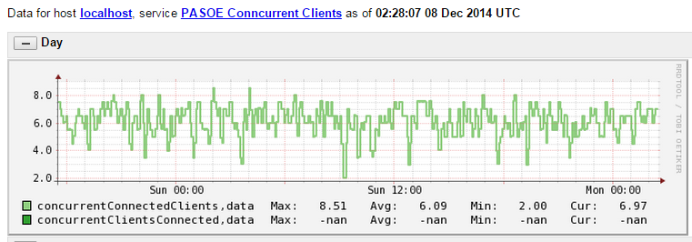
Pacific Application Server Platform
Easy management
  Common set of enhanced management tools
  No Tomcat knowledge necessary
Open monitoring
  JMX console/scripting
  Any third party Tomcat monitoring tools
Extensible
  Each product can extend core functionality for specific product needs

Slide 7
Pacific Application Server Platform
Uses the Tomcat idea of “instances”
The Progress install will:
  Create a READ-ONLY tomcat home directory (a.k.a. CATALINA_HOME)
  And a default instance (a.k.a. CATALINA_BASE)
Applications run in the instances

Slide 8
PAS for OpenEdge Architecture

Slide 9
Architectural Drivers
Secure production web server
  Installation, administration
Simpler
  Administration, scalability, application migration, deployment
  AppServer connection and operating STATEs
Customer Extensible
  Open REST APIs for customer developed metrics, monitoring, and administration
  Installation tailoring
Better analysis tools
  Built-in metrics gathering, current state queries
Faster and optimizes resources
  Runs same ABL application and client load with less memory and CPU consumption

Slide 10
Architecture: Basics
It is a web server:
  Tomcat
It is not a repackaged AppServer
  We migrated the functionality – not the implementation
Its designed for the Cloud
  Highly Scalable
  Security built-in
  New monitoring and administration tools

Slide 11
Architecture: Components
Classic AppServer Components
PAS for OpenEdge Components
Client
AIA WSA
REST/Mobile
Client
AdminServer
PAS for OpenEdge
NameServer
APSV (AIA)
SOAP (WSA)
REST/Mobile
AppServer
Session Manager
Agent
(1 ABL Session)
MSAgent
Agent
(1 ABL Session)
Agent
(1 ABL Session)
Agent
(1 ABL Session)
1 ABL Session
ABL Sessions
1 ABL Session
1 ABL Session
1 ABL Session
1 ABL Session
Notes:
CLASSIC
Must have an AdminServer
- AdminServer starts NameServer and AppServer
- then the AdminServer is just used to monitor and manage
Client connects to NameServer (optional) and is then redirected to the AppServer
If the Client needs to connect through the internet (HTTP/HTTPS)
- you must install and configure separate and distinct adapters AIA/WSA/REST/Mobile
PAS for OE
Start the PAS for OE instance
Client connects using HTTP/HTTPS always
+ AdminServer is not necessary (except for running OEMgmt on the same machine or publishing)
+ There is NO NameServer (load balancing and fault tolerance are handled another way)

Slide 12
Architecture: Session Models
Classic Appserver | PAS for OpenEdge
AppServer sets connection state State-aware, State-reset, Stateless State-free | PAS for OE has no connection state
Client must connect to AppServer with expected state | Client controls ABL session model via CONNECT –sessionModel Stateful: -sessionModel Session-Managed Statefree: -sessionModel Session-Free

Slide 13
PAS for OpenEdge ABL Application Architecture Models
Client controls ABL session model via traditional AppServer –sessionModel option
Stateless session model (i.e. Session-Free)
  Client’s request can be executed in any ABL session, in any Agent, in any PAS for OE server
  A client can execute concurrent ABL requests
  User context managed entirely by the server application and client code
Stateful session model (i.e. Session-Managed)
  Used for classic AppServer State-Reset, State-Aware, and Stateless
  Each client’s request routed to same PASOE server, MSAgent, and ABL session (until DISCONNECT)
  A user’s context is stored within an Agent’s ABL session between requests
  Supports Automatic Transactions [that span multiple requests]
  A client can execute pipelined async requests [to single ABL session]

Slide 14
Architecture: Sample
Classic AppServer Components
PAS for OpenEdge Components
Client
AIA WSA
REST/Mobile
Client
AdminServer
NameServer
PAS for OpenEdge
State-Free
Rest/Mobile
APSV (AIA)
SOAP (WSA)
REST/Mobile
State-Aware
Stateless
AppServer
AppServer
Session Manager
AppServer
50 Agents
50 Agents
50 Agents
MSAgent
Agent
(1 ABL Session)
Agent
(1 ABL Session)
Agent
(1 ABL Session)
Agent
(1 ABL Session)
Agent
(1 ABL Session)
Agent
(1 ABL Session)
Agent
(1 ABL Session)
Agent
(1 ABL Session)
Agent
(1 ABL Session)
150 ABL Sessions
1 ABL Session
1 ABL Session
1 ABL Session
1 ABL Session
Notes:
CLASSIC
Must have an AdminServer
- AdminServer starts NameServer and AppServer
- then the AdminServer is just used to monitor and manage
Client connects to NameServer (optional) and is then redirected to the AppServer
If the Client needs to connect through the internet (HTTP/HTTPS)
- you must install and configure separate and distinct adapters AIA/WSA/REST/Mobile
PAS for OE
Start the PAS for OE instance
Client connects using HTTP/HTTPS always
+ AdminServer is not necessary (except for running OEMgmt on the same machine or publishing)
+ There is NO NameServer (load balancing and fault tolerance are handled another way)

Slide 15
Architecture: Multi-Session Agent
Multiple client requests at the same time
Supports both Session-Managed and Session-Free request simultaneously
Manages database shared memory connections
Uses much less system resources
Handles multiple times more transactions than the single session AppServer agents

Slide 16
RDBMS Self-service Connections
Classic AppServer | PAS for OpenEdge
One connection per DB per Agent process: no ABL SESSION sharing | One connection per DB per Agent process: shared by all ABL SESSIONs
Connected @ ABL SESSION startup or CONNECT | Connected on 1st SESSION startup or CONNECT statement
Disconnected @ ABL SESSION shutdown or DISCONNECT | Disconnected when last SESSION shuts down or last DISCONNECT
PROMON show one connection per ABL SESSION | PROMON shows one connection per SESSION + 1 Agent (admin) SESSION
PROMON disconnect one ABL SESSION at a time | PROMON disconnects ALL SESSIONs when Agent (admin) SESSION disconnected

Slide 17
PROMON - RDBMS Self-service Connections
User Control: by user number for all tenants
Usr:Ten Name Domain Type Wait Table:Part Dbkey Trans PID Sem Srv Login Time
0 root 0 BROK -- 0 0 0 8068 0 0 04/01/15 19:14
5 root -4 SELF/PASA -- 0 0 0 9596 2 0 04/01/15 19:19
6 root 0 SELF/PASN -- 6 1412160 0 9596 3 0 04/01/15 19:19
7 root 0 SELF/PASN -- 6 924864 0 9596 3 0 04/01/15 19:19
8 root -4 SELF/PASN -- 0 0 0 9596 4 0 04/01/15 19:19
9 root -4 SELF/PASN -- 6 030912 0 9596 4 0 04/01/15 19:19
10 root -4 SELF/PASN -- 6 1427776 0 9596 5 0 04/01/15 19:19
11 root 0 MON -- 0 0 0 1359 5 0 04/02/15 15:10

Slide 18
PROMON - RDBMS Self-service Connections
User Control: by user number for all tenants
Usr:Ten Name Domain Type Wait Table:Part Dbkey Trans PID Sem Srv Login Time
0 root 0 BROK -- 0 0 0 8068 0 0 04/01/15 19:14
5 root -4 SELF/PASA -- 0 0 0 9596 2 0 04/01/15 19:19
6 root 0 SELF/PASN -- 6 1412160 0 9596 3 0 04/01/15 19:19
7 root 0 SELF/PASN -- 6 924864 0 9596 3 0 04/01/15 19:19
8 root -4 SELF/PASN -- 0 0 0 9596 4 0 04/01/15 19:19
9 root -4 SELF/PASN -- 6 030912 0 9596 4 0 04/01/15 19:19
10 root -4 SELF/PASN -- 6 1427776 0 9596 5 0 04/01/15 19:19
11 root 0 MON -- 0 0 0 1359 5 0 04/02/15 15:10

Slide 19
PROMON - RDBMS Self-service Connections
User Control: by user number for all tenants
Usr:Ten Name Domain Type Wait Table:Part Dbkey Trans PID Sem Srv Login Time
0 root 0 BROK -- 0 0 0 8068 0 0 04/01/15 19:14
5 root -4 SELF/PASA -- 0 0 0 9596 2 0 04/01/15 19:19
6 root 0 SELF/PASN -- 6 1412160 0 9596 3 0 04/01/15 19:19
7 root 0 SELF/PASN -- 6 924864 0 9596 3 0 04/01/15 19:19
8 root -4 SELF/PASN -- 0 0 0 9596 4 0 04/01/15 19:19
9 root -4 SELF/PASN -- 6 030912 0 9596 4 0 04/01/15 19:19
10 root -4 SELF/PASN -- 6 1427776 0 9596 5 0 04/01/15 19:19
11 root 0 MON -- 0 0 0 1359 5 0 04/02/15 15:10

Slide 20
PAS for OpenEdge Production versus Development Products
PAS for OE Development | PAS for OE Production
Can compile code | Cannot compile code
Non-secure configuration | Secure configuration
Test server instance in $WRKDIR | No test server instances
Remote administration included Tomcat remote admin enabled OpenEdge remote admin enabled | Remote administration optional Tomcat remote admin optional OpenEdge remote admin optional
Built-in oeabl web application (ROOT) All transport deployed and enabled | Built-in oeabl web application (ROOT) All transports deployed but disabled
Restricted 5 concurrent requests 1 agent | Unrestricted concurrent requests number of agents

Slide 21
Architecture: NameServer and AdminServer
There is _NO_ NameServer with PAS for OpenEdge
  Load balancing will be handled _before_ the PAS for OpenEdge instance
  Any HTTP/HTTPS load balancing product should work
The AdminServer is not required to manage PAS for OE unless:
  you want to PUBLISH from Developer’s Studio (PDSOE)
  you want to manage PAS for OpenEdge using OpenEdge Explorer
  you want to monitor PAS for OpenEdge using OpenEdge Management

Slide 22
PAS for OpenEdge Configuration

Slide 23
Configuration
Create a new PAS for OpenEdge instance
  In the Classic AppServer you created a new AppServer by adding a definition in the ubroker.properties file
  With PAS for OpenEdge you create an working instance of the “read-only” instance in $DLC/servers/pasoe in a new location
$DLC/servers/pasoe/bin/tcman.sh create /psc/115/wrk/oepas1
Start the new PAS for OpenEdge instance
  <pas_instance>/bin/tcman.sh start

Slide 24
Configuration: PAS for OpenEdge at Instance Create and Run-time
$DLC/servers/pasoe
$WRKDIR/oepas1
OS Process
PAS for OE (template)
PAS for OE Instance
PAS for OE Process
lib
bin
*.sh
conf
webapps
common/lib
openedge
extras
*.sh
conf
logs
temp
work
webapps
openedge
lib
bin
*.sh
conf
logs
temp
work
webapps
common/lib
openedge
Copy & tailor
Full copy
( ROOT [ *.war ] )
Full copy
tcman create
tcman start
( CATALINA_HOME )
( CATALINA_BASE )

Slide 25
PAS for OpenEdge Administration

Slide 26
Administration: tcman.sh/.bat
TCMAN is your all-in-one administration tool
  tcman extends all Tomcat administration and enables PAS for OE administration
For help with TCMAN: tcman.sh/.bat help
tcman.sh/.bat help action
Server actions
  create
  start
  clean
  feature
  env
  plist
Manager actions
  deploy
  enable
  delete
  stop
  clean -A
  ON or OFF
  env and running status
  process IDs
  undeploy web apps
  disable web apps

Slide 27
Administration: More Command Line Tools…
deployREST.sh(.bat)
  deployREST.sh(bat) <paar-file> <appname>
deploySOAP.sh (.bat)
  deploySOAP.sh(.bat) <wsm-file> <appname>
oeprop.sh (.bat)
  oeprop.sh (.bat) oepas1.ROOT.SOAP.wsaUrl=http://localhost:8888/soap
  oeprop.sh (.bat) +AppServer.Agent.oepas1.PROPATH=.,${WRKDIR}
  oeprop.sh (.bat) ~ AppServer.SessMgr.agentStartupParam="-db sports"

Slide 28
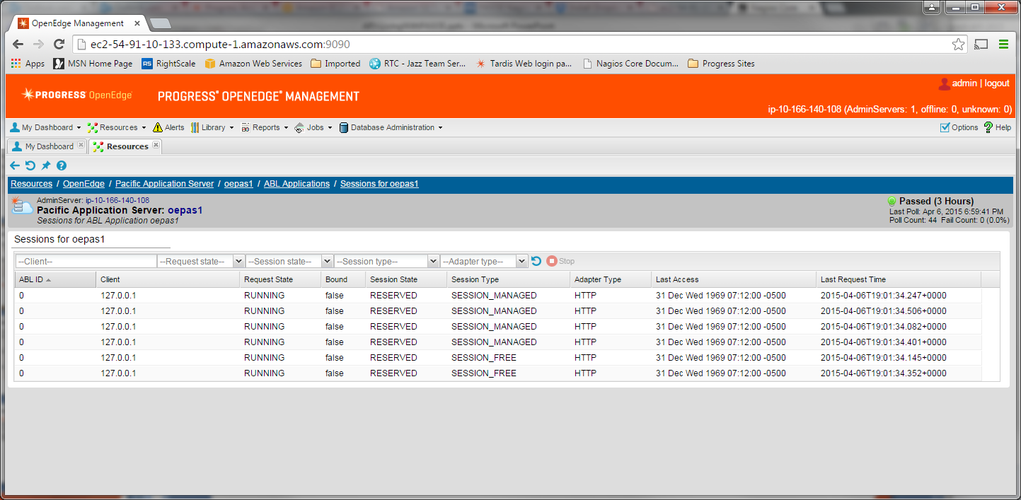
Administration: OpenEdge Explorer and Management
OpenEdge Explorer
  For full management AdminServer must be local
OpenEdge Management
  For full management AdminServer must be local
  Can monitor and alert
  But trending is not available yet
More in DEMO

Slide 29
Administration: Where do I find my config and log files?
PAS for OE’s DLC & WRKDIR environment variable definition | $CATALINA_BASE/bin/openedge_setenv.sh
Application’s environment variable definitions | $CATALINA_BASE/bin/<app-name>_setenv.sh
PAS for OE installation path environment variable definition PAS for OE instance’s path environment variable definition | $CATALINA_BASE/bin/{tcman|startup|shutdown|configtest|version}.sh
PAS for OE configuration properties | $CATALINA_BASE/conf/appserver.properties $CATALINA_BASE/conf/catalina.properties $CATALINA_BASE/conf/jvm.properties
Optional deployment files (web applications & other files) | $CATALINA_HOME/extras
PAS for OE & web application log files | $CATALINA_BASE/logs
PAS logging configuration | $CATALINA_BASE/conf/logging.xml (ref Tomcat logging)
PAS for OE session manager & MSAgent logging configuration | $CATALINA_BASE/conf/openedge.properties
oeabl web application logging configuration | $CATALINA_BASE/ROOT/WEB-INF/logging.xml
oemanager remote admin web application loggin configuration | $CATALINA_BASE/oemanager/WEB-INF/logging.xml
Test user accounts and roles | $CATALINA_BASE/conf/tomcat-users.xml
PAS for OE instance registration list | $CATALINA_HOME/conf/instances.unix
JAVA_HOME & JSE_HOME environment variable definition | $CATALINA_BASE/bin/javacfg.sh

Slide 30
Administration: New Monitoring Access!
Classic AppServer tools
asbman –query
OpenEdge Explorer
OpenEdge Management
PAS for OpenEdge
Management REST API
  The “oemanager” application must be installed for access to the REST API
JMX access
  Using Jconsole
  Locally by PID
  Remotely running “tcman.sh/.bat feature JMXLifecycle=on”
Nagios
  3rd party tool recommended by Tomcat for monitoring
  Uses the tools above to monitor, alert and graph
More in DEMO

Slide 31
PAS for OpenEdge Migration

Slide 32
Migration: Connect Method
REST/Mobile clients: URL still uses ../rest/..
SOAP clients: ../soap/.. instead of ../wsa/.. in URL
OpenEdge clients URL connection format only
    -URL http://myhost:8810/(appname)/apsv
    If appname=ROOT, you may use ROOT or skip the appname
    -URL http://myhost:8810/ROOT/apsv or -URL http://myhost:8810/apsv
Reference: Connecting to AppServers Using a URL
NOTE: Since all of the old web servlets are now encapsulated in one PASOE we use these “transports” to identify the communication: rest, soap and apsv

Slide 33
Migration: Configuring and Using AppServer Event Procedures
agentStartupProc & agentShutdownProc
  Executes one time when starting / stopping an MSAgent OS process
PAS for OpenEdge renamed classic AppServer event procedures:
srvrXxxxx → sessionXxxxx
sessionStartupProc & sessionShutdownProc
  Executed in classic AppServer when the Agent’s single ABL SESSION started/stopped
  Executes in PAS for OE when the MSAgent starts/stops each ABL SESSION
sessionConnectProc & sessionDisconnectProc
  Same as classic AppServer for all Session-Managed client connections
sessionActivateProc & sessionDeactivateProc
  Executed in classic AppServer on every Stateless & State-Free client request
  Follows traditional Stateless model

Slide 34
Migration: Session state
Some current ABL applications will require no session state changes
  State-free is the same as –sessionModel Session-free
  State-less is the same as –sessionModel Session-managed (without changes)
However some ABL applications will require changes in the:
  sessionStartupProc & sessionShutdownProc
  While using the –sessionModel Session-managed
    State-Aware requires “binding a session” in PASOE
    State-Reset requires a QUIT in the shutdown to cleanup

Slide 35
Migration - PASOE Upgrades
CATALINA_BASE
Inst1
PAS OE
(version 11.6)
PASOE
(version 11.5)
Inst2
Inst3
Inst4
$DLC/servers/pasoe/bin/tcman.sh register

Slide 36
PAS for OpenEdge Deployment

Slide 37
Deployment: Applications
Design your Application in Developer’s Studio (PDSOE)
  Test your application from PDSOE to PASOE
  Package it for deployment to PASOE
Copy and change tailoring script to tailor your deployment package
  Use $DLC/servers/pasoe/bin/oeabl_tailor.sh(.ps1) and oeabl_tlr.sh(.bat) as templates
  Add, modify openedge.properties as need
  Add any tailoring you need
Install your Production PASOE
  Copy tailoring scripts to $DLC/servers/pasoe/bin
  Copy war file to production location
  Deploy your application with <pas-instance>/bin/tcman.sh(.bat) deploy <war-file>

Slide 38
Deployment: Classic WebSpeed Messenger with PASOE
Designed to add Classic WebSpeed Messenger with 11.5.1
  WebSpeed functionality not in 11.5
  This allows you to run the PASOE web server as the messenger host
Files
  In $DLC/servers/pasoe/extras/wscgi.war
  In $DLC/servers/pasoe/bin
    wscgi_tlr.sh
      wscgi_tailor.sh
    wscgi_tailor.bat
      wscgi_tailor.ps1
  Great example of application tailoring files

Slide 39
Performance and Scalability

Slide 40
Performance and Scalability Improvements
Threads vs Processes
  Single multi-threaded process supports multiple, concurrent, ABL sessions
    Sessions share resources
  Single-threaded process supports single ABL session
Session Manager integrated with Tomcat
  No separate Java UBroker process
  Removes one network copy in stack
Initial sessions created at startup
  numInitialSessions -> numInitialAgents
  Sessions initialize quicker, minimizing service connection storms

Slide 41
Resource Sharing in Initial Release
Shared | Not Shared (yet)
Self-service OpenEdge database connections | Temp-tables / ProDatasets
Procedure libraries | Sockets (including SOAP and AppServer connections)
R-code | Network OpenEdge database connections
Promsg files | LBI & DBI files
OS threads | ABL session memory

Slide 42
Pacific Application Server for OpenEdge - Performance
 |  | Classic AppServer | PAS for OE | Difference
Scalability
 | Client connections | 221 | 1312 | 493%
Server Resources
 | CPU | 10 CPUs | 5.2 CPUs | 192%
 | Memory | 2.1 GB | 670 MB | 313%
 | Transactions | 203 tps | 1698 tps | 736%
Client performance
 | OpenEdge | 472ms | 340ms | 138%
Notes:
Linux OS
24 CPUs
8 GB memory
Shared memory database connections
ABL clients
ATM database test used for performance #s
Using Statefull ABL application model

Slide 43
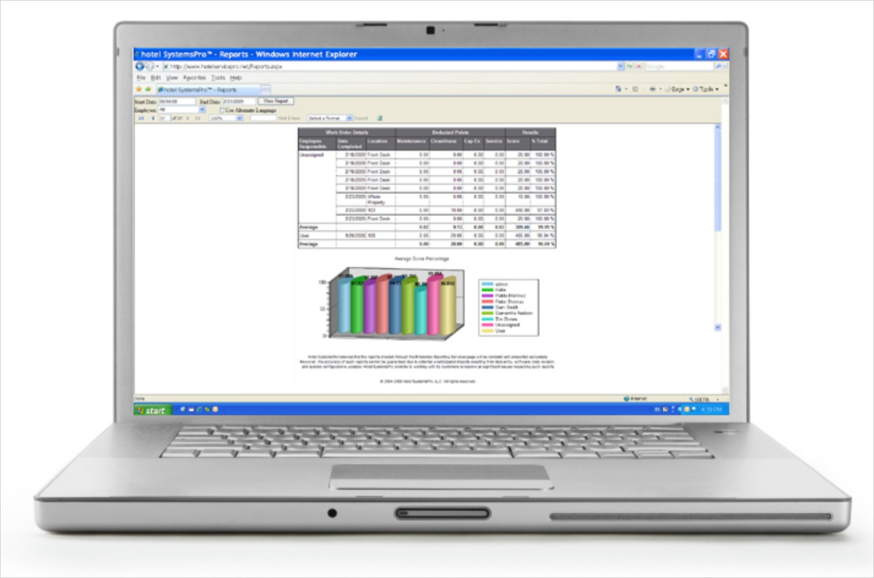
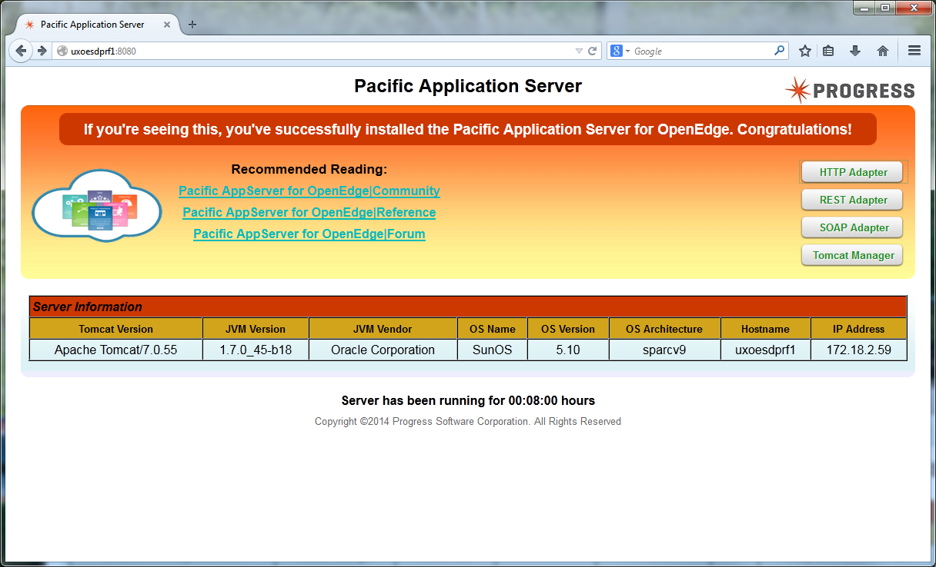
Live Demo Manage and Monitor
Notes:
Need extra power point slides showing demo in case of problems and when the slides are posted online.
Show HTTP connect
Show REST API call
Show Nagios with data

Slide 44
Q&A

