Slide 1
REST API to manage Pacific Application Server for OpenEdge instances
Srinivas Munigala
smunigal@progress.com

Slide 2
Agenda
Introduction to PAS for OpenEdge
How is it different from classic Application Server?
PAS for OpenEdge Administration
PAS for OpenEdge REST API
Demo
Advantages of PAS for OpenEdge REST API

Slide 3
Introduction to PAS for OpenEdge
  What is PAS?
  What is PAS for OpenEdge?
  Why PAS for OpenEdge?

Slide 4
What is Pacific Application Server?
PAS utilizes Apache Tomcat Server as its web server
Unified Application Server for Progress based applications
  OpenEdge
  Rollbase
  Corticon
TOMCAT
PAS

Slide 5
What is Pacific Application Server for OpenEdge?
OpenEdge variation of PAS
Integrated into one layer
Two Products:
  Development Server
  Production Server
PAS
PASOE

Slide 6
Why Pacific Application Server for OpenEdge?
Simple
Extensible
Analysis Tools
Faster and Optimized
Administration
Scalability
Deployment
Administration
Metrics
Current state query
Less memory
Less CPU utilization
Faster
Notes:
. Tomcat itself is a scalable, load-balancing

Slide 7
How is it different from Classic AppServer?

Slide 8
PAS for OpenEdge Architectural Concepts
Classic AppServer Components
PAS for OpenEdge Components
Client
AIA WSA
REST/Mobile
Client
Admin Server
Name Server
PAS for OpenEdge
APSV (AIA)
SOAP (WSA)
REST/Mobile
State-Aware
Stateless
State-free
Broker
Broker
Session Manager
Broker
“n” Agents
“n” Agents
“n” Agents
MSAgent
Agent
(1 ABL Session)
Agent
(1 ABL Session)
Agent
(1 ABL Session)
Agent
(1 ABL Session)
Agent
(1 ABL Session)
Agent
(1 ABL Session)
Agent
(1 ABL Session)
Agent
(1 ABL Session)
Agent
(1 ABL Session)
“n” ABL Sessions
1 ABL Session
1 ABL Session
1 ABL Session
1 ABL Session

Slide 9
PAS for OpenEdge Administration

Slide 10
Classic AppServer versus PAS for OpenEdge Administrations
Classic AppServer
PAS for OpenEdge
OEE/OEM
OEE/OEM
AdminServer
AdminServer
REST
Client
asbman
tcman
pasoe1
*manager
asbroker1
tcman
pasoe2
*manager
asbroker2
JMX
Client
Legend:
always exists
------- optional install & use

Slide 11
Administration: tcman.sh/.bat
tcman
Server Actions
Manager Actions
General Actions
tcman help tcman help <action>
create | delete
start | stop
clean | clean -A
feature | config
instances
list
deploy
enable
undeploy
disable
help
env

Slide 12
Administration: More Command Line Tools…
SOAP
deploySOAP
REST
deployREST
ABL App
oeprop

Slide 13
REST API to manage “PAS for OpenEdge” instances

Slide 14
Introduction to REST
Representational State Transfer
Style of software architecture
Does not define Specification
Does not define a message format
Stateless
Resource-based
CRUD Model
Resource
Unique identifier
Uniform interfaces
Representation
Stateless
REST
Principles
Old Web

Slide 15
Introducing PAS for OpenEdge REST API
delete
put
PAS for OpenEdge
HTTP (S)
Your App
get
post

Slide 16
Understanding PAS for OpenEdge resources
OE ABL Application
/oemanager/applications/
/oemanager/applications/<appName>/webApps
WebApps
/oemanager/applications/<appName>/webApps/<webAppName>/transports/rest/oeservices
APSV, SOAP
REST
Transports
/oemanager/applications/<appName>/sessions
Session Mgr
Properties
Statistics
/oemanager/applications/<appName>/agents
Agents
Properties
State
/oemanager/applications/<appName>/clients
Clients

Slide 17
How to enable REST API?
oemanager.war provides REST API
Available at $DLC/servers/pasoe/extras
oemanager.war must be deployed
Uses JSON input / output payloads
It requires user login

Slide 18
Using REST API - What to manage?
Application Management
Transport Management
Session Management
Agent Management

Slide 19
Application Management
List all OEABL applications
Get information about OEABL application
List all web applications
Get information about a web application
Application Management
Transport Management
Session Management
Agent Management

Slide 20
Transport Management
List deployed services
Get information about a specific service
Deploy a new service
Remove a service
Enable / Disable a transport
Get configuration of a transport
Update configuration of a transport
Get runtime metrics of a transport
Reset runtime metrics of a transport
Application Management
Transport Management
Session Management
Agent Management

Slide 21
Session Management
Get Session information
Get client information
Get current request information
Get Configuration properties
Update configuration properties
Get runtime metrics
Re-set runtime metrics
Cancel a request
Terminate a session
Application Management
Transport Management
Session Management
Agent Management

Slide 22
Agent Management
List agents
Get an agent status information
Get session metrics
Get connection information
Get Request information
Get configuration properties
Update configuration properties
Stop an Agent
Application Management
Transport Management
Session Management
Agent Management

Slide 23
Sample API for “Get all the requests”
HTTP Operation | GET
URI | /oemanager/applications/<AppName>/requests
Example | curl -v http://localhost:1234/oemanager/applications/test/requests
Media-Type | application/vnd.progress+json
Request Body
Response Code | 200 Success 500 Unexpected Server Error
Response Body | <JSON Response data>

Slide 24
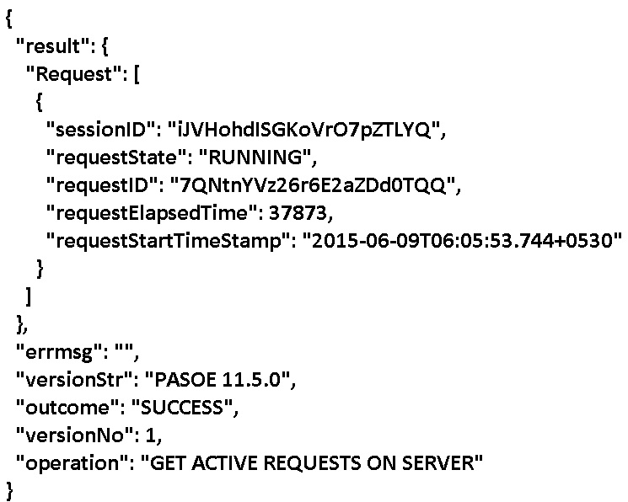
Sample JSON Response

Slide 25
Demo

Slide 26
Demo: Prerequisites
Create an Instance
  $DLC/servers/pasoe/bin/tcman create test -p 1234 -P 5678 -s 9876
Deploy oemanager.war into ROOT
  test\bin\tcman deploy $DLC\servers\pasoe\extras\oemanager.war
  Place server procedures at test\bin\tcman\openedge\
Start the instance
  test\bin\tcman start

Slide 27
Demo: Use Case 1
A user lists all the oeabl applications
Steps:
  Execute the following REST API using a REST client
  Curl –u tomcat:tomcat http://localhost:1234/oemanager/applications

Slide 28
Demo: Use Case 2
A user updates configuration properties of Session Manager
Steps:
  Execute the following REST API using a REST client
  curl -u tomcat:tomcat -X PUT -H "Content-Type: application/vnd.progress+json" -d {"agentLogThreshold":”500000"} http://localhost:1234/oemanager/applications/test/properties

Slide 29
Demo: Use Case 3
A user cancels a request which is running more than expected time
Steps:
  Execute a client request which runs more than the expected time
  Execute the following REST API using a REST client
  Curl –u tomcat:tomcat –X DELETE http://localhost:1234/oemanager/applications/test/requests?requestID=<reqID>&sessionID=<sessionID>

Slide 30
Demo: Use Case 4
A user stops an agent
Steps:
  Execute the following REST API using a REST client
  Curl –u tomcat:tomcat –X DELETE http://localhost:1234/oemanager/applications/test/agents/<agentID /agentPID>

Slide 31
Demo: Use Case 5
A user deploys a REST service description (.paar)
Steps:
  Execute the following REST API using a REST client
  Curl -u tomcat:tomcat -X POST --data-binary @dateService.paar http://localhost:1234/oemanager/applications/test/webapps/ROOT/transports/rest/oeservices "Accept: application/vnd.progress+json" -H "Content-Type: application/vnd.progress.paar+zip" -H "Content-Disposition: attachment; filename=dateService.paar"

Slide 32
Demo: Use Case 6
A user gets runtime metrics of a SOAP transport
Steps:
  Deploy a SOAP service
  Execute few requests on SOAP service
  Execute the following REST API using a REST client
  curl -u tomcat:tomcat http://localhost:1234/oemanager/applications/test/webapps/ROOT/transports/soap/metrics

Slide 33
Advantages
Standard HTTP call outs
Standard based security
Flexible formats
Manage server Programmatically
Extensible:
  Customized command line tools
  Integration with 3rd party admin tools like Nagios
  ABL client with new HTTP out support

Slide 34
Summary
What is Pacific Application Server for OpenEdge
How is it different from classic Application Server?
PAS for OpenEdge Administration
REST API to manage PAS for OpenEdge
Advantages of PAS for OpenEdge Administration

Slide 35
Q&A

