Slide 1
What's new in OpenEdge BPM 11.x
Abhinav Agarwal
June 8th , 2015

Slide 2
Agenda
Brief introduction to OEBPM
OE BPM Components
New Features in OEBPM

Slide 3
Progress OpenEdge BPM
What is it?
  Extends OpenEdge to a comprehensive platform that simplifies the development and deployment of applications that are both transaction-oriented and process-centric
  Purposed for OpenEdge use cases
What are the additional benefits?
  Workflow automation
    Allows your customers to automate the workflows that drive their business
    Transform applications from transaction-oriented to process-oriented
  Visibility
    Allows your customers to get visibility into how well their processes are performing
  Model driven development
    Customization without code changes
    Leverages your existing application
    Quickly-generate key parts of your application
  Model-driven integration
    Easily integrate external systems, e.g. e-mail, Web services

Slide 4
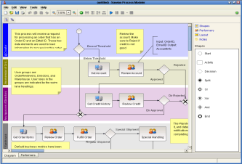
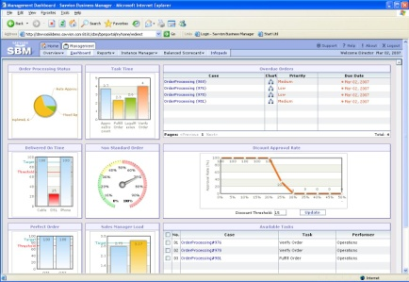
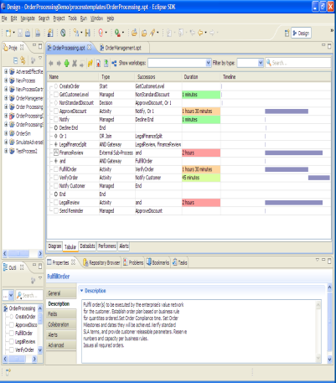
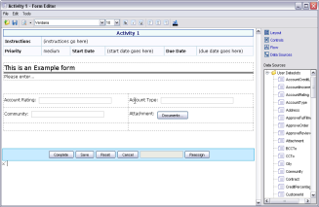
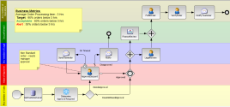
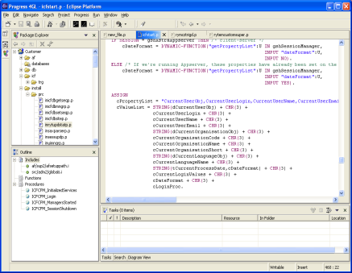
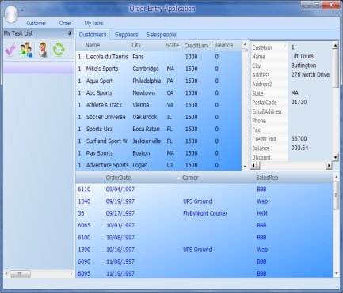
Key Components of OpenEdge BPM
Key Components of OpenEdge BPM
Process Modeler
BPM Portal
BPM Studio
BPM Server
BPM-enabled
OpenEdge AppServer
BPM-Enabled Progress Developer Studio
BPM-enabled OpenEdge AppServer
OpenEdge UI
Progress Developer Studio for OpenEdge
OpenEdge
AppServer

Slide 5
New features at a glance 11.3
  Integrated Installer
  SSO using Client Principal
  SPA
  Natively supports ABL datatypes
  Multiple Presentation types
  GEL Editor

Slide 6
New features at a glance 11.4
  Corticon Adapter
  LongChar data
  SharePoint adapter
  Easyl support in db adapter
  Rollbase as presentation type

Slide 7
New features at a glance 11.5
  Clustering support
  Multi-language support in Email adapter

Slide 8
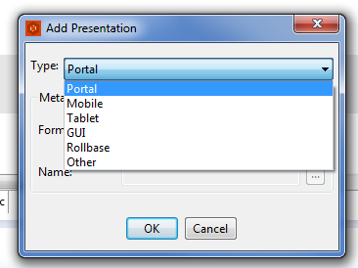
Presentation Types
Have multiple UI’s to complete human work steps
Each presentation type has its own metadata
ABL API / web service API to get presentation type information

Slide 9
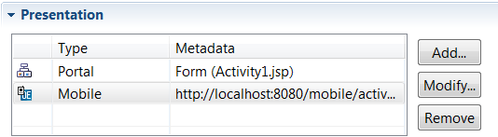
Presentation Type – Metadata
Mobile – URL
Tablet – URL
GUI – Name of the program

Slide 10
Corticon Adapter
Business Rules using Corticon Adapter in OEBPM
Use-case
  Health Insurance – Calculate Risk Factor
Why Corticon Business Rules
  Easily model complex business rules without custom coding
  Excel like Structure
  Identify conflicting rules
Export dataslot as BRVD file
Import it in Corticon studio and design rules

Slide 11

Sharepoint Adapter
Write Business Processes that run on SharePoint documents
Supports SharePoint 2010 and 2013
Invoke Business Process on create/change of a document or
its metadata in SharePoint
Ability to get/set content and its metadata from OEBPM

Slide 12
Q&A

