Slide 1
REST for any application
Using REST+JSON with OpenEdge ABL, WebSpeed, and Kendo UI
Matt Baker
mbaker@progress.com

Slide 2
Please feel free to interrupt and ask questions or make comments

Slide 3
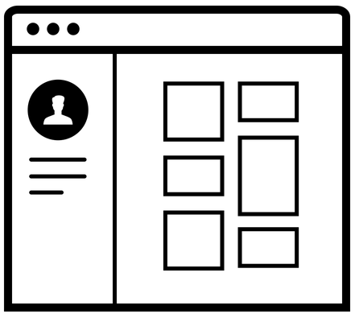
Demo

Slide 4





What did I just see?

Slide 5
REST – the service architecture

Slide 6


REST – Not These
Notes:
Easy to type
Easy to parse
UTF-8 only
Native to web browsers
Works in the ABL

Slide 7
REST
REST
(Representational state transfer)
A software architecture style consisting of guidelines and best practices for creating scalable web services
- wikipedia
Notes:
Easy to type
Easy to parse
UTF-8 only
Native to web browsers
Works in the ABL

Slide 8
REST – Formalized best practices
REST is a set of best practices
  Formally specified back in 2000
  Service architecture, not implementation
Swagger.io provides a nice way to document your API
JSONAPI Used to resolve arguments
Notes:
2000 by Roy Fielding
Alternative to soap – just a set of best practices
Boiled down to just a few for this demo

Slide 9
REST – Officially
Client-server architecture
Stateless
Cacheable
Layered
On demand
Unified interface

Slide 10
REST – Usually
(usually) communicate using HTTP
(usually) make sure of standard HTTP GET, PUT, POST, DELETE (and others) verbs.
(usually) uses JSON and sometimes XML
(usually) easy to load balance
(usually) uses URIs as resource identifiers
(usually) HTTP status codes to indicate success or failure
Notes:
Normally URIs (URLs) are used on the web. You could come up with your own scheme

Slide 11
REST - The Verbs
  GET – Get something. Typically a single resource, or a set of resources. May have some filtering
  POST – Create something. Typically this create a new resource inside an existing collection.
  PUT – Update something. Resource should already exist.
  DELETE – Remove something. Resource should already exist.

Slide 12
REST – running something
  PUT – Update something. Update the state of something to “running” or “executing’.
Notes:
Use the URL to dictate what gets run.
In OEM issugin a PUT to a URL with a simple JSON object with a property of “running” = “true” indicates start or stop the service

Slide 13
REST – The Nouns
  GET http://server:8080/rest/customers/
  Retrieve the list of customers
  GET http://server:8080/rest/customers?q={ “id” : { “lt” : “100”}
  Retrieve a list of filtered customers
  GET http://server:8080/rest/customers/1
  Get a single customer object
  POST http://server:8080/rest/customers/
  Create a new customer
  PUT http://server:8080/rest/customers/1974
  Update an existing customer
  DELETE http://server:8080/rest/customers/1974
  Delete a customer
Notes:
URLs should use nouns. Verbs are what you are doing to them

Slide 14
Why REST?

Slide 15
REST – not SOAP
Because it is not SOAP!
Notes:
Soap became too complicated. It doesn’t work well with web browsers

Slide 16











REST - The Internet runs on REST

Slide 17
REST – everyone’s doing it
World Region | Population (est. 2014) | Internet Users (est.) | %
Africa | 1,125,721,038 | 297,885,898 | 26.5
Asia | 3,996,408,007 | 1,386,188,112 | 34.7
Europe | 825,824,883 | 582,441,059 | 70.5
Middle East | 231,588,580 | 111,809,510 | 48.3
North America | 353,860,227 | 310,322,257 | 87.7
Latin America | 612,279,181 | 320,312,562 | 52.3
Oceana | 36,724,649 | 26,789,942 | 72.9
Total | 7,182,406,565 | 3,035,749,340 | 42.3
Notes:
Soap became too complicated. It doesn’t work well with web browsers

Slide 18
REST –someone else’s API
Google API http://code.google.com/more/
Facebook API https://developers.facebook.com/
Twitter API https://dev.twitter.com/docs
Amazon API https://affiliate-program.amazon.com/gp/advertising/api/detail/main.html
Salesforce API http://www.salesforce.com/us/developer/docs/api/index.htm
YouTube API http://code.google.com/apis/youtube/overview.html
WordPress API http://codex.wordpress.org/WordPress_APIs
Flickr API http://www.flickr.com/services/developer/
Dropbox API http://www.dropbox.com/developers

Slide 19
JSON

Slide 20


JSON – Not this one
Notes:
Easy to type
Easy to parse
UTF-8 only
Native to web browsers
Works in the ABL

Slide 21
JSON
JSON
(JavaScript Object Notation)
a lightweight data-interchange format. It is easy for humans to read and write. It is easy for machines to parse and generate. It is based on a subset of the JavaScript programming language
- json.org
Notes:
Easy to type
Easy to parse
UTF-8 only
Native to web browsers
Works in the ABL

Slide 22
JSON
Lingua Franca
lin·gua fran·ca
/ˌliNGɡwə ˈfraNGkə/
a language that is adopted as a common language between speakers whose native languages are different.
- google.com
Notes:
Easy to type
Easy to parse
UTF-8 only
Native to web browsers
Works in the ABL

Slide 23
JSON – looks like this
{"menu":
{ "id": "file",
"value": "File",
"popup": {
"menuitem": [
{"value": "New", "onclick": "CreateNewDoc()“},
{"value": "Open", "onclick": "OpenDoc()"},
{"value": "Close", "onclick": "CloseDoc()"}
]
}
}
}
Notes:
it IS javascript
Start with an object tags – squigglies
Has name value pairs separated by colons since it uses object initializer syntax
The colors aren’t necessary
Properties and string values are quoted
Only 5 data types object, array, string, number, boolean
Dates are iso8601 format
Always serialized as UTF-8 – extremely compatible

Slide 24
JSON – similar to XML
<menu id="file" value="File">
<popup>
<menuitem value="New" onclick="CreateNewDoc()" />
<menuitem value="Open" onclick="OpenDoc()" />
<menuitem value="Close" onclick="CloseDoc()" />
</popup>
</menu>

Slide 25
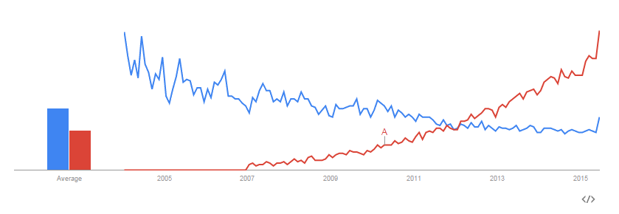
JSON – beats XML

Slide 26
ABL

Slide 27
REST – Join the crowd
ABL Language: 10.2B introduced JSON for temp-tables
  Supported directly in temp-tables
ABL OO: 11.0 introduced JsonObject + JsonArray
    Full OO implementation for creating JSON documents and serialization
Server side: 11.2 introduced OpenEdge Web Server (REST Adapter)
  Provides REST out support for clients accessing OpenEdge AppServer
  Java servlet application
  Design the service with PDSOE
  Nice for with OpenEdge Mobile + JSDO
Client side: 11.5.1 introduces OpenEdge.Net.HTTP
  Full HTTP Client written in 100% ABL
  Direct supports JSON and XML payloads
  Yes, the library works fine as far back as 10.2B
Notes:
Yes

Slide 28
JSON – Loading from LongChar
define variable myLongchar as longchar no-undo init "".
define variable myParser as Progress.Json.ObjectModel.ObjectModelParser no-undo.
define variable Request as Progress.Json.ObjectModel.JsonConstruct no-undo.
fix-codepage(myLongchar) = "utf-8".
copy-lob from file "ttCust.json" to mylongchar.
myParser = new Progress.Json.ObjectModel.ObjectModelParser().
Request = myParser:Parse(myLongchar).
define temp-table ttCust like Customer.
temp-table ttCust:read-json("JsonObject", Request, "empty").

Slide 29
JSON – Write a temp-table to a file
define temp-table ttCust no-undo like Customer.
for each Customer where Customer.CustNum < 100:
buffer-copy Customer to ttcust.
end.
temp-table ttCust:WRITE-JSON("file", "ttCustom.json", true).

Slide 30
JSON – Using HTTP client to retrieve a web page
using OpenEdge.Net.HTTP.*.
define variable oClient as IHttpClient.
define variable oRequest as IHttpRequest.
define variable oResponse as IHttpResponse.
oClient = ClientBuilder:Build():Client.
oRequest = RequestBuilder:Get('https://www.progress.com'):Request.
oResponse = oClient:Execute(oRequest).
message
oResponse:StatusCode skip
oResponse:StatusReason view-as alert-box.

Slide 31
JSON – Using HTTP client to PUT some data
oClient = ClientBuilder:Build():Client.
entity = new JsonObject().
entity:Add(“some", “data”).
creds = new Credentials(“user”, “password”).
oRequest = RequestBuilder:put(url, entity):
UsingBasicAuthentication(creds):
Request.
oResponse = oClient:Execute(oRequest).

Slide 32
WebSpeed

Slide 33

WebSpeed + REST – Why?
Because I can
  I like WebSpeed
  Convenient
  WebSpeed needs some love
Because you need a service on the Internet
You might not want to deal with REST Adapter
Because you want to use Kendo Charts
REST + JSON fits fairly well with existing WebSpeed applications
  Stateless
  Can run any ABL code – including the new HTTPClient
  Can stream any form of data back to the caller

Slide 34
WebSpeed – for each customer: display customer.
Create a .html file or cgi-wrapper
Add some SpeedScript
Compile that to r-code
Deploy that out to the WebSpeed agent PROPATH
Open a web browser with a URL something like:
  http://localhost/cgi-bin/cgiip.exe/WService=wsbroker1/ui/weather.p
Data access through some other .p, building all the HTML in the agent
Images and .css and javascript are all stored on the web server

Slide 35




WebSpeed – separation of concerns
Create a .html file
Create a .js file that can execute an XHR request
Create a REST API service .p
  Use temp-tables or JsonObject
Define URI pattern
Compile that to r-code
Deploy the .html file and .js to the web server
Deploy the .p to the WebSpeed agent PROPATH
REST Service
Notes:
Problem with WebSpeed model is separation of concerns. If you write speedscript you have violated separation of UI and data. JSON + REST can help you split this.

Slide 36
WebSpeed – Use the WEBSTREAM
define input parameter webstream as handle no-undo.
define temp-table ttCust no-undo like Customer.
for each Customer where Customer.CustNum < 100:
buffer-copy Customer to ttcust.
end.
temp-table ttCust:write-json("stream-handle", webstream:handle ).

Slide 37
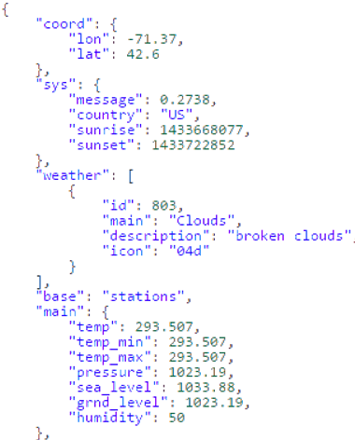
openweathermap.org – current weather

Slide 38
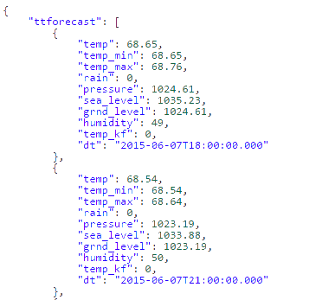
WebSpeed – temp-tables as JSON

Slide 39
Technique - dispatch your own URI
This works
http://<host>/cgi-bin/cgiip.exe/rest/customers.p?custid=1
This is much better
http://<host>/cgi-bin/cgiip.exe/rest/customers/1

Slide 40
Technique – how to dispatch
http://<host>/rest/{entity}/{collection}/{resource}
http://<host>/rest/{entity}/{collection}?<query syntax>
Copy and modify web-disp.p to detect REST
if PATH_INFO begins “REST” then
Use the ABL MATCHES function
  Or write your own..whatever…its your implementation
if PATH_INFO matches “/rest/customer/customers/*” then
run <businessentity>.p (input …)
Notes:
This is what rest adapter does for you based on .pidl file generated out of PDSOE.

Slide 41

How it is done

Slide 42
WebSpeed – incomplete match for REST
Messenger only supports GET and POST
  DELETE has no parallel – left as an exercise for the reader
    Talk to your product manager to get this fixed
    Use the REST Adapter instead
  PUT can almost always be mapped to POST
URIs in WebSpeed are the name of the program
  Have to dispatch your own requests
  Use REST Adapter + AppServer if you want declarative dispatching
  There is no framework to handle the dispatching for you
PASOE is supposed to fix this stuff – Go see Banks and Cleary’s talk on WebSpeed new Object Model

Slide 43
ABL + REST + JSON – The easy parts
Retrieving and calling REST services
Loading data into dataset or temp-tables – but only if data is simple
Creating new JSON objects in memory and writing them to streams
Temp-tables map exactly to what kendo expects for charts and basic grids
Changing property names in temp-table done through serialize-name
REST adapter works nice if you have AppServer

Slide 44
ABL + REST + JSON – The hard parts
Incoming data doesn’t map directly to dataset or temp-table
  You have to hand write the code to convert the JSON structure
  Reorganizing complex data may take a lot of work if the format is very different
Outgoing data doesn’t map directly to dataset or temp-table
  You have to match what the API to what your caller expects
  Arrays of objects that have nested objects cannot be mapped to temp-table or dataset
You cannot serialize to<->from ABL objects
  No support in current version to read or write to ABL objects
  ABL object serialization only works with AppServer
  JSON objects do not have to be equivalent
  Temp-tables are “flat” in that all rows have the same properties
REST adapter for AppServer takes a lot more setup

Slide 45
REST – someone else’s opinion
  http://martinfowler.com/articles/enterpriseREST.html
  http://jsonapi.org/format/
  http://swagger.io
  http://en.wikipedia.org/wiki/Representational_state_transfer

Slide 46
What I’ve learned

Slide 47
What I’ve learned – its for you
Make it friendly to developers
  Don’t try to make one API do too much
  Document it so someone can find it later
It might also be for someone else
  Be aware of what your API might grow into

Slide 48
What I’ve learned – Errors
Encode errors the same as your messages
  Encode messages as JSON if you are using JSON
  {
  "code" : 1234,
  "message" : "Something bad happened :(",
  "description" : "More details about the error here"
  }

Slide 49
What I’ve learned – URLs
URLs are nouns and identifiers
  Prefer plural nouns
Don’t nest your API too deep
  Its not a menu
The URLs should make sense
  Use this /cars
  Don’t do this /items/large/type/3

Slide 50
What I’ve learned – get some tools
For someone else’s API
  Use POSTMAN Chrome plugin
  Browser debugger – not everyone documents every field
  Find an Eclipse plugin
  Fiddler - to inspect raw HTTP connection
For your API
  Document it

Slide 51
What I’ve learned – filtering, paging
Filtering on the query, not the path
  Use this /cars?color=red
  Don’t do this /cars/red/
Don’t be afraid to alias common or difficult queries
  /queries/MultiTenantConvertableTables
Paging
  You are going to need server side paging
  Different UI toolkits have different requirements for identifying paging attributes

Slide 52
What I’ve learned – security
Use SSL!
REST is supposed to be stateless
  But that isn’t always practical
  HTTP Basic
  OAuth

Slide 53
What I’ve learned – Caching
Be aware it exists, especially on the internet
Etag isn’t as simple as it sounds
  Records need a unique id and a modification stamp
  Or a hash

Slide 54

Q&A
mbaker@progress.com

Slide 55
This template makes my eyes hurt.

Slide 56
Please turn the lights back on.

Slide 57




