Slide 1
Corticon Integration with OpenEdge and BPM
Name DivyaTheja Pachipula
Title Senior Engineer
Date 9th June, 2015

Slide 2
Agenda
Business Rules and challenges
Need of Progress Corticon
Corticon integration with ABL
Corticon integration with BPM

Slide 3


Business Rules
Business Rules are Statements that define an action
  Constraint
  Decision
Practical Rules
  Safe Driving
    IF red, THEN stop
    IF emergency vehicle comes by, THEN move right and stop until it passes
    IF.. THEN ..

Slide 4
Use case - Credit Card authorization
100+ Rules are
Validated in
Background
Decline
Payment
No
In the Store /
Online Payment
Gateway
Initialize
Transaction
Fraud
Check
Inform
Customer by
Email/SMS
Rules include:
Credit Card valid? Is Credit Card expired? Are we crossing the credit limit available in Credit Card? From which Geographical location, the transaction is being done?
Yes
Approve
Payment

Slide 5
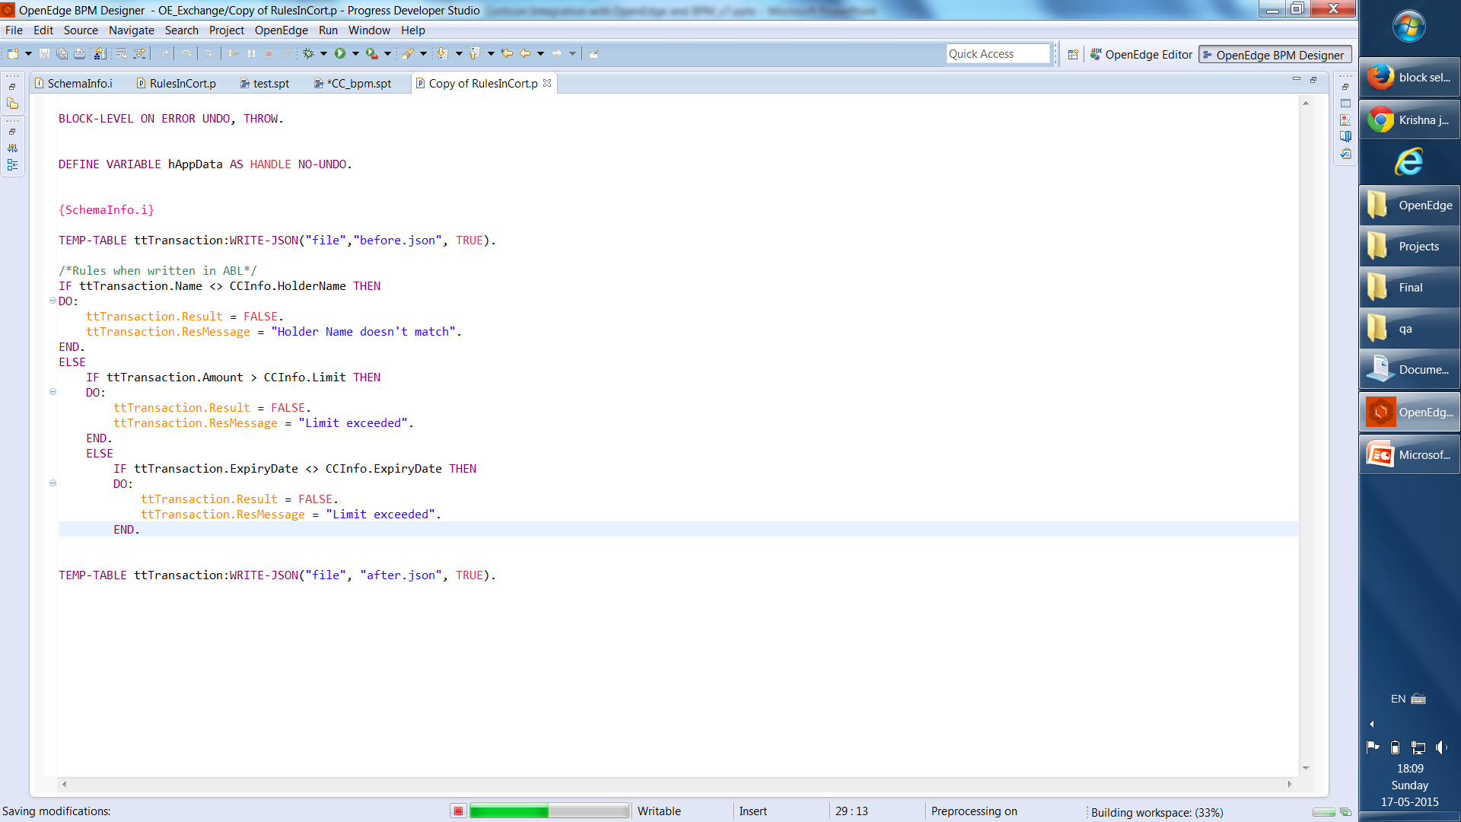
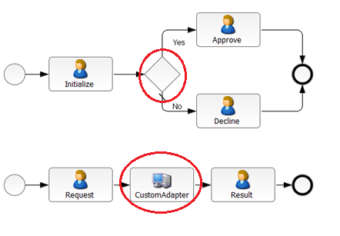
Rules for Credit card authorization written in ABL and BPM
ABL Application
Business Process Application

Slide 6

Challenges when rules embedded in ABL Application
Completely developer centric
High maintenance cost
Barrier between Business Experts and ABL Developers
Cannot identify conflicting rules
Single change can impact hundreds of rules
Business Logic
DBMS
Traditional Application

Slide 7

Challenges when rules modeled in BPM
Process centric rules
Reusability of rules across different process
Changing the logic results in modification, redeployment and testing of process
Difficulty in modelling complex rules
Business Logic
DBMS
Business Process Application

Slide 8
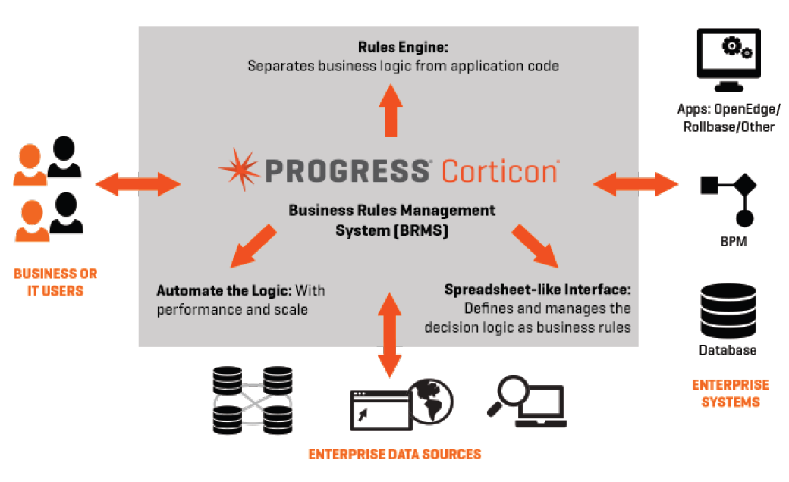
Corticon Business Rules Management

Slide 9
Progress Corticon Architecture
Vocabulary
Corticon Studio
Corticon Server
  Domains
  Entities
  Attributes
Schema
RuleFlow
Decision
Service
v1.0
Rulesheet 1
RuleSheet N
RuleSheet 1
Rulesheet N
  Conditions
  Filters
  Actions
  Message
Decision
Service
v2.0
Dashed line: optional components

Slide 10
OpenEdge ABL – Corticon

Slide 11
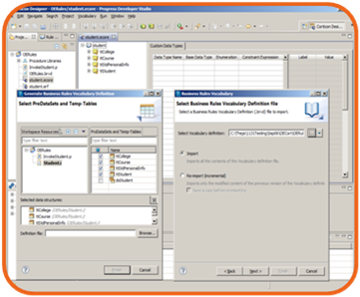
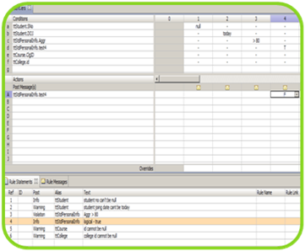
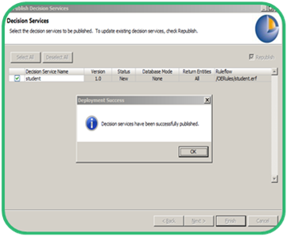
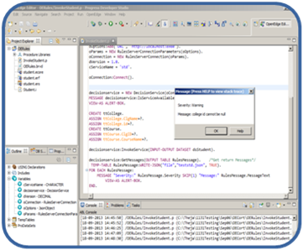
OpenEdge – Corticon
Define Schema
Create Rules
Deploy
Invoke Decision Service
Define Schema
in ABL
Write business rules in Corticon
Deploy the rules to Corticon Server
Invoke Decision Service from ABL

Slide 12
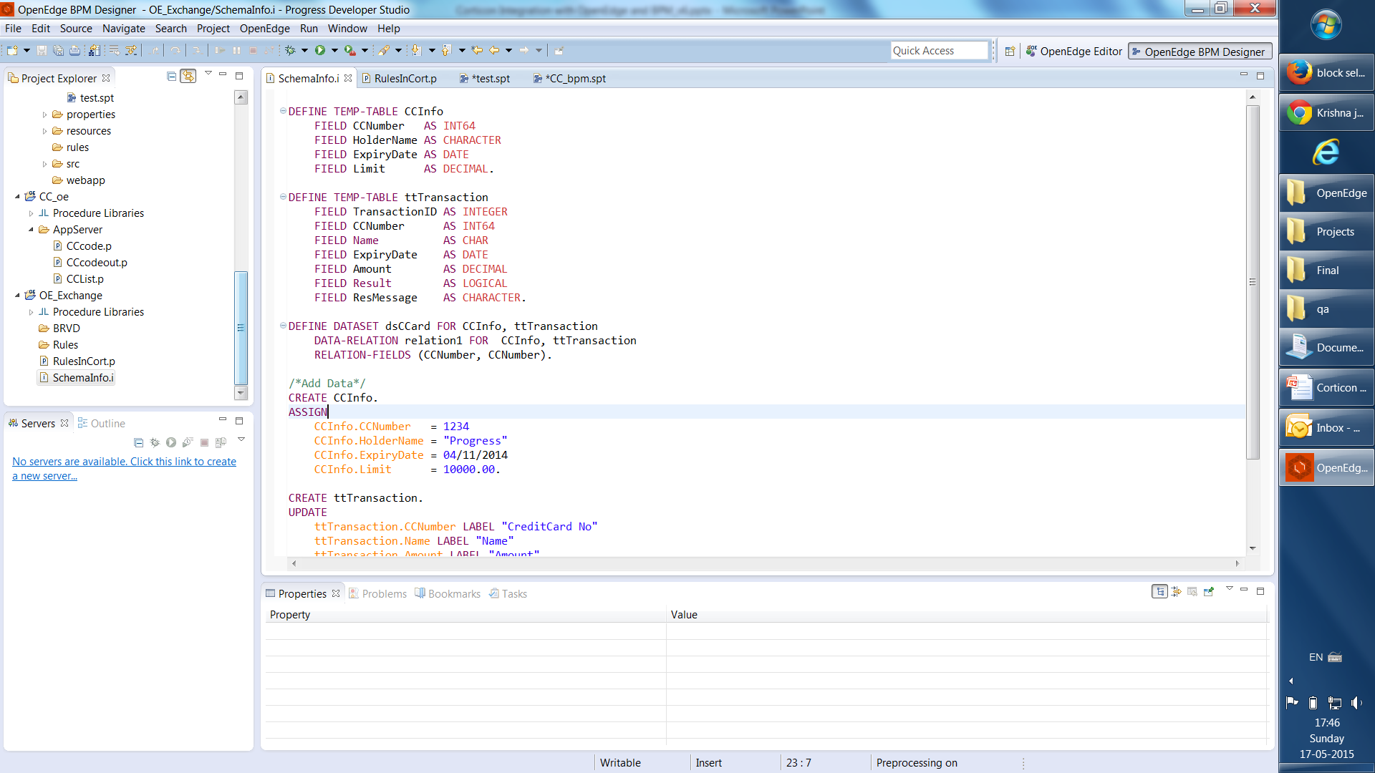
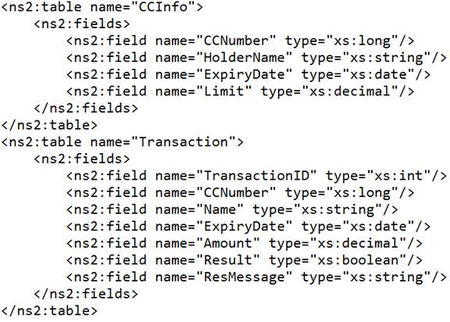
OpenEdge – Corticon
Define Schema
Create Rules
Deploy
Invoke Decision Service
Define ABL Schema
  Temp-Table
  ProDataSet
Export Schema
  Export from
  PDS for OE
  Business Rules Vocabulary Definition(BRVD) file

Slide 13
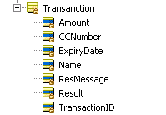
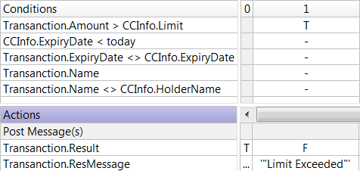
OpenEdge – Corticon
Define Schema
Create Rules
Deploy
Invoke Decision Service
Import Schema
  BRVD file -> Vocabulary file
  Temp-Table -> Entity
  Temp-Table Fields -> Entity Attributes
Write Rules
  Create Rule Sheet
  Write rules

Slide 14
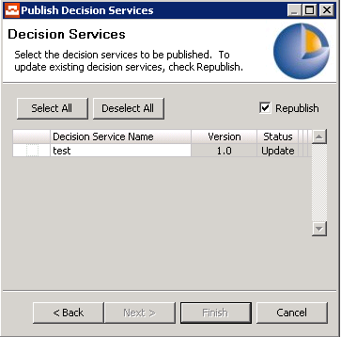
OpenEdge – Corticon
Define Schema
Create Rules
Deploy
Invoke Decision Service
Define Flow
  Create Rule flow
  Define the flow
Deploy
  Configure Corticon Server
  Deploy Rule Flow to Server

Slide 15
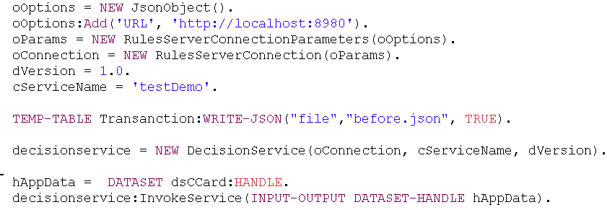
OpenEdge – Corticon
Define Schema
Create Rules
Deploy
Invoke Decision Service
Invoke Decision Service
  ABL API
    Connect
    IsDecisionService
    InvokeService
    GetMsgs
    Disconnect

Slide 16

OpenEdge – Corticon

Slide 17
OpenEdge BPM – Corticon

Slide 18
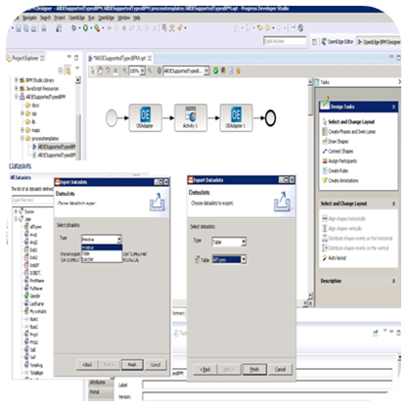
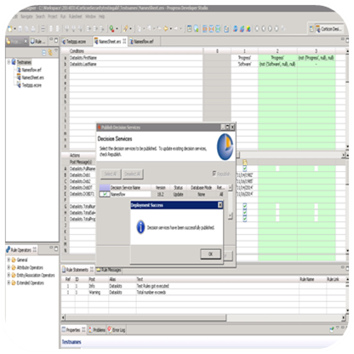
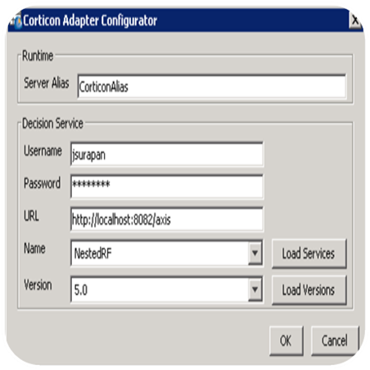
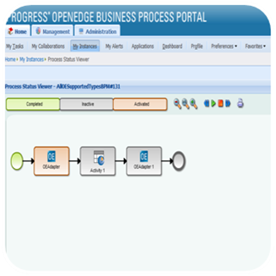
OpenEdge BPM – Corticon
Define Schema
Model & Deploy Business Rules
Configure Corticon Adapter
Invoke Decision Service
Export Schema from Dataslots and Import it as Vocabulary
Create Business Rules and Deploy
Configure Corticon Adapter
Invoke the adapter from Business Process

Slide 19
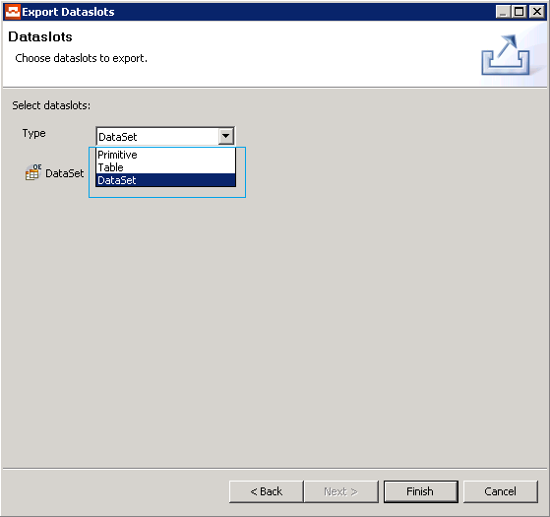
OpenEdge BPM – Corticon
Define Schema
Model & Deploy Business Rules
Configure Corticon Adapter
Invoke Decision Service
Define Schema
  Dataslots
    Primitives, Prodatasets and
    Temp-Table types
    Assign schema definition for Prodatasets and Temp-Table
BRVD Export
  Primitives
  Prodatasets
  Temp-Table

Slide 20
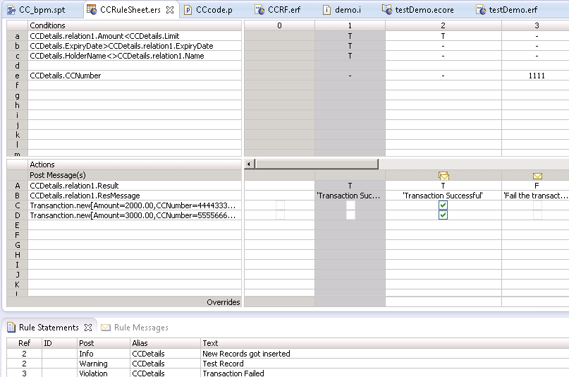
OpenEdge BPM – Corticon
Define Schema
Model & Deploy Business Rules
Configure Corticon Adapter
Invoke Decision Service
Corticon studio
  Create Corticon Project
  Import BRVD
  Create Rule sheet and model rules
  Define Rule flow using the Rule sheet
Corticon server
  Deploy the modeled Rule flow

Slide 21
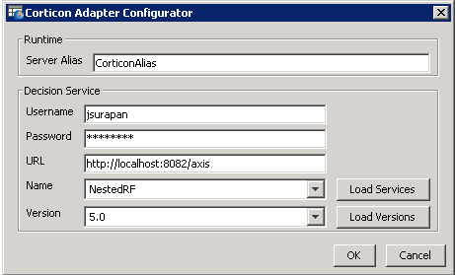
OpenEdge BPM – Corticon
Define Schema
Model & Deploy Business Rules
Configure Corticon Adapter
Invoke Decision Service
In BPM studio
  Model BPM process
  Add Corticon adapter
In Corticon Adapter
  Username & Password (If secured)
  Server URL
  Decision Service name
  Decision Service version
  Define dataslot mapping for either Primitive/Prodataset/Temp-Table types

Slide 22
OpenEdge BPM – Corticon
Define Schema
Model & Deploy Business Rules
Configure Corticon Adapter
Invoke Decision Service
Deploy the Business Process
In Portal
  Instantiate the process
  Invoke decision service using Corticon Adapter

Slide 23
OpenEdge BPM – Corticon

Slide 24
Corticon and OpenEdge
Development Tools
  Progress Developer Studio for OpenEdge
  OpenEdge BPM Studio
  Corticon Studio
Server
  Corticon Server
  Pacific AppServer for OpenEdge
Development
PDS OE
OE BPM
Server
Pacific AppServer for OE
Corticon Studio
Corticon Server

Slide 25
Supported Versions
OpenEdge – Corticon
  OpenEdge 11.3
  Corticon 5.3.2
OpenEdge BPM – Corticon
  OpenEdge 11.4
  Corticon 5.3.2

Slide 27
