Slide 1
New Rollbase User Interface
Thierry Ciot
Rollbase Dev Lead
tciot@progress.com
June 8th 2015

Slide 2
Agenda
Quick Tour
Rollbase and Kendo UI - Built-in themes
Responsive UI.
Customization

Slide 3
Assumptions
You are familiar with current UI and Rollbase concepts
This talk is not about learning how to create and/or manage an application

Slide 4
Not Released Software
We may encounter some bugs during demo ☺

Slide 5
Quick Tour

Slide 6
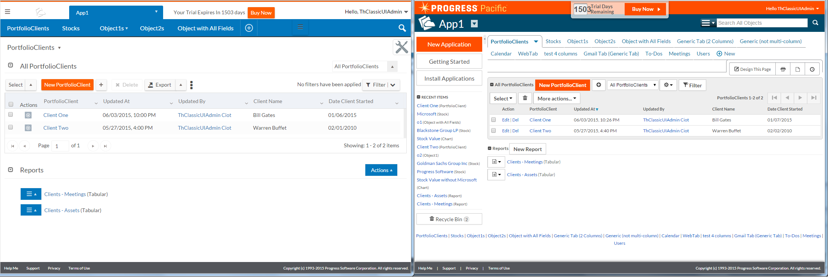
Initial Screen

Slide 7
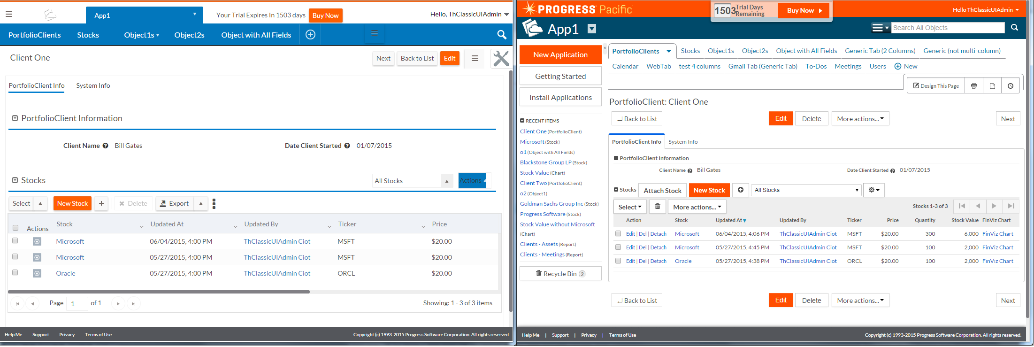
Drill Down to Portfolio Client

Slide 8
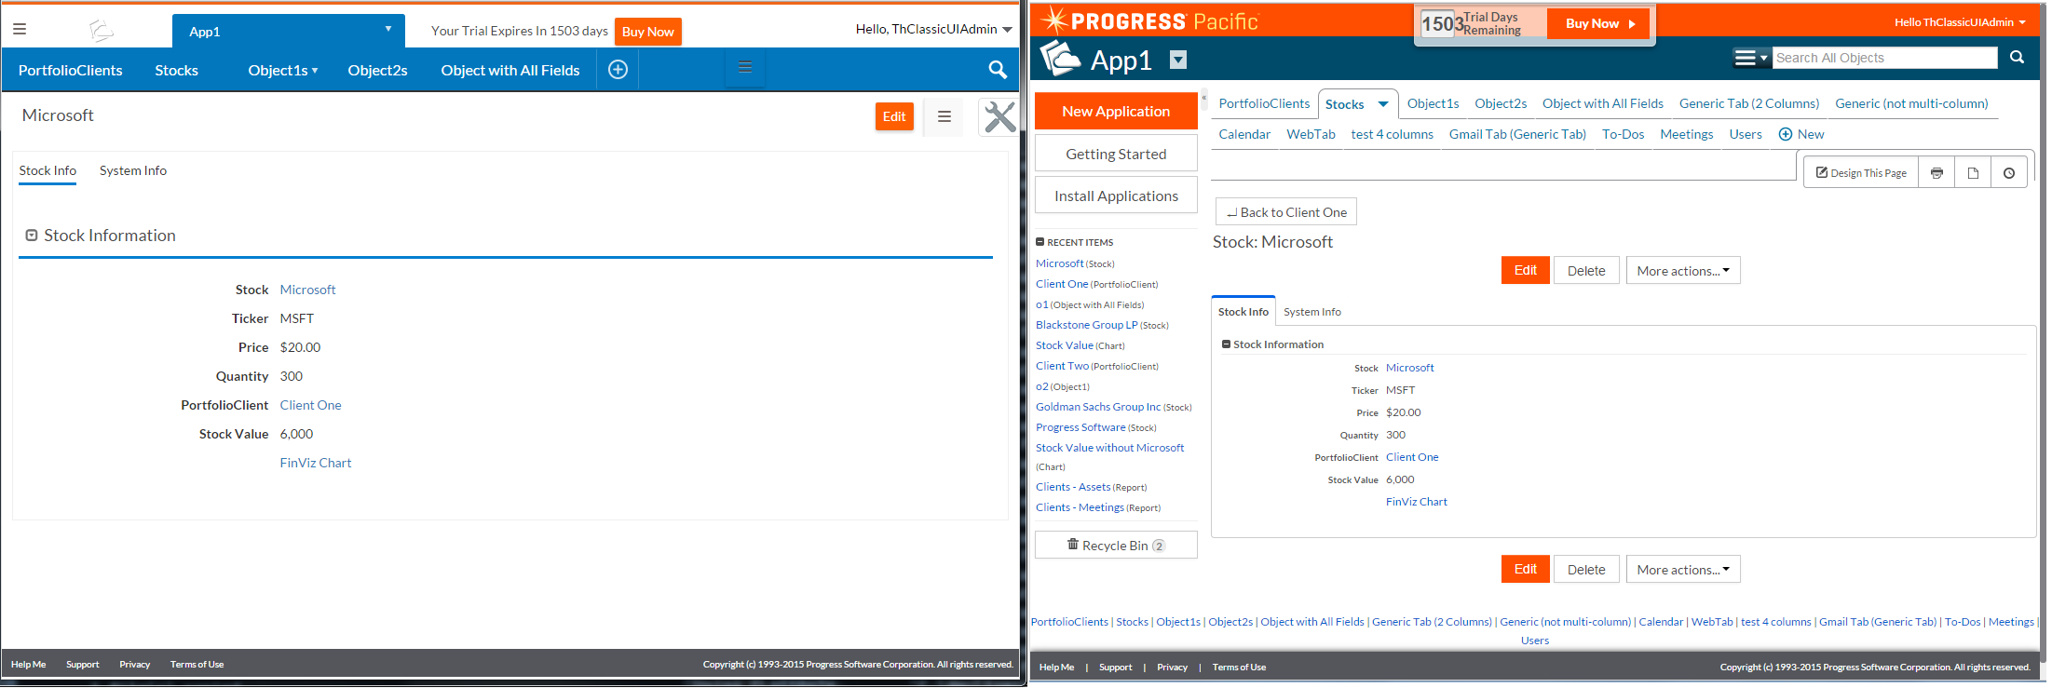
Drill Down One Stock - Object View

Slide 9
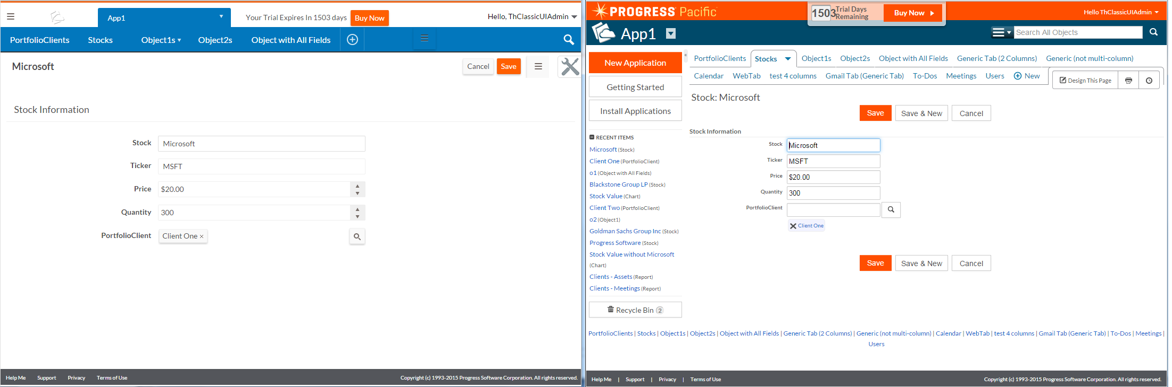
Edit One Stock – Object Edit

Slide 10
New UI General enhancements
New Page Structure
  Scroll Content only – no more links at bottom, no double toolbar on view and edit page
New Headers
  Tabs are now menus + scale better (Overflow)
  New Hamburger menu – Rollbase Menu (No more Side Bar)
  Page Menu
  Page Tool

Slide 11
Grid (List) Enhancements Examples
Column Sizing – Drag and Drop Column Reordering
Select – Copy and Paste
Inline Edit: Object 1 – o2 on second view (red coloring when intFieldOne > 1)
List Size
    Page Size vs Grid height
    existing views will get a grid Height property of -1 meaning autoheight
    newly added views will get default grid height property set to 300px
    setting the value to 0 will reset the grid to the default height specified above

Slide 12
Enhancements
Lots of smaller enhancements
Can’t list them all
Encourage to try it out

Slide 13
Agenda
Quick Tour
Rollbase and Kendo UI - Built-in themes
Responsive UI.
Customization

Slide 14
Rollbase with Kendo UI
Usage of Kendo UI Controls is pervasive
Examples:
  Objects with All Fields Edit
  Calendar

Slide 15
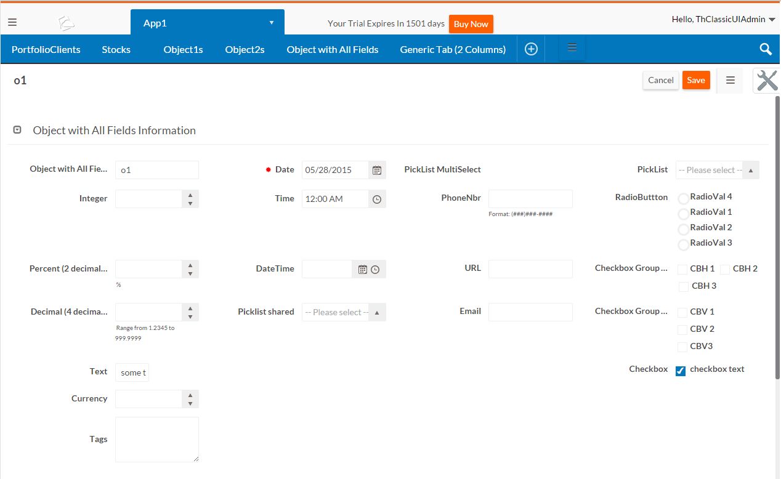

Slide 16
Themes
New Rollbase Theme (Default)
12 Built-in themes from Kendo UI
Font awesome Icons:
  Scalable vector icons that can be customized — size, color, drop shadow, and anything that can be done with CSS.
  We will see an example with customization
  http://fortawesome.github.io/Font-Awesome/cheatsheet/
  http://fortawesome.github.io/Font-Awesome/examples/

Slide 17
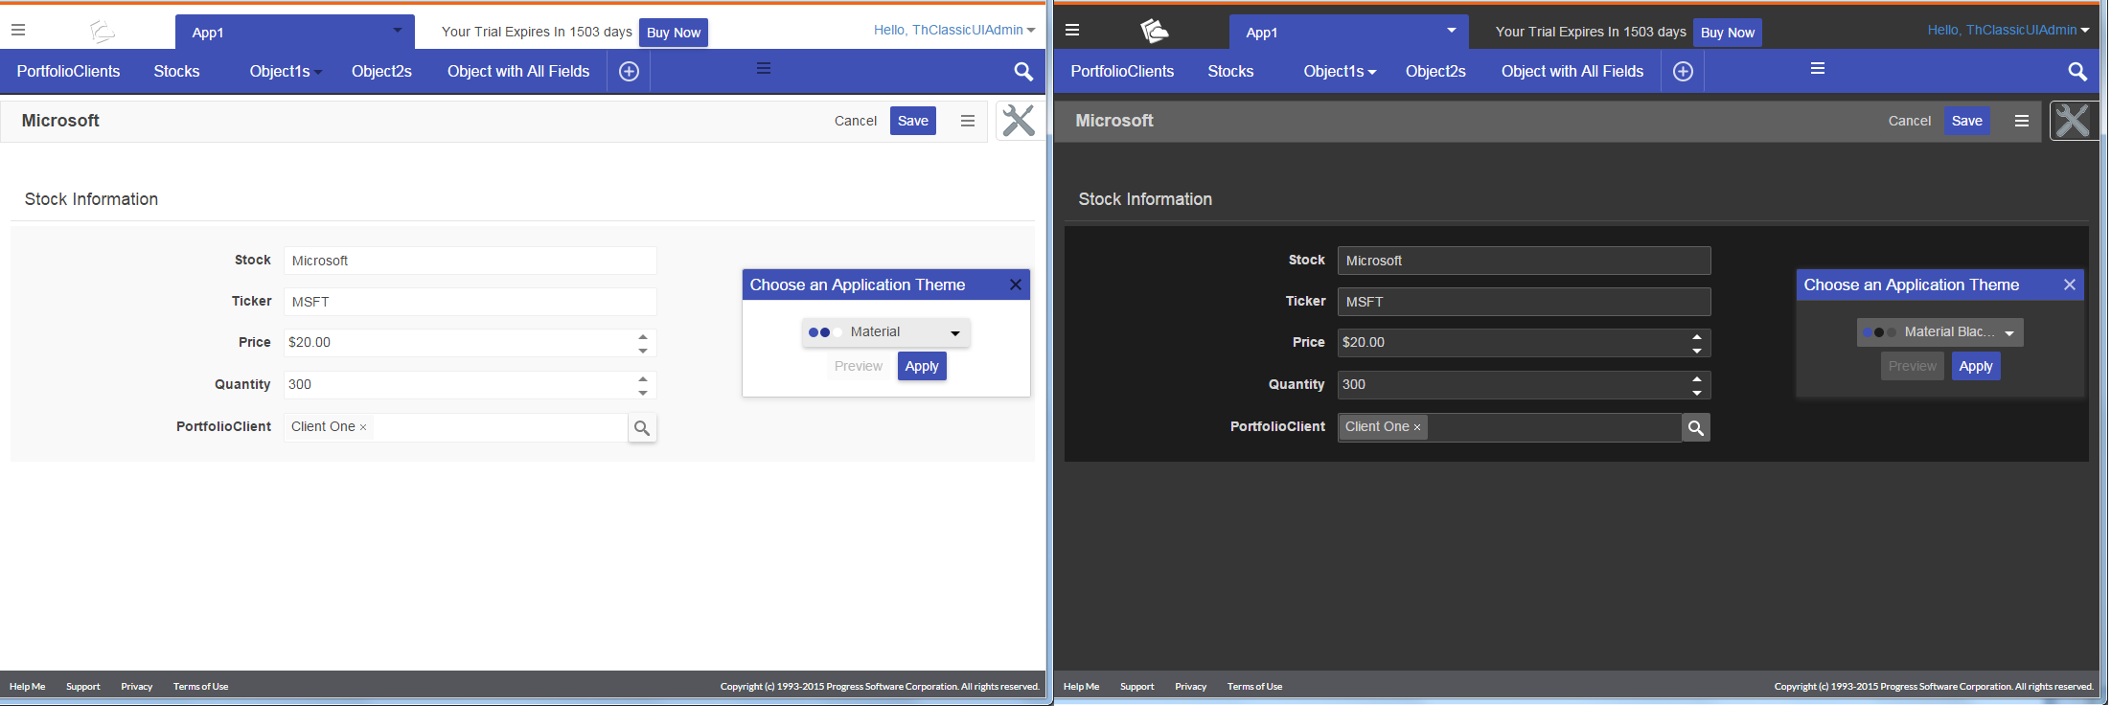
Theme Examples – Material and Material Black

Slide 18
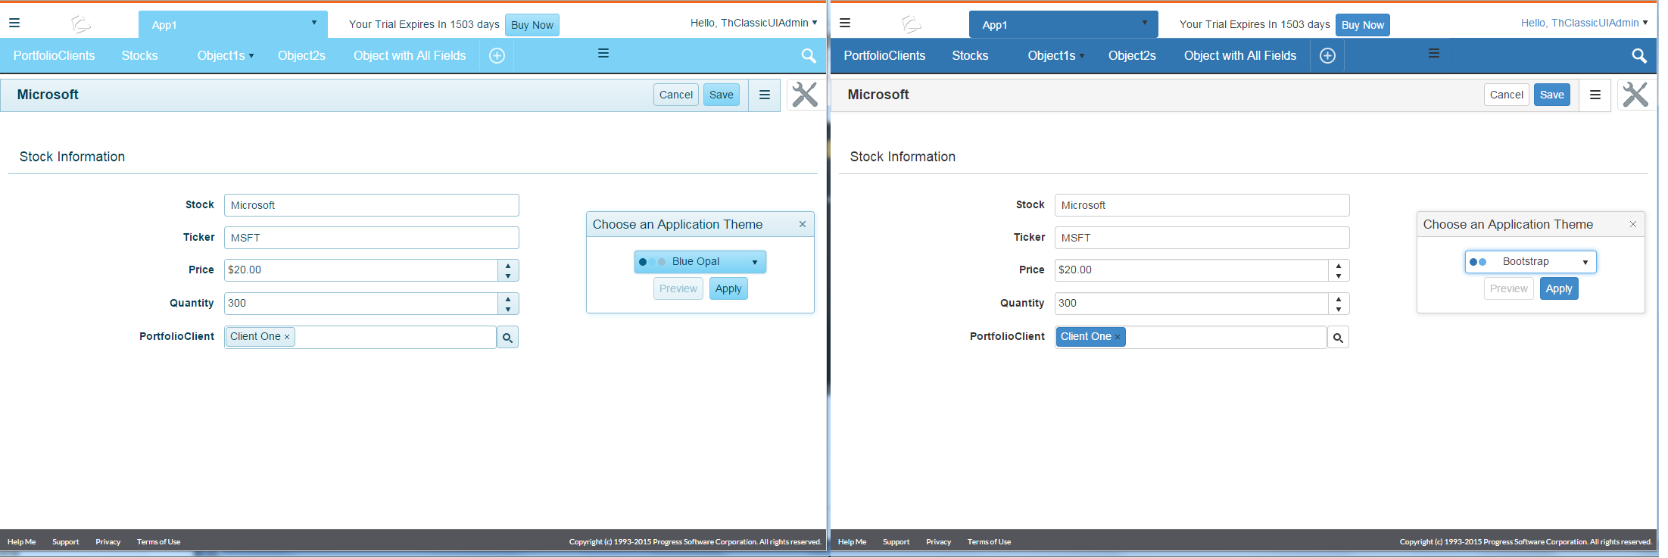
Theme Examples – Blue Opal - Bootstrap

Slide 19
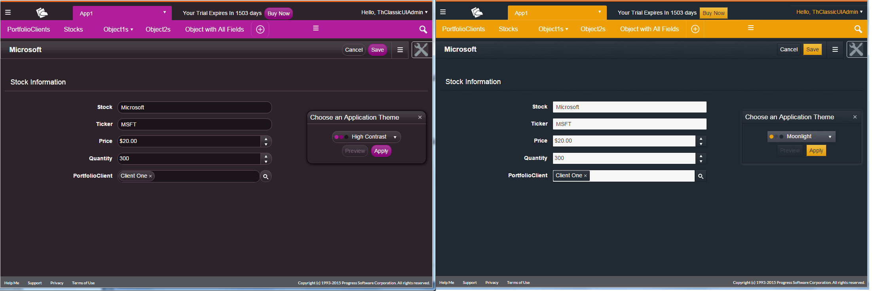
Theme Examples – High Contrast - Moonlight

Slide 20
Agenda
Quick Tour
Rollbase and Kendo UI - Built-in themes
Responsive UI.
Customization

Slide 21
Responsive UI.
Foundation:
Bootstrap V3
  Only New UI – Classic UI still V2
Up to 4 columns in Page Designer
Responsive features in Kendo UI Widgets

Slide 22
Typical Breakpoints
@media only screen and (max-width: 768px) {
Device is Extra Small
}
@media only screen and (min-width: 769px) and (max-width: 992px) {
Device is Small
}
@media only screen and (min-width: 993px) and (max-width: 1200px) {
Device is Medium
}
@media only screen and (min-width: 1200px) {
Device is Large
}

Slide 23
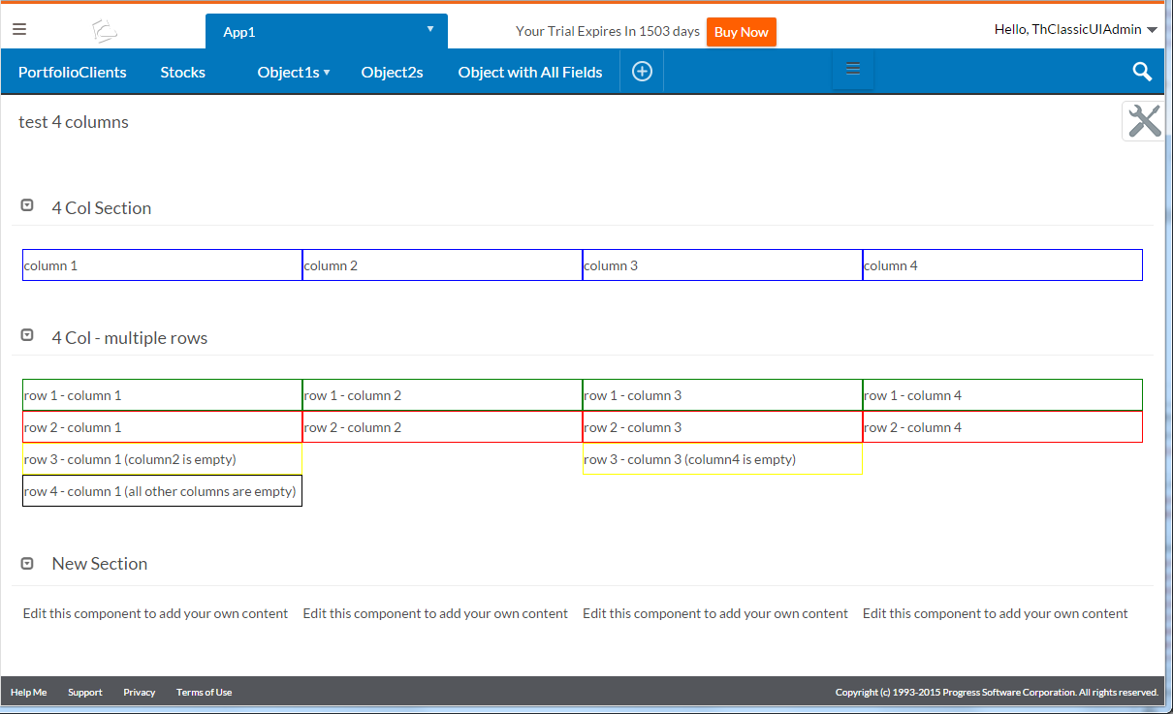
At 1200 or greater

Slide 24
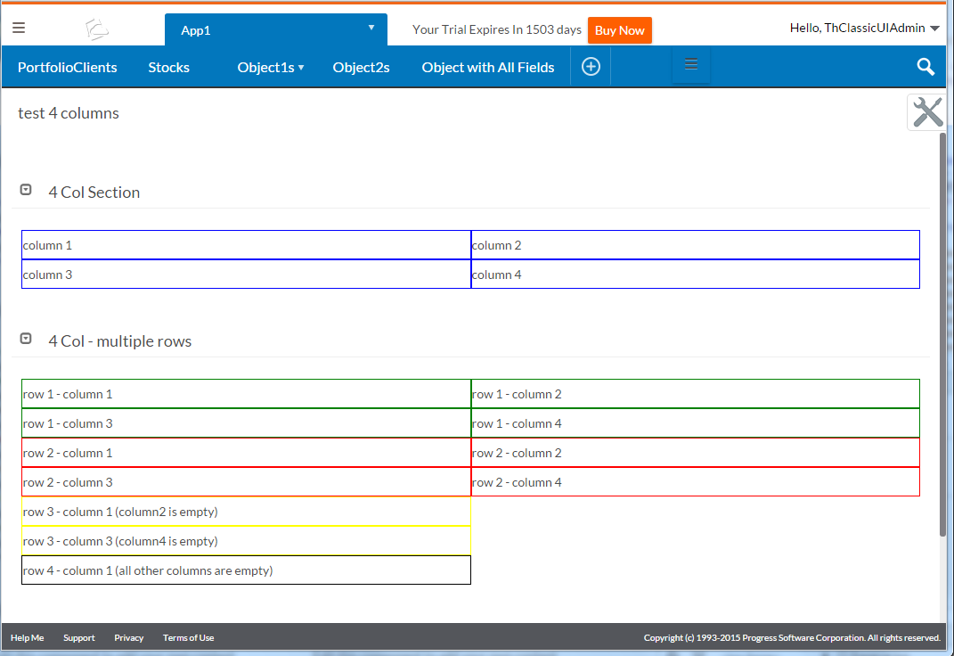
At 768px to 1199px

Slide 25
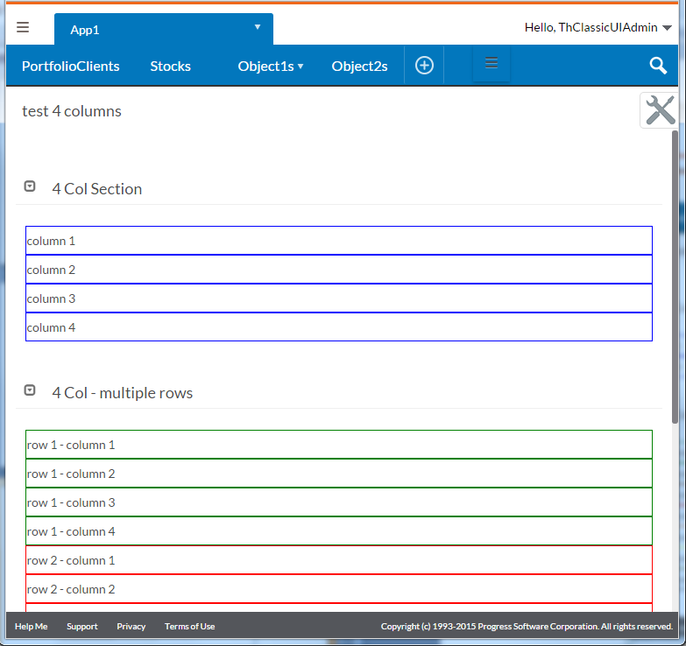
Less than 768px

Slide 26
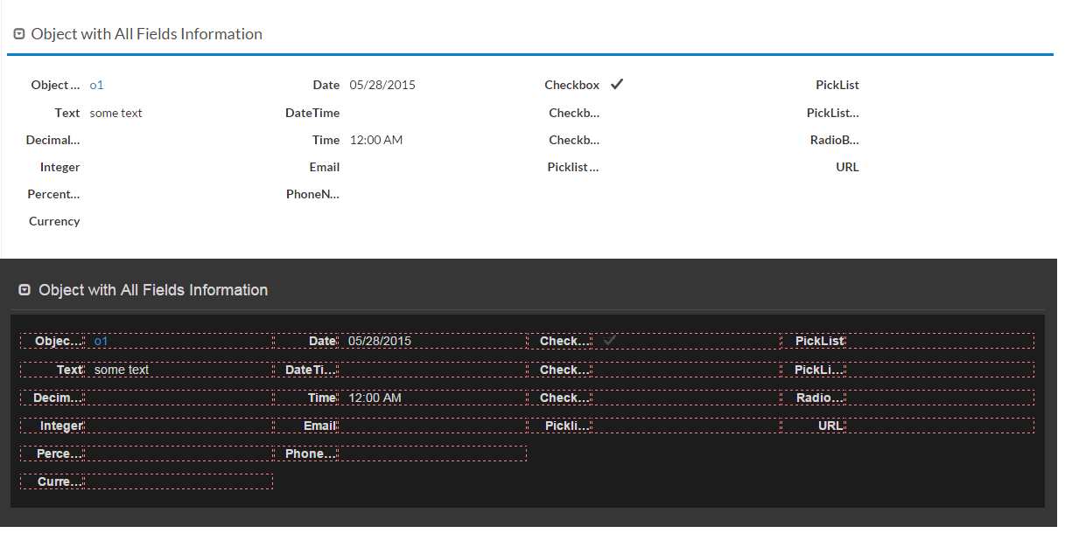
Responsive UI. Object View Query param: demoFieldsLayout

Slide 27
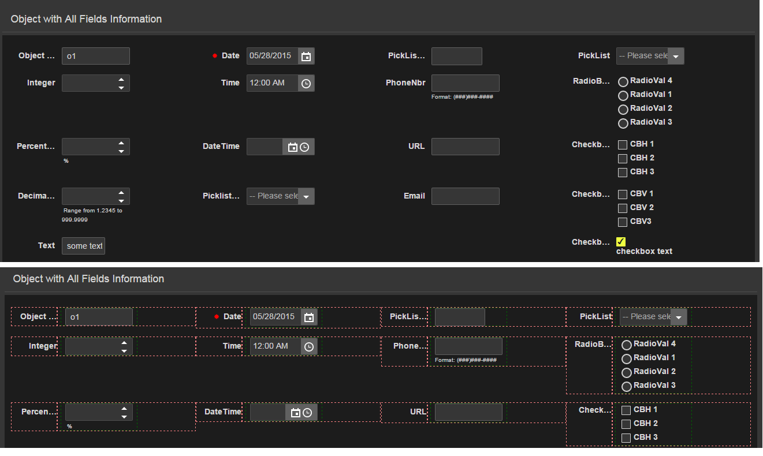
Responsive UI. Object View and Edit View

Slide 28
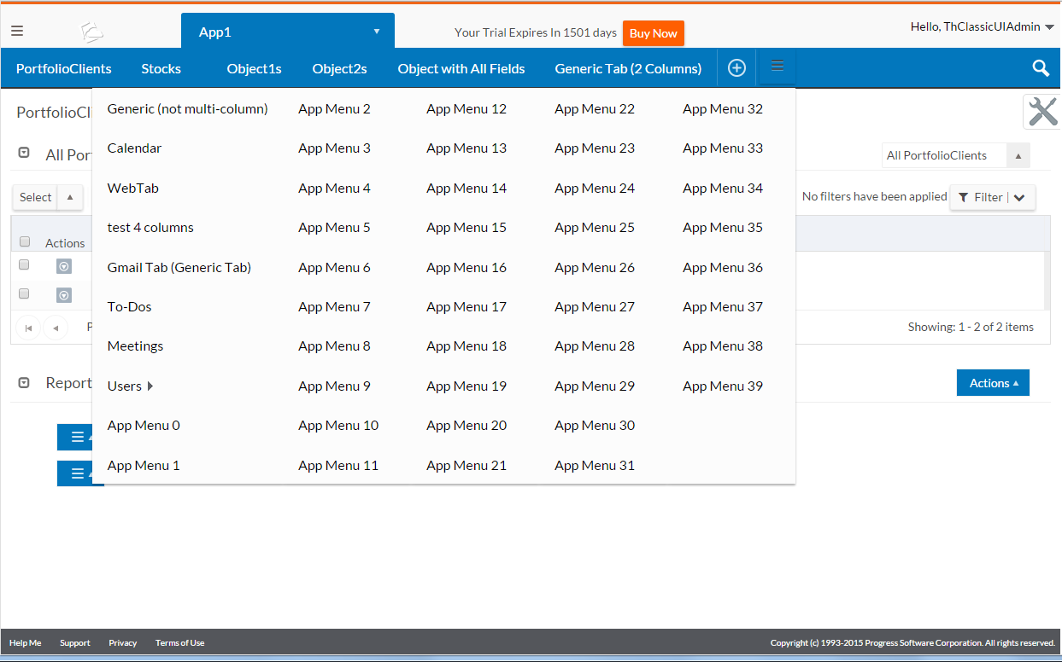
Responsive UI: Lots of Menus &testLotsOfApplicationMenus=40

Slide 29
Agenda
Quick Tour
Rollbase and Kendo UI - Built-in themes
Responsive UI.
Customization

Slide 30
Customization
Foundation:
Custom Header and/or Footer and Custom Sidebar

Slide 31
Customization - Css Override
CSS Inclusion order:
  newuiStructure.css
  newui.css
  newui.<theme-name>.css
Custom Header or Custom Sidebar:
  Included after other CSS files
  Can leverage to do App specific theme
Hosted File:
  Now only an override (Classic UI was a full replacement)
  Can leverage to do Tenant wide styles

Slide 32
Customization
Theme Kendo Component:
http://demos.telerik.com/kendo-ui/themebuilder
Theme and Kendo CSS Rules:
http://docs.telerik.com/kendo-ui/web/appearance-styling

Slide 33
CSS Hosted File – For Reference
It's a 2 steps process, where one uploads a modified CSS file as a hosted file and then sets it as the CSS file to use on the tenant.
Creating the hosted file:
  Log under separate tenant (not master tenant)
  Under current app setting click hosted files
  choose New Hosted file and give it a name
Assigning CSS (hosted file) to Tenant (Customer).
  Go to setup home
  Select Account settings (only available if logged under different tenant).
  in Appearance, select, for the css stylesheet, the name of the style created previously

Slide 34
Example: App with Custom Styles
.rbs-sectionTitle
{
font-style: italic;
color: darkorchid;
}
/* This is how we color the expand/collapse icon */
.k-panelbar .k-icon.k-panelbar-collapse,
.k-panelbar .k-icon.k-panelbar-expand
{
color: darkorchid;
}

Slide 35
Example
Adding Field Separator – Object View – Object Edit
<script>
$(".rbs-separator-cell").text("=");
$(".rbs-separator-cell").width("1em;");
$(".rbs-simpleField-label").css("margin-right", "0.4em");
</script>

Slide 36
Customization
Bootstrap 3 – Kendo UI – Font Awesome available to you
Example: Object 1 – Kendo Toolbar and Grid
CSS Base Rule to Trigger Conditionl Rules:
For example: k-ie, k-ie9, k-pdf

Slide 37
Customization - Custom Events
rbs_ui_resized is raised when layout manager has finished resizing.
Usage Example:
$(document).on ( "rbs_ui_resized", function( customEvent ) {
// customEvent.contentSize -> the new content size (does not include headers and footer)
// customEvent.totalPaddingHeight -> content padding
});
rbs_sectionExpanded' or rbs_sectionCollapsed
rbs_tabActivated is raised when the page tab is activated and fully visible on the page.
rbs_recordSelectionCleared and rbs_recordsSelected are raised when items selection from the grid is cleared or items are selected.

Slide 38
Questions
IE 9 support – how important for you?

Slide 39
Conclusion
Major new features
  New Controls
  Themes
  Responsive UI
  Simplified Design and removed clutter
  Easier and more maintainable customizations
Sum of Lots of smaller enhancements = substantial changes
Very Solid Foundation for Future

Slide 40

Thanks for Coming
Notes:
Rollbase future is bright

Slide 41




