Slide 1
385
Amazing UI Modernization Using Telerik UI for WinForms
Shelley Chase Senior Software Architect, Progress Software
Richard A. Zaslaw Sales Engineer, Telerik Inc.
June 2015

Slide 2


Agenda
OpenEdge Product: GUI for .NET
Telerik Product: UI for WinForms
Demo – Showcasing the Telerik UI for WinForms
Progress Developer Studio Visual Designer
Wrap up and Q & A

Slide 3
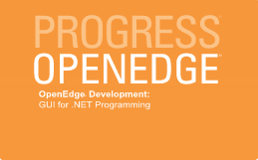
What is the OpenEdge GUI for .NET?
Modern UI for OpenEdge applications using Microsoft WinForms
  Desktop enterprise business applications
  Microsoft and third-party control providers results in hundreds of UI components
    Data-centric UI controls
    ADO.NET maps well to OpenEdge ProDataSet™
  Visual Designer in Progress Developer Studio for OpenEdge
  WAIT-FOR event model for .NET forms
More than just GUI – supports “most” .NET classes
  Expands your ABL program with .NET libraries
  Object-oriented programming directly in ABL

Slide 4

The Promise of GUI for .NET
Utilize existing skills – ABL and Progress Developer Studio for OpenEdge
  Full access to .NET classes in ABL
  ABL enhanced to support .NET – WAIT-FOR, .NET classes
  Drag-and-drop WYSIWYG designer in PDS for OE
Modernize at your own pace
  Create new navigation and menu system as MDI container
  Mix new windows with existing classic GUI windows
    Migrate most important windows first, other windows over time
    WinForms wrapper provided for classic GUI windows
    WinForms container provided for embedded windows
Notes:
ABL Language
Built-in data binding using ABL data sources
Event handlers written in ABL for .NET UI events
Reuse your existing business logic
Work with your ABL GUI windows allowing you to adopt at your own pace.
OpenEdge Architect
Development environment you already know
No need to purchase, learn or use non-OpenEdge products (Visual Studio®)

Slide 5
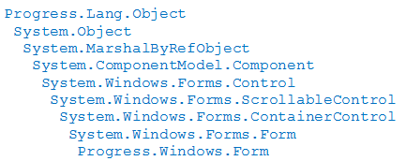
ABL Extensions to support GUI for .NET
Progress.Windows.Form
  Extends .NET Form class
  InitializeComponent method (generated)
  Coming: Progress.Windows.RadForm
Progress.Data.BindingSource
  Extends .NET BindingSource class
  Binds .NET control to ABL data source (query)
ABL SUBSCRIBE added to every .NET UI event
  Takes an ABL method or procedure name
Enhanced WAIT-FOR for .NET
  Waits for .NET application, form or modal dialog
Notes:
Several extensions to Progress GUI environment… our “secret sauce”
Extends form so Progress GUI windows can work with .NET forms
DataBindingSource extends .NET binding source so that it can supply ABL data to a .NET control
Can bind to query for ProDataSet, temp table, DB table… supports batching
Events… Added a “subscribe” method that allows you to provide an ABL method or procedure name

Slide 6
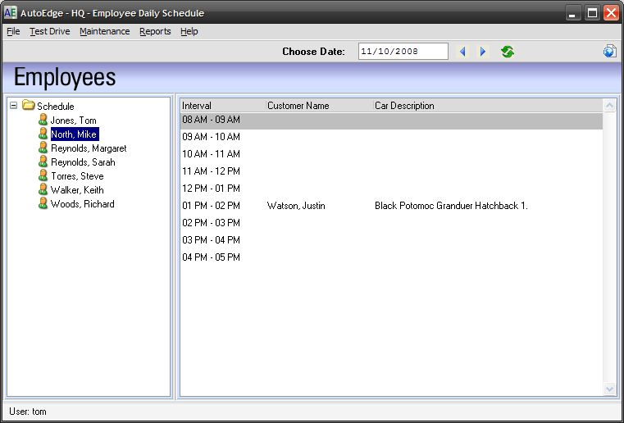
Sample Transformation – From GUI Classic
Schedule Test Drives
File menu
Employee TreeView
  Single select
Date picker and scroll
Appointment List
  Need to go to menu to edit appointments

Slide 7
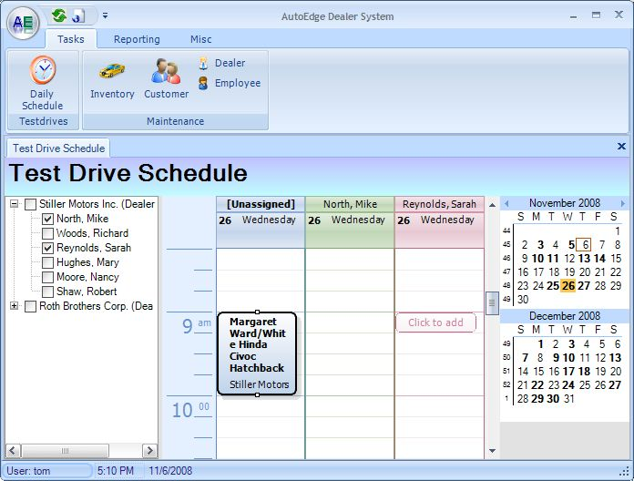
Sample Transformation – To GUI for .NET
Schedule Test Drives
Ribbon bar
Hierarchical Checked TreeView
  Dealer selection
  Employee by dealer
Calendar with Appointments
  Date picker on calendar
  View multiple employees
  In calendar appointments
  Click on calendar
    Add new appointment
    View/Edit existing one

Slide 8
Sample Transformation – Side-by-side

Slide 9
Telerik UI for WinForms
Energized Enterprise Desktop Development

Slide 10
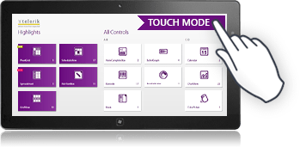
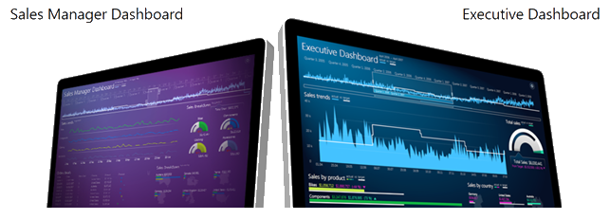
Enterprise Development
“What exactly are we building?”
Line of Business (LOB) Applications
Enterprise Applications
Vibrant Dashboards
Touch Enabled Applications

Slide 11
UI for WinForms
“Energize your apps!”
110+ Unique UI Controls ( Editors, GridView, RichTextBox, Scheduler)
Highly Optimized Performance
  Powerful Data Engine – Blazing fast data loading and updates
  Virtualization – Cells/rows and Columns
  Minimized repainting and layout rearrangements
Build Touch-Enabled Apps (Windows 7 +)
  Multi-touch API fully supports touch gestures
  Touch-Enabled Controls (GridView, TreeView, Panorama)
  Metro UI (Windows Store Apps) Theme
Productivity Tools (Visual Style Builder, Control Spy, Shape Editor)

Slide 12
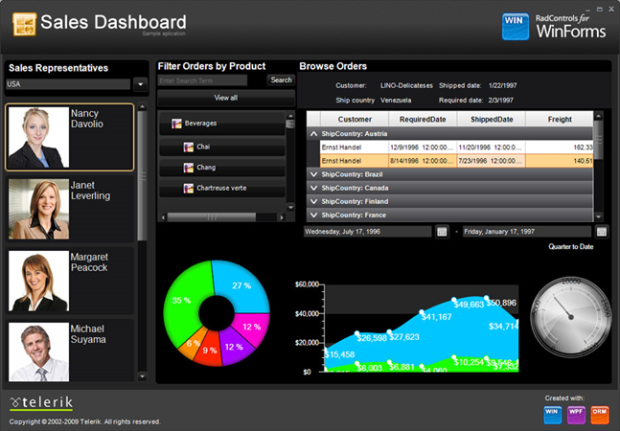
Telerik Presentation Framework
“WPF Inspired Architecture”
A completely customizable architecture for WinForms controls based on WPF best practices
  Stunning WPF-like User Interface - Scaling, Rotation, Animations, Transparency
  Flash-like Animations
  Superior Performance
  Rich Text Formatting through HTML
  Unlimited Nesting of UI Elements
  Granular Customization of All Elements
  Custom Controls
  Theme Support

Slide 13
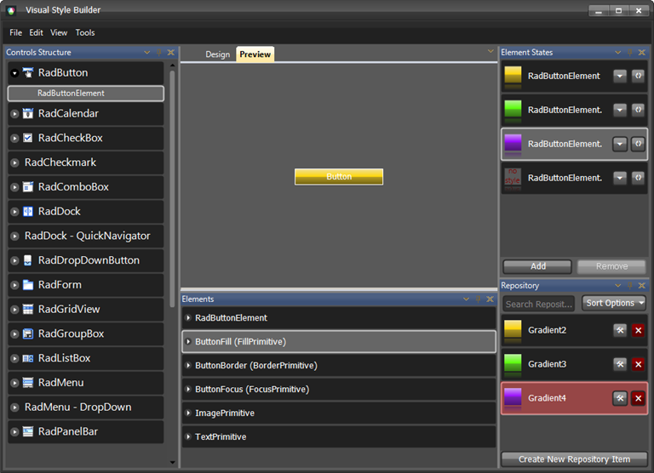
Full Theme Support
“Next generation look and feel”
Use predefined themes or build new ones from scratch
Apply themes across all of the WinForms controls
Themes available as standalone components
Drag and drop control skinning using Visual Studio Toolbox
Visual Style Builder
  Set Properties
  Inherit Properties
  Animate Changes
  Save modified themes

Slide 14
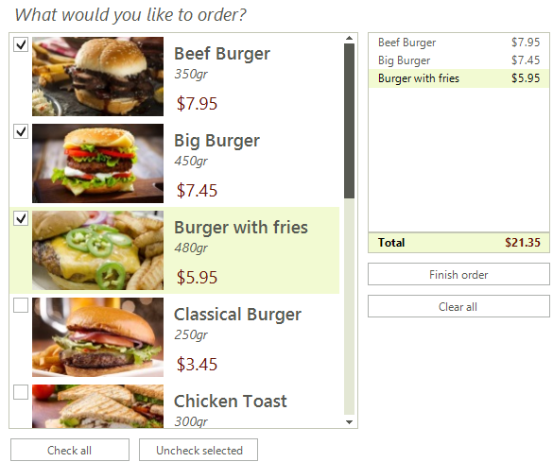
UI for WinForms
“What’s New in the Q1 2015 Release”
Visual Studio Templates ^{New!}
  Rapid Application Development
  Outlook and Word-Inspired Templates
  Ready-to-use templates which can be used for immediate start if you need an application that mimics the look and feel of the Microsoft app
^{Enhanced!} RadPdfProcessing (RTM), RadSpreadProcessing, RadWordProcessing
  Enables users to manipulate documents and convert from one type to another solely using Telerik tools
  No need for end users to have Adobe or Office or any third-party app
  Developed by XAML Team and ported to WinForms
RadCheckedListBox^{New!}
  Highly requested control

Slide 15
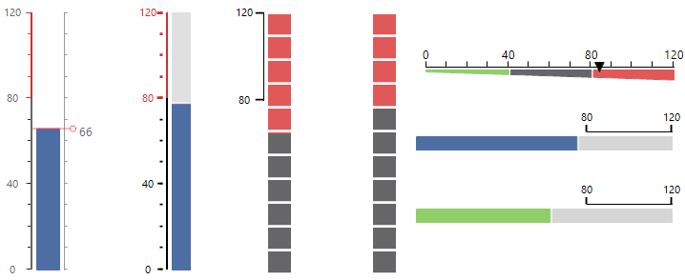
UI for WinForms
“What’s New in the Q1 2015 Release”
RadLinearGauge, RadBulletGraph ^{New!}
  New Data Visualization tools
^{Beta!} RadDiagram
    Provide a framework (control and API) to facilitate the creation of diagramming and rich data visualizations
    easily create a variety of diagramming solutions such as org charts, flow and process diagrams, etc.
Enhancements to RadChartView ^{Added Features!}
  Annotations: Plot bands, Marked Zones, Grid lines + Radial lines
  Inverse Axis, Mouse aware pan + zoom
  Export charts to images

Slide 16
Demos
Quick Start Framework
250 + Individual sample applications with full source code (C#, VB.Net)

Slide 17
The Telerik Difference
Vibrant Community & Resources
  1,400,000+ registered users
  Active forums, blogs, videos, webinars, code libraries
  Extensive product documentation & targeted demos
Industry Leading Support
  Support ticketing system (24 hour guaranteed response)
  Full support access for trial users
  Phone support option with DevCraft Ultimate
Beyond Exceptional Software
  Aggressive release schedule (3 major releases/year + Service packs + interim builds)
  Proven track record of 10+ years of innovation not imitation

Slide 18
Visual Designer for WinForms
Progress Developer Studio for OpenEdge

Slide 19
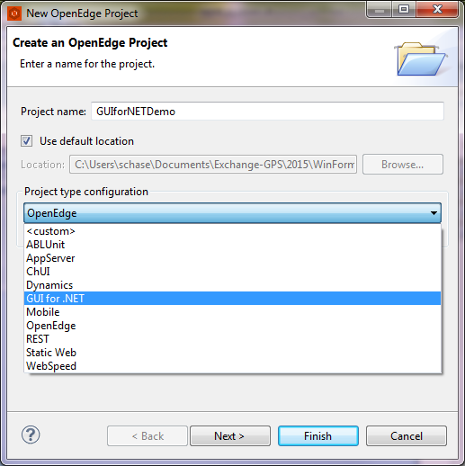
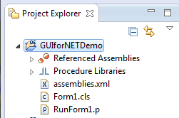
GUI for .NET in Progress Developer Studio
Project type with perspective
  Creates an empty form class
  Creates a run procedure
  Includes .NET assembly references

Slide 20
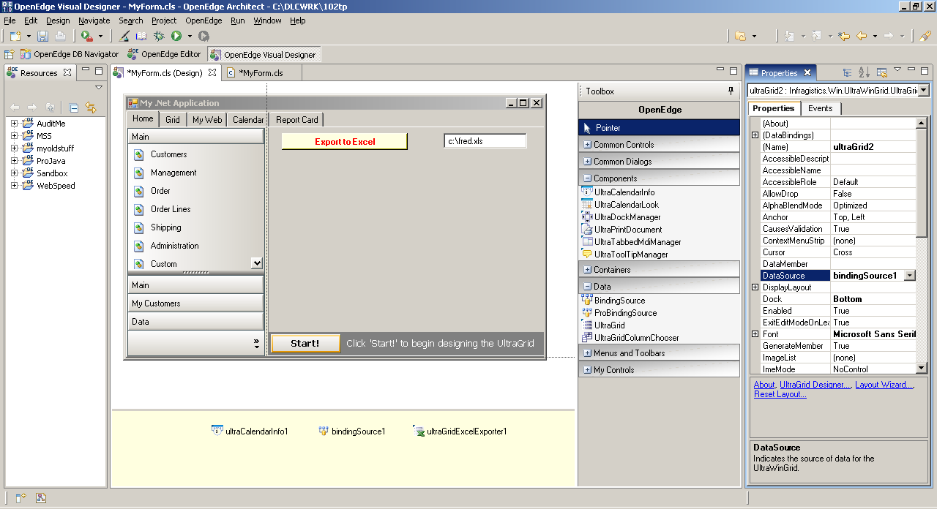
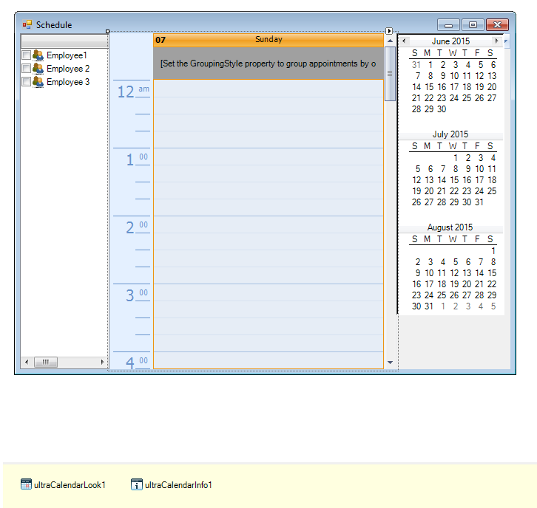
Visual Designer in Progress Developer Studio (like Microsoft Visual Studio)

Slide 21
Visual Designer in Progress Developer Studio (like Microsoft Visual Studio)
Form

Slide 22
Visual Designer in Progress Developer Studio (like Microsoft Visual Studio)
Toolbox

Slide 23
Visual Designer in Progress Developer Studio (like Microsoft Visual Studio)
Properties/Events

Slide 24
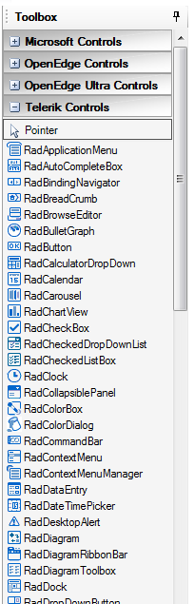
GUI for .NET and Telerik UI for WinForms
Telerik controls in toolbox for drag-and-drop UI design
  Code generated automatically for you
  Assemblies.xml automatically updated
ProBindingSource component provides data binding to OpenEdge
  Query is mapped to UI component
C# code samples translate to ABL “relatively easy”

Slide 25
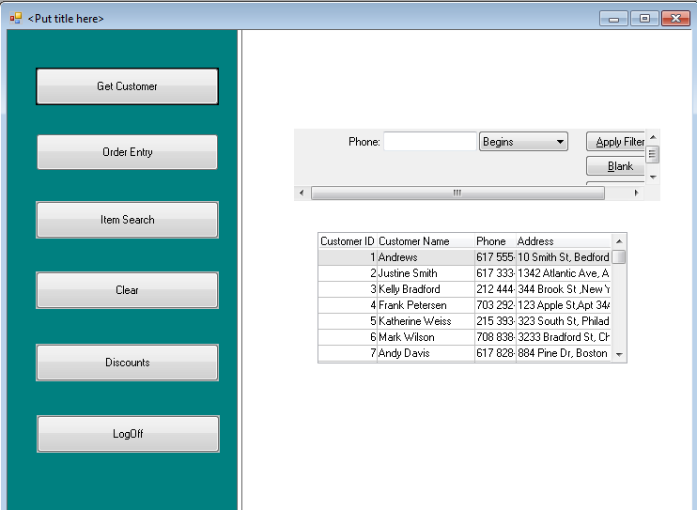
Transformation Using Telerik UI for WinForms

Slide 26
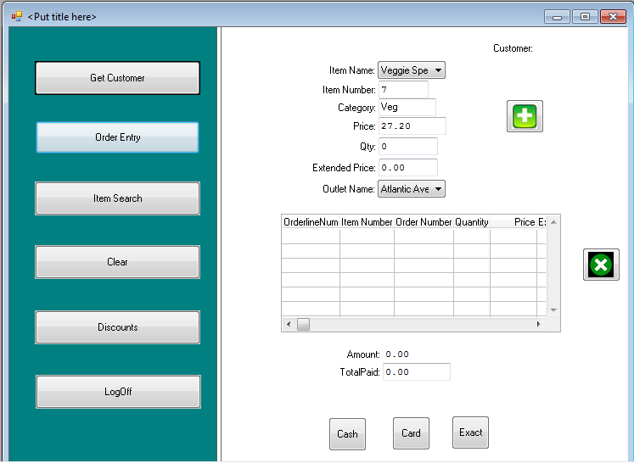
Transformation Using Telerik UI for WinForms

Slide 27
In Summary
Modern, competitive UI built entirely with OpenEdge
  WYSIWYG Visual designer
  “Unlimited” set of .NET controls available
  Data-binding using ProBindingSource
  ABL event handlers
Using existing business logic and leverages what you know
  Any architecture supported (client-server, “fat” client, n-tier)
  ABL events, business logic, data constructs, queries
  Built-in migration path with existing GUI windows
  Event-driven programming you know (WAIT-FOR)
Telerik UI for WinForms takes GUI for .NET to the next level!
Notes:
My first demo showed you can create a modern, competitive, comprehensive application within OpenEdge tools and language. You don’t have to leave Architect to build your application. There is a wealth of .NET controls available from very simple to very complex and purposed components. The Visual Designer allow you to create your UI using drag and drop features so you do not have to leave all the complexities of programming against the .NET controls. The Visual Designer automatically generates ABL code.
The ABL GUI and GUI for .NET work together so you can migrate over time rather than having to redo all of your user interface at one time.
Data binding is easy to do using the ProBindingSource object. Existing ABL data sources are used directly so there is no duplication of data.
And finally your investment in your ABL business logic is not lost by going to the GUI for .NET.

Slide 28

Comments, Q&A

Slide 30
Notes:
Change color

