Slide 1
378
Building a Mobile App With The Telerik Platform
Shelley Chase Senior Software Architect, Progress Software
Ricardo Perdigao Solutions Architect, Progress Software
Richard A. Zaslaw Sales Engineer, Telerik Inc.
June 2015

Slide 2
Agenda
The Journey to Telerik Platform
Demo: Using Telerik Platform
Integration of Telerik Platform and OpenEdge
Demo: Accessing OpenEdge from AppBuilder
Migration of existing apps
The Future for Mobile

Slide 3
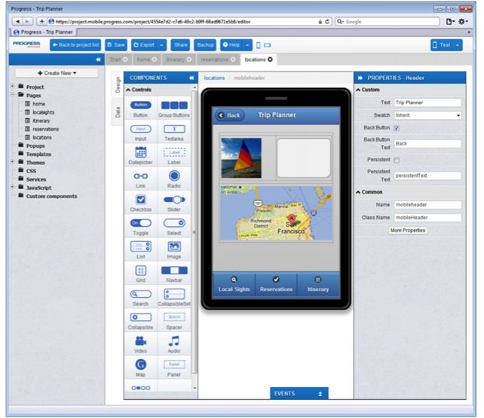
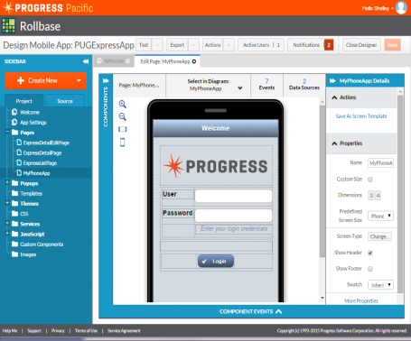
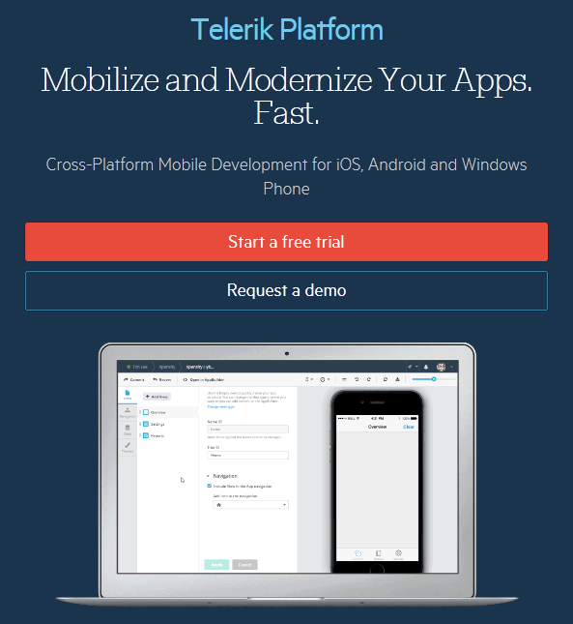
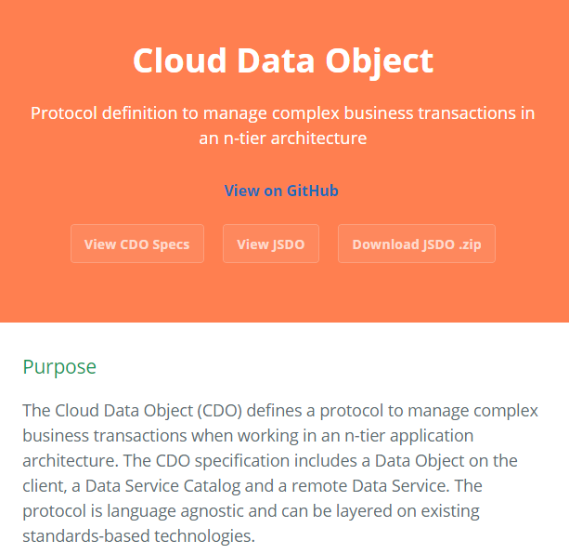
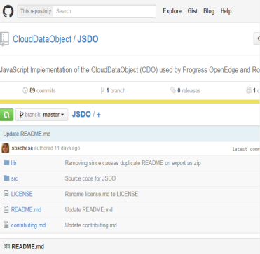
The Evolution of Mobile Development in OpenEdge
2012
2014
Q1 2015
Q2 2015
OE Mobile
Mobile App Builder
Business Entity
Mobile Service
JavaScript Data Object (JSDO)
Rebrand Mobile for Pacific
Announce move to Telerik Platform
JSDO Open Sourced
Kendo UI DataSource for JSDO

Slide 4

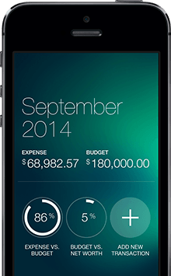

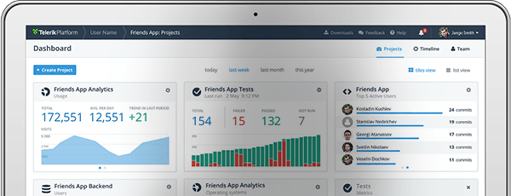

Making Great Apps Possible
Next Gen Tools and Services to Build Apps
130,000
customers
465
of Fortune 500
“VISIONARY”

Slide 5







1.4M Developers Trust Telerik to
Make the Cross-Platform Development Lifecycle a Breeze
AppBuilder*
Screen Builder
Backend Services*
Design
Build
Connect
Connectors
Kendo UI
DataSync
Fiddler
Analytics
Device Cloud
Measure
Deploy
Test
AppFeedback
AppManager
Test Studio
* Similar features to OE Mobile AppBuilder

Slide 6




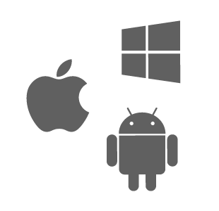

Cross-platform Frameworks in Telerik Platform
Mobile Web Apps
Hybrid Apps
Native Apps
Using
Using
Using
NativeScript
or
or
Fastest performing framework
Built by Telerik
Verified Cordova Plug-ins Marketplace by Telerik
100% Shared UI
Built by Telerik
Single code-base, but not one-size-fits-all
All inside the Telerik Platform using pure JavaScript, HTML and CSS

Slide 7
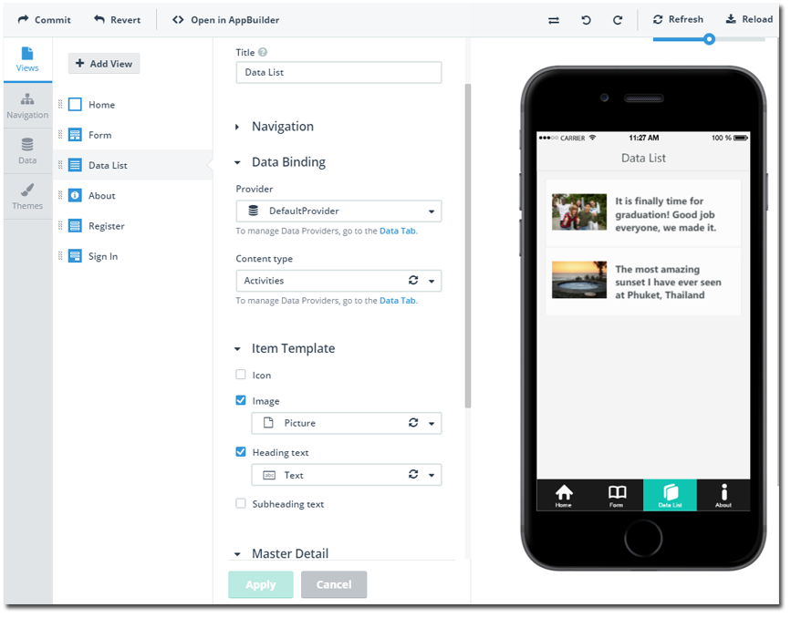
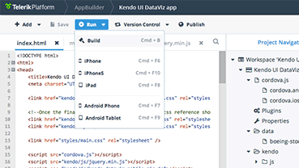
DEMO: Telerik Platform in Action
Screen Builder
AppBuilder

Slide 8
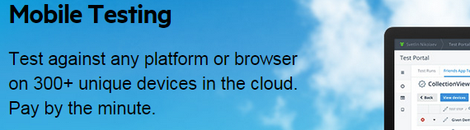
Other Products in the Telerik Platform: Mobile Testing

Slide 9
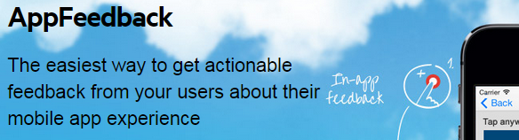
Other Products in the Telerik Platform: AppFeedback

Slide 10
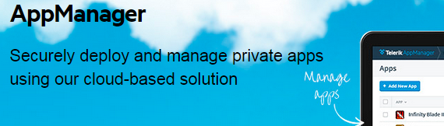
Other Products in the Telerik Platform: AppManager

Slide 11
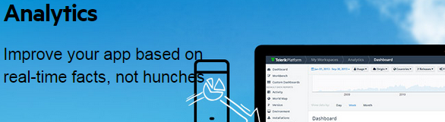
Other Products in the Telerik Platform: Analytics

Slide 12
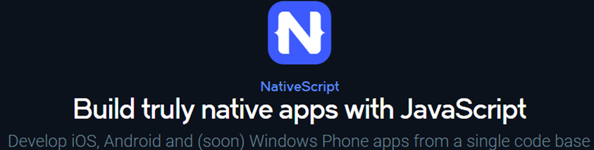
Other Products in the Telerik Platform: NativeScript

Slide 13
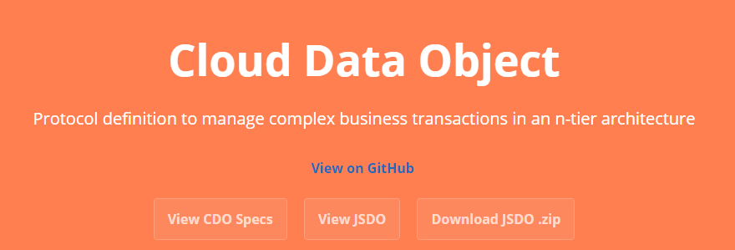
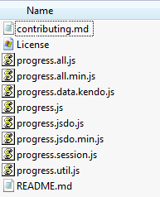
Open Source - Cloud Data Object and JSDO
[6/3/2015 12:34 PM] Ricardo Perdigao:
http://clouddataobject.github.io/CDO/
CDO Specifications for remote data management and synchronization
JSDO Reference implementation of CDO in JavaScript

Slide 14
Integrate Telerik Platform with OpenEdge: Progress Data Service
Progress Data Service == JSDO
JSDO Dialect for Kendo UI DataSource
  Create one DataSource for each table in the JSDO
  JSDO manages hierarchical and transactional data updates to server
Invoke operations called directly on JSDO instance
var customerDS = new kendo.data.DataSource({
transport: {
jsdo: “Customer”
},
error: function (e) {
console.log('Error: ', e);
}
});
Notes:
Overrides how the create, read, update,delete and submit operations go to the backend.
Invoke operations called directly off the JSDO

Slide 15
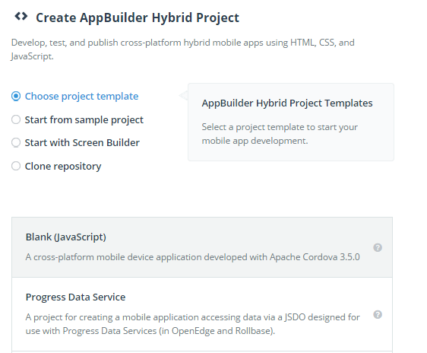
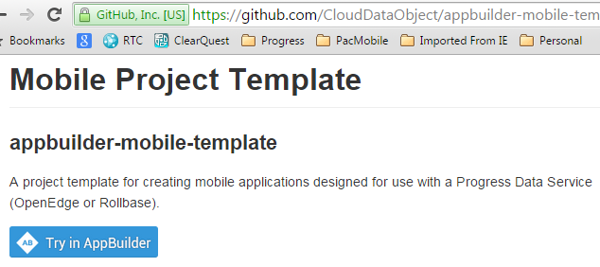
Integrate Telerik Platform with OpenEdge: Progress Data Service Project Template
Project Template in GitHub or AppBuilder
  Includes Progress (JSDO) libraries
  Session management included
  Sample data-bound list

Slide 16
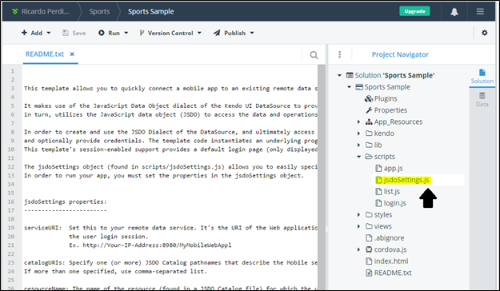
DEMO: Integration with OpenEdge

Slide 17
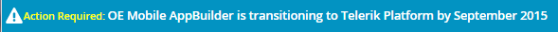
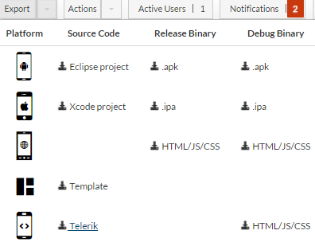
Migrate Existing Apps to Telerik Platform
OE Mobile available through September 2015
  Existing apps can be migrated to Telerik Platform
  App continues to use jQuery Mobile UI
Telerik Platform available today
  OE Mobile licenses transferred
  Integrates with OpenEdge Mobile Services

Slide 18
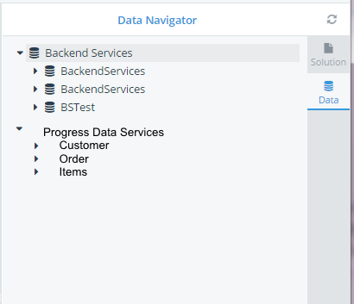
Future Plans
Telerik Platform – Product Development
Telerik Platform – OpenEdge-specific
  Tooling integration for Progress Data Service (JSDO)
  NativeScript support for Progress Data Service
JSDO Enhancements
  Data caching in JSDO
  Offline support enhancements
  Simplify hierarchical support for Kendo UI DataSource

Slide 19

Kendo UI Campaign in Market Right Now

Slide 20
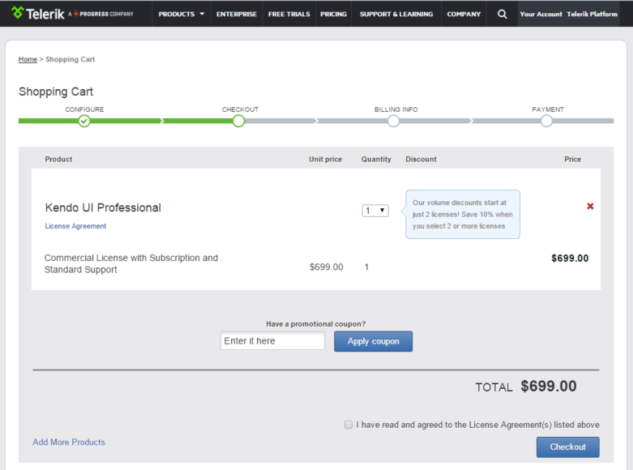
COU-WZEFCC

Slide 21

Comments, Q&A

Slide 23
Notes:
Change color

