Slide 1
Performance testing of Progress Appservers and a plug-in for Jmeter
Syed Irfan Pasha
Progress Software

Slide 2

Functionality
User Interface
Performance
k
✓
✓
?
Vs
Existing features
New features

Slide 3

Agenda
Performance testing of Appservers
OpenEdge Plug-in “in” Jmeter
Demo

Slide 4
Process followed for OpenEdge Appservers Performance testing
  Emphasizing more on Process than the numbers
Process
Scenarios
Measurement
Beyond Performance
Process followed by PSC
Statistics we get out of our Performance tests
Different types of tests and their significance
Siblings of Performance like Load, Endurance etc..

Slide 5
Components involved and factors measured
OpenEdge ABL
Jmeter for SOAP and REST
Java OpenClient
Clients
Transports
Appservers
Operating Modes
Session-Managed
Session-free
Client Execution time
Agent Execution time
Throughput
Resource Utilization
Network I/O
Performance Parameters
Direct/Nameserver
AIA/APSV
REST & SOAP
Classic
PAS for OE

Slide 6

Types of tests followed
Types of Tests
OpenEdge
Appserver
OpenEdge Clients
OpenEdge
ABL Client
C
OpenEdge
DB
R
OpenEdge
Appserver
U
D
ATM tests
Not the real one
CRUD Operation
Database transactions with datasets
Datasets transfer to-fro

Slide 7
Types of tests - ATM
OpenEdge
Appserver
OpenEdge Clients
OpenEdge
ABL Client
C
OpenEdge
DB
R
OpenEdge
Appserver
U
D
Adds, deletes and modifies accounts.
Measures the number of transactions completed and the average seconds for each transaction
Transaction times are measured at the AppServer agent not at the client.
Measure - Transactions per sec(TPS)
1

Slide 8
Types of tests – CRUD Operation
OpenEdge
Appserver
OpenEdge Clients
OpenEdge
ABL Client
C
OpenEdge
DB
R
OpenEdge
Appserver
U
D
Huge datasets performing CRUD operations
Runs for all transports ( Direct/Nameserver, AIA/APSV, REST and SOAP)
Measure execution time at the Client & Resource Utilization of all servers
Measure - Average client execution time in millisec
2

Slide 9
Types of tests – Dataset transfer
OpenEdge
Appserver
OpenEdge Clients
OpenEdge
ABL Client
C
OpenEdge
DB
R
OpenEdge
Appserver
U
D
3
Huge payloads of datasets from Client to Appserver to and fro
Measures Client execution time and Resource Utilization
Measure - Average client execution time in millisec

Slide 10
Types of tests – Summary
OpenEdge
Appserver
OpenEdge Clients
OpenEdge
ABL Client
C
OpenEdge
DB
R
OpenEdge
Appserver
U
D
All tests run for single-client and multiple concurrent clients
Each test has its own significance
Combined, we could get different Performance Statistics and perform various kinds of Performance testing
1
2
3

Slide 11
More than Performance tests
Profiling
Webserver & Agent
Compression
With various payloads/network
Endurance Testing
Running for more than a week
Load testing
Load by Payload/Clients
Garbage Collection
Running with different collectors

Slide 12

Performance Results - Good
CRUD - PAS for OE Response times (%) Improvement
11.5.1
21%
10%
48%
28%
Create
Update
Read
PAS OE Vs Classic
(APSV Direct)
Delete
Initial runs
30%
25%
22%
52%
% PASOE slower than Classic
% PASOE faster than Classic
MS-Agent = 8X Classic-Agent
ATM Tests
(faster)
Does not apply to the Client
Response time
PASOE – 1 Agent / n sessions
Classic – n Agents

Slide 13


Performance Results – Bad & Ugly
Dataset Transfer to & fro
CRUD - SOAP Transport
1281
2 X PASOE = Classic
1263
1029
Response time in millisec
22%
Vs
Create
Update
Read
Delete
APSV
Classic - Direct
AIA
Working on HTTP transport to boost Performance
PASOE-SOAP
11.5.1 is 10% faster than 11.5

Slide 14


Slide 15
OpenEdge Apserver Performance tool
Expectations from a OpenEdge Appserver Performance tool
  Performance tool/utility that could be seamlessly easy to run ABL business logic over OE-Transport
  Should be very easy to parse/validate the request or response
  Parameterization and concurrent clients execution capabilities
Accurate Calculations
Integration
Platform Independent
Concurrency
Robust Framework
Above all ....
Establish confidence that it can be used for Performance testing

Slide 16
Considering an Open Source tool and enhancing it
Develop everything from scratch
Define a Standard
Making it Stable
Robust Framework
Considering a OpenSource tool and extending it
Accurate Stats
Enhancements to be added to use Jmeter
Concurrent Clients
OE Adapter in Jmeter
OE I/O variable parsing
Jmeter-OE Serialization
Parameterization for OE
GUI for OE
OE Response Parser
Integration
Platform Independent
Jmeter

Slide 17

Jmeter and its whereabouts
Apache Jmeter
Apache Jakarta Project for Performance/load testing of variety of Java Applications(originally)
Later added support for various services
  JDBC,JMS, FTP,LDAP,TCP, HTTP, SOAP & REST
Advanced support for monitoring resources and distributing client load remotely
Gives all kinds of statistics and reports
Features like Assertions, Post Processors, Pre-processors
Many functions & scripting options
A short tour to Jmeter

Slide 18

Considering Jmeter for the Framework
OpenClient in Jmeter
Easy to use
Mostly used for API’s testing
Calls through Java OpenClient to Appserver
Designed Sampler for OpenEdge needs
Tool without OE install
Works on all platforms
Proven Performance testing tool
Reliable
Considering Jmeter
Apache Jmeter
OpenEdge Application Server
OpenEdge Plug-in

Slide 19
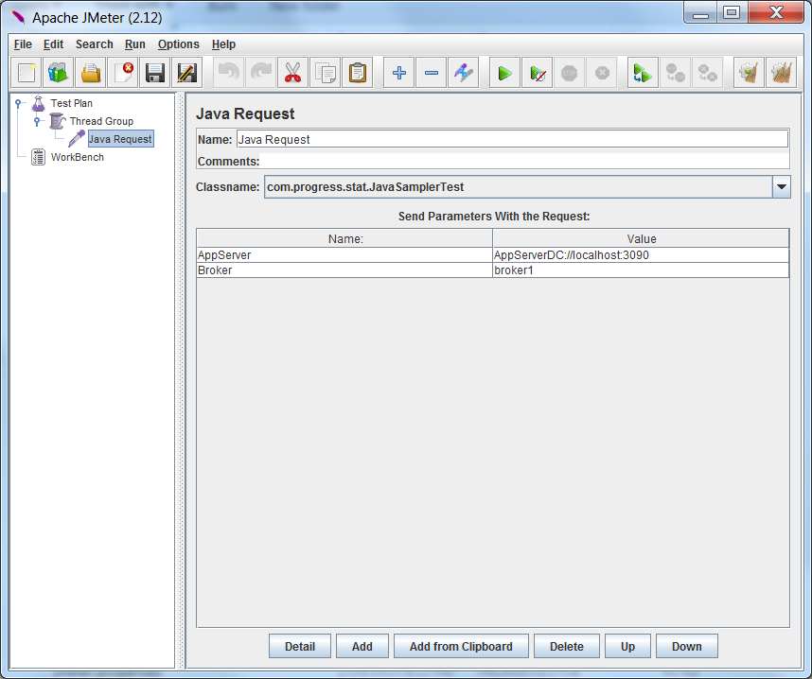
Implementing customized basic Java Sampler
A custom Java Sampler developed using AbstractJavaSamplerClient Interface

Slide 20

Customized JavaSampler and the Use-case
We were expecting more in this Sampler
  A new GUI Interface with a different functionality
  Dynamic class reader to parse the input/output variables
  Dynamic input request file parser for complex datatypes
  Storing the entire input in one file and passing the input to the sampler in the same format
All together, we wanted a new Sampler

Slide 21
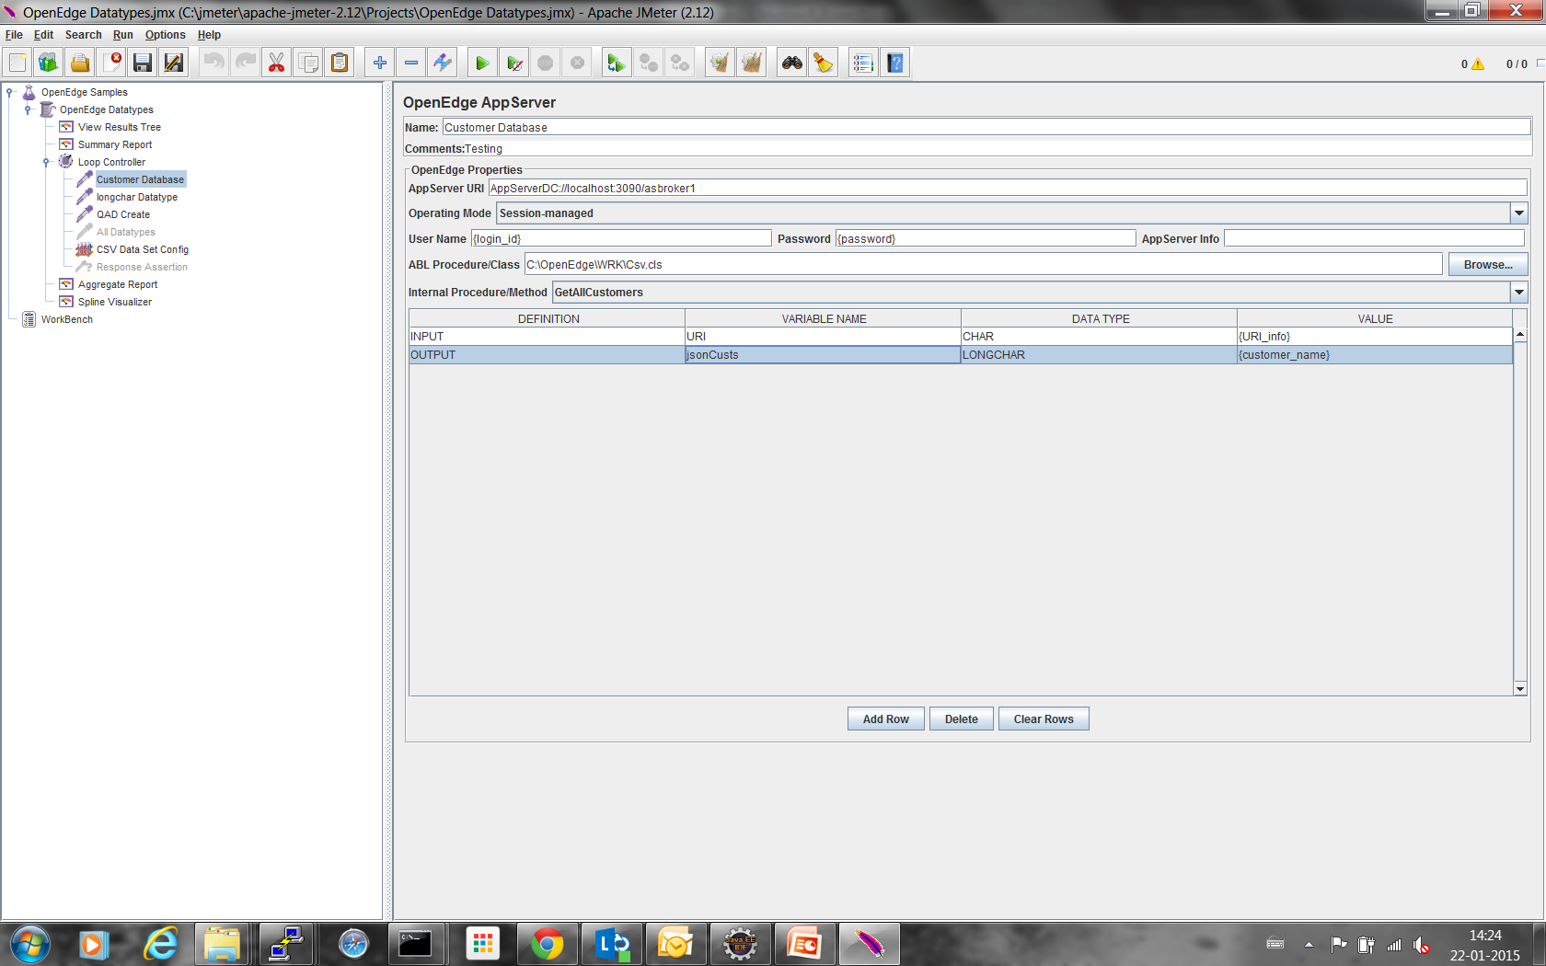


Framework in a bigger Picture
Jmeter Samplers
OpenEdge Appserver
HTTP
SOAP
OpenEdge Response Parser
Customized JSON Parser
OpenEdge Appserver
GUI Interface for OE
Sampler Processer
OE Client
OE Client Response Builder

Slide 22
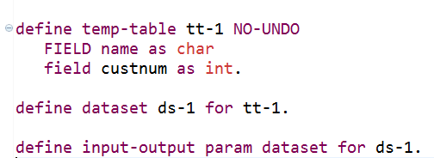
Testing an OpenEdge Procedure
Create Customers & Update Customers
Array of Temp-tables - “n” elements

Slide 23
Testing OpenEdge Procedure - Scenarios
Execute the dataset procedure
Validate the output/response
Stop if your validation is failed
Pass the output of create to update operation
Parameterize tt-1 attributes for “n” elements running with “m” concurrent users for “iter” iterations
Validate the output/response
Parse/get a specific elements attribute value
Executing a OpenEdge procedure using
“OpenEdge Plug-in for Jmeter”
Measure the Performance for every Appserver call with all statistics

Slide 24
Testing OpenEdge Procedure – Scenarios(Cntd..)
Parameterize tt-1 attributes for “n” elements running with “m” concurrent users for “iter” iterations
Request Payload
User-1
Dataset ds-1
temp-table tt-1[0]
name
custnum
.............
temp-table tt-1[n]
name
custnum
Iterations
User-2
User-3
DO WHILE cnt <= iter
/* concurrent users execution */
Assign cnt = cnt + 1.
End.
.............
User-m

Slide 25

Time for a Demo

Slide 26

Code , Time
& Effort

Slide 27
Lines of Code and Statistics
4500
Lines of Code
OpenEdge Client
Jmeter Samplers
1500
3000
2000 Lines of Code
2 ½ Engineers – 5 Days
2500 Lines of Code
1 ½ Engineers – 30 Days
Developing the base framework
Make the framework resilient
Things were getting complex
Adding more features

Slide 28

Just ask ! I am here to answer now and even later
isyed@progress.com

Slide 30
Performance Results - Good
CRUD - PAS for OE Response times (%) Improvement
ATM Tests
11.5.1
PASOE –APSV Vs Classic-Direct
Initial runs
MS-Agent = 8X Classic-Agent
Create
52%
21%
(faster)
Update
30%
10%
- Does not apply to the Client
Response time
Read
25%
48%
Delete
22%
28%
% PASOE slower than Classic
% PASOE faster than Classic
PAS for OE(MS-Agent with n sessions) = Classic n Agents

