Slide 1

Top Performance Enhancers & Destroyers
Presented by: Dan Foreman

Slide 2
Dan Foreman
Progress User since 1984
Author of several Progress related Publications
  Progress Performance Tuning Guide
  Progress Database Administration Guide
  Progress VST & System Tables
Author of several useful Progress DBA Tools
  ProMonitor & ProCheck & LockMon
  Pro Dump&Load
  Balanced Benchmark
Basketball & Bicycle Fanatic…which sometimes leads to unexpected trips to the Emergency Room: WARNING POTENTIALLY DISTURBING CONTENT

Slide 3

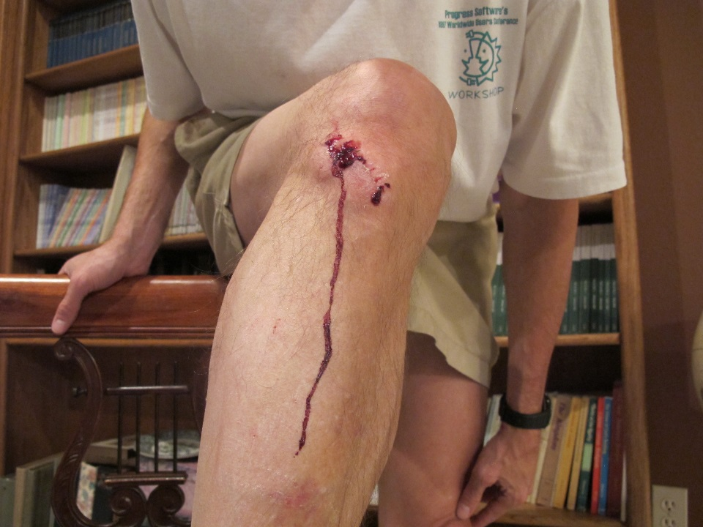



Slide 4

April - June Flights

Slide 5

I Won a Progress Earth Day Photo Contest

Slide 6
Audience Survey - Demographics
How many have used Progress for less than one year?
How many are in a company that has used Progress for less than one year?

Slide 7
Audience Survey - Technical
Largest Single Progress DB
Highest Progress Version
Lowest Progress Version
Are you using
  Auditing
  Multi-Tenancy
  OE Replication
  TDE
  Table Partitioning

Slide 8
Introduction
The slide titles are numbered, but that is not necessarily a rank or priority ordering

Slide 9
Enhancers #1 - Basic DB Tuning – Crucial
-spin (-spin)
DB Buffer Cache (-B)
Before Image Cluster Size (proutil –bi)
APWs (proapw)
BIW (probiw)
AIW (proaiw)

Slide 10
Enhancers #2 – DB Configuration
Database Block Size 8k or 4k
  Can be controversial
  My preference is 8k because it tends to reduce record fragmentation
  The default empty DB Block Size has been 4k since V10
Lesser
  Type 2 Storage Areas
Least
  Fixed Extents

Slide 11
Enhancers #3 - Indexing
The cost of adding a new index is relatively small compared to the benefits….assuming that the index is properly utilized
  Is the Index used at all?
  Bracketing on all components of the key?
  Proper hierarchy in the components?
  Not duplicated?

Slide 12
Enhancers #4 – Remote Client Communication
Message Size (-Mm) parameter for Remote Clients
Does NOT apply to SQL/ODBC Clients
Best results seen with NO-LOCK reads
Must be specified on the Database and the Client (fixed in V11.6!)
Default: 1024
Sweet spot: 4096-8192 (YUOMMV)

Slide 13
Enhancers #5 – Dump & Load
Metrics to use
  Scatter Factor (mainly Type 1 Areas)
    How many have heard that Type 2 Areas don’t require a D&L?
  Fragmentation – a percent is easier to understand than Factor
  Time it takes to run proutil dbanalys
    Use –scan in early V10 to prevent locking conflicts
  Elapsed time to run a set of Killer Reports

Slide 14
Enhancers #6 – Reporting Database
OLTP and Reporting exercise the DB Engine in somewhat contrary ways
Some ad-hoc queries may not be able to take advantage of existing indexes
Ad Hoc & Period Ending reports run against a Production DB with some ODBC based BI or other Reporting Tool
  Copy of Production DB
  Refreshed periodically (backups or AI logs) or real time (OE Replication)
  Should reside on a different server
Look @ BravePoint’s Pro2* Product Suite
  Pro2SQL
  Pro2Oracle
  Pro2Pro

Slide 15
Enhancers #7 – SQL
Regularly run UPDATE STATISTICS
  Use Moderation!
Separate Login Broker for SQL Clients (-m3 & -ServerType)

Slide 16
Enhancers #8 – Storage
SSD Storage
Flash Storage

Slide 17
Destroyers #1 – Poor Coding Techniques
Code that reads the same record (or set of records) repeatedly
Produces Hit Ratios that exceed 10000:1
Compare Table I/O (_tablestat) with dbanalys record counts

Slide 18
Destroyers #2 – Poor Coding Techniques
Code that repetitively exits to the operating system
  Context switch
  Create sub-process
  Terminate sub-process
  Repeat

Slide 19
Destroyers #3 – Indexing
Developers who don’t understand (or ignore) the Progress Indexing Rules
The Rules are reasonably well documented
  Progress Documentation
  Progress Performance Tuning Guide

Slide 20
Destroyers #4 – AppServers & WebSpeed Tuning
Poorly Tuned AppServers & WebSpeed Agents
Depending on the State, one AS/WS might run code for thousands of users
Important Parameters:
  Exec Buffer (-mmax #)
  Sort File Block Size (-TB 31)
  Sort Memory Buffers (-TM 32)
  R-Code Quick Request (-q)
  Temp-Table Buffers (-Bt #)
  Temp File Location (-T)
  Temp File Visibility (-t)
  Message Compression (-mc) WAN only

Slide 21
Destroyers #5 - Java
Java (or processes written in Java)
  WebSpeed Broker
  AppServer Broker
  Admin Server
  Name Server
  Tomcat
Monitor excessive memory use and/or high CPU utilization

Slide 22
Destroyers #6 - Checkpoints
There are several major performance issues that can occur @ Checkpoint time
  Buffers Flushed
  BI Cluster Formatting
  sync call (old versions of Progress)
  fdatasync call (new versions of Progress)
  Other stuff
CheckPoints will be covered in detail in another session

Slide 23
Destroyers #7 – Logical Scatter Factor
When the physical contiguosity of the data doesn’t match the order used by the index
Applies to both Type 1 and Type 2 Areas!

Slide 24
Destroyers #8 – Remote Client Access
Versus Self-Service Client DB connections
Abnormal death of a SELF Client can bring the DB down

Slide 25
Destroyers #9 – Accessing _Lock VST
Potentially very slow
High CPU activity
High Latch activity

Slide 26
Destroyers #10 – Storage
RAID 5
RAID 6
RAID DP – equals RAID 6
Lot’s of Cache only delays the inevitable
NetApp

Slide 27
Destroyers #11 - NUMA
Non-Uniform Memory Architecture
If the number of CPU Cores exceeds 64 (approximately), Progress does not scale always well
Latch activity needs to be propagated to the cache of each CPU

Slide 28
Destroyers #12 – DB Configuration
Tables or Indexes stored in the Schema Area – frequently seen in custom or side DBs
  The Schema Area is a Type 1 Area
AI Extents not separated from DB/BI Extents (mainly for integrity, performance is secondary)

Slide 29
Destroyers #13 – Miscellaneous
32-Bit Database License
Poorly configured or inadequately resourced Virtual Machines

Slide 30
Thank You!
Questions?
dforeman@bravepoint.com
Mobile: +1 541 908 3437
Request: Please thank PCA organizers for their hard work in putting together an excellent conference

