Slide 1

Checkpoints – What You Need to Know
Presented by: Dan Foreman

Slide 2
Dan Foreman
Progress User since 1984
Author of several Progress related Publications
  Progress Performance Tuning Guide
  Progress Database Administration Guide
  Progress VST & System Tables
Author of several Progress DBA Tools
  ProMonitor & ProCheck & LockMon
  Pro Dump&Load
  Balanced Benchmark
Basketball & Bicycle Fanatic…which sometimes leads to unexpected trips to the Emergency Room: WARNING POTENTIALLY DISTURBING CONTENT

Slide 3
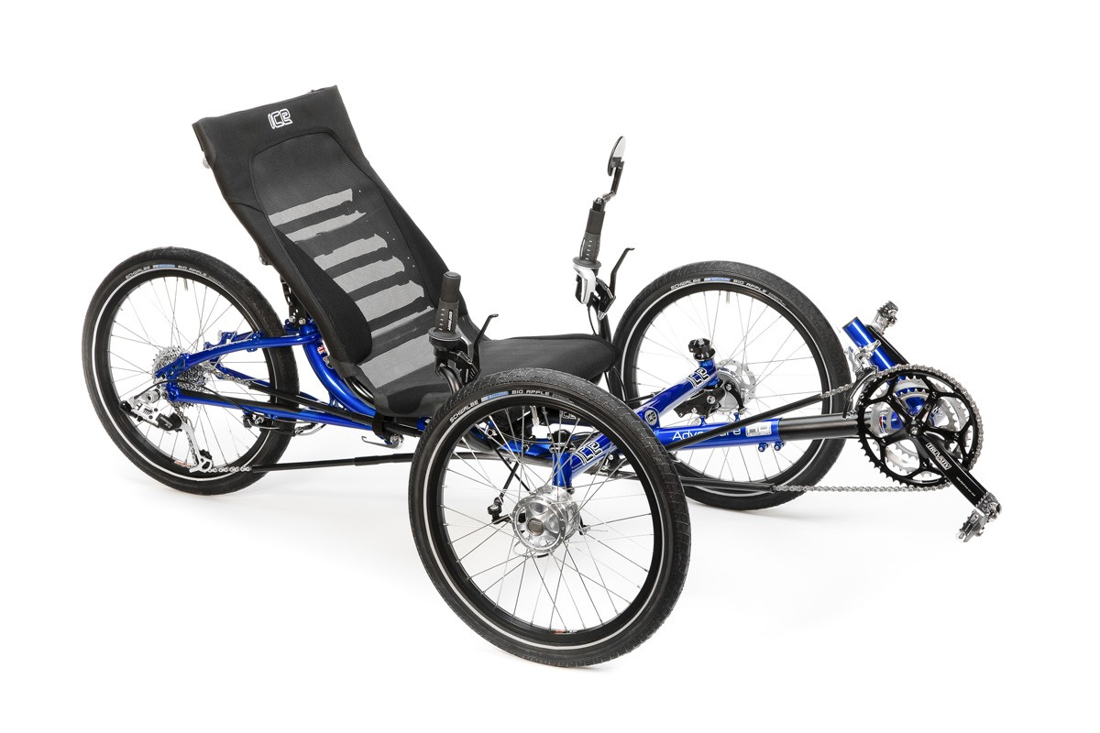

Slide 4
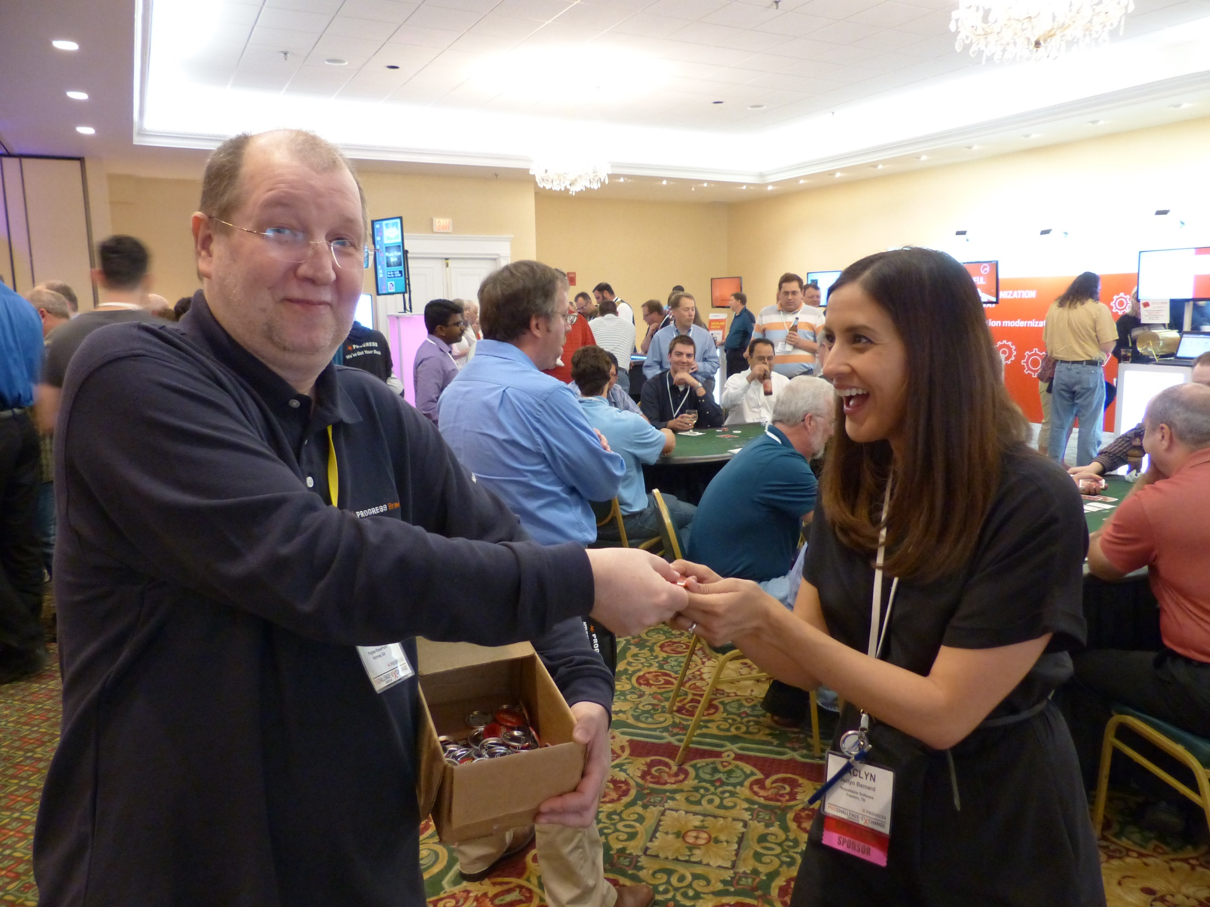

Slide 5

The Gus-mobile

Slide 6
Audience Survey - Demographics
How many have used Progress for less than one year?
How many are in a company that has used Progress for less than one year?

Slide 7
Audience Survey - Technical
Largest Single Progress DB
Highest Progress Version
Lowest Progress Version
Are you using
  Auditing
  Multi-Tenancy
  OE Replication
  TDE
  Table Partitioning

Slide 8
Checkpoint – Definition & Background
There is a bunch of updated data stored in the DB Buffer Cache, i.e. the “memory resident database state”
That data needs to get written to disk periodically
Checkpoints give us the opportunity to perform that task
Gus Definition:
A checkpoint is a process for making what is on disk consistent with the changed or updated database parts that are present only in memory.
It is a process, not an event.
I call it an event or point-in-time just to annoy Gus.
And also because some potentially bad things happen at particular points in the Checkpoint process

Slide 9
The Checkpoint Process
Beginning
Middle
End
For more information about Checkpoint internals:
http://pugchallenge.org/downloads2013/224_bi_checkpoints_crashes_v03.pdf

Slide 10
Checkpoint - Beginning
BI buffers flushed
All dirty (i.e. modified) blocks in –B/-B2 placed on Checkpoint Queue
Next BI Cluster opened
  Look for a reusable Cluster
  If no reusable Clusters are available a new one needs to be created
Checkpoint Timeline
B
E
Cluster 1
Cluster 2
Cluster 3

Slide 11
Brief Tangent – BI Cluster Basics
The BI file can have a minimum of 4 Clusters (on a running DB, a truncated BI has zero Clusters)
The BI Clusters are maintained as a ‘ring’, i.e. a double-linked list
Minimum Cluster size: 16k – Don’t use it
Maximum Cluster size: 256mb – Use with Caution

Slide 12
Brief Tangent – BI Cluster Reuse
To reuse a Cluster only the next adjacent Cluster in the ring can be reused
That Cluster cannot contain notes from an ACTIVE transaction
And in V9 and older, all transactions had to be committed or rolled back for a minimum of 60 seconds

Slide 13
Checkpoint - Middle
Asynchronous Page Writers take blocks off the Checkpoint Queue and write them to disk.
APW’s pace themselves, i.e. attempt to spread out the writes to avoid I/O spikes
Checkpoint Timeline
B
E
Cluster 1
Clus
ter 2
Cluster 3

Slide 14
Checkpoint - End
As the Cluster approaches full, all blocks from Checkpoint Queue “should have” been written to disk
But things don’t always go according to plan
Checkpoint Timeline
B
E
Cluster 1
Cluster 2
Cluster 3

Slide 15
How to “Watch” a Checkpoint
06/09/15 Status: BI Log
04:19:08
Before-image cluster age time: 0 seconds
Before-image block size: 8192 bytes
Before-image cluster size: 32768 kb (33554432 bytes)
Number of before-image extents: 1
Before-image log size (kb): 131192
Bytes free in current cluster: 11130610 (34 %)
Last checkpoint was at: 06/09/15 04:19
Number of BI buffers: 20
Full buffers: 19
Hint: when the % counts down to 0, refresh the screen repeatedly & quickly and if there is a pause between 0 and 100%, that pause is also being experienced by the users

Slide 16
Checkpoint – The Bad Stuff
A Summary of the bad things
  Buffers Flushed
  Cluster Formatting
  OS sync Call (V9 and older)
  OS fdatasync Call (V10 and above)
  Other Stuff
These things occur at the point when a Cluster is filled up

Slide 17
Checkpoint Problem #1 - Buffers Flushed
Modified DB Buffers (in –B/-B2 Cache) need to be written to the DB
Those writes are synchronous!
All transaction activity is FROZEN until all of the buffers have been written
Solutions:
  APWs – that asynchronously write the buffers during the ‘middle’ phase of the Checkpoint
  A BI Cluster size large enough to give the APWs time to do their job
    32-256mb on fast modern hardware
    Generally 30-60 seconds between Checkpoints is good
    The default BI Cluster size is 512k !!

Slide 18
Checkpoint Problem #1 - Buffers Flushed
Promon > Activity
Activity - Sampled at 06/09/15 04:32 for 0:14:02.
Event Total Per Sec Event Total Per Sec
Commits 294637 349.9 Undos 1 0.0
Record Updates 0 0.0 Record Reads 375 0.4
Record Creates 294638 349.9 Record Deletes 0 0.0
DB Writes 6408 7.6 DB Reads 161 0.2
BI Writes 19144 22.7 BI Reads 18 0.0
AI Writes 0 0.0
Record Locks 1178567 1399.7 Record Waits 0 0.0
Checkpoints 4 0.0 Buffs Flushed 3025 3.6
Rec Lock Waits 0 % BI Buf Waits 1 % AI Buf Waits 0 %
Writes by APW 0 % Writes by BIW 0 % Writes by AIW 0 %
Buffer Hits 100 % Primary Hits 100 % Alternate Hits 0 %
DB Size 40 MB BI Size 128 MB AI Size 0 K
FR chain 59 blocks RM chain 3 blocks
Shared Memory 17669K Segments 1

Slide 19
Checkpoint Problem #1 - Buffers Flushed
Promon > R&D > Other > Checkpoints
04/24/15 Checkpoints
12:30:06
Ckpt ------ Database Writes ------
No. Time Len Freq Dirty CPT Q Scan APW Q Flushes Duration Sync Time
5 12:27:38 148 0 10658 0 0 0 0 2.51 0.00
4 12:22:22 316 316 11651 0 0 0 4854 3.61 0.00
3 12:15:04 438 438 7647 0 0 0 6797 0.40 0.00
2 12:00:34 870 870 1021 0 0 0 850 0.20 0.00
1 12:00:03 31 31 171 0 0 0 171 0.15 0.00
0 11:57:44 139 139 0 0 0 0 0 0.00 0.00

Slide 20
Checkpoint Problem #2 – BI Cluster Formatting
If there are no reusable BI Clusters, to create a new Cluster, Progress must allocate space and format that space
Fixed size extents take care of space allocation
Fixed size extents DO NOT prevent the formatting
All transaction activity is FROZEN until the formatting is complete
Analogy : unformatted diskettes
Solution:
  Don’t truncate the BI File…unless necessary
  Preformat the BI File with proutil bigrow
    Make the script smart, bigrow appends to any existing BI file

Slide 21
Checkpoint Problem #3 – sync Call
In older versions of Progress, a sync call is issued to force the dirty buffers in the OS Cache to disk
Sync is a synchronous event
All transaction activity is FROZEN until the sync call completes
Solutions:
  -directio
  Tune the sync daemon (60 second default)
  Reduce the OS Buffer Cache
  Monitor sync call duration
  UPGRADE!

Slide 22
Checkpoint Problem #3 – -directio
Changes database writes to be synchronous, like BI writes
No OS buffering is involved, so sync is no longer needed
Added in V6
Only worked with DG (Data General) & Sequent
Starting in V8 applies to all platforms but the documentation was not updated to reflect that change
Bad news on:
  Windows
  Linux
  At least it was in some benchmarks a few years ago

Slide 23
Checkpoint Problem #4 – fdatasync Call
The sync call is evil because it flushes the entire OS buffer cache to disk
In V10 Progress replaced sync with fdatasync
The ‘f’ is File…fdatasync forces the writes for specific files
The idea is that the amount I/O required to write dirty DB extents should be less than writing the entire OS buffer cache
But not always!
My peers claim that fdatasync has made –directio obsolete….they are wrong

Slide 24
Checkpoint Problem #4 – fdatasync Call
Promon > R&D > Other > Checkpoints
04/05/13 Checkpoints
01:00:31
Ckpt ------ Database Writes ------
No. Time Len Freq Dirty CPT Q Scan APW Q Flushes Duration Sync Time
968 00:59:07 84 0 40285 30641 377 299 0 4.93 3.48
967 00:58:32 34 35 41689 33957 245 84 0 5.40 3.74
966 00:58:03 28 29 41606 33822 343 88 0 6.19 4.27
965 00:57:31 32 32 44671 36390 320 89 593 6.18 4.99
964 00:57:03 27 28 47257 39790 182 149 0 6.11 4.72
963 00:56:34 28 29 49035 41428 439 49 0 4.68 3.09
962 00:56:07 26 27 31657 24269 217 52 0 3.03 1.00
961 00:54:35 91 92 20442 12729 650 78 0 2.94 1.08

Slide 25
Checkpoint Problem #5 – Other Stuff
All dirty –B/-B2 Buffers must scanned and placed on the CheckPoint Queue
Checkpoint Queue has to be rebuilt…to do that must scan the entire –B/-B2
New BI Cluster (even one that is already formatte) the cluster header has to be initialized (one synchronous write)
Active slot in the Transaction table have to be written out
There is no measurement in any Progress version that shows us the cost of these activities

Slide 26
Thank You!
Questions?
dforeman@bravepoint.com
Mobile: +1 541 908 3437
Request: Please thank PCA organizers for their hard work in putting together an excellent conference

