Slide 1

“OpenEdge Rules” in Action:
Business Logic Agility & Transparency
David Atkins
Principal Solutions Engineer
June 2015

Slide 2
Agenda
What is Corticon?
When can Corticon add value?
Why to use it?
OpenEdge – Corticon Integration
  Design-time meta data integration
  OpenEdge Rules ABL API for runtime integration
  DEMO ONE – simple Decision Service creation, deployment & OpenEdge integration
  Dynamic Data Integration – Corticon Enterprise Data Connector
  DEMO TWO – OpenEdge DB integration via EDC
What’s new in Corticon v5.5
  DEMO THREE – Advanced RuleFlow Features
Q&A

Slide 3


The Problem Corticon Solves: Fragile Code-based Rules Automation
Traditional approach is programming-based
Simple rules difficult to automate, sophisticated ones impossible
Single change can impact hundreds of rules/processes
Policies
Regulations
Consumer Behavior
Market Shifts
Competition
Fraudsters Adapting
There Is a Better Way…

Slide 4











The Solution: Progress Corticon
Business Rules Management System
Separate some decision logic from code
Empower BAs/SMEs where appropriate
Ensure performance & scalability
Enable fast, safe changes
Model Rules
with Integrity
Execute as
Open Standards
Decision Services
Decision Modelers
Enterprise Systems
Enterprise Data Sources
Notes:
The same decision service can be deployed and executed in a number of technical architectures:
It can be run in the native process of the application, directly in Java or .NET
It can be called as a step in a transaction process or workflow as a SOAP Web Service
It can run in a high performance batch process, directly against a database

Slide 5

Choosing Between ABL and Corticon
Does you logic need to be customized
for different clients/channels/products?
Do you make frequent changes to your application logic?
Do you need greater transparency into you application’s logic?
Is your business logic complex?
Is there a high cost to faulty logic?
Would direct BA/SME input to logic maintenance be beneficial?
Do you spend too much time customizing vs. building new functionality you can monetize?
Think IDEAL situation! The more “yes” answers, the Corticon can help!
Notes:
Is the business logic the result of relatively complex decisions? Are there many IF-THEN-ELSE blocks and/or CASE statements in the code, relating to setting relatively few, or even just a single, flag or field value(s)?
Is the business logic customised per customer or tenant (in a multi-tenant model), and who determines the changes in the business logic? If changes are made on a per-industry basis (eg. income tax tables, for example) it’s more likely that all customers of an application would require an update; if changes are made per-customer (eg. life insurance risk weightings) then the scope of the changes required are limited to that customer.
How frequently are changes required to the application’s business logic, particularly relative to the application vendor’s release schedule? If business logic changes are relatively infrequent, and releases are relatively frequent, then customers may benefit from the vendor’s development and testing expertise, and not have to perform those actions themselves.
Business analysts and/or business domain experts are readily available at a customer site, but are non-technical.

Slide 6
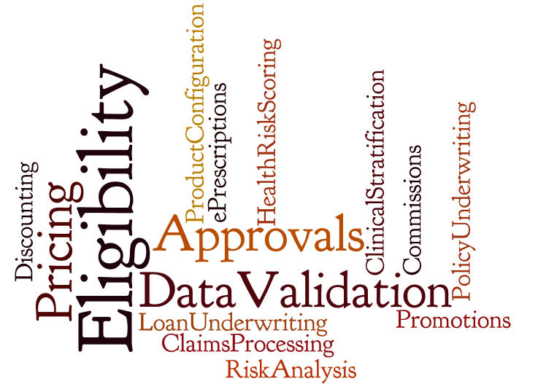
Corticon Use Cases

Slide 7
Why choose Corticon?
Model-driven Development
Automate rules without coding
Guaranteed Rules Integrity
Ensure safe changes
Performance & Scalability
Do more with less
OpenEdge Integration
Rapid and pain free adoption
Ease of use
Reliable
Fast
Productive

Slide 8
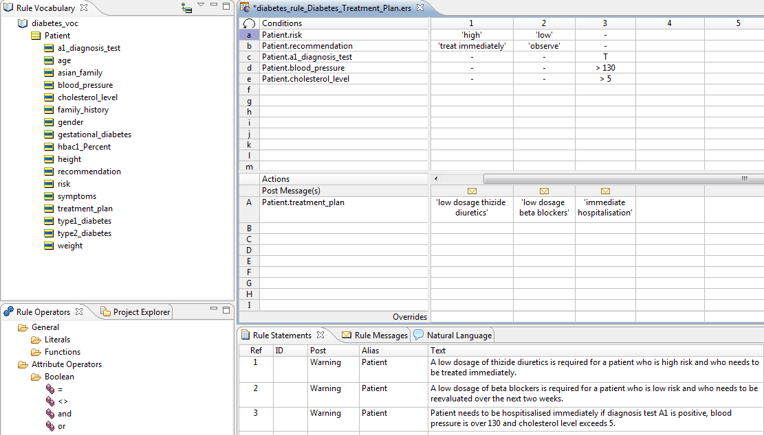
Why Corticon #1: Model-Driven Rules Development
Vocabulary consists of your business objects/terms
Intuitive no-coding approach
Empowers Business Analysts
Accelerate IT Professionals
Patented Excel-like modeling tool
No programming
Business friendly
Natural text
Simple deployment
Rules are constructed with drag-and-drop ease
Comprehensive, extensible library of operators
(akin to Excel functions)
Rule Statements provide rule documentation and traceability
Proven with the most sophisticated business problems

Slide 9
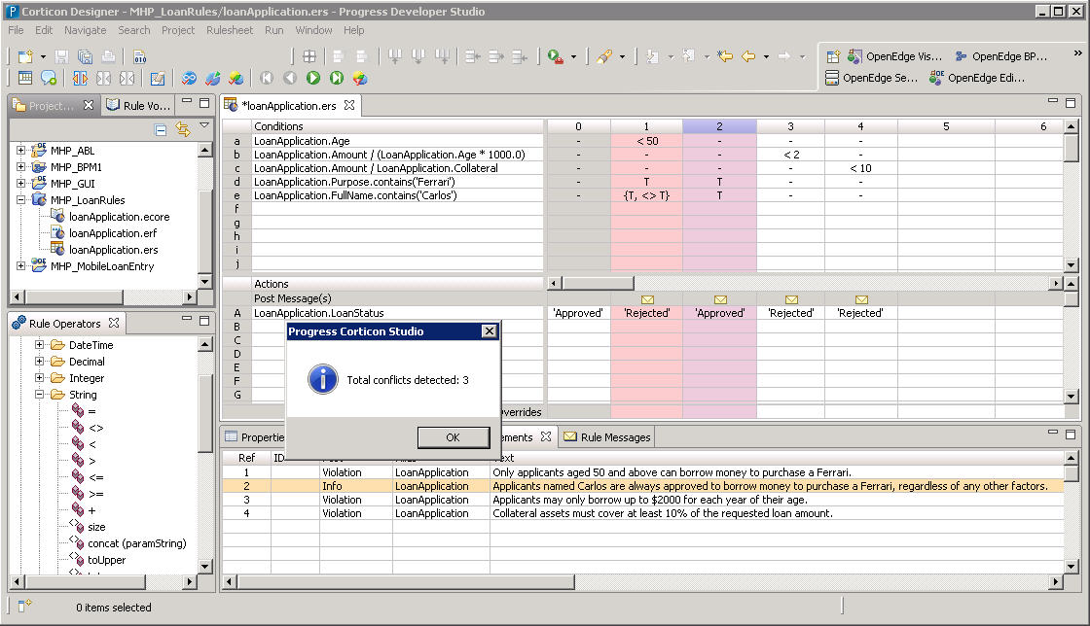
Why Corticon #2: Guaranteed Rule Integrity
Logical Loops
Conflicts
Completeness
Built-in integrity checks ensure creation of accurate, complete & robust rules

Slide 10
Guaranteed Rule Integrity Compresses Development Lifecycle
Traditional Approach
Often contains errors and performance issues
Specify
Design
Templates
Test
Integrate
Deploy
Code
Reduce development
and change cycles
by 90%
Corticon
Approach
Model
Integrate
Deploy
Higher quality, higher performance, agility
Requires Technical Resource

Slide 11

NCAA Case Study: Proven Productivity Benefits of Corticon
Sample ROI Analysis* – Automation of single, decision-making task
 | 1st Generation | Corticon
Initial Development
Analyze | 20 hours | 20 hours
Prepare – Design | 5 hours | N/A
Prepare – Implement | 200 hours | 2 hours
Total | 225 hours | 22 hours
10x
Improvement
Change Cycle
Analyze | 15 hours | 0.5 hours
Prepare – Design | 7 hours | N/A
Prepare – Implement | 28 hours | 1.5 hours
Total | 50 hours | 2 hours
25x
Improvement
*Per NCAA customer testimonial.

Slide 12
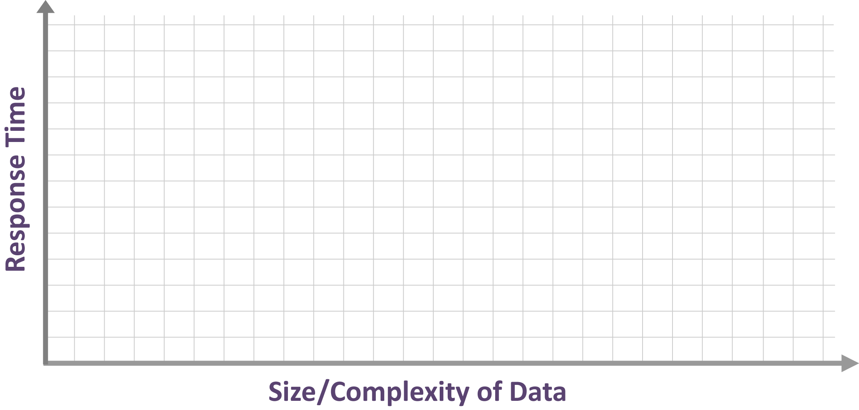






Why Corticon #3: Performance & Scalability
Traditional pattern matching algorithm is Rete
  Scales well with increasing number of rules
  Degrades exponentially with increasing complexity of data – the “Rete Wall”
Corticon’s patented DeTI (Design Time) algorithm
  Scales linearly with number of rules and complexity of data

Slide 13
Why Corticon #4: Simple OpenEdge Integration
Design-time Meta-data integration
  Create Corticon vocabulary from existing TempTables and ProDataSets
Simple, fast ABL API
  Simple API that hides most invocation complexity & abstracts transport
  Allows ABL apps to reuse existing data structures as inputs/outputs (ProDataSets, Temp Tables)
  Productivity macros: BR-CONNECT, BR-INVOKE and BR-GETMSG
Run-time code-free database integration using Corticon Enterprise Data Connector
  Enrich request data with dynamic OE DB lookup
  Add or update data in OE DB direct from Corticon decision service
Corticon complements OpenEdge BPM, Rollbase, Sitefinity, Telerik Platform
Standard SOAP Web Services integration (pre v11.3 OpenEdge)

Slide 14
Corticon is Integral to OERA and “Modernization”
Open Client Access
ANY PLATFORM, ANY DEVICE, ANY CLOUD
Security
User Interface
Service Interfaces
Mobile
Desktop
Web
Tools
Management
Developer Studio
Process and Policy
Business Processes
Business Rules
Application
Community Frameworks
Adv. Business Language
Integration
Application Server
Data
RDBMS
Replication
DataServers

Slide 15
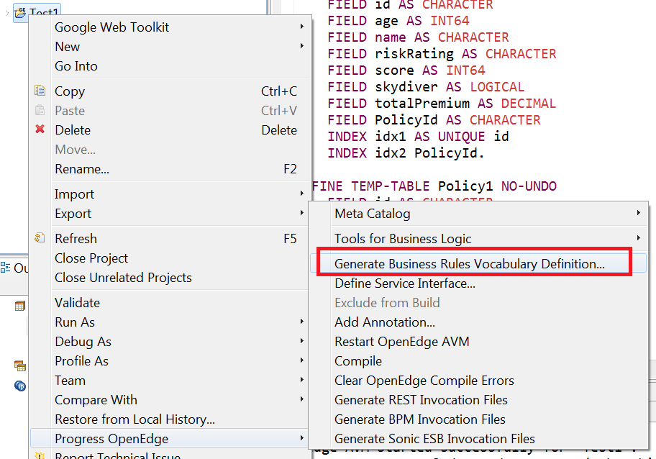
1. Design-time Meta-data Integration
Integrated development experience
  Shared Definition of Vocabulary that rules operate on:
  import Schema definitions, ProDataSets & Temp tables as Corticon vocabulary Entities
Export Temp Table or
Prodataset
to create a
Corticon vocabulary
from Progress Developer
Studio

Slide 16
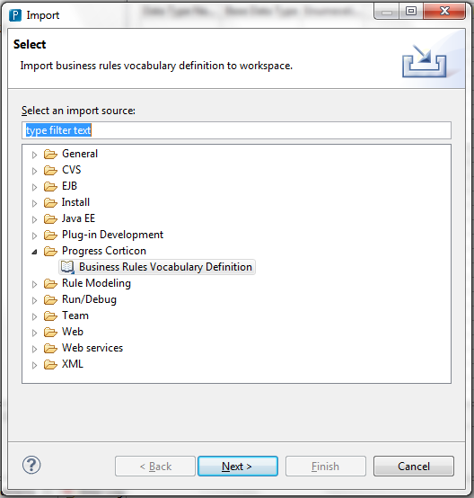
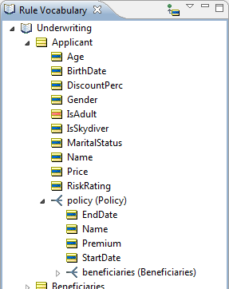
1. Design-time Meta-data Integration
Integrated development experience (continued)
In Corticon Studio
import the .brvd file.
This will create your
Corticon vocabulary.

Slide 17
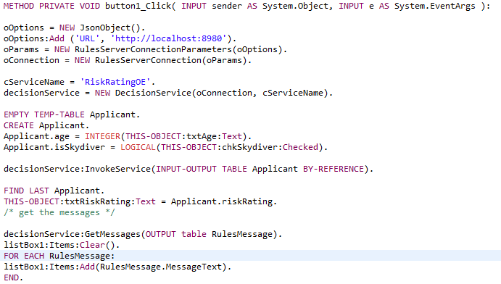
2. OpenEdge Rules ABL API
Establish connection with decision service
Call decision service
Work with the rule execution messages

Slide 18

Demo 1 – Build & integrate a simple Corticon Decision Service

Slide 19
Overview of Corticon Terminology and Rule Modeling Workflow
Corticon Studio
Corticon Server
Vocabulary
RuleFlow
Schema
(TT/PDS...)
Domains
Entities
Attributes
Decision
Service
v1.0
Rulesheet 1
RuleTest
. . .
RuleSheet
Decision
Service
v2.0
Conditions
Filters
Actions
Messages
Rulesheet N
Dashed line: optional step
Notes:
First let’s consider the high level workflow when modeling and deploying rule logic with Corticon.
- start by defining the data on which the decision or calculation will be based, in Corticon this is termed a Vocabulary. It can be hand-crafted or imported from existing metadata such XML Schema Definitions or Database schema
- then rules are modeled in RuleSheets and Integrity Checks are applied to them to ensure completeness and lack of conflicts
- RuleTests are then created to confirm each rules’ implementation is accurately reflecting the intended logical behavior (note that because of the integrity checks applied at the rule modeling step, it is not necessary to craft test cases to detect incompleteness or unwanted ambiguity/conflict between rules)
- RuleSheets can then be assembled into RuleFlows
- RuleFlow are then deployed as executable Decision Services

Slide 20
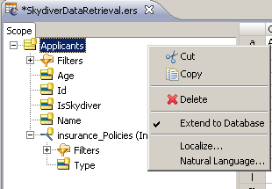
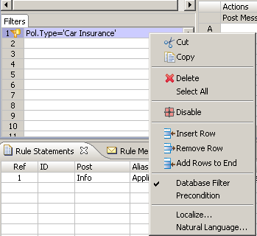
3. Run-time Code-free Database Integration
Corticon access to OpenEdge data and services
  Corticon EDC (Enterprise Data Connectivity) for OE DB (via DataDirect JDBC drivers). Support for OE 11.x and 10.2B
Bind your Corticon
vocabulary to your
OE database tables
Conditionally retrieve
data and optionally
persist results whilst
processing rules
without SQL coding!

Slide 21



Corticon EDC Data Connectivity (no writing code, no writing SQL)
JDBC
OpenEdge…
DataBase
!NO Java Coding!
OpenAccess
For
OpenEdge
OpenEdge
AppServer
(classic/PASOE)
JDBC
Java Open
Client
Corticon Server
Enterprise Data Connector
DataDirect
Cloud
JDBC
SOAP /
JSON

Slide 22
Demo 2 –Enterprise Data Connector

Slide 23
Corticon v5.5 Highlights - !!Released TODAY!!
Embeddable RuleFlows
  Simplifies complex RuleFlows
Conditional branching in RuleFlows
  Makes complex RuleFlows more visually intuitive
REST Management APIs
High performance logging implementation
New threading model management

Slide 24
Demo 3 – Complex RuleFlow design

Slide 25

Additional Resources

Slide 26
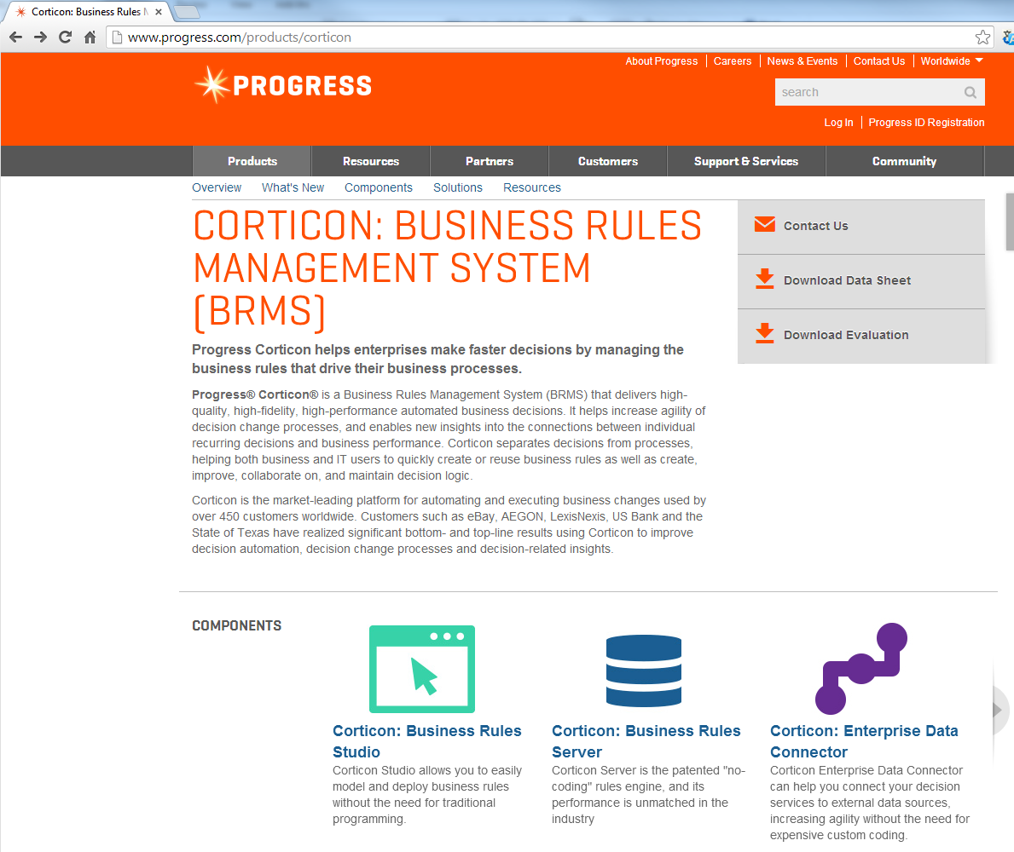
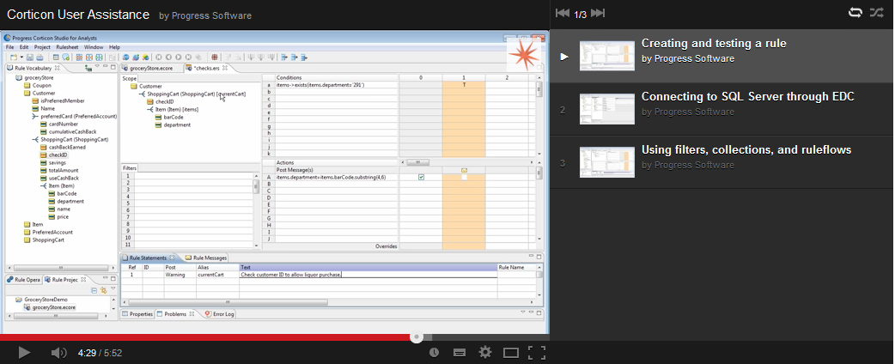





To learn more…
Corticon evaluation / POC
Corticon on YouTube
http://www.youtube.com/user/ProgressSW
Web-based Training
Corticon on Communities
datkins@progress.com
617-372-2155

