Slide 1
Transaction & Record Scoping

Slide 2

About Me
Saravanakumar B – Solutions Architect @ Nuware Systems LLP
Frequent Speaker – presented multiple while papers/presentations both at National & International Level
Professional Trainer and have trained over 25 batches on Progress, Microstrategy and Hadoop
Audio and Video recordings of my Progress Sessions are available @ Nuware repository which is used as an effective training material

Slide 3
Agenda
Record Scoping
  What is Record Scoping?
  Blocks & Record Scoping Properties
  Types of Record Scope
  Rules
Transaction Scoping
  What is a Transaction?
  Default & Forced Transactions
  Making Transaction Size Larger and Smaller – Why? How?
Sub Transactions
Record Locking
Record Scope Vs Transaction Scope

Slide 4
Record Scoping

Slide 5



What is Record Scoping?
When Progress reads a record from the database, it stores in a record buffer. The scope of a record is the portion of the procedure where the record buffer is available.
Record scope does not guarentee that the record is always available
Record Buffer holds one record from one table at a time. If in case user wants to access 2 records of the same table in parallel, user has to create a new reference to the table by defining a buffer
[Database]
[Record Buffer]
[Screen Buffer]
[User Screen]

Slide 6

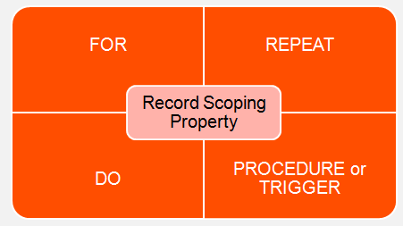



Blocks & Record Scoping Properties

Slide 7
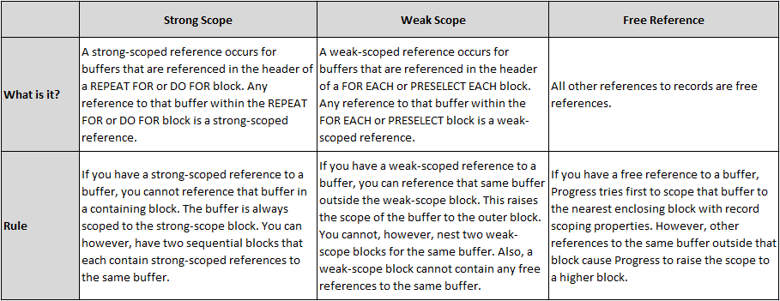
Types of Record Scope
Strong Scope
Weak Scope
Free Reference

Slide 8
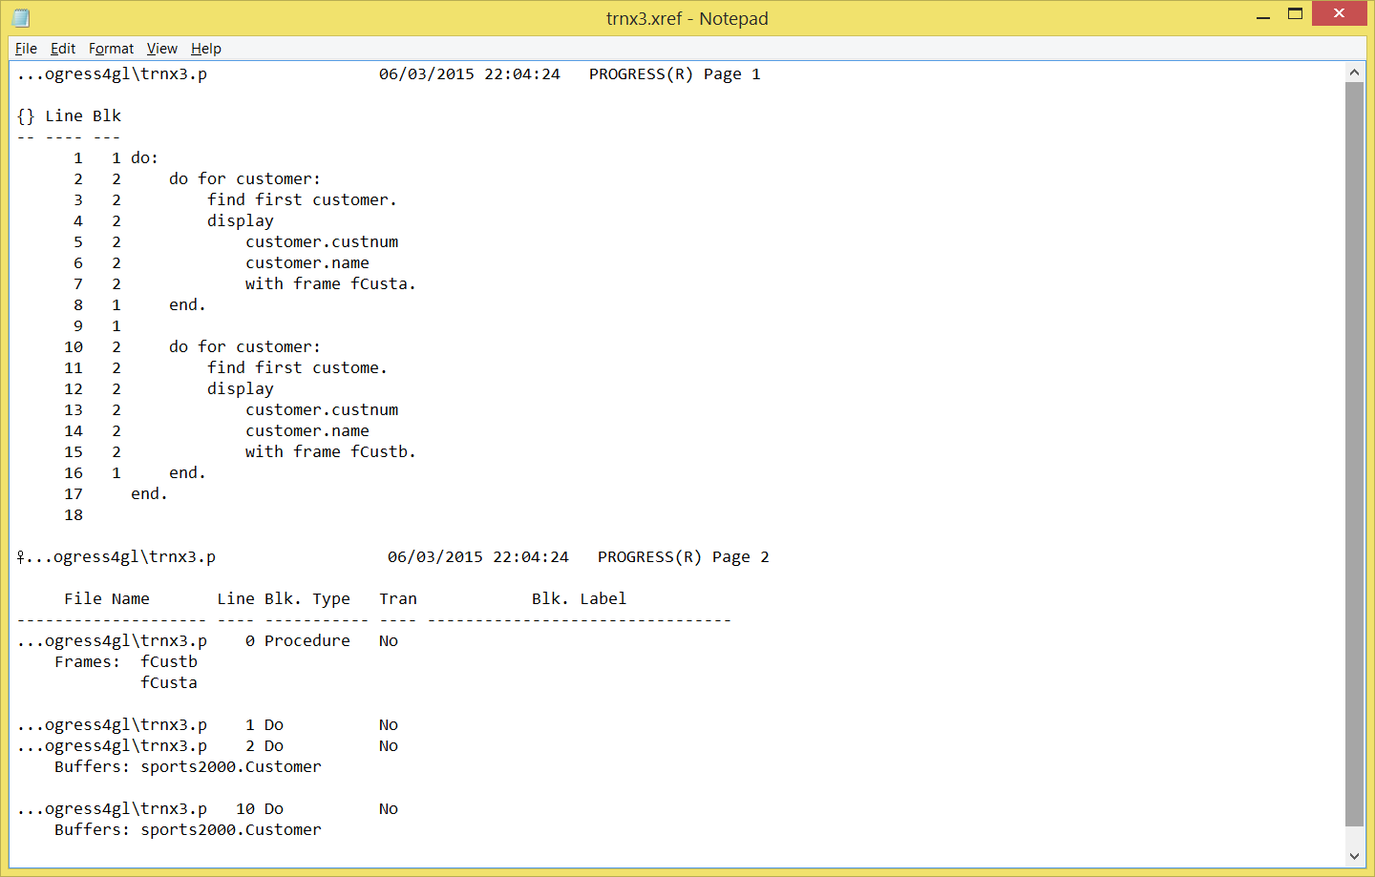
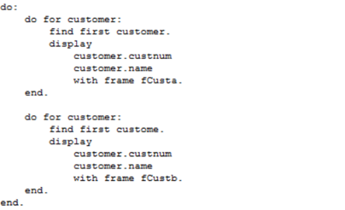
Strong Scope
Strong Scope
Strong Scope
(Listing File)

Slide 9
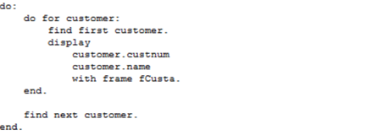
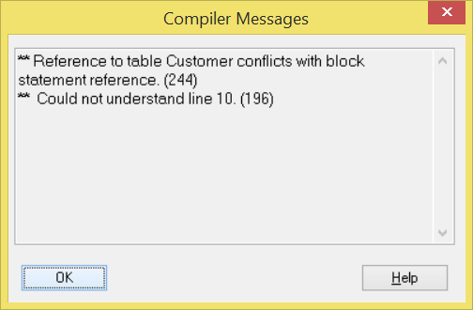
Strong Scope (continued…)
Strong Scope
Progress Error

Slide 10
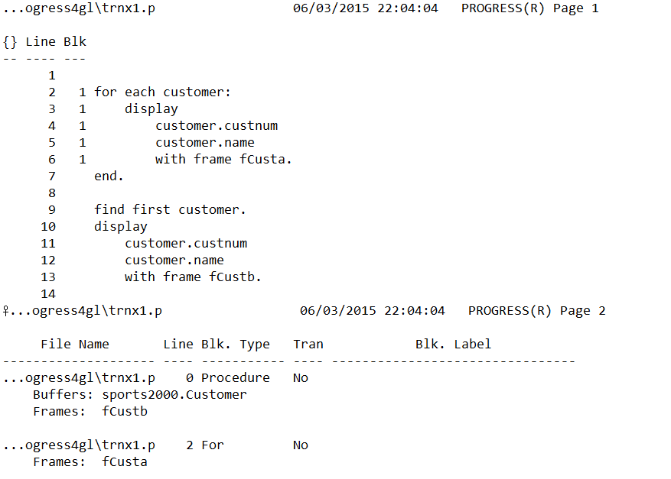
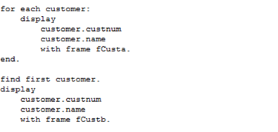
Weak Scope
Scope raised to the procedure
(Listing File)

Slide 11
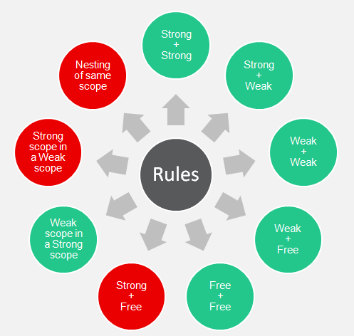


Record Scoping - Rules
Legend
Allowed
Not Allowed

Slide 12
Transaction Scoping

Slide 13
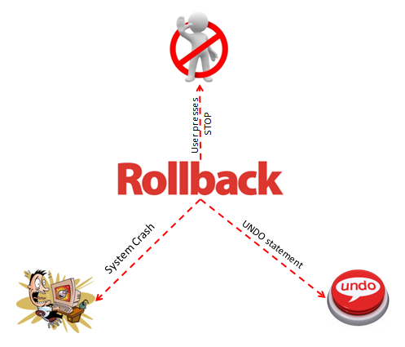
What is a Transaction Scope?
A transaction is a set of changes to the database that is either executed completely or leaves no modification to the database
Only one transaction is open at a time for a Progress Session

Slide 14
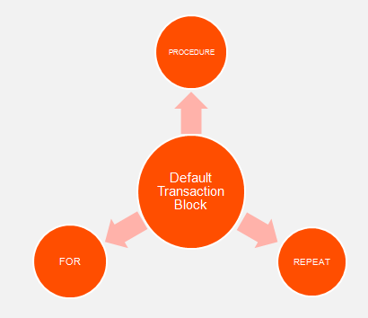
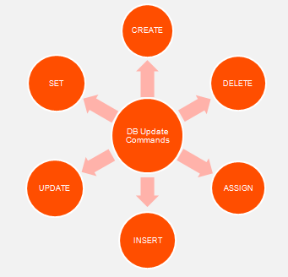
Default Transaction Blocks
Default Transaction Blocks have transaction property if they contain statements that updates DB.
[Default Transaction Blocks]
[Database Update Commands]

Slide 15
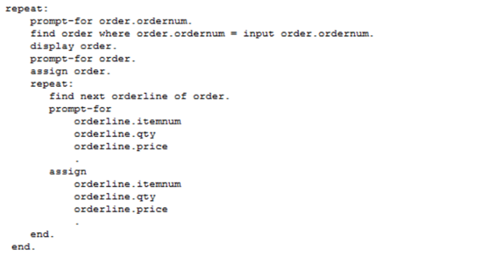
Default Transaction - Example
Every iteration is a net new Transaction Block
In the below example, every iteration of a REPEAT statement is a new transaction;
New transaction @ each iteration

Slide 16
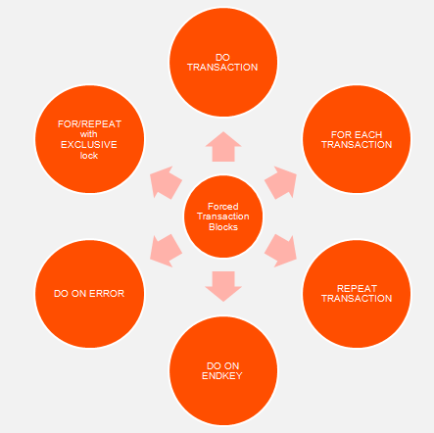
Forced Transaction Blocks

Slide 17
Why will I Override Default Transaction?
If in case user wants to control how much work to rollback – user can make a transaction block smaller or larger based on the business need. This can be achieved by using forced transaction blocks.

Slide 18
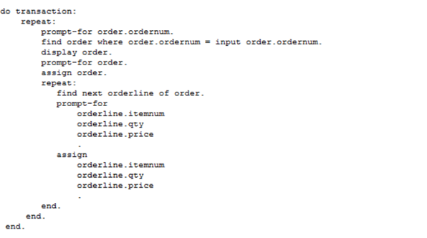
Making Transactions Larger
When? - If in case your business needs are to do all or nothing
In this case you will expand the size of transaction by wrapping the code with a DO..TRANSACTION block. All the iterations are part of a single transaction.
All in one Single Transaction

Slide 19
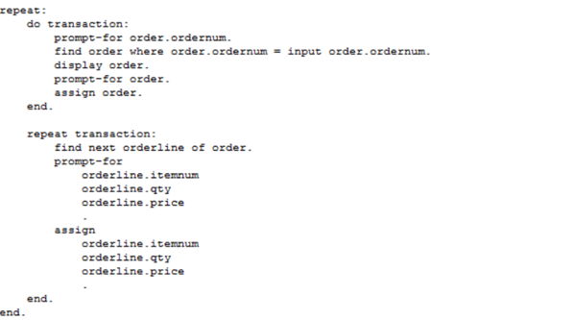
Making Transactions Smaller
On the same example if you want to minimize the transaction; and rollback only limited # of records then you can achieve the same by readjusting your transaction blocks as shown below;
Two Transaction Scopes

Slide 20
Sub Transactions

Slide 21
Sub Transactions
A Transaction nested within another currently active transaction is termed as a Sub-Transaction and allows to undo or error handling of smaller units. [Sub transactions are not involved in database recovery; rather they undo work from the user interface]
Progress backs out work from beginning of the sub transaction, if an error occurs at sub transaction block level
Progress backs out work from beginning of the transaction, if a system crash occurs at sub transaction block level.

Slide 22
Sub Transaction (continued...)
Active Transaction
Sub Transaction

Slide 23
Record Locks

Slide 24
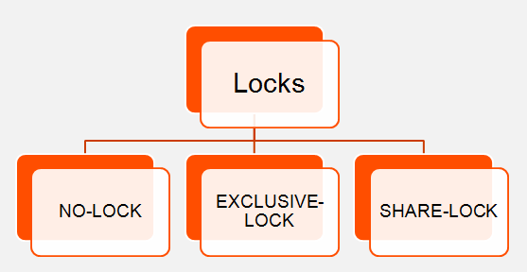
Record Locks
Locks are necessary to resolve concurrency issues and ensure data integrity in a multiuser environment
How do we do that? – Let's explore more on type of record locks!
Record Scope can have adverse effect on Record Locks

Slide 25
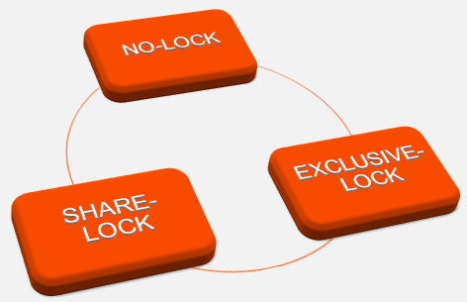
More about Locks…
If user wants to only read a record, then use NO-LOCK
If user wants to read, update or delete a record, user could use SHARE-LOCK [but the lock will be upgraded by Progress only when no other user holds the same record in SHARE-LOCK or EXCLUSIVE-LOCK]
Ill Effects: DEAD LOCK situation could occur more often due to locking contention issues. You could follow proper locking strategies to make sure your system doesn’t get into embarrassing situations.
If user wants to read update or delete the record then use EXCLUSIVE-LOCK.

Slide 26
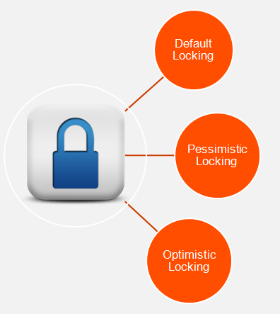
Optimistic Vs Pessimistic Locking
User retrieves a record with SHARE-LOCK. Progress attempts to upgrade the lock to EXCLUSIVE-LOCK when user tries to update the record. [User may end up getting blocked from updating the record in a multi user environment while other users are accessing the same]
User always retrieves a record with EXCLUSIVE-LOCK. [What can other users do? – they can only bye pass and read a record using NO-LOCK. None of the other users could update the record until the its released – Pretty Bad Strategy! Unless you are sure that the record will always be accessed by only one user at a time]
User retrieves a record with NO-LOCK and when re-fetches the record with an EXCLUSIVE-LOCK when he wants to commit the record changes to the database. [Better Strategy! But the only ill-effect is the record could be updated or deleted by another user when you are holding the record with NO-LOCK. CURRENT-CHANGED function will serve as a helping hand though]

Slide 27
Connecting the DOTS…

Slide 28
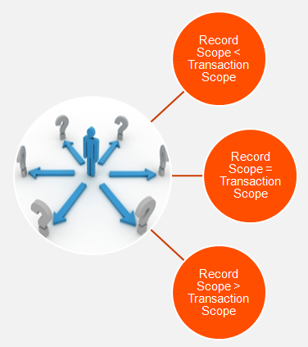
Scenarios
All record locks will be released only at the end of the transaction, if record scope is less than a transaction scope (Note: Few application uses RELEASE statement within the transaction block but it just flushes the record from the record buffer but doesn’t release the lock until the transaction gets released).
Ideal Scenario! It’s better to keep Record Scope equivalent to a Transaction Scope to run your application smooth without an adverse effect.
Record Bleeding – At the end of a transaction if the record scope is greater than the transaction block, the EXCLUSIVE-LOCK gets downgraded to SHARE-LOCK which could cause embarrassing situations to your application.

Slide 29

Presented By,
Saravanakumar B

