Slide 1
DBAnalys To The Rescue!
Dmitri Levin, alphabroder USA
George Potemkin,
Progress Technologies Russia

Slide 2
How to read dbanalys
Part B: Indexes
Long Chains
Firefighting fragmentation
DB Structure Reorganization (D&L)

Slide 3
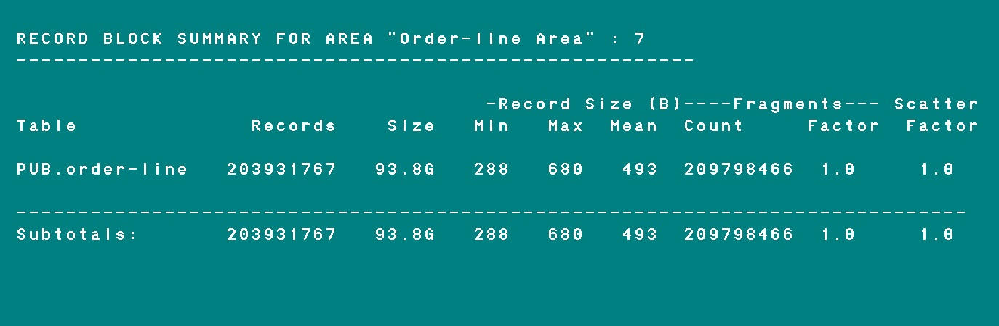
Dbanalys

Slide 4
Dbanalys options
proutil db-name -C dbanalys [ area area-name ]
Need speed: 1. Multi-User mode
2. Parallel dbanalys for each area.
proutil db-name -C dbanalys -RO
probkup db-name bkup-name -withdbanalys
No time stamps for each step ….. etc

Slide 5
Need timestamps
proutil dbname -C dbanalys | \
while IFS="" read Line
do
echo `date '+%H:%M:%S'` "$Line"
done > dbname.dbanalys.log
10:19:52 INDEX DELETE CHAIN ANALYSIS
10:19:52 -----------------
10:19:52 AREA "Order-line Area" : 7 BLOCK ANALYSIS
10:19:52 -------------------------------------------------
10:19:52
11:55:37 13212671 block(s) found in the area.
11:55:37
11:55:37 Current high water mark: 13212671
11:55:37

Slide 6
Problems
1. Difficult to analyze, sort, filter for human eyes.
Fixed 11.4
2. There are no names for objects in chain analyses.
Fixed 11.4
0 block(s) found in the free chain of Table object 1
1312170 block(s) found in the RM chain of Table object 1
3. No information for LOB fields.*
How to report of the space used by LOBS?
http://knowledgebase.progress.com/articles/Article/000048563
Notes:
Too many objects in dbanalys to comprehend. If you know the table that you are looking for it is not a problem, but to find tables using certain characteristic it is difficult.

Slide 7
Version 11.4
proutil db-name -C dbanalys [ area area-name ]
[ tenant tenant-name| group group-name| shared ]
[-csoutput [ -fieldsep sep-value][ -csfilePrefix pref-name ]
[ -verbose ]]
-csoutput
-fieldsep sep-value (default is space )
-csfilePrefix pref-name (default db-name)
-verbose
proutil sports –C dbanalys -csoutput -verbose
Notes:
This new parameter is a must have.

Slide 8
Output files
sports.block.txt
sports.ch.txt
sports.ix.txt
sports.tbl.txt
-verbose
-csfilePrefix
"Time Stamp" "DBUID" "DB name" "Area" "Area #" "Partition Type" "Tenancy"
"Tenancy #" "Partition Policy" "Partition" "Partition #" "Owner" "Table" "Table #"
"Records" "Size" "Min" "Max" "Mean“
2015-04-06T14:59:00.000-4:00 "njVjvK5a8qfvEyE+7KM4WA" "sports"
"Customer/Order Area" 8 "-" "-" 0 "-" "-" 0 "PUB" "Customer"
2 83 12377 118 222 149 83 1.0 1.0
2015-04-06T14:59:00.000-4:00 "njVjvK5a8qfvEyE+7KM4WA" "sports"
"Customer/Order Area" 8 "-" "-" 0 "-" "-" 0 "PUB" "Order"
4 207 11730 53 61 56 207 1.0 1.0
-fieldsep

Slide 9
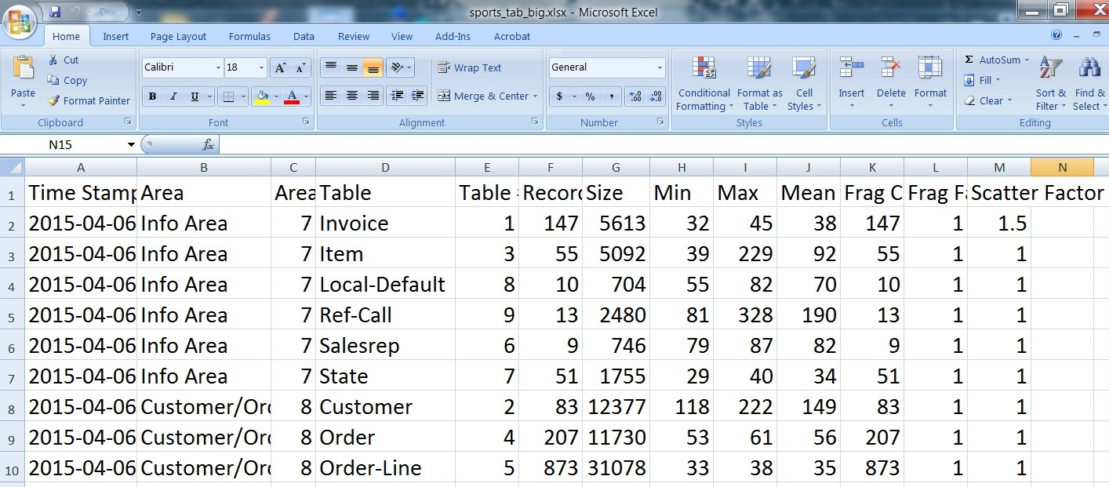
Loading sports.tbl.txt in Excel

Slide 10
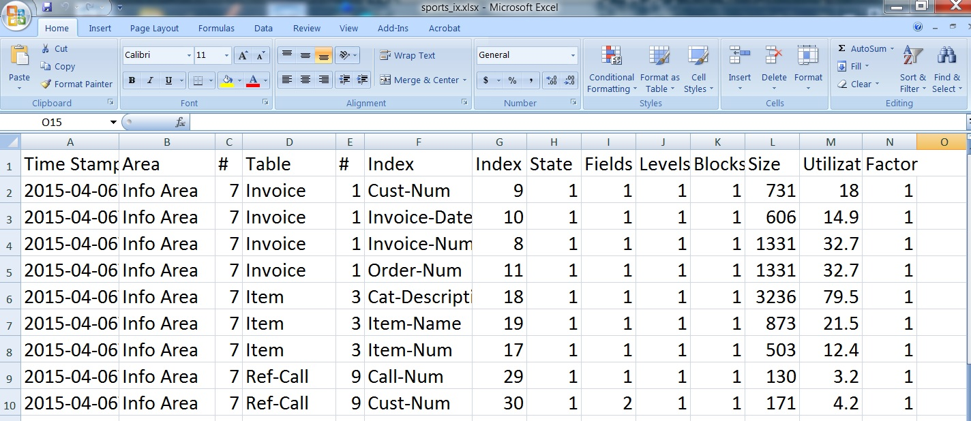
Loading sports.ix.txt in Excel

Slide 11
Before Version 11.4
LoadDbanalys.p by George Potemkin
ftp://ftp.progress-tech.ru/pub/Users/george/Programs/LoadDbanalys.p

Slide 12
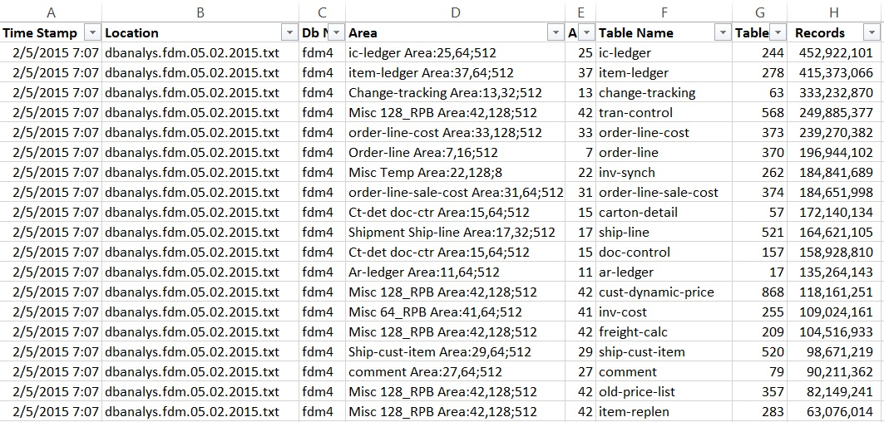
LoadDbanalys.p by George Potemkin
Notes:
It supposes to process a bunch of the dbanalys files at once (for the
different databases, for the similar databases from the different branches,
for the same database from the different times);

Slide 13
LoadDbanalys.p by George Potemkin
ftp://ftp.progress-tech.ru/pub/Users/george/Programs/LoadDbanalys.p
1. Creates the output files that are similar to the -csoutput in 11.4
2. Processes a bunch of the dbanalys files at once
3. Analyses the difference between database structures
4. Creates the LOB report
5. Has additional columns for convenience of analyses
6. Tested with 10.2B but could be used with rather wide range of Progress versions.

Slide 14
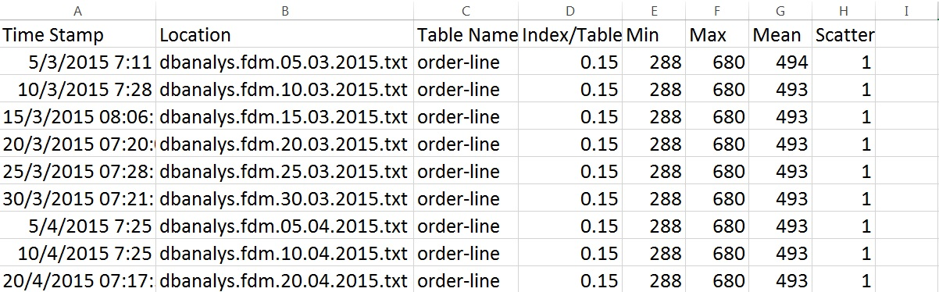
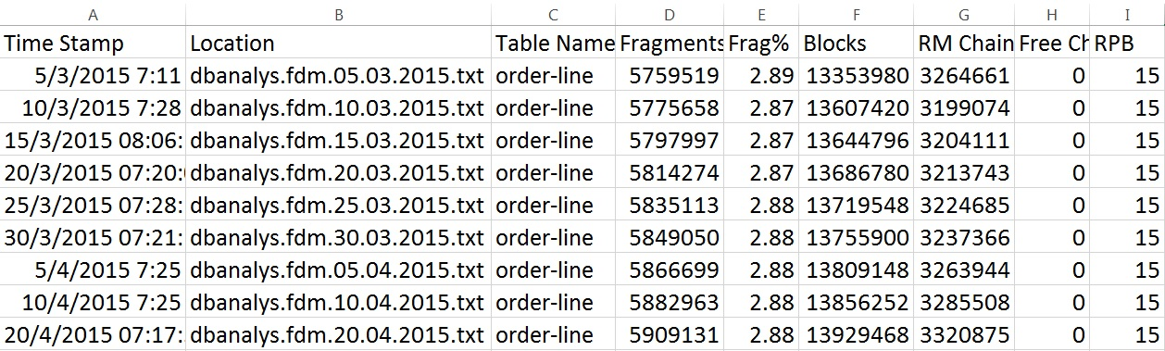
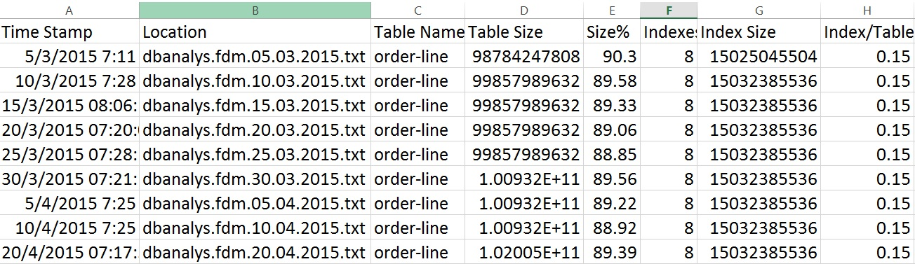
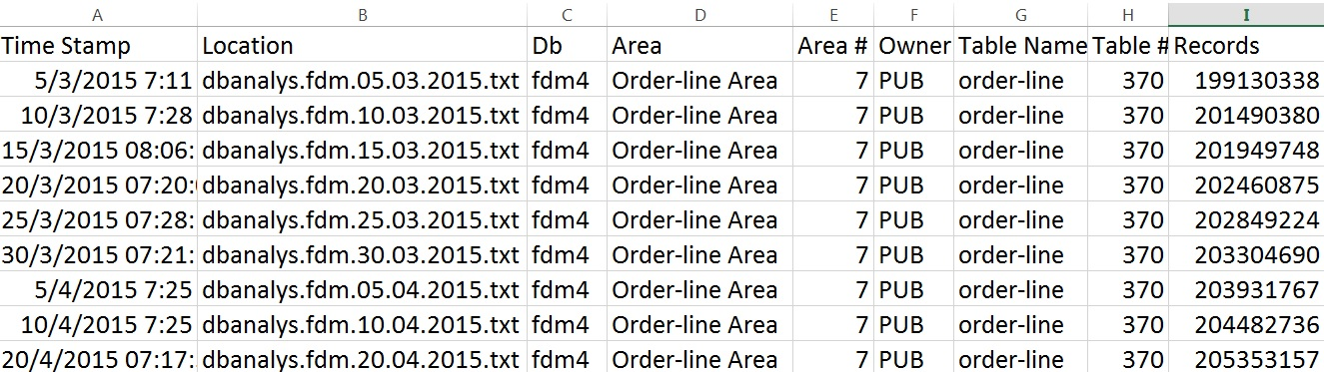
LoadDbanalys.p by George Potemkin
Notes:
It supposes to process a bunch of the dbanalys files at once (for the
different databases, for the similar databases from the different branches,
for the same database from the different times);

Slide 15
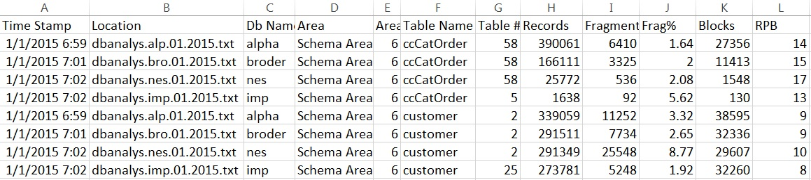
LoadDbanalys.p by George Potemkin
Notes:
It supposes to process a bunch of the dbanalys files at once (for the
different databases, for the similar databases from the different branches,
for the same database from the different times);

Slide 16
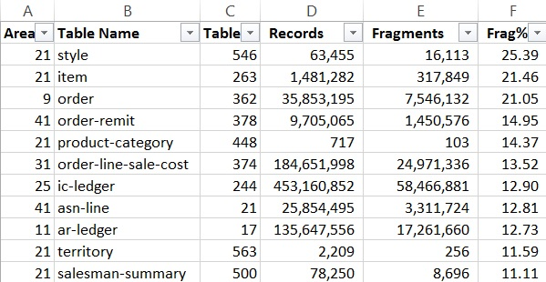
Fragmentation %

Slide 17
Dbanalys

Slide 18
Fragmentation %

Slide 19
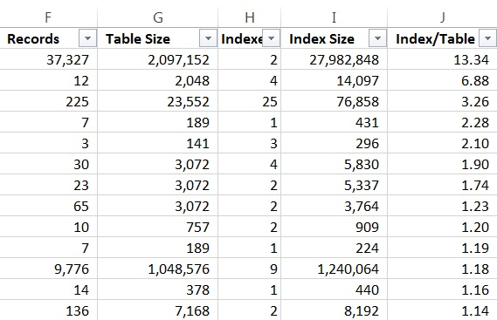
Index / Table Ratio
Normal Ratio 0.1 or 0.2

Slide 20
Order Field Name Data Type Flags
----- ----------------------- ----------------- -----
10 company char i
20 working-date date i
30 user-id char i
40 module char i
50 tally inte
pu cr-user-log-idx 4 + company
+ working-date
+ user-id
+ module
cr-user-mod 3 + company
+ user-id
+ module

Slide 21
Index is too big
PUB.table_name
cr-user-log-idx 247 4 3 5170 25.6M 63.6 1.7
cr-user-mod 1706 3 2 130 700.1K 67.6 1.6
Run idxbuild or idxcompact
PUB. table_name
cr-user-log-idx 247 4 2 144 1.1M 97.9 1.0
cr-user-mod 1706 3 2 131 723.5K 69.3 1.6
for each table_name no-lock:
end.
4 times faster

Slide 22
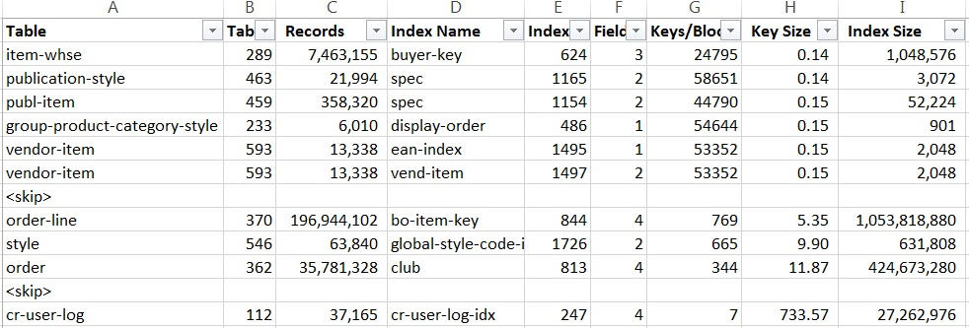
Index key size
(from db_name.index.txt)

Slide 23

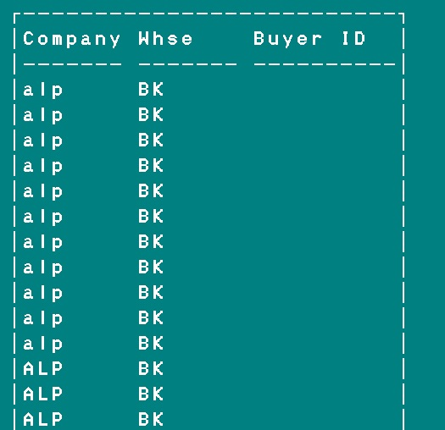
Index key size
Same
Values
Notes:
Shows index definition and values. All or almost all values are the same. We need to pay a close look at those indexes. May be we need them, may be not. Look _IndexStat for them.

Slide 24
Index key size
(from db_name.index.txt)
Average key size in my database is from 2 to 20

Slide 25
Load dbanalys into DB
TabAnalys
Order Field Name Data Type Flags
----- -------------------------------- ----------- -----
10 database_name char i
20 TableName char i
30 Records inte
40 Size char
50 SizeNumeric deci-0 i
60 MinRec inte
70 MaxRec inte
80 MeanRec inte
90 CreateDate date
Notes:
Schema of TabAnalys table, a real table in our database where I load dbanalys data.

Slide 26
Load dbanalys into DB
IdxAnalys
Order Field Name Data Type Flags
----- -------------------------------- ----------- -----
10 database_name char i
20 TableName char I
30 IndexName char i
40 IndexNum inte
50 IdxFields inte
60 IdxLevels inte
70 IdxBlocks inte
80 IdxSize char
90 IdxUtil deci-2
100 IdxFactor deci-2
110 SizeNumeric deci-0 i
120 CreateDate date
Notes:
Schema of IdxAnalys table, a real table in our database where I load dbanalys data.

Slide 27
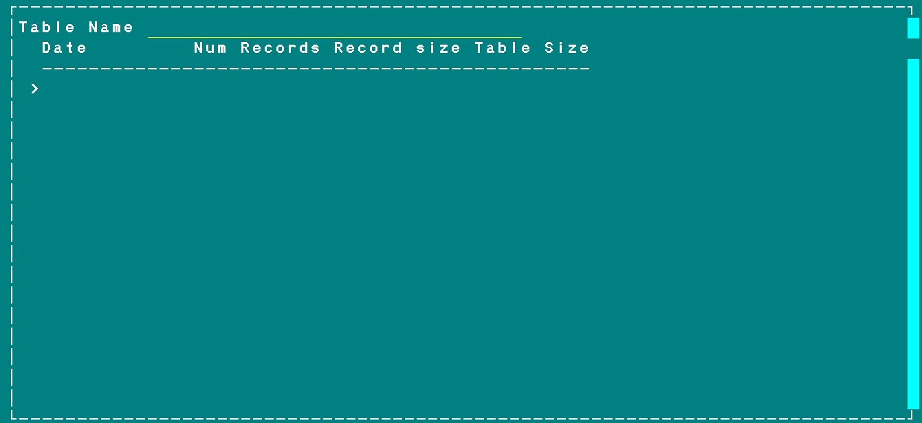
How big is that table?
Notes:
Users often ask how big is that table. Or even worse, they run for each in production. Here they enter the table name to get that information from dbanalys

Slide 28
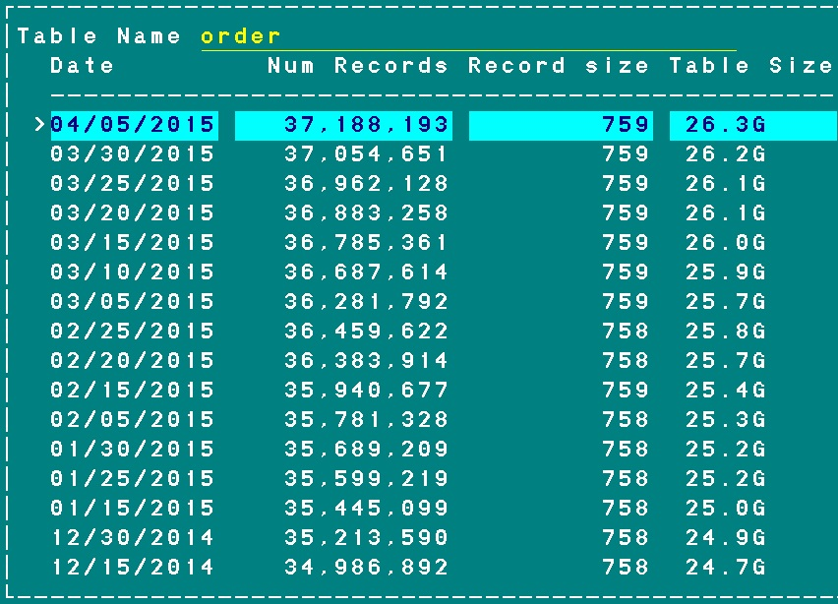
Notes:
Here are historical dbanalys data for one table in our database

Slide 29
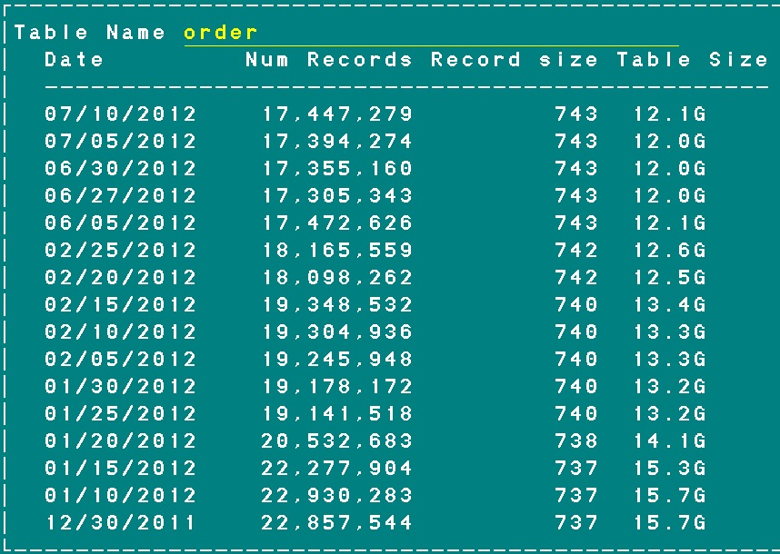
When did we do the database purge?
Notes:
Here the same table, but for older 2012 data shows that we had big data purge in the months of January and February 2012.

Slide 30
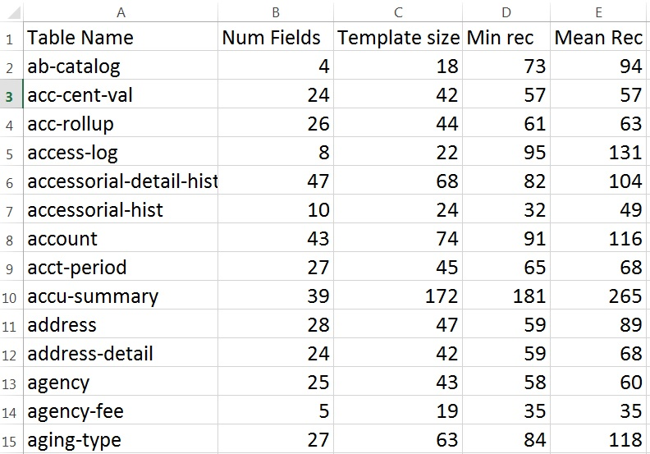
Min Record Length
Notes:
It looks there is no relationship between template size and min record length. Let’s sort tables by number of fields and see.

Slide 31
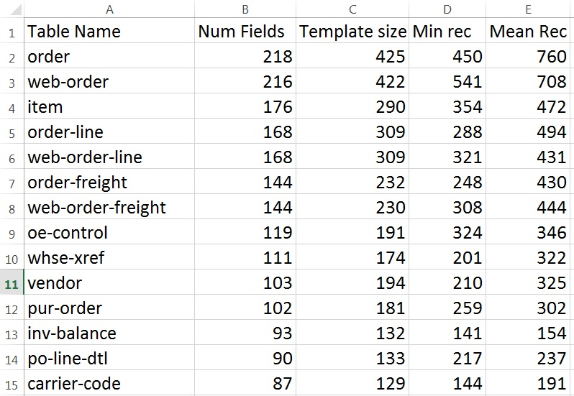
Min Record Length

Slide 32
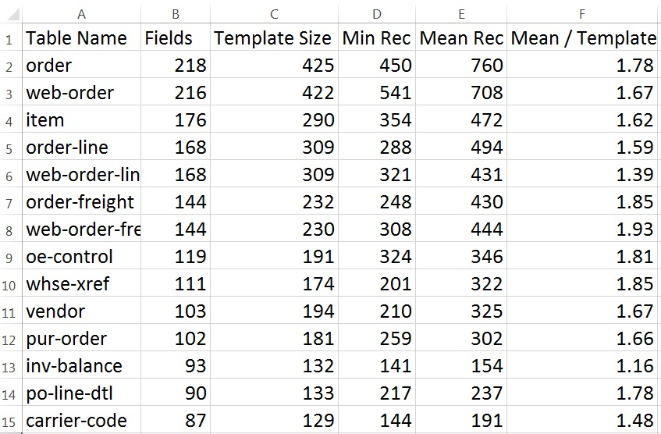
Mean Record Length
Notes:
When developing the schema of future database table, if there is not data, pay attention at template size and use it for estimation of mean record size

Slide 33
How to read dbanalys
Part B: Indexes
Long Chains
Firefighting fragmentation
DB Structure Reorganization (D&L)

Slide 34
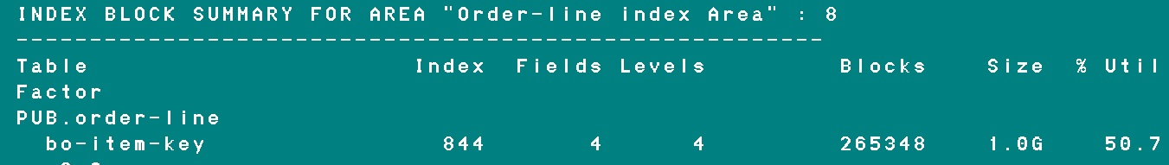
Building the script for idxcompact
_IndexStat-read > 1000000
IdxAnalys.IdxUtil < 70
IdxAnalys.IdxBlocks > 15
TabAnalys.Records > 100
Relatively active indexes
Bad index Utilization
Relatively big
proutil <db_name> -C idxcompact <_file-name>.<_index-name>
Notes:
It runs at maintenance window, i.e. on Saturday and creates a script that is later executed also during maintenance window. Unforunatly idxcompact create tiny tranactions and could cause bi trouble.

Slide 35

Question to the audience

Slide 36
What index would you choose to read whole table?
Table Index Fields Levels Blocks Size % Util Factor
PUB.item
cat-key 556 4 3 3266 17.3M 68.1 1.6
color-size 557 4 3 2193 13.7M 80.4 1.4
date-created 558 3 3 2941 13.7M 59.8 1.8
detail-style-key 559 4 3 1427 7.5M 67.3 1.7
gtin-key 561 2 3 2264 14.2M 80.5 1.4
harm-annex 562 3 2 431 1.6M 48.0 2.0
item-key 555 2 3 2153 13.4M 79.9 1.4
item-name 563 2 3 3443 16.9M 63.1 1.7
make-buy 564 3 3 2687 13.5M 64.5 1.7
mfg-part-no 565 2 3 639 2.8M 56.1 1.9
royalty-code 566 2 2 276 1.1M 57.4 1.9
season-key 567 2 2 367 1.7M 60.4 1.8
size-color 568 4 3 2757 14.1M 65.7 1.7
type-key 569 3 3 2709 13.4M 63.6 1.7
upc-code 570 2 3 2887 15.2M 67.7 1.6
wname-key 571 1 3 1522 7.1M 60.3 1.8

Slide 37
Good index / Bad index
Dan F: logical index scatter
rRPB 8
Good index read

Slide 38
Good index / Bad index
Dan F: logical index scatter
A
rRPB 8
Bad index read
B

Slide 39
Good index / Bad index
Dan F: logical index scatter
Bad index problem # 1 ("Read ratio“)
Read ratio – ratio number of record block reads
to the number of record blocks needed.
Min = 1
Max = rRPB
Mean = rRPB / 2
Bad index problem # 2 ("Read path“)
Read path – how far to travel to the next block
Notes:
Out of the two “Read path” is a strong factor

Slide 40
Good index / Bad index
Dan F: logical index scatter
Bad index problem # 1 ("Read ratio“)
Bad index problem # 2 ("Read path“)
The bigger the table – less likely it will fit in
buffer-cache and disk-cache
The bigger the table – more likely read ratio will grow
The bigger the table – more distance Read path will have
When a table grows 2 times – it takes 4 times more to read it
Notes:
We have the effect of quadruple.

Slide 41
How to read dbanalys
Part B: Indexes
Long Chains
Firefighting fragmentation
DB Structure Reorganization (D&L)

Slide 42
Long RM chain
RM CHAIN ANALYSIS
-----------------
1349167 block(s) found in the RM chain of Table object 362
Is it good or bad?
Why we have RM chain?
Main reason: average record length >> default toss limit = 300
But that not necessary results in long RM chain
Set toss limit = average record length + 10%
Notes:
Long RM chain example and recommendations. Why we have RM chain? To use disk space.
This recommendation (avgsize + 10%) just improves the odds.

Slide 43
Long RM chain
Set toss limit = average record length + 10%
proutil db-name -C settabletosslimit table-name toss-limit
Data RM chain
15.02.2015 1365736
20.02.2015 1309925
25.02.2015 1314147
05.03.2015 1340165
10.03.2015 1340395
15.03.2015 1342530
20.03.2015 1344121
25.03.2015 1345386
30.03.2015 1345928
05.04.2015 1348511
10.04.2015 1349167
20.04.2015 1352019
25.04.2015 1354427

Slide 44
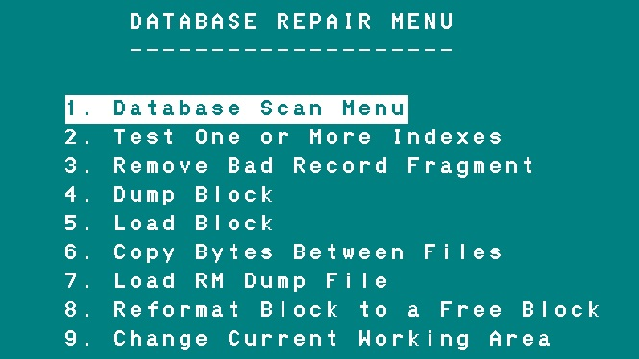
Long RM chain
proutil db_name -C dbrpr
Notes:
dbrpr for fix RM chain

Slide 45
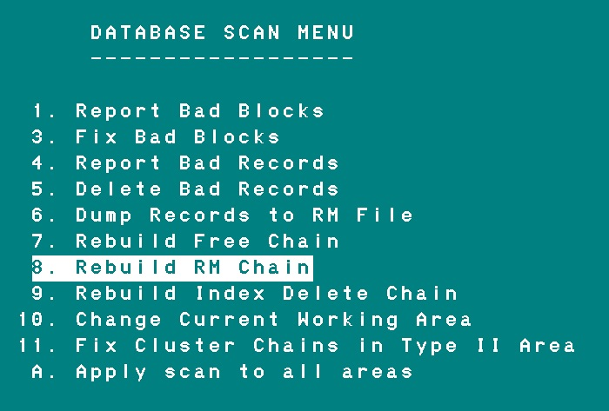
Long RM chain
proutil db_name -C dbrpr
Notes:
dbrpr for fix RM chain

Slide 46
Long RM chain
proutil db_name -C dbrpr
dbanalys before dbrpr
1313186 block(s) found in the RM chain of Table object 362
Scan of Order Area extent 1 10% complete
Scan of Order Area extent 1 20% complete
Scan of Order Area extent 1 30% complete
Scan of Order Area extent 1 40% complete
Scan of Order Area extent 1 50% complete
Scan of Order Area extent 1 60% complete
Scan of Order Area extent 1 70% complete
Scan of Order Area extent 1 80% complete
Scan of Order Area extent 1 90% complete
Scan of Order Area extent 1 100% complete
dbanalys after dbrpr
120813 block(s) found in the RM chain of Table object 362
Notes:
dbrpr for fix RM chain

Slide 47
Long RM chain
proutil db_name -C dbrpr
1. dbrpr worked 30 min
2. dbrpr reduced RM chain 10 times
3. Only works off-line
Notes:
dbrpr for fix RM chain.

Slide 48
Long RM chain
Is it good or bad?
RM chain input is about 1% for area. Not that significant.
It is based on notes in AI scan.
But on an other hand --- bad for record scatter.
Notes:
dbrpr for fix RM chain.

Slide 49
Index Delete chain
20731 block(s) found in the Index Delete chain of Index object 622
idxcompact
proutil db_name -C idxcompact item-tax.item-group
0 block(s) found in the Index Delete chain of Index object 622
Notes:
Unique indexes only, and after massive delete.

Slide 50
Index Delete chain
grep "Index Delete chain" dbanalys.file | sort -n
28 block(s) found in the Index Delete chain of Index object 2235
138 block(s) found in the Index Delete chain of Index object 1357
7573 block(s) found in the Index Delete chain of Index object 580
Notes:
Unique indexes only, and after massive delete.

Slide 51
How to read dbanalys
Part B: Indexes
Long Chains
Firefighting fragmentation
DB Structure Reorganization (D&L)

Slide 52
Defrag.p
Version 1.0 (“WMD”)
1. Works online (4GL)
2. Defrags all records, even those that do not need it
Version 2.0 (“Precision weapon”)
Notes:
????

Slide 53
Testing results
for each <table> no-lock use-index <small-index>:
end.
Before defrag.p : 2 hr 19 min or 139 min
After defrag.p : 22 min or more then 6 times faster
proutil -C dump index 0
Before defrag.p : 102 min
After defrag.p : 10 min or more then 10 times faster
for each <table> no-lock :
end.
Before defrag.p : 19 hr 39 min or 1179 min
After defrag.p : 25 hr 23 min or 1523 min
Notes:
Testing defrag.p

Slide 54
Testing results
Dbanalys before Fragments Scatter
Table Records Size Min Max Mean Count Factor Factor
PUB.table 36526234 25.8G 450 13519 758 44145861 1.2 1.0
Dbanalys after
PUB.table 36526234 25.9G 450 13509 760 36581627 1.0 1.0
Database Size grew a bit
Less fragmentation
Average record length changed. Why?

Slide 55
How to read dbanalys
Part B: Indexes
Long Chains
Firefighting fragmentation
DB Structure Reorganization (D&L)

Slide 56
DB Structure Reorganization (D&L)
1. Spread the tables between areas based on size
Some big table-areas
corresponding index-areas
2. Two social areas. One for all tables. One for all indexes.
3. LOBs in their own areas.
4. Set RPB according to dbanalys.
Cluster size 512 for tables and 64 for indexes.
Notes:
Advices for DB reorganization, like Dump and Load for example.

Slide 57
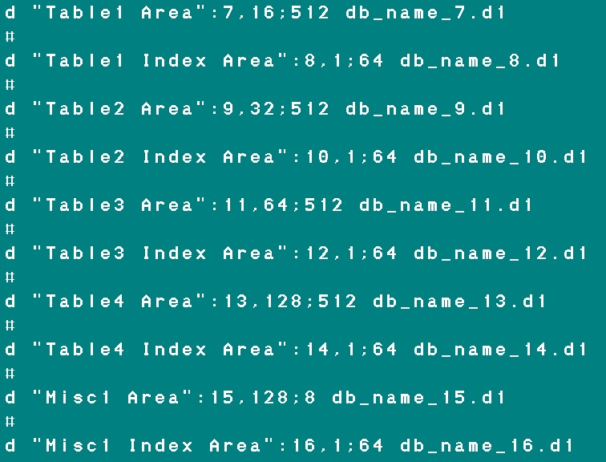
DB Structure Reorganization (D&L)
Notes:
Example of .st file. Here we have 4 big tables in their own areas. RPB should be chosen for then individually. Here I just randomly put 16, 23, 64 and 128. All table areas have cluster size 512, except Miscellaneous area that has 8. Index areas have RPB 1 and cluster size 64.

Slide 58
DB Structure Reorganization (D&L)
TOSS LIMIT
Set toss limit = average record length + 10%
default 300
RECORD BLOCK SUMMARY FOR AREA "Empty Area" : 46
-------------------------------------------------------
-Record Size (B)- ---Fragments--- Scatter
Table Records Size Min Max Mean Count Factor Factor
PUB.ReplicationList 335880647 13.4G 32 52 42 335880647 1.0 1.0
Set toss limit = 50
Notes:
Here we can reduce toss limit to 50 for a tiny small records.

Slide 59
DB Structure Reorganization (D&L)
TOSS LIMIT
RECORD BLOCK SUMMARY FOR AREA "IntegrationBody Area" : 26
-------------------------------------------------------
-Record Size (B)- ---Fragments--- Scatter
Table Records Size Min Max Mean Count Factor Factor
PUB.IntMessageBody 166772423 264.2G 26 8240 1700 200084543 1.0 1.0
Do not change toss limit
For all other cases, where Mean record size < 1000
Set toss limit = average record length + 10%
Notes:
Here is example for huge recrods, more then 1K in size. No recommendation. slide

Slide 60
DB Structure Reorganization (D&L)
CREATE LIMIT
Ratio: _TableStat-update / _TableStat-create
Table create update ratio
item-ledger 52,109 52,109 1.00
ar-ledger 58,007 65,701 1.13
change-tracking 154,159 156,914 1.02
freight-cust 2,878 2,904 1.01
cust-dynamic-price 49,649 12,891 .26
order 24,835 553,166 22.27
order-line 137,190 1,332,265 9.71
gl-ledger 1,715 61,068 35.61
order-freight 17,517 427,318 24.39
Notes:
Create limit advice depends on how table is updated. First chunk (of 5) tables are updated basically once at create time. The second chunk (of 4) tables are updated many times during their life.

Slide 61
DB Structure Reorganization (D&L)
CREATE LIMIT
If ratio is about 1 then
create limit = average length – min length
If ratio >= 2 then ???
if no fragmentation then leave default 150
if fragmentation then increase create limit
Notes:
For the first chunk of tables we have an advice. For the second we do not.

Slide 62
Silent schema changes
func_schema_delta() {
$DLC/bin/_progres $DEVDB -db $LIVEDB -b -p /usr/dbs/dev/schema/dump_inc.p
mv delta.df db_name.df
}
/* /usr/dbs/dev/schema/dump_inc.p */
RUN prodict/dump_inc.p.
QUIT
Remove lines that should not go to Live at this time
Drop db_name.df into “schema” directory on production server
change.sh: runs in database startup script
Check for db_name.df
_progres $DBNAME -b -param db_name.df -p /usr/dbx/live/schema/load_df.p
Move db_name.df to backup directory
Recompile the application code
db_name.e file
cat db_name.e | mail -s"Live schema change error" dlevin@mycompany.com
Notes:
This slide shows how to do unattended schema changes, for example at maintenance window from cron at night. First part ( above the line ) is manual preparation. We create delta.df and place it into schema directory. Second part ( below the line ) is done automatically at night.
The main idea is that we do not need to bring DB down during normal hours.
_msg

Slide 63

George potemkin@progress-tech.ru
Dmitri d_levin@hotmail.com

