Slide 1
243: Case Study: Integrating CyberQuery with a SAAS Application
Paul Bouscaren, Outlook Park Holdings

Slide 2
Introduction: Who am I and why are YOU here?

Slide 3
243: Case Study: Integrating CyberQuery with a SAAS Application
Paul Bouscaren – Career Highlights
  Bachelor of Science in Computer Science from California State University at Dominguez Hills
  Minor in Philosophy
  Bluebird Systems (Auto Rental Division) Programmer/Analyst 1988-1992 (Business Basic)
  Bluebird Auto Rental Systems Programmer/Analyst 1994-1998 (Business Basic/Progress *)
  Mitzi International Handbags Programmer/Analyst (EDI) 2001-2008 (Progress CHUI)
  Bluebird Auto Rental Systems Programmer/Analyst 2008-2014 (Progress)
  Senior Programmer/Analyst Contractor 2014-present (Progress)
    World Courier SAP integration project

Slide 4
243: Case Study: Integrating CyberQuery with a SAAS Application
Next, a few words from my silent sponsor, Bluebird Auto Rental Systems
  RentWorks is the premier Auto Rental business software solution
  It was brilliantly conceived and executed by a group of dedicated individuals who probably don’t even know how good they are, and how capable , advanced, and well-designed the system and programming really is. And, I have to say that as someone who has been ‘out in the market’.
  Without Bluebird’s assent and assistance, this presentation would have been far less possible!
  Please say ‘Hello’ to my former coworker and still-current friend, Elfi Quitt
Finally, let me be sure to mention Mike Main and Jeff Willson from CyberScience, without the help of whom, again, this presentation would have been far less
And the good folks at Progress Software and Bravepoint.

Slide 5
Why a third-party reporting solution?

Slide 6
243: Case Study: Integrating CyberQuery with a SAAS Application
Why a Third-party reporting solution?
  How much can you do with just Progress ABL?
    Perhaps quite a lot – if you work at it!
    OUTPUT TO PRINTER PAGED
    PAGE-SIZE x
    How do you determine the page size?
    When do you choose the font?
    When do you choose the paper orientation?
    How do you create Excel file output?
    How do you choose and format a page header?
      DEFINE FRAME framename HEADER TODAY AT 1 “some header text” AT 10 FORMAT “x(102)” “Page “ AT 120 PAGE-NUMBER SKIP “STRING(TIME,”HH:MM:SS”) AT 1 “MORE HEADER TEXT” AT 10 FORMAT “X(102)” SKIP
      …
      WITH PAGE-TOP FRAME framename STREAM-IO WIDTH 132.

Slide 7
243: Case Study: Integrating CyberQuery with a SAAS Application
FIRST Third-Party reporting solution: VSPRINTER
  OCX Control
  Actually a report output management solution
  Helps you select printers
  Helps you choose paper type and orientation
  Does NOT do anything for you with respect to PAGE-SIZE or the width of the output frames.
  Does NOT help with Excel output.
  I work with a Bluebird client who prefers to see a larger font size on the reports, and the reports oriented in Landscape. This should be a trivial exercise, but it was not trivial!

Slide 8
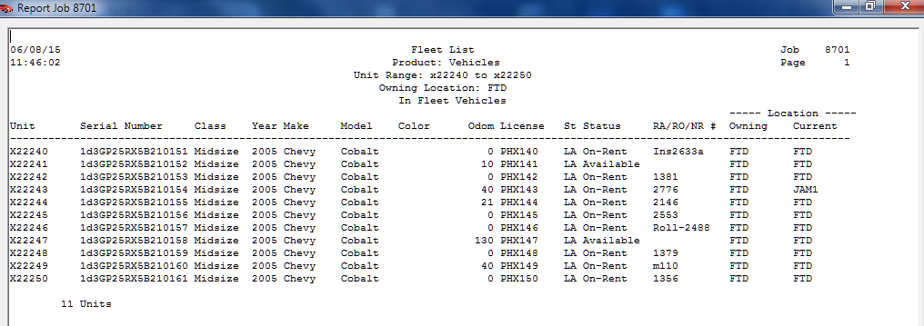
243: Case Study: Integrating CyberQuery with a SAAS Application
Example of 4GL report output:

Slide 9
243: Case Study: Integrating CyberQuery with a SAAS Application
Second and Third reporting solutions:
  CyberQuery
  DataPA
Both of these were implemented on a case-by-case basis as third-party non-integrated reporting tools.
So far as that goes, both are very good at what they do
For full-fledged reporting tools, either is vastly superior to what can be done with a roomful of 4GL or ABL programmers, especially for ad-hoc reporting.

Slide 10
243: Case Study: Integrating CyberQuery with a SAAS Application
My suggestion at this point in the process:
  Arrange to license full-license versions of whatever solution or solutions you are considering
  License them as stand-alone third-party reporting tools
Why?
  Get familiar with capabilities and limitations
  Are they scalable and adaptable to your enterprise?
  Get familiar with the configuration of the parts.
  Build some reports
  Get trained in how to use the tool
But Paul, all this costs time and money
What is the cost of regret?
  Be aware there may not be a perfect solution – so pick your pony and ride like the wind!

Slide 11
243: Case Study: Integrating CyberQuery with a SAAS Application
The requirements for the ultimate solution:
  Must be integrated with the application
  The client need not know the underlying reporting language*
  The integration is intended to eventually supplant all of the original 4GL reports
  The integration must be able to be turned ‘on’ and ‘off’
    To support phased implementation
    To support the 4GL reports as a fallback
    To facilitate parallel testing of the implementation of a new report
    To continue using existing reports if the ‘new solution’ fails for any of a variety of reasons
    You will probably find that there are some things you will still need the ABL reports for
    Hybrid reporting solution? (Remind me about this point if I don’t get back to it)

Slide 12
Important integration considerations: SAAS Application capabilities– vs –CyberQuery reporting capabilities and licensing costs.

Slide 13
243: Case Study: Integrating CyberQuery with a SAAS Application
Let’s step back for a moment, and look at the Bluebird RentWorks architecture
  Web client, appserver, server
  Or, client-server without the Web client
  Communication across the appserver boundary is via ProDataSets
  The client (User Interface) has no connection to the database
  The reporting system utilizes a report queue
    The client UI collects reporting criteria, places them in the report queue, then then starts a listener process (on the client).
    This lends itself to implementation of a scheduler for delayed running of reports
    Reports run on the server, then the client listener polls to see when it completes.
    The report output may or may not be passed back to the client. In many cases it is, and it is returned as a character large object (CLOB).

Slide 14
243: Case Study: Integrating CyberQuery with a SAAS Application
Web Client
App Server
Database Server
Progress DB
Workstation
Server
Server

Slide 15
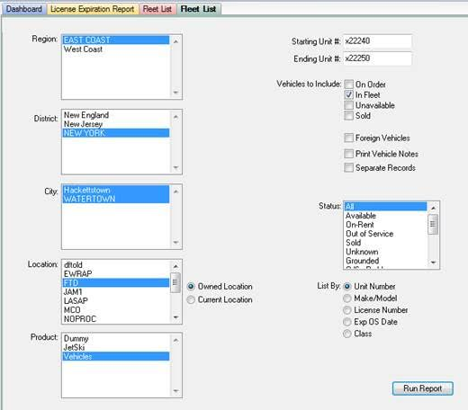
243: Case Study: Integrating CyberQuery with a SAAS Application
Fleet List client UI

Slide 16
243: Case Study: Integrating CyberQuery with a SAAS Application
Fleet List ABL output

Slide 17
243: Case Study: Integrating CyberQuery with a SAAS Application
How does the Web Client-based UI get its report criteria to the AppServer?
How does the AppServer create a report?
How does the report get back to the Web Client?

Slide 18
243: Case Study: Integrating CyberQuery with a SAAS Application
Back to the topic of CyberQuery licensing considerations
  The licensing model is not unlike Progress Software’s licensing model
  There is a cafe style licensing model
  Get what you need – do not pay for what you don’t use
One of the more powerful tools that CyberScience offers for CyberQuery is a report scheduling engine.
  Bluebird decided not to license this portion of the product
  Cost-saving measure
  Led to implementation resistance later on…
The basic RentWorks reporting system includes a report scheduler
  The RentWorks scheduler is implemented on the server
  The CyberQuery report integration is implemented on the client

Slide 19
243: Case Study: Integrating CyberQuery with a SAAS Application
So, now we have a post-implementation pre-rollout problem:
  When the CyberQuery reports are implemented, they will not be able to be scheduled!
  This is seen as an undesired reduction in the feature set for the product
  Still unwilling to license the CyberQuery scheduler… due to cost
  It is possible to leverage the RentWorks report scheduler to make it all work
  However, I lobbied against that, because the RentWorks report scheduler and all of its parts and pieces together have some issues of their own
    Suspected memory leak
    Unreliable (my perception based on reports from Product Support)
    Requires a ‘manual’ start because you can’t configure a Progress client session startup as a Windows service.
My advice to you: Choose wisely, Grasshopper!
  In other words, you know your own implementation best, and you can best make that choice

Slide 20
Let’s get on with the implementation, already!

Slide 21
243: Case Study: Integrating CyberQuery with a SAAS Application
CQCS client interface
  This was the first interface I implemented
  Works great!
  Small client program which can be loaded on the workstation a few different ways…
    Download over intranet from CQCS server installation
    Install package…
    Sneakernet?
  Drawbacks?
    Well, it is another piece of client software
    For tightly secured systems, this can be a problem
CQCS web interface
  Nothing to install – every workstation has a browser, right? RIGHT?!

Slide 22
243: Case Study: Integrating CyberQuery with a SAAS Application
CyberQuery CyberScreen Client Implementation Diagram
CQCS Report Engine
Web Client
App Server
Database Server
Progress DB
CQCS Windows Client
Workstation
Server
Server

Slide 23
243: Case Study: Integrating CyberQuery with a SAAS Application
CyberQuery CyberScreen Intranet Implementation Diagram
CQCS Report Engine
Web Client
App Server
Database Server
Progress DB
Spawn a browser with HTTP:// call to CQCS Engine
Workstation
Server
Server

Slide 24
243: Case Study: Integrating CyberQuery with a SAAS Application
So, why would you ever choose the CQCS client over the browser-based client-less solution?
  Firstly, the CQCS client was well-proven, available, and the first solution I was introduced to.
    (Sometimes your pony gets picked for you…)
  Secondly, (as I recall) the browser-based client-less solution wasn’t quite ready for prime time
  Finally, it gave me the chance to work out the major implementation issues on a stable platform.
  And there was plenty of stuff to work out!

Slide 25
243: Case Study: Integrating CyberQuery with a SAAS Application
A short list of some of the general challenges…
  Remember the fleet list client screen showing the report criteria? How do we get all of that to the CQCS client?
  How do we build that report in CyberQuery’s reporting language?
  How do we make that report ‘pay attention’ to the report criteria we are foisting upon it from the ABL?
We have to think like the software we’re trying to integrate
  Create an ad-hoc table for reporting criteria
  Populate it
  Push it in a dataset to the appserver, and on to the database
  Start the CyberQuery client with startup parameters which indicate which report to run (Report ID)
  CyberQuery can actually create self-generating code…

Slide 26
243: Case Study: Integrating CyberQuery with a SAAS Application
For the web browser implementation, the same fundamentals apply… it is just a different way to get the CyberQuery engine to act on what we want it to do.
Talk a bit more about implementation details such as the SQL92 interface, and what it means for the Progress Databse.

Slide 27
243: Case Study: Integrating CyberQuery with a SAAS Application
Fleet List client UI

Slide 28
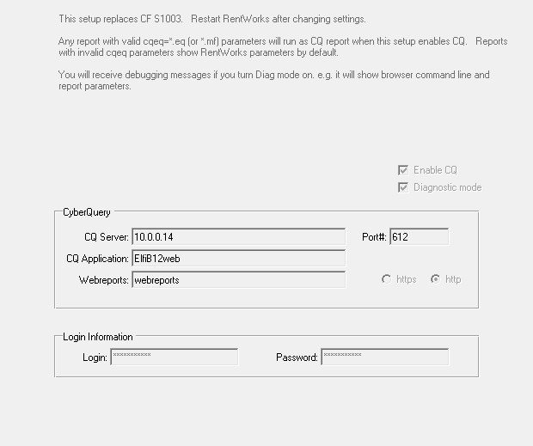
243: Case Study: Integrating CyberQuery with a SAAS Application

Slide 29
243: Case Study: Integrating CyberQuery with a SAAS Application
Questions? Help?
Paul Bouscaren, Outlook Park Holdings
E-Mail: pauldfixr@outlookpark.com
Phone: 201-602-0273

