Slide 1
What Are My Choices for Building a Modern Web UI?
Sunil Belgaonkar
Director of OpenEdge Solutions Strategy
Progress

Slide 2

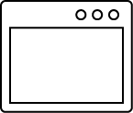




Business Applications of Today and Tomorrow
Mobile Apps
Web Apps
Satellite Apps
Desktop Apps
Websites
Various Personas
Application API
OpenEdge Platform
Data Management

Slide 3
UI Development Paradigm – Lots of Choices
Hand Crafted UI
Generated UI
UI Development Paradigm
Your Choice
Your Choice
Your Choice
OpenEdge customers want to apply a 80-20 rule
for generated UI vs. handcrafted UI

Slide 4



UX Trends for 2015
The ascent of user experience as a business strategy
House of cards
More targeted and tailored experiences for different device types
Embracing the material design
Source: UX Magazine http://uxmag.com/articles/the-top-ux-predictions-for-2015

Slide 5
Browser Based UI – Industry Update

Slide 6
UI Industry Terminology
Model-View-Controller (MVC)
Model-View-View Model (MVVM)
UI Templates – Views
Directives
  Directives are JavaScript functions that manipulate and add behaviors to HTML DOM elements
Dependency Injection
  Dependency Injection (DI) is a software design pattern that deals with how components get hold of their dependencies
Routing
  Routing is the way the framework handles the mapping of the URL path
User Interaction
User Interaction
Bi-direction
data binding
Passes calls to
View
View
Fires events
View Model
Controller
Model
Manipulates
Manipulates
Model
Fires events
Model-View-Controller
Model-View-View Model

Slide 7
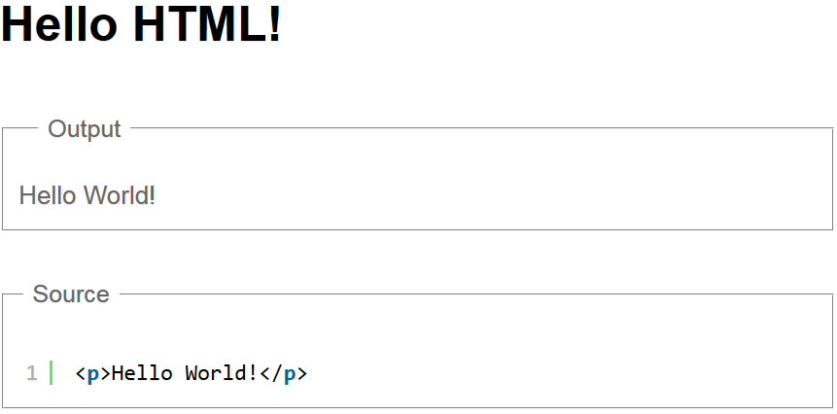
Source: https://igorminar.github.io/ng-slides/angular-intro/index.html#11

Slide 8
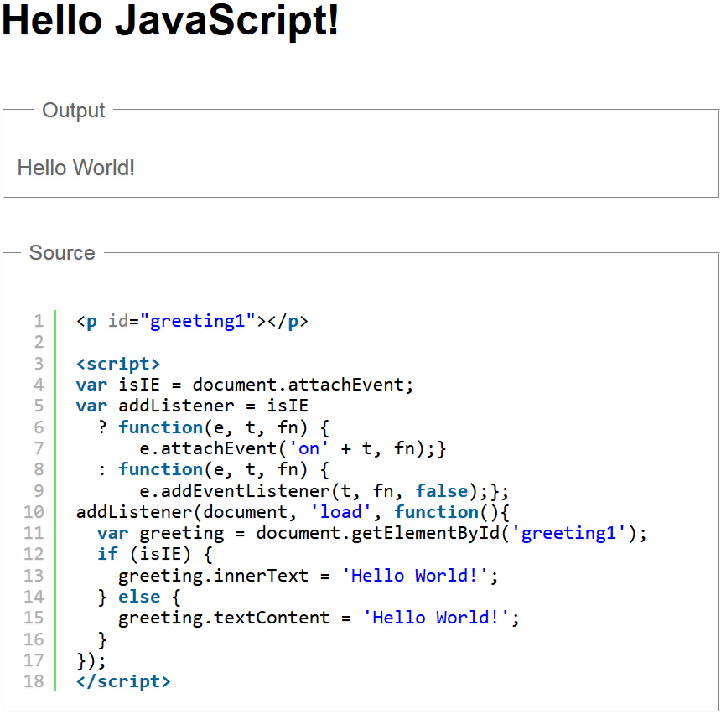
Source: https://igorminar.github.io/ng-slides/angular-intro/index.html#11

Slide 9
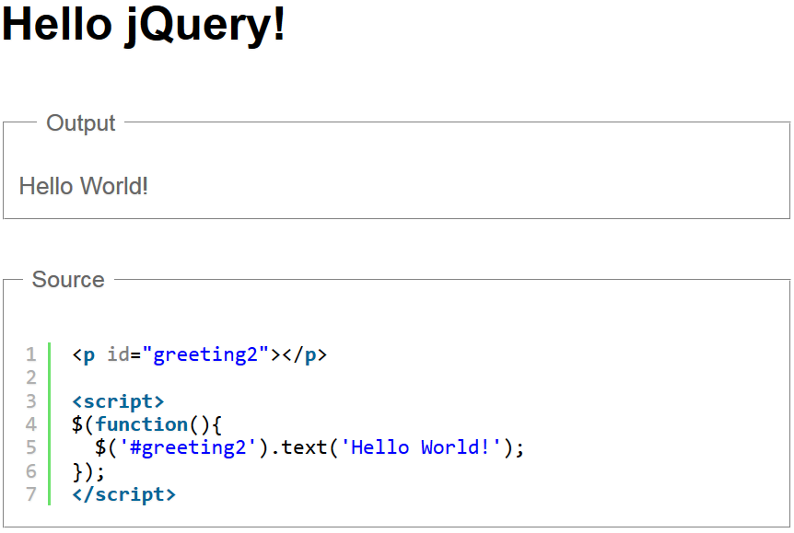
Source: https://igorminar.github.io/ng-slides/angular-intro/index.html#11

Slide 10
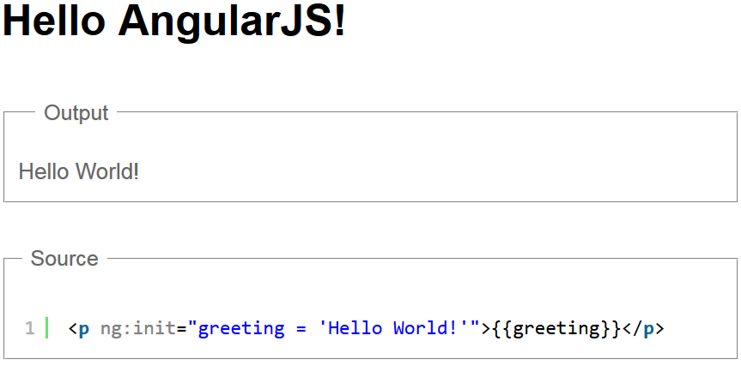
Source: https://igorminar.github.io/ng-slides/angular-intro/index.html#11

Slide 11
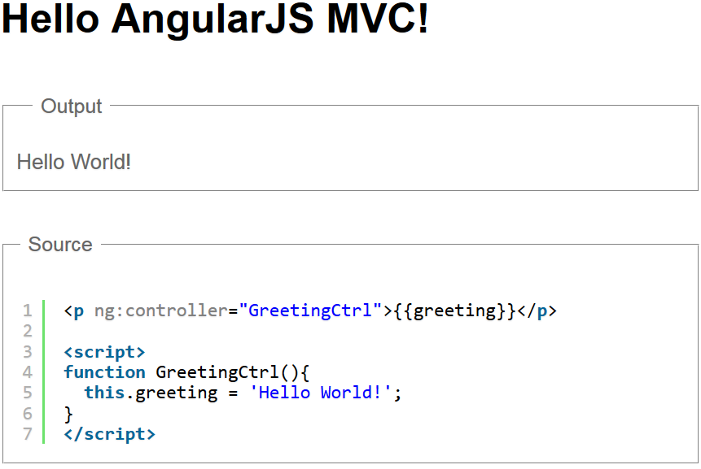

Slide 12
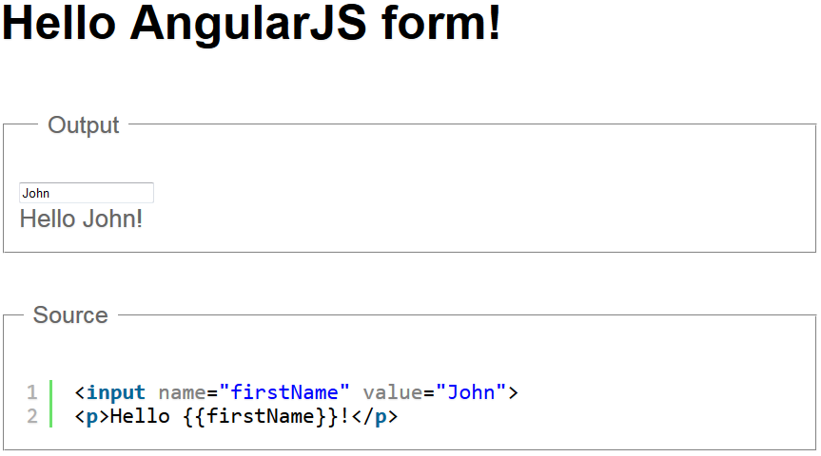

Slide 13
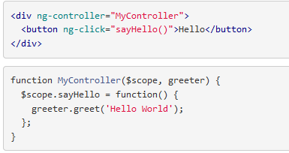
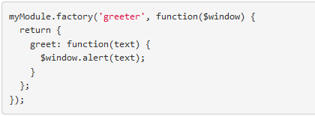
AngularJS Dependency Injection – Example
Source: https://docs.angularjs.org/guide/di

Slide 14
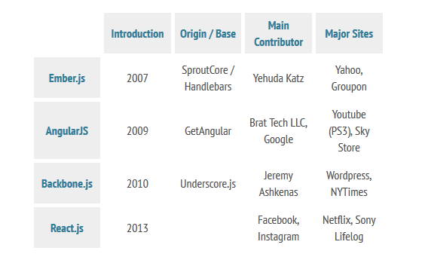
Browser Based UI – Current Frameworks
Source: http://www.developereconomics.com/comparison-4-popular-javascript-mv-frameworks-part-2/

Slide 15

Wait…Where is Kendo UI?

Slide 16
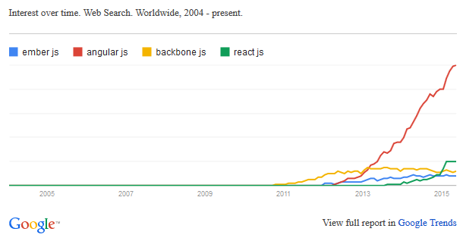
Browser Based UI – Google Trends

Slide 17
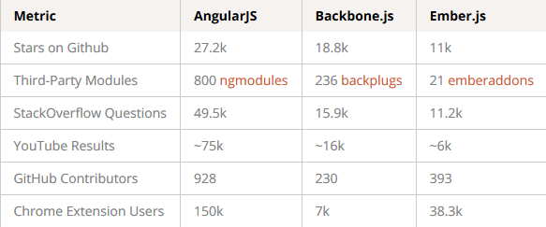
Browser Based UI – Community
Source: https://www.airpair.com/js/javascript-framework-comparison

Slide 18



Key Features of UI Frameworks
Easy to learn
Plays well with almost any library and 3rd party APIs
Super light
Modular design
Most flexible
Still have to do some leg work
No data bindings (Needs a 3rd party plugin)
“Memory management (manually destroy views/events, etc.)
Source: http://www.mobileandemerging.technology/an-overview-of-js-mv-frameworks/

Slide 19

Key Features of UI Frameworks
Allows precompiled templates
Lots of granular configuration
Good for “large” apps
Very structured
High learning curve
Data binding can be verbose
Dependencies/size can be heavy for mobile
Not very flexible
Source: http://www.mobileandemerging.technology/an-overview-of-js-mv-frameworks/

Slide 20

Key Features of UI Frameworks
1.x
Dependency injection
Easy two way data binding
Modular design
Good for: Small -> Medium -> Large apps
Does not play well with 3rd party APIs
jQuery or other DOM manipulation
Dirty checking can be expensive
DOM based template (everything loaded on start up)
SEO can be a hassle since template is DOM based
Source: http://www.mobileandemerging.technology/an-overview-of-js-mv-frameworks/

Slide 21

Key Features of UI Frameworks
Easy to understand code
React is only view layer

Slide 22
So Angular.js 1.x is the best… right?

Slide 23

Introducing ANGULAR 2.0…

Slide 24
ANGULARJS 2.0 is very
different from 1.x

Slide 25
Angular 2.0 Goals
Evolving Web Standards
  Shadow DOM and Ecma Script 6 modules
Performance
Simplified cognitive model
Source: https://angular2-intro.firebaseapp.com/

Slide 26
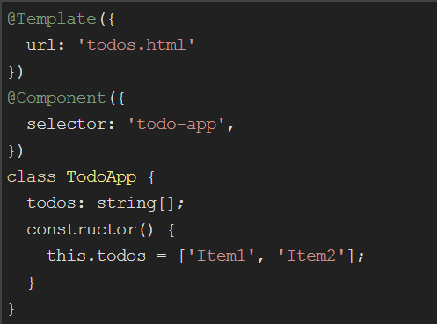
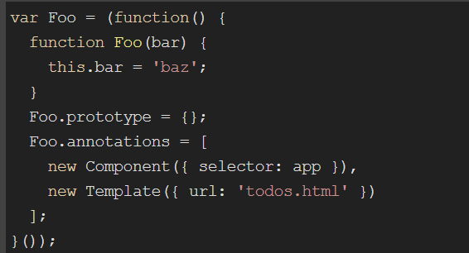
Angular 2.0 Code Sample
Typescript is Optional
A typed superset of JavaScript that compiles to plain JavaScript
Source: https://angular2-intro.firebaseapp.com/

Slide 27
Angular 2.0 Forms
Imperative Driven
Data Driven
Template Driven
  Built with Code
  Automatic
  Similar to 1.x
Source: https://github.com/DeborahK/ab2015

Slide 28
Cool…
When will ANGULAR 2.0 be ready?

Slide 29
ANGULAR 2.0
is still under development

Slide 30
TOO MANY CHOICES!
Isn’t there something that
would let me mix-and-match
and get the best?

Slide 31

How do YOU use
Bootstrap?

Slide 32
How do YOU use
Kendo UI?

Slide 33
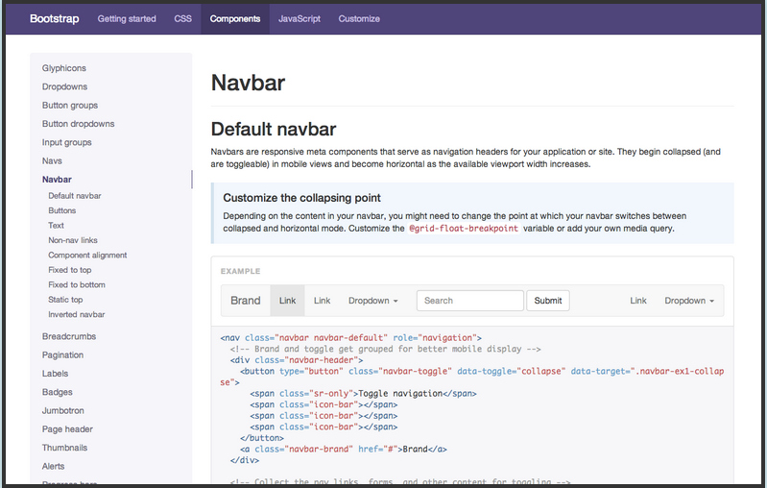
1. GO TO THE DOCS

Slide 34
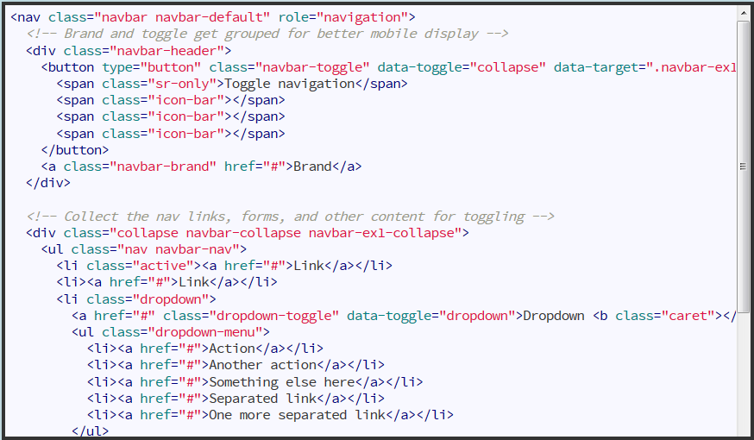
2. COPY ALL THE THINGS

Slide 35
3. RECEIVE WIDGET

Slide 36
We can do better…

Slide 37
2. COPY ALL THE THINGS

Slide 38
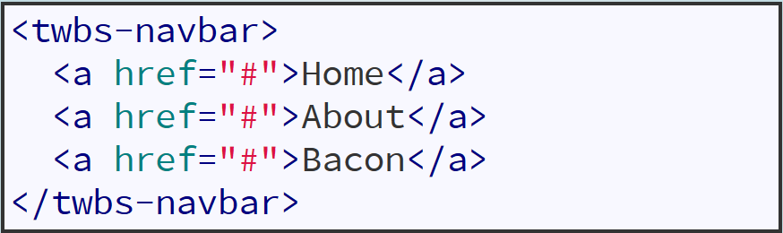
2. USE THE THING

Slide 39


Slide 40

Web Components
Templates define chunks of markup that are inert but can be activated for use later
Custom Elements let authors define their own elements, including new presentation and API, that can be used in HTML documents
Shadow DOM defines how presentation and behavior of decorators and custom elements fit together in the DOM tree
HTML Imports provide a way to include and reuse HTML documents in other HTML documents
The component model for the Web (also known as Web Components) consists of four pieces designed to be used together to let web application authors define widgets with a level of visual richness not possible with CSS alone, and ease of composition and reuse not possible with script libraries today.
Source: http://robdodson.me/why-web-components/

Slide 41
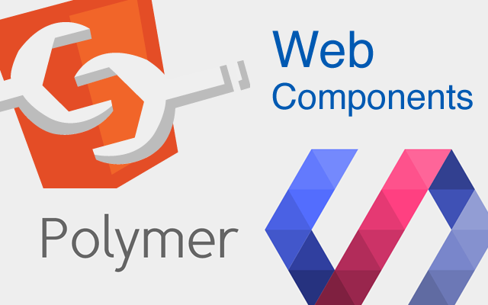
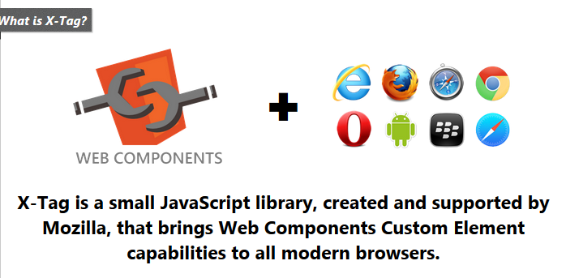
How Do I Create Web Components?

Slide 42

Why Do I Need Angular and Polymer?
Polymer
A library for creating Web Components, which are a set of W3C standards and upcoming browser APIs for defining your own custom HTML elements.
Angular
A complete framework for building webapps, whereas Polymer is a library for creating Web Components. Those components, however, can then be used to build a webapp.

Slide 43
It’s all about UX
This is a fast evolving space
Separate UI Model for UI View --- this is future proof

Slide 44
Web UI – What Is the Progress Strategy?

Slide 45
Disclaimer
Future plans discussed in this section are for informational purposes only, and the reader is hereby cautioned that actual product development may vary significantly from what is discussed here
Future plans discussed in this section may not be interpreted as any commitment on behalf of Progress, and future development, timing and release of any features or functionality described in this roadmap remains at our sole discretion

Slide 46
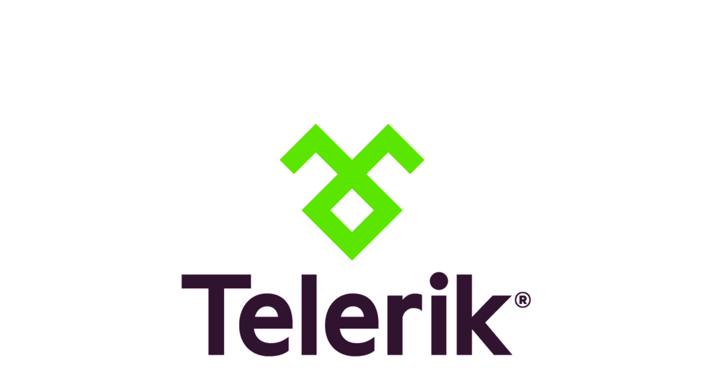

The Progress UI Strategy
VIEW
CONTROLLER
MODEL
  Kendo UI Data Binding
  Write your own JS
  Data driven OE Community frameworks
  Industry frameworks for
  hand crafted UI
  JavaScript Data Object
  (JSDO)
  Kendo UI/Angular Binding

Slide 47



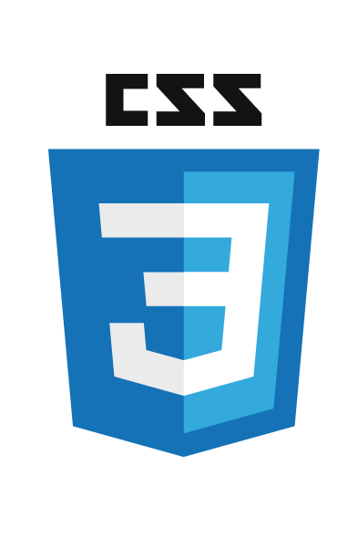

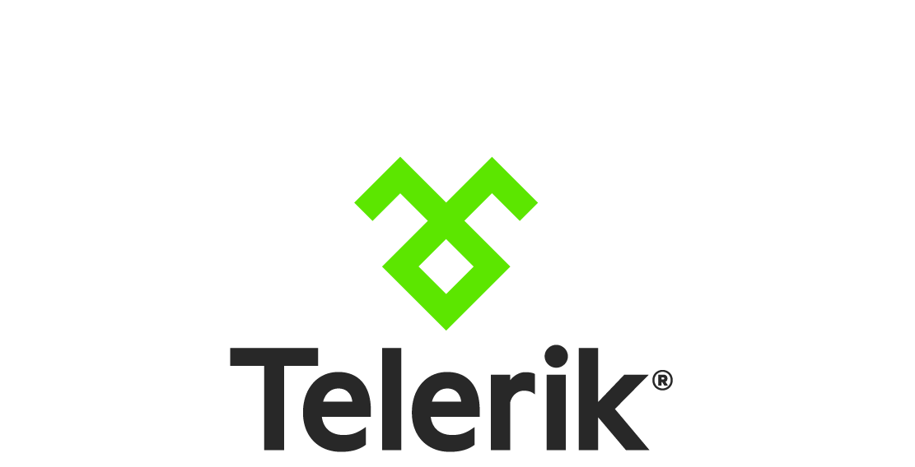


User Experience Is Everything
WebSpeed
Beautiful pre-designed widgets.
80% productivity increase.
Grids
Data Visualization
Navigation
Diagramming
Scheduling
Lists
Interactivity
Geo Visualization
A library of 70+ HTML5 UI for cross-platform apps.
Fastest Performance
Open and extensible

Slide 48
The Benefits of Using JSDO
Simple JavaScript access to existing Business Logic via CRUD & invoke ops
Built-in http client sessions to REST services
Write once, deploy everywhere
Open client & server components
Transactional operations with optional before-imaging
Optional local data caching
Presentation Layer
Client UI Controls
Client MVC Logic
JSDO
(session)
(data cache)
Local
Data
Common Business
Logic Layer
REST Service Interface
Data Layer
Notes:
1) The JSDO is the simplest way to access the OpenEdge backend from a JavaScript client. 2) The JSDO supports anonymous, BASIC and FORM based authentication and can perform CRUD operations and INVOKE operations. 3) The JSDO makes code independent of URIs. The URIs are in a catalog file and loaded by the Session. From JavaScript, the JSDO only needs to refer to the name of the resource to know what operations are available. 4) The JSDO provides a programming model to work with data locally. No URIs are referenced. Developers just use the JSDO API. 5) The JSDO is Open.
The JSDO will be released as Open Source in the near future.
The JSDO has no dependencies but JavaScript [and the XMLHttpRequest object] and can be used with multiple JavaScript frameworks including Kendo UI.
The JSDO is not just JavaScript and OpenEdge. (The model used by the JSDO allows for multiple additional server implementations as well as client implementation. For example, a Swift Data Object for native iOS.)

Slide 49



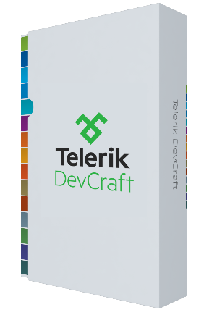
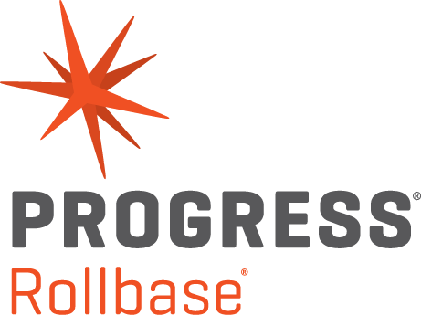
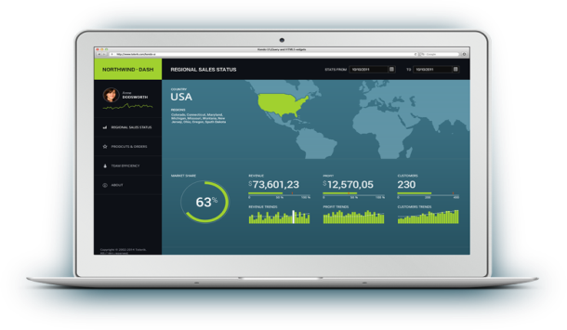

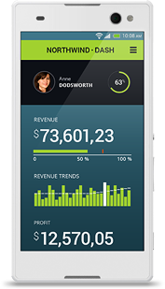


Modernization Preferred Technology Choices
JSDO
Development
Environment
REST Interfaces
OpenEdge
Mgmt
Pacific Application Server for OpenEdge
Webspeed
OpenEdge
BPM
Corticon BRMS
OpenEdge
RDBMS
OpenEdge
Replication
OpenEdge
DataServers

Slide 50



Future Plans for Progress Higher Productivity of UI – View
1
2
3
TEMPLATES
  Built-in business patterns like parent-child relations, Filters, etc.
COMPONENT BUILDER
  Ability to reuse components and build UI quickly
UI BUILDER
  WYSIWYG designer
  Integrated with choice of web frameworks like Angular.js, etc.

Slide 51
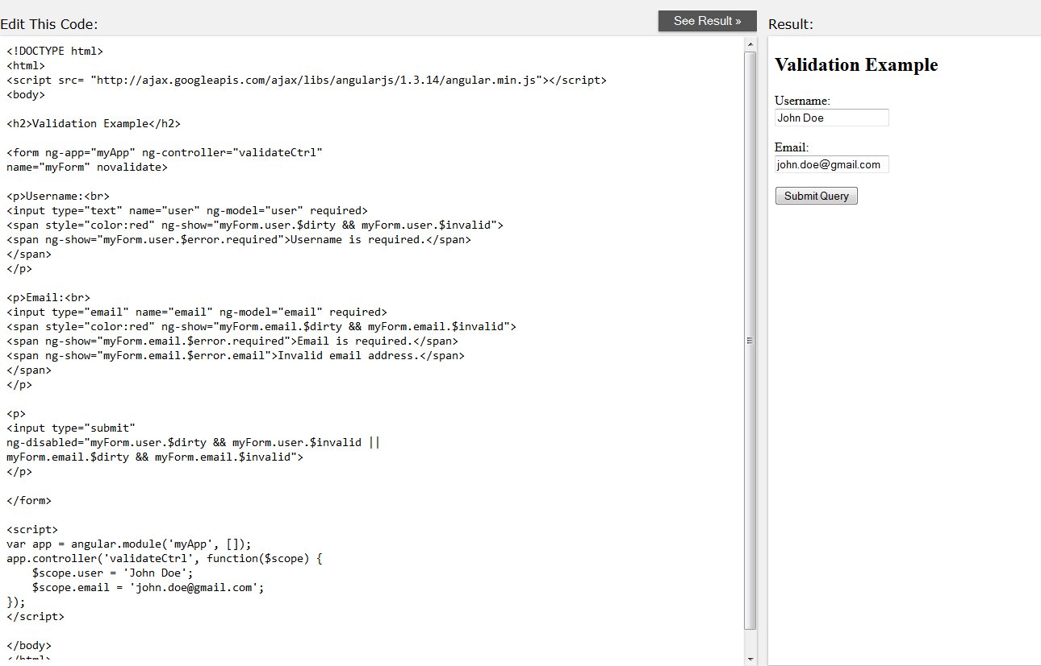
AngularJS Complete Example

Slide 52
Summary
Lots of choices!
Progress has a great offerings and a good strategy …so stay tuned!

