Slide 1
A New Object Model for WebSpeed and HTTP
David Cleary
Mike Banks
Progress Software

Slide 2


Michael Banks Bio
Speaker Bio
Michael Banks is a principal engineer in the OpenEdge group at Progress Software. His contributions span the OpenEdge product set and include work on the .NET Bridge, WebSpeed, the Web Services Adapter, the REST Adapter, OpenEdge BPM, the OpenEdge AppServer, and the Pacific Application Server for OpenEdge.
In addition to his interest in server-side software, Michael has a background in computer graphics and has presented at Siggraph and other UI events. He has also been a speaker at several Exchange and PUG conferences. Michael is also an Adjunct Lecturer at Bentley University in Waltham, MA.

Slide 3
Legal Disclaimer
The contents of these materials are confidential information of Progress Software Corporation or its affiliated entities (collectively Progress Software).
These materials may also include information about future features, products, technologies and/or services that are under consideration by Progress Software.
Progress Software makes no commitments with respect to such future features, products, technologies and/or services.
The information contained in these materials is subject to change.
Progress Software does not guarantee any release dates or that there will be a release of any future features, products, technologies and/or services (if any) referenced herein.

Slide 4
Pacific Application Server for OpenEdge Overview
ABL application server tightly integrated into PAS:
  startup, shutdown, client request threading and scheduling
One PAS for OE instance equals one classic AppServer instance ( i.e. one ABL app )
  Uses a single threaded OS process to run concurrent ABL sessions
    Most classic AppServer application migrate with few changes
Supports http clients for: REST, SOAP, OpenEdge WebClient
  Can port pre 11.5 REST & Mobile web application
  Supports classic AppServer clients using a HTTP bridge
Open REST administration for OpenEdge components (same as used by OEE/OEM)
Command line utilities for secure deployments environments
OEE/OEM & AdminServer optional
Progress Development Studio for OpenEdge support

Slide 5
PAS for OpenEdge 11.5.1
Contains over 50 bug fixes (internal and customer reported)
Support for paths with spaces on Windows
Added cgiip messenger support to connect to Classic WebSpeed
Performance improvements

Slide 6
Feature Enhancements in PAS for OpenEdge 11.6
All four transports supported in a single application server
  APSV, SOAP, REST, WEB
OERealm and ClientPrincipal support on all transports
  Share a security context between transports
Multiple application support in a single instance
  Each application has its own session manager
Performance improvements
Context management through HTTP sessions
Support for Classic WebSpeed
New OpenHTTP programming model

Slide 7
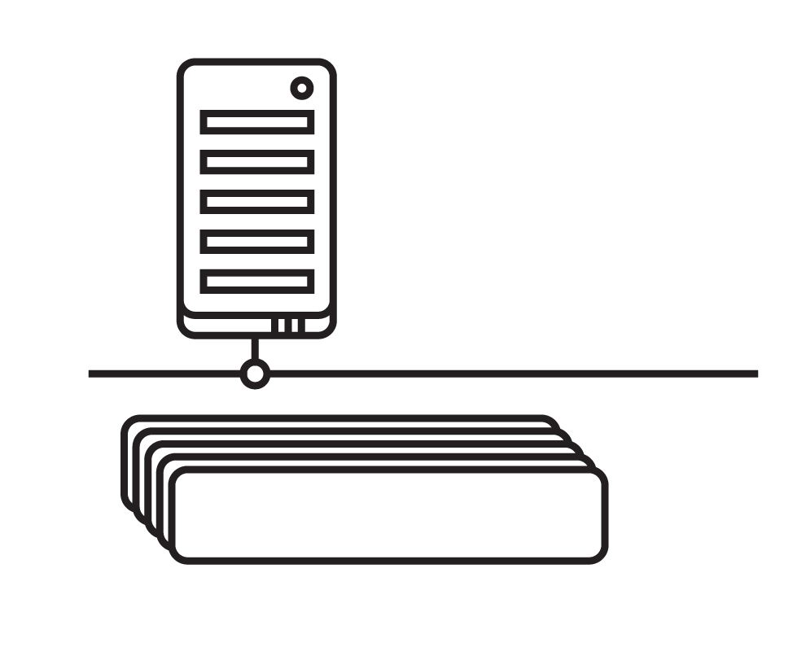
Webspeed support in Pacific Application Server for OpenEdge
  Next generation Application Server platform that integrates multiple functions
  Same core server for Rollbase, Corticon, and OpenEdge AppServer / WebSpeed ABL applications
  ABL applications run in the new multi-session agent, which uses a single OS process for improved performance and scalability
  Simpler administration / deployment and is preconfigured to operate as a production-ready server
Pacific Application Server (includes Webspeed support)
ABL Sessions
Notes:
Next generation Application Server platform that integrates multiple functions
Web Server (Tomcat), OpenEdge AppServer, OpenEdge AppServer Adapters
Runs in the unified Progress Pacific Application Server (PAS) platform
Same core server for OpenEdge (ABL), Rollbase (JavaScript) and Corticon (Java)
Common server installation, administration and configuration
Powered by a new multi-session agent that runs in a single process (ABL virtual machine)
Reduces the number of OS processes
Allows for resource sharing like DB connections across multiple sessions
Supplied in addition to (and not a replacement for) the current/classic AppServer
OE AppServer licenses are traded-in as appropriate
The Pacific Application Server for OpenEdge is aPAS server with a embedded ABL language engine -- ABL application server for managing ABL Sessions that execute ABL Requests. As an example, PAS for OE is an Progress product that can be installed into any PAS distribution. Acceptable abbreviations are PAS for OpenEdge or PAS for OE.

Slide 8
Classic Webspeed vs. PAS for OpenEdge
Classic Webspeed
Client (http)
Browser
Browser
Web
Server +
Messenger
Web Server
+
Messenger
PAS for OpenEdge
HTTP
APSV (AIA)
SOAP (WSA)
REST/Mobile
APSV (AIA)
SOAP (WSA)
REST/Mobile
Stateless
AdminServer
Session Manager
Session Manager
WebSpeed
NameServer
MSAgent
MSAgent
50 Agents
Agent
(1 ABL Session)
150 ABL Sessions
Agent
(1 ABL Session)
50 ABL Sessions
Agent
(1 ABL Session)
Notes:
CLASSIC
Must have an AdminServer
- AdminServer starts NameServer and AppServer
- then the AdminServer is just used to monitor and manage
Client connects to NameServer (optional) and is then redirected to the AppServer
If the Client needs to connect through the internet (HTTP/HTTPS)
- you must install and configure separate and distinct adapters AIA/WSA/REST/Mobile
PAS for OE
Start the PAS for OE instance
Client connects using HTTP/HTTPS always
+ AdminServer is not necessary (except for running OEMgmt on the same machine or publishing)
State Reset not supported (no one used it).
+ There is NO NameServer (load balancing and fault tolerance are handled another way)

Slide 9
Benefits of Migrating WebSpeed Applications to PAS for OE
Runs the same* WebSpeed application code
Consolidated ABL application deployment
Supports web application security requirements
Well defined deployment models
Migration path to full HTTP request/response handling & present day UI technologies
Pacific Application Server (includes Webspeed support)
ABL Sessions
* Some changes may be required to support customized OpenEdge distributed procedures
Notes:
Consolidate your application’s deployment to a single web server
Scalable web application using industry standard load balancers and clusters
Share application server and web server functionality in a single deployment platform
Full compatibility (@98%) with classic WebSpeed, and still benefit from the multi-session agent technology
Well defined deployment models to simplify distributing your application
Simplify OpenEdge updates by updating the OE installation – not your deployed application server(s)
Clear migration path to using present day UI technologies and full open access to HTTP for classic WebSpeed applications
Enhanced development platform with the ability to transparently use UNIX servers
Built-in industry tested web authentication and roll-based authorization to your application

Slide 10
Why a new model?
All HTTP verbs
Full HTTP request
Control of HTTP response

Slide 11
Goals
Object-oriented Programming Model
Compatibility with existing WebSpeed application code*
Coexistence with Pacific Application Server applications
Customer-specified handlers (à la web-disp.p)
Pacific Application Server (includes Webspeed support)
ABL Sessions
* Some changes may be required

Slide 12
Introduction
Client
HTTP Request
HTTP Response
Tomcat
Web Transport
Web Stream
Pacific Application Server Agent
Customer Object (implements IWebHandler)

Slide 13
Progress.Web.IWebHandler
INTERFACE Progress.Web.IWebHandler:
METHOD PUBLIC INTEGER HandleRequest( ).
END INTERFACE.

Slide 14
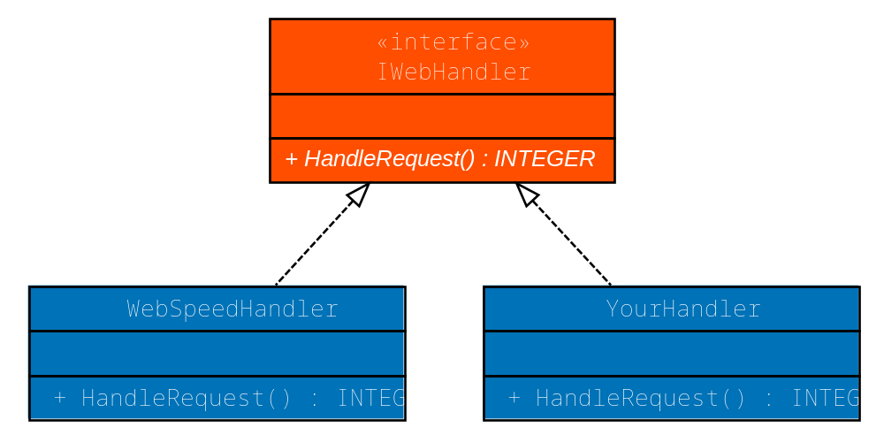
Web Handlers

Slide 15
Web Handler Configuration
In openedge.properties
[pas1.ROOT.WEB]
defaultHandler=OpenEdge.Web.WebspeedHandler
If you wrote your own handler
[pas1.ROOT.WEB]
defaultHandler=MyCustomHandler

Slide 16
WebspeedHandler
Implements IWebHandler
The HandleRequest() method
  Starts web/objects/web-handler.p persistently if not started
  runs process-web-request in the handle
web/objects/web-handler.p is the web-disp replacement
  Starts webutil/paswebstart.p (sets itself as web-utilities-hdl)
  The web-notify event is changed to process-web-request
  The wait-for logic is removed

Slide 17
WebspeedHandler
webutil/paswebstart.p
  Uses old web-start as include
New function GetEnv()
  All calls to OS-GETENV() changed to use new GetEnv() function
New multi-session-agent() function that returns true if in pas
Some configuration properties are now in openedge.properties instead of web-context

Slide 18
Demos
Compatibility Handler

Slide 19
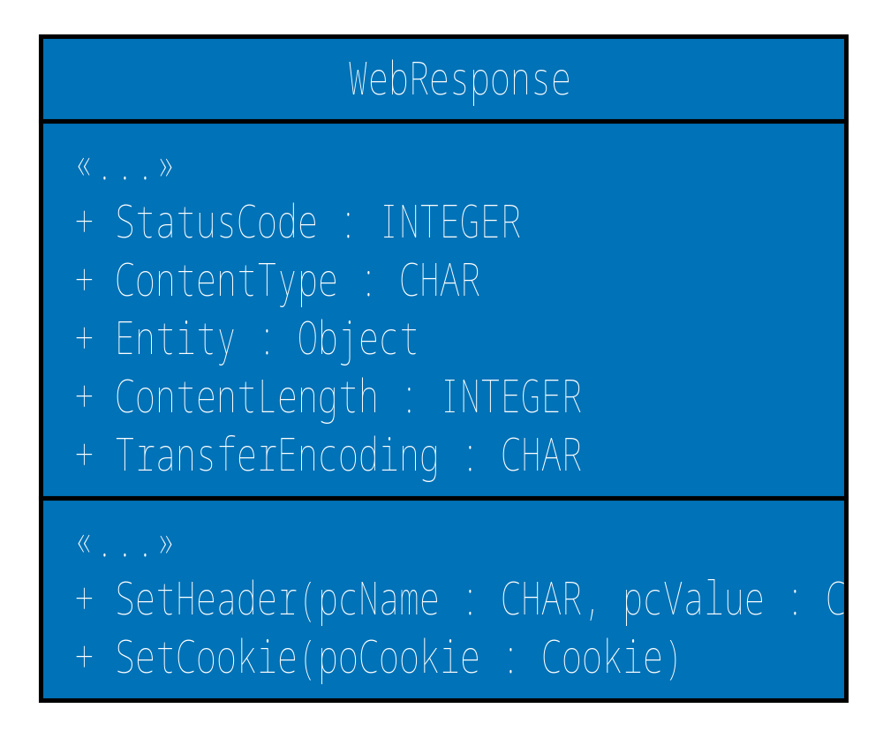
WebResponse Object
Object representation of HTTP response
Properties for common elements
Methods for headers, cookies

Slide 20
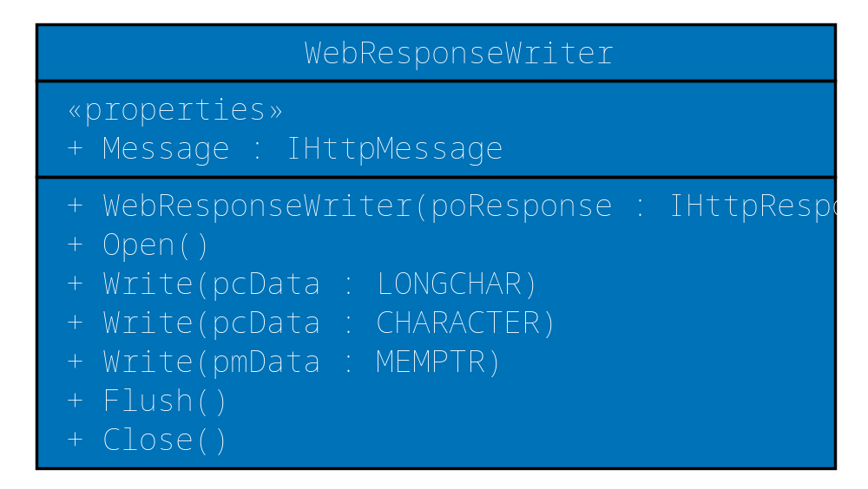
WebResponseWriter
Writes an HTTP response to the Web Stream
Status/Headers written on first use of Write()
Close to “commit” response

Slide 21
Demos
Basic IWebHandler

Slide 22
OpenHTTP

Slide 23
OpenHTTP
Writing your own Web Handler from scratch can be difficult
Most applications will not use all HTTP verbs
Some behavior is frequently common for all handlers

Slide 24
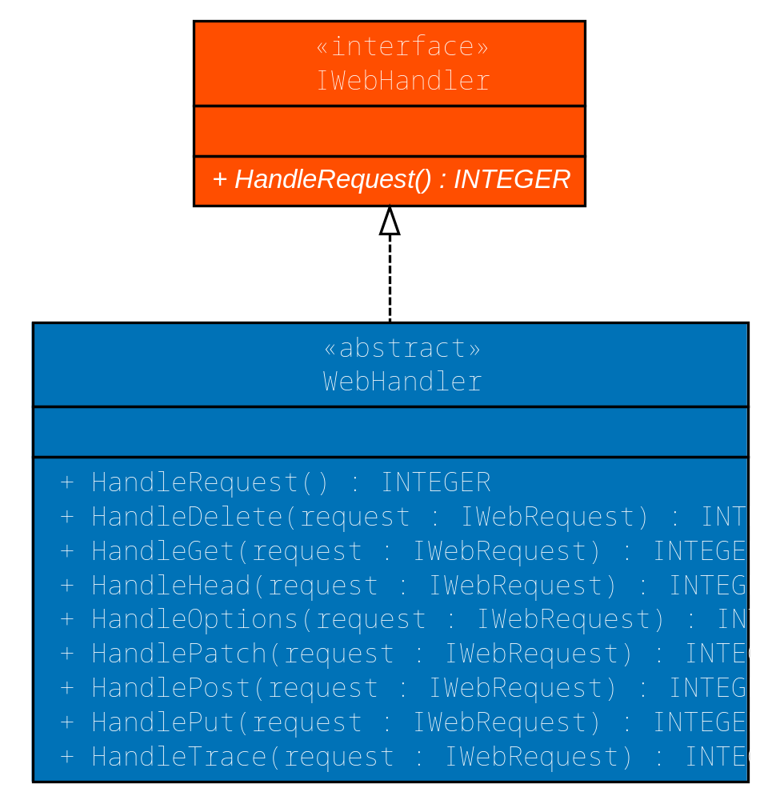
OpenHTTP WebHandler
An abstract class that implements the IWebHandler interface
Dispatching for all the common HTTP verbs
Provides default behavior for the methods you don’t override

Slide 25
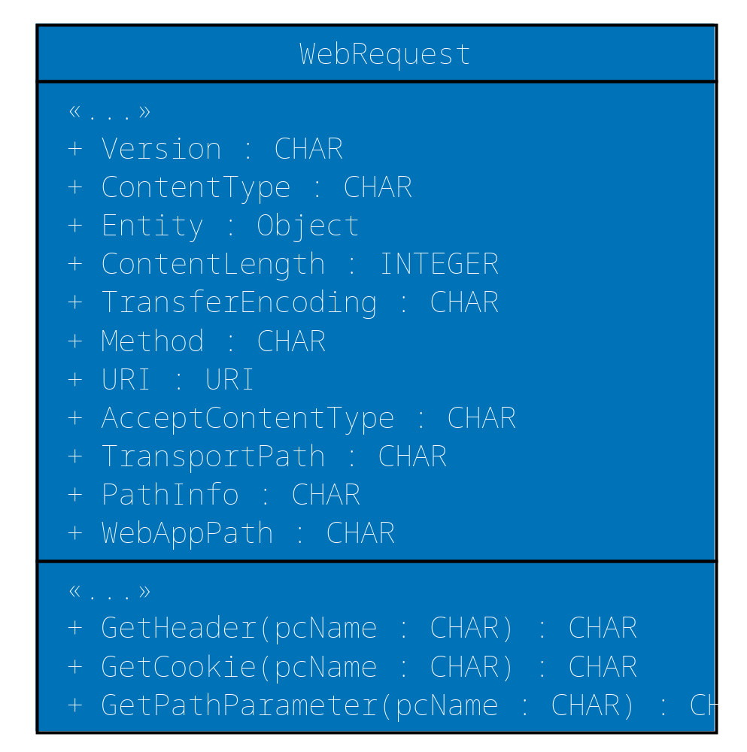
WebRequest Class
Object representation of HTTP request
Properties for common elements
Methods for headers, cookies, path parameters

Slide 26
Demo
OpenHTTP

Slide 27
Advanced Web Handler Configuration
In openedge.properties
[pas1.ROOT.WEB]
defaultHandler=OpenEdge.Web.DefaultHandler
handler1=OrderWebHandler: /customer/{custid}/order/{orderid}
handler2=CustomerWebHandler: /customer/{custid}

Slide 28
Demo
OpenHTTP Resource Mapping

Slide 29

When can I get it?

Slide 30
OpenEdge 11.6 ESAP 3
Target date of June 17
Compatibility testing with your existing WebSpeed applications
OpenHTTP API

Slide 31
Q & A

