Slide 1
OE Realm & Your Application’s Authentication Process
PUG Challenge 2015
Mike Jacobs Kumar Navneet
Senior Software Architect Principal Software Engineer
Progress Software Corp. Progress Software Corp.

Slide 2
Agenda
The OE Realm feature: what it is, and what it is not.
OE Realm architecture
OE Realm Server Class Implementation Best Practices
Configuring OE Realm Clients
OE Realm Server Class Error Handling
AppServer security considerations
Debugging Tips

Slide 3
The OE Realm feature: what it is, and what it is not?

Slide 4
OpenEdge Realm Feature
Customer Requirement:
I have a large investment in my application managing and using application defined user accounts.
When I integrate with other Progress products I want to provide my application defined user accounts to lower administration costs and provide a better user experience.
Component of a OpenEdge Single Point of Authentication (SPA) architecture
  SPA: When each application’s authentication system uses a single source of user account information
Supports three Progress product’s authentication systems
  OEBPM
  OpenEdge REST services ( classic REST services & PAS for OE )
  Rollbase
Notes:
The entire OERealm feature is based on customer requirements with security best practices applied. OERealm is a component of a larger SPA (Single Point of Authentication) architecture.

Slide 5
OE Realm is NOT …
An authentication system
  The server class you write does not control the remote authentication system’s user login success / failure
Limited to using the OpenEdge database’s _User table
Limited to supporting one OE domain or tenant
Limited to only one implemented class per AppServer
Limited to only OpenEdge written OERealm clients
Able to support remotely created and deleted user accounts
Notes:
We in engineering have received a lot of questions about the feature, which shipped initially with little documentation, an overly simple sample, and wasn’t fully true. So we will answer those questions again for you to eliminate the simple things.

Slide 6
OE Realm Architecture
Notes:
To become comfortable with features like OERealm, it really helps to understand how it fits in with real life authentication processes and products. Otherwise you will be more of a trial and error to get it running. This is something that will not be documented.

Slide 7
OERealm Architecture
Three components
  OERealm client ( part of remote system’s authentication plug-in)
  OERealm server OOABL interface ( common API definition )
  OERealm server class ( supplies user account field information to caller )
OERealm server class runs in a Session-Free AppServer as a Singleton OOABL class
  Why: Session-free supports multi-threaded OERealm clients and fail-over
OERealm client uses abstract user account property names
  The ABL developer’s OERealm server class supplies the mapping of abstract to physical
Uses user account numerical IDs for user account uniqueness
  OERealm server classes responsibility to manage ID for multiple OE Domains/tenants

Slide 8






OE Realm – Big Picture
Client application code
OE Realm
server class
User account system library
Physical user account storage
Log-in
login
Authn
Process
OERealm
interface
Security Layer
Users
OE Realm
Client
request
Log-in
response
( OE-DB |LDAP |… )
REST,
BPM, or
Rollbase
OE AppServer / PAS for OE
Notes:
The source of user account can be OpenEdge Database, an LDAP server or anything else.
The OE Realm Service Interface is an OO ABL class that will have methods to validate a user’s identity and provide attribute information about the validated user. The IdM for a very simplified case using OpenEdge _User table can be implemented in OpenEdge’s _Sec-* system tables.
The OE Realm Clients will have users logging in. The OE Realm Client will have to implement its own authentication process. The OE Realm Service Interface will provide only the user account information.
Currently, OpenEdge supports REST, BPM and Rollbase as the OE Realm Clients.
Typically a user of the OE Realm Client will log in.
The OE Realm client will ask the OE Realm Service interface for the numeric User-Id of that User.
The OE Realm will lookup the User account source, and provide the user-id.
The OE Realm Client will then send the password (either encrypted or in digest form – as per configuration). OE Realm will validate the password and return a “yes” or a “no”.
If it is a “no”, user is NOT authenticated. Login access will be denied by the OE Realm Client.
If it is a “yes”, user is authenticated. However, he is not yet authorized.
Based on the security requirements of the OE Realm Client authentication System, the OE Realm Client will seek other information about the authenticated user (like roles assigned to him, his city, his surname, whether his account is active, locked etc) and will authorize the user if the information is as per the OE Realm Client security settings.
The implementer the OE Realm can add an extra layer of Security for all incoming requests to the AppServer. This can be based on a C-P file that the implementer will distribute to the OE Realm Client in chain of his trust.

Slide 9
OE Realm Client – Server Interaction
OE Realm
Client
OE Realm
Server
(Client-Principal)
Lookup account (userid )
Return account ID# / -1
(Client-Principal)
Get/Set account attribute ( ID#, attr-name )
Return attr-value / “”
(Client-Principal)
Validate password ( ID#, password )
Return YES / NO
Notes:
There are 3 types of APIs in an OERealm server’s OOABL interface:
Account lookup
GET/SET user account attributes ( aka fields/properties )
Account secret (aka password) validation
Because each request will run in a separate ABL session (i.e. state-free), a Client-Principal identifying the OERealm client can be sent to the server so that it can validate which OE client it should surrender user account information to.

Slide 10
Authentication System – OERealm Client Interaction
Authentication System
Get user
credentials
Authentication System Plug-in
Lookup user
account
OE Realm
Client
( a Java
OpenClient
application )
found
Validate secret
fail
ok
Get attributes
ok
pass
Build security
token
Notes:
A typical production grade authentication system is a process.
The implementation always has a means of using ‘plug-in user account source’ modules. This accommodates the needs of different production installations.
That process’s implementation is fixed and executes the same every time – regardless of where the user account data originates from.
OERealm client is just a part of one of those configurable plug-in modules. It is a conduit to where the user account information is stored and managed.
The plug-in is called to:
See if the account exists
See if the supplied password credentials are valid
Get various (configurable) account properties to determine whether to let the user login or not

Slide 11
Spring Security and OpenEdge Filters
Spring Security Framework
Pre
authentication
[PreAuth filter]
OpenEdge
AppServer
Client
[ ClientPrincipal filter ]
Spring
Session
(Authn)
Post
authentication
Filter
Spring
[RBA]
Authorization
Run
HTTP
Request
Token
Direct
authentication
Exchange Spring Token
for Client-Princpal version
[OERealm]
Tomcat HTTP
Session Storage
Spring session
data
Token
[ ClientPrincipal ]

Slide 12
OE Realm Server Class: Implementation Best Practices

Slide 13
Development Process Overview
Implement the OERealm interface (there are now requirements…)
  Provision user accounts (if not already in your application)
  Code minimum OERealm class methods for one user account Domain
Deploy OERealm class(es) to AppServer
Configure OERealm client in the remote authentication process
Test & debug
Optional, but HIGHLY recommended:
  Create a sealed Client-Principal for OERealm client SSO to the AppServer OERealm class
  Code the OERealm server class’s SSO Client-Principal validation
Optional:
  Create a new OERealm keystore with the OE Domain(s) Access-Code
  Consider if multi-tenancy ( i.e. multiple user account domains ) will be required

Slide 14
Comparing OERealm Client Requirements
 | OE BPM | OE REST | Rollbase
Server session type | Session-free | Session-free | Session-free
SSL connections | No | Optional | Optional
Client-Principal authn | Yes | Yes | Yes
Enabled attribute | TBD | Yes | Yes
Locked attribute | TBD | Yes | Yes
Expired attribute | TBD | Yes | Yes
Roles attribute | No | Yes | Yes
Multi-domain enabled | Yes | Yes | No
Query account names | Yes | No | No
Query attribute names | Yes | No | No
Get/set attributes | Yes | No | No

Slide 15
Supporting User Accounts In OERealm Server Class
Every user account must have a unique numerical ID for any given source
  If the source of user accounts does not support numerical IDs, you have to manage the IDs in your OERealm server class
  If multiple user account domains are supported, the ID must be unique across all domains
If a user account attribute is not supported, return a default value
Map the locked attribute to exceeded maximum password failures
Map the expired attribute to password expired
Map the roles attribute to roles or groups
Map the enabled attribute to account enabled
Some authentication systems may interpret attribute data as case-sensitive

Slide 16
OE Realm Clients

Slide 17
OE Realm Clients
OpenEdge BPM
REST Adapter (Mobile / Rest webapps)
PAS for OE web applications ( oemanager.war / oeabl.war )
Rollbase private cloud
Notes:
This slide lists the products that use OE Realm as a source of user account for their authentication process.
OE BPM was first to use OE Realm for fetching the user account details.
REST/Mobile web applications, OE ABL and oemanager web applications running on Pacific Application Server and Rollbase can all use OE Realm as a source of user account to perform authentication process of their users.

Slide 18
Common Client Configuration
Parameter | Description | Mandatory
Realm URL | URL to connect to OE Realm AppServer | Yes
Realm Class | Fully qualified name of the OOABL Server Class | Yes
Password authentication mode | Clear-text or HTTP Digest | No
Attribute Names | Static user account attribute name | No
Realm Token File | C-P token to SSO to the OE Realm | No
Certificate Store Location | Used for SSL enabled OE Realm AppServer | No
OpenEdge Domain | Used to qualify user’s domain in the OE Application. Defaults to Blank. | No
OpenEdge Domain Access Code | Used to seal the C-P produced by the OE Realm Client after the authentication process is complete. Defaults to Blank. | No
Notes:
All the Realm Clients be it OEBPM, REST or Rollbase will need to know how to communicate with the OE Realm Service Interface. The OE Realm server class is an OO ABL class running in a state-free appserver. So the clients will need to configure parameter to communicate with the OE Realm. This table list some common parameters. Some are mandatory like Realm URL and Realm Class. Others may be required in some clients and may not in others.
Once the OE Realm Client has got account information from the OE Realm and performed authentication successfully, it may want to convert the user login into a Sealed Client-Principal (C-P). For that purpose, the OE Realm Client may ask you to configure OE Domain and access code to seal the C-P created by the authentication process.
To create a Sealed C-P, the Realm Client may ask you to configure the OpenEdge Domain and Domain Access Code.

Slide 19
Realm URL values
S.No. | Realm URL values | OE Realm implemented on
1 | AppServer[s]://<name-server-host>:<name-server-port>/<service-name> | Remote classic AppServer using NameServer
2 | AppServerDC[s]://<AppServer-host>:<AppServer-port>/<service-name> | Remote classic AppServer using Direct Connect
3 | http[s]://<host>[:<port>]/<aia-app-name>/aia | Remote classic AppServer via AIA
4 | http[s]://<host>[:<port>]/[oeabl-app-name/]apsv | Remote PAS for OE Application Server
5 | internal://localhost/nxgas | Local PAS for OE Application Server
The Realm URL value is same as what you provide in the Java OpenClient Connection URL
Notes:
This slide gives you the list for valid Realm URL values depending on where your realm class is implemented.

Slide 20
Realm Token File (for additional / optional security)
Generated using $DLC/genspacp.bat | sh
Generated by implementer of the OE Realm Service Interface
Distributed to the OE Realm Client in the line of trust
genspacp –password <text> [-user <user> -role <text> -domain <text> -file <text>]
Generates a Client-Principal (C-P) file sealed by “password”
If not provided following defaults are used:
  User = BPSServer, Role = SPAClient, Domain = OESPA, File = oespaclient.cp
Tip: Don’t rely on defaults
Tip: Supply information for all of the fields
Notes:
The Realm Class methods may be implemented in such a way that it allows only those requests to go thru that have a valid sealed C-P. This way the OE Realm implementation can ensure that requests from only certain clients that have a copy of sealed C-P distributed by the Realm Implementer are allowed.
This slide talks about how that sealed C-P token file is produced using genspacp utility.

Slide 21
Realm Client 1: OpenEdge BPM
First OpenEdge product to use OE Realm
Configure the attributes of your custom authentication realm in BPSHOME/conf/umacl.conf
  oeauth.server.location=<Realm URL>
  oeauth.server.provider=<Fully qualified OO ABL Server Class>
  oeauth.server.authmethod=<basic|digest>
  oeauth.server.clientprincipal=<realm Token file>
Notes:
OEBPM was the first to use OE Realm. This slide touches the basic configuration needed. More details in documentation.

Slide 22
Realm Client 2: REST Adapter and Pacific Application Server
  Edit web.xml :
    Provide template file name for contextConfigLocation context-param.
For HTTP Basic authentication
  REST web app - appSecurity-basic-oerealm.xml
  PAS OE web app - oeablSecurity-basic-oerealm.xml
For Form Login
  REST web app - appSecurity-form-oerealm.xml
  PAS OE web app - oeablSecurity-form-oerealm.xml
Notes:
REST, Mobile or OEABL/OEMANAGER applications running on PAS has Spring Security system that perform authentication and authorization process. The source of the user account to be used for authentication can be a local file or OE Realm.
If you want to use OE Realm, then based on the authentication mode (basic or form) you will need to choose a security template files and provide it in web.xml’s contextConfigLocation context-parameter .

Slide 23
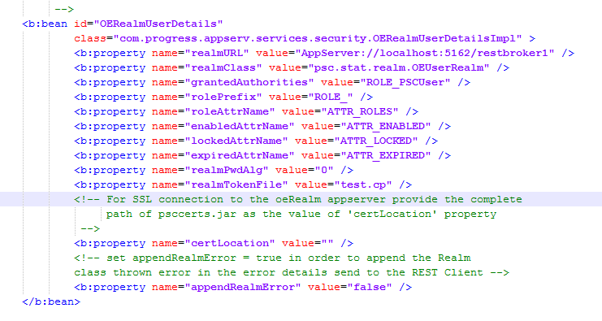
OERealmUserDetails configuration
Notes:
In the security template file you will need to find OERealmUserDetails and configure parameters that will allow Spring Security to know where the OE Realm AppServer run and to communicate and fetch account details for performing authentication.

Slide 24
OERealmUserDetails configuration
realmURL values | For OE Realm implemented on
AppServer[s]://<name-server-host>:<name-server-port>/<service-name> | remote classic AppServer using NameServer
AppServerDC[s]://<AppServer-host>:<AppServer-port>/<service-name> | remote classic AppServer using Direct Connect
http[s]://<host>[:<port>]/<aia-app-name>/aia | remote classic AppServer via AIA
http[s]://<host>[:<port>]/[oeabl-app-name/]apsv | remote PAS for OE Application Server
internal://localhost/nxgas | Local PAS for OE Application Server
realmURL values | For OE Realm implemented on
AppServer[s]://<name-server-host>:<name-server-port>/<service-name> | remote classic AppServer using NameServer
AppServerDC[s]://<AppServer-host>:<AppServer-port>/<service-name> | remote classic AppServer using Direct Connect
http[s]://<host>[:<port>]/<aia-app-name>/aia | remote classic AppServer via AIA
http[s]://<host>[:<port>]/[oeabl-app-name/]apsv | remote PAS for OE Application Server
internal://localhost/nxgas | localPAS for OE Application Server
Notes:
These are the values realmURL can take the values listed.

Slide 25
OERealmUserDetails configuration (contd…)
Spring Property | Default value | Description
realmClassName | HybridRealm | Fully qualified Name of the OO ABL Realm Server Class.
grantedAuthorities | ROLE_PSCUser | The static Spring role granted if the AppServer realm service interface does not support roles
rolePrefix | ROLE_ | The ROLE name prefix Spring uses in converting external role names into Spring usable role names
roleAttrName | ATTR_ROLE | The string name supported by the Realm service interface to return a comma separated list of role names
enabledAttrName | ATTR_ENABLED | The string name supported by the Realm service interface to return an account's enabled state
lockedAttrName | ATTR_LOCKED | The string name supported by the Realm service interface to return an account's locked state
expiredAttrName | ATTR_EXPIRED | The string name supported by the Realm service interface to return an account's expired state
realmPwdAlg | 0 | The format of the password passed to the Realm service interface for validation: "0" = clear-text; "3" = http digest
realmTokenFile | “” | When non-blank it specifies a file name holding a serialized ClientPrincipal used to authenticate to the AppServer's OERealm service interface
certLocation | “” | Certificate location for connecting to SSL enabled Realm AppServer
appendRealmErrors | false | If true, the Realm class thrown error in the error details is send to the REST Client
Notes:
Details about each parameter

Slide 26
Beware of the Spring Implementation details
Attribute Values are case sensitive
The role names returned from OE Realm Server Class must NOT contain “ROLE_” prefix
    Character getAttribute (user-id, “ATTR_ROLES”)
    {
      Return PSCUser,PSCDebug /* valid */
      Return ROLE_PSCUser,ROLE_PSCDebug /* Not valid */
    }
þ
ý

Slide 27
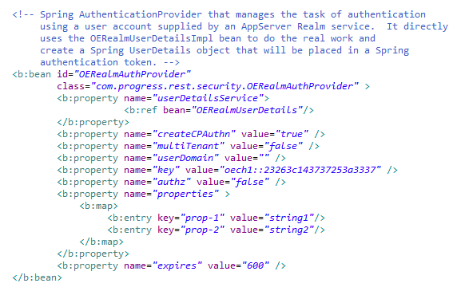
OERealmAuthProvider – Single tenant
Notes:
Once the Spring Security has granted login to the user, the call to the AppServer (where REST services’ Business Logic runs) is made. You may want to convert the user login in a Client Principal, add domain information plus some additional properties to it and then seal it and push it down to the AppServer.
For that purpose you need to configure the OERealmAuthProvider bean.
In case of single tenant, you need to provide the User Domain name and the key (domain access key)

Slide 28
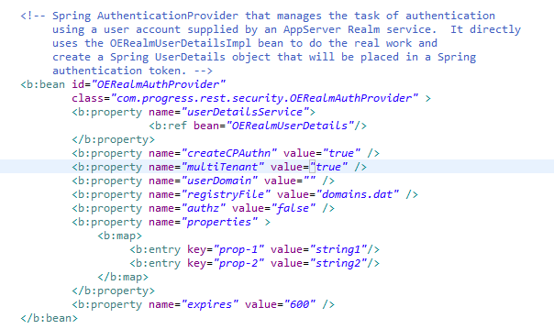


OERealmAuthProvider – Multi-tenant
Generated by gendomreg.bat | sh
Notes:
In case of multiTenant, you need to create a registryFile which is a keystore of domains, and access code and supply it in the configuration. The registryFile is produced using gendomreg utility and has to be placed in the WEB-INF/classes folder (or conf folder of PASOE)

Slide 29


Realm Client 3 : Rollbase
OE Realm
server class
User account system library
1
Request for User account
login
Authn
Process
2
3
User account details
4
OE AppServer / PAS for OE
Sealed C-P
SSO
Pre-authenticated REST Request for OE Service
5

Slide 30
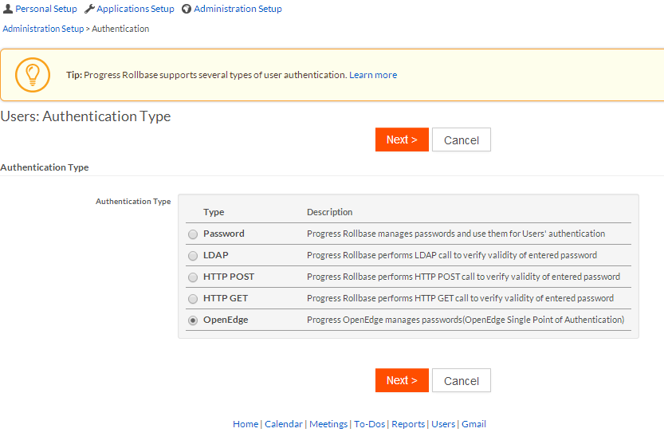
Realm Client 3: Rollbase OpenEdge Authentication Setup
Notes:
The Rollbase Admin need to chose OpenEdge as the authentication type if he has to use OERealm

Slide 31
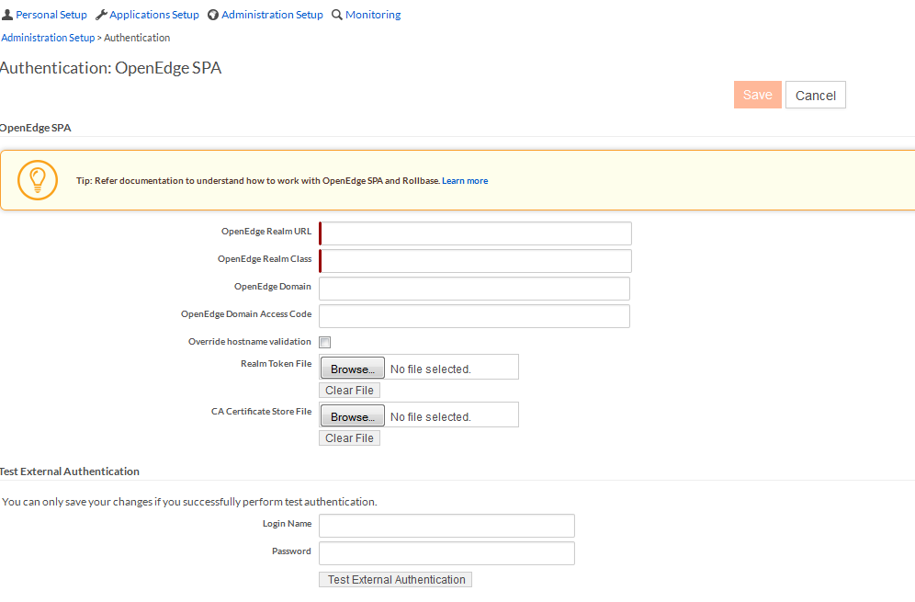
Rollbase OpenEdge Authentication Setup (contd…)
NOTE: OpenEdge Domain and Domain Access Key must be same as configured in the REST Adapter and in the registered
Domains of the AppServer running the REST business logic. ( OpenEdge allows blank Domain and blank access key. It is
recommended that you change blank access code for production)
Notes:
After that the Rollbase admin need to configure Realm Client parameters like RealmURL and class name so that Rollbase knows where the Realm classes run.
After authentication process for a user is complete, the user may want to access a REST/Mobile service using OpenEdge Service object. Since the user is authenticated, Rollbase will create a C-P belonging to the OE Domain configured and seal it by the Domain Access Code configured. This will be used as a SSO token to call a REST/Mobile services deployed on Tomcat or PAS OE.

Slide 32
REST Adapter Configuration for Rollbase SSO

Slide 33

Rollbase OpenEdge Authentication and SSO to OE REST Services
OE Realm AppServer
User account system library
OE Realm
server class
User account system library
1
Request for User account
login
Authn
Process
2
3
User account details
4
OE AppServer / PAS for OE
Sealed C-P
SSO
Pre-authenticated REST Request for OE Service
5
REST AppServer
Tomcat
Business Entity
OpenEdge DB
6
sso
Pre-auth Filter
OE Webapp
OE AppServer
Notes:
This slide shows:
Rollbase user Logs in
Rollbase seeks user details from OE Realm
Rollbase’s authn process grants login to the user
For accessing OE Service object, Rollbase creates a SSO token (Which a sealed C-P created using the details of the user login with some Rollbase specific properties added to it).
When Rollbase calls the REST service, it has a SSO token. Thus, if the REST web app has pre-auth filter enabled the REST Service only checks if the C-P is sealed by a valid key and if the user has sufficient privilege.

Slide 34
Rollbase OpenEdge Authentication and SSO to OE REST Services
OE REALM
OE Realm
server class
User account system library
User account system library
Request for User account
login
Authn
Process
User account details
Sealed C-P
OE AppServer / PAS for OE
SSO
Pre-authenticated REST Request for OE Service
OpenEdge DB
Business Entity
Pre-auth Filter
OE Web app
REST Transport
PAS for OE
Notes:
Same as last slide with REST service deployed in PAS OE instead of Tomcat

Slide 35
Rollbase SSO
Rollbase Authentication Process – Creates a Sealed C-P
Rollbase SSO
  The sealed C-P is passed to the REST service using a custom HTTP header :
  Key: “X-OE-CLIENT-CONTEXT-ID” value: “OECP <base64(C-P)> ”
REST Service
  Must have the pre-auth filter enabled
  If the C-P in the custom header is valid, only an authorization test is done
  The user is allowed access. The C-P is sent to the AppServer

Slide 36
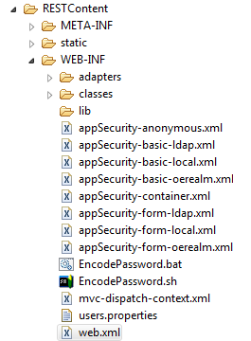
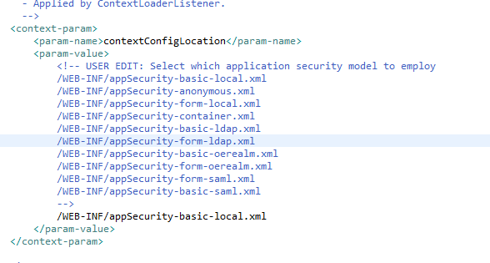
web.xml
NOTE: You don’t need to select appSecurity-xxxx-oerealm.xml. User account source doesn’t matter, so you can use any template
of your choice other than anonymous.

Slide 37
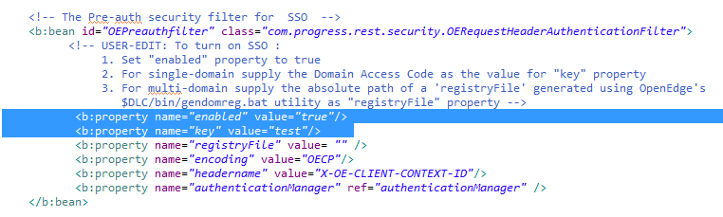
appSecurity-xxx.xml
NOTE: key is important. It must match the OpenEdge Domain Access code configured in Rollbase and that used in the registered
domains used in the AppServer.

Slide 38
Debugging the Rollbase SSO via REST Adapter
Ensure that the C-P created by Rollbase authentication process has:
  ATTR_ENABLED = true
  ATTR_LOCKED = false
  ATTR_EXPIRED = false
Ensure that the C-P has roles that match the intercept URL in the REST Adapter
<intercept-url pattern=“/rest/**” access=“hasAnyRole(‘ROLE_PSCUser’)”/ >
Increase logging level in log4j.properties for Spring Security log
Increase logging level in runtime.properties for Application log

Slide 39
OE Realm Server Class Error Handling

Slide 40
Remember – you are not in control…
OERealm clients interpret any error / exception they receive as a fatal server error
Assume any information in the error may be logged and then discarded
Best practices
  Never return an error/exception from validateUser()
  Return an exception from other methods only when
    The user-account ID does not correspond to a physical user account
    The library used to access the physical user accounts throws an exception
  Log all errors and warnings by user account name or user-account-number
  Return defined defaults for accessing user account properties when
    The account property does not exist
    The account property is defined as null / unknown

Slide 41
Security Considerations

Slide 42
OERealm Security Best Practices
Design for security at the beginning
Be paranoid when implementing
Use OS file system security to protect your OERealm ABL code modules
Use SSL/TLS for non-local network connections
Isolate the OERealm server functionality in its own AppServer ( if possible )
Authenticate and authorize each request using the OERealm client’s Client-Principal
Apply copious amounts of ABL error and exception handling

Slide 43
Debugging Tips

Slide 44
Debug the Flow
Look at the Realm Client Logs (Rollbase, BPM or REST)
Add log messages at different levels – basic, debug and trace in OE Realm Class
Use logging to track the request flow in the OE Realm:
  Did the request reach the activate procedure
  Did the request contain valid C-P ?
  Was security-policy:set-client() or set-db-client() done? Did it pass?
  Were the parameters passed correct?
  Entry /Exit points and Input / Output Parameters to OE Realm Methods
If needed, increase logging level for broker and server

Slide 45
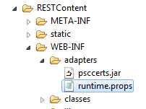
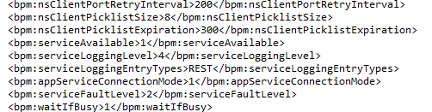
Debugging REST Service – Application Log
Look at the
WEB-INF/adapters/<AppName.log> for detailed logging

Slide 46
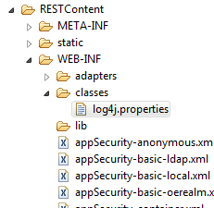
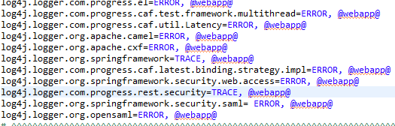
Debugging REST Service – Security and Spring Logs
Look at the
WEB-INF/adapters/<AppName.log> for detailed logging

