Slide 1
Title: Congratulations! You're Our New Progress DBA! Now What?
“Congrats!” said the boss. “You’re now the DBA.” After a congratulatory handshake, he stops as he heads out of your office. “Oh, by the way… since you’re the DBA, make sure that system stuff doesn’t bother me any more.” Great…. But now what? You know a thing or two about databases, but do you know enough? What do you need to pay attention to? What can you ignore? What should you lose sleep over, and what should make you update your resume? In this session we will show you the way through the challenges that lie in front of you and help bring peace to your weekends and evenings.
Highlights:
• How do I make a backup?
• Starting and stopping a database.
• None of my SQL knowledge works...
• After-imaging, the dba's best friend!
• About killing users...
• Where are my startup parameters and how do I change them?
o What definitely needs to be changed?
o What should I never touch?
• What can I (safely) ignore? For how long?
• When should I raise the 4-alarm fire alarm?
• Where are the log files?
• Monitoring your database.
• Where can I learn more or get help?
• It's not just a database -- there is code too!

Slide 2
Congratulations!
You’re Our New Progress DBA!
Tom Bascom, White Star Software tom@wss.com
Dan Foreman, Progress dforeman@progress.com
Gus Bjorklund, Progress gus@progress.com

Slide 3

Now What?!?

Slide 4
A Few Words about the Speakers!
Tom – 28 years in the real world
Dan – 31 years in the real world
Gus – 8 months in the real world + 27 years in the PSC Development Wizard role
  We invited him because he is always good for a insightful or incendiary comment
Notes:
I have been working with Progress since 1987
… and today I am both President of DBAppraise;
The remote database management service…
where we simplify the job of managing and monitoring the worlds best business applications;
and Vice President of White Star Software;
where we offer expert consulting services covering all aspects of Progress and OpenEdge.

Slide 5
Audience Survey
How many do at least some Progress DBA work?

Slide 6
Audience Survey
How many do at least some Progress DBA work?
How many have been doing that work for less than a year?

Slide 7
Audience Survey
How many do at least some Progress DBA work?
How many have been doing that work for less than a year?
Is anyone on a version of Progress that is a single digit number…i.e. V9, V8, etc.

Slide 8
Audience Survey
How many do at least some Progress DBA work?
How many have been doing that work for less than a year?
Is anyone on a version of Progress that is a single digit number…i.e. V9, V8, etc.
Who is on OpenEdge 10?

Slide 9
Audience Survey
How many do at least some Progress DBA work?
How many have been doing that work for less than a year?
Is anyone on a version of Progress that is a single digit number…i.e. V9, V8, etc.
Who is on OpenEdge 10?
How about 11.x?

Slide 10
The Documentation

Slide 11
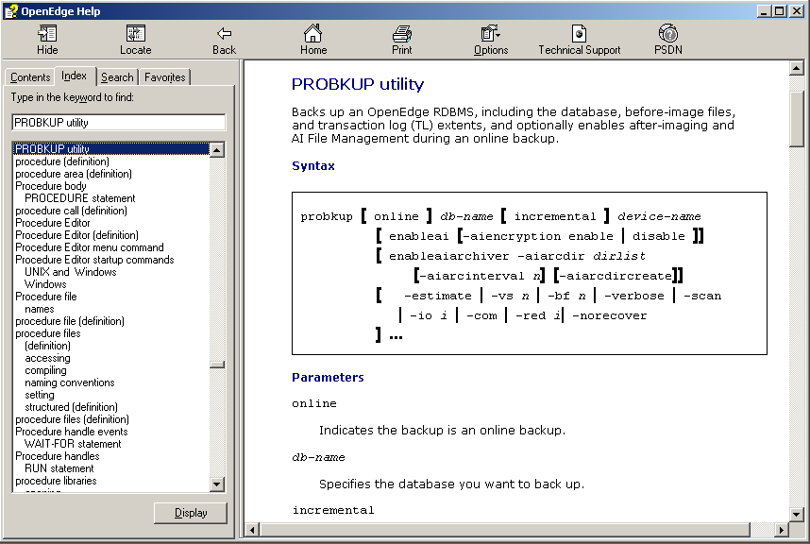
The Documentation
Online Manuals:
http://www.progress.com/support-and-services/support-services/Support%20Guide
Knowledgebase:
http://knowledgebase.progress.com/
Start ->
OpenEdge ->
Help ->

Slide 12
The Environment

Slide 13
PROENV
Provides a command line environment that is properly configured to run all administrative commands.
  DLC & WRKDIR environment variables will be set.
  PATH will include $DLC/bin and other useful bits.

Slide 14
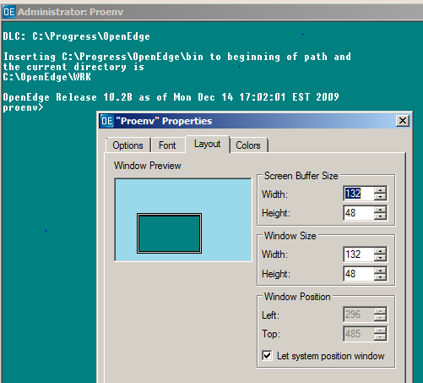
PROENV
Pro Tip! If you are running on Windows make sure to adjust the width and height of the proenv window!
The default is 300 lines by 24 columns – and that does not work well for anyone.

Slide 15
Starting a Database

Slide 16
Starting a Database
PROSERVE
DBMAN
Exploder

Slide 17
PROSERVE
Pro
Con
Command Line
Easy to Script
Lots of Control
Repeatable
Sequence of actions is guaranteed
Command Line
Must Provide Details like “dbname”
Dinosaur stigma
$ proserve dbname –n 500 –spin 3149 –B 1000000 –L 50000
$ probiw dbname
$ proaiw dbname
$ prowdog dbname
$ proapw dbname

Slide 18
DBMAN
Pro
Con
Command Line
Works with conmgr.properties
Easy to Script
Starts Writers & Watchdog
Avoids Windows “user logout closes background windows” issue.
Command Line
Uses conmgr.properties
Admin Server must be running
Order of operations is not controllable.
Uses Java
proenv> dbman dbName -start

Slide 19
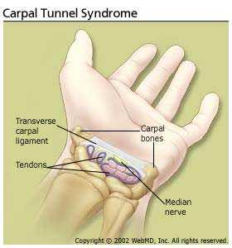
Exploder
Pro
Con
Exercises Health Care Benefits
Graphical Interface
Requires Admin Server
Requires conmgr.properties
Ugly
Confusing
Incomplete
Unreliable (Java)
But if you like that sort of thing…

Slide 20
Exploder Pro Tip
Always make sure that the admin server is running before deciding that Exploder (or dbman) isn’t working properly!
proenv>proadsv -query
OpenEdge Release 10.2B as of Mon Dec 14 17:02:01 EST 2009
AdminServer is alive. (8545)
proenv>

Slide 21
Stopping a Database

Slide 22
Stopping a Database
PROSHUT
DBMAN
Exploder
$ proshut -by sports2000
Shutdown is executing. (1613)
Shutdown complete. (1614)

Slide 23
Stopping a Database
PROSHUT
DBMAN
Exploder
Delete the .lk file…
Kill -9
Reboot server…
Trip over plug…

Slide 24


Slide 25
Stopping a Database
PROSHUT
DBMAN
Exploder
Delete the .lk file…
Kill -9
Reboot server…
Trip over plug…
On the bright side Progress crash recovery works very, very well – none of the above will corrupt an OpenEdge database. (Do NOT, however, try these techniques with certain other big name databases…)

Slide 26
PROSHUT
Pro
Con
Command Line
Easy to Script
Lots of Control
Fast
What’s a Command Line?
$ proshut –by dbname

Slide 27
DBMAN
Pro
Con
Command Line
Works with conmgr.properties
Easy to Script
Command Line
Uses conmgr.properties
Admin Server must be running
$ dbman dbName -stop

Slide 28
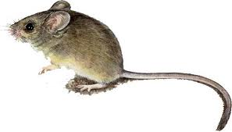
Exploder
Pro
Con
Graphical Interface
Requires Admin Server
Requires conmgr.properties
Ugly, Confusing, Incomplete
Unreliable
Cannot control sequence
Easy to shutdown the wrong db

Slide 29
How Do I Make a
Backup?

Slide 30
How Do I Make a Backup?
PROBKUP – the preferred method endorsed by experienced Progress DBAs everywhere.
Methods used by Future Job-Seekers:
  Disk Mirroring
  OS Backup
  3rd Party Tools
  VM or SAN “snapshots”

Slide 31
PROBKUP
Knows where all of the parts of the database are (even the parts in memory or in unusual disk locations).
Can be executed with the database online.
Can skip empty space in the db.
Can be used to change “physical” DB Structure (extent size & location)
Can turn on after-imaging online if you forget!
$ probkup online dbname dbname.pbk -com

Slide 32
“All The Parts of the DB”
# sports.st
#
b /bi/sports.b1
#
d "Schema Area":6,32;1 /db/sports.d1
d "Info Area":7,32;1 /db/sports_7.d1
d "Customer/Order Area":8,32;8 /db/sports_8.d1
d "Primary Index Area":9,1;8 /db/sports_9.d1
d "Customer Index Area":10,1;64 /db2/sports_10.d1
d "Order Index Area":11,32;64 /db/sports_11.d1
#
a /ai/sports.a1
a /ai/sports.a2
a /ai/sports.a3
a /ai/sports.a4

Slide 33
OS Backup & 3rd Party Tools
The database must be offline or in a “quiescent state”.
You are responsible for making certain of the above.
You must also ensure that all parts of the database are included in the backup.

Slide 34
VM or SAN “Snapshots”
The snapshot must be a consistent, point in time image of the entire database.
The database will be in a crashed state when recovered.
Not all snapshot products are created equally!
Progress has tested and certified EMC’s SRDF.
Users report success with VMWare’s Vmotion (but beware of possible performance issues).

Slide 35
Other Stuff to Backup
$DLC/properties
DB Log Files
Structure (.st) Files
Parameter (.pf) Files
$DLC/startup.pf
repl.properties etc.
$DLC/certs

Slide 36
None of My
SQL
Knowledge Works

Slide 37


Slide 38
None of My SQL Works!?!
Progress is NOT SQL.
Period. Full Stop. End of Story.
Thinking about Progress like SQL will only lead to pain and agony.

Slide 39
4gl vs SQL
There are 2 “languages” – 4gl and SQL-92 that share a common “storage engine”.
The storage engine is what DBAs manage.
Virtually all Progress applications are written with the 4gl.
SQL is used almost exclusively for external reporting or data extracts.
The languages are not aware of each other.
  Triggers and stored procedures in one language are not known to triggers in the other!

Slide 40
SQL-89
The 4GL language has some very old and very limited SQL-89 syntax embedded in it.
This permits trivial ad-hoc queries within a 4gl session such as:
select count(*) from customer.
This makes a good demo.
Attempting to use the embedded SQL-89 in application code will only lead to pain, suffering and agony. Do not go there. You have been warned.

Slide 41
Progress is NOT SQL! Progress is much better than that.
The 4GL language does not respect “field width” – all data is variable width.
A field format is just a default suggestion used when the programmer provides no other input or display format – it is not a constraint.
For instance a character field defined as “x(30)” might be “overstuffed” with a string of length 2,000.
This is normal and very common practice within 4gl applications. It is not an error.

Slide 42
DBTOOL
http://knowledgebase.progress.com/articles/Article/P24496
$ dbtool sports
DATABASE TOOLS MENU - 10.2B
-------------------------------------------
1. SQL Width & Date Scan w/Report Option
2. SQL Width Scan w/Fix Option
3. Record Validation
4. Record Version Validation
5. Read or Validate Database Block(s)
6. Record Fixup
7. Schema Validation
9. Enable/Disable File Logging
Q. Quit
Choice:

Slide 43
SQL-92 Interface
SQLEXP
ODBC/JDBC
DBTOOL
UPDATE STATISTICS
SQLDUMP

Slide 44
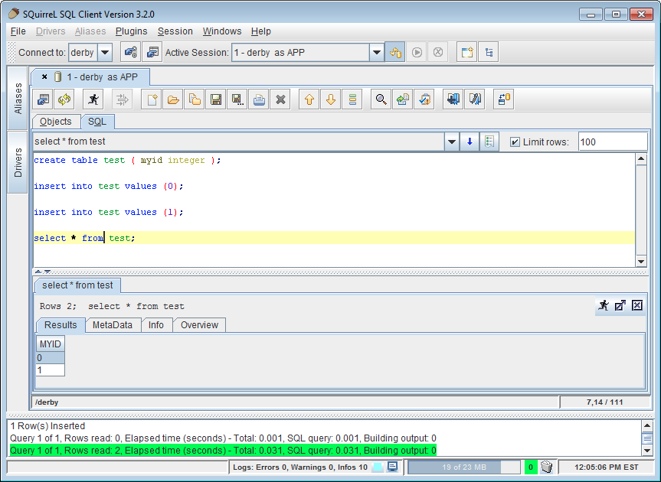
ODBC/JDBC

Slide 45
SQLEXP
$DLC/bin/sqlexp -user userName -password passWord \
-db dnName -S servicePort \
–infile script.sql –outfile sqlexp.log
Run SQL scripts
GRANT and REVOKE perms (save the scripts because the SQL permissions are not included in a dump & load!)

Slide 46
UPDATE STATISTICS
/* genUpdateSQL.p
*
* mpro dbName –p genUpdateSQL.p -param ”updSQLstats.sql"
*
* sqlexp -user userName -password passWord \
* -db dnName -S servicePort \
* -infile updSQLstats.sql –outfile updSQLtats.log */
output to value("updSQLstats.sql" ).
for each _file no-lock where _hidden = no:
put unformatted
"UPDATE TABLE STATISTICS AND INDEX STATISTICS AND ”
“ALL COLUMN STATISTICS FOR PUB."
'"' _file._file-name '"' ";"
skip
"commit work;”
skip.
end.
output close.

Slide 47
A Few Words About “killing”
Users

Slide 48

About “killing” Users…
If you are on UNIX:
  “kill -9” is dangerous! You will crash the database!
  “kill -9” does not “always work”
  “kill -1” (“hangup”) is safe and
  effective
  proshut dbname –C disconnect usr#

Slide 49
About “killing” Users…
If you are on Windows:
  We’re sorry ☹
  Task Manager “end task” is equivalent to kill -9.
  Logging out can terminate all of your background windows – including “scheduled tasks”. Which will act like a kill -9.

Slide 50
After-Imaging
The DBA’s Best Friend

Slide 51
After-Imaging
Roll-forward recovery.
A journal of transaction “notes” that can be replayed against a baseline backup to restore a database to the last completed transaction or a point in time or a specific transaction number.
This is the same concept that some other databases refer to as the “redo log”.

Slide 52
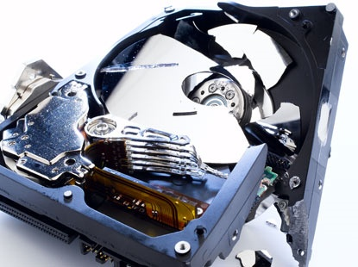
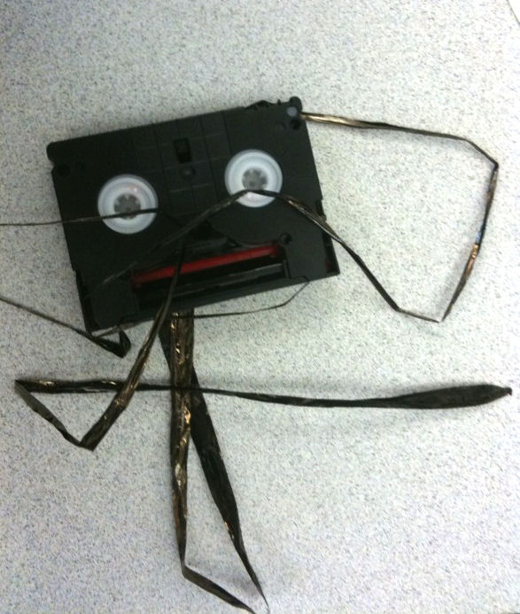
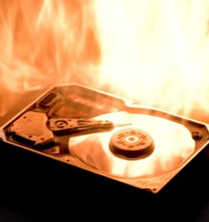
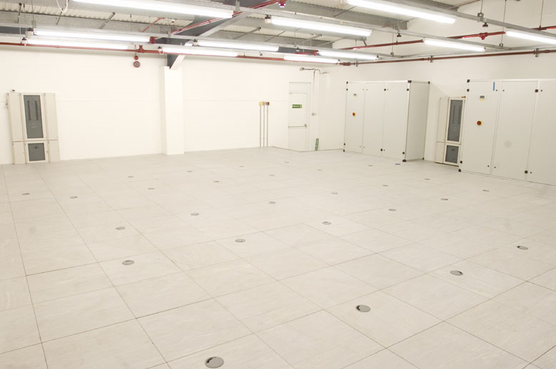
Why do I need after-imaging?
Protection from media loss -- such as bad tapes, a crashed disk, a destroyed data center or stolen servers…
Notes:
Theft of servers from data centers really happens.
So do lots of other bad things.

Slide 53



Why else do I need after-imaging?
Protection from human errors:
Human error is at least as big a risk as hardware problems.
$ cd /db
$ rm *
for each order:
delivered = yes.
end.
for each customer:
delete customer.
end.
$ vi dbname.db
…
:x
Notes:
Some humans are bigger errors than others ;)

Slide 54
After-Imaging Best Practices
Enable after-imaging on all updateable databases.
Place after-image extents on separate disks from data extents.
Use 8 to 16 variable extents with “large files” enabled (more for OER).
Run an AIW.
Switch extents as often as the business needs you to.
Use the sequence number when naming archived logs.
Copy archived logs to an external location ASAP.
Verify your process by continuously rolling forward.
Monitor both your “empty” and “full” extents.
Keep at least 30+ days of archived after-image logs.
Establish dedicated backup and recovery filesystems.

Slide 55
Startup Parameters

Slide 56
Where to Find Them?
On the command line.
In a script.
In “.pf” files.
In $DLC/properties/conmgr.properties ☹
Verify by examining the “dbname.lg” file.
  Search for “(333)” and examine the next 50-75 lines…

Slide 57
Startup Parameters
Which ones should be changed?
Which ones should be left alone!
Which ones are crucial?
338: Top Performance Destroyers and Enhancers in Progress
Dan Foreman
Progress Software
This Morning ☹

Slide 58
Tune in Tomorrow Morning!
Which ones should be changed?
Which ones should be left alone!
Which ones are crucial?
229: The Secrets Behind DB Start-up Parameters
Paul Koufalis
White Star Software
Tuesday, June 9 at 8:30am

Slide 59
Important Configuration Options

Slide 60
Important Configuration Options
BI Cluster Size
Block Sizes
Storage Areas
Rows Per Block

Slide 61
BI Cluster Size
The Default varies with release, 512KB is current.
For “Workgroup” Licenses smaller is better.
  More, but smaller, delays.
For “Enterprise” Licenses bigger is better.
  May increase crash recovery time a bit.
  But reduces the risk of painful delays during heavy processing.
  32768 KB is “a good start”.
proutil dbname –C truncate bi –bi 32768

Slide 62
Block Sizes
DB Block (Must Dump & Load to Change)
  4KB or 8KB
  NOT 1KB or 2KB
BI Block
  16KB
  proutil dbname –C truncate bi –biblocksize 16
AI Block
  16KB
  rfutil dbname –C aimage truncate –ai 16
  AI must be disabled so do it ‘early’

Slide 63
Storage Areas
Type 2 storage areas are the foundation for all advanced features of the OpenEdge database.
Type 2 areas have cluster sizes of 8, 64 or 512.
Data blocks in Type 2 areas contain data from just one table.
Use Many (Type 2) Storage Areas (and never use Type 1 Areas).
Do NOT assign tables to areas based on “function”.
Instead group objects by common “technical attributes” (Rows Per Block, size, activity level).
Put Large Objects (LOBs) in separate Areas.
Do NOT store data, indexes or LOBs in the “Schema Area”.

Slide 64



20 slides to go!

Slide 65
Where Are the Log Files?

Slide 66
Where are the log files?
dbname.lg
Admin Server:
  $WRKDIR/admserv.log
App Servers:
  $WRKDIR/appsrv.broker.log
  $WRKDIR/appsrv.server.log
  Location of $WRKDIR can be found in $DLC/bin/proenv
OS Logs
  /var/log, /usr/adm

Slide 67
Monitoring

Slide 68
Monitoring
What to ignore.
What to pay attention to.
What to panic over…
What not to miss!

Slide 69
What to Ignore
(452) Login by root on /dev/pts/6.
(453) Logout by root on /dev/pts/6.
(708) Userid is now tom.
(8873) Login usernum 2547, remote SQL client.
(14658) Previous message sent on behalf of user 2542, server pid 22516, broker pid 5778.
(12699) Database xyz Options:
And a few squillion more “noise” messages…
Msg Type Client Type
| |
Date Time Process-Id v v Usr# Msg# Message Text
------------------------------------------------------------------------------------------------
[2014/08/23@09:34:36.572-0400] P-336 T-1240798976 I ABL 5: (452) Login by tom on /dev/pts/1.
[2014/10/24@13:07:54.129-0400] P-11073 T-1226471168 I ABL : (334) Single-user session end.

Slide 70
What to Pay Attention To
(2248) Begin normal shutdown
(2249) Begin ABNORMAL shutdown
(542) Server shutdown started by root on /dev/pts/6.
(5292) SYSTEM ERROR: The broker is exiting unexpectedly, beginning Abnormal Shutdown.
(1384) The database is being shutdown.
(915) Lock table overflow, increase -L on server
(1081) Too many users requested semaphore undo, increase SEMMNU.
SYSTEM ERROR: Too many subprocesses, cannot fork. Errno=12.
Note: not a comprehensive list or errors but you get the idea
Note2: not all SYSTEM ERRORs are worth getting out of bed for

Slide 71
What to Pay Attention To
Buffer Cache Hit (or Miss) Ratio
Insanely high DB Requests
Buffers Flushed
AI & BI Empty Buffer Waits
Latch Timeouts
Record Lock Waits

Slide 72
What to Pay Attention To #2
Before Image Size
Long Running Transactions

Slide 73
What to Panic Over!
(37) Your database was damaged. Dump its data and reload it.
(43) Cannot find or open file <filename>, errno = <number>.
(1124) SYSTEM ERROR: Wrong dbkey in block. Found 5512, should be 1458 in area 15.
(886) The database was last used <date/time>.
(887) The before-image file expected <date/time>.
(888) Those dates don't match, so you have the wrong copy of one of them.
SYSTEM ERROR: …

Slide 74
What Not To Miss
(1362) Full backup started.
(1364) Full backup successfully completed.
(7129) Usr 61 set name to Aimage full.
(3778) This is after-image file number 270 since the last AIMAGE BEGIN
(3777) Switched to ai extent /ai/sports.a4.
The lack of these messages means that backups are not executing.
Or that after-imaging is not functioning.

Slide 75
Monitoring Tools & Services
PROMON (free, included)
ProTop (free!)
138: Monitoring OpenEdge with ProTop
Tuesday 2:15pm
Roll your own with Virtual System Tables
OE Management (“Fathom Management”)
Progress Managed DBA
DBAppraise

Slide 76
It’s Not “just” a Database

Slide 77
It’s Not “Just” a Database
Any Amount of Tuning can always be defeated by lousy code.

Slide 78
The performance enhancement possible with a given improvement is limited by the fraction of the execution time that the improved feature is used.
-- Amdahl’s Law

Slide 79
Users!
Sometimes you need to know what they are doing:
  UNIX: kill –USR1 <pid>
  Windows: %DLC%\bin\proGetStack <pid>
Must own the process or be root/administrator
Creates a protrace.<PID> in working directory
The protrace contains a 4gl stack trace!

Slide 80
protrace.<PID>
PROGRESS stack trace as of Tue Dec 4 11:28:00 2012
Command line arguments are
/progress/dlc/bin/_progres -p mls.p -pf /los_prod/develop.pf -T /dbtmp
Startup parameters:
-pf /progress/dlc/startup.pf,-T /dbtmp,-clientlog /los_logs/debug/client_f474458_20121204_112720_45302816.log
... (snip)
+++PARALLEL TOOLS CONSORTIUM LIGHTWEIGHT COREFILE FORMAT version 1.0
... (snip)
** 4GL Stack Trace **
--> obj/mnu/menu (/los_prod/obj/mnu/menu.r) at line 416
obj/src/startup (/los_prod/obj/src/startup.r) at line 2042
mls.p (/los_prod/mls.r) at line 26
** Persistent procedures/Classes **
Handle File Name
001010 /los_prod/obj/tools/proclib.r
000000 /los_prod/config.r (STATIC)
001000 /los_prod/obj/prt/genBarcode.r

Slide 81
Storage
RAID 5 is EVIL!
So are the variants spawned from it:
  RAID 6
  RAID DP (Double Parity or Definitely Putrid)
  Et al – Parity based RAID provides a Parody of Performance (all RAID other than RAID 10 is parity based).
NAS <> SAN
If at all possible avoid NetApp
SANs exist to make life easy for storage admins – they are not there to make your database run faster.

Slide 82
Where Can I Find More Help?

Slide 83
Where Can I Find Help?
Local PUG Meetings!
PUG Challenge:
    Americas – Usually in June
    EMEA – November 4-6, Copenhagen Denmark
Progress Software:
  Documentation:
  https://community.progress.com/technicalusers/w/openedgegeneral/1329.openedge-product-documentation-overview.aspx
  Knowledgebase: http://knowledgebase.progress.com
  “Communities”: http://communities.progress.com
PEG, Progress E-Mail Group – http://peg.com
ProgressTalk – http://progresstalk.com
Refrigerator magnet with Tom or Dan’s contact info
Stack Overflow – http://stackoverflow.com/questions/tagged/progress-4gl

Slide 84
Stuff we won’t have time to get to but want to list
Separate Login Brokers for SQL & 4GL Remote Clients
Non-overlapping Minport & Maxport
Set the Max Servers (-Mn) always larger than you need
Always set –tablerangesize & -indexrangesize

Slide 85
Questions?
Notes:
And now we have some time for questions…

Slide 86
Thank You!

