Slide 1
138: Monitoring OpenEdge with ProTop
The ProTop 3 web browser client is a powerful new tool in every DBA's arsenal.
ProTop is a free, Open Source database monitor for Progress OpenEdge databases. ProTop sorts, filters and groups realtime VST data into insightful analysis screens that help to keep your database and application performance in tip top shape. This session will examine ProTop's "out of the box" capabilities. We'll learn how to approach common monitoring problems through live demonstrations and explain how to get started on the road to proactively managing your database and application.

Slide 3

Open Source Monitoring For Your
Progress OpenEdge
Database

Slide 4
A Few Words About The Speaker
Tom Bascom, Roaming DBA & Progress User since 1987
President, DBAppraise, LLC
  Remote Database Management Service.
  Simplifying the job of Managing and Monitoring the world’s best business applications.
  tom@dbappraise.com
VP, White Star Software, LLC
  Expert Consulting Services related to all aspects of Progress and OpenEdge.
  tom@wss.com

Slide 5
What Is It?
What Is It Good For?
How Do I Use It?
How To Install?

Slide 6
What is It?
An Interactive Monitoring Program for Your OpenEdge Database
A hybrid of PROMON and the UNIX “top” monitor.
Based on Virtual System Tables…
… plus some meta-schema and OS bits.
Open Source!
Free!

Slide 7
ProTop Flavors
ProTop xxi – v9, OE10+ Character client only.
  Still works with version 11+
  Limited support for “new stuff”.
ProTop 2.0 – 10.2A, .NET GUI
  Pretty.
  But impossible to maintain and ship.
ProTop 3.x – 10.1C+, ChUI, Browser
  Much better separation of UI and Logic.

Slide 8
New Features!
All new look & feel!
  Character client *requires* 132 columns & 48 rows.
  Web client
  Browser client
“Data Collectors” can communicate with clients via:
  Shared Memory (character only)
  REST
An actual install script!
Windows MSI Installer.

Slide 9
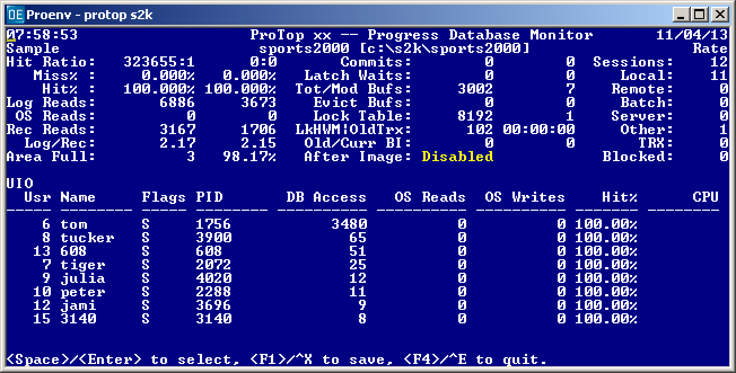
ProTop xxi

Slide 10
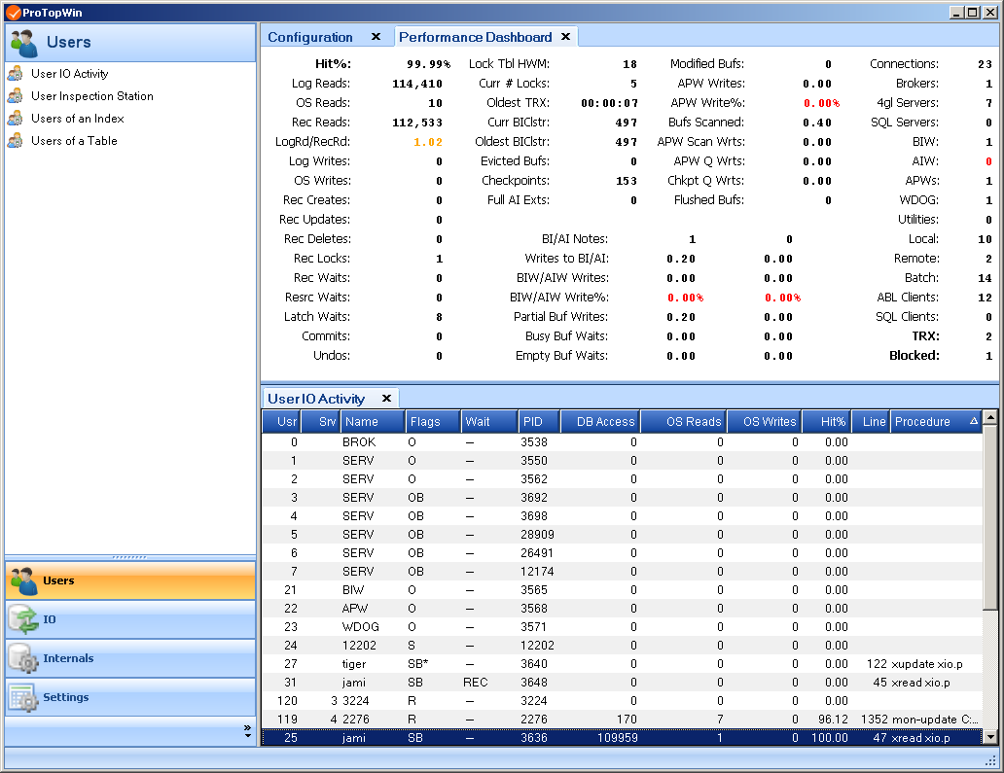
ProTop 2

Slide 11
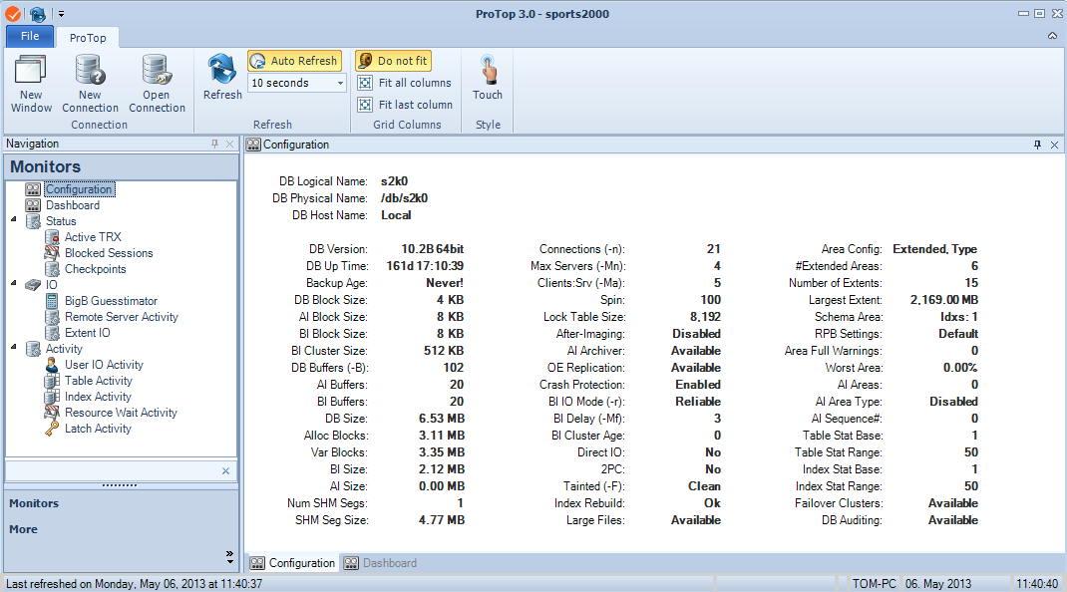
ProTop 3 – Web Client

Slide 12
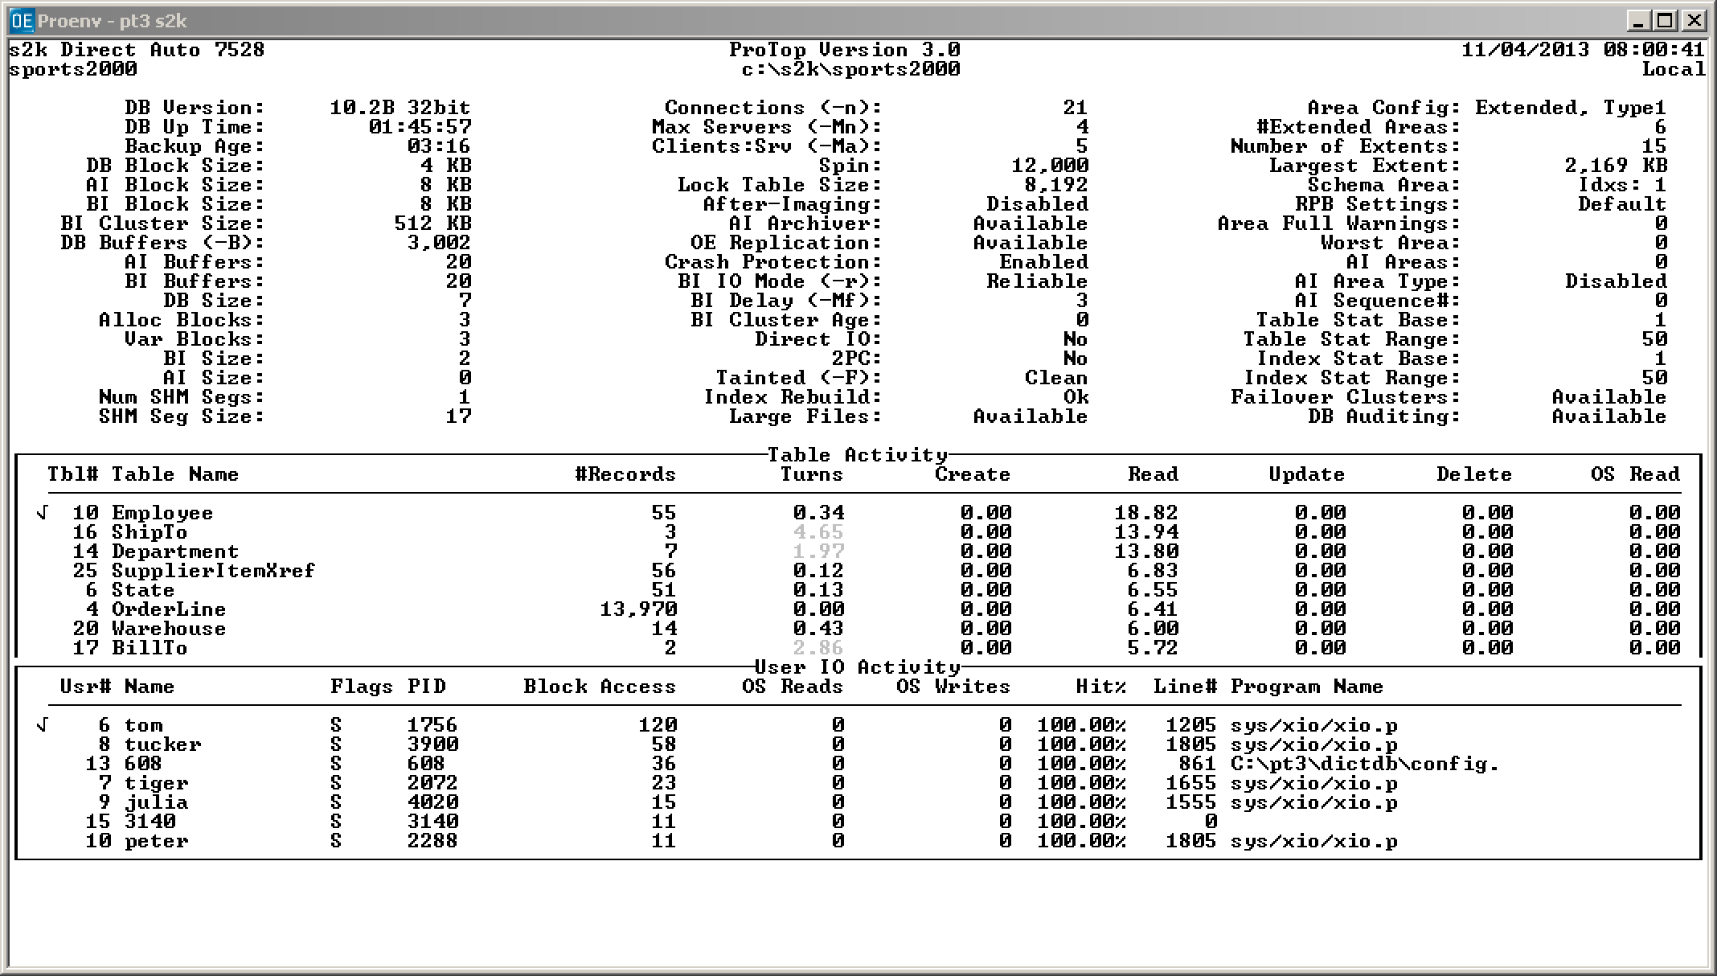
ProTop 3 – Character

Slide 13
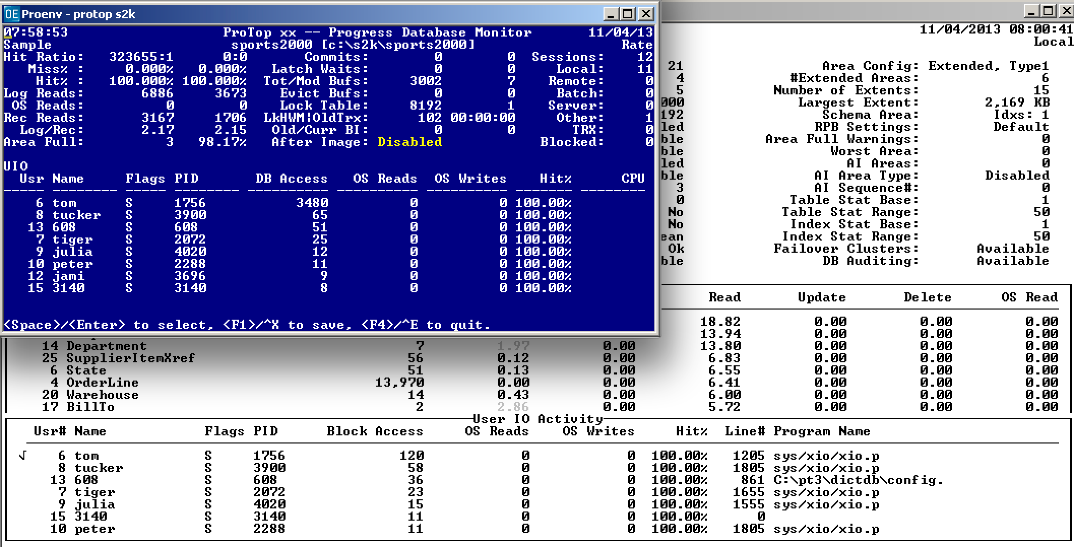
ProTop 3 – Character

Slide 14
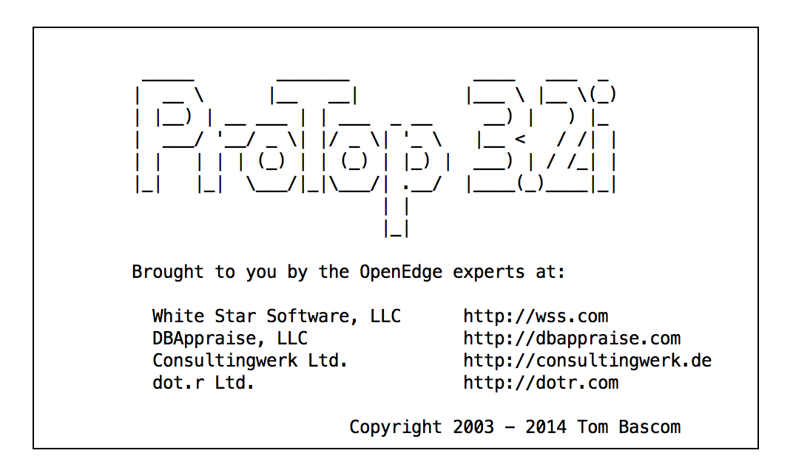
New Logo!

Slide 15

New Logo!

Slide 16
What Is It Good For?
Checking Your Configuration
Development and Testing
  Comparing Theory to Reality
Identifying Performance Problem Areas
Correlating Scattered Metrics
Finding Trends
Drilling Down
Studying VST focused 4GL Coding Techniques

Slide 17
How Do I Use It?

Slide 18
How Do I Use It?
Demo!

Slide 20
How To Install?
Download from dbappraise.com/protop.html
  Choose the flavor that you need
Follow the instructions carefully ☺
Send questions to:
adam@wss.com

Slide 21
How To Install?
Download from dbappraise.com/protop.html
  Choose the flavor that you need
Follow the instructions carefully ☺
Send questions that you want answered to:
tom@wss.com

Slide 22
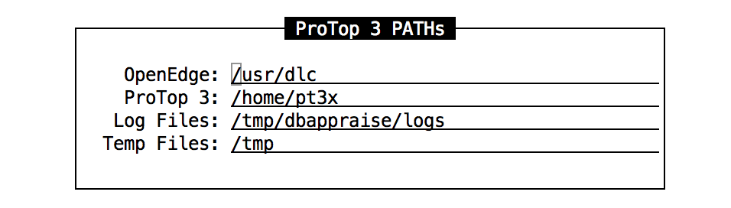
How To Install?
proenv> gunzip pt3*.tar.gz
proenv> tar xvf pt3*.tar
proenv> ./pt3inst.sh
proenv> \pt3inst.bat

Slide 23
How To Configure?
Create etc/dbname.pf for each database you would like to monitor:
# etc/dbname.pf
#
-db /path/dbname

Slide 24
{inc/disclaimer.i}
Your mileage will vary.
Remember what you paid for it ;)
Notes:
“liters per 100km”

Slide 25
Questions?

Slide 26
Suggestions/
Enhancement Requests?

Slide 27
Thank You!

