Slide 1
How I Stopped Using Shared Variables and Learned to Love OO
Abstract: The use, and abuse, of shared variables has been with us since version 3 of the 4GL. For many years programmers have been hearing stern warnings that shared variables are evil and that they should not be used. We will discuss why that is so and, more importantly, exactly what you can actually do about it and why a modern OO approach is not only "better" but simpler to code and how it fits in right alongside your old legacy code starting you down the path to a bright new future.
This isn't just some theoretical "clean sheet of paper" recommendation -- this is actual code that you can really use right now in your existing applications.
We will also show how the basic approach that supports replacing simple shared variables can be painlessly extended to support complex data and configuration that previously was usually implemented by way of database record lookups. By encapsulating and abstracting this logic you can take concrete steps towards moving a legacy application to a modern footing!

Slide 2
How I Stopped Using Shared Variables and Learned to Love OO
Actual Code That You Can
Use Right Now
Tom Bascom, White Star Software
tom@wss.com

Slide 3
A Few Words about the Speaker
Tom Bascom; Progress user & roaming DBA since 1987
VP, White Star Software, LLC
  Expert consulting services related to all aspects of Progress and OpenEdge.
  tom@wss.com
President, DBAppraise, LLC
  Remote database management service for OpenEdge.
  Simplifying the job of managing and monitoring the world’s best business applications.
  tom@dbappraise.com
Notes:
I have been working with Progress since 1987
… and today I am both President of DBAppraise;
The remote database management service…
where we simplify the job of managing and monitoring the worlds best business applications;
and Vice President of White Star Software;
where we offer expert consulting services covering all aspects of Progress and OpenEdge.

Slide 4


Slide 5
Audience Survey
Who has a legacy application?
  What version of Progress originally?
  What version is it currently deployed on?
  Does it use shared variables?
  Was it your idea? Or did you inherit it?
Who is currently using the OO4GL?

Slide 6
Shared Variables
Widely used “worst practice” in many legacy applications.
Plain old “shared” vs “global shared”:
Every “new” of a plain “shared” variable creates a new copy – so you need to be aware of the stack.
  If you are depending on that you’re begging for trouble.
There is only ever one copy of a “global”, a redundant “new global” does not re-initialize and can always be used safely.
/* define.p */
define new shared variable xyzzy as integer no-undo.
define new global shared variable pflugh as integer no-undo.
/* use.p */
define shared variable xyzzy as integer no-undo.
Notes:
“New global” is optional if someone already created it – but if you are unsure it does no harm.
“define shared variable xyzzy as integer no-undo.“ will work in a calling program for either a “shared” or a “global shared” – there is no way to know which it is though.
If you are using “shared” rather than “global” and that business with the stack is meaningful you’re in trouble…

Slide 7
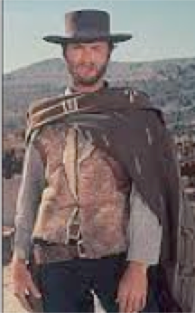
The Good
Compact and simple syntax.
Allows data sharing between
procedures!
  Parameter passing came with v6 in 1989.
Gets you around the 63k r-code limit!
  Remained problematic until v9 (longer for some people).
Avoids long lists of mostly unused parameters being passed as arguments.
  Passing temp-tables, XML and now JSON have helped with that problem. Passing objects is allowed too.
Notes:
Used sparingly, for instance -- behind the scenes in framework code, they can be useful…
Before parameter passing they were the only practical way for procedures to communicate.

Slide 8
The Good
Compact and simple syntax.
Notes:
Used sparingly, for instance -- behind the scenes in framework code, they can be useful…
Before parameter passing they were the only practical way for procedures to communicate.

Slide 9

The Bad
Conflict in extent, datatype or undo
status for global xyzzy. (390)
Shared variable pflugh has not yet
been created. (392)
Thus often defined within include files:
Include files are a “worst practices” talk for another time…
define {1} variable xyzzy as integer no-undo.
define {1} variable pflugh as integer no-undo.
Notes:
Tight coupling, contract violations.
Hard to track down references and side-effects.

Slide 10
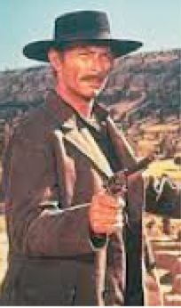
The Ugly
Undocumented Interfaces
“Tight Coupling” – modules are
dependent on each other’s internals.
No input/output control like with
parameters.
Undesired side effects from global scope.
Unit testing is “challenging”.
Ridicule from your peers.
Notes:
Rigid – definitions must match in all modules – thus often implemented with include files, “Conflict in extent, datatype or undo status for global xyzzy. (390)”
Ugly error message at runtime when they do not match. “Shared variable xyzzy has not yet been created. (392)”
The multi-layered “shared” problem.
Unexpected side-effects.

Slide 11
legacy.p
/* src/legacy.p
*/
{inc/common.i “new global”}
/*** snip happens… ***/
find customer no-lock where custNum = cNum no-error.
/*** more snip happens… ***/

Slide 12
legacy.p
/* src/legacy.p
*/
{inc/common.i “new global”}
/*** snip happens… ***/
find customer no-lock where custNum = cNum no-error.
/*** more snip happens… ***/
No parameters!
Lots of things that (probably) aren’t used!
Hidden coupling to other programs!

Slide 13
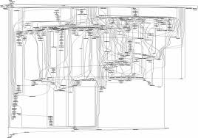
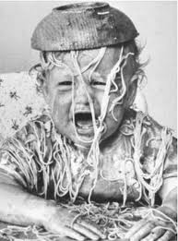
A Maze of Twisty Passages…
Notes:
Yes, it hurts my eyes just to look at it…
Appropriately enough – “The Good, The Bad and The Ugly” was a “Spaghetti Western”

Slide 14
Along Came
OO4GL…

Slide 15
General OO Myths
You have to rewrite to "pure” OO.
OO is the grand ultimate solution.
With OO your application is more flexible.
OO is more productive.
OO is more understandable.
With OO, modeling “the real world” is easier.

Slide 16
Bullspit!
Search and replace “OO” with anything that has been popular in programming circles in the last 50 years and that list looks awfully familiar.
None of those technologies delivered...
Technology is a tool. The quality of results depends on the person using the tool.

Slide 17
OpenEdge OO Myths
Progress doesn’t support “true” OO
OO is just for GUI
Procedural code and OO code do not mix
Progress is done with adding OO features
Objects and Relational Databases don’t mix
My application was written back when v4 was exciting – OO features don’t apply to me ☹
Notes:
Whenever you hear “true” you know that you are dealing with a zealot… just nod sagely and move on.

Slide 18
OpenEdge OO Facts
Progress started rolling out the OO4gl in version 10.1A – circa 2005. Advancement has been quite rapid and still continues!
  What's New in the ABL in Progress OpenEdge Release 11
OO works quite well with GUI, ChUI, WUI and BUI… and you can mix it into “procedural” code too.
I’m here to talk about your v4 app ☺

Slide 19
bar.cls
Place in a directory called “foo”…
“compile foo/bar.cls save” results in foo/bar.r
/* foo/bar.cls
*/
class foo.bar: /* foo.bar => foo/bar.cls */
define public property drink as character no-undo get . set .
method public void orderDrink():
message drink "please!".
end method.
end class.

Slide 20
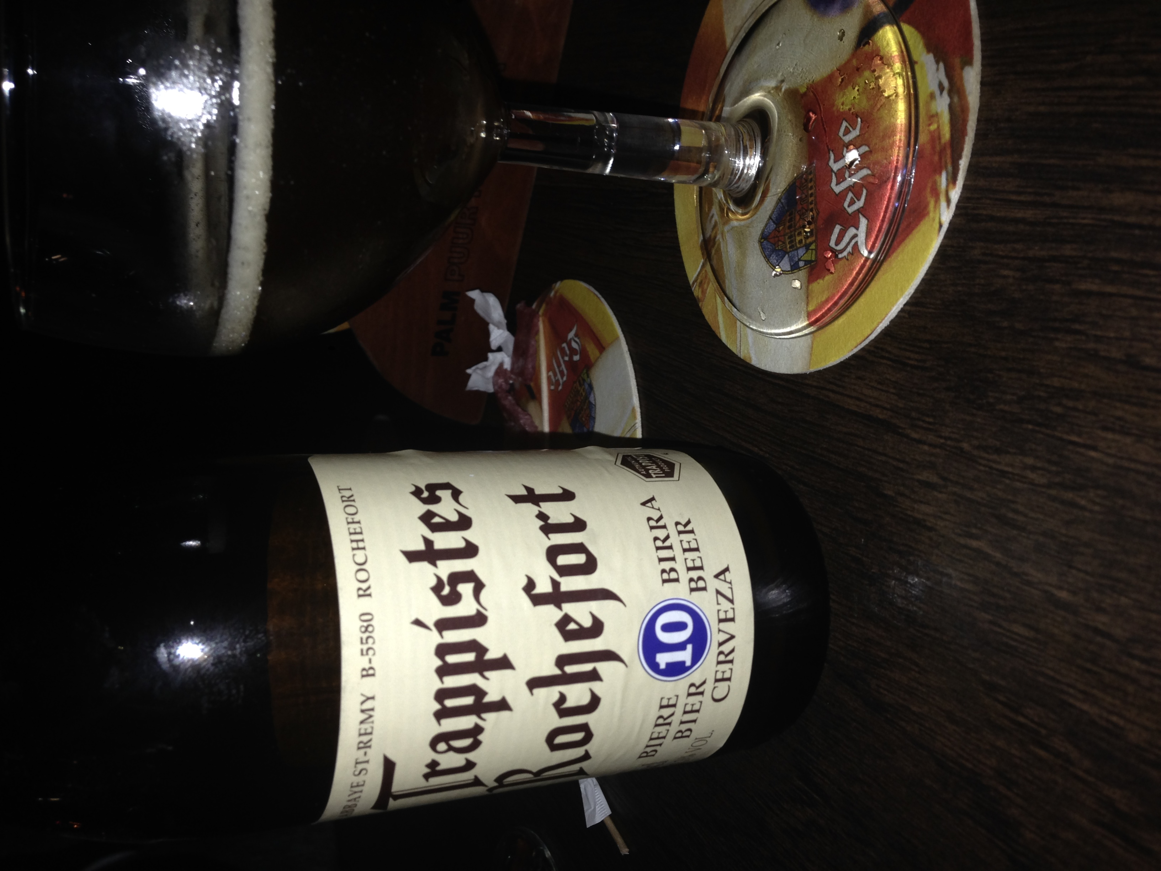
order.p
/* order.p
*/
using foo.*.
define variable myBar as bar no-undo.
myBar = new bar().
myBar:drink = "Beer".
myBar:orderDrink().

Slide 21
Shared Variables vs. Objects
Shared Variables:
  Shared variable consistency is checked at run time.
  Shared variable definitions have to match everywhere.
  Which encourages include files ☹
Objects have:
  Compile time type checking.
  Encapsulation (no include files!)
  Single Implementation.
  Control privacy, protection & security (unplanned writes & side effects).

Slide 22
Singletons
and
Statics

Slide 23
What is a “Singleton”?
Something that there is just one copy of.
  Progress lets us create these by using only “static” properties and methods in our class (and no DB references!).
Some people think that singletons are an “anti-pattern” because they introduce global state.
We’re not introducing it – we’re getting control of something that is already there.

Slide 24

So?
You can reference a static class without explicitly instantiating it.

Slide 25

So?
You can reference a static class without explicitly instantiating it.
No “USING”, no “NEW”.

Slide 26

So?
You can reference a static class without explicitly instantiating it.
No “USING”, no “NEW”.
Which means that replacing shared variable references could be as simple as a global search and replace.

Slide 27
legacy.p
/* src/legacy.p
*/
{inc/common.i “new global”}
/*** snip happens… ***/
find customer no-lock where custNum = cNum no-error.
/*** more snip happens… ***/

Slide 28
gsv.cls
/* foo/gsv.cls
*/
class foo.gsv:
define public static property cNum as integer no-undo
get .
set .
end class.

Slide 29
legacy.p (version 2)
/* src/legacy.p
*/
{inc/common.i “new global”}
/*** snip happens… ***/
find customer no-lock where custNum = foo.gsv:cNum no-error.
/*** more snip happens… ***/

Slide 30

What Can I Do About
Unwanted
Side Effects?

Slide 31
update.p
/* src/update.p
*/
{inc/common.i “new global”}
/*** snip happens… ***/
/* cNum = customer.custNum. */
foo.gsv:cNum = customer.custNum.
/*** more snip happens… ***/

Slide 32
gsv.cls
/* foo/gsv.cls
*/
class foo.gsv:
define public static property cNum as integer no-undo
get .
/* set . */
end class.

Slide 33
update.p
/* src/update.p
*/
{inc/common.i “new global”}
/*** snip happens… ***/
/* cNum = customer.custNum. */
foo.gsv:cNum = customer.custNum.
/*** more snip happens… ***/

Slide 34
update.p
/* src/update.p
*/
{inc/common.i “new global”}
/*** snip happens… ***/
/* cNum = customer.custNum. */
foo.gsv:cNum = customer.custNum.
/*** more snip happens… ***/
---------------------------- Compiler Message ----------------------------
| Cannot update cNum because it is a property that is read-only. (13824) |
| ** Could not understand line 9. (196) |

Slide 35
gsv.cls
/* foo/gsv.cls
*/
class foo.gsv:
define public static property cNum as integer no-undo
get .
private set .
method public static void set_cNum ( n as integer ):
cNum = n.
end.
end class.

Slide 36
update.p
/* src/update.p
*/
{inc/common.i “new global”}
/*** snip happens… ***/
/* cNum = customer.custNum. */
foo.gsv:set_cNum( customer.custNum ).
/*** more snip happens… ***/

Slide 37
Now That I Have Objects…
What else can I do with them?
  Use them to cache db fields!
  Extend the 4gl!

Slide 38

Cache DB Fields (eye exam, sorry!)
class cache:
define private static property lastCheck as datetime no-undo initial ? get . set .
define public static property ttl as integer no-undo initial 15 get . set .
define public static property sysName as character no-undo initial ?
get:
if interval( now, lastCheck, "seconds" ) < ttl and lastCheck <> ? then
return sysName.
else
do:
define variable bh as handle no-undo.
create buffer bh for table 'sysConfig'.
lastCheck = now.
bh:find-unique( 'where sysCfgItem = "sysName"', no-lock ).
if bh:available = no then
sysName = ?.
else
sysName = bh:buffer-field( 'sysCfgValue' ):buffer-value.
finally:
delete object bh.
end.
end.
end.
private set .
end class.

Slide 39
Cache DB Fields - Test
/* cacheTest.p
*
* start with –rereadnolock ;)
*/
define variable i as integer no-undo.
find sysConfig where sysCfgItem = "sysName".
sysCfgValue = "Test".
do while true:
i = i + 1.
if cache:sysName = "done" then leave.
if i modulo 10000 = 0 then display i.
end.

Slide 40
Extend the 4GL!
class i4gl:
procedure putenv external "/lib64/libc.so.6" persistent:
define input parameter env as character.
define return parameter x as long.
end.
method public static void
os-putenv( envName as character, envValue as character ):
define variable r as integer no-undo.
run putenv( substitute( “&1=&2” envName, envValue ), output r ).
end.
end class.

Slide 41
The Imaginary 4GL Class…
File Edit Search Buffer Compile Tools Help
─────────────────────────────────────────────────────────────
i4gl:os-putenv( "PFLUGH", "xyzzy" ).
display os-getenv( "PFLUGH" ).
─────────────────────────────────────────────────────────────
┌────────┐
│"xyzzy" │
└────────┘

Slide 42
Caveats and Warnings
No database references allowed. If you need data you need to use dynamic queries.
Naming and paths take some getting used to.
Static classes cannot be unloaded from memory – you have to restart the session to change them.
If you are using “shared” rather than “global” and that business with the stack is meaningful you’re in trouble…

Slide 43

Cool!
No DEFINE…
No USING…
No NEW…
No FORWARD…
Just a simple reference
Compile time strong typing
Improved Encapsulation
Abstraction of implementation

Slide 44
Questions?
Notes:
And now we have some time for questions…

Slide 45
Thank You!

Slide 46


