Slide 1

Real World Database Problems
Real World Database Solutions
Presented by: Mike Furgal

Slide 2
Introductions
Mike Furgal
  Progress employee from 1989-2012
  Director of the Database Group at BravePoint since 2012
  Progress OpenEdge Database Expert
  MFurgal@BravePoint.com

Slide 3
Introduction - BravePoint
FACTS
  The Largest Progress consulting group in the world
  Founded in 1987
  Formerly called United Systems Inc (USI)
  Sponsor of the Bunker Tests
  The Managed Database Team has 4 former Progress Employees
  Dan Foreman, John Harlow
  Purveyor of many OpenEdge related books

Slide 4
Agenda
Disasters Area
Performance Problems
Migrations and Upgrades

Slide 5
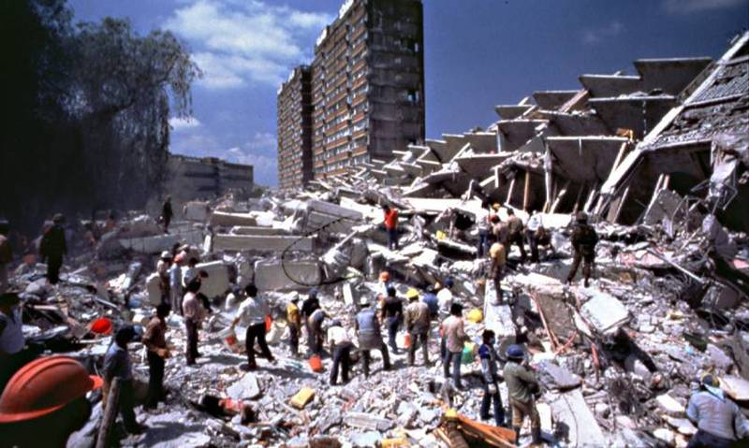
Disaster Area

Slide 6
Disaster Area
Case Study 1
  A large distribution center had a power failure. When the power came back on the machine booted but the database did not start
[2013/08/02@09:04:07.626-0500] P-7188 T-507976656 I : (43) ** Cannot find or open file /agility/prod/prod_db/platte_11.d5, errno = 2.
[2013/08/02@09:09:57.111-0500] P-8609 T--1155527728 I : (451) prostrct list session begin for root on /dev/pts/0.
[2013/08/02@09:09:57.116-0500] P-8609 T--1155527728 I : (12475) Unable to get file status for extent /agility/prod/prod_db/platte_11.d5
[2013/08/02@09:09:57.116-0500] P-8609 T--1155527728 I : (334) prostrct list session end.

Slide 7
Specifics
Database was 80 GB
Last good backup was 1 week old
Not running After Imaging
Platform was Linux

Slide 8
WHAT WOULD YOU DO?

Slide 9
Approach
Made a copy of the existing database incase we made a mistake
Used PROSTRCT LIST to determine which files were missing
  We were lucky that the missing file was part of a storage area that only held indexes
Tools Available
  PROSTRCT UNLOCK
  PROSTRCT BUILDDB

Slide 10
Solution
Restored the missing extent from the week old backup and ran PROSTRCT UNLOCK
Rebuilt the indexes
  # proutil db –C idxbuild all
  BUT…….
Index rebuild failed due to finding back blocks in the storage area where the records were stored

Slide 11
NOW WHAT?

Slide 12
Back to the Beginning
Copied the backed up database to start over.
  Good thing we had copied all the files in the first place
Add the missing extent
Truncate the BI and do a DBRPR scan
  Fix bad blocks
  Fix bad records

Slide 13
Dump and Load
After all the corruption was removed it was time to dump and load
Need to do an ASCII Dump to dump around some bad records

Slide 14
Lessons Learned
This Database was important to this customer, hence they wanted it back when it got corrupted.
They need to treat the Database better
  Daily Backups
  After Imaging
A good DR plan saves a lot of heartache

Slide 15
Next Steps
Implement a good Disaster Recover plan which includes
  Frequent backups
  After Imaging implemented
Test the Disaster Recover Plan
  Annually
Disaster Recover Plan needs to be on Paper
  Can’t be just on the computer
  Need a backup plan incase the DR plan fails

Slide 16
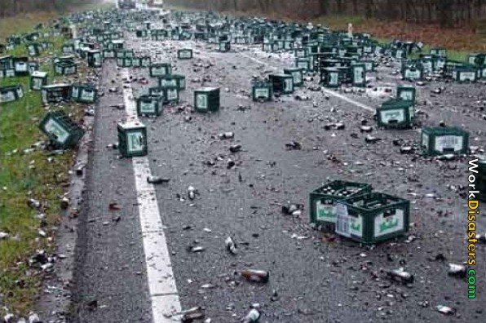
Disaster Area

Slide 17
Disaster Area
Case Study 2
  A brand name US bank had SAN corruption. This prevented Crash Recovery from completing. They had a Hot Standby machine and database using OE Replication.

Slide 18
Specifics
Had a local backup and local AI files, but the backup would not restore
Previous backup was not available
Replica Database was up to date
Platform was Windows
Database size 50 GB

Slide 19
What’s the Problem
Customer refused to fail-over
  They never tested running on the fail-over machine. Had little confidence that the application would run in the fail-over environment.
  Customer worried about the time it takes to fail-back once failed over.

Slide 20
Making Matters Worse
Copying the DR database to the production machine is measured in days
Options presented to Management included FORCED ACCESS to the Database

Slide 21


Slide 22
What Next
Forced into the database.
Index Rebuild DOES NOT fix the database
Dump and Load DOES NOT fix the database

Slide 23
Lesson Learned
Have confidence in your Disaster Recovery Plan
  There is no sense of having one if you are never going to use it
Be Careful of the “QUICK FIX”
  Non technical people will ALWAYS choose the fastest approach to the solution without understanding the consequences

Slide 24
Next Steps
Worked with the customer to do a fail-over test.
Made the fail-over testing an annual event

Slide 25

Disaster Area

Slide 26
Disaster Area
Case Study 3
  A Large school district needs to get their reports cards out to 30,000+ students. They discovered they had corruption in the database because backups stopped working for about a week

Slide 27
Specifics
10.2B05 Windows 64bit OpenEdge
Last good backup is 1 week old
All report card data for 30,000+ students entered since that last good backup
After Imaging is turned on, but AI file retention was less than 1 week
Database is about 300 GB
They have the 1 week old backup restored to a different location

Slide 28
WHAT WOULD YOU DO?

Slide 29
Approach
We had 2 plans
Plan A – Get the corruption out of the live database
  Use any and all tools to remove the corruption
Plan B – Revert back to the week old database
  See if we can take all the report card data from the live database and import it into the week old database.

Slide 30
Plan A
The database .lg file showed the extents where the corruption was located.
Each storage area was a single variable length extent
Corruption was in an 80 GB extent (Ugh!)
  Used DBRPR to scan and fix bad blocks
  This took hours to run on this large extent
  In the end this failed

Slide 31
Plan B
Worked with the vendor to find all the tables that made up the report card processing
  This was about 12 tables
Dumped these tables from the live database
  There was no corruption in these tables
Had to figure out how to get the table data into the week old database

Slide 32
HMMMMM…..

Slide 33
Plan B
Dumped the schema for the 12 tables
Went into the dictionary and renamed the tables
  Added _old to the end of the table name
Loaded the schema for the 12 tables
Loaded the data for the 12 tables
This is a very useful trick
  Didn’t need to recompile – the application worked

Slide 34
Plan A (revisited)
Dumped and Loaded the plan A database
There were 5 tables where the dump and load failed.
Did a 4GL dump
  FOR EACH … BY field. EXPORT…
  FOR EACH … BY field DESCENDING. EXPORT …
Didn’t trust the data, so we use the same table rename technique to get these tables from the week old backup.

Slide 35


Slide 36
But Wait – There’s More
A week later they found they also had corruption in a different database
  That was solved by restore and roll forward
  Needed to upgrade to 10.2B08 for Roll Forward to work properly

Slide 37
Next Steps
Implement a DR solution
  OpenEdge Replication
  Rolling Forward AI
Restore the backup and roll forward on the same machine
  This verifies the backup is functional
  DB block corruption does not get replication from roll forward
  License Costs associated with both approaches

Slide 38
Agenda
Disasters Area
Performance Problems
Migrations and Upgrades

Slide 39


Slide 40
Performance Problems
Case Study 4
  A customer recently purchased a new Linux machine to upgrade their old Linux machine. The new machine has more memory, faster disks, and twice the CPUs.
  Their application runs slower on the new hardware.
Specifics
  CPUs are not busy
  System Load is high (60 to 80)
  Application is sluggish
  Cannot identify a process causing the system load to go up

Slide 41
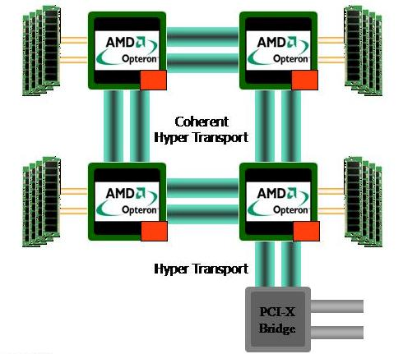
NUMA
Non-Uniform Memory Architecture

Slide 42
Cache Coherence
OpenEdge needs to gain exclusive access to a region of shared memory
  A test is performed to see if the region is locked.
  This test requires all the CPUs to stop what they are doing, synchronize their cache-lines to make sure that multiple processes are not thinking that they obtained the lock at the same time.
  As CPUs scale out wide, the Cache Coherency problem gets worse

Slide 43
Far Memory Reads
Shared Memory Region spans nodes
  Far Memory Access is commonly referred to as the NUMA Ratio
  This is the time difference it takes to access memory from a CPU on node 1 to memory on node n. When the ratio is 1 it means you are on a SMP machine, when it’s higher than 1, then you are on a NUMA machine.
  Typical NUMA ratios are 3:1 or higher. This means that it takes 3x longer the access memory on a remote node than it does to access memory on a local node.
  Given that database systems like OpenEdge, Oracle, MSSQL, etc access memory extensively, this 3x slowdown becomes a noticeable bottleneck.

Slide 44
Solutions
Change operating mode to client/server
  Less processes directly connected to shared memory
Disable CPUs
  Helps Cache Coherence problem
Purchased a new machine

Slide 45
Agenda
Disasters Area
Performance Problems
Migrations and Upgrades

Slide 46


Slide 47
YOU GET TO PIC THE NEXT MIGRATION PICTURE

Slide 48
Migrations and Upgrades
Case Study 5
  A large warehouse distribution center is migrating from an older machine to a newer machine. They are 24x7x365, so downtime is a minimum.
Specifics
  Not changing platforms (AIX -> AIX)
  DB size is 500 GB, it takes 6 hours to copy it the new machine

Slide 49
Constraints
Blocked out a 2 hour window for the data migration
Do you need any more constraints than this?

Slide 50
Approach
Build a test environment and
TEST TEST TEST
Migrate:
  Application Files
  System Files
  Other files (in this case, custom terminfo)

Slide 51
TEST TEST TEST

Slide 52
Special Sauce
Use After Imaging to keep the soon to be production database in synch.
During the cut-over period only need to transfer last AI file and apply it
This fits into the 2 hour downtime window with ease

Slide 53


Slide 54
Application Upgrades
Case Study 6
  A customer has replication in place using AI files. They are an end user of an Application Partner who does frequent updates of the application. The Application Partner is aware of the DR machine, and updates the application on the DR machine. Sometimes this causes problems
Specifics
  Windows Application

Slide 55
The Problem
The application support personnel doing the upgrade follows a a script which at times includes not only updating the Application, but also connecting to the database

Slide 56
The Problem
Once the database is connected to, crash recovery is performed and no other AI files can be applied

Slide 57
So…..
When we can’t apply any more AI files, we need to rebaseline the database. The database size is 80GB and the replica is on a WAN, so rebaselining is a pain.

Slide 58
Solution #1
Use the oplock and opunlock commands.
  rfutil dbname –C roll forward oplock –a file.a1
  rfutil dbname –C roll forward opunlock

Slide 59
Solution #1
However, this prevented the support engineer from doing the upgrade properly as they didn’t have control over when/how it connected to the database

Slide 60
Solution #2
We provided a secondary database that is a backup of the replica database on the DR machine
  We used probkup with the –norecovery switch to make sure future AI files can still be applied

Slide 61
Solution #2
The support engineer was able to complete the upgrade using this database copy
The Database Changes from the upgrade are THROW AWAY
  These changes will migrate from the PRODUCTION Database to the REPLICA Database via Replication

Slide 62
Summary
These are examples of some real world Database Problems
Don’t assume things can’t go wrong
Having a plan is not going enough
  Testing the plan and having confidence is required
If all else fails, seek professional help

Slide 63
Questions
THANK YOU FOR YOUR TIME

Slide 64
Thank You!
Questions?

