Slide 1
What's New In Progress Developer Studio for OpenEdge?
DivyaTheja Pachipula
Senior Engineer
June 11, 2014

Slide 2
Disclaimer
This presentation includes information about future products and/or product enhancements.
What we are going to say reflects our current thinking, but the information contained herein is preliminary and subject to change. Any future products we ultimately deliver may be materially different from what is described here.
D I S C L A I M E R

Slide 3
Focus of the Session
Unit Testing
ABLUnit
Editor Improvements
Organize USING Statements
Freeform Query
Performance Improvements
Exclude from OpenEdge Tooling
Miscellaneous Updates
General
Mobile
Find References

Slide 4
Unit Testing
ABLUnit
Editor Improvements
Organize USING Statements
Freeform Query
Performance Improvements
Exclude from OpenEdge Tooling
Miscellaneous Updates
General
Mobile
Find References

Slide 5
Unit Testing - ABLUnit
Unit testing framework for ABL
Supports both classes and procedures as test cases
Support for all data types
Integrated with PDS OE
Separate perspective and project type
Integrated Results View
Command-line and Ant task support

Slide 6
Unit Testing - ABLUnit and Steps Involved
Write Unit Tests
Include in nightly builds
Organize and run
Environment Setup
Setup the environment
Organize and run tests
Include tests in nightly builds
Write unit tests

Slide 7
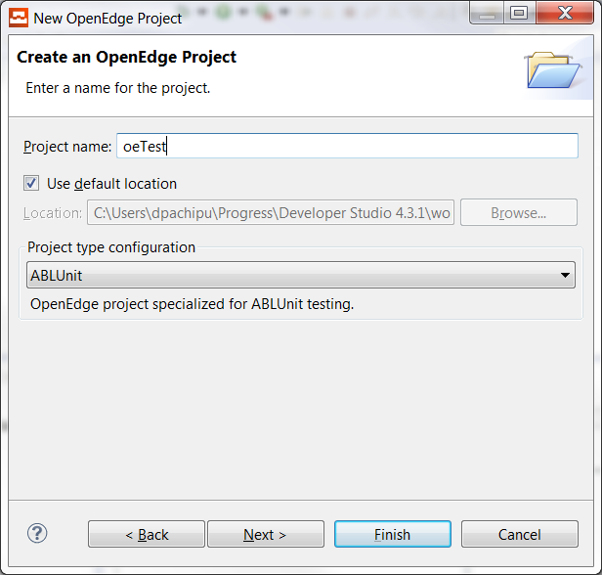
Unit Testing - ABLUnit
Environment Setup
Write Unit Tests
Organize and Run
Nightly Builds
ABLUnit Perspective
  Easy access to related context menu options
  ABLUnit results view
ABLUnit Project
  ablunit.pl added to PROPATH
  A default folder ‘tests’ has been added

Slide 8




Unit Testing - ABLUnit
Environment Setup
Write Unit Tests
Organize and Run
Nightly Builds
Create a Test Case
  Test Case Procedure
  Test Case Class
Add Test in Test Case
  Test Procedure
  Test Method
Write test code
Decorate the test with annotation
Test Case (.p/.cls)

Slide 9
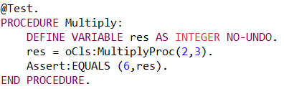
Unit Testing - ABLUnit
Environment Setup
Write Unit Tests
Organize and Run
Nightly Builds
Add Assertions to test the expected results
Assertion Methods
  Equals
  IsTrue
  IsFalse
  IsNull
  NotNull
  IsInteger

Slide 10
Unit Testing - ABLUnit
Environment Setup
Write Unit Tests
Organize and Run
Nightly Builds
Test Case (.p/.cls)
Setup (@Setup)
Test1 (@Test)
Before (@Before)
TearDown (@TearDown)
After (@After)
Setup
Test2
TearDown

Slide 11
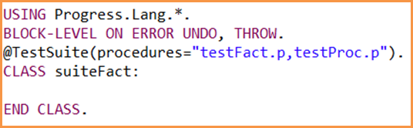
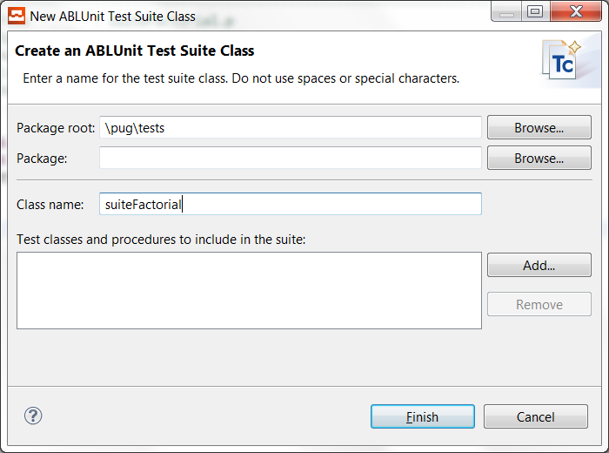
Unit Testing - ABLUnit
Environment Setup
Write Unit Tests
Organize and Run
Nightly Builds
Test Suite
  Organize your tests
  Run your tests
  Contains
    Test Case Classes
    Test Case Procedures
    Other test suites
New Wizard
  Test Suite Class
  Test Suite Procedure

Slide 12
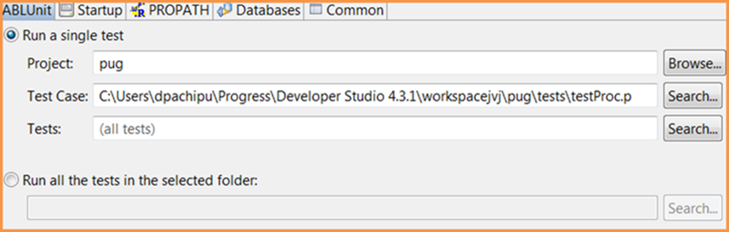
Unit Testing - ABLUnit
Environment Setup
Write Unit Tests
Organize and Run
Nightly Builds
Run using ABLUnit Run Configuration
Run Options
  Test
  Test case
  Test Suite
  Tests in Folder

Slide 13
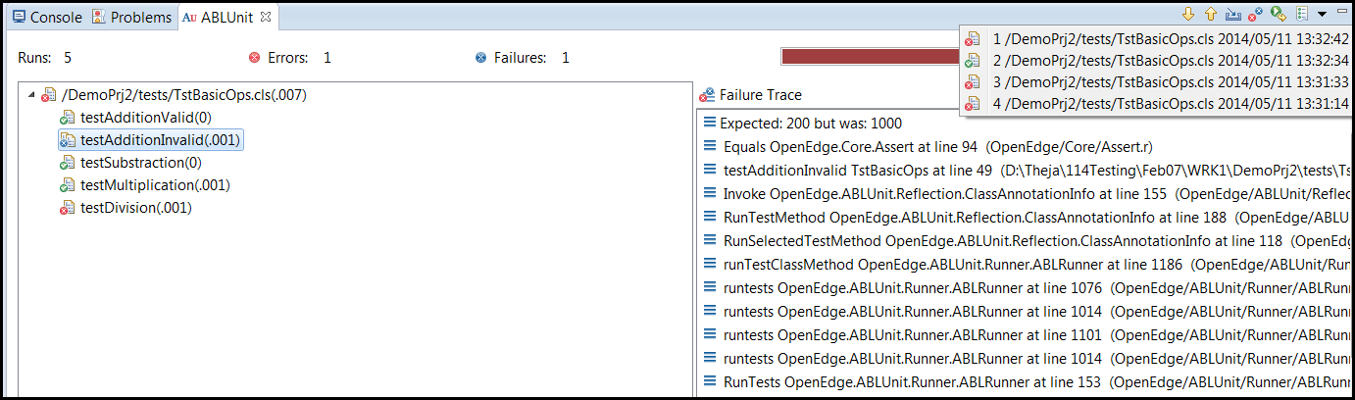
Unit Testing - ABLUnit
Environment Setup
Write Unit Tests
Organize and Run
Nightly Builds
Test Result
history
Bar is green if
all tests pass,
red otherwise
Only
Failures
Rerun
tests
Import
results
This test passed
Time taken to run
the test.
This test failed
Error raised
Failed test reason

Slide 14
Unit Testing - ABLUnit
Environment Setup
Write Unit Tests
Organize and Run
Nightly Builds
Command line support
ANT task to run ABLUnit tests cases.
  The task is a part of ant-ablunit.jar and is located in %DLC%\java
Run | Command
Single Test | prowin32 –p ABLUnitCore.p –param <TestCase#Test>
Single Test Case | prowin32 –p ABLUnitCore.p –param <TestCase>
Single Test Suite | prowin32 –p ABLUnitCore.p –param <TestSuite>
Tests in folder | prowin32 –p ABLUnitCore.p –param <Folder>
Tests in configuration file | prowin32 –p ABLUnitCore.p –param <CFG File>

Slide 15


Slide 16
Unit Testing
ABLUnit
Editor Improvements
Organize USING Statements
Freeform Query
Performance Improvements
Exclude from OpenEdge Tooling
Miscellaneous Updates
General
Mobile
Find References

Slide 17
Editor Improvements - Find References
Finds out all occurrences of a specific ABL element
Scope
  Workspace
  Project
References for
  ABL file
  ABL constructs
Can be performed from
  Outline
  File and Editor context menus ->References
  Shortcut Ctrl+Shift+G

Slide 18
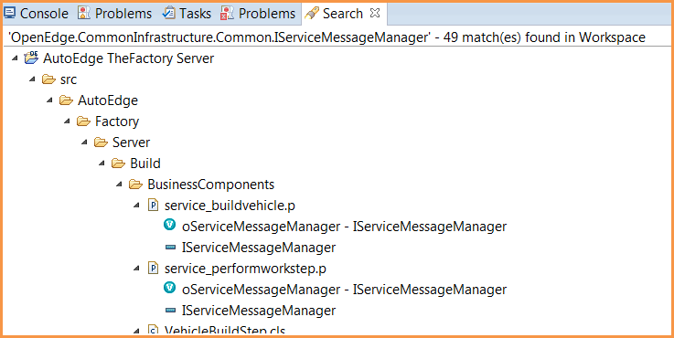
Editor Improvements - Find References
Search View
  Quick access to all references
  of an ABL element
  Navigation
  Search Again
  Multiple References

Slide 19
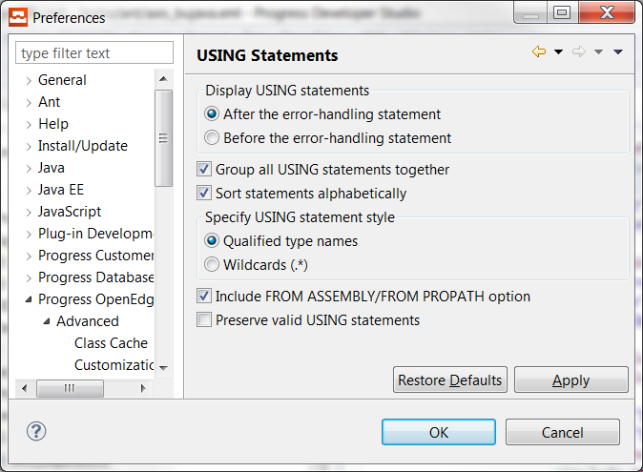
Editor Improvements - Organize USING Statements
Organizes USING statements in your workspace
  Remove duplicates
  Remove unused
  Add used
Custom Rules
  Position of statements
  Sorting
  Grouping
  USING Statement style
  Preserve existing ones
Invoke from Source Menu
The Gun - Ctrl+Shift+O

Slide 20
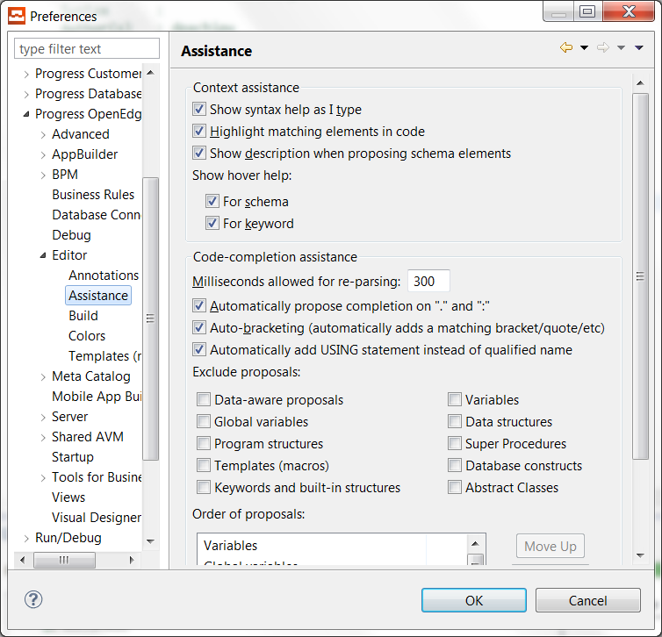


Editor Improvements - Content Assist for Class selection
Existing behavior
New Preference option
New behavior

Slide 21
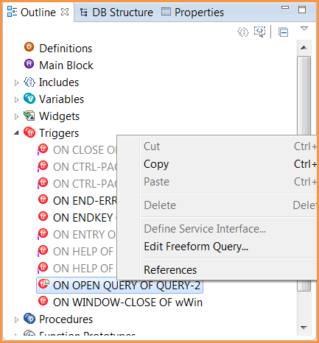
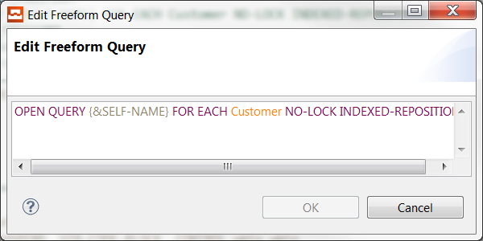
Editor Improvements - Freeform Query Editor
Editing support for Query from Outline view
Freeform Query Editor
  Color coding
  Content Assistance

Slide 23
Unit Testing
ABLUnit
Editor Improvements
Organize USING Statements
Freeform Query
Performance Improvements
Exclude from OpenEdge Tooling
Miscellaneous Updates
General
Mobile
Find References

Slide 24
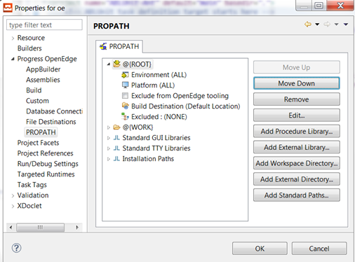
Performance Improvements – Exclude from OpenEdge Tooling
Upon PDS OE start-up, the Initializing OpenEdge tooling will start in the background
Initializing OpenEdge tooling takes long time to complete when there are more number of PROPATH entries
A new option introduced to exclude PROPATH entries

Slide 25
Unit Testing
ABLUnit
Editor Improvements
Organize USING Statements
Freeform Query
Performance Improvements
Exclude from OpenEdge Tooling
Miscellaneous Updates
General
Mobile
Find References

Slide 26
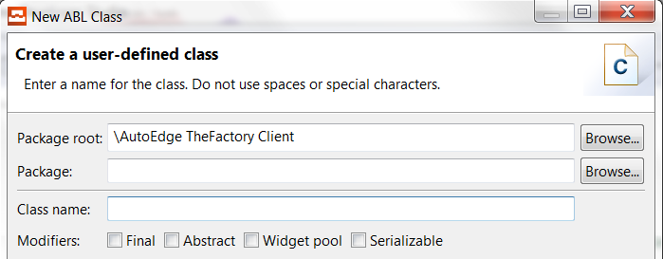
Miscellaneous Updates - General
Support for Eclipse 4.3.1
Infragistics update to 14.1.20141.2019
  New Controls
    UltraTreePrintDocument
    UltraRadialMenu
    UltraPivotGrid
    UltraLiveTileView
Support for Language Changes
  Serializable
  Get-Class

Slide 27
Miscellaneous Updates - Mobile
Offline Data Support for disconnect use
JSDO Catalog Changes
  Automatic recognition of constraints in Schema
  Support for Annotations
    ReadOnly
    RecordName
Business Entity Inheritance

