Slide 1
Using TDD
Making code maintainable, reusable and readable by writing tests

Slide 2
Intro
Julian Lyndon-Smith
  Co-founder dot.r, whoGloo
Using progress since v3 ..
Specialists in
  OO design, Code refactoring
  Mentoring
  Versioning and Application Lifecycle Management
  System integration

Slide 3
Introduction to TDD
Test Driven Development
  Test first
  Code second
Different from traditional development methods
  Takes buy in from all involved
  Makes you think differently
  Hard to make the switch

Slide 4
History of TDD
1989 : “fit”, one of the first testing frameworks written
1994 : Extreme Programming (XP) starts appearing
1999 : a number of books on TDD start appearing
2000 : jUnit launched
2004 : proUnit
2010 : OEUnit
2014 : ABLUnit (or so I believe .. )

Slide 5
Traditional development cycle
Write code
Run tests
deploy
Fix bugs

Slide 6
TDD cycle
Write test
refactor
Run tests
Fix bugs
Write code
deploy
Run tests

Slide 7
TDD cycle : Red, green, refactor
Red
  Tests fail
Green
  Tests pass
Refactor
  Make code better to maintain and test

Slide 8
TDD cycle : Red
Write a test for a class or method
  That does not exist
  A new requirement
Test will (should) fail
Why should we do this ?
  Makes you think of what functionality you are testing
  Makes you write the code required to pass the test only

Slide 9
TDD cycle : Green
Now, write just enough code to make the test pass
  This is the difficult part !
Take this business requirement:
  A new method must, given an integer input value of 42, return false
  What is enough code to make the test pass ?

Slide 10
When enough is too much
/** A new method must, given an integer input value of 42, return false */
method public logical myMethod(a as int):
if a eq 42 then return false.
else return true.
end method.

Slide 11
WRONG…
The requirement only stated what the method should do for an input value of 42.
All other values are undetermined
No requirement .. No test
  Otherwise you are writing code that may never be used

Slide 12
When enough is enough
/** A new method must, given an integer input value of 42, return false */
method public logical myMethod(a as int):
return false.
end method.

Slide 13
Requirements are tests
The previous example shows that there is at least one more requirement needed
  Other numbers apart from 42
The developer should liaise with other stakeholders
  “are you needing different results for other numbers?”
Write new tests for new requirements

Slide 14
TDD cycle : Refactor
Refactoring code is done to make the code
  Maintainable
  Readable
  Good code quality
Your unit tests will help to check that you don’t break functionality
DRY

Slide 15
The benefits of TDD
Ensures quality code from the very beginning
Promotes loosely-coupled code
Can provide specifications by tests
Give you confidence that your code works

Slide 16
The benefits of TDD
Keeps unused code out of your systems
Makes you think hard about application design
Finds bugs quickly

Slide 17
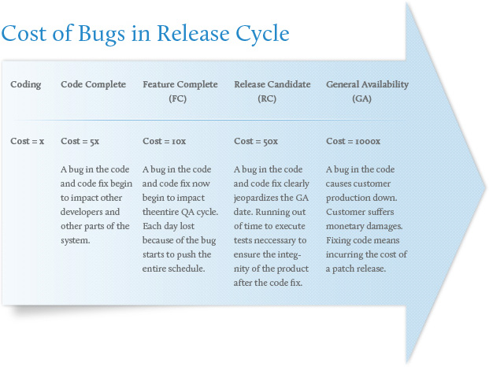
The cost of bugs - augmentum.com

Slide 18
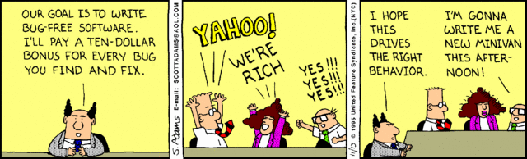
The cost of bugs – Dilbert

Slide 19
The benefits of TDD
Code coverage
Regression testing for free
Stops recurring bugs
Clean API design
Reduced debugging
Reduced development costs

Slide 20
The benefits of TDD (real world)
Development of Maia4
  Complete rewrite of Maia
Took 3 weeks
  Including writing unit tests
Found 4 bugs in progress …

Slide 21
The benefits of TDD (real world)
Return in finally
  Doesn’t return longchars
Recursive delete of a directory fails
  If path contains a folder starting with “.”
Json parser hangs if data contains comments
  /* */
Static properties and method calls as part of a parameter cause gpf

Slide 22
The benefits of TDD (real world)
Only 2 bugs in maia4 found after initial alpha release
  Extents not generated at all (missing code)
  Custom properties assigned to db
Several bugs found in UI …
  No unit tests ☺
if not oProperty:has("isDbField") then return "".

Slide 23
The downsides of TDD
Big time in investment
Additional Complexity
Harder than you think
Selling to management
Selling to developers ;)
You lose the title of “Hacker” !

Slide 24
Unit tests
What is a unit test ?
  Test of one requirement for one method
Isolation
  other code / tests
  Other developers
Targeted
Repeatable
Predictable

Slide 25
Example of the TDD approach

Slide 26
Achieving good design
Writing tests first means that you have to describe what you want to achieve before you write the code
In order to keep tests understandable and maintainable, keep them as short as possible. Long tests imply that the unit under test is too large
If a component requires too many dependencies, then it is too difficult to test

Slide 27
Code design to help with TDD
SOLID
Code “smell”
Refactoring

Slide 28
SOLID
Single responsibility
  Each method and class should have only one responsibility
  Open / Close principle
  Open for extension, closed for modification
  Inheritance
Liskov subsititution principle
  An object should be replaceable by the super class without breaking the application

Slide 29
SOLID
Interface segregation principle
  Must not rely on interfaces that a client does not need
Dependency inversion
  Code should depend on abstractions, not implementation

Slide 30
Code smell
Mistaks: repeated mistaks ;)
Duplicate code
Big classes, huge methods
Comments
  controversial …
Bad names
Too many if .. Then or case statements

Slide 31
Code refactoring – rename members
method public decimal getValue(a as int,b as int):
def var p as dec init 3.14159265359 no-undo.
return (a * a) * b * p.
end method.

Slide 32
Code refactoring – rename members
method public decimal getCylinderVolume(radius as int, height as int):
def var Pi as dec init 3.14159265359 no-undo.
return (radius * radius) * height * Pi.
end method.

Slide 33
Code refactoring
Extract methods
Extract interfaces
  Multiple implementation
Encapsulation of properties
  Get / set
Replace conditionals with polymorphism

Slide 34
Achieving good design
Code which is complicated is
  Bad design
  Hard to maintain
  Hard to test
  Expensive to fix

Slide 35
TDD: Testing “smells” (1)
Writing tests after writing code
Not writing tests !
Duplicate logic in tests
Code apart from asserts / setup
  logic in tests == bugs in tests (>90% likelyhood)

Slide 36
TDD: Testing “smells” (2)
Remove tests
Change tests
Have test dependent on another test
Have multiple asserts per test
  unless checking multiple properties per object

Slide 37
TDD: Best Practices (1)
Increase code coverage
Test reviews
Manually introduce a bug
  if all tests pass, there’s a problem with the test
Write tests first
Make tests isolated

Slide 38
TDD: Best Practices (2)
Ensure all unit tests pass. None should fail
Integration tests should be in a separate project
Test only publics (If possible)
SOLID design
Use Setup methods / refactor code into “helpers”

Slide 39
TDD: Best Practices (3)
Make tests readable rather than maintainable
Enforce test isolation
Each test should set up and clean up it’s own state
Any test should be repeatable
Use variables instead of constants to make tests readable

Slide 40
TDD: Best Practices (bad naming)
@Test.
method public void test#1():
def var lv_data as char no-undo.
assign lv_data = gecode:getGPS("maitland","southend").
AssertString:IsNotNullOrEmpty(lv_data).
end method.

Slide 41
TDD: Best Practices (good naming)
@Test.
method public void get_the_GPS_coordinates_for_a_building_in_a_town():
def var lv_gpsCoord as char no-undo.
def var lv_Town as char init "southend" no-undo.
def var lv_Building as char init "maitland" no-undo.
assign lv_gpsCoord = gecode:getGPS(lv_Building,lv_Town).
AssertString:IsNotNullOrEmpty(lv_gpsCoord ).
end method.

Slide 42
TDD: Best Practices (4)
Tests should run in any order
Name tests (add_LessThanZero_throwsException)
Name variables / use pre-processor
Start using Interfaces to facilitate tests
“mocks”

Slide 43
maintainable
trustworthy
readable

Slide 44
book
The art of unit testing
  Second edition
Roy Osherove

Slide 45
Questions / Demos

