Slide 1
Progress Rollbase and OpenEdge
Roy Ellis
ellis@progress.com
June 10, 2014

Slide 2
What are we going to talk about?
What is Pacific?
What is Rollbase?
How do I use Rollbase?
How do I use OpenEdge with Rollbase?
How do I get more information?

Slide 3
What is Pacific?
Notes:
Why am I talking about Pacific? Because Rollbase was the basis for Pacific.

Slide 4
What is Pacific?
From the beginning, Progress has helped business professionals build powerful applications with purpose
Business professionals have unique requirements:
1. Need simplicity without having to rely on deep technical skills
2. Need to connect to critical data
3. Need to see before they build
4. Need to show results right away
5. And they need to do it without a long, expensive IT project
Rapid development
Data driven
Open standards

Slide 5


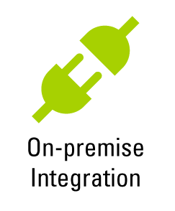
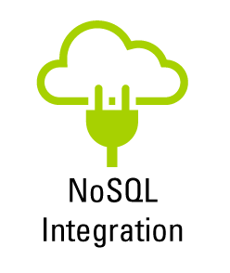
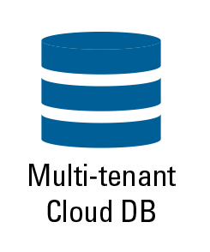

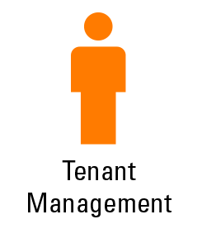


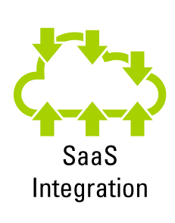

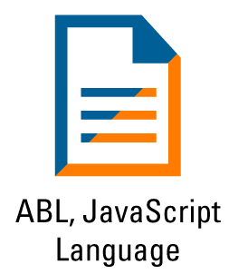

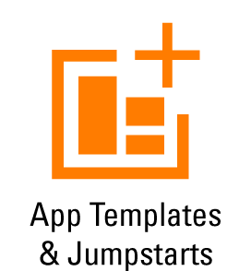

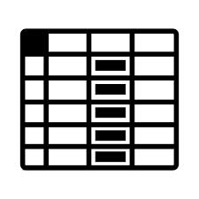


PROGRESS DATADIRECT
PROGRESS OPENEDGE
PROGRESS CORTICON
PROGRESS ROLLBASE
PROGRESS EASYL
COMMUNITY
CONSISTENT USER EXPERIENCE
Notes:
Progress Pacific is the aPaaS delivery of Progress products.
DataDirect, Easyl, Rollbase are currently included
Corticon and OpenEdge in the future (see Dave Cleary’s talk about the new PASOE server)

Slide 6
What is Rollbase?

Slide 7
What is Rollbase?
Progress Rollbase is a cloud platform for development and delivery of software as a service (SaaS) business applications using point & click, drag & drop tools in a standard web browser with a minimal amount of code.
Rollbase continues to extend Progress’ commitment to empowering business users and other people who are not professional programmers to enable them create their own applications.
In this talk we introduce you to this new, easy application development and deployment platform that can complement your existing OpenEdge applications.

Slide 8



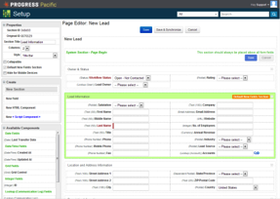
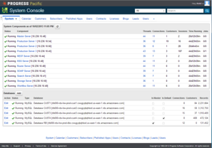
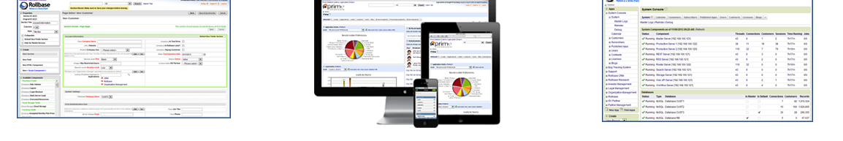
Rollbase: Build Data-driven Applications on any Cloud for any Device
Build
  Drag & drop development enables business users to create apps without coding
  Developers can go much further with JavaScript, APIs and custom components
Deploy
  Publish and deploy applications to one or more tenants
  Choose your hosting environment public, hybrid or private cloud
Manage
  Central dashboard to manage servers, databases, tenants, users, applications and more
  Monitor system components and user activity, access tenants to provide support, resource metering, etc.
Notes:
Build
Drag & drop application development allows business users can create apps without coding
Developers can go much further with JavaScript, APIs and custom components
Deploy
Publish and deploy applications to one or more tenants
Role and user-based access control, tenant and user provisioning
Manage
Central dashboard to manage servers, databases, tenants, users, applications and more
Monitor system components and user activity, access tenants to provide support, resource metering, etc.

Slide 9
Rollbase in Action
Notes:
Rollbase in action book is now 577 pages in length.

Slide 10
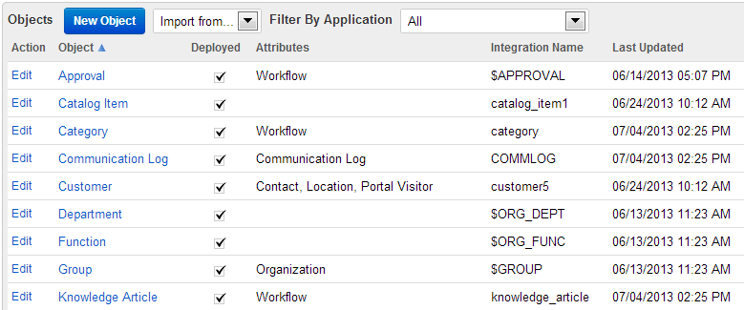
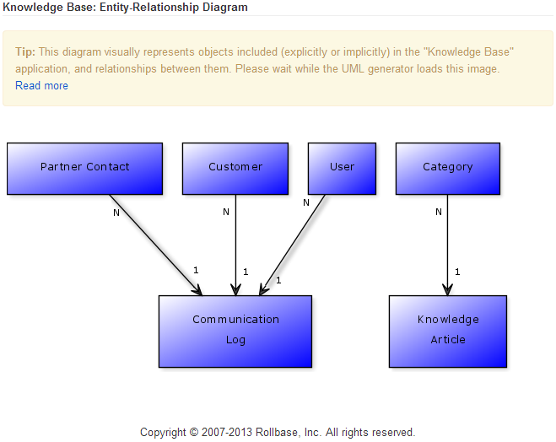
Core Concepts: Objects, Fields, Relationships and Cardinalities
Applications are data-driven – Objects are the core business entities
Objects have properties and attributes associated with them
Objects have Fields associated with them
Object relationships and cardinalities are modeled visually
Underlying database physics are completely hidden – it‘s aPaaS !
Notes:
Rollbase is a PaaS, shielding devlopers from underlying technical complexity such as database schemas and relationships.
Developers model coarse-grained (business objects) in the browser-based authoring environment. These are typically objects such as Customer, Article, User etc.
Object properties indicate e.g. auditing, reporting capabilities for the object.
Objects have associated attributes e.g. Workflow, Task, Survey, … Selecting attributes for an object enables specific behaviour for the object e.g. location attribute.
Field are associated with objects and are typed.
The developer declares the relationship between related objects and their respective cardinalities.
(This is a good point to jump to a short demo. Login to Rollbase, explore/navigate development environment, explore objects/cardinalities and fields).

Slide 11
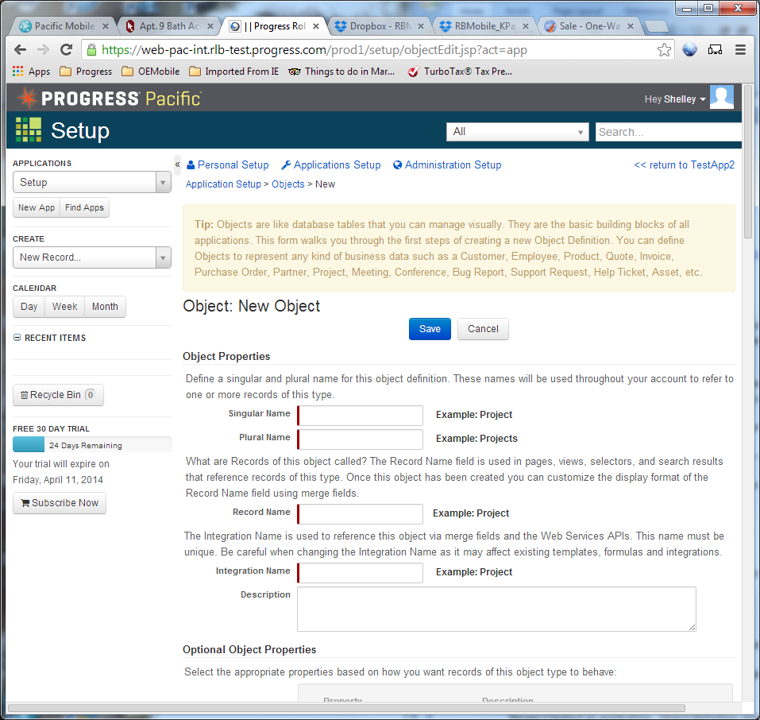
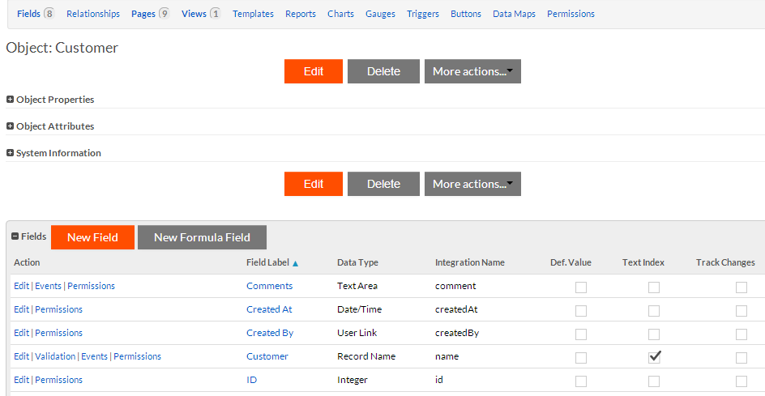
Create Object
Notes:
Everything starts with Objects.
There are predefined tables in the Rollbase database and you can create objects from these, or from external datasources using: D2C, non-Rollbase tables in the same DB (External Tables) and Web Service objects

Slide 12
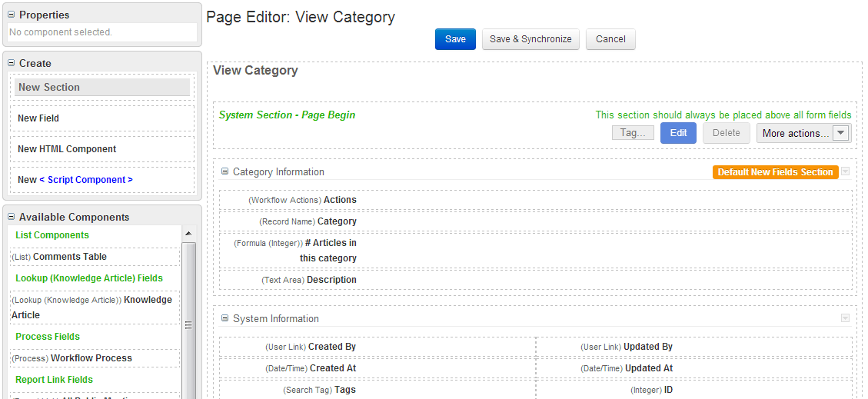
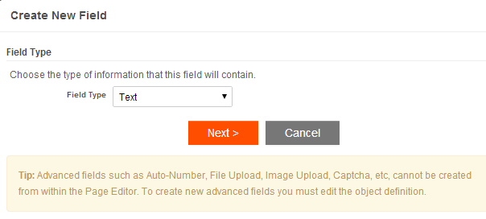
Building the User Interface (UI)
Build UI using integrated WYSIWYG editor
UI Tabs are automatically generated for each Object
Page elements are created and edited using drag-and-drop
Changes immediately reflected in the UI
Notes:
Rollbase includes a WYSIWYG (what-you-see-if-what-you-get) UI builder which runs in-browser. Simply via point-and-click, drag-and-drop, developers can easily build compelling, modern, browser-based UIs.
Layout changes are immediately reflected in the UI upon saving.
Tabs are a convenient way to navigate an application, and are automatically generated for each object definition.
(This is another good point to leave ppt and jump to a short demo of the HTML WYSIWYG authoring capabilities).

Slide 13
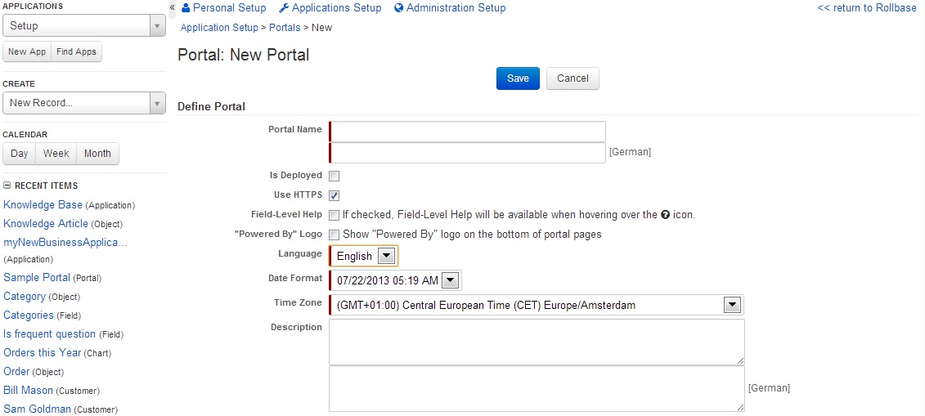
Publishing Applications
Applications can be published and accessible via a user-facing Portal
Several Portals can be defined per Application
Fine-grained (user/role) authentication and access control fully configurable
Notes:
Once built, Applications can have Portals associated with them.
Several Portals per Application can be configured.
HTTPS is a check-box.
Fine-grained users access control requires careful planning.
Applications can be mobile-enabled.

Slide 14
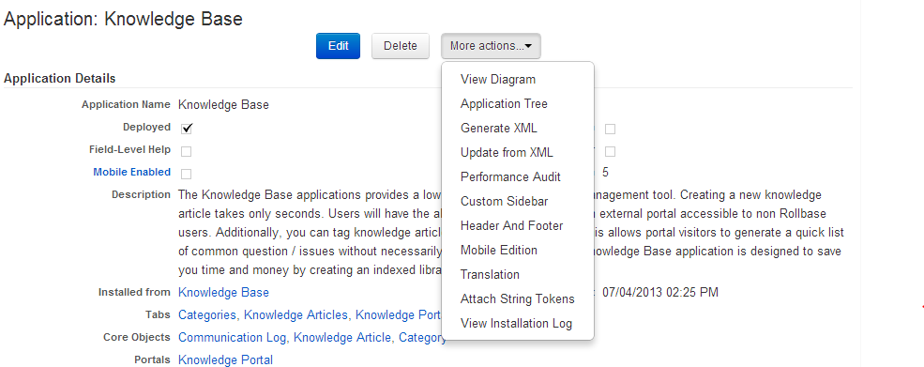
Installing and Updating Applications
Application composition is described in an XML document (Application tree)
Install and upgrade Applications by installing the provided XML
Supports fine-grained control for sub-components (Locked, Partially Locked, Unlocked)
Applications are versioned and can be rolled back if necessary
Notes:
Applications are described in a proprietary XML format (Application tree)
Install an Application by applying the XML file which was distributed
Rollbase supports fine-grained control over Application sub-components (KEY VALUE POINT FOR ISVs)
(This is a good jump off point to demo the application tree (and possibly a rollback))

Slide 15
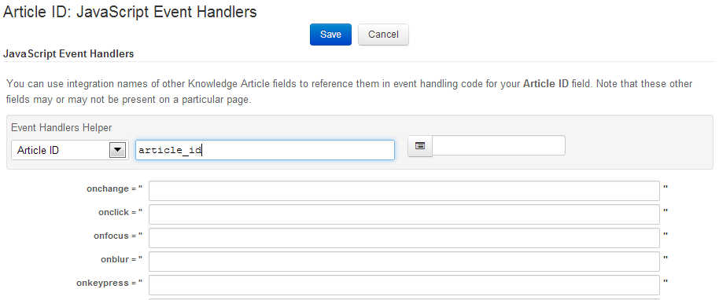
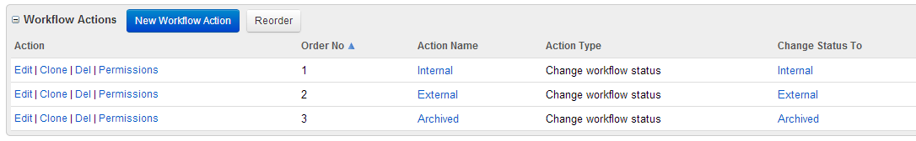
Advanced Topics
Powerful AJAX API for Applications demanding a rich, interactive browser experience
On-premise Rollbase supports the integration of external databases (e.g. OpenEdge DB)
Rollbase has powerful facilities :
  Triggers
  Workflow
  Server-side JavaScript logic
Notes:
These topics are (in a sense) more advanced.
Discuss the power of integrating HTML/Javascript event handlers to the UI.
Also, discuss the built-in mechanisms for Workflow and Triggers…
(This is another good opportunity to jump to a short demo of the capabilities).
(The on-premise version of Rollbase will also allow you to configure-in external databases e.g OpenEdge).

Slide 16
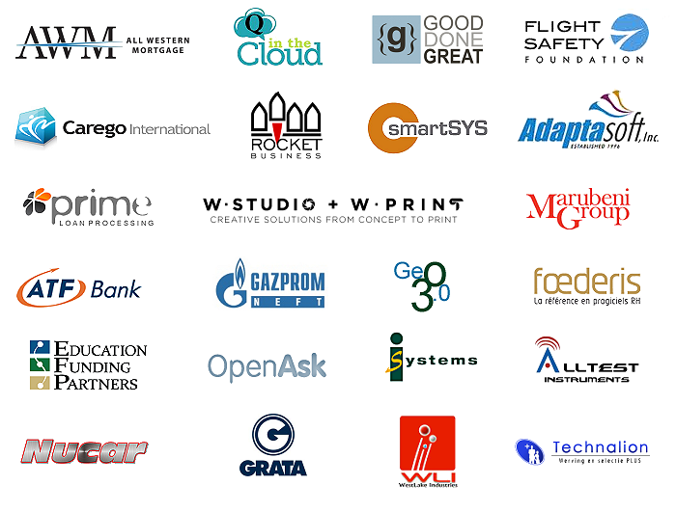






Rollbase Applications
Over 10,000 users in 10 languages
Notes:
Prime Load Processing - In use by 450-500 mortgage brokers ($95/month per user)
Ionit Network systems - Monitors the temperature of grease tanks - REST APIs used to provide data
Used by restaurants
GeO 3.0 - Jungle Laser
Towns and municipalities – 100 of Apps available to run their town. (pet licenses, trash collection schedule)
Runs fully on hosted environment - Customize UI for each tenant
1st ISV – helped identify key features for ISVs
GeO 3.0 – Parks and Recreation
DMSi – long time OpenEdge partner – long time SaaS provider, started in the AsPen days

Slide 17
Rollbase with OpenEdge

Slide 18
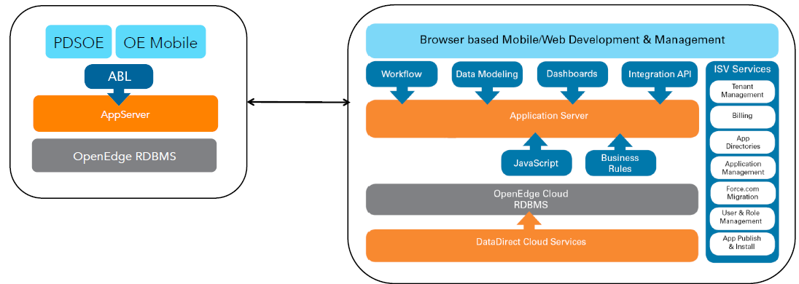
Rollbase and OpenEdge Integration
6 Options (OE 11.3.2+)
0: OpenEdge Service Objects
1: DataDirect Cloud (aka D2C)
2: External tables
3: External tables with auxiliary databases
4: Web Services / SOAP
5: Java Open Client
OpenEdge
Rollbase

Slide 19

0: OpenEdge Service Objects – The Preferred Approach
Rollbase
Server
OpenEdge
AppServer
Tomcat
Rollbase Objects
Business Entities
RB Server
JSDO Catalog
REST
Adapter
AppServer
REST
JDBC
driver
HTTP/JSON
(REST)
RB DB
OE DB
RB Schema
Rollbase tables
PUB Schema
your tables

Slide 20
0: OpenEdge Service Objects: The “Preferred” Approach
Rollbase Business Entities (i.e. Objects) based on OpenEdge “Business Entities”
  OERA-certified
  Builds on JavaScript Data Object (JSDO) Catalog in OpenEdge Mobile
  First priority for Rollbase work: “Parity with native objects”
Phased implementation – current functionality:
  Tenant-based identity
  Single Table ProDataSet
  Direct CRUD support - INVOKE done in ObjectScript

Slide 21
1: DataDirect Cloud + OpenEdge RDBMS
Rollbase
Server
DataDirect Cloud
OpenEdge
Database
Rollbase Objects
RB Server
JDBC
Driver: OEDB
OE SQL
Server
tcp/ip
tcp/ip
JDBC
driver
JDBC
Driver: …
RB DB
OE DB
RB Schema
Rollbase tables
PUB Schema
your tables

Slide 22
1: DataDirect Cloud + OpenEdge RDBMS
D2C Server runs in Amazon cloud
  Served by OpenEdge RDBMS
  Your application's data are on your server
  Enables building new, hosted, customized Web Applications on Partner and DEU platforms
  10.2B onward
Rollbase runs either hosted or on-premise
  Rollbase talks to D2C
  D2C talks to your server
Limitations:
  Latency can be high
    Access to Database, not Business Logic
  Requires detailed knowledge of data

Slide 23
2: External Tables + OpenEdge RDBMS
On-premise Rollbase Server
OpenEdge
AppServer
Rollbase Objects
RB Server
JDBC
driver
OE SQL
Server
tcp/ip
OEDB
RB Schema
Rollbase tables
PUB Schema
your tables
One and only one database

Slide 24
2: "External" tables – On Premise Only
Rollbase on-premise has a database
  Rollbase has about 25 tables
  Tables used by Rollbase are in the RB schema
  Do not touch these tables
The "external" tables must be in the SAME database
  In a different schema, e.g. PUB
Limitations
  Cannot modify schema in Rollbase
  Requires detailed knowledge of data
  Must be in shared namespace and single database
  Must have a unique numeric column or text column

Slide 25
3: External Tables + OpenEdge RDBMS
Rollbase
Server
OpenEdge
AppServer
Rollbase Objects
RB Server
multi-database property file
JDBC
driver
OE SQL
Server
tcp/ip
RB DB
OE DB
RB Schema
Rollbase tables
PUB Schema
your tables
main database
auxiliary database

Slide 26
3: External tables with auxiliary databases
OpenEdge SQL Server process serves data from multiple databases
Main database is read-write
  Contains Rollbase tables only
Auxiliary databases are read-only to Rollbase
  Auxiliary db contains your application's tables
  Must be on same system as main database
  Property file describes auxiliary database
  and names the tables therein
  User id for main and auxiliary db must be the same
  Rollbase thinks there is just one database

Slide 27
4: Web Services / SOAP
Rollbase
Server
OpenEdge
AppServer
Tomcat
Rollbase Objects
Business Entities
RB Server
SOAP
API
WSA
Adapter
AppServer
SOAP
JDBC
driver
HTTP/SOAP
RB DB
OE DB
RB Schema
Rollbase tables
PUB Schema
your tables

Slide 28
5: Java Open Client
Rollbase
Server
OpenEdge
AppServer
Rollbase Objects
Business Entities
RB Server
OpenClient Proxy
AppServer
JAVA
JDBC
driver
AppServer Protocol
RB DB
OE DB
RB Schema
Rollbase tables
PUB Schema
your tables

Slide 29
OpenEdge Service Objects – The Preferred Approach
Requirements
  Application Server
  Progress Developer’s Studio
Steps
  Create a Mobile Application using the ExpressMobile process in PDSOE
  Create a new object in Rollbase using the JSON file from the ExpressMobile project
Result
  Access to your AppServer logic and data

Slide 30
DEMO: OpenEdge Service Objects – The Preferred Approach
Rollbase
Server
OpenEdge
AppServer
Tomcat
Rollbase Objects
DEMO
Business Entities
RB Server
JSDO Catalog
REST
Adapter
AppServer
REST
JDBC
driver
HTTP/JSON
(REST)
RB DB
OE DB
RB Schema
Rollbase tables
PUB Schema
your tables

Slide 31
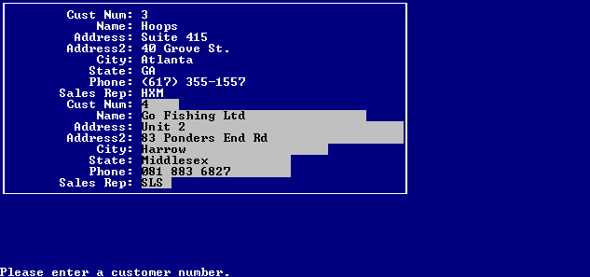
But what if I don’t use an AppServer?

Slide 32
External Tables + OpenEdge RDBMS
Requirements
  OpenEdge RDBMS
  Private Rollbase
Steps
  Add the Rollbase schema to an existing OpenEdge RDBMS
  Modify Rollbase to use the existing OE DB with new schema
  Create a new object using External tables
Result
  Access to your data

Slide 33
DEMO: External Tables + OpenEdge RDBMS
On-premise Rollbase Server
OpenEdge
AppServer
Rollbase Objects
DEMO
RB Server
JDBC
driver
OE SQL
Server
tcp/ip
OEDB
RB Schema
Rollbase tables
PUB Schema
your tables
One and only one database

Slide 34
Documentation References
Topic | Where
Rollbase | Rollbase in Action
OpenEdge Service Objects | Rollbase In Action, Appendix C, Using External Tables as Rollbase Objects
OpenEdge Service Objects | Rollbase In Action, Appendix E, Creating Rollbase Objects From OpenEdge Services
DataDirect Cloud | Rollbase In Action, Using Rollbase With DataDirect Cloud

Slide 35
Documentation References (continued)
Topic | Where
JSDO | White Paper: Accessing the Progress OpenEdge AppServer from Progress Rollbase using JSDO Code
Object Script | White Paper: Accessing the Progress OpenEdge AppServer from Progress Rollbase using Object Script
OpenClient | White Paper: Rollbase access to ABL Business Logic VIA OpenClient
Corticon | White Paper: Business Rules in Rollbase with Corticon
Express Mobile | Documentation: Creating an Express Mobile Application

Slide 36
In Summary…
Rollbase is:
  A drag & drop, point & click, object based, WYSIWYG, browser based development tool
  That also allows publishing of multi-tenant (through Portals) applications
  Updating of applications, monitoring and metering support
  Cloud hosted or On-Premise
Rollbase can access your OpenEdge Application or Database
  Preferred method is using the OpenEdge Services Object (11.3.2)
  Hosted Rollbase can access OE DB using DataDirect (10.2B+)
  Fully On-Premise can access the OE DB directly with External Tables
  And there are more ways…
Help is available
  See the document resources
  We continue to improve and add functionality

Slide 37
Questions
?

