Slide 1
PUG Challenge Americas
Introduction to Easyl
Adam Breakey – Progress Software
Carlo (Minollo) Innocenti – Progress Software
Gary Lamb - DataPA

Slide 2



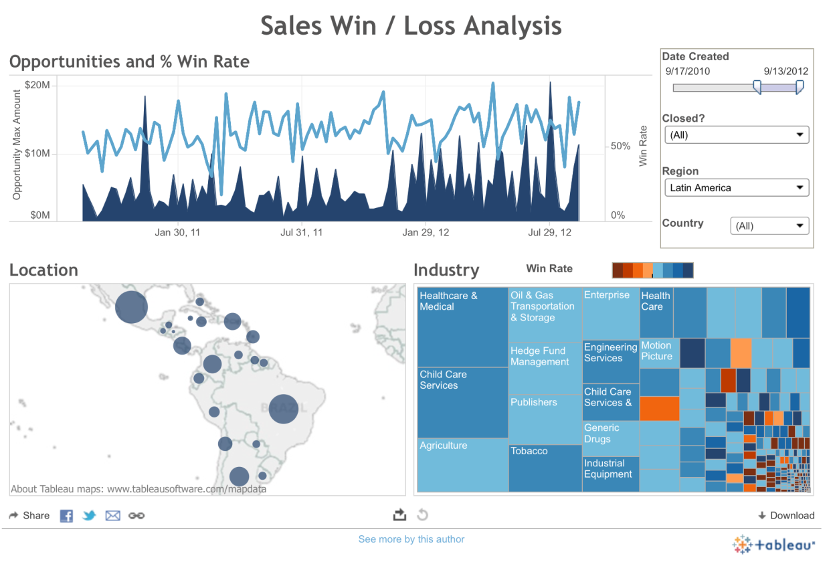














Spotting Trends and Building Visualizations
This is what I have
This is what I want

Slide 3
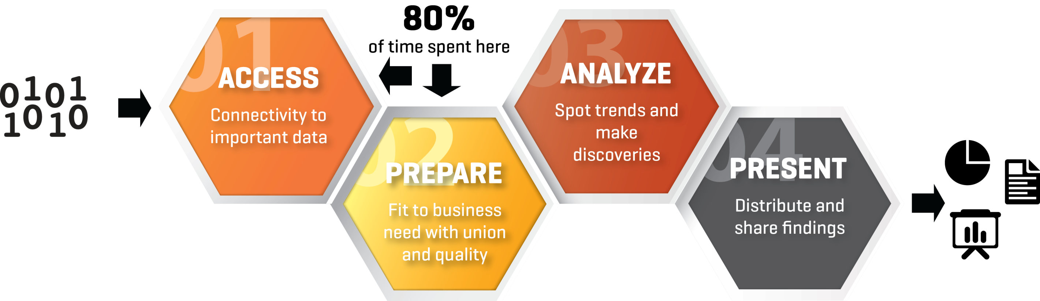
The Data-to-Dashboard Process
Operations Teams Waste Most of Their Time Preparing Data for Analysis!

Slide 4






Your Customers Need to Report ACROSS Applications
Integration Becomes a Major Challenge for Them
Who do I have in pipeline for this promotion?
contact
close_date
opportunity
amount
company
weighted_amount
stage
zip code
partner
title
title
address
country
email
amount
email
stage
contact
zip code
partner
close_date
role
account_id
created_date
stage
role
address
account_id
company
account_id
created_date
amount
role
weighted_amount
opportunity_owner
country
opportunity
opportunity_owner
Which prospects engage in related campaigns?
contact
address
company
title
email
address
contact
form
segment
campaign
website
country
website
activity
segment
segment
clicked_link
segment
email
email
activity
clicked_link
industry
campaign_date
contact
activity
industry
company
company
country
created_date
campaign
country
address
zip code
title
campaign
form
title
industry
Historically, what are aggregated buying patterns and predictions?
owner
street
expires
dollars_usd
expires
units
fact
country
contact
quarter
quarter
royalty
time
region
dollars_usd
owner
time
units
contact
fact
units
owner
currency
country
maintenance
city
city
fact
currency
royalty
contact
expires
quarter
maintenance
region
dollars_usd
street
maintenance
country

Slide 5








Most Business Users Cross The Chasm Manually
Export, Excel, Email… it is Truly Brute-Force
Limitations With This Approach
Every report starts from scratch
Each export can reset the process
Time intensive joins and filters
No governance on sharing
Reliance on other departments
Not repeatable, not scalable
Manual
Exports
Manual Joins
and Filters
Shared via email
Shared via Dropbox
Master List

Slide 6





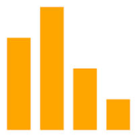

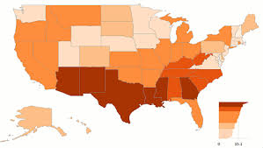



How Easyl Works
SaaS Data
Template
Favorite Dashboard or BI Tool For You or Your Customer
Cloud Data Mart
Union
and
Filter
Quality
and
Enrich
Produce
View
ODBC/JDBC
OpenEdge
SQL Server
Big Data
Easyl Gallery
Dropbox-like report sharing
On-premise Data
Publish as Excel

Slide 7

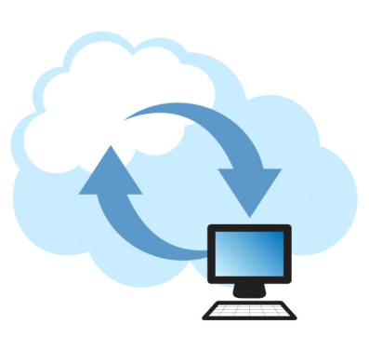


Progress Easyl Key Features
360° Reporting for your OpenEdge and Rollbase Applications
Unite Fragments of Data
On-Premise or
In The Cloud
Collaborate
and Share
Guided by
Templates
Zero Infrastructure
to Manage
Connect, combine, and clean data across many applications and sources to spot correlations, enable predictions, and power your visualizations
No matter where your data is located – in SaaS apps such as Salesforce, or on premise in OE databases – Easyl can access it without changing your firewall
Prepared data can be shared between co-workers, or with your customers, to support collaboration and for separation of roles
Out of the box templates for Sales & Marketing, ISV templates for domain-specific value, and customer created templates for personalized needs
Easyl is a cloud service that eliminates the need for traditional IT-led integration projects. It scales on demand with no servers to manage

Slide 8

Data Integration for the Masses

