Slide 1
OpenEdge Rules!
Corticon for OpenEdge: What? When? Why? & How?
David Atkins (datkins@progress.com)
Progress System Engineer
June 2014

Slide 2

Overview & Goals
  WHAT is Corticon?
  WHEN can OpenEdge apps benefit from Corticon?
  WHY is Corticon THE best BRMS?
  HOW does Corticon integrate with OpenEdge?
  Q and A
  Think of a use case… Evaluate… Experiment… We’ll help!
  WORKSHOP TODAY @PROGRESS BEDFORD 1:00-5:00

Slide 3
What is Corticon?
Software to help make
the Right Decision at the Right Time
with Business Agility
Should we pay this claim?
What offer should we make, now?
What resource should we allocate?

Slide 4
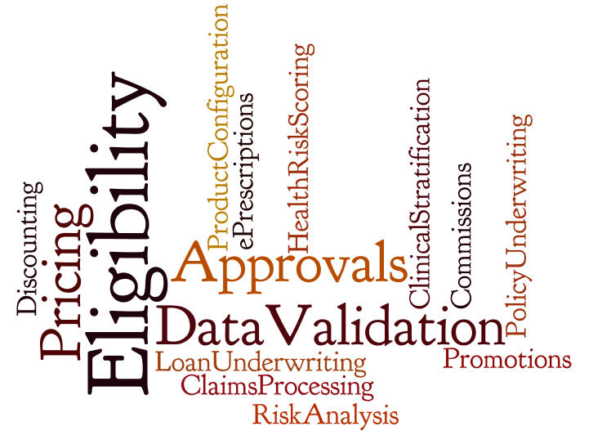
Corticon Use Cases

Slide 5


About Corticon
Corticon enables organizations to make better, faster decisions by automating business rules
DECISIONS
Should we extend this loan?
How to plan a shipment?
Hazardous materials must be shipped in double hull tankers
Don’t offer credit to delinquent accounts
RULES
Decisions in seconds, prevent losses, increase customer satisfaction
avoid disastrous oil spill,
reduce costs

Slide 6


Automating Business Rules – The Problem
Traditional approach is programming-based
Simple rules difficult to automate, sophisticated ones impossible
Single change can impact hundreds of rules/processes
Policies
Regulations
Consumer Behavior
Market Shifts
Competition
Fraudsters Adapting
“That change requires 2 years & 5M”
There Is a Better Way…

Slide 7

Demo 1 – Corticon Rule Modeling

Slide 8

When can OpenEdge Apps Benefit from Corticon?
Is business logic enabling
relatively complex decisions?
Is business logic customized
or personalized for each end user?
Are changes frequently required
to the application’s business logic?
Is accuracy / integrity of logic critical?
Do you require more transparency
into how decisions are made?
The more “yes” answers, the greater the benefit from applying Corticon!
Notes:
Is the business logic the result of relatively complex decisions? Are there many IF-THEN-ELSE blocks and/or CASE statements in the code, relating to setting relatively few, or even just a single, flag or field value(s)?
Is the business logic customised per customer or tenant (in a multi-tenant model), and who determines the changes in the business logic? If changes are made on a per-industry basis (eg. income tax tables, for example) it’s more likely that all customers of an application would require an update; if changes are made per-customer (eg. life insurance risk weightings) then the scope of the changes required are limited to that customer.
How frequently are changes required to the application’s business logic, particularly relative to the application vendor’s release schedule? If business logic changes are relatively infrequent, and releases are relatively frequent, then customers may benefit from the vendor’s development and testing expertise, and not have to perform those actions themselves.
Business analysts and/or business domain experts are readily available at a customer site, but are non-technical.

Slide 9
Corticon Myths
“BRMS is too complex”
  Most BRMSs are, Corticon ISN’T – its ease of use is its #1 differentiator
“BRMS takes too long to learn and apply”
  Many BRMSs do, Corticon DOESN’T – 4 days training + 5 days mentoring is typical
  ‘Forward-engineering’ decision logic is best practice, whenever possible
“BRMS is too expensive”
  Most are, Corticon has User/AA-based pricing aligned with OE licensing models
“BRMS is too ‘Enterprisey’ to apply to me…”
  Usually means too expensive/hard/resource intensive – see above…
Almost any application can benefit from the application of Corticon

Slide 10
Why is Corticon the Best BRMS?
Model-driven Development
Automate rules without coding
Guaranteed Rules Integrity
Ensure safe changes
DeTI (Design Time Inferencing) engine
Market-best performance & scalability
Ease of use
Reliable
Fast
Design-time and Run-time Integration with OpenEdge

Slide 11
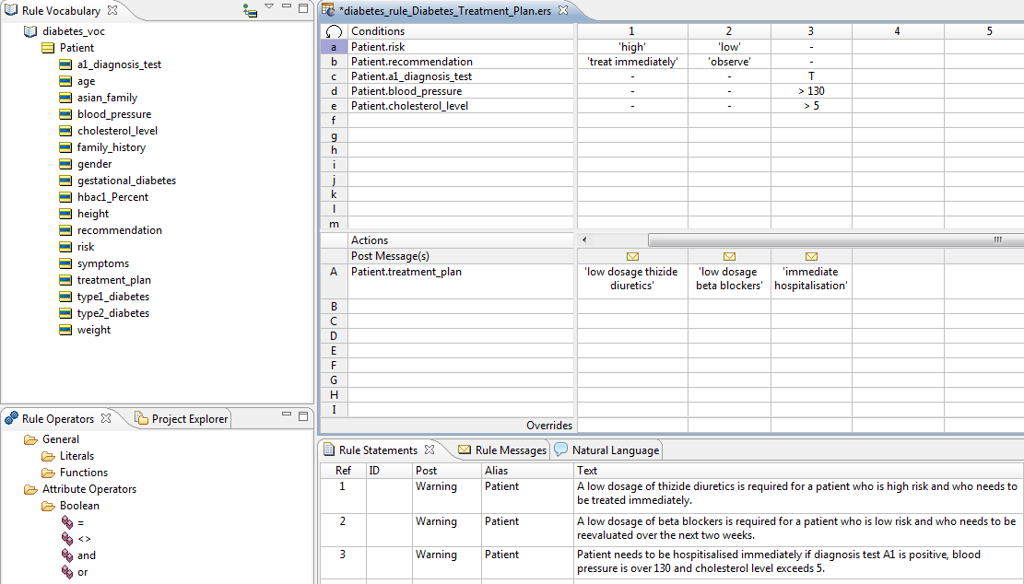
Model-Driven Rules Development
Vocabulary consists of your business objects/terms
Intuitive no-coding approach
Empowers Business Analysts
Accelerate IT Professionals
Patented Excel-like modeling tool
No programming
Business friendly
Natural text
Simple deployment
Rules are constructed with drag-and-drop ease
Comprehensive, extensible library of operators
(akin to Excel functions)
Rule Statements provide rule documentation and traceability
Proven with the most sophisticated business problems

Slide 12
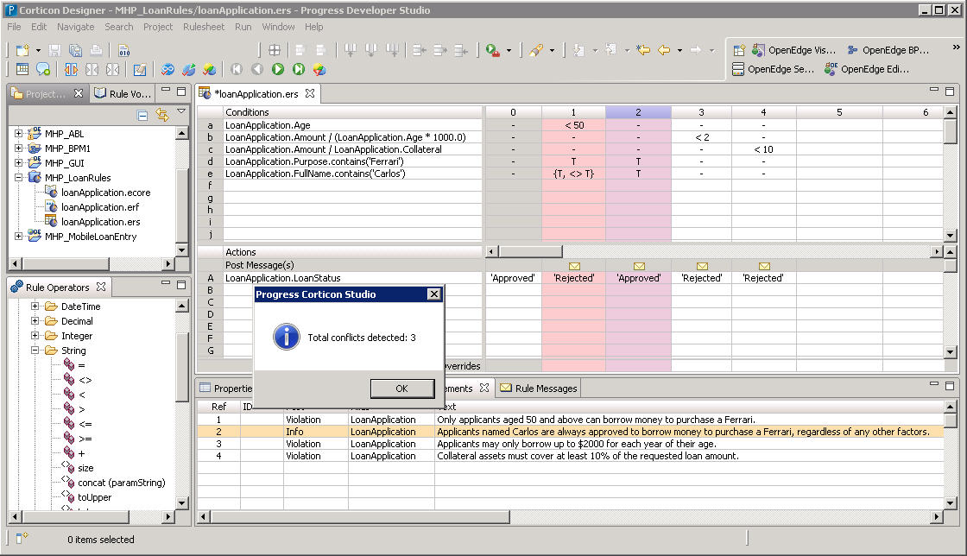
Guaranteed Rule Integrity
Logical Loops
Conflicts
Completeness
Built-in integrity checks ensure creation of accurate, complete & robust rules

Slide 13
Guaranteed Rule Integrity Compresses Development Lifecycle
Traditional Approach
Often contains errors and performance issues
Specify
Design
Templates
Test
Integrate
Deploy
Code
Reduce development
and change cycles
by 90%
Corticon
Approach
Model
Integrate
Deploy
Higher quality, higher performance, agility
Requires Technical Resource

Slide 14

NCAA Case Study: Proven Productivity Benefits of Corticon
Sample ROI Analysis* – Automation of single, decision-making task
 | 1st Generation | Corticon
Initial Development
Analyze | 20 hours | 20 hours
Prepare – Design | 5 hours | N/A
Prepare – Implement | 200 hours | 2 hours
Total | 225 hours | 22 hours
10x
Improvement
Change Cycle
Analyze | 15 hours | 0.5 hours
Prepare – Design | 7 hours | N/A
Prepare – Implement | 28 hours | 1.5 hours
Total | 50 hours | 2 hours
25x
Improvement
*Per NCAA customer testimonial.

Slide 15
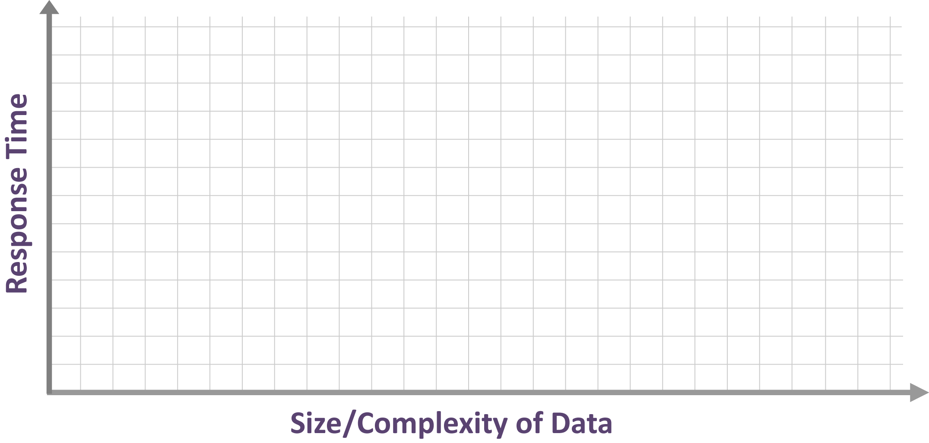






Performance & Scalability
Traditional pattern matching algorithm is Rete
  Scales well with increasing number of rules
  Degrades exponentially with increasing complexity of data – the “Rete Wall”
Corticon’s patented DeTI (Design Time) algorithm
  Scales linearly with number of rules and complexity of data

Slide 16

Next Generation eCommerce
Market Segment:
eCommerce
Online marketplace
Application:
World’s largest online marketplace
Corticon used in next generation eBay marketplace
Corticon selected over IBM Ilog, Drools and in-house rules engine, due to:
  Scalability to hundred+ millions of transactions per day
  Guaranteed rule integrity
  Speed of development
Processing >140M transactions per day, <10ms per transaction

Slide 17

Integration with OpenEdge

Slide 18
How does Corticon integration with OpenEdge?
Design-time Meta-data integration
  Create Corticon vocabulary from existing TempTables and ProDataSets
Simple, fast ABL API
  Simple API that hides most invocation complexity & abstracts transport
  Allows ABL apps to reuse existing data structures as inputs/outputs (ProDataSets, Temp Tables)
  Productivity macros: BR-CONNECT, BR-INVOKE and BR-GETMSG
Run-time code-free database integration using Corticon Enterprise Data Connector
  Enrich request data with dynamic OE DB lookup
  Add or update data in OE DB direct from Corticon decision service
Corticon (and OE-BPM) have there place in OERA
Corticon complements OpenEdge BPM and Rollbase
Web Services integration (pre v11.3)

Slide 19
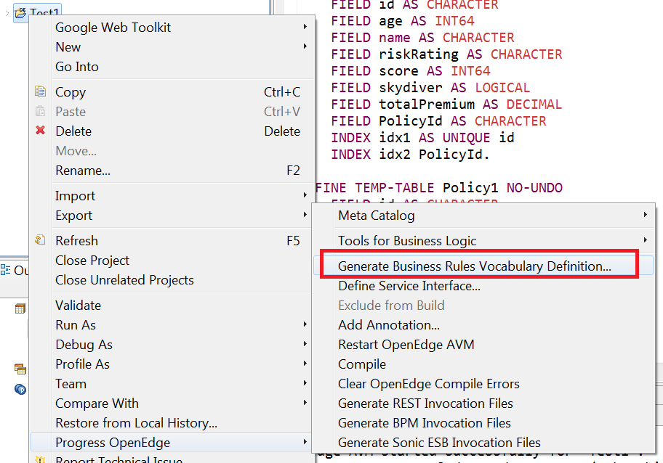
1. Design-time Meta-data Integration
Integrated development experience
  Shared Definition of Vocabulary that rules operate on:
  import Schema definitions, ProDataSets & Temp tables as Corticon vocabulary Entities
Export Temp Table or
Prodataset
to create a
Corticon vocabulary
from Progress Developer
Studio

Slide 20
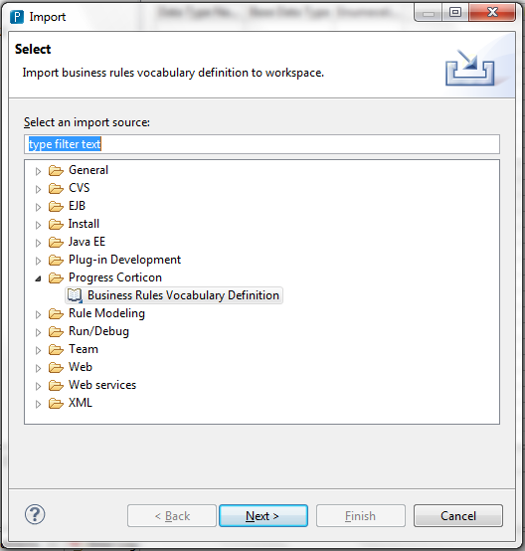
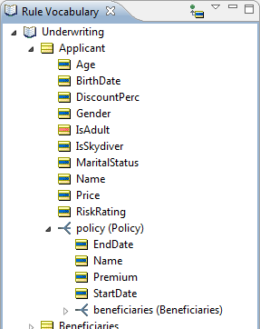
1. Design-time Meta-data Integration
Integrated development experience (continued)
In Corticon Studio
import the .brvd file.
This will create your
Corticon vocabulary.

Slide 21
Demo 2 – Metadata Integration

Slide 22
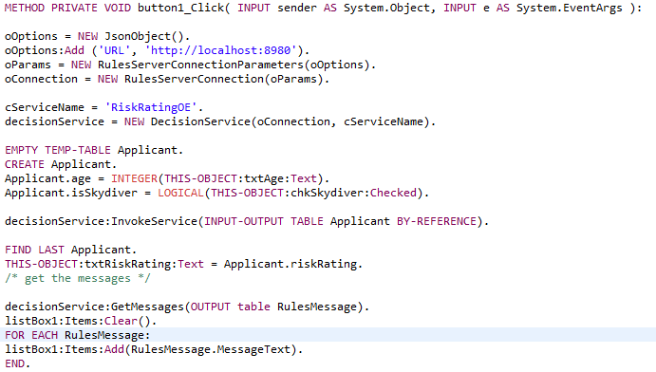
2. OpenEdge Rules ABL API
Establish connection with decision service
Call decision service
Work with the rule execution messages

Slide 23
Demo 3 – OE Rules ABL API

Slide 24
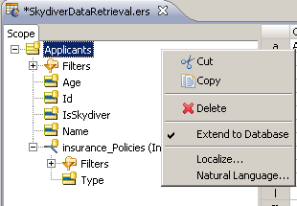
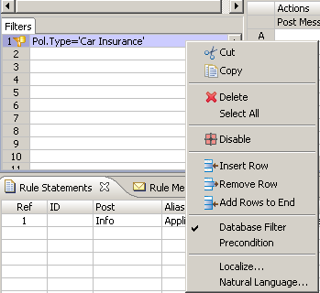
3. Run-time Code-free Database Integration
Corticon access to OpenEdge data and services
  Corticon EDC (Enterprise Data Connectivity) for OE DB (via DataDirect JDBC drivers). Support for OE 11.x and 10.2B
Bind your Corticon
vocabulary to your
OE database tables
Conditionally retrieve
data and optionally
persist results whilst
processing rules
without SQL coding!

Slide 25
Demo 4 – Dynamic Data Integration

Slide 26
4. Corticon is a Core Component of OERA
Open Client Access
ANY PLATFORM, ANY DEVICE, ANY CLOUD
Security
User Interface
Service Interfaces
Mobile
Desktop
Web
Tools
Management
Developer Studio
Process and Policy
Business Processes
Business Rules
Application
Community Frameworks
Adv. Business Language
Integration
Application Server
Data
RDBMS
Replication
DataServers

Slide 27
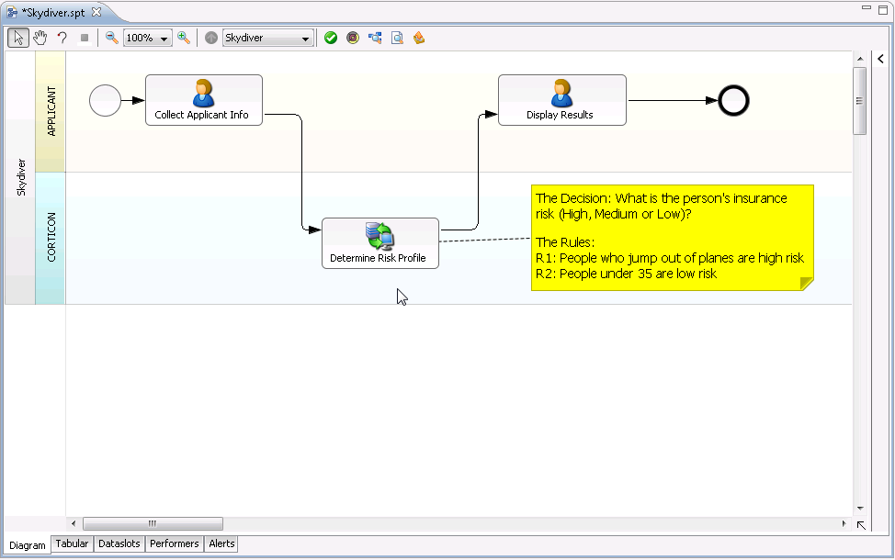
5. Corticon complements OpenEdge-BPM
Access from OpenEdge BPM
  From BPM you would use an OE Managed Adapter
  OE Managed Adapter calls ABL which using OE Rules API to call Corticon
Native Corticon Managed Adapter planned for future OE-BPM release

Slide 28







5. Progress Pacific: Bringing Everything Together
+
+
+
+
Great new capabilities for on-premise deployments
Next-generation platform for SaaS applications
The fast track between
on-premise
and the cloud

Slide 29

Benefits of using Corticon for OE

Slide 30

Why Use Corticon?
Enables business domain experts to more directly assist IT in creation of decision logic
Can free up valuable OE resources
Allows decision logic to be managed in a separate tier with a more agile lifecycle
Accelerates logic development and reduces maintenance time/cost
Improves ease of use through good visual tooling
Integrity checks improve quality of decisions

Slide 31

Additional Resources

Slide 32
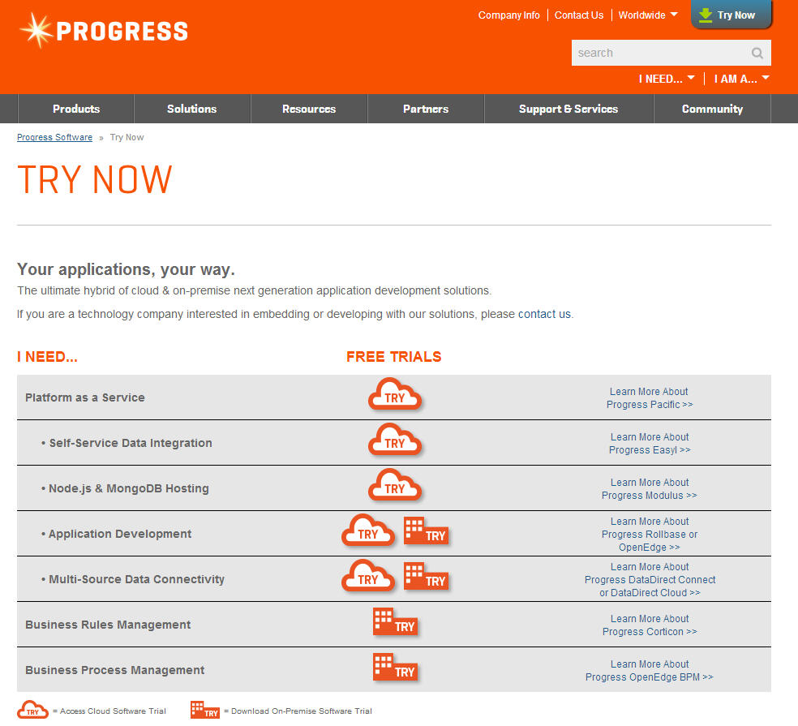
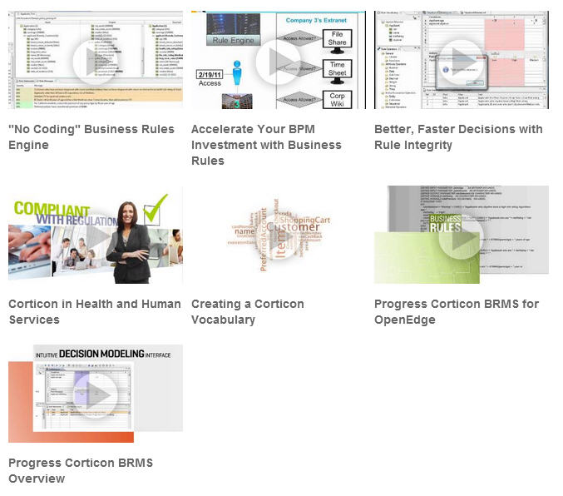

To learn more…
Evaluate Corticon
Corticon on Progress.com / YouTube
Training Courses!

Slide 33

What Next?
TODAY
Corticon Workshop 1:00-5:00 TODAY in Progress Corporate, Bedford
TOMORROW…
Brainstorm use cases with your team – and with your Progress team
Experience a custom demo of Corticon applied in your context
Download an evaluation of Corticon Studio
Build out a proof point use case – it doesn’t take long – and we’ll help!

