Slide 1
XML, JSON and OpenEdge
Robin Brown
Principal Software Engineer, Progress Software
10-June-2014

Slide 2
Disclaimer
This talk includes information about future product enhancements
What we are going to say reflects our views on future projects. The information contained herein is preliminary and subject to change. Any future product we ultimately deliver may be materially different from what is described here.

Slide 3
OpenEdge Support for XML/JSON in the ABL
Release 10
XML Sax-Writer
Release 11
Version 9
XML Schema Validation
More ProDataSet XML Schema Support
XML X-Document
ProDataSet to/from XML
XML Sax-Reader
JSON OO-ABL API
ProDataSet to/from JSON
ProDataSet JSON Before-Image
We keep making XML and JSON easier to use
1999 2000 2001 2002 2003 2004 2005 2006 2007 2008 2009 2010 2011 2012 2013 2014

Slide 4
Agenda
XML in OpenEdge
JSON in OpenEdge
XML vs. JSON
Q & A

Slide 5
Why XML is Important
Why XML?
  Industry standard format for document/data exchange
Use Cases
  Sending structured data over the Internet
    Back bone of Web Services/SOAP
  Sharing data with 3rd party applications
    Crystal Reports
  Persistent storage between ABL sessions
    Context Management

Slide 6
DOM and SAX – V9
Document Object Model (DOM)
  W3C standard
  DOM Tree in Memory
  Application logic - Tree traversal & tree building
Simple API for XML (SAX)
  De facto standard
  Stream – forward only
  Application logic – Callbacks
  Sax-Writer 10.1A
CREATE X-DOCUMENT hDoc.
hDoc:LOAD("file", “Music.xml", FALSE).
CREATE SAX-READER hSax.
hSax:SET-INPUT-SOURCE(“file", "Music.xml").
RUN Handler.p Persistent SET h.
hSax:HANDLER = h.
hSax:PARSE().

Slide 7
SAX-WRITER - STRICT ATTRIBUTE - 10.1A
Forces well-formed XML
CREATE SAX-WRITER
SET-OUTPUT-DESTINATION
START-DOCUMENT
START-ELEMENT
START-ELEMENT
INSERT-ATTRIBUTE
WRITE-DATA-ELEMENT
END-ELEMENT
WRITE-CHARACTERS
END-ELEMENT
END-DOCUMENT

Slide 8
DOM/SAX XML Schema Validation – 10.1A
CREATE X-DOCUMENT hDoc.
hDoc:ADD-SCHEMA-LOCATION ("urn:music", "Music.xsd").
hDoc:LOAD("file", "Music.xml", TRUE /* validate */).
CREATE SAX-READER hSax.
hSax:SET-INPUT-SOURCE (“file”, “Music.xml”).
hSax:SCHEMA-LOCATION = “urn:music Music.xsd”.
hSax:VALIDATION-ENABLED = TRUE. /* validate */
hSax:PARSE( ).

Slide 9
DOM vs. SAX
 | Advantages | Disadvantages
DOM | All data always available In-place updates | Memory Intensive - Cannot handle large docs
SAX | Much less memory than DOM Can stop the parse early Can access data from a “bad” document (Partial Load) | Forward Only Requires Context Management - Callbacks / global variables

Slide 10
ProDataSet/Temp-Table to/from XML – 10.1A
DataSet
WRITE-XML
WRITE-XMLSCHEMA
READ-XML
READ-XMLSCHEMA
ttOrder
ttOline
ttItem
Methods apply to
  ProDataSet
  Temp-Table
  Temp-Table Buffer
.xsd
.xsd
.xml
.xml

Slide 11
WRITE-XML ( ) / WRITE-XMLSCHEMA – 10.1A
Syntax
WRITE-XML (target-type,
{file | stream | memptr | handle | longchar}
[,formatted [,encoding
[,schema-location [,write-schema [,min-schema
[,write-before-image [,omit-initial-values]]]]]])
WRITE-XMLSCHEMA (target-type,
{file | stream | memptr | handle | longchar}
[,formatted [,encoding [,min-schema [,omit-initial-values]]]])
*omit-initial-values added in 10.2A

Slide 12
XML Attributes
Gives you Control over XML format
Attribute | Applies to...
NAMESPACE-URI / NAMESPACE-PREFIX | ProDataSet, Temp-Table and Buffer
XML-NODE-TYPE | Buffer-Field
XML-DATA-TYPE | Buffer-Field
NESTED | Data-Relation
XML-NODE-NAME (10.1C) | ProDataSet, Temp-Table and Buffer
FOREIGN-KEY-HIDDEN (10.2A) | Data-Relation
SERIALIZE-NAME (10.2B) | ProDataSet, Temp-Table and Buffer
SERIALIZE-HIDDEN (10.2B) | Buffer-Field

Slide 13
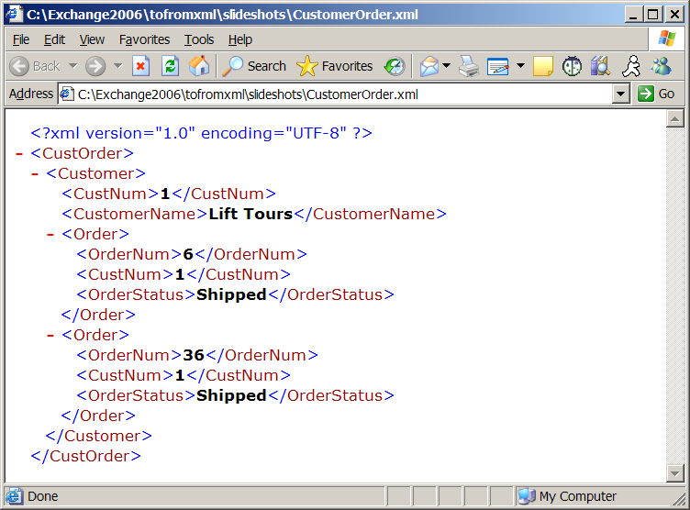
Nested/Foreign-Key-Hidden - Data-Relation
DATASET CustOrder:GET-RELATION(“custOrd”):NESTED = TRUE.
DATASET CustOrder:GET-RELATION(“custOrd”):FOREIGN-KEY-HIDDEN = TRUE.
CustNum not present with FOREIGN-KEY-HIDDEN

Slide 14
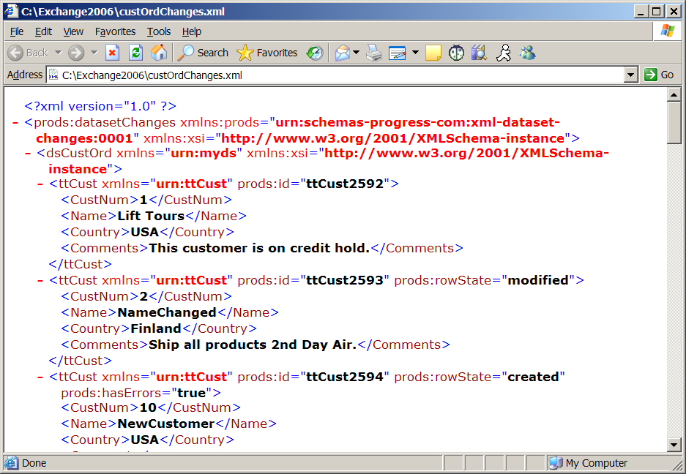
ProDataSet - write-before-image = TRUE
After table data
Record marked as “modified”
Record marked as “created”

Slide 15
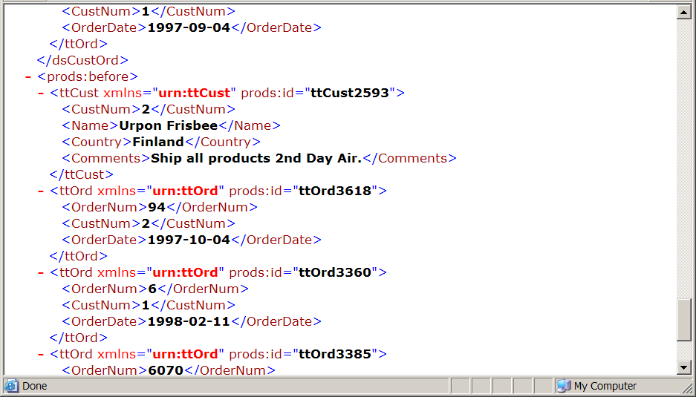
ProDataSet – write-before-image = TRUE
Before-image of modified record

Slide 16
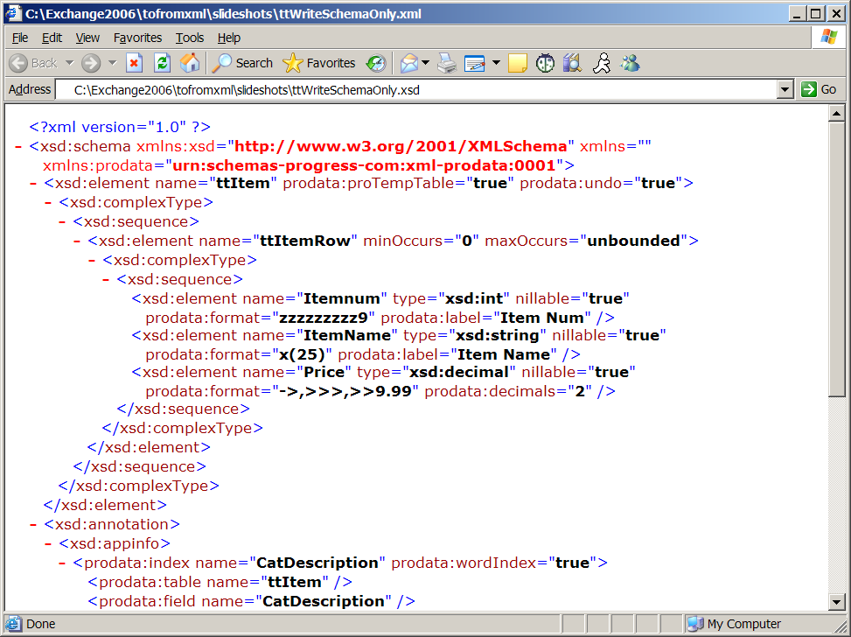
Progress XML Schema Extensions
“prodata” namespace
field-level attributes
non-unique index definition

Slide 17
READ-XML ( ) / READ-XML-SCHEMA ( ) - 10.1A
READ-XML (source-type,
{file | memptr | handle | longchar}
, read-mode, schema‑location, override-default-mapping
[, field-type-mapping [, verify-schema-mode ]])
  Recognizes Before-image format – Progress and Microsoft
  Infers Schema from Data
  Recognizes non-Progress XML Schema formats
    Creates a DataSet - when it can!
READ-XMLSCHEMA (source-type,
{file | memptr | handle | longchar}
, override-default-mapping [, field-type-mapping
[, verify-schema-mode ]])

Slide 18
XML utilities – 10.1A
xsdto4gl – XSD to 4GL utility
  Produces .i with Dataset definition from XML Schema file
wsdldoc – WSDL Analyzer update
  Produces documentation on Web service operation invocation
    Converts <complexType> parameters to Datasets when appropriate
bproxsdto4gl
{ xml-schema-file ... }
bprowsdldoc
{ WSDL-URL ... }

Slide 19
Recognize more XML formats as DataSets – 11.0
Benefit
  Easier integration with 3rd party products
PARENT-ID-RELATION
  Child record has field with RECID of parent
    PARENT-ID-FIELD
  PARENT-FIELDS-BEFORE/AFTER
Availability:
  READ-XML/READ-XMLSCHEMA ( )
  xsdto4gl utility
  wsdldoc utility
WRITE-XML ( ) does the right thing

Slide 20
Example – PARENT-ID-RELATION
<CustomerOrders>
<Customer>
<CustNum>1</CustNum>
<Name>Lift Tours</Name>
<Order>
<OrdNum>100</OrdNum>
<OrdTot>234.89</OrdTot>
</Order>
</Customer>
<Customer>
<CustNum>3</CustNum>
<Name>Hoops</Name>
<Order>
<OrdNum>200</OrdNum>
<OrdTot>899.99</OrdTot>
</Order>
</Customer>
</CustomerOrders>
DEFINE TEMP-TABLE Customer
FIELD CustNum AS INTEGER
FIELD Name AS CHARACTER.
DEFINE TEMP-TABLE Order
FIELD OrdNum AS INTEGER
FIELD OrdTot AS DECIMAL
FIELD Customer_Id AS RECID
XML-NODE-TYPE “Hidden”.
DEFINE DATASET CustomerOrders
FOR Customer, Order
PARENT-ID-RELATION rel1
FOR Customer, Order
PARENT-ID-FIELD Customer_Id.

Slide 21
Example – PARENT-FIELDS-AFTER
<CustomerOrders>
<Customer>
<Order>
<OrdNum>100</OrdNum>
<OrdTot>234.89</OrdTot>
</Order>
<CustNum>1</CustNum>
<Name>Lift Tours</Name>
</Customer>
<Customer>
<Order>
<OrdNum>200</OrdNum>
<OrdTot>899.99</OrdTot>
</Order>
<CustNum>3</CustNum>
<Name>Hoops</Name>
</Customer>
</CustomerOrders>
DEFINE TEMP-TABLE Customer
FIELD CustNum AS INTEGER
FIELD Name AS CHARACTER.
DEFINE TEMP-TABLE Order
FIELD OrdNum AS INTEGER
FIELD OrdTot AS DECIMAL
FIELD Customer_Id AS RECID
XML-NODE-TYPE “Hidden”.
DEFINE DATASET CustomerOrders
FOR Customer, Order
PARENT-ID-RELATION rel1
FOR Customer, Order
PARENT-ID-FIELD Customer_Id
PARENT-FIELDS-AFTER (CustNum, Name).

Slide 22
XML-NODE-TYPE “Hidden” / SERIALIZE-HIDDEN on DATASET – 11.0
Root node maps to temp-table
<person>
<name>Ken</name>
<children>
<child age=“15”>Adam</child>
<child age=“20”>Elana</child>
</children>
</person>
DEFINE DATASET personDset XML-NODE-TYPE “HIDDEN”
FOR person, children, child
...

Slide 23
Agenda
XML in OpenEdge
JSON in OpenEdge
XML vs. JSON
Q & A

Slide 24
Why JSON is Important
JSON: JavaScript Object Notation
  Lightweight data exchange format – Alternative to XML
  http://json.org
Use Cases
  Web development - JavaScript Libraries support JSON
  OE can easily become the back end of a Rich Internet Application (RIA)
    AppServer
    WebSpeed
    REST Adapter and OE Mobile use JSON – 11.2
  Persistent storage between ABL sessions
    Less verbose than XML

Slide 25
JSON Data Types
Four simple data types
  string – “jump rope”
  number – 17, 54.35, 0.9582e-42
  boolean – true, false
  null – null
Non-standard data types commonly used
  date/time – “2011-09-21T11:00:00-04:00”
  binary – Base64 encoded string
Complex data types
  Object
  Array

Slide 26
WRITE-JSON ( ) / READ-JSON ( ) - 10.2B
WRITE-JSON ( mode,
{ file | stream | stream-handle | memptr | longchar }
[, formatted [, encoding [, omit-initial-values
[,omit-outer-object [, write-before-image ] ] ] ] ] )
*omit-outer-object added in 11.0
*write-before-image added in 11.4
READ-JSON ( source-type,
{ file | memptr | handle | longchar | JsonArray | JsonObject }
[, read-mode ] )
*JsonArray and JsonObject added in 11.0

Slide 27
JSON Attributes
Gives you Control over JSON format
Attribute | Applies to...
NESTED | Data-Relation
FOREIGN-KEY-HIDDEN (10.2A) | Data-Relation
SERIALIZE-NAME (10.2B) | ProDataSet, Temp-Table and Buffer
SERIALIZE-HIDDEN (10.2B) | Buffer-Field
PARENT-ID-RELATION (11.0) | Data-Relation

Slide 28
Nested/Foreign-Key-Hidden - Data-Relation
DATASET CustOrder:GET-RELATION(“custOrd”):NESTED = TRUE.
DATASET CustOrder:GET-RELATION(“custOrd”):FOREIGN-KEY-HIDDEN = TRUE.
{"CustomerOrder": {
"Customer": [
{ /* Row */
"CustNum": 1, /* Column */
"Name": ["L","Frank","Baum"],
"Balance": 55000.0,
"Order": [
{"OrderNum":100,"CustNum":1,"OrderDate":"2009-01-12"},
{"OrderNum":101,"CustNum":1,"OrderDate":"2009-01-12"}
]
}
]
}}
CustNum not present with FOREIGN-KEY-HIDDEN

Slide 29
WRITE-JSON – omit-outer-object – 11.0
omit-outer-object = FALSE
omit-outer-object = TRUE
{“tt”: [
{“f1”: 11, “f2”: 12},
{“f1”: 21, “f2”: 22},
{“f1”: 31, “f2”: 32}
]}
[
{“f1”: 11, “f2”: 12},
{“f1”: 21, “f2”: 22},
{“f1”: 31, “f2”: 32}
]

Slide 30
ProDataSet - write-before-image = TRUE – 11.4
After table data
{"dsCustomer": {
"prods:hasChanges": true,
"ttCust": [
{
"prods:id": "ttCust10497",
"prods:rowState": "modified",
"CustNum": 2,
"NAME": "Urpon Frisbee_NewName",
"Balance": 903.64
},
{
"prods:id": "ttCust10498",
"prods:rowState": "created",
"CustNum": 10,
"NAME": "Customer10",
"Balance": 56000.0
}
],
Record marked as “modified”
Record marked as “created”

Slide 31
ProDataSet – write-before-image = TRUE
Before table data
"prods:before": {
"ttCust": [
{
"prods:id": "ttCust8449",
"prods:rowState": "deleted",
"CustNum": 3,
"NAME": "Hoops",
"Balance": 1199.95
},
{
"prods:id": "ttCust10497",
"prods:rowState": "modified",
"CustNum": 2,
"NAME": "Urpon Frisbee",
"Balance": 437.63
}
]
}
Before-image of deleted record
Before-image of modified record

Slide 32
Inferring Schema from JSON Data – READ-JSON ( )
Examines data to determine type
  CHARACTER (JSON string type)
  DECIMAL (JSON number type)
  LOGICAL (JSON boolean type)
  If all data values are null (?)
    CHARACTER
Can infer NESTED Dataset Relationships
  Including PARENT-ID-RELATIONs

Slide 33
Buffer-Object:SERIALIZE-ROW ( ) – 11.0
Serialize ONLY current row
Target-format “JSON” and “XML”
Syntax
SERIALIZE-ROW
( target-format, target-type,
{ file | stream | stream-handle | memptr | longchar }
[, formatted [, encoding [, omit-initial-values
[, omit-outer-object ] ] ] ] )

Slide 34
OOABL JSON API – JSON Object – 11.0
Progress.Json.ObjectModel.JsonObject
  Collection of name/value pairs
  No order
  Access by property name
  Object surrounded by curly braces { }
Can INHERIT from
{ “name-1” : value-1, “name-2” : value-2, “name-3” : value-3}

Slide 35
JSON Object Example
myObject = NEW JsonObject().
myObject:Add("name", "Dorothy Gale").
myObject:Add("age", 38).
myObject:Add("region", "Kansas, USA").
myObject:Write(myLongchar, TRUE).
myLongchar:
{
"name" : "Dorothy Gale",
"age" : 38,
"region" : "Kansas, USA"
}
vChar = myObject:GetCharacter(“name”).
vInt = myObject:GetInteger(“age”).

Slide 36
OOABL JSON API – JSON Array – 11.0
Progress.Json.ObjectModel.JsonArray
  Ordered list of unnamed values
  Strict order
  Access by array index
  Surrounded by square brackets [ ]
Can INHERIT from
[ value-1, value-2, value-3, value-4 ]

Slide 37
JSON Array Example
myArray = NEW JsonArray().
myArray:Add(1).
myArray:Add(FALSE).
myArray.Add(“jump rope”).
myArray:AddNull().
myArray:Write(myLongchar, TRUE).
myLongchar:
[ 1, false, “jump rope”, null ]
myArray:Set(2, 6.0).
vDec = myArray:GetDecimal(2). /* vDec = 6.0 */
vLog = myArray:GetLogical(4). /* vLog = ? */

Slide 38
Complex JSON Values
Combination of simple values, objects and arrays
{
"salesRep" : { "name" : "Dorothy Gale",
"age" : 38,
"region" : "Kansas, USA"
},
"tractorSales" : { "2009Quarterly" : [ 13, 27, 18, 9 ],
"2008Quarterly" : [ 11, 17, 32, 5 ],
"2007Quarterly" : [ 9, 25, 16, 10 ]
}
}

Slide 39
JSON API ProDataSet / Temp-Table Support
JsonObject:Read ( )
  Dataset
  Temp-Table
  Temp-Table Buffer
JsonArray:Read ( )
  Temp-Table
READ-JSON ( ) Enhancement
  New source types
    JsonObject
    JsonArray

Slide 40
Agenda
XML in OpenEdge
JSON in OpenEdge
XML vs. JSON
Q & A

Slide 41
XML vs. JSON
 | Advantages | Disadvantages
XML | Extensible Formal XML Schema support (W3C) Datasets can interoperate with .NET format | More verbose than JSON Can be memory Intensive - READ-XML cannot handle large docs
JSON | Lighter weight than XML Easily consumed by JavaScript, etc. Data maps directly to native variables Preferred for RESTful web services | No formal schema support JSON Schema not in ABL Harder to deal with binary data
Consider the consumer of your data

Slide 42
Google: XML vs. JSON
“In terms of simplicity, openness, and interoperability, JSON and XML are tied.”
“Both of these standards use Unicode standards and they both create data in a way the allows generic tools to manipulate the data.”
https://www.udemy.com/blog/json-vs-xml
“JSON is a better data exchange format. XML is a better document exchange format. Use the right tool for the right job.”
“XML is document-oriented. JSON is data-oriented. JSON can be mapped more easily to object-oriented systems.”
http://www.json.org/xml.html

