Slide 1
Introducing OpenEdge Mobile
June 2014
Shelley Chase, Senior Architect, Progress

Slide 2
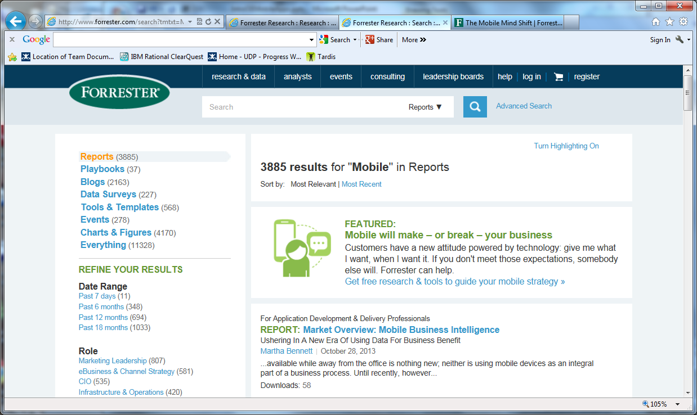
Mobile Apps are Essential for Businesses Today
Gartner: Mobile Trends and Issues From 2013 to 2016
…mobility is also the best opportunity for genuine business innovation that most companies will see this decade.
27 March 2013
Gartner Recommends a Hybrid Approach for Business-to-Employee Mobile Apps
HTML5-based web apps and native apps, will be used in more than 50 percent of mobile apps by 2016
"Predicts 2013: Portal and Web Technologies."

Slide 3
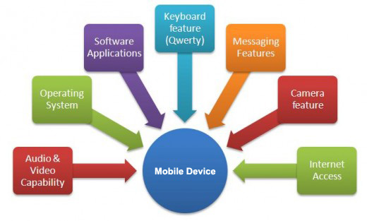
Mobile Devices and Apps
Mobile Devices
  Tablets and smart phones
  Devices that combine telephony and computing
  Screen sizes vary from 3 inches to over 10 inches
  Most high end devices have multiple cores and large amounts of RAM
Mobile Apps (Software applications)
  Utilities: e-mail, calendar
  Time wasters: Facebook, Angry Birds
  Business Apps for employees
  Business Apps for B2C
Notes:
So what exactly is a mobile device? I am sure we can all agree that a device which implies mobility should be portable. It is generally either a smartphone or a tablet with screen sizes typically ranging from 3 inches to over 10 inches. A mobile device available today also has large computing power- it generally has multiple processor cores running at a few GHz and large amounts of RAM. In fact, a mobile device is almost as powerful as a traditional PC. Smartphones and tablets combine computing and telephony apart from providing a number of other bells and whistles like hi-res cameras, HD displays and multimedia capabilities. They also sport myriad connectivity options like wifi , 3/4G, DLNA, Bluetooth and NFC. Mobile devices support intuitive user interaction via touch interfaces.

Slide 4
Mobile App Development – Challenges
OS fragmentation
  Different development environments
  Different programming languages
  Duplicate codebase
Market demand
  Rapid App Development (RAD) imperative
  Critical offering in today's pressing competition
  Frequent updates; short shelf life
Integration with disparate backend systems
  Access existing systems and data sources
  Manage changes to backend systems
Notes:
The first on top of the list is the large scale fragmentation in the mobile OS/platform market. Though there are signs of consolidation, the market is far from having a clear winner. Till such time, developers have no option but to have an app for each major OS unless they have very specific requirements and target a single platform.
Though there are development tools provided by the major platform vendors, these are specific to their particular platform. There are very few tools which allow you to seamlessly develop, test and deploy on all the major platforms.
Add to this the problem of the rising spread of malware in mobiles. What was once the preserve of PCs has now found a fertile breeding ground in the mobile space.
It is imperative to ensure security at both the client level and the server level. There should be support for client-server communication over HTTPS using SSL/TLS.

Slide 5
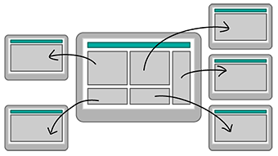
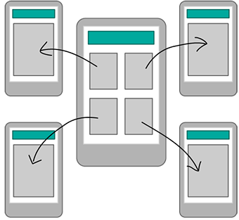
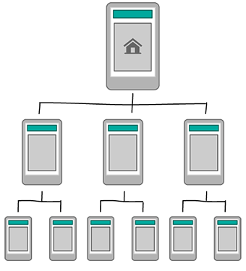
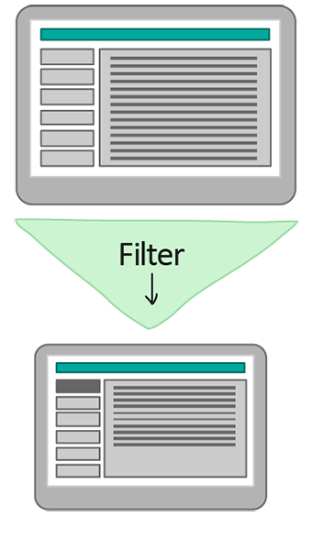
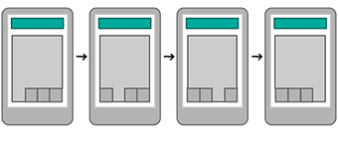
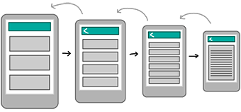
Mobile App Development – User Experience is Key
Focused functionality – specific for the task at hand
  Productive user experience; natural look and feel for the device
Functionality will be used on many devices and computers
  Consistency in all mediums is critical
Bento Box / Dashbox
Hub and Spoke
Filtered View
Hierarchy
Tabbed View
Nested Doll
Notes:
Mobile apps should also offer a seamless user experience when transitioning across devices. Consider the example of a user who initiates an order from some online vendor on a PC. He then monitors the status on a tablet while attending a meeting. The vendor then sends alerts to his smartphone when the user happens to be commuting.

Slide 6
OpenEdge Mobile

Slide 7
Mobile Applications in OpenEdge: Dual Approach
  OpenEdge REST Adapter
  Loosely-coupled architecture
  Any client
  Define Service Interface using annotations
  HTTP/JSON
  OpenEdge Mobile
  Tightly-coupled architecture - prescriptive
  Mobile App Builder using jQuery Mobile and Cordova
  Business Entity support as well as service interface annotations
  HTTP/JSON but prescriptive content

Slide 8
OpenEdge Mobile
Value Proposition
  Write Once, Run Anywhere Portability with the Benefits of Native Applications. The Easiest Way to Build an OpenEdge Application Supporting Mobile Devices, End-to-end
Benefits
  A comprehensive and integrated tool set with support for a wide variety of devices
  Mobile UI development is cloud-based, so collaboration among the development team, business analysts and with end users is fully supported
  Leverage existing business logic, the OpenEdge AppServer and OE database

Slide 9
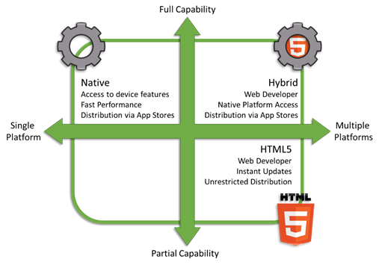
Types of Mobile Apps

Slide 10

Requirements for Android Native App Development
Need to learn Java
Need Java development environment (free ones available)
App review more relaxed than Apple
Large variation of OS versions and customizations by device vendors
  A lot of devices in use with old versions
Notes:
Developing a pure native app for Android is fraught with its own set of problems. The main problem is the sheer number of both OS versions and devices. In sharp contrast with Apple which has a limited number of devices (two phones and two tablets), anything goes in the Android world. As there are no fixed device sizes to speak of, developers will have to compromise by developing apps with an average form factor in mind. Add to this the problem where a number of Android devices are still running on earlier versions of Android. If you want to support these devices, you will have to jump through a few hoops and also miss out on using the new features and API available in later versions.

Slide 11

Requirements for Native App Development
Development must be done using Mac OSX
Need to learn Objective-C
Need a developer subscription
iOS UI can change drastically across releases
Controlled distribution:
  Every app is reviewed by Apple — even updates
Notes:
Let us now look at problems developers face when developing native apps specifically for one of the two dominant platforms- iOS. As you know, native apps are written specifically for a particular platform. Native apps for iOS presuppose a good knowledge of Objective C.
App review is sometimes whimsical- your app can be rejected if Apple decides it does not conform to its high standards. The review process also takes variable time. This can be especially problematic when trying to push quick updates to existing apps. Developer subscription fees are $ 99 yearly- this is $299 for subscription to the Enterprise program.
Look and Feel could also change drastically across versions. Case in point- iOS 7 has completely changed the shape of buttons, fonts and flattened a number of elements. If you had spent a lot of time and effort on getting those custom UI elements just right, you would have no option but to go back to the drawing board to fit in with Apple’s new design philosophy.

Slide 12
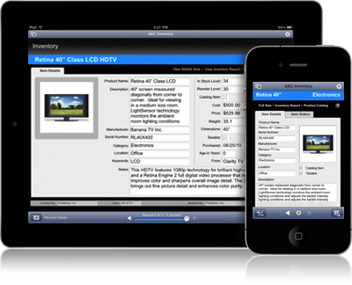
OpenEdge Mobile Apps = “The Best Of Both Worlds”
Hybrid App (Native Wrapper + Web App)
Standards-based solution
Write the UI code once, deploy to multiple devices
Native container provides support for App Store and HTML5 limitations
Flexible deployment options of both Web App and Hybrid App
No need to learn device-specific languages or development environments
By 2015, 80% of all mobile web applications developed will be hybrid or mobile web.
Gartner 2012: Magic Quadrant for Mobile Consumer Application Platforms

Slide 13
OpenEdge Mobile in Action

Slide 14
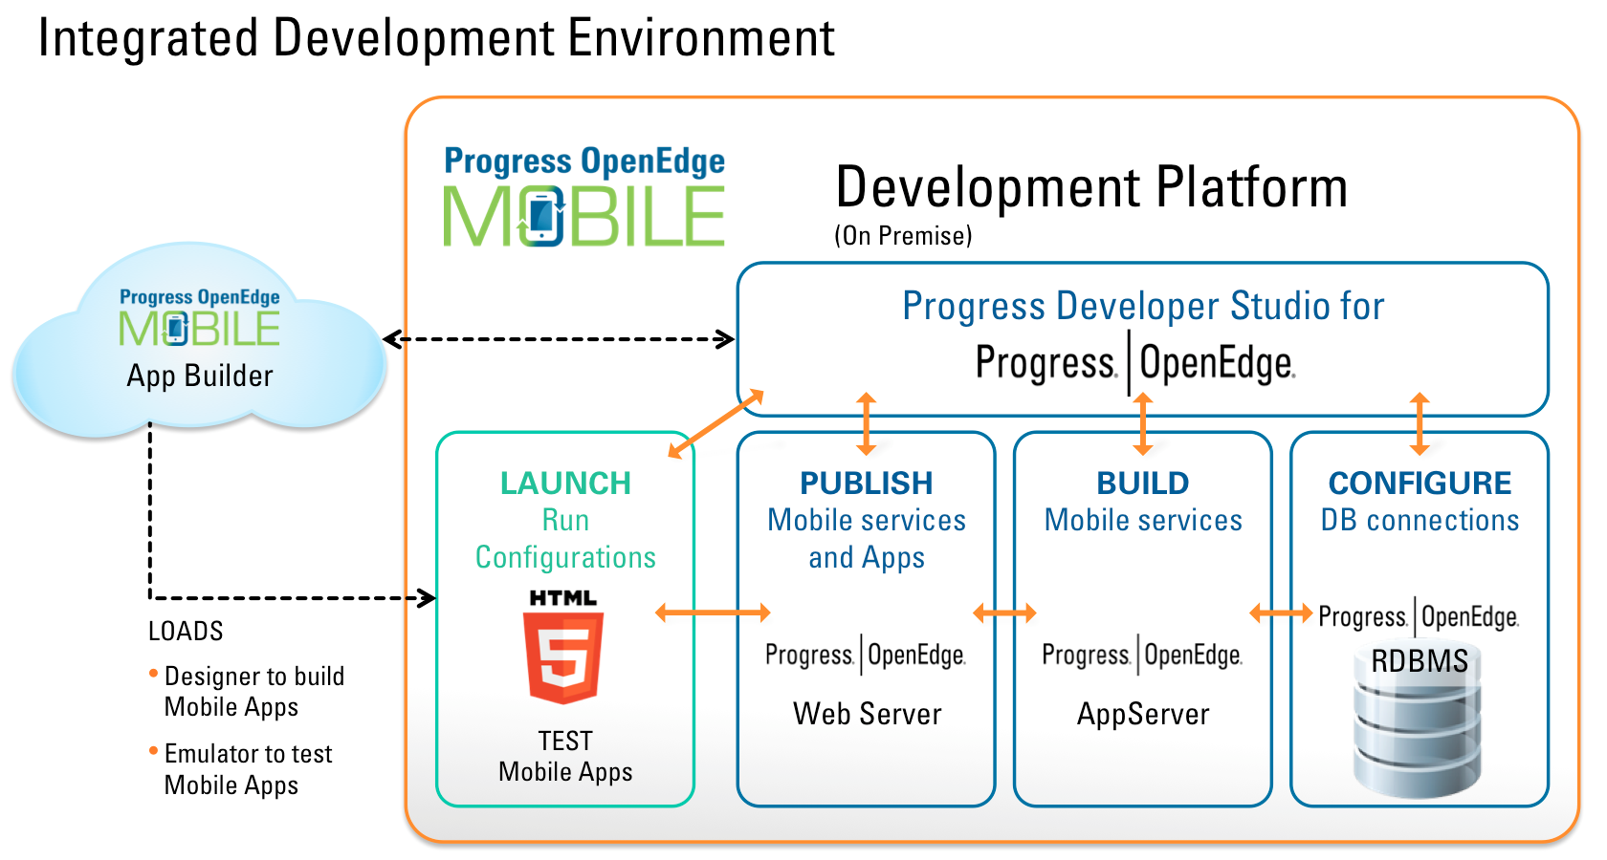
Development: Integrated Development Environment
Developer Studio for OE
  Define and build Mobile services
    JavaScript Data Object (JSDO) catalog
  Deploy Mobile services and Mobile Web Apps
  Run in emulator
Mobile App Builder
  Drag-n-drop UI designer
  Tight data binding to OE data using JSDO
  Export mobile apps for deployment
  Integrated emulator
Notes:
Let’s start with description that sums up OpenEdge Mobile.
OpenEdge Mobile provides support to write applications designed to run on mobile devices
that can access business logic and data on OpenEdge AppServers.
We’ll dive deep taking a look at how to develop and deploy OpenEdge Mobile applications,
and to gain a full appreciation of why OpenEdge Mobile is a compelling product in the market place today.

Slide 15
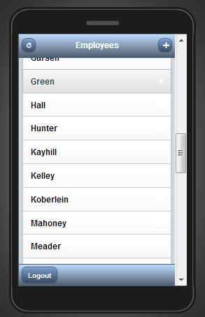
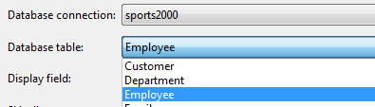
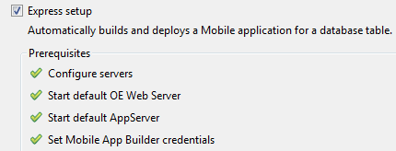
Progress Developer Studio for OpenEdge: Express Mobile App
Select a database table
Automatic check of system configuration
Wait while App is built and deployed
  Fully functional CRUD Mobile App with login screen

Slide 16
Developing a Custom Mobile App
Step 1
Step 2
Step 3
Step 4
Define OE services
Build UI
Build and deploy
Bind data and UI
Define OE services (Business Entities) in Progress Developer Studio for OpenEdge
Build UI in cloud-based Mobile App Builder
Import OE services to Mobile App Builder and map data to UI
Finally build and deploy as native or mobile web app

Slide 17
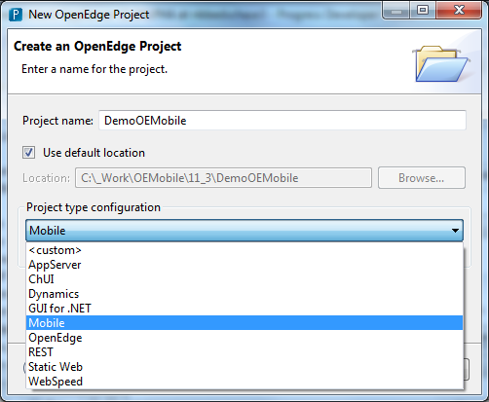
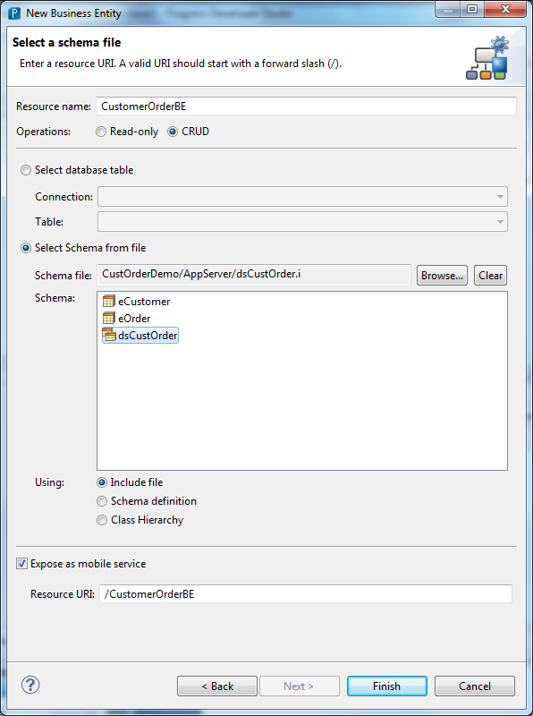
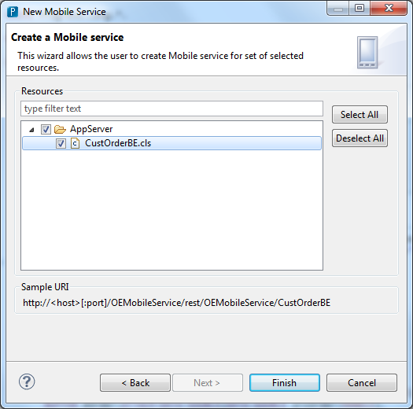
Step 1: Define Mobile Service
  CRUD operations
  Invoke operations
  Mobile Resources
  Create Business Entity classes
  or annotate existing code
  Deploy / publish

Slide 18
Create Mobile Project

Slide 19
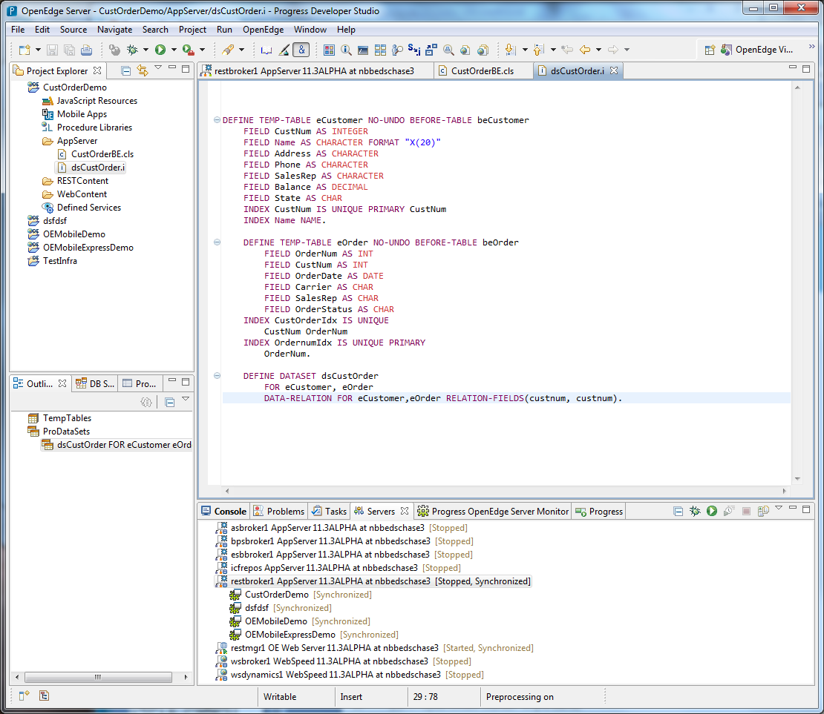
Business Entity

Slide 20
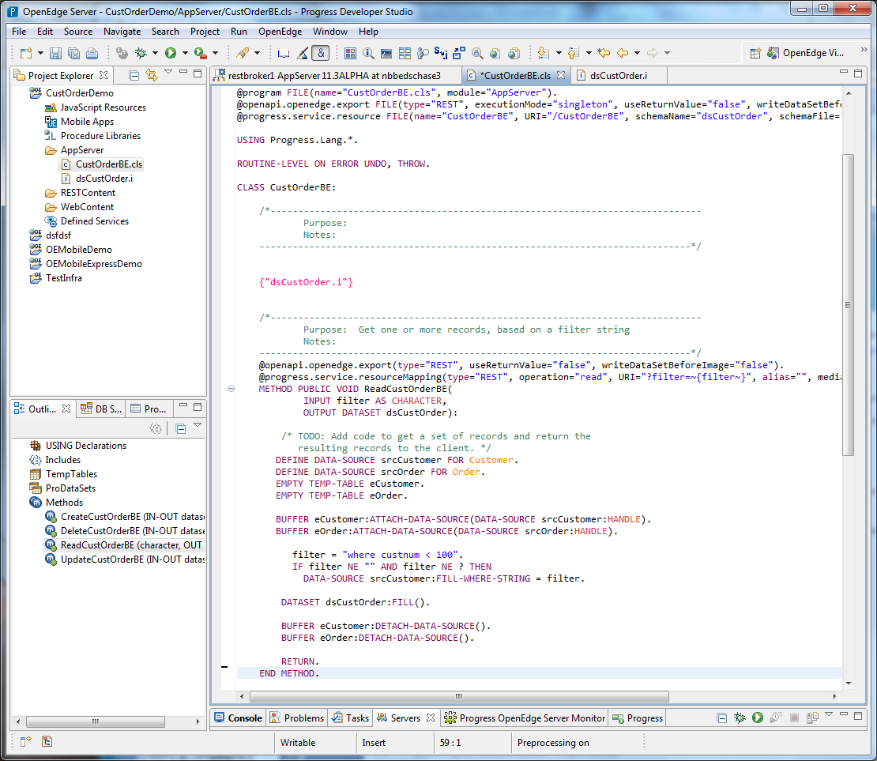
Business Entity

Slide 21
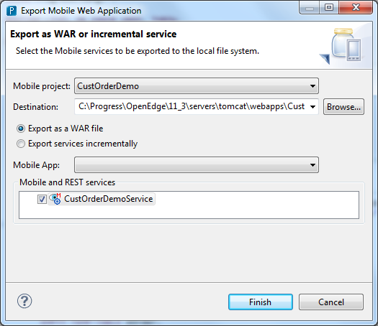
Build and Deploy Mobile Service

Slide 22
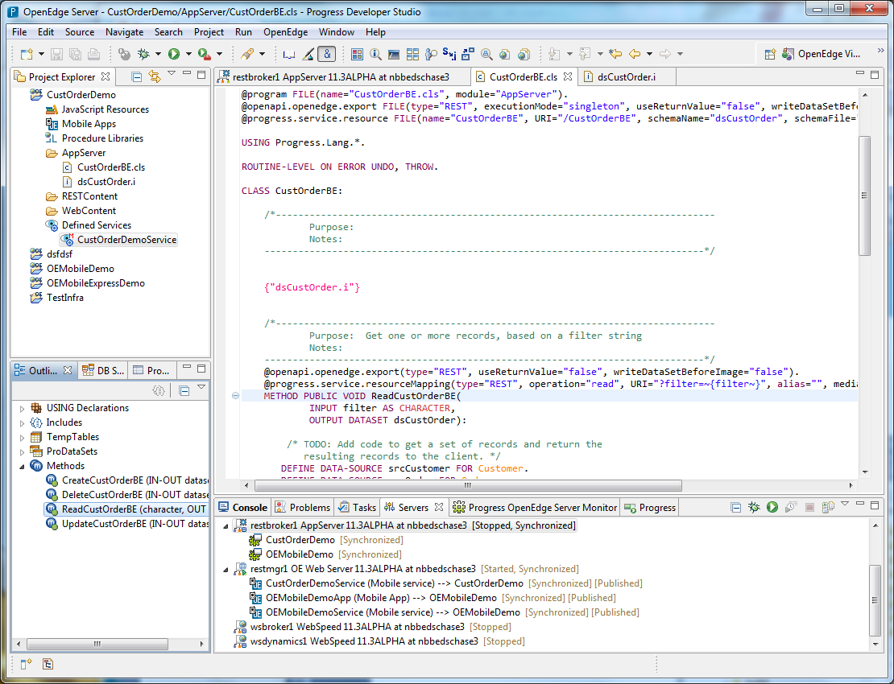
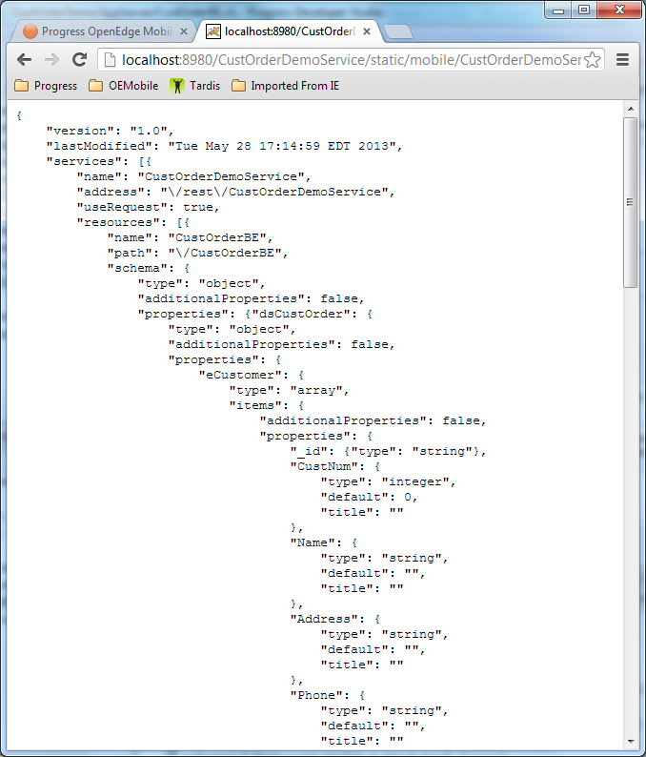
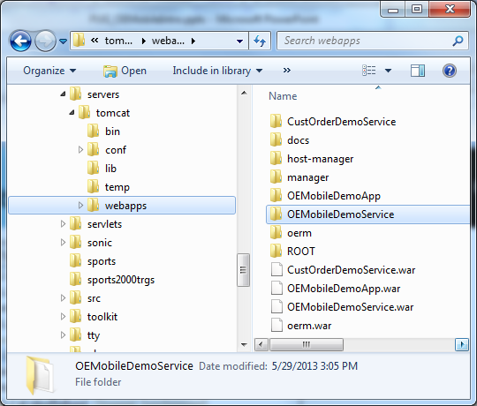
Deployed Mobile Service

Slide 23
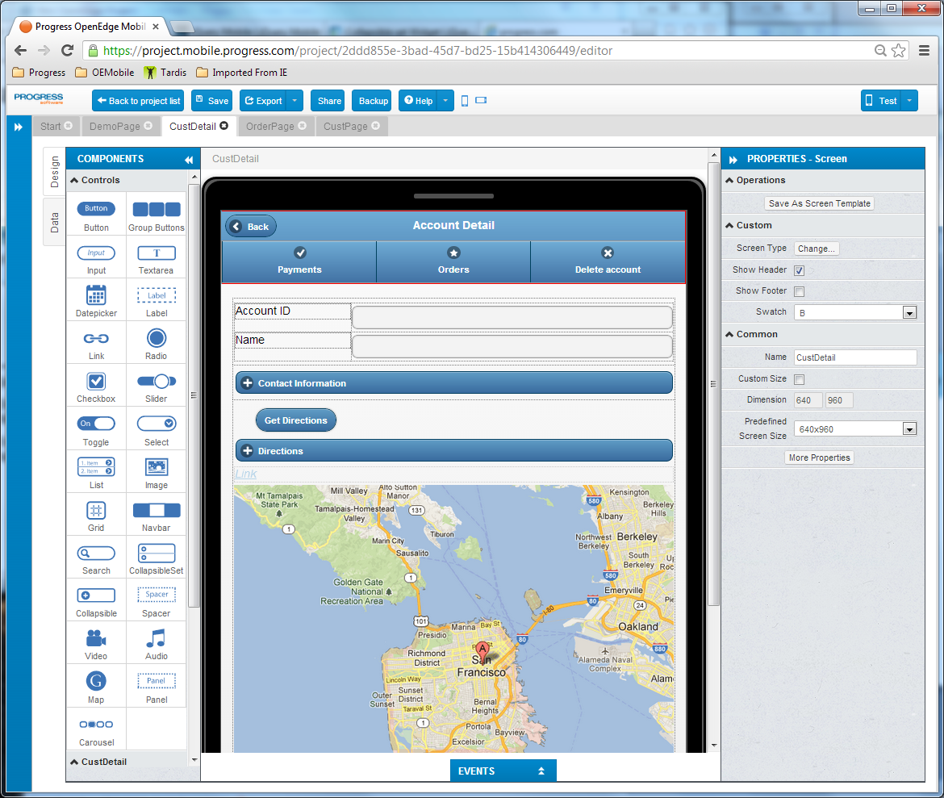
Step 2: Build the UI

Slide 24
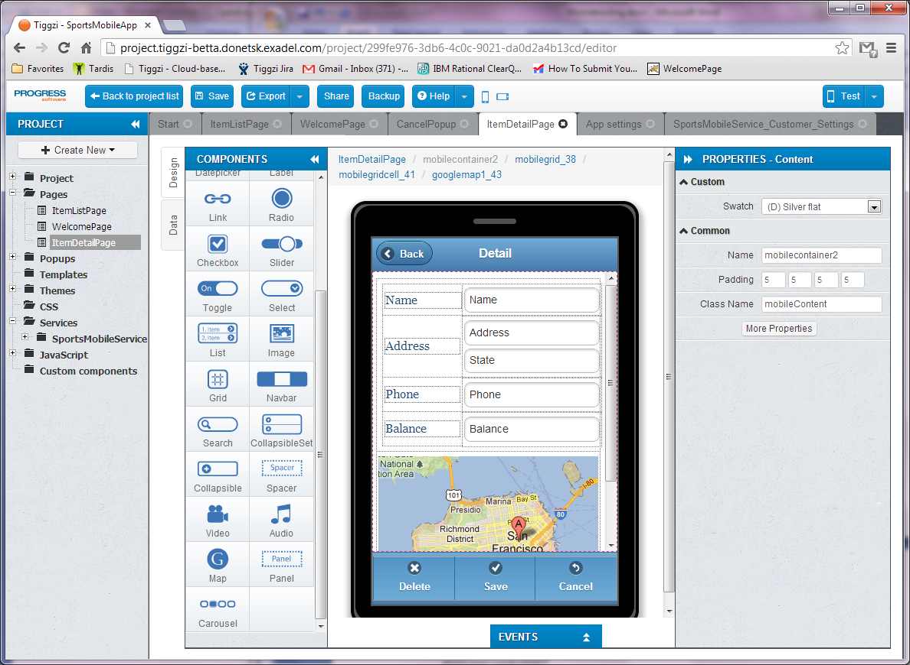
“WYSIWYG” Designer

Slide 25
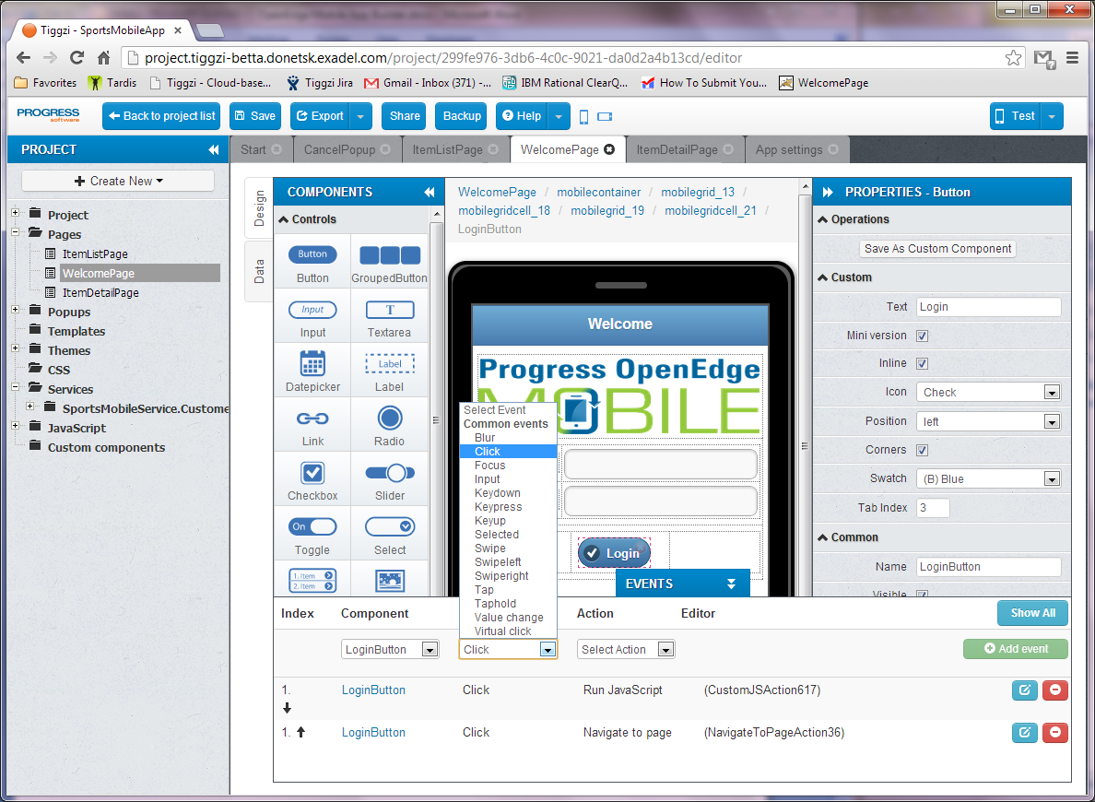
Add Events for UI Logic

Slide 26
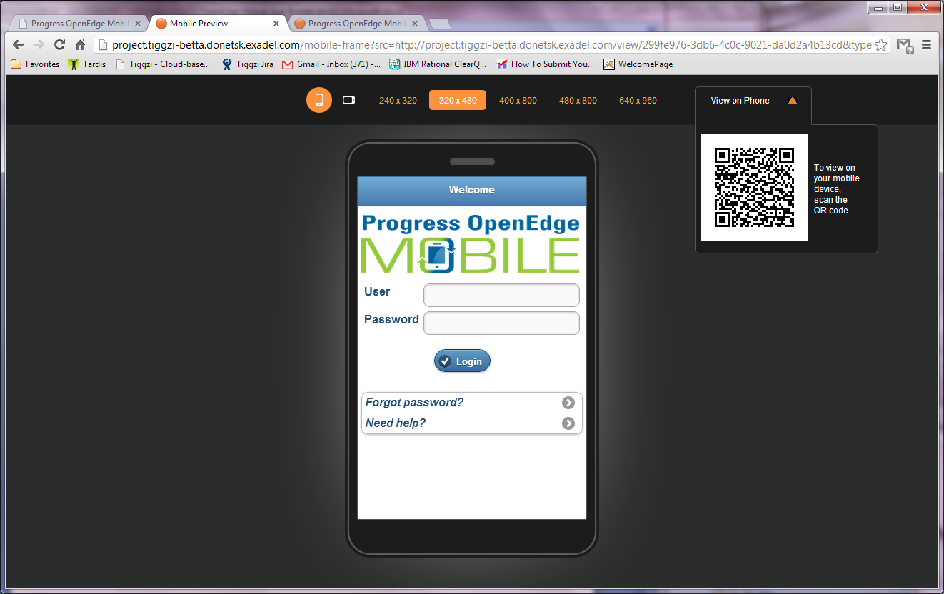
Emulator

Slide 27
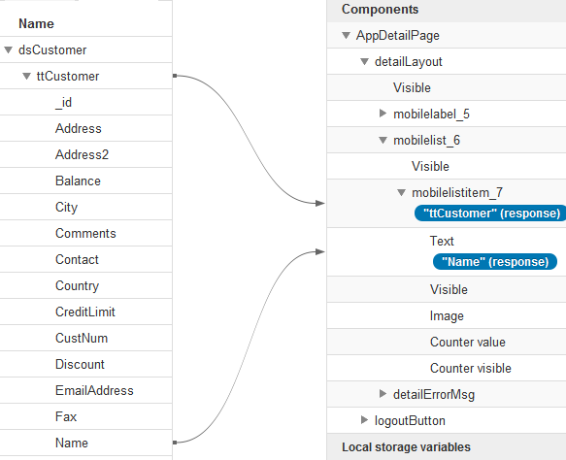
Step 3: Bind Data and UI
  JavaScript Data Object (JSDO)
    Simplifies interaction with REST Services
    Client-side data set
    Support for CRUD and invoke operations
    Handles connection and communication
    Session management built-in
JSDO
Customer
Order

Slide 28
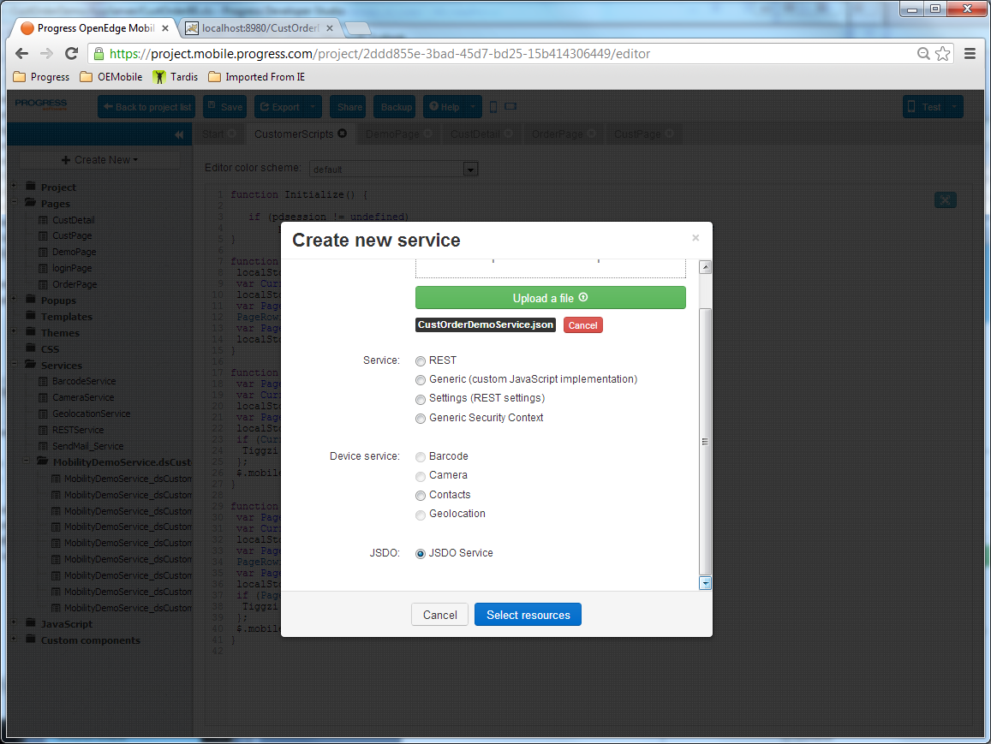
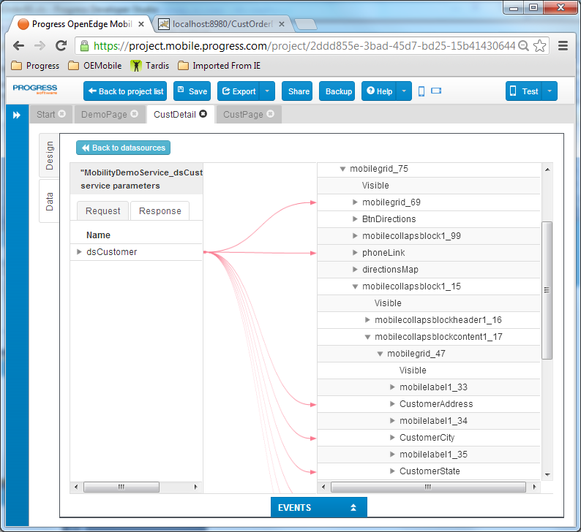
Use JSDO Service for Visual Data Mapping

Slide 29
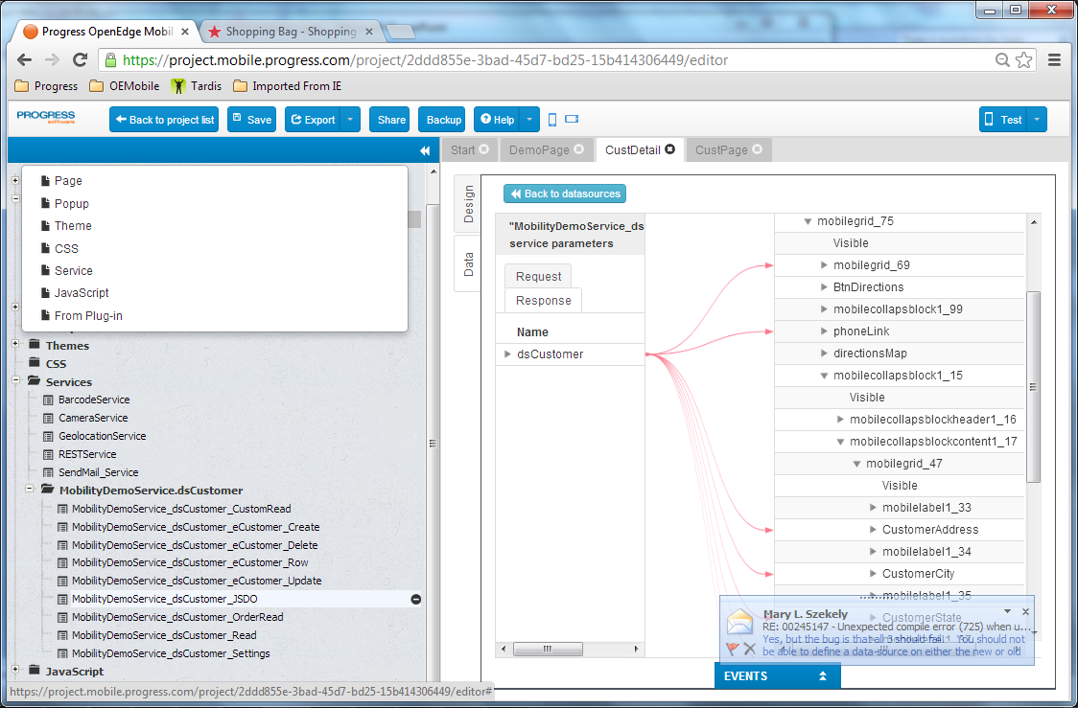
Create JSDO Service from Catalog

Slide 30
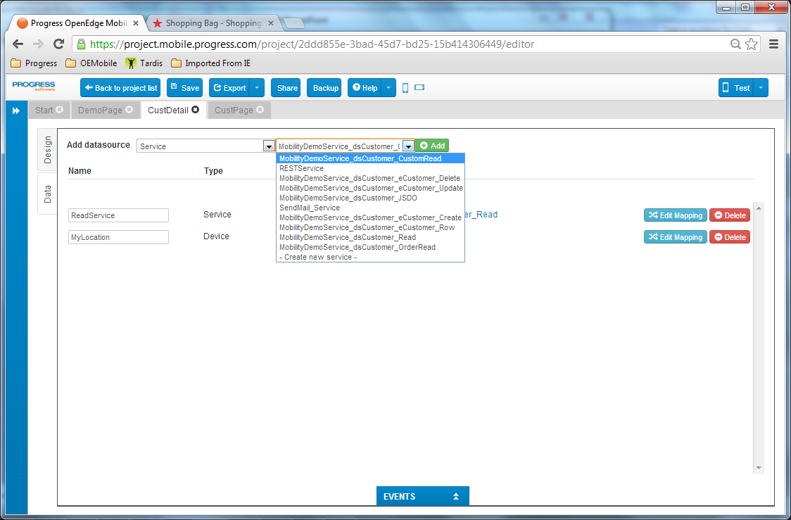
Add JSDO Services to UI

Slide 31
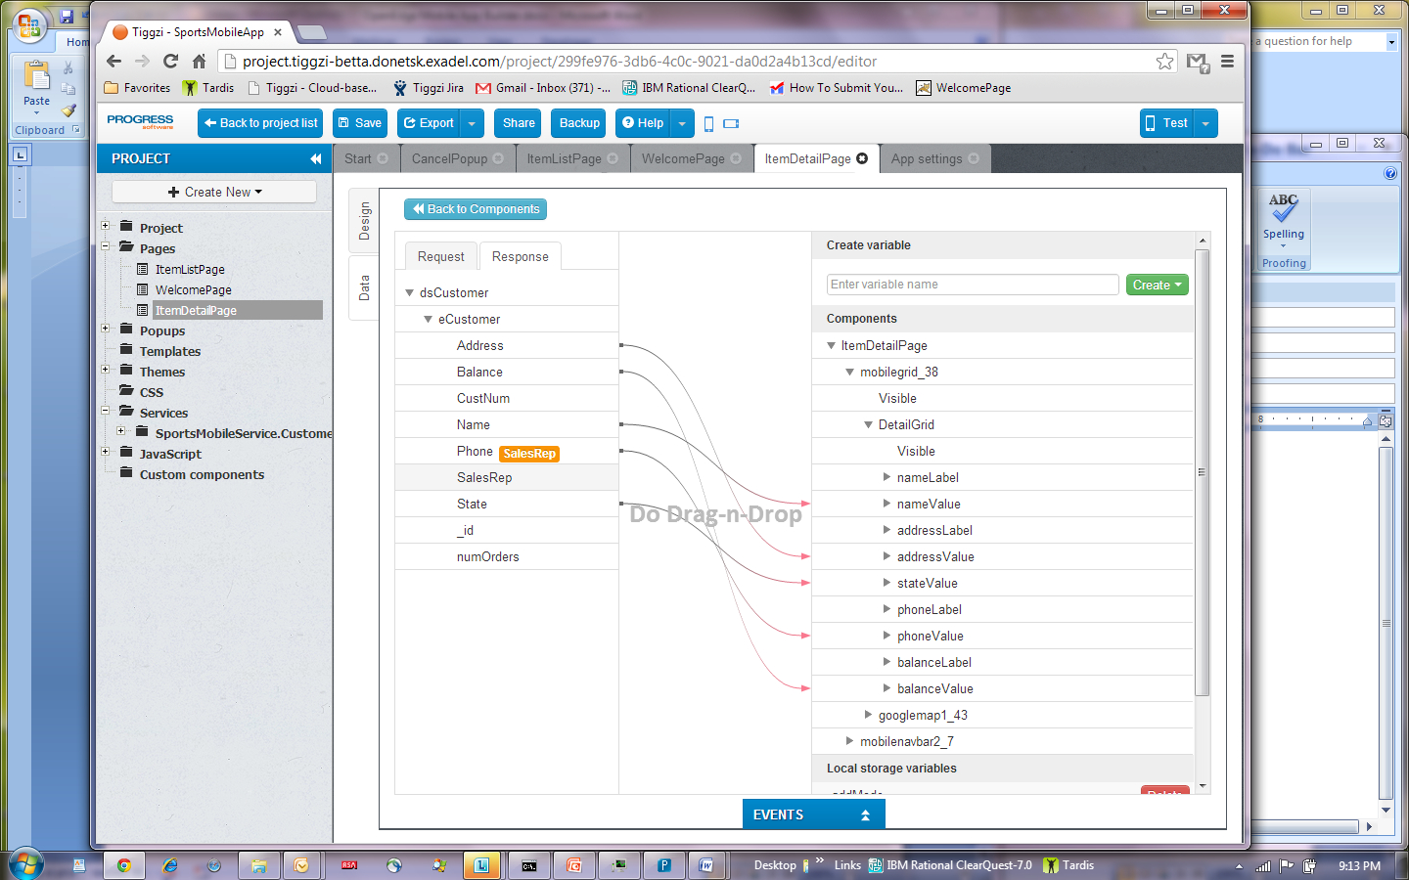
Drag-n-drop Data mapping

Slide 32
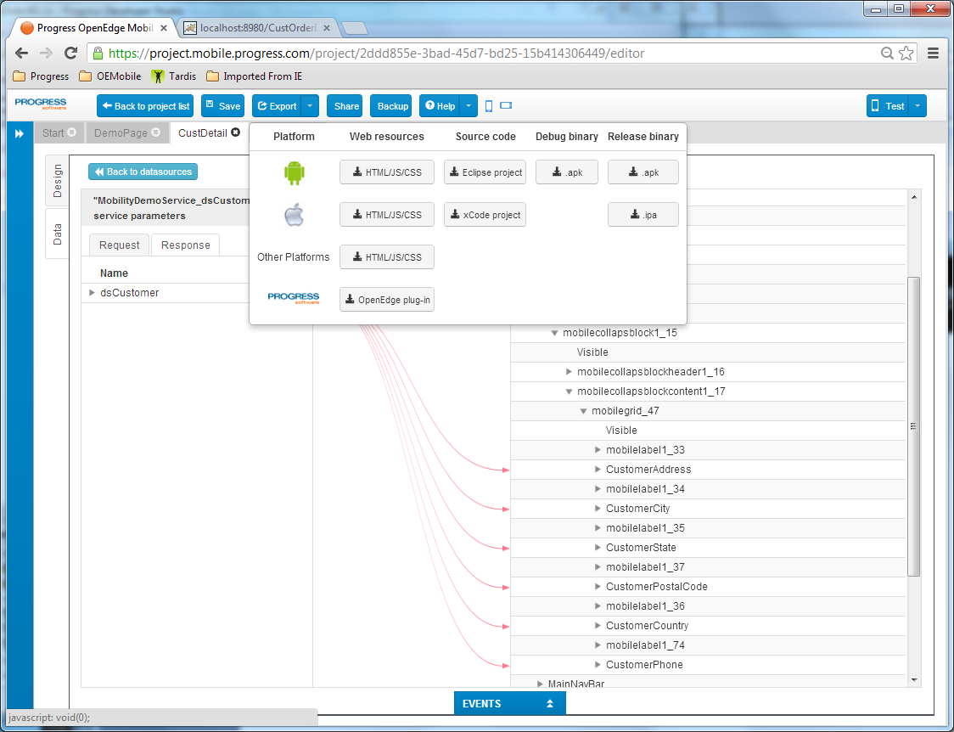


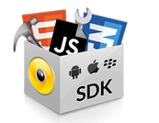


Step 4: Build and Deploy
Step 1: Generate Mobile Web App (HTML, CSS, JS)
Step 2: Wrap code in Phonegap
Step 3: Build native app using SDKs

Slide 33
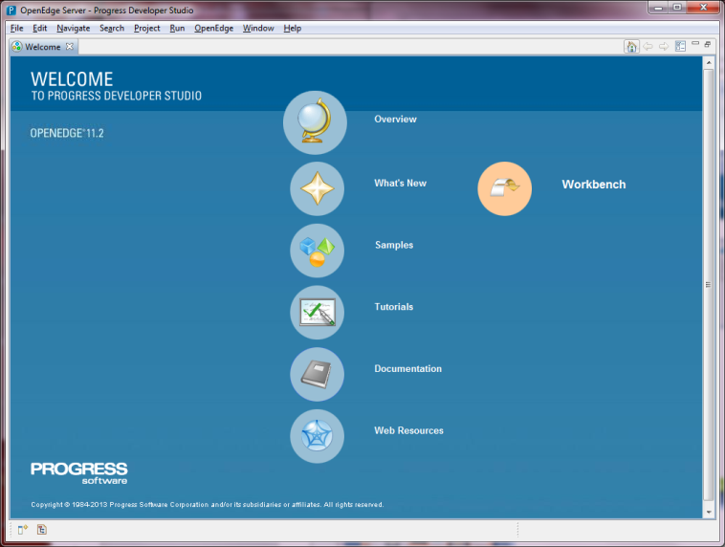


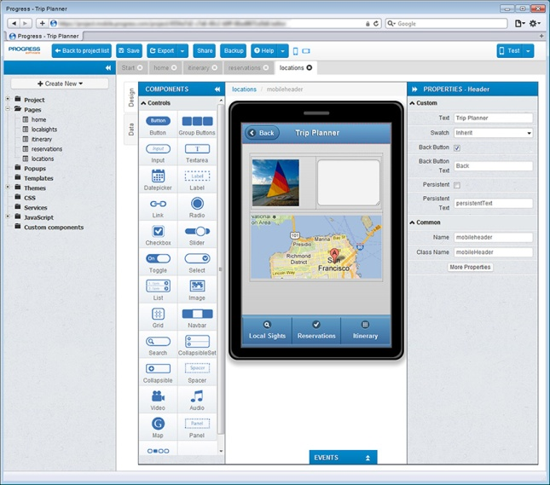

Build and Deploy – Mobile Web App
  Generates files for App
  Test in cloud or copy files local to PDSOE
    Deploy Mobile Web App to OE Web Server

Slide 34



Build and Deploy– Native App
  Generates files for App
  Creates PhoneGap project
    Uses Mac farm for iOS
  Builds binary file; downloaded to local machine
  Test on local device or deploy to App Store

Slide 35
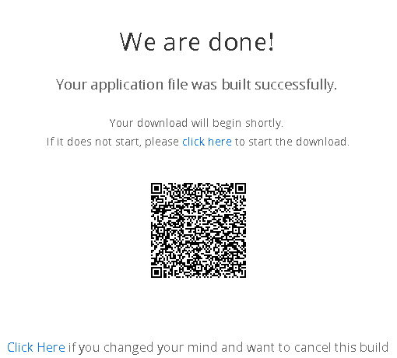
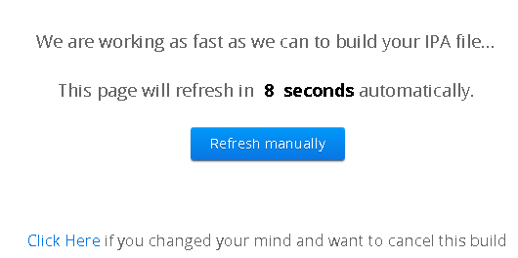
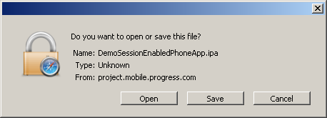
Deployment

Slide 36
Inside the JSDO

Slide 37
JSDO – Progress Java Script Data Object
CRUD + Invoke
  add() (CREATE)
  fill() (READ)
  assign() (UPDATE)
  remove() (DELETE)
  method() (INVOKE)
Properties
  autoSort (11.3)
  caseSensitive (11.3)
  name
  record
  useRelationships
Methods
  addRecords()
  find()
  findById()
  Foreach()
  getData()
  getId()
  getSchema()
  saveChanges()
  sort() (11.3)
  subscribe()
  unsubscribe()

Slide 38
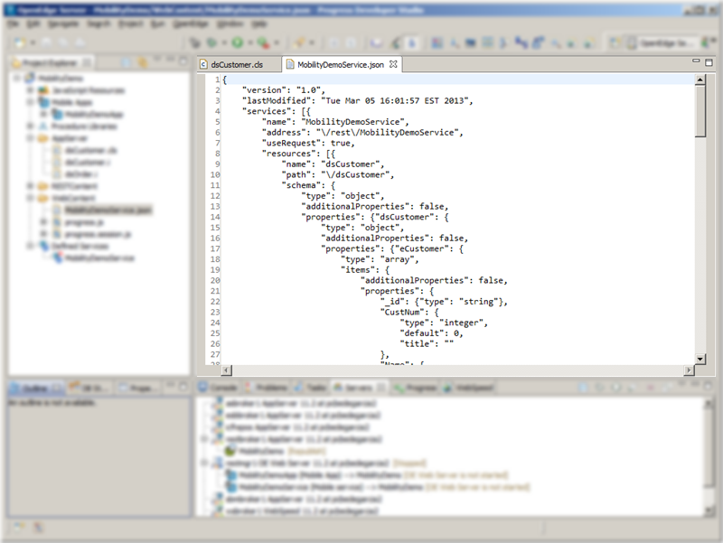
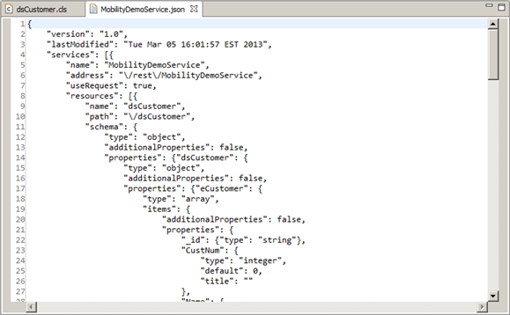
JSDO Catalog – Generated from Business Entity Definition

Slide 39
JSDO Operation Mapping
JSDO
Customer
Order
Mobile App
OE Web Server
OpenEdge AppServer
Customer JSDO
Customer Catalog
Customers.cls
fill( )
Read operation
ReadCustomers( )
remove( )
save Changes( )
DeleteCustomers( )
Delete operation
add( )
saveChanges( )
Create operation
CreateCustomers( )
assign( )
saveChanges( )
Update operation
UpdateCustomers( )
getCreditHistory( )
Invoke operation
GetCreditHistory( )
getOrderHistory( )
Invoke operation
GetOrderHistory( )
Notes:
Now we’re going a little deeper to see the JSDO methods that are called in a Mobile App to do specific operations on the AppServer.
We have the familiar architectural structure, but using Customers to give it a more realistic flavor dealing with a specific set of operations.
Thus we have a Customers JSDO, an OrderEntry Mobile service, and an ABL Customers.cls.
<CLICK>
In this case we want get the data for a set of customers from the AppServer to the Mobile App.
We are working with the Customers JSDO, and calling the JSDO fill( ) method, which is used to request data.
OpenEdge Mobile provides a set of built-in definitions for a set of CRUD operations. One of these operations is the READ operation, and that is represent here as one of the methods that is available in the Customers Resource, of the OrderEntry Mobile service.
The JSDO fill( ) operation causes an HTTP Request to be sent to the Customer Resource, Read operation.
The Read operation on the Web server - calls the ReadCustomers( ) method - in the Customers.cls class on the AppServer.
The ReadCustomers( ) method is an ABL method that was written by a developer to implement the Read operation.
In the session on the AppServer business entities we’ll see how the ReadCustomers.cls class is coded.
In our example the ReadCustomers( ) method reads the customers from an OpenEdge database, using any filter that may have been provided in the call from the Mobile App. This data is returned back travelling by the same route. The Mobile App handles the returned data in the HTTP Response that was sent by the Read operation.
<CLICK>
I’ve expanded the display to show all of the built-in operations. This work the same way. We can see the methods that are called in the JSDO for each one. We’ll go into more detail on these methods in the session on the JSDO.
The CURD operations for remove( ), add( ) and assign( ) – all operate on the local store, client side only. The saveChanges( ) sends the updates to the server.
<CLICK>
This completes the set of operations that have been defined. The last two operations are called using Invoke, which provides support for calling all singleton ABL routines, that are not built-in operations.
Although getOrderHistory is the same name on both sides, the INVOKE in the JSDO is done by calling the method name in JavaScript. The name of the method in JavaScript does not need to be the same as the business entity name, since the catalog is the one that does the mapping.
Note: remove( ) was selected for the JSDO operation since delete is a reserve word in the JSDO.
-----------
Summary: The Mobile resource maps to an ABL class singleton object, which provides the ABL routines (methods, in this case) that implement the Mobile operations of that resource.

Slide 40
Using the JSDO in JavaScript
session = new progress.data.Session();
session.login(<url-to-service>, "", "");
session.addCatalog(<url-to-jsdo-catalog>);
jsdo = new progress.data.JSDO({ name: 'dsCustomer' });
jsdo.subscribe('AfterFill', onAfterFillCustomers, this);
jsdo.fill();

Slide 41
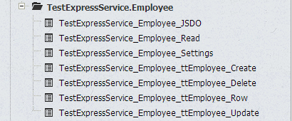
JSDO Services – Generated from JSDO Catalog
Access to the JSDO from the Mobile App Builder
JSDO - create object
CRUD operations
  Create
  Read
  Update
  Delete
Row – like buffer in ABL
Invoke operations
  Custom business logic

Slide 42
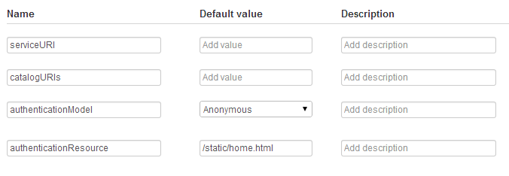
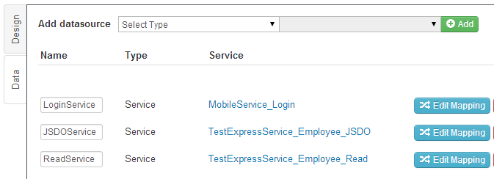
JSDO Services – Drag and drop programming
Session identified using configuration settings
Add Service as datasource for the page

Slide 43
OpenEdge Mobile at Runtime

Slide 44
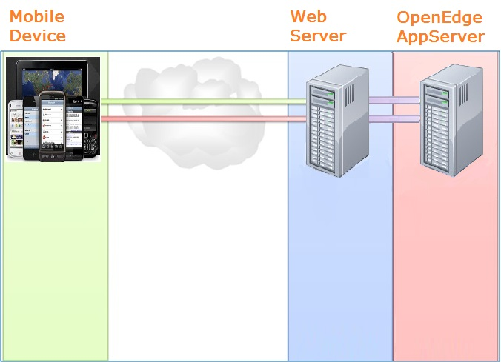
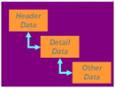
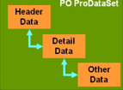
Runtime: Architecture for OE Mobile
HTTP (REST / JSON)
Internet
*.js
*.html
Business Entity
JSDO
JSDO-BE Mapping
OE DB
ABL
Client-side
App resides on device
Server-side
n-tier architecture with
Business Logic and data

Slide 45

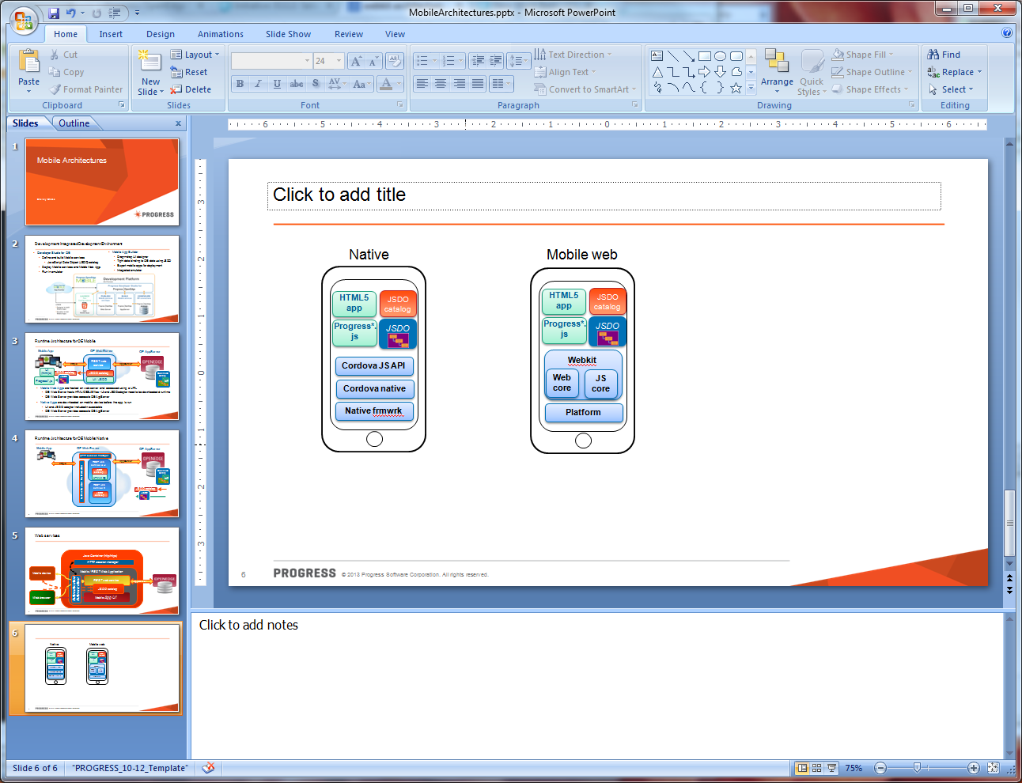


Runtime Architecture: Native
Mobile App
OE Web Server
HTTP session manager
REST web service & UI
OE AppServer
Authentication / Authorization
JSDO catalog
HTML5 app
AppServer
http/s
Business Entity
REST web service 2
ABL
JSDO catalog

Slide 46
Runtime Architecture: Mobile Web App
Mobile App
OE Web Server
HTTP session manager
REST web service & UI
OE AppServer
Authentication / Authorization
JSDO catalog
HTML5 app
AppServer
http/s
Business Entity
REST web service 2
ABL
JSDO catalog

Slide 47
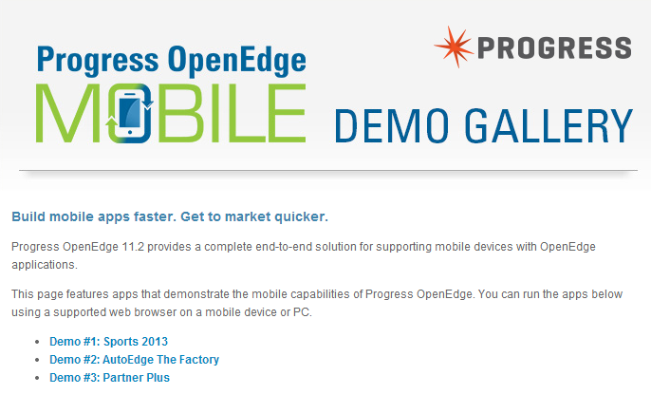
OE Mobile Preview
mobile.progress.com – requires ProgressID
oemobiledemo.progress.com – demo apps

Slide 48
Devices Supported and Pricing Considerations
Supported Devices
  iPhone – iOS 5 or later
  iPad – iOS 5 or later
  Android 4.0 or later (Ice Cream Sandwich, Jelly Bean)
  Web browser (HTML5/CSS3/JavaScipt) – latest versions
Pricing Highlights:
  Development Licenses for Mobile App Builder: Annual Subscription per Developer

Slide 49
11.4 and Beyond

Slide 50

Announcing Rollbase Mobile: OpenEdge Mobile Merges into Rollbase
Rebranding of same technology
  We now own the IP for the Mobile App Builder, BaaS, etc
  Hosted in Pacific cloud – Progress have full control
Licensing
  OE Mobile paid subscriptions will be converted to Rollbase Developer licenses
  OE mobile trial subscriptions renewed at 30 days in Rollbase on 11.4 ship date

Slide 51
New Mobile Features in 11.4
Before-image support in JSDO
Transaction support in Business Entities
  Submit operation
Offline notification at the Service level
Express JSDO Services project
Push notification support in ABL and Mobile Apps

Slide 52
Summary
OpenEdge Mobile / Rollbase Mobile
  A Complete End-to-end Solution for Supporting Mobile Devices with OpenEdge Applications
  Develop with the premier OpenEdge development environment, Progress Developer Studio for OpenEdge
  Mobile App Builder in the cloud
Ease-of-use features to simplify interaction with OpenEdge applications
  Express setup provides One-click Mobile App
  JavaScript Data Objects easily connect UI screens to the supporting data
  REST Manager to make it easy to execute OpenEdge business logic and access data on the AppServer from other clients

Slide 53

Questions

Slide 54
Notes:
Change color

