Slide 1
Wireless
Bob Brennan
Integrated Manufacturing Systems, Inc.

Slide 2
Agenda
Wireless
History
Physics
Take Away
Q&A

Slide 3
Access Points
Wireless device that provides a bridge between the wired and wireless environments
Single Threaded - Half Duplex.
  Only one device talking at a time
  Only sending or receiving data at a time
Sort of like an old school HUB

Slide 4
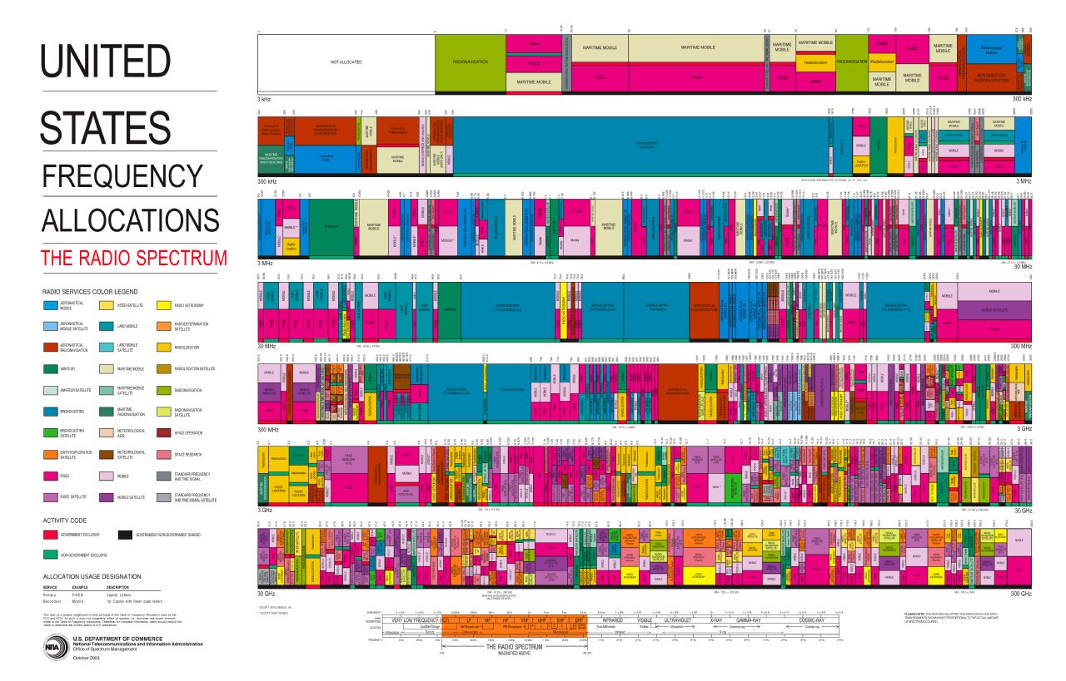
Radio Spectrum in the USA

Slide 5
Industrial, Scientific & Medical Band (ISM)
Frequency range |  | Bandwidth | Center frequency | Availability
6.765 MHz | 6.795 MHz | 30 kHz | 6.780 MHz | Subject to local acceptance
13.553 MHz | 13.567 MHz | 14 kHz | 13.560 MHz | Worldwide
26.957 MHz | 27.283 MHz | 326 kHz | 27.120 MHz | Worldwide
40.660 MHz | 40.700 MHz | 40 kHz | 40.680 MHz | Worldwide
433.050 MHz | 434.790 MHz | 1.74 MHz | 433.920 MHz | Region 1 only and subject to local acceptance
902.000 MHz | 928.000 MHz | 26 MHz | 915.000 MHz | Region 2 only (with some exceptions)
2.400 GHz | 2.500 GHz | 100 MHz | 2.450 GHz | Worldwide
5.725 GHz | 5.875 GHz | 150 MHz | 5.800 GHz | Worldwide
24.000 GHz | 24.250 GHz | 250 MHz | 24.125 GHz | Worldwide
61.000 GHz | 61.500 GHz | 500 MHz | 61.250 GHz | Subject to local acceptance
122.000 GHz | 123.000 GHz | 1 GHz | 122.500 GHz | Subject to local acceptance
244.000 GHz | 246.000 GHz | 2 GHz | 245.000 GHz | Subject to local acceptance

Slide 6
Agenda
Wireless
History
Physics
Take Away
Q&A

Slide 7
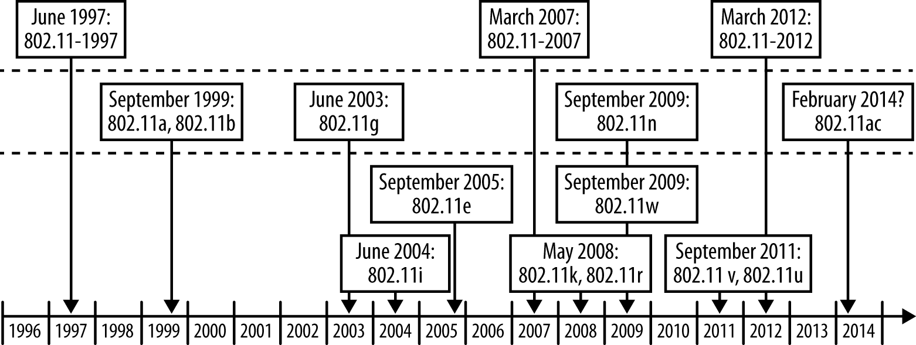
IEEE 802 History

Slide 8
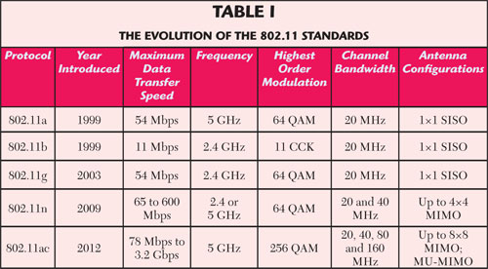
802.11 Evolution

Slide 9
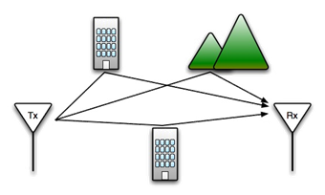
Multipath

Slide 10
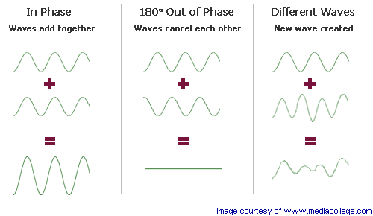
Interference

Slide 11
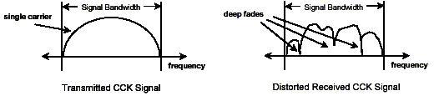
Multipath Distortion
Each path from the transmitter to the receiver has a unique time delay and phase shift associated with it.
Received signal can be severely distorted. that particular frequency

Slide 12
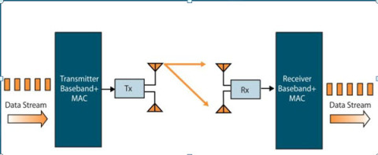
Single In Single Out
State of the art before 802.11N
Transmit on one Antenna, Receive on Both

Slide 13
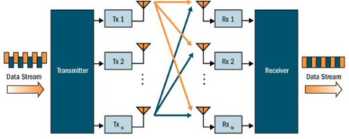
Multiple In Multiple Out MIMO

Slide 14
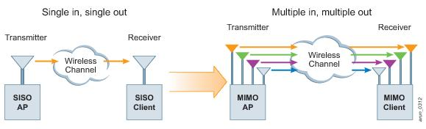
Single to Multiple
Pre - N
N and Beyond

Slide 15
802.11 B
802.11b has a maximum raw data rate of 11 Mbit/s and uses the same media access method defined in the original (prior) standard.
Spread Spectrum & Frequency Hopping Successor
The dramatic increase in throughput of 802.11b (compared to the original standard) along with simultaneous substantial price reductions led to the rapid acceptance of 802.11b as the definitive wireless LAN technology.
1 Radio using 2.4 Ghz

Slide 16
802.11 A
Supports a maximum theoretical bandwidth of 54 Megabits, a noticeable advantage over 802.11b
Speed on par with 802.11g performance.
Limited deployments due to higher hardware equipment costs and limited radio availability
Orthogonal frequency-division multiplexing (OFDM) is a method of encoding digital data on multiple carrier frequencies.
1 Radio using 5 GHz

Slide 17
802.11 G
Supports a maximum theoretical bandwidth of 54 Megabits, a noticeable advantage over 802.11b
Speed on par with 802.11a performance.
Limited deployments due to higher hardware equipment costs and limited radio availability
ODFM
1 Radio using 2.4 GHz

Slide 18
802.11N
Multiple-input multiple-output antennas (MIMO).
Up to 4 Radios and 8 Antenna
Operates on both the 2.4 GHz and 5 GHz bands.
Support for 5 GHz bands is optional.
It operates at a maximum net data rate from 54 Mbit/s to 600 Mbit/s.
20 MHz Channel Width at 2.4GHz
20 or 40 MHz Channel Width at 5 GHz
ODFM
Power Over Ethernet Issues

Slide 19
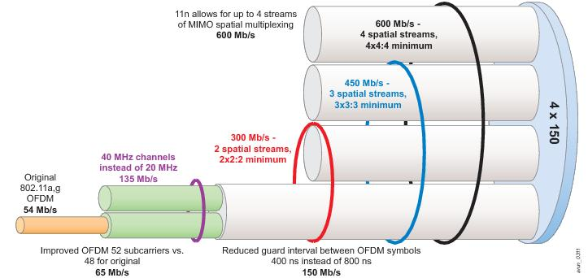
Bandwidth
Courtesy of Aruba Networks

Slide 20
802.11ac
Newest Standard
MIMO
Up to 8 Streams (Radios) with 2x antennas
Only 5GHz
Channel Widths 20, 40, 80, 160 MHz
* Up to 866 Megabits per second
Power over Ethernet issues
Very Limited range for High Speed ~10 Meters
Green Field Opportunities Only

Slide 21
802.11 AD
The “Next Big Thing”
Uses 60 GHz but packaged in Tri-Band to maintain backward compatibility
WiGig is the marketing name
Up to 7 gigabits per second in first draft
Builds on MIMO techniques
Very efficient use of power
Wire-like latencies
Lots of head room for improvement

Slide 22
Agenda
Wireless
History
Physics
Take Away
Q&A

Slide 23
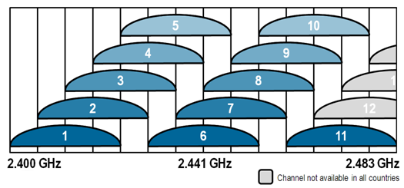
2.4 GHz Band
Range of Frequencies
22 MHz Channels
11 Channels USA, 13 or 14 Europe/Asia

Slide 24
2.4 and We Are Not Alone
Wi-Fi Wireless
Bluetooth
Zigbee/Industrial Device Connections
Microwave Ovens
Cordless Phones
Baby Monitors
Wireless Video Projectors (Data PA)

Slide 25
2.4 GHz vs 5 GHz
Energy being the same, 5GHz has about half the reach
About Twice as many Access Points Required for the same coverage.
2.4 is crowded (~0.125m or 4.9”wavelength )
5 GHz more susceptible to attenuation (~.06m or 2.36”)

Slide 26

Channel Conflict
Let’s Just Take a Sniff

Slide 27
Beam Forming

Slide 28
Spatial Streams
Each Radio has a pair of antenna
Each Radio transmits a stream of data on a Channel
Each Channel is broken down into Multiple subcarriers based on the channel width
Same Data on Multiple Channels
N AP talking to NON-N Client

Slide 29
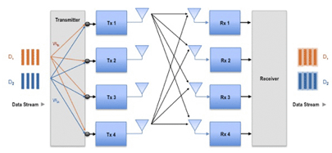
Spatial Multiplexing
N – N Connections
Sender and Receiver both have a encoder/decoder
First real world use of Linear Algebra Matrices

Slide 30


Omni vs Directional Antenna

Slide 31
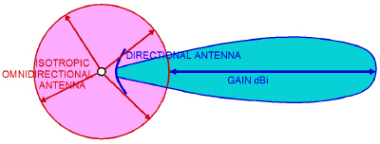
Antenna Gain

Slide 32
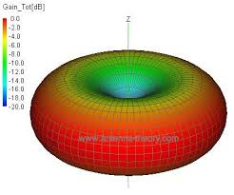
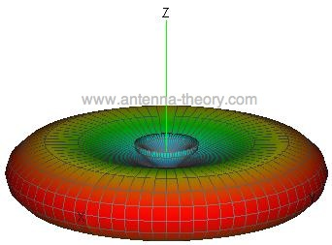
Visualized Gain

Slide 33
Agenda
Wireless
History
Physics
Take Away
Q&A

Slide 34
Mobility as a Developer
What can you count on for coverage and speed
Remember when coding for memory and disk was important?
Design Patterns for disconnected and ultra slow connections
Cell Radio vs Gigabit (10/100/1000)
Lowest Common Denominator Design

Slide 35
What you can control
Great Design for Low/No Bandwidth applications
Security
Networking – if it is your facility.
Network Transitions: WAN-LAN design Foreshadowing

Slide 36
What you can’t control
Perhaps the infrastructure
Interference is everywhere
Perhaps Power Consumption
Perhaps Data Consumption

Slide 37
Random Thoughts
Apple no longer includes hard wired NIC
  Remember Diskettes?
  Remember CD and DVD Media
Security Concerns
Interference is beyond your control
Bridging the LAN to the WAN

Slide 38
802.11u
Back Haul
Phone companies need to get data off of the cell network
HotSpot 2.0 – Single sign-on via MAC Address and registry
Great idea with a lot of implementation issues

Slide 39

Bob Brennan
Integrated Manufacturing Systems, Inc.
(603) 424-0109

