Slide 1
Language Enhancement 11.x
(with a preview of 11.4)
Evan Bleicher
Senior Development Manager
PUG Challenge Americas 2014
June 09, 2014

Slide 2
Agenda
OOABL
JSON
ABL
Singleton / Single-run
Win64
Diagnostic
Performance
Remove Limitations
11.4

Slide 3
Interface Inheritance (Release 11.0)
Problem:
Consistent with other OO languages, I want to program using polymorphism using Interfaces
Solution:
The ABL Interface definition now support inheriting from multiple interface types

Slide 4
OOABL: Interface Inheritance
OOABL Interface type
  Inherit from multiple interface types
  Inherit from .NET interface type
Syntax
INTERFACE InterfaceName
  [ INHERITS SuperName1 [ , SuperName2 ] ... ] :

Slide 5
OOABL: Interface Inheritance
IVehicle
i
ICar
ITruck
i
i
Altima
Tundra
c
c

Slide 6
OOABL: Interface Inheritance
Program to the interfaces via polymorphism
TYPE-OF function and IsA
  Returns TRUE for Interface in hierarchy
PUBLIC METHOD LOGICAL handleVehicle(INPUT refVehicle AS CLASS IVehicle):
IF TYPE-OF(refVehicle, "ICar") EQ TRUE
THEN THIS-OBJECT:handleCar(refVehicle).
ELSE IF TYPE-OF(refVehicle, "ITruck") EQ TRUE
THEN THIS-OBJECT:handleTruck(refVehicle).
ELSE THIS-OBJECT:handleGeneric(refVehicle).

Slide 7
OOABL: Interface Inheritance
Program to the interfaces via polymorphism
TYPE-OF function and IsA
  Returns TRUE for Interface in hierarchy

Slide 8
Enhance Dynamic Access (Release 11.0/11.3)
Problem:
The ABL’s Reflection class is not complete and does not support dynamic access to Properties as well as OpenEdge built-in OOABL types
Solution:
Enhance Progress.Lang.Class to support dynamic access (set / get) to OOABL class properties. (Release 11.0)
The ABL built-in OO objects can now be accessed dynamically, using either Dynamic-* functions or Reflection with the Progress.Lang.Class methods. (11.3)
  This applies to the following built-in objects:
    Progress.BPM.* Progress.Data.*
    Progress.Json.* Progress.Security.*
    Progress.Lang.*

Slide 9
OOABL: Dynamic Properties (Release 11.0)
Dynamically (pre-11.0 functionality)
  Instantiate a class
  Invoke a method
Dynamically get or set OOABL property
DYNAMIC-PROPERTY function
Progress.Lang.Class
  GetPropertyValue
  SetPropertyValue

Slide 10
OOABL: Dynamic Properties
DEFINE INPUT PARAMETER myDynClassName AS CHARACTER.
DEFINE INPUT PARAMETER myDynPropName AS CHARACTER.
DEFINE OUTPUT PARAMETER mychar AS CHARACTER.
DEFINE VARIABLE myClass AS Progress.Lang.Class.
DEFINE VARIABLE myObj AS Progress.Lang.Object.
myClass = Progress.Lang.Class:GetClass(myDynClassName).
myObj = myClass:New().
mychar = DYNAMIC-PROPERTY( myObj, myDynPropName).
/* OR */
mychar = myClass:GetPropertyValue(myObj, myDynPropName).

Slide 11
OOABL: Dynamic Access to Built-in Objects (Release 11.3)
Non Dynamic
Dynamic
Dynamic with Reflection
DEFINE VARIABLE jaCustomer AS Progress.Json.ObjectModel.JsonArray.
jaCustomer = NEW Progress.Json.ObjectModel.JsonArray().
DEFINE VARIABLE jaCustomer AS Progress.Json.ObjectModel.JsonArray.
jaCustomer = DYNAMIC-NEW “Progress.Json.ObjectModel.JsonArray”().
DEFINE VARIABLE plcjArray AS Progress.Lang.Class.
plcjArray = Progress.Lang.Class:GetClass("Progress.Json.ObjectModel.JsonArray").
myPLO = plcjArray:New().

Slide 12
OOABL: LIKE Phrase for Method and Function Parameters (Release 11.1)
Problem:
I want to use the LIKE phrase to define parameters for methods and functions so I can keep the parameters consistent throughout my application.
Solution:
LIKE phrase can now be used to define parameters for methods and functions
METHOD PUBLIC VOID showLikeParms
(INPUT cName LIKE Customer.Name, /* Database */
INPUT eName LIKE ttEmail.Name, /* Temp-table */
INPUT tVar LIKE testVar): /* Variable */
END.

Slide 13

OOABL: Class Private and Protected Data Members (Release 11.3)
Problem:
The ABL doesn’t work like other OO languages when it comes to accessing
Private and Protected data members.
Solution:
Private and protected class members have changed from instance based to class based access.
Instance-based (then)
Private/protected class members could only be accessed in the current instance of the class / hierarchy
Class-based (now)
Private/protected data members can be accessed from another instance of the same class / hierarchy
This change affects variables, properties, methods and events

Slide 14
Agenda
OOABL
JSON
ABL
Singleton / Single-run
Win64
Diagnostic
Performance
Remove Limitations
11.4

Slide 15
Support JSON (Release 11.0)
Problem:
Need my ABL application to interoperate with applications which utilize JSON
Solution:
The ABL supports built-in classes which simplify reading/writing JSON data.

Slide 16
JSON Data Types
Four simple data types
  string – “jump rope”
  number – 17, 54.35, 0.9582e-42
  boolean – true, false
  null – null
Complex data types
  Object
  Array

Slide 17
JSON Complex Data Types
Progress.Json.ObjectModel.JsonObject
  Collection of name/value pairs
  No order
  Access by property name
  Object surrounded by curly braces { }
Progress.Json.ObjectModel.JsonArray
  Ordered list of unnamed values
  Strict order
  Access by array index
  Surrounded by square brackets [ ]

Slide 18
JSON Values Example
Combination of simple values, objects and arrays
{
"salesRep" : { "name" : "Dorothy Gale",
"age" : 35,
"region" : "Kansas, USA"
},
"tractorSales" : { "2014Quarterly" : [ 13, 27, 18, 9 ],
"2013Quarterly" : [ 11, 17, 32, 5 ],
"2012Quarterly" : [ 9, 25, 16, 10 ]
}
}

Slide 19
ABL XML and JSON Improvements
Recognize more XML/JSON formats as DATASETs
  Benefit - easier integration with 3rd party products
WRITE-JSON method
  New omit-outer-object argument
See Robin Brown’s presentation tomorrow (Westford South) @ 4:45 on XML & JSON

Slide 20
Agenda
OOABL
JSON
ABL
Singleton / Single-run
Win64
Diagnostic
Performance
Remove Limitations
11.4

Slide 21

Sub-second PAUSE (Release 11.2)
Problem:
I can not use a fractional value in the PAUSE statement, therefore I cannot pause for less than 1 second.
Solution:
PAUSE now allows the AVM to process a fractional value of n
Before: PAUSE 1
After: PAUSE .5

Slide 22
ProVersion enhancement (Release 11.2)
Problem:
I need to know exactly which release my application is running on.
Solution:
PROVERSION() now provides service pack, hotfix, and build numbers.
PROVERSION() returns major and minor release numbers (e.g.: 11.3)
PROVERSION(1) plus service pack, hotfix, and build numbers (e.g.: 11.3.1.001.1234)

Slide 23

RCODE-INFO:DISPLAY-TYPE (Release 11.3)
Problem:
I need to determine programmatically which display environment
(GUI or TTY) this code must execute in.
Solution:
New attribute on the RCODE-INFO system handle:
  DISPLAY-TYPE
Return value | Has UI statements | COMPILE/RUN On
“GUI” | Yes | GUI
“TTY” | Yes | TTY
“” (empty string) | No | Any

Slide 24
SOAP 1.2 (Release 11.3)
Problem:
I need to be able to access a SOAP 1.2 web service from the ABL client
Solution:
The OE client now supports accessing a SOAP 1.2 web service.
New attribute on server handle, hWebService:SOAP-VERSION
  Returns “1.1” or “1.2” depending on the web service you connected to
WSDL Analyzer : now includes the SOAP VERSION on the service.html page
  SOAP 1.1 and/or SOAP 1.2
What should I know to use this?
  There are new attributes and methods on the SOAP-HEADER-ENTRYREF and
  SOAP-FAULT objects
SOAP 1.1
OE CLIENT
SOAP 1.2

Slide 25
Block Level Undo Throw Directive (Release 11.2)
  Problem:
Cannot easily change the default error directive on REPEAT, FOR, or DO TRANSACTION blocks throughout a procedure file
  Solution:
  Added BLOCK-LEVEL error directive
  BLOCK-LEVEL ON ERROR UNDO, THROW statement
  Changes the default for all blocks in a file that have a default error directive, including routine blocks, to have the UNDO, THROW error directive instead
    Routine-level blocks
    REPEAT blocks
    FOR blocks
    DO TRANSACTION blocks

Slide 26
Block Level Undo Throw Directive
Problem:
I don’t want to have to change all of the files in my application and I need to be able to tell which files are using which error directive.
Solution:
New startup parameter: -undothrow n, used at compile time
Behaves as if the statement was inserted in every source code file being compiled
  n=1, ROUTINE-LEVEL statement
  n=2, BLOCK-LEVEL statement
  > prowin32.exe –p compile-application.p –undothrow 2
This will change the behavior of your application
  The app must be coded accordingly

Slide 27
Unicode Filename Support (Release 11.3)
Problem:
I need to access files that have Unicode characters in their names from ABL.
Solution:
Most ABL constructs (statements, widget methods, and functions) now allow filenames with Unicode characters.
Examples: INPUT FROM, OUTPUT TO, editor:SAVE-FILE(), COPY-LOB, image files, OS-COMMAND, SYSTEM-DIALOG GET-FILE, xml-document:LOAD(), …
Exceptions: Procedure files, class files, database files, log files
Unicode printer names are also supported
Recommendation: Use –cpinternal UTF-8 to ensure that
the full range of possible filenames can be converted

Slide 28
Agenda
OOABL
JSON
ABL
Singleton / Single-run
Win64
Diagnostic
Performance
Remove Limitations
11.4

Slide 29
Support for Single-Run / Singleton (Release 11.2/11.3)
Problem 1:
  An AppServer agent is bound (or dedicated) to a particular client
Problem 2:
When running a remote internal procedure on the AppServer, at least 3 trips between client and AppServer are necessary:
  Establish the persistent procedure and execute the main block
  Run an internal procedure within the persistent procedure
  Delete the persistent procedure
Solution:
Introduced support for Single-Run / Singleton

Slide 30
Support for Single-Run / Singleton
Benefits
  Reduce trips between client and AppServer for increased performance
  Eliminates an AppServer agent from getting bound to a particular client
  Client requests can go to any AppServer agent, no context information is retained
Available with stateless and state-free AppServers
  Singleton
    Procedure is not deleted until the AppServer agent is shutdown
    Procedure is instantiated on an AppServer agent, that procedure is used for all subsequent requests to that agent, even if requested by another client
  Single-Run
    Procedure is deleted after the procedure is executed
A .p that is used for Single-Run/Singleton cannot have parameters on the main block

Slide 31
Agenda
OOABL
JSON
ABL
Singleton / Single-run
Win64
Diagnostic
Performance
Remove Limitations
11.4

Slide 32
Windows 64-bit GUI Client (Release 11.3)
What it is
  Replaces the 32-bit GUI client which was included with 64-bit OpenEdge products on Windows
  The 64-bit client allows access to a much larger address space (virtual memory) than the 32-bit client does: 2GB on 32-bit versus 8TB on 64-bit
What it isn’t
  It isn’t a requirement on 64-bit Windows systems
    64-bit versions of Windows can run 32-bit applications
  It isn’t necessarily faster than 32-bit
  It isn’t always a “plug-and-play” migration from 32-bit to 64-bit

Slide 33
Windows 64-bit GUI Client
  Progress Developer Studio is available in both 32-bit and 64-bit versions
  Install
    You cannot install both the 32-bit and 64-bit versions of the same release on a machine
    You can install 32-bit and 64-bit versions of different releases on the same machine
  R-code is portable between 32-bit and 64-bit
The 64-bit client supports these image formats:
  .BMP – Windows Bitmap
  .GIF – Graphics Interchange Format
  .ICO – Windows Icon
  .JPG – Jpeg
  .PNG – Portable Network Graphics
  .TIF – Tagged Image File Format

Slide 34
Windows 64-bit GUI Client
External Procedure calls (DLL calls)
  Compatibility:
    The 64-bit client can only load 64-bit DLLs
    The 32-bit client can only load 32-bit DLLs
OCX Controls
  OCX controls are mostly a thing of the past
  Applications that use OCX controls extensively will need major work to run with the 64-bit GUI client
GUI for .NET
  .NET assemblies can be 32-bit (x86), 64-bit (x64), or both (AnyCPU)
  Infragistics assemblies are built for AnyCPU and work with both the 32-bit and 64-bit clients
  Most third-party assemblies are also built for AnyCPU

Slide 35
Agenda
OOABL
JSON
ABL
Singleton / Single-run
Win64
Diagnostic
Performance
Remove Limitations
11.4

Slide 36



Diagnostics – Temp-tables
Problem:
I need better diagnostics to determine use of temp-tables in my application. How many temp-tables are in scope in the session? Which program created each temp-table? Most accessed temp-tables? Growing DBI file. Why?
Solution:
Create Virtual System Tables which provide extensive information.

Slide 37
VSTs for Temp-Tables (Release 11.0)
VSTs (Virtual System Tables) supported for OpenEdge databases
(i.e. _TableStat, _ActSummary)
Support extended to temp-tables
Statistics and performance analysis
Only VSTs that apply to temp-tables

Slide 38
VSTs for Temp-Tables
Built-in OOABL Class
  Progress.Database.TempTableInfo
  Provide info on (static or dynamic):
  Number of temp-tables in scope
  List of temp-tables
  Temp-table name
  Name of procedure or class that instantiated it
  Access to temp-table’s handle

Slide 39
VSTs for Temp-Tables
  List of temp-tables in scope (including static temp-tables)
USING Progress.Database.*.
<…>
REPEAT i = 1 TO TempTableInfo:TempTableCount:
TempTableInfo:GetTableInfoByPosition (i,
OUTPUT hTable,
OUTPUT cProcName).
DISPLAY hTable:NAME LABEL “Table Name”
cProcName LABEL “Procedure Name”
hTable:DYNAMIC LABEL “Dynamic”.
END.

Slide 40
Temp-table Logging
New log entry type (Temp-Tables)
Entries logged:
  Creation
  Deletion
  Explicit EMPTY
  Bind
  Unbind
Basic statistics (number and size of record)
  Created TEMP-TABLE ttCust (ID:1 Indexes:1) test.p @ 3
  Deleted TEMP-TABLE ttCust (ID:1) test.p @ 10

Slide 41
Agenda
OOABL
JSON
ABL
Singleton / Single-run
Win64
Diagnostic
Performance
Remove Limitations
11.4

Slide 42
Delayed Instantiation (Release 11.0)
Delay instantiation:
  Temp-table
  Associated Indexes
  ProDataSet
Improves procedure / class instantiation
No coding
Sample performance data (YMMV)
  Class with 10 temp-tables – instantiation improved more than 50%

Slide 43
Table Scan (Release 11.0)
Table Scan – used when accessing ALL records via FOR EACH
Table must be in Type II storage area
Does not use index to access
  Access records sequentially
  Data maybe in a different order than using an index
  FOR EACH mytable TABLE-SCAN:
  totalCost = totalCost + mytable.cost
  END.

Slide 44
Internal Changes (Release 11.0)
No coding
Improvements to class instantiation
Improvements to method invocation
Improvements to AVM internals
Fast table drop (type II area)

Slide 45
Agenda
OOABL
JSON
ABL
Singleton / Single-run
Win64
Diagnostic
Performance
Remove Limitations
11.4

Slide 46
GUI for .NET (Release 11.0)
.NET objects that are not related to UI are supported
  Also supported in 10.2B02
Non-user-interface executables support .NET objects
  prowin32 –b (batch GUI client)
  _proapsv (AppServer agent)
  _progres (char client, WebSpeed agent)

Slide 47
Input Blocking Statements (Release 11.0)
Input blocking statements (pre-11.0 functionality)
  UPDATE, SET, PROMPT-FOR, CHOOSE, INSERT, WAIT-FOR, PROCESS EVENTS and READKEY
  Restricted use, notably:
    User-defined function
    Non-void method
    Or if user-defined function, non-void method are on call stack
Restriction removed!

Slide 48
Suppress Warning Messages (Release 11.0)
Suppress list of warning messages
  swl startup option
  SESSION:SUPPRESS-WARNING-LIST
Suppress all warning message
  sw startup option
  SESSION:SUPPRESS-WARNINGS

Slide 49
Startup Options (Release 11.0)
–inp
  Maximum increased from 32,000 to 2,147,483,647
  Also increased in 10.2B03
-lkwtmo
  Minimum decreased from 60 seconds to 10 seconds

Slide 50
Agenda
OOABL
JSON
ABL
Singleton / Single-run
Win64
Diagnostic
Performance
Remove Limitations
11.4

Slide 51
Disclaimer
This talk includes information about future product enhancements
What we are going to say reflects our views on future projects. The information contained herein is preliminary and subject to change. Any future product we ultimately deliver may be materially different from what is described here.

Slide 52
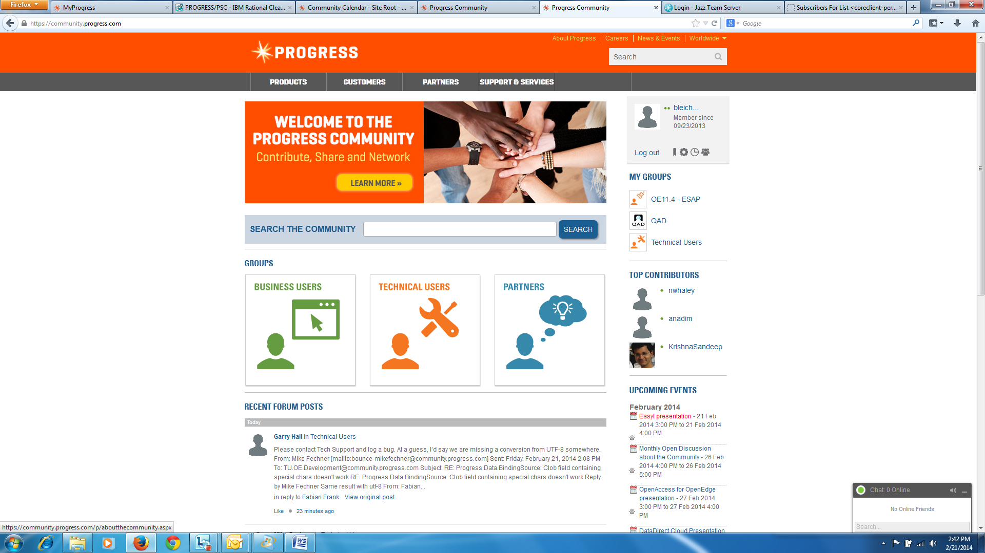
ESAP
All features available via ESAP
Need to register for the ESAP
early-software-admin@progress.com
Provide feedback via forum
  I used this
  I like this
  I like this less
No guarantee that these features will be in 11.4!

Slide 53
Agenda
OOABL serialization
GET-CLASS
JSON Before-Image Support
64-bit WebClient

Slide 54
Object Serialization - Motivation
Problem
I need to efficiently pass OOABL between an ABL client and an AppServer
Solution
Use built-in OOABL object serialization
  Works between an ABL client and AppServer
  Serialization and de-serialization built into the language

Slide 55
Object Serialization
Throwing OOABL error objects
Passing OOABL objects
Including OOABL objects in a temp-table
Next steps

Slide 56
Object Serialization – Current behavior – prior to 11.4
THROW OOABL objects – not supported
  Generated warning in the AppServer log file
  ERROR raised on client
  No object instance returned
Pass an OOABL object
  Runtime error

Slide 57
Object Serialization – Overview
THROW OOABL objects – supported
  Between AppServer and ABL Client
    Not other client types
Pass an OOABL object
  Some built-in objects
  User-defined objects
Class must be marked serializable
  All class in hierarchy
  Otherwise error

Slide 58
Object Serialization – Overview (cont)
Receiving side
  Recreates the object instance
  Pass by Value
  Sender’s object instance may be garbage collected
Both sides must be 11.4
  11.4 client -> older AppServer
    Parameter passing errors
  11.4 AppServer -> older client
    OOABL error object not thrown
    Parameter passing errors
  VersionInfo property
    CURRENT-REQUEST-INFO and CURRENT-RESPONSE-INFO
    SESSION and SERVER

Slide 59
Object Serialization – Serialization Rules
All non-static data members are serialized
  Variables
  Properties
  ProDataSets
  Temp-tables
All access modes
  Public
  Protected
  Private
Property getters
  Not invoked
  Value transferred

Slide 60
Object Serialization – Serialization Rules (cont)
MEMPTRs
  Serialize if allocated by the ABL application
  Not serialized if allocated from external sources
    DLL or shared library
    Initial value when the object is deserialized
Handle-based variables (widgets, queries, buffers)
  Serialized with the handle value
  Data contained by the handle is not serialized
  Only useful to round-trip data

Slide 61
Object Serialization – Serialization Rules (cont)
Deep-copy
  Serialize data member object references
  Object graph is serialized - maintaining multiple references
Class B
Data B1
Class A
Data A1
Data A2
Class D
Class C
Data C1

Slide 62
Object Serialization – Serialization Rules (cont)
  References are not maintained across parameters for a RUN statement
    Parameter 1
    Parameter 2
Class B
Data B1
Class B
Data B1
Class A
Data A1
Data A2
Class A
Data A1
Data A2
Class G
Class C
Data C1
Class C
Data C1
Class G
Class E
Data E1
Class E
Data E1
Class D
Data D1
Data D2
Class D
Data D1
Data D2
Class G
Class F
Data F1
Class F
Data F1

Slide 63
Object Serialization - Serialization Rules (cont)
The AVM does not maintain state
  Open queries/cursor position
  Buffer contents
  Open files
  Streams
  Event subscriptions
Not all built-in classes can be serialized
Cannot serialize .NET or hybrid objects
  AVM raises an error

Slide 64
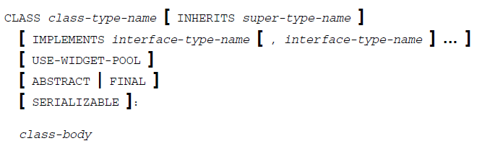
Object Serialization - Syntax
Indicates objects of the class can be passed as a parameter between an AppServer and a remote client
Compiler enforced
  Entire hierarchy must be marked
  Cannot be used with ABL-extended .NET classes

Slide 65
Object Serialization – Serializable Built-in OOABL Objects
Classes which implement Progress.Lang.Error
  Progress.Lang.SysError
  Progress.Lang.AppError
  Progress.Lang.JsonError
  Progress.Lang.JsonParserError
  Progress.BPM.BPMError
Progress.Json.ObjectModel.JsonObject
Progress.Json.ObjectModel.JsonArray
Progress.Json.ObjectModel.ObjectModelParser
Progress.Lang.Object

Slide 66
Object Serialization – Deserialization Rules
Creating the new instance
  Instance Constructor not invoked
  Property Setters not invoked
  Static Constructors are invoked
Only the object’s data is deserialized
  R-code must already exist on both sides of the wire

Slide 67
Object Serialization – Object compatibility - Client / AppServer
Class on Client and AppServer must be the same(*)
Method signature and data members must match exactly
  Public, Protected and Private data members
  AVM maintains an MD5 value
Error is raised on RUN statement if values do not match
Application needs to maintain compatibility between the client and AppServer versions
  May need to design specific classes for parameter passing
AVM does not check if the r-code matches
  Business logic can change in AppServer code and not impact passing objects

Slide 68
Object Serialization - CallStack
Error objects can optionally contain Callstack information
  SESSION:ERROR-STACK-TRACE attribute to TRUE
  -errorstack startup parameter
Callstack augmented with info from both client and AppServer call stacks
client_se_bl.p at line 20 (client_se_bl.p)
runit.p at line 2 (runit.p)
Server StackTrace:
server-se-bl.p at line 8 (./server-se-bl.p)

Slide 69
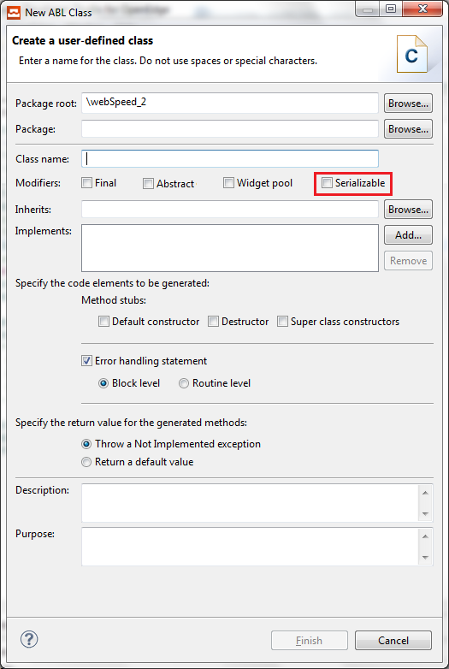
Object Serialization - PDSOE

Slide 70
Object Serialization – Temp-Table
Restriction lifted
  Pass temp-table to AppServer if it contains an OOABL class
  Field is defined as Progress.Lang.Object

Slide 71
Object Serialization - Reflection
Progress.Lang.Class
IsSerializable ( ) returns a LOGICAL
  Indicating whether the specified object type defined as SERIALIZABLE
  Valid for built-in classes

Slide 72
Object Serialization – Tooling
COMPILE XREF output updated to reflect if class is serializable
  class-name,[ INHERITS inherited-class-name
    [ (inherited-class-name ...) ] ],
    [ IMPLEMENTS interface-name
    [ interface-name ]... ],
    [ USE-WIDGET-POOL ], [ FINAL ], [ ABSTRACT ], [ SERIALIZABLE ]
  <Class-ref>
  <Source-guid>t6BMga8eOYXVE8DcTJMLng</Source-guid>
  <Ref-seq>4</Ref-seq>
  <Inherited-list/>
  <Implements-list/>
  <Has-use-pool>false</Has-use-pool>
  <Is-final>true</Is-final>
  <Is-serializable>true</Is-serializable>

Slide 73
Object Serialization – Tooling (cont)
Logging
  DynObjects.Class
  Logging that the AVM created the object during deserialization

Slide 74
Object Serialization - Async
Asynchronous invocation supports object passing
Asynchronous invocation does not support thrown OOABL errors

Slide 75
Agenda
OOABL serialization
GET-CLASS
JSON Before-Image Support
64-bit WebClient

Slide 76
GET-CLASS - Motivation
Problem
ABL supports today Progress.Lang.Class:GetClass(<type-name-exp>)
The ABL does not provide compile time validation of type-name-exp
Solution
Introduce GET-CLASS built-in function
  Accepts a type-name parameter
    not a character expression

Slide 77
GET-CLASS
Syntax
Returns a Progress.Lang.Class
USING statements are applied to a non-qualified name
Compiler error if not found
GET-CLASS(<type-name>).

Slide 78
Agenda
OOABL serialization
GET-CLASS
JSON Before-Image Support
64-bit WebClient

Slide 79
JSON – Before-Image - Motivation
Problem
Lack of serialize / deserialize for a ProDataSet with before-image data to JSON
Solution
Introduce new language elements which express before-image data in JSON
  Similar to support in the product for XML

Slide 80
Agenda
OOABL serialization
GET-CLASS
JSON Before-Image Support
64-bit WebClient

Slide 81
WebClient – Windows 64-bit
Problem
Missing functionality – support for 64-bit WebClient
Solution
WebClient application can be defined as supporting
  32-bit platform
  64-bit platform
  Both

