Slide 1
Agile Development Primer – Using Roundtable TSMS in an Agile Shop
Michael G. Solomon
Solomon Consulting Inc.

Slide 2
Motivation
Your presenter – Michael Solomon
  OpenEdge/Roundtable/Security consultant
  PMP (Project Management Professional)
  Author ← (This role started the whole process)
    CS textbooks and courses (Jones and Bartlett)
    PMP prep books and courses (Pearson, Learnkey)
Currently work in an Agile shop
Difficulties with existing tools
  Not OpenEdge friendly
As an integrator I began wondering …
  The answer …
Can Roundtable
be Agile friendly?

Slide 3
What Is Agile?
Project methodology derived from Lean thinking
Focus: identifying (and managing) three types of work
Customer Value Added Work (highest value)
  Time spent on building a deliverable
Business Value Added Work
  Activities needed to maintain competitiveness or compliance
Non Value Added Work
  Wasted time (overhead)

Slide 4
Agile Values…
Individuals and Interactions
over
Processes and Tools
Working Software
over
Comprehensive Documentation
Customer Collaboration
over
Contract Negotiation
Responding to Change
over
Following a Plan

Slide 5
Differences from Waterfall
Waterfall (traditional software project management)
  Planning for whole project precedes any work
  All work must conform to the plan
  Activities organized as linear phases
  Attempts to minimize variance
Agile (Scrum)
  Work only planned for each sprint (generally 2-4 weeks)
  Work accomplished determines releases
  Sprints involve the entire team
  Adaptability that increases customer value is encouraged

Slide 6
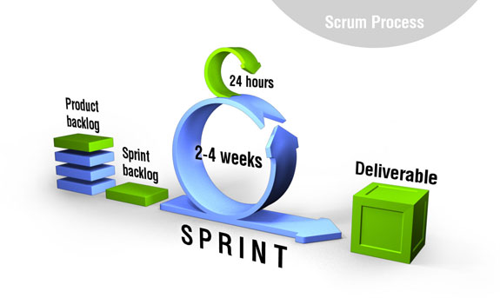
Agile Scrum High-level Process
“Scrum is an iterative and incremental agile software development
framework for managing product development” *
Copyright © 2014, Intellias Ltd.
* Wikipedia contributors. "Scrum (software development)." Wikipedia, The Free Encyclopedia. Wikipedia, The Free Encyclopedia, 6 Jun. 2014. Web. 6 Jun. 2014.

Slide 7
Scrum Elements
Roles
Product owner
Scrum master
Team member
Activities
Sprint planning
Daily scrum
Sprint demo
Retrospective
Artifacts
Product backlog
Sprint backlog
Burndown chart
Working product
Notes:
Overview

Slide 8
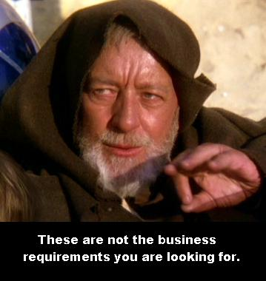
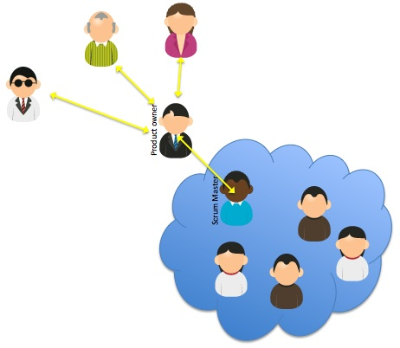
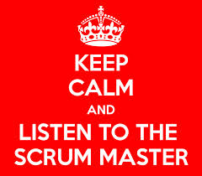
Roles
Product owner
  Subject matter expert (SME)
  Defines and gathers requirements from stakeholders
  Set priorities (responsible for ROI)
Scrum master
  Coach – guidance and education
  Gatekeeper – remove impediments and protect the team
Team member
  People doing the work
  Typically, teams contain 5 – 9 members

Slide 9
Activities (Time Boxes)
Sprint planning
  At the beginning of each sprint
  Sprints are generally 2 – 4 weeks
  Product owner builds sprint backlog
Daily scrum
  Standup, 15 minutes
  Same 3 questions
Sprint demo
  Show the sprint’s deliverables
Retrospective
  Lessons learned
What did you do yesterday?
What will you do today?
Are there any impediments in your way?

Slide 10
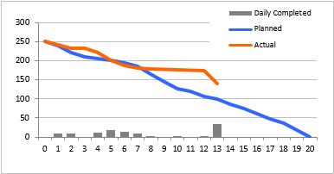
Artifacts
Product backlog
  All requirements (constantly changing)
  User stories and feature descriptions
  Product owner owns and prioritizes
Sprint backlog
  Highest priority items from product backlog
  Broken down into tasks
Burndown chart
  Graphic depiction of remaining work in a sprint
Working product
  Primary sprint deliverable
Before each sprint

Slide 11
How Do We Use Agile – Scrum?
Six easy steps to implement Scrum
  Build your product backlog
  Organize a collaborative workspace
  Plan the first sprint
  Sprint
    Do the work
    Track the work (Burndown chart, etc.)
  Stop (on time)
  Review -> Reflect -> Repeat
The right tool(s) can make the process easier
  (This is where Roundtable comes in)

Slide 12

What Is Roundtable?
Roundtable TSMS is a team-oriented extension for the OpenEdge development environment that provides:
Software Configuration Management (SCM)
Developer productivity tools
(Yes, it plays well with Agile, too)
Notes:
----------------------------------
Definition: Software Configuration Management is the discipline of managing the entire life cycle of a software project.

Slide 13
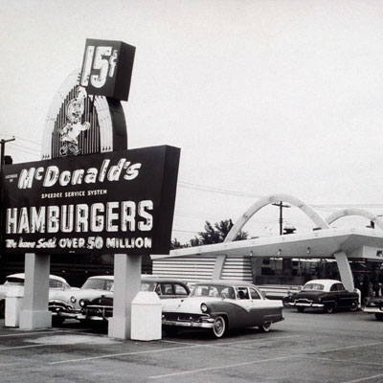
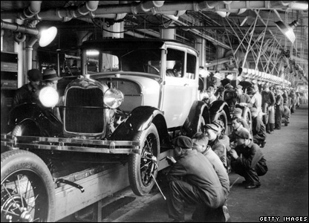
What Roundtable TSMS does
Roundtable TSMS creates a structure – based on the principles of the manufacturing model – that delivers repeatable, high-quality production of software applications.
Notes:
It is a centralized system in which all development will be done.
Version Control = added check-in and check-out; merely tracking.
Software Configuration Management = work in the system; it maximize efficiencies and automates processes for you.
For newbies, it may be an issue of trust and control to do all work within a centralized system, but several hundred clients use SCM (and rave about the advantages); they cannot be wrong!

Slide 14
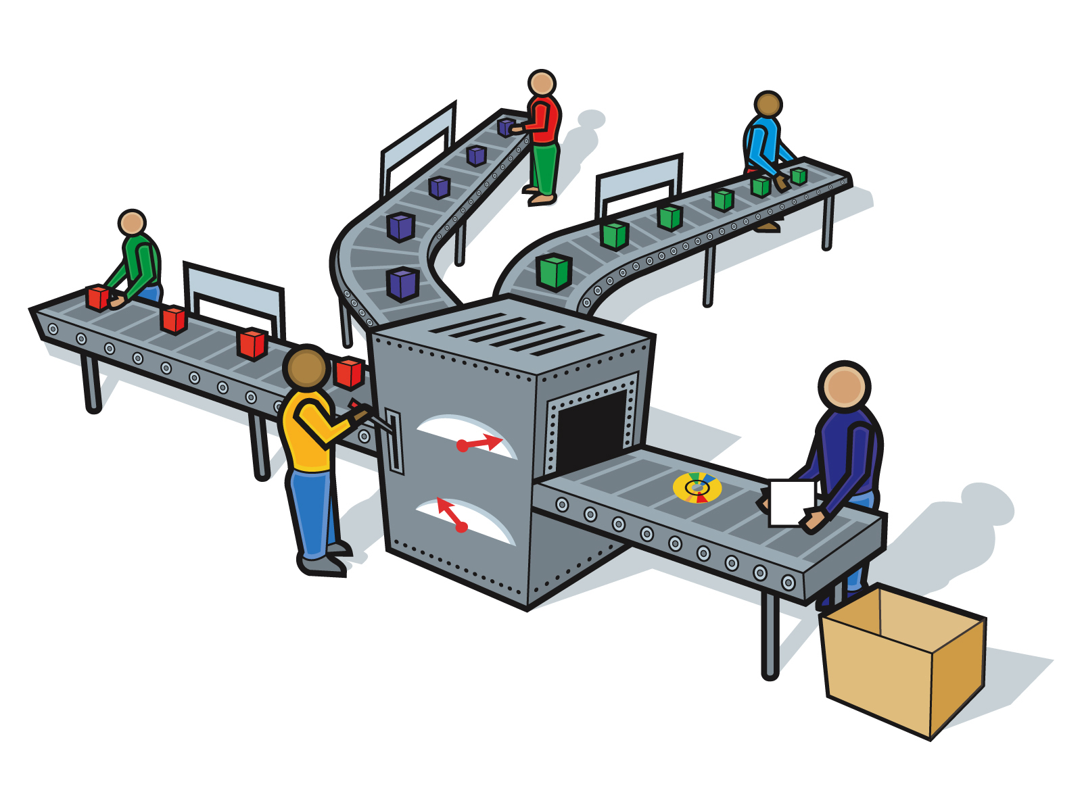







Defines the process
Applies controls
Manages changes
Audits results
Notes:
DEFINE THE PROCESS: Identifies items and processes that make up an application. Maximizes efficiencies (e.g., promote changes).
APPLIES CONTROLS: Defines who has access to what and under what conditions.
MANAGES CHANGES: Identifies who changed what, when, and why. Allows for reverting changes (code and schema).
AUDITS RESULTS: Enables users to determine if what has been planned has been completed to specifications.
These are industry best-practice items that also satisfy Sarbanes-Oxley (and similar) compliance requirements.

Slide 15
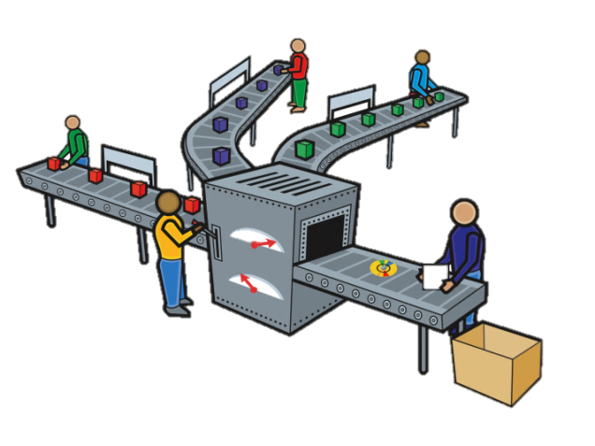


… applied to every level
Development Environment
Test Environment
Pre-production Environment
Partner source code (when applicable)
Custom Environment
Deployment
Notes:
The software application “assembly line” looks more like this, though it can vary from organization to organization.
The advantages that SCM provides at one development stage (previous slide) apply through all stages of the software lifecycle (this slide).
----------------------------------
NOTES:
The orange packaging in the image indicates a scenario in which the development team is working with source code from a third-party (e.g., the delivery of MFG Pro).
The blue assembly line in the image represents a scenario in which the core application is copied and modified for another site(s).

Slide 16
Where Does Roundtable Fit In?
Remember that Agile values
Individuals and Interactions
over
Processes and Tools
Roundtable supports agile - it doesn’t enforce agile
  Empowers developers to employ agile
Roundtable’s features fit nicely into the agile method
  Primary visibility of tools – creating artifacts
Consistent with each sprint’s goal – to deliver value to the stakeholders

Slide 17
Collaborative Workspaces
Collaboration is a cornerstone of scrum
Physical – work area that promotes organic communication and idea exchange
Logical – development environment that encourages team-oriented software development
Roundtable Workspaces support collaborative teams
DEV
TEST
PROD

Slide 18
Multiple Simultaneous Sprints
Roundtable workspaces effortlessly manages team development
Teams work in integrated workspaces or in isolation
  Or even in a hybrid model
DEV Sprint A
TEST Sprint A
TEST
A & B
PROD
DEV Sprint B
TEST Sprint B

Slide 19

Artifacts in a Roundtable World
Backlog – a list of all features (and bugs)
  Document of something the user wants
  User story – common method to express backlog items
    “As a <role>, I want <goal/desire> so that <benefit>”
Product backlog – all user stories in a product
  Prioritized by product owner (after each sprint)
Sprint backlog
  User stories selected for a sprint
  Work to satisfy user stories
    Roundtable tasks

Slide 20
Roundtable Tasks as Artifacts
Roundtable Tasks
  Organize and control all work
  Any change to any object
Backlog elements are Roundtable tasks
  Tasks initially own backlog documents (docx, txt, etc.)
  As sprint work progresses, objects attach to tasks
Task Groups - Sprint Definitions
  Sprint Task Group = All tasks in the sprint backlog
Task Notations
  Task details necessary for tracking sprint activity
  Priority, Estimated time, Actual time, etc.

Slide 21
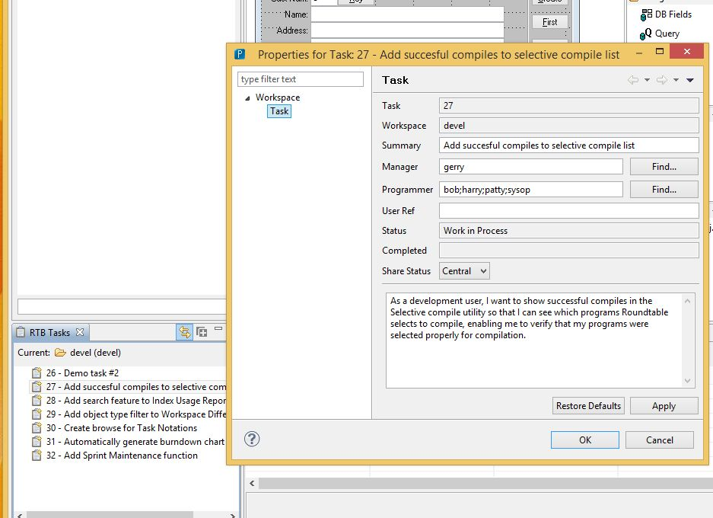
Roundtable Task Maintenance

Slide 22
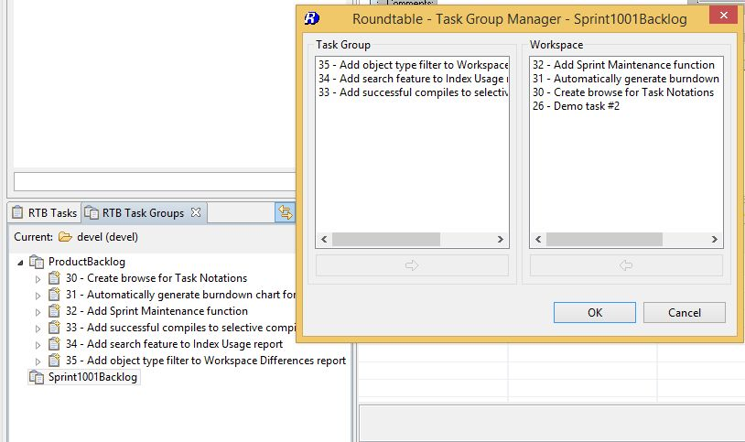
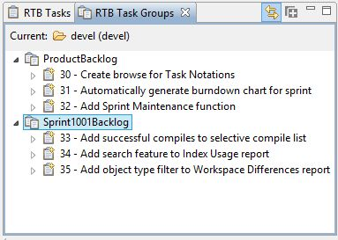
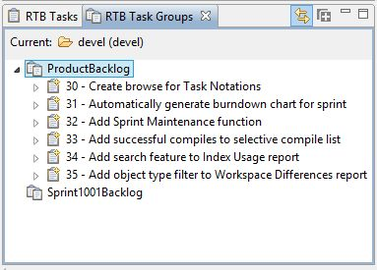
Roundtable Task Groups

Slide 23
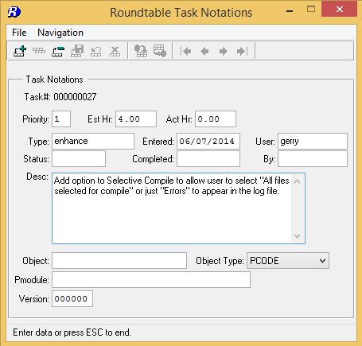
Roundtable Task Notations

Slide 24
Burndown Chart

Slide 25
Roundtable-Agile Benefits
Integrated development management
  Promotes efficient development – doesn’t get in the way
Sprint-centric activities
  Task focus supports sprint concept
On-demand managed sprint code promotion
Visibility
  Within team
  Outside team
Auditability
  All events are tracked and associated with sprint

Slide 26
Future Work
Product enhancement requests – NOT commitments
Import by Task Group
  Currently, import by Task
New reports
  Sprint Task List
  Burndown chart
  Product backlog
  Sprint backlog
More granular/detailed Task Notation information
  Current Task Notation Maintenance is provided as source

Slide 27
Summary
Agile/Scrum is the most popular development model
  Focus is on delivering highest value to customer
Roundtable empowers OpenEdge developers to embrace scrum philosophy
  Stakeholders enjoy visibility and auditability
    When using Roundtable TSMS

Slide 28
Questions?
Michael G. Solomon
Solomon Consulting Inc.
michael@solomonconsulting.com

