Slide 1
How Progress uses Progress
Jordi Sastre
IT Architect, Progress Software Corporation
10 June 2014

Slide 2
Agenda
About Progress IT
Platform Strategy for Applications
Application Portfolio
Data Integration Architecture
Integration Examples
ProDesk (IT HelpDesk application)
Business Intelligence and Data Warehousing

Slide 3
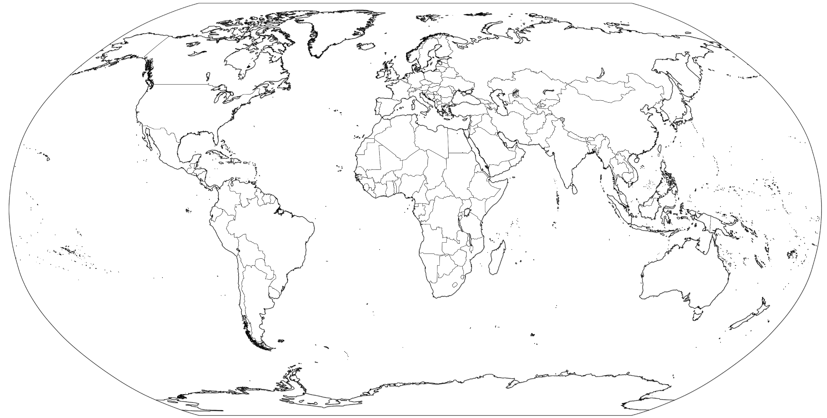
About Progress IT
82 employees in 5 countries (USA, India, Australia, Ireland and the Netherlands)
24x5 live IT support provided to 1,100+ users, 17 offices in 13 countries
24x7 support of critical systems
24x7 support of critical business applications

Slide 4
Platform Strategy for Applications
We don’t have the manpower to write and maintain business applications
We want to the best of breed for business functions
We want to take advantage of the Cloud, like everybody else
The most critical business operations applications are based on OpenEdge
  Order Management
  Financials
When we need to develop we choose Progress (OpenEdge, Rollbase)
Data integration across all systems is key

Slide 5





















Platform Strategy for Applications (cont.)
Enterprise Collaboration
Web Sites
Field Operations
Business Operations
Product Operations
Promsgs
PID
3rd Party Components
Test Results
Beta Program Management
Which DB
Integration Layer
Customer
Product
Employee
Business Intelligence & Data Warehouse

Slide 6
Platform Strategy for Applications (cont.)
Enterprise Collaboration
Web Sites
Enterprise Collaboration
  User/Employee Authentication and Single Sign On
  Email, Calendar, Community, SharePoint, Lync, Web Sites

Slide 7
Platform Strategy for Applications (cont.)
Field Operations
Field Operations
  CRM (front-end) applications for lead flow, sales automation, customer support
  Mainly cloud based for easy access

Slide 8
Platform Strategy for Applications (cont.)
Business Operations
Business Operations
  ERP (back-end) applications for order entry, financials, invoicing and human resources
  On-premise (OpenEdge) and cloud

Slide 9
Platform Strategy for Applications (cont.)
Product Operations
Promsgs
PID
3rd Party Components
Test Results
Beta Program Management
Which DB
Product Operations
  Source code management, defect tracking, product build, etc.
  On-premise

Slide 10
Platform Strategy for Applications (cont.)
Integration Layer
  Data entity and service-oriented integration layer to share and replicate data across platforms
  Mainly based on OpenEdge
Integration Layer
Customer
Product
Employee

Slide 11
Platform Strategy for Applications (cont.)
Business Intelligence and Data Warehouse
  Transformation of operational data entities and transactions into reporting data models (cubes)
  OpenEdge database available to WebSpeed and Tableau
Business Intelligence & Data Warehouse

Slide 12
Main Business Applications
Function | Vendor | Technology
Web Collaboration | Microsoft, OpenAM, Telligent | Several
Sales | Salesforce.com | Cloud
Order Management | QAD | OpenEdge
Electronic Software Download | Flexera | Cloud
Customer Support | Service Cloud | Cloud
Financials | Advanced Computer Software | OpenEdge
Human Resources | Lawson | Outhosted
IT HelpDesk | Progress IT | OpenEdge
Data Warehousing | Tableau / Progress IT | Cloud / OpenEdge
Integration | Progress IT | OpenEdge
Other | Progress IT | OpenEdge, Java

Slide 13







Data Integration

Slide 14
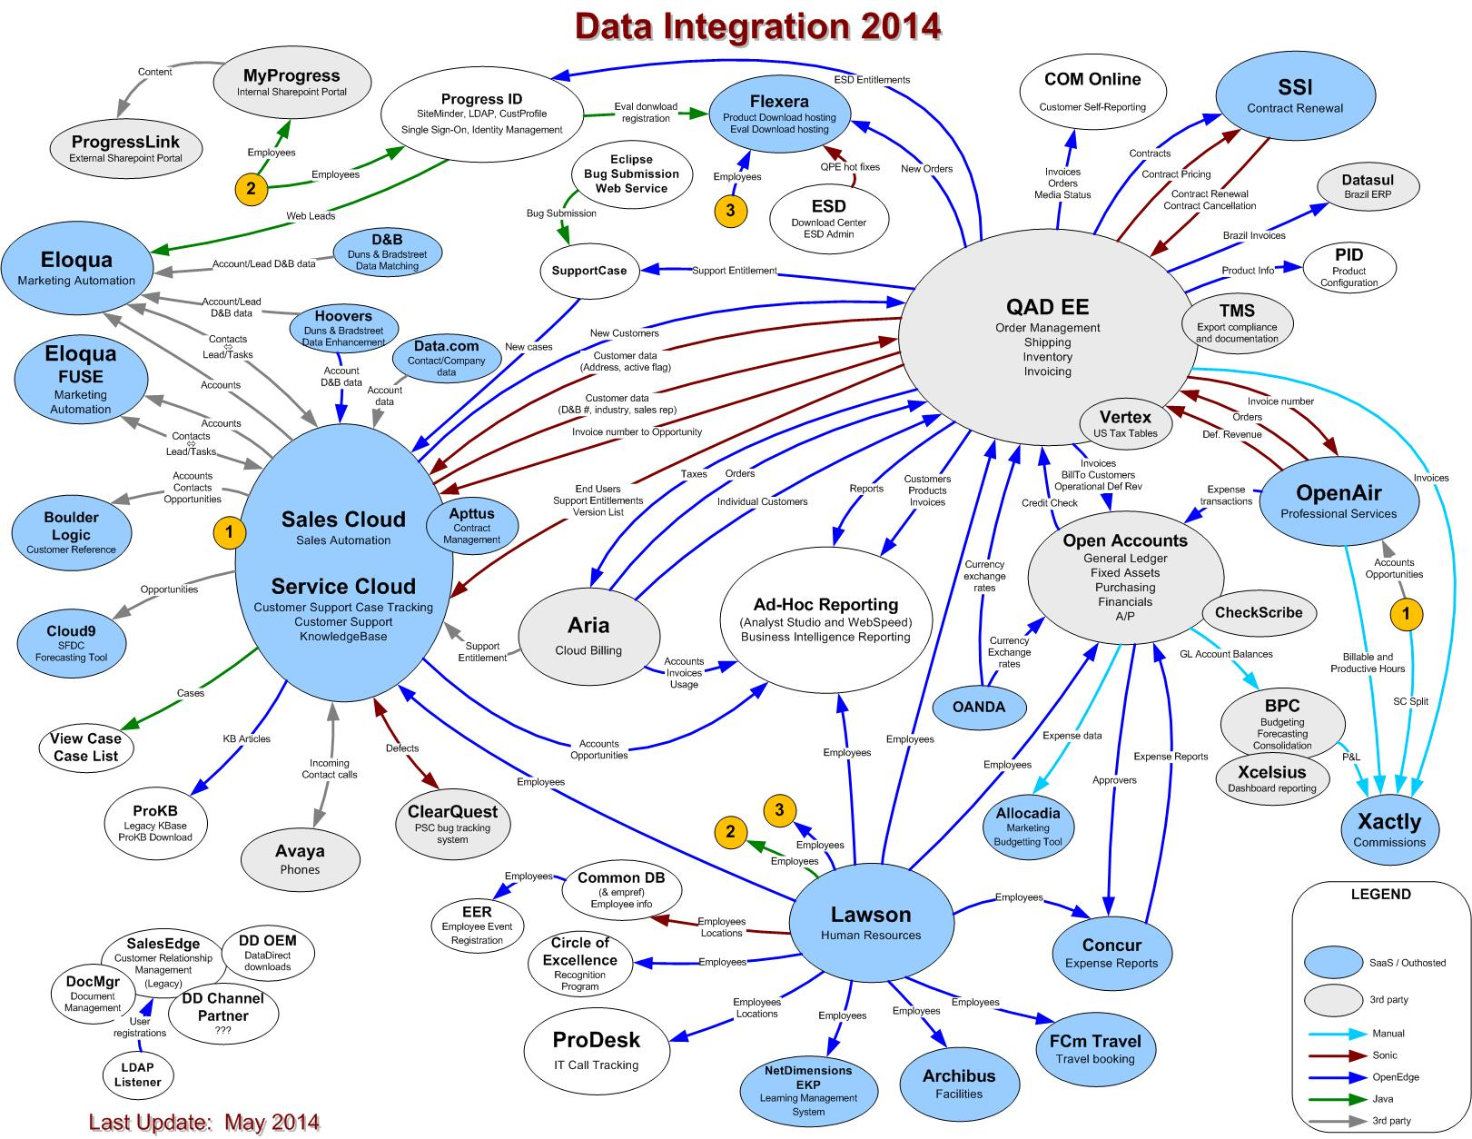
Data Integration

Slide 15
Data Integration Architecture

Slide 16
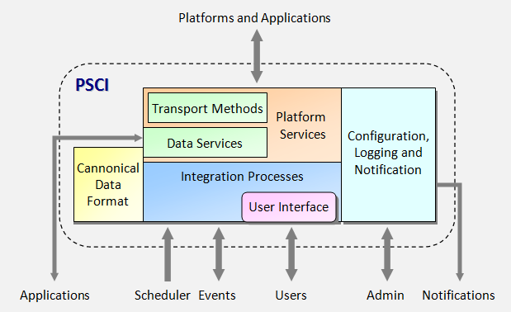
Data Integration Architecture
Framework based on OpenEdge
  Persistent procedures
  Include files
  Method libraries
  Event database
Service oriented
Data entity oriented
Layered:
  Integration processes
  Data services
  Transport methods

Slide 17
Integration Principles
Architecture focused on supportability and functionality
Service oriented, as opposed to point-to-point integration
Data entity oriented, as opposed to application oriented
Separation of logics (transport, data service, process / presentation, process, services / MVC)
Reuse of logic, code and data
Highly configurable to avoid code modifications
Easy replacement of applications
Support for multiple transport mechanisms, including flat files, SCP, (S)FTP, JMS messages, SOAP and REST Web Services, OpenEdge AppServers, OpenEdge Procedures and Email
Integrations from/to externally hosted applications need to be secure and encrypted
Use of the best technology for each integration point
Reduced set of technologies, mainly based on Progress Software technologies

Slide 18
Integration Example:
Create Customer

Slide 19

Integration Example: Customer Creation
1
Account
2
Customer
3

Slide 20
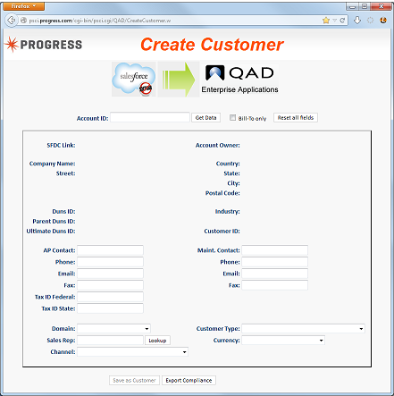
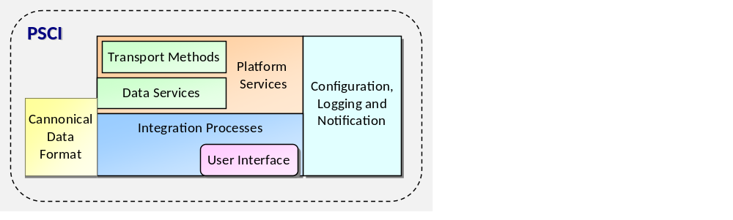
Integration Example: Customer Creation

Slide 21
Integration Example: Customer Creation
Force.com
QXtend

Slide 22
Integration Example: Customer Creation
Force.com
QXtend
libSFDC.p
libQXtend.p
SOAP
SOAP

Slide 23
Integration Example: Customer Creation
CreateCustomer.html
CreateCustomer.w
Force.com
QXtend
libSFDC.p
libQXtend.p
SOAP
SOAP

Slide 24
Get Salesforce.com data using libSFDC.p
ttAccount.i
DEF TEMP-TABLE ttAccount NO-UNDO
FIELD Id AS CHAR
FIELD Name AS CHAR
FIELD CustNum AS CHAR HELP "Customer_Number__c"
FIELD AccountType AS CHAR HELP "Account_Type__c"
FIELD OwnerName AS CHAR HELP "Owner.Name"
FIELD RepCode AS CHAR HELP "Owner.Alias"
(...)
DEF VAR httAccount AS HANDLE NO-UNDO.
httAccount = TEMP-TABLE ttAccount:HANDLE.
CreateCustomer.w
RUN SFDCQuery(INPUT "SELECT * FROM Account WHERE Id = '" + cProspectID + "'"
,INPUT-OUTPUT httAccount
,OUTPUT iRecords).

Slide 25
Transform and display data using wsbp.i – HTML
CreateCustomer.html
(...)
<tr>
<td class="label"> Company Name: </td>
<td> <input name="SFDC-Company" size="40" value=""> [[SFDC-Company]] </td>
<td class="label"> Street: </td>
<td> <input name="SFDC-Address1" size="40" value=""> [[SFDC-Address1]] </td>
<td class="label"> </td>
<td> <input name="SFDC-Address2" size="40" value=""> [[SFDC-Address2]] </td>
<td class="label"> Phone: </td> <td><input name="SFDC-Phone" value="" ><td class="label"> Country: </td>
<td> <select name="SFDC-Country" onchange="countryChanged()">
[[COUNTRY-OPTIONS]]</select>
[[CountryCode]] &nbsp;&nbsp;([[CountryName]]) </td>
</tr><tr>
<td class="label"> State: </td>
<td> <select name="SFDC-State" id="SFDC-State">
[[STATE-OPTIONS]] </select>
[[StateCode]] &nbsp;&nbsp;[[StateName]] </td>
</tr>
(...)

Slide 26
Transform and display data using wsbp.i – ABL
CreateCustomer.w
(...)
SetFieldValue("SFDC-ID",ttAccount.Id).
SetFieldValue("SFDC-Owner",ttAccount.OwnerName).
SetFieldValue("SFDC-Company",ttAccount.Name).
SetFieldValue("SFDC-Address1"
,TRIM(ENTRY(1,ttAccount.BillingStreet,CHR(10)))).
IF NUM-ENTRIES(ttAccount.BillingStreet,CHR(10)) > 1 THEN
SetFieldValue("SFDC-Address2"
,TRIM(ENTRY(2,ttAccount.BillingStreet,CHR(10)))).
IF NUM-ENTRIES(ttAccount.BillingStreet,CHR(10)) > 2 THEN DO:
c = "".
DO i = 3 TO NUM-ENTRIES(ttAccount.BillingStreet,CHR(10)).
c = c + TRIM(ENTRY(i,ttAccount.BillingStreet,CHR(10))) + " ".
END.
SetFieldValue("SFDC-Address3",TRIM(c)).
END.
SetFieldValue("SFDC-Country",ttAccount.BillingCountry).
(...)

Slide 27
Transform and write QAD EE data using libQXtend.p
ttCustomer.i
CreateCustomer.w
DEF TEMP-TABLE ttCustomer NO-UNDO
FIELD CustID AS CHAR
FIELD CustName AS CHAR
FIELD Address1 AS CHAR
FIELD Address2 AS CHAR
FIELD City AS CHAR
(...)
CREATE ttCustomer.
ttCustomer.SupportStatus = "STANDARD".
ttCustomer.CreatedBy = REMOTE_USER.
ttCustomer.CreditLimit = ttCurrency.CreditLimit.
ttCustomer.EntityID = ttDomain.EntityID.
ttCustomer.LanguageID = ttDomain.LanguageID.
ttCustomer.CustName = GetFieldValue("SFDC-Company").
ttCustomer.Address1 = GetFieldValue("SFDC-Address1").
ttCustomer.Address2 = GetFieldValue("SFDC-Address2").
ttCustomer.IsActive = YES.
ttCustomer.SfdcID = IF cMode = "SoldTo"
THEN GetFieldValue("SFDC-ID")
ELSE "".
(...)
RUN QXCreateCustomer(INPUT-OUTPUT TABLE ttCustomer).

Slide 28
Integration Example: Customer Creation
CreateCustomer.html
CreateCustomer.w
Force.com
QXtend
libSFDC.p
libQXtend.p
SOAP
SOAP

Slide 29
Integration Example:
Support Case

Slide 30
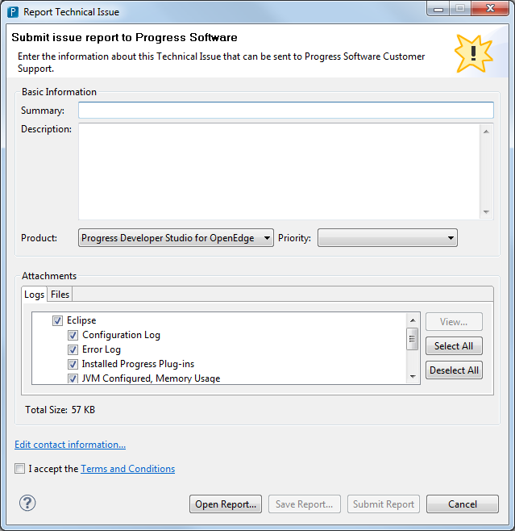
Integration Example: SupportCase
1
3
2

Slide 31


Integration Example: SupportCase
Web Service
Force.com
QXtend
libSFDC.p
libQXtend.p
SOAP
SOAP

Slide 32
Integration Example: SupportCase
Web Service
Force.com
QXtend
SupportCase.p
libSFDC.p
libQXtend.p
SOAP
SOAP

Slide 33
Integration Example: Support Case
Web Service
file
Start
Parse web service file into fields
QAD EE
QAD EE
QXtend
Use serial number to get entitlement
Use email addres to get Contact
Salesforce.com
Create Contact if it doesn’t exist
Salesforce.com
Sforce API
Create Case
Attach files
End

Slide 34
Integration Example: Support Case
Web Service
file
Start
lOK = hDS:READ-XML("FILE",cXMLfile,"EMPTY",?,?,?,?).
Parse web service file into fields
QAD EE
QAD EE
RUN QXGetSupportMaint("",ttCase.Serial,INPUT-OUTPUT TABLE ttSupportMaint).
QXtend
Use serial number to get entitlement
RUN SFDCQuery(INPUT "SELECT Id,Name,Account.Id,Account.Name " +
"FROM Contact WHERE Email = '" + cEmail + "'"
,INPUT-OUTPUT httContactQuery,OUTPUT iRecords).
Use email addres to get contact
Salesforce.com
Create Contact if it doesn’t exist
IF iRecords = 0 THEN
RUN SFDCCreate(httContact,OUTPUT iErrors).
Salesforce.com
Sforce API
Create Case
RUN SFDCCreate(httCase,OUTPUT iErrors).
Attach files
RUN SFDCCreate(httAttachment,OUTPUT iErrors).
RUN SFDCCreate(httCaseComment,OUTPUT iErrors).
End

Slide 35
Other Salesforce.com ←→ QAD EE Integrations
Create Customer
Support Case
Customer Updates
Support Entitlements
Account Updates
Trigger
APEX
Web Services
Web App
Force.com
Batch
QXtend
libSFDC.p
libQXtend.p

Slide 36
Application:
ProDesk

Slide 37
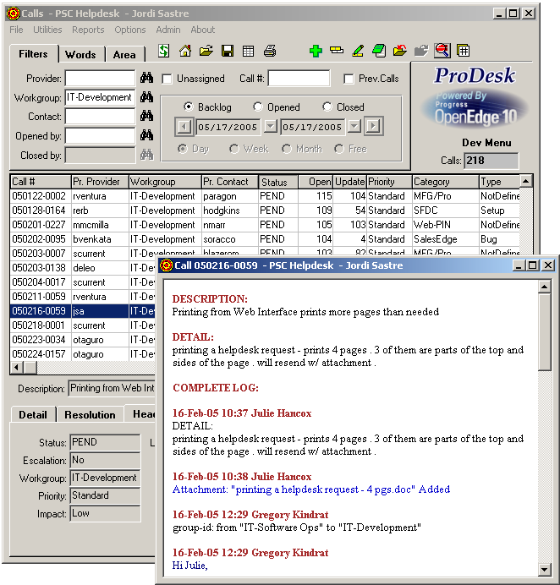
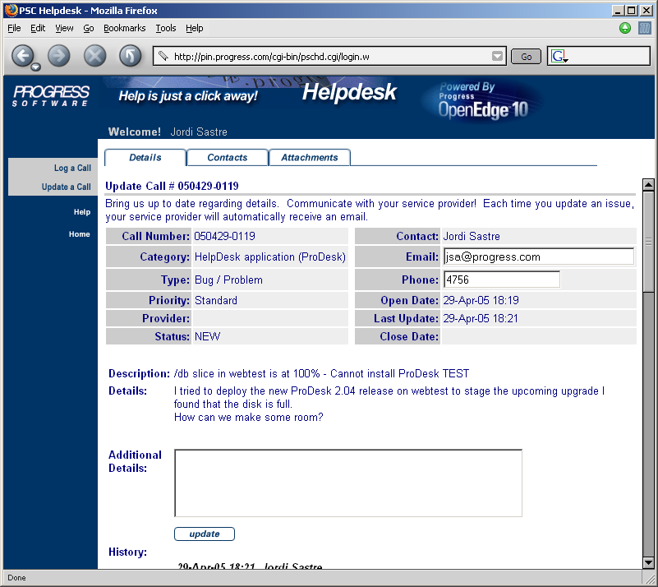
IT HelpDesk (ProDesk)
Application developed and implemented in 2004
OpenEdge 10.0B
  Rich GUI Client for service providers
    SmartObjects, Progress WebClient
  WebSpeed UI for company employees

Slide 38
ProDesk Architecture
OpenEdge Reference Architecture concepts
WebSpeed
Web
Interface
Users
AppServer
Business
Logic
WebClient
GUI
Interface
Providers
Database

Slide 39

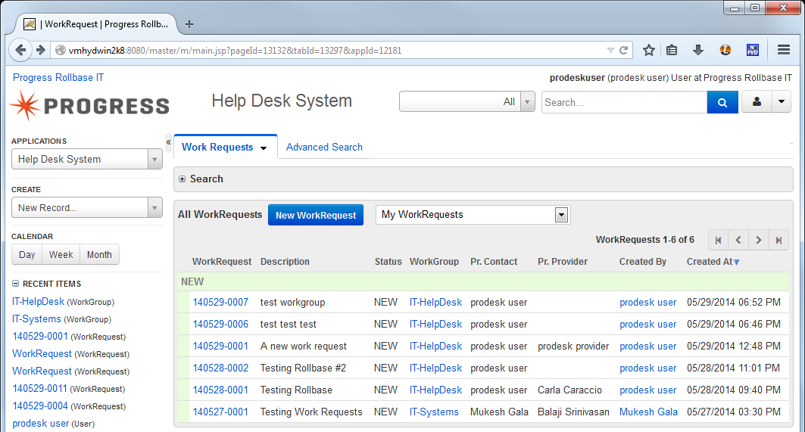
Options for modernizing ProDesk
Replace with a Rollbase-based version

Slide 40
Options for modernizing ProDesk
Replace with a Rollbase-based version
Upgrade to 11.x with a JavaScript-based front end (jQuery, DHTMLX)
JS Framework
AppServer
Ajax
User
Interface
Business
Logic
Users
Client Logic
Provider
Interface
Providers
Database

Slide 41
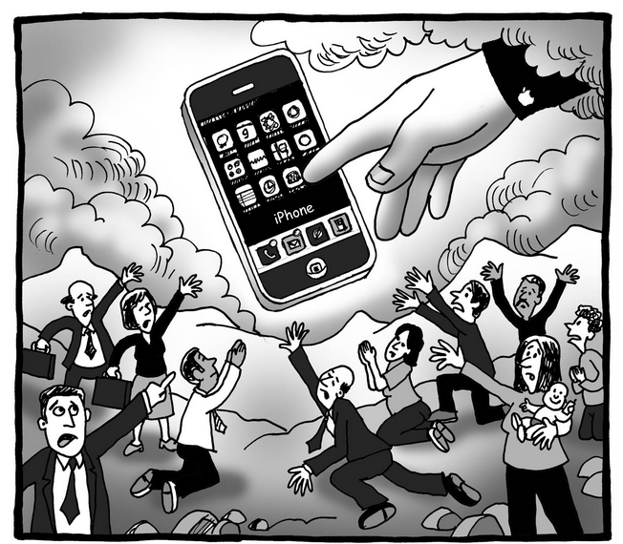
Options for modernizing ProDesk
Replace with a Rollbase-based version
Upgrade to 11.x with a JavaScript-based front end (jQuery, DHTMLX)
Add a mobile client

Slide 42
Business Intelligence
&
Data Warehousing

Slide 43
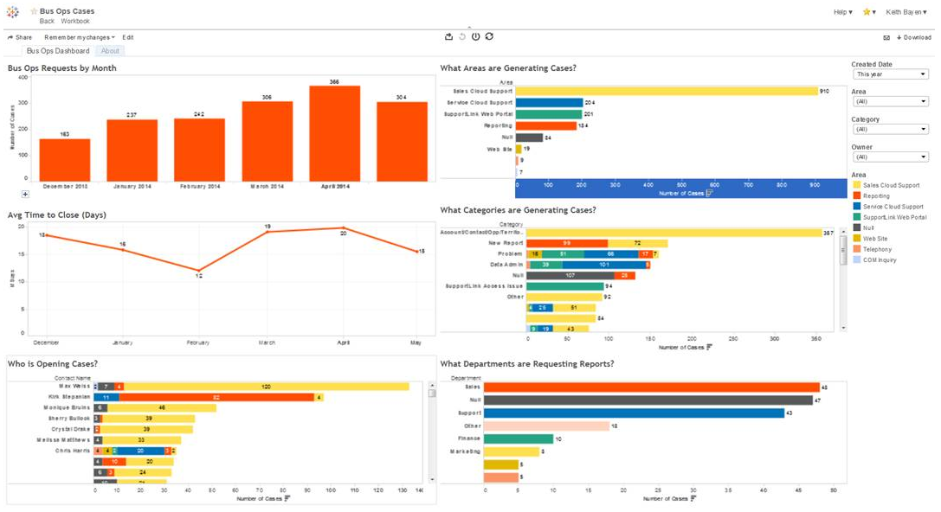

BI and DW

Slide 44
BI and DW

Slide 45


BI and DW

Slide 46
Summary
Progress IT combines cloud with on-premise, third-party with home-grown
OpenEdge used for critical business applications, simple tools and integration
Well designed frameworks make life easier and users happier
Pacific products are making its way into the technology portfolio

