Slide 1
Client Principal in the wild
Or, how we learnt to love the client principal …
Julian Lyndon-Smith, whoGloo

Slide 2
help --> about
Julian Lyndon-Smith
  co-founder of several startups, including dot.r and whoGloo
progress v3
*not* a dba guy
  know enough to keep things running
  so may get some db stuff wrong. throw your rotten tomatoes ;)
know enough about security to make me paranoid
  you should be too

Slide 3
agenda
A little history of openedge security
  setuserid
First looks at the client principal
Getting deeper
The client principal in the wild
  aka real code
Tips and tricks
questions

Slide 4
disclaimer
This talk includes information about real-world products and applications
What I am about to say reflects our current thinking, but the information contained herein is probably heretical, wrong, may annoy progress, and is definitely subject to change
Any future talks on this subject may be materially different from what is described here
I may offend “users” ..

Slide 5
V11 ?
11.x introduced new features for the client principal
  Initialize method
  Progress.Security.PAMStatus
  Get-db-client
  Db-list method
11.1 introduced callbacks
This presentation concentrates on the v11 features, as v10
  Is not as secure
  No callbacks
  Does not have the same level of helper methods etc

Slide 6
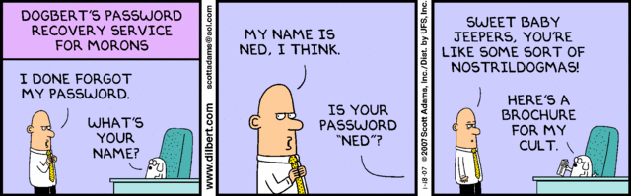
Why do we need user authentication ?

Slide 7
Why do we need user authentication ?
Sarbanes-Oxley (SOX)
  http://en.wikipedia.org/wiki/Sarbanes-Oxley_Act
Customer requirements
Application requirements
N-tier applications
  Appserver / webspeed
Auditing
  Who did what / where / when

Slide 8
authentication is not authorisation
Authentication is who the user is
Authorisation is what the authorised user can do
  Often called “roles”
You should always, however, be tracking changes to critical data
  Use the auditing systems built into OpenEdge
  Beyond the scope of this presentation
  documentation.progress.com/output/OpenEdge113/pdfs/gscsv/gscsv.pdf

Slide 9
A short history : setuserid
We’ve always used setuserid()
Present in all versions of progress since at least v3
  Not old enough to remember that far back
Simple premise
  Setuserid(“user”,”password” [,”database”])
  Authenticates a user for the specified database
  Tries to match a user account in the _User table of the database
  Returns true or false

Slide 10
Setuserid : problems
Maintenance of the _user table is painful
Only the logged in user can change password
  Which leads to problems if the user forgets their password ;)
  Only solution is to delete the _user, and recreate
Have to setuserid for each connected database
It does not generate any audit events, such as for login and logout

Slide 11
Setuserid : problems #2
The password encoding algorithm does not meet any industry standards such as PCI/DSS
“cracking” programs exist to reveal password
Not easy to use external authentication systems
  Ldap etc
Can’t “logout” or invalidate the authentication session

Slide 12
Enter client principal
First introduced with 10.0
  Much improved since
  11.3 version is very useful ;)
Represents a user login session
Share a session between appservers and agents
Sets user id
  For the ABL application
  For the database connection

Slide 13
Enter client principal
Audit logs record login and logout of the user
Internal authentication schemes
External authentication schemes
Session data can be stored as raw value
Once “sealed” data cannot be changed

Slide 14
Using client principal
Several things need to be set up in order to use the client principal
Authentication systems
Domains
Database options

Slide 15
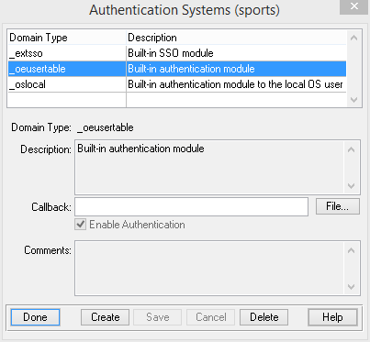
Authentication systems

Slide 16
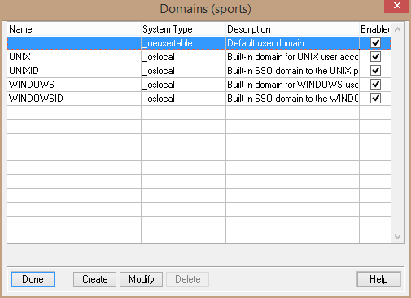
domains

Slide 17
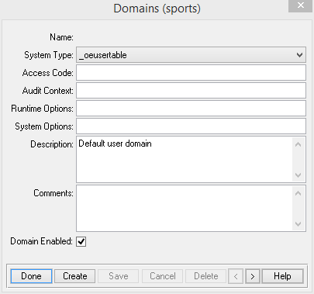
Domain options
System type
This is the authentication system
Access code
case-sensitive key used to seal the client-principal. A domain with the same name and access code must exist in the db for a sealed CP to be validated
Audit context
This value is stored in the _event-context field of any auditing record

Slide 18
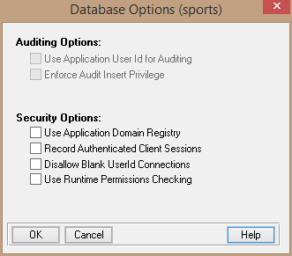
Database options
Override database domain registry, trust the application registry
Apply CAN-READ / CAN-WRITE permissions and runtime, not compile time

Slide 19
gotchas
Can only access primary-passphrase from within a callback
Domain access codes are hard to keep secret in code
  very very very very bad practice ;)
Memory leak with security-policy:get-client
Secure access to any stored client principal records
Long-lived CP

Slide 20
gotchas
<context>Authentication System library open failure (16357)
  The <context> operation could not find/load the external shared library containing an Authentication System plug-in module" " “
  Aka I can’t find the auth program you specified …
Try to avoid setuserid() in your code after using client-principal
  Overwrites *and locks out* set-db-client()
  Fix this by using set-db-client(?)

Slide 21
Best practices for password ? (user)
Enforce password changes on a regular basis
  NO!
Add time delays between sign-in attempts
  5s or so
Consider allowing sentences as passwords
  My little pony
  Bacon, lettuce and tomato
  Another day, another password
  Easily cracked ;)

Slide 22
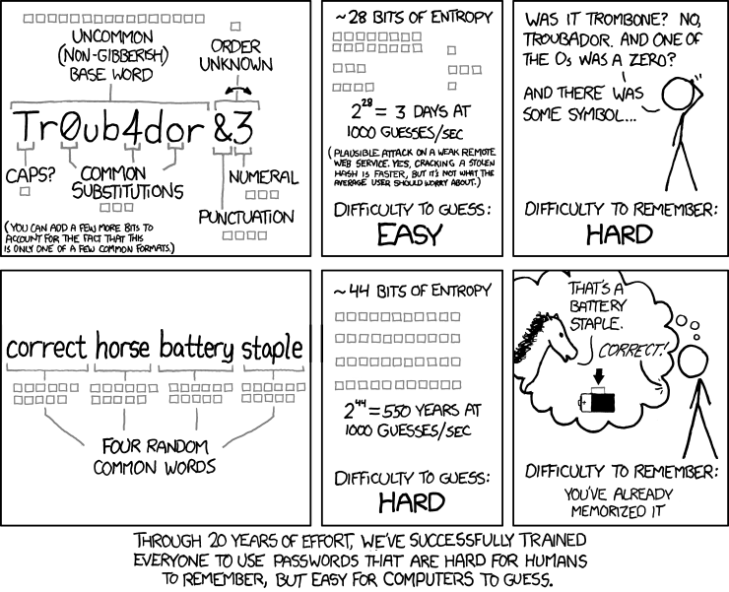

Slide 23
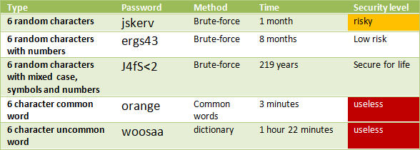

Best practices for password ? (user)
It is 10 times more secure to use "this is fun" as your password, than "J4fS<2".
http://www.baekdal.com/insights/password-security-usability

Slide 24
Best practices for password ? (user)
http://arstechnica.com/security/2012/08/passwords-under-assault/
http://tinyurl.com/nxpaxp5 (How the bible and youtube are cracking your passwords)
“Of the 4,400 unique words or phrases they mined from the Twitter searches,
1,976 of them were all or part of actual passwords used by MilitarySingles users”
Dustin's computer can perform 30 billion guesses per second against standard Windows hashes.
The $800 system uses four AMD Sapphire Radeon 7950 cards.

Slide 25
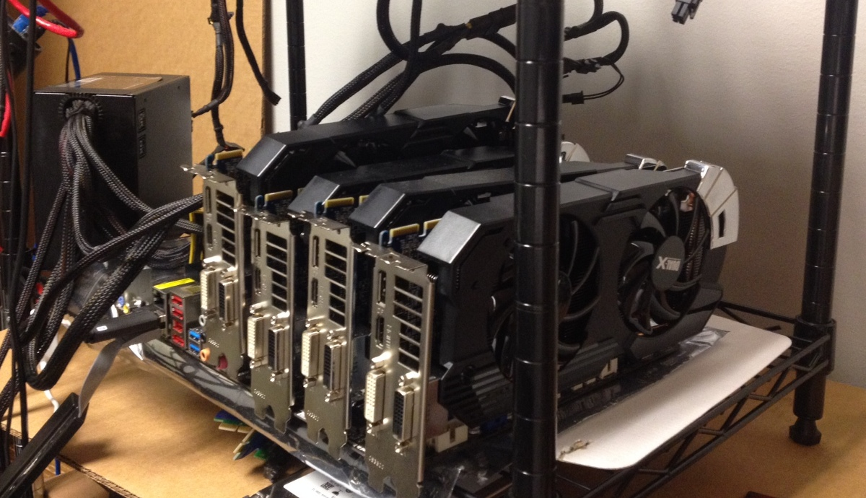
Best practices for password ? (user)

Slide 26
Best practices for password (system)
Never, ever, ever store passwords in plain text. Ever!
  http://plaintextoffenders.com/archive
  http://mashable.com/2014/01/16/starbucks-mobile-passwords-plaintext/
Never, ever, ever, store passwords with reversible encryption
Always hash the password before storing.
  Each user should have a different salt for the hash
Always try to use https on web / appserver connections
  So what if the NSA can see it ? ;)
Ensure you have a low-level user with no permissions
  Change userid when your user logs out (appserver etc)

Slide 27
Let’s do this
Let’s create a new authentication system
  Create new domain
  Create new authentication system
  Create callback procedure to validate credentials
  Create a session storage mechanism
Validate with user code & password
  Store a sealed client principal
  Retrieve stored client principal
  authenticate

Slide 28
Questions ?
Thank you for your time

