Slide 1

The Progress Myth Detectives
Presented by: Dan Foreman (danf@prodb.com)

Slide 2

Our Mentors

Slide 3
Introduction – Dan Foreman
Progress User since 1984
Author of several Progress related Publications
  Progress Performance Tuning Guide
  Progress Database Administration Guide
  Progress VST & System Tables
Author of several useful Progress DBA Tools
  ProMonitor & ProCheck & LockMon
  Pro Dump&Load
  Balanced Benchmark
Basketball & Bicycle Fanatic…which sometimes leads to unexpected trips to the Emergency Room

Slide 4


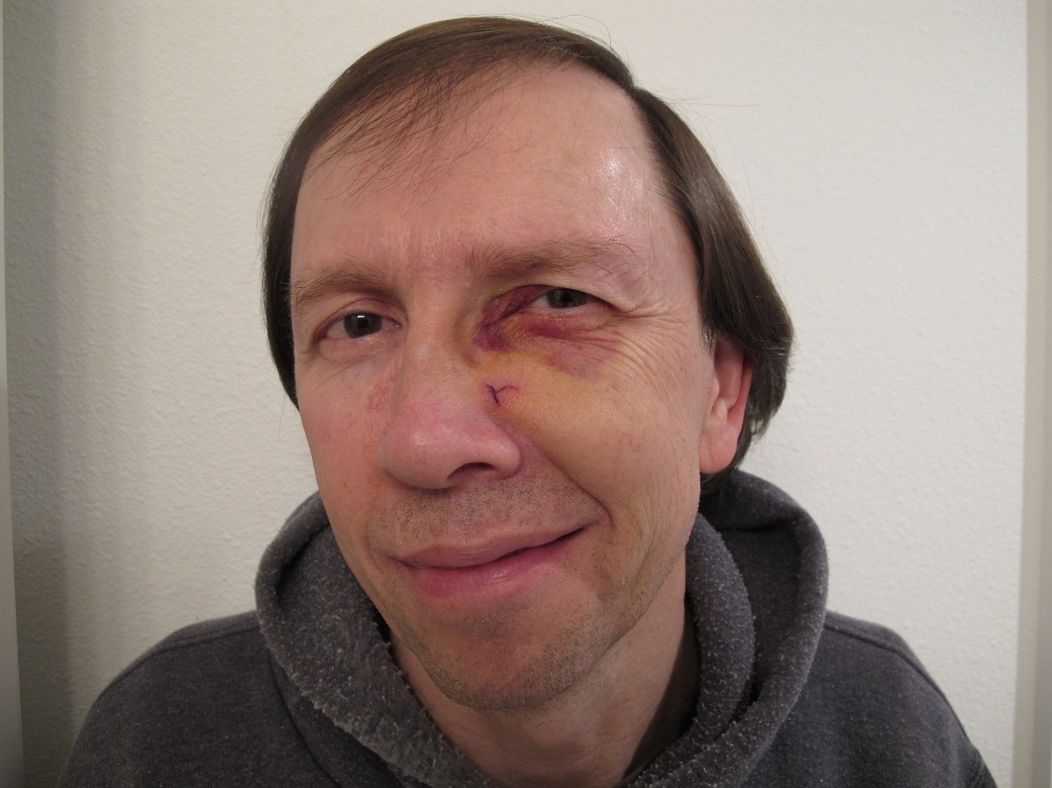


Slide 5

My New Wheels
(so I won’t fall over)

Slide 6
Wikipedia definition of Mythology
The term mythology can refer either to a collection of myths (a mythos, e.g., Inca mythology) or to the study of myths (e.g.,comparative mythology).^{[1]} According toAlan Dundes, a myth is a sacrednarrative explaining how the world and humankind assumed their present form,^{[2]}although, in a very broad sense, the word can refer to any traditional story.^{[3]} Bruce Lincoln defines myth as "ideology in narrative form".^{[4]} Myths may arise as either truthful depictions oroverelaborated accounts of historical events, as allegory for or personificationof natural phenomena, or as anexplanation of ritual. They are used to convey religious or idealized experience, to establish behavioral models, and to teach. Early rival classifications of Greek mythos by Euhemerus,Plato's Phaedrus, and Sallustius were developed by the neoplatonists and revived by Renaissance mythographers as in the Theologia mythologica(1532). Nineteenth-century comparative mythology reinterpreted myth as evolution toward science (E. B. Tylor), "disease of language" (Max Müller), or misinterpretation of magical ritual (James Frazer). Later interpretations rejected opposition between myth and science, such as Jungianarchetypes, Joseph Campbell's "metaphor of spiritual potentiality", or Lévi-Strauss's fixed mental architecture. Tension between Campbell's comparative search for monomyth or Ur-myth and anthropological mythologists' skepticism of universal origin has marked the 20th century. Further, modern mythopoeia such as fantasy novels, manga, and urban legend, with many competing artificial mythoi acknowledged as fiction, supports the idea of myth as ongoing social practice.

Slide 7
Dictinary.com definition of Mythology
a traditional story, esp. one concerning the early history of a people or explaining some natural or social phenomenon, and typically involving supernatural beings or events
a widely held but false belief or idea

Slide 8
Wikipedia definition of Folklore
Folklore (or lore) consists of legends, music, oral history, proverbs, jokes, popular beliefs, fairy tales, stories, tall tales, and customs included in the traditions of a culture, subculture, or group. It also includes the set of practices through which those expressive genres are shared. The study of folklore is sometimes called folkloristics, and people who study folklore are sometimes referred to as "folklorists". The English antiquarian William Thomsintroduced the word "folklore" in a letter published in the London journal The Athenaeum in 1846.^{[1]} In usage, there is a continuum between folklore and mythology. Stith Thompson (1885-1976) made a major attempt to index the motifs of both folklore and mythology, providing an outline for classifying new motifs, and within which scholars can keep track of all older motifs.

Slide 9
Dictionary.com definition of Folklore
the traditional beliefs, customs, and stories of a community, passed through the generations by word of mouth.
synonyms: mythology, lore, oral history, tradition, folk tradition; More
a body of popular myth and beliefs relating to a particular place, activity, or group of people.

Slide 10
Warning
To keep things interesting, I’ve embedded some half truths among the falsehoods

Slide 11
Database Storage & Configuration
Type 2 Storage Areas don’t need to be Dumped & Loaded
Records Per Block (RPB) of 1 is good for Index Areas
A Data Cluster Size of 8 is good for Index Areas
Always use a 4k DB block size if the File System block size is 4k (Windows NTFS, AIX, Linux)

Slide 12
Storage
Progress doesn’t work well with RAID 5
  Only Progress??
RAID 5 will perform well if there is enough cache
  How much is ‘enough’?
  Cache is still finite
  SAN Cache is expensive
Large SAN Caches and File System caches are good enough, no need for a large Buffer Cache (-B)

Slide 13
Storage – RAID Levels
If RAID 10 is better than RAID 5, then RAID 6 must also be better than RAID 5
RAID DP is even better because it doesn’t use numbers
  DP = Double Parity
RAID 50 is 10X better than RAID 5
RAID 50 is 5X better than RAID 10

Slide 14
Contrary Myths
Classic: Must use Fixed size extents because of the overhead of growing a variable extent
Modern: There is no need to use Fixed size extents any more because Storage is much faster than the old days

Slide 15
Database Tuning
Must truncate the BI for good performance
Must truncate the BI file daily
-spin Formula: 10000 * # of CPUs
Set -B to 10% of DB Size
One Async Page Writer (APW) per DB disk + 1
  Came from the era when Sequent existed
AI Buffers (-aiabufs) = BI Buffers (-bibufs) * 1.5
  Embedded in the Progress Documentation
  May have been started by Gus

Slide 16
Database Tuning
-directio only works on Data General or Sequent
  Was true in V6 & V7
-directio is no longer required
  V9.1E and V10/V11: fdatasync

Slide 17
DB Administration
An index rebuild is just as good as a full dump & load for improving performance

Slide 18
DB Administration
You can use -F to force in to a database and then idxbuild will make it all better (i.e. reset the tainted flag)
-F is evil

Slide 19
DB Administration
-F is evil
  On proutil truncate bi Agree (but might not have any option)
  On proshut Agree
  On promon Disagree

Slide 20
DB Administration
It’s possible to re-org data online with proutil tablemove

Slide 21
DB Administration
It’s possible to re-org data online with proutil tablemove
  All done as a single transaction (BI Size)
  AI Size
  Table is locked for the duration of the move
  Accessing the table with NO-LOCK during the move will produce wacky results

Slide 22
Metrics & Measurements
A Buffer Hit % of 99% is Excellent
If I’m finding data in memory rather than going to the DB on disk all is well

Slide 23
Progress Scalability
More CPUs/Cores = Better Performance
Progress can’t handle large databases
Going from 32-bit Progress to 64-bit Progress will make things twice as fast

Slide 24
Controversial
Workgroup database is still a viable product
  With every contemporary server being multi-core
All of the wish list items from various Information Exchanges will be added to the product
Remote Clients are much slower than Self-Service Clients

Slide 25
4GL
The primary function of the RELEASE statement is to release record locks
The Mandatory attribute in the Data Dictionary specifies whether data is optional or not

Slide 26
4GL Development Methodology
Progress builds or recommends the best tools & methodologies for building applications:
  FastTrack
  Shell methodology
  ADM1
  ADM2
  AppBuilder
  Results
  Report Builder
  Rollbase
  Ad infinitum
  And probably some I’ve missed

Slide 27
Historical Myths
Microsoft was going to purchase Progress Software (in the 90’s)

Slide 28
Trivia
Source of the Database Epoch Date (Day 0)
  The Epoch Date serves as a reference point from which time is measured
  May 2, 1950
Day 0 in the 4GL
  4714BC

Slide 29
The 5 Minute Rule (for DB Conversion)
Where did that rule come from?
New Index Manager in V7
The old index manager was removed
Gus says that was a mistake
Why
It meant that converting from a V6 DB to V7 required the indexes to be built in the new format….very time consuming in some cases

Slide 30
When/Why were multiple extents added
EWC Electronics had the largest single volume Progress DB at the time and it was approaching 2GB
V4
Same company subsequently hit
  A bug related to 2gb size
  A bug related to 4gb (limit of 32 bits)

Slide 31
Famous Quotes
“You’re too stupid to be using our product” – Clyde Kessel, DLC/Progress Founding member in a conversation with a customer
“Unix is snake oil” – Ken Olsen, CEO of DEC (when DEC still existed)

Slide 32
Progress Software
The half life of a Progress Marketing VP seems to be less than a year

Slide 33
Conclusion
Does anyone have any Myths they would like debunked or confirmed?

Slide 34
Thank You!
Questions?

