Slide 1

Captain, Captain,
Where should I go?
What should I do?
Presented by: Dan Foreman (danf@prodb.com)

Slide 2
Introduction – Dan Foreman
Progress User since 1984
Author of several Progress related Publications
  Progress Performance Tuning Guide
  Progress Database Administration Guide
  Progress VST & System Tables
Author of several useful Progress DBA Tools
  ProMonitor & ProCheck & LockMon
  Pro Dump&Load
  Balanced Benchmark
I’ve flown 3 million miles on United Airlines and 3 million miles on American Airlines

Slide 3
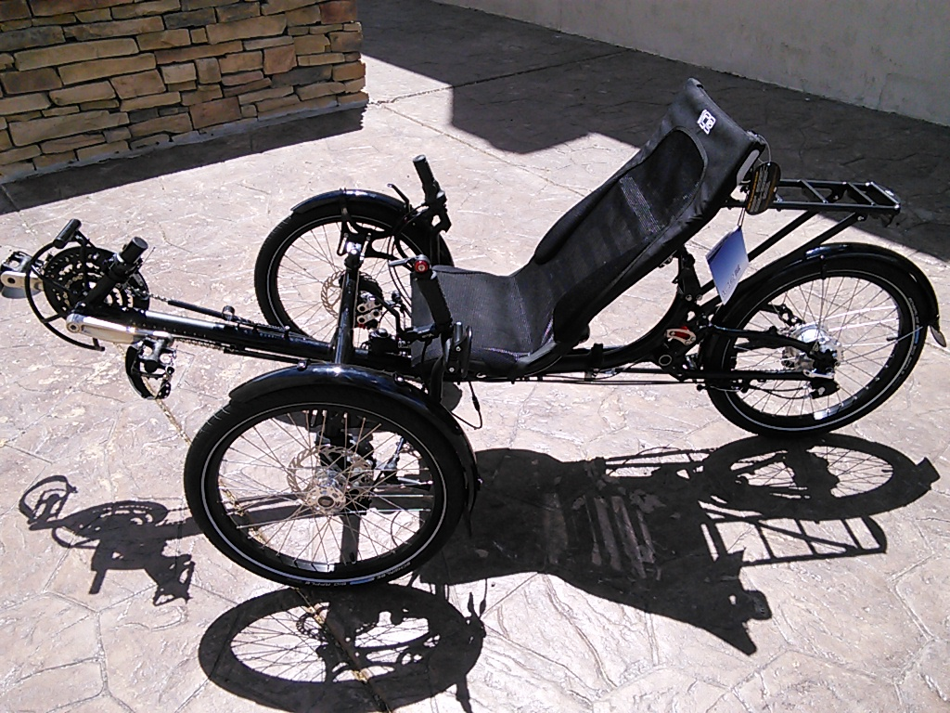

Slide 4
Presentation Title
The session title (Captain, Captain. Where should I go?
What should I do?) is one of my favorite lines from the Titanic movie (James Cameron version)
That phrase is meant to illustrate how things can be chaotic during times of disaster
  How leaders can be frozen by the magnitude of the event

Slide 5
Presentation Overview
This session is Progress centric
Over the years I’ve been asked many times if there is a checklist for recovering a broken DB…
The reality is that I’m not confident that it is possible to produce such a how-to-fix-it document

Slide 6
Basic Disaster Prevention & Planning
After Imaging
Replication of DB and/or AI files
  I prefer the “and” because OE Replication is somewhat fragile
Test your recovery plan frequently

Slide 7


Slide 8
Iceberg! Dead Ahead!
Is it truly a disaster?
  What is your definition of disaster?
  What is the business’s definition of disaster?
  Is an Outage the same as a Disaster?

Slide 9
From the DB Perspective
Is the DB Really Down?
  Is everyone locked out/frozen/etc ?
  Are entries still being written to the DB log?
  Could it be an AI Stall or BI Stall?
  Can I promon into the DB?
  If promon hangs, try promon –F
    If –F works, gather as much data as possible (i.e. screen shots) because the ship is sinking

Slide 10
This Presentation’s Definition of Disaster
The database is down
The database is:
  Not re-startable
  Or Corrupted
  Or both
The DB can’t be opened or examined by various utilities

Slide 11
Initial Steps
Preserve the crime scene
  Backup the DB (non-Progress)
    Not enough space, shame on you
  Preserve the DB log (could be overwritten if DB is restored from backup) or your scripts
  Preserve any other logs that might be overwritten…have a list handy so you don’t forget any
  Structure (.st) file, if it’s not up-to-date, shame on you
Make sure only one person is driving the process that touches the database

Slide 12
Initial Steps
Stop Automated Tasks via cron or the Windows Scheduler
Inform the business/user community (it’s better to have someone else do that…if you get slain, you won’t be able to accomplish much)
Don’t try truncate the BI file unless you are sure there is enough disk space available to complete Crash Recovery
Don’t truncate with –F until the crime scene is backed up

Slide 13


Slide 14
Other People
I don’t think Ghost Busters knows anything about Progress
If you don’t have enough security permissions (i.e. root or Administrator), get in touch with someone who does
If the backup is stored off-site, dispatch someone to get it
  If it’s stored off-site but not accessible 24/7 that’s just wrong
Get a Webex, Goto My PC, or similar session fired up
Open a Support call with PTS
Open a Support call with your Application Vendor
See if Dan Foreman or Tom Bascom, et al are available

Slide 15
Time Constraints
Time required to restore from backup & Roll Forward versus fixing the problem
  Do you know how long a restore + RF takes?
  Do you know how long it takes to failover to Replicated DB?
  Do you know how long it takes to run some of the scanning/repair utilities?
Can I do some activities in parallel?
  Restore & Roll Forward
  Failover to Replicated DB
  Fix the DB
  Do you have enough hands to multi-task? Very Dangerous!!

Slide 16
DB Status
DB is Down and won’t restart
  If the Broker won’t restart, try connecting with a Client session
  If the Client won’t connect, try using Read Only (-RO)
  If the Client still can’t connect, truncate the BI file

Slide 17
More Complexity
DB is Startable but corrupted
  What kind of corruption?
    Internal
    Missing extents
DB is gone
Is only “simple” recovery required
  Restore from Backup + Roll Forward
  Switch over to a Replicated Database…if there is one

Slide 18
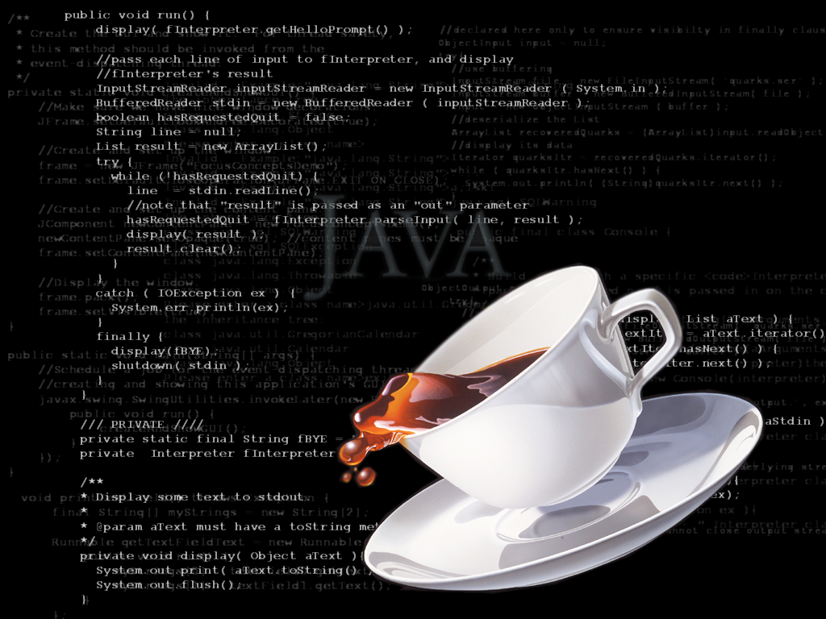
Remove Java from the Equation

Slide 19
Remove Java from the Equation
If DB is normally started with dbman or OE Management try starting from the command line…if you don’t know how, learn now…it’s a good skill to have

Slide 20
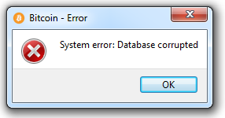
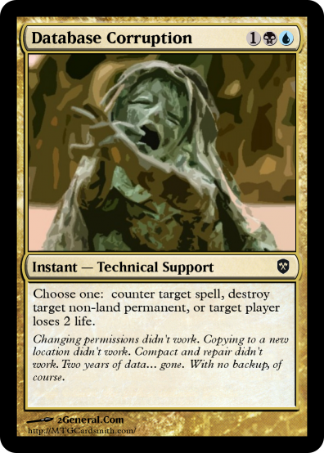
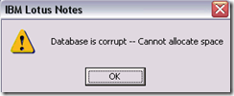

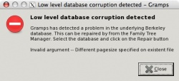

Slide 21
If there is evidence of Physical Corruption
Run one or more of the following:
  proutil dbrpr
  proutil dbscan
  proutil idxfix
There is a good chapter on the pro’s & con’s of these proutil options in Dan’s Progress Database Administration Guide
Check system logs; any evidence of a disk and/or memory error?

Slide 22
Logical Corruption?
How easy/difficult to detect?
Work with the business to create a list of programs that can be used to ‘validate’ the DB

Slide 23


Slide 24
Post Mortem
Document the incident
  Actions taken & the sequence of those actions
  What worked
  What didn’t (so it doesn’t get repeated in the future)
  Resources required (disk space, etc)

Slide 25
Post Mortem
Put in place whatever is required to prevent a similar event from happening in the future
  Enhanced monitoring
  Better logging
  Better documentation
  Newer version of Progress
  Etc.

Slide 26
Thank You!
Questions?

