Slide 1

Recovery Log Notes
Gus Björklund, Progress
Dan Foreman, Bravepoint
2014 Americas PUG Challenge
Westford, MA
June 8 – June 11 2014

Slide 2
Abstract
The OpenEdge RDBMS uses two kinds of transaction logs. These form the basis for a variety of important features like transaction rollback, crash recovery, replication, media failure recovery and so on.
In this talk we will open the bonnet on the topic of After-Image Journaling and Recovery Log Records (aka "Notes").
We will describe what they are, what they do, and how to monitor them. But most importantly, we will show you some practical applications of your newfound understanding of Notes.

Slide 3
who uses after-imaging ?

Slide 4
who uses after-imaging ?
who uses the after-imaging daemon ?

Slide 5
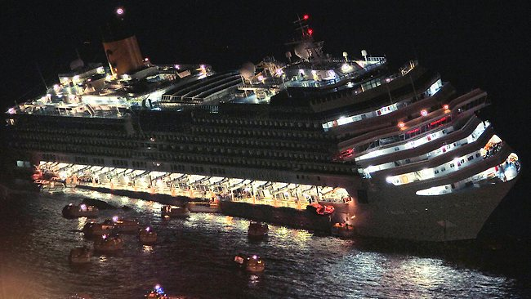
disaster strikes ! (ap photo)

Slide 6
transaction logging to the rescue!

Slide 7
Two transaction logs
BI
Undo-Redo Log
(Before-Image Log)
db
db’
Original
Database
Transactions
make changes
Changed
Database
AI
Redo-Log
(After-Image Journals)

Slide 8
Two transaction logs
BI
Undo-Redo Log
(Before-Image Log)
db
db’
Original
Database
Transactions
make changes
Changed
Database
AI
Redo-Log
(After-Image Journals)

Slide 9
transaction log records (aka “notes”)
T1: begin
actions taken by transaction 1
T1: action 1
Time
T1: action 2
actions taken by transaction 2
T2: begin
T1: action 3
actions taken by transaction 3
T3: begin
T1: action 4
T3: action 1
T3: action 2
T2: action 1
T1: end
T2: action 2
T3: end
T2: action 3
T2: action 4
notes form a complete history of everything

Slide 10
Over to Dan

Slide 11
log records (notes)
generated for every change to database.
each describes exactly one change to one database block.
  almost - there are log records that describe changes to purely memory-resident data structures like the transaction table
apply only to specific version number of block
some operations require more than one change
  index splits, multi-block records
written in same order changes are executed.
notes from concurrent transactions are mixed together.

Slide 12
Undo-Redo (aka Before-Image) Log Records
each log record (or “note”) contains:
  transaction number
  data area number
  database block number (its dbkey)
  database block's version number
  note type – specifies what operation to perform
  any information needed to undo the operation
    in case we have to roll back
  any information needed to redo the operation
    in case we lose the result before writing to disk

Slide 13
Redo (aka After-Image) Log Records
each log record (or “note”) contains:
  transaction number
  data area number
  database block number (its dbkey)
  database block's version number
  note type – specifies what operation to perform
  any information needed to undo the operation
    in case we have to roll back
  any information needed to redo the operation
    in case we lose the result before writing to disk

Slide 14
Did you notice anything about those two kinds of notes (bi and ai) ????

Slide 15
Special cases
After-image journalling
  AI extent switches generate notes
Replication
  causes "parenthesis" notes to bracket logical operations
JTA (Java Transaction API)
  can cause bracketing notes
Auditing
  generates extra notes for creating audit records and their index entries
TDE (Transparent Data Encryption)
  generates extra notes when encryption policies set or changed
etc.

Slide 16
The So-Called "Before-Image" File Is NOT
Does not really contain before images
It has a record of all recent database changes
The data are sufficient to:
  Undo or roll back transactions
  Perform crash recovery

Slide 17
The So-Called "After-Image" File Is NOT
Does not really contain after images
It has a record of all database changes after a backup
  this can be called time 0
The data are sufficient to:
  Recreate everything that happened since time 0
  Recreate the before-image log
  Undo or roll back transactions
  Perform crash recovery

Slide 18
why?
Over to Gus

Slide 19
because
What if someone unplugs server to plug in vacuum cleaner?
What if we want to undo (roll back) ?
What if we make several more changes and only one block of a fragmented record chain is written to disk to make room in the buffer pool ?
What if our ship runs aground and falls down

Slide 20
because
What if someone unplugs server to plug in vacuum cleaner?
  the change will be lost
What if we want to undo (rollback) ?
  we don’t know the old value or how to undo
What if we make several more changes and only one block of a fragmented record chain is written to disk to make room in the buffer pool ?
  the database will be corrupted
What if our ship runs aground and falls down
  the database will disappear completely
these are all bad things (tm)

Slide 21
scanning after-image journals
over to Dan

Slide 22
Questions
When was an ‘evil’ transaction started?
Then i know how far to Roll Forward
What transactions were active during an online backup?
those would be reversed if the backup was restored
What transactions were active during a quiet point?
those would be reversed if the backup was restored
What userid is causing the BI file to grow?
and why?
Is my database code crappy?
Why did lock table overflow?
Who caused it?

Slide 23
rfutil aimage scan
Prerequisites:
After Imaging is enabled
Use the "verbose" option to get exquisite detail
aimage scan verbose is VERY verbose.
you might use up all of your disk space
and cause a disaster
Prior to V10.1A the transaction index rolls over at 32767 in the report

Slide 24
How to do it
prostrct add foo ai.st
rfutil foo –C mark
rfutil foo –C aimage begin
.... change stuff in database
rfutil bar –C aimage scan verbose \
–a longaimagefilename.a1 \
> aiscanreport.txt
NOTE: cannot do this with live ai extents,
only archived ones or copies
dbname "bar" does not matter here.

Slide 25
what do you get?
Trid: 17 dbkey = 0 update counter = 0 (12530)
Trid: 18 Wed Jan 27 16:54:06 2010. (2598)
Trid: 18 User Id: Dan (12531)
Trid: 18 code = RL_TBGN version = 1 (12528)
Trid: 18 dbkey = 0 update counter = 0 (12530)
Trid: 18 code = RL_RMCR version = 2 (12528)
Trid: 18 area = 7 dbkey = 480 update counter = 5 (12529)
Trid: 18 code = RL_CXINS version = 2 (12528)
Trid: 18 area = 9 dbkey = 28 update counter = 24 (12529)
Trid: 18 code = RL_CXINS version = 2 (12528)
Trid: 18 area = 9 dbkey = 36 update counter = 24 (12529)
Trid: 18 code = RL_CXINS version = 2 (12528)
Trid: 18 area = 9 dbkey = 44 update counter = 24 (12529)
Trid: 18 Wed Jan 27 16:54:06 2010. (2598)
Trid: 18 code = RL_TEND version = 1 (12528)
Trid: 18 dbkey = 0 update counter = 0 (12530)
Trid: 19 Wed Jan 27 16:54:06 2010. (2598

Slide 26
over to dan & gus

Slide 27
Now, let see some 4GL examples
and their patterns
a few are from George Potemkin

Slide 28
first, we play with customers

Slide 29
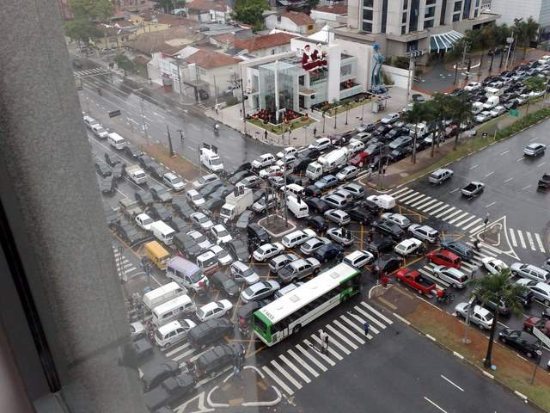
we need a picture here

Slide 30
example 0
DO TRANSACTION:
FIND Customer 1 NO-LOCK NO-ERROR.
END.

Slide 32
example 1
DO TRANSACTION:
FIND Customer 1 EXCLUSIVE-LOCK NO-ERROR.
END.

Slide 34
example 2
DO TRANSACTION:
CREATE Customer.
DELETE Customer.
END.

Slide 35
Trid: 27955 Thu Jun 5 14:25:13 2014. (2598)
Trid: 27955 User Id: gus (12531)
Trid: 27955 code = RL_TBGN version = 1 (12528)
Trid: 27955 dbkey = 0 update counter = 0 (12530)
Trid: 27955 code = RL_SEINC version = 1 (12528)
Trid: 27955 area = 6 dbkey = 96 update counter = 27 (12529)
Trid: 27955 code = RL_TMSAVE version = 2 (12528)
Trid: 27955 dbkey = 0 update counter = 0 (12530)
Trid: 27955 code = RL_RMCR version = 2 (12528)
Trid: 27955 area = 9 dbkey = 1344 update counter = 22 (12529)
Trid: 27955 code = RL_CXINS version = 2 (12528)
Trid: 27955 area = 10 dbkey = 640 update counter = 220 (12529)
Trid: 27955 code = RL_CXREM version = 2 (12528)
Trid: 27955 area = 10 dbkey = 640 update counter = 221 (12529)
Trid: 27955 code = RL_RMDEL version = 2 (12528)
Trid: 27955 area = 9 dbkey = 1344 update counter = 23 (12529)
Trid: 27955 code = RL_RMCR version = 2 (12528)
Trid: 27955 area = 9 dbkey = 1344 update counter = 24 (12529)
Trid: 27955 Thu Jun 5 14:25:13 2014. (2598)
Trid: 27955 code = RL_TEND version = 1 (12528)
Trid: 27955 dbkey = 0 update counter = 0 (12530)

Slide 36
example 3
DISABLE TRIGGERS FOR LOAD OF Customer.
DO TRANSACTION:
CREATE Customer.
DELETE Customer.
END.

Slide 38
example 4
DEF VAR N AS INT NO-UNDO.
DISABLE TRIGGERS FOR LOAD OF Customer.
DO TRANSACTION:
CREATE Customer.
N = RECID(Customer).
DELETE Customer.
END.

Slide 39
Trid: 27957 Thu Jun 5 14:25:13 2014. (2598)
Trid: 27957 User Id: gus (12531)
Trid: 27957 code = RL_TBGN version = 1 (12528)
Trid: 27957 dbkey = 0 update counter = 0 (12530)
Trid: 27957 code = RL_RMDEL version = 2 (12528)
Trid: 27957 area = 9 dbkey = 1344 update counter = 25 (12529)
Trid: 27957 code = RL_RMCR version = 2 (12528)
Trid: 27957 area = 9 dbkey = 1344 update counter = 26 (12529)
Trid: 27957 code = RL_RMDEL version = 2 (12528)
Trid: 27957 area = 9 dbkey = 1344 update counter = 27 (12529)
Trid: 27957 code = RL_RMCR version = 2 (12528)
Trid: 27957 area = 9 dbkey = 1344 update counter = 28 (12529)
Trid: 27957 Thu Jun 5 14:25:13 2014. (2598)
Trid: 27957 code = RL_TEND version = 1 (12528)
Trid: 27957 dbkey = 0 update counter = 0 (12530)

Slide 40
then, we play with orders

Slide 41
example 5
create order.
assign
custnum = 1
orderdate = today
ordernum = time
shipdate = today + 1
.

Slide 42
Trid: 27985 code = RL_TBGN version = 1 (12528)
Trid: 27985 dbkey = 0 update counter = 0 (12530)
Trid: 27985 code = RL_SEINC version = 1 (12528)
Trid: 27985 area = 6 dbkey = 96 update counter = 33 (12529)
Trid: 27985 code = RL_TMSAVE version = 2 (12528)
Trid: 27985 dbkey = 0 update counter = 0 (12530)
Trid: 27985 code = RL_RMCR version = 2 (12528)
Trid: 27985 area = 11 dbkey = 20544 update counter = 14 (12529)
Trid: 27985 code = RL_CXINS version = 2 (12528)
Trid: 27985 area = 11 dbkey = 4768 update counter = 354 (12529)
part 1 ...

Slide 43
Trid: 27985 code = RL_CXREM version = 2 (12528)
Trid: 27985 area = 11 dbkey = 4768 update counter = 355 (12529)
Trid: 27985 code = RL_CXINS version = 2 (12528)
Trid: 27985 area = 11 dbkey = 864 update counter = 68 (12529)
Trid: 27985 code = RL_CXINS version = 2 (12528)
Trid: 27985 area = 11 dbkey = 4768 update counter = 356 (12529)
Trid: 27985 code = RL_CXINS version = 2 (12528)
Trid: 27985 area = 11 dbkey = 3104 update counter = 474 (12529)
Trid: 27985 code = RL_CXINS version = 2 (12528)
Trid: 27985 area = 11 dbkey = 384 update counter = 3956 (12529)
Trid: 27985 code = RL_CXINS version = 2 (12528)
Trid: 27985 area = 11 dbkey = 4704 update counter = 215 (12529)
Trid: 27985 code = RL_RMCHG version = 2 (12528)
Trid: 27985 area = 11 dbkey = 20544 update counter = 15 (12529)
Trid: 27985 Fri Jun 6 13:44:12 2014. (2598)
Trid: 27985 code = RL_TEND version = 1 (12528)
part 2

Slide 44
example 6
disable triggers for load of order.
create order.
assign
custnum = 1
orderdate = today
ordernum = time
shipdate = today + 1.

Slide 45
Trid: 27987 User Id: gus (12531)
Trid: 27987 code = RL_TBGN version = 1 (12528)
Trid: 27987 dbkey = 0 update counter = 0 (12530)
Trid: 27987 code = RL_RMCR version = 2 (12528)
Trid: 27987 area = 11 dbkey = 20544 update counter = 18 (12529)
Trid: 27987 code = RL_CXINS version = 2 (12528)
Trid: 27987 area = 11 dbkey = 864 update counter = 70 (12529)
Trid: 27987 code = RL_CXINS version = 2 (12528)
Trid: 27987 area = 11 dbkey = 4768 update counter = 360 (12529)
Trid: 27987 code = RL_CXINS version = 2 (12528)
Trid: 27987 area = 11 dbkey = 3104 update counter = 476 (12529)
Trid: 27987 code = RL_CXINS version = 2 (12528)
Trid: 27987 area = 11 dbkey = 384 update counter = 3958 (12529)
Trid: 27987 code = RL_CXINS version = 2 (12528)
Trid: 27987 area = 11 dbkey = 4704 update counter = 217 (12529)
Trid: 27987 Fri Jun 6 14:05:17 2014. (2598)
Trid: 27987 code = RL_TEND version = 1 (12528)
Trid: 27987 dbkey = 0 update counter = 0 (12530)

Slide 46
example 7
disable triggers for load of order.
create order.
assign
custnum = 1
orderdate = today
ordernum = time.
shipdate = today + 1.

Slide 47
example 7
disable triggers for load of order.
create order.
assign
custnum = 1
orderdate = today
ordernum = time.
shipdate = today + 1.

Slide 48
Trid: 27988 Fri Jun 6 14:13:25 2014. (2598)
Trid: 27988 User Id: gus (12531)
Trid: 27988 code = RL_TBGN version = 1 (12528)
Trid: 27988 dbkey = 0 update counter = 0 (12530)
Trid: 27988 code = RL_RMCR version = 2 (12528)
Trid: 27988 area = 11 dbkey = 20544 update counter = 19 (12529)
Trid: 27988 code = RL_CXINS version = 2 (12528)
Trid: 27988 area = 11 dbkey = 864 update counter = 71 (12529)
Trid: 27988 code = RL_CXINS version = 2 (12528)
Trid: 27988 area = 11 dbkey = 4768 update counter = 361 (12529)
Trid: 27988 code = RL_CXINS version = 2 (12528)
Trid: 27988 area = 11 dbkey = 3104 update counter = 477 (12529)
Trid: 27988 code = RL_CXINS version = 2 (12528)
Trid: 27988 area = 11 dbkey = 384 update counter = 3959 (12529)
Trid: 27988 code = RL_CXINS version = 2 (12528)
Trid: 27988 area = 11 dbkey = 4704 update counter = 218 (12529)
Trid: 27988 code = RL_RMCHG version = 2 (12528)
Trid: 27988 area = 11 dbkey = 20544 update counter = 20 (12529)
Trid: 27988 Fri Jun 6 14:13:25 2014. (2598)
Trid: 27988 code = RL_TEND version = 1 (12528)
Trid: 27988 dbkey = 0 update counter = 0 (12530)

Slide 49
example 8 (... serendipity)
find order 1.
misc-info = fill("abc", 6000).
display record-length (order).

Slide 50
Trid: 0 code = RL_INMEM version = 3 (12528)
Trid: 0 dbkey = 0 update counter = 0 (12530)
Trid: 0 code = RL_LSTMOD version = 2 (12528)
Trid: 0 area = 6 dbkey = 32 update counter = 31 (12529)
Trid: 15 Fri Jun 6 15:27:29 2014. (2598)
Trid: 15 User Id: gus (12531)
Trid: 15 code = RL_TBGN version = 1 (12528)
Trid: 15 dbkey = 0 update counter = 0 (12530)
Trid: 15 code = RL_RMDEL version = 2 (12528)
Trid: 15 area = 8 dbkey = 3136 update counter = 19 (12529)
Trid: 15 code = RL_RMCR version = 2 (12528)
Trid: 15 area = 8 dbkey = 3136 update counter = 20 (12529)
Trid: 15 code = RL_RMCR version = 2 (12528)
Trid: 15 area = 8 dbkey = 3152 update counter = 6 (12529)
Trid: 15 code = RL_BKFRM version = 2 (12528)
Trid: 15 area = 8 dbkey = 3072 update counter = 2 (12529)
Trid: 15 code = RL_BKFRB version = 2 (12528)
Trid: 15 area = 8 dbkey = 3152 update counter = 7 (12529)
Trid: 15 code = RL_RMCR version = 2 (12528)
Trid: 15 area = 8 dbkey = 3168 update counter = 1 (12529)
Trid: 15 code = RL_BKFRM version = 2 (12528)
Trid: 15 area = 8 dbkey = 3072 update counter = 3 (12529)
Trid: 15 code = RL_BKFRB version = 2 (12528)
Trid: 15 area = 8 dbkey = 3168 update counter = 2 (12529)
Trid: 15 code = RL_RMCR version = 2 (12528)
Trid: 15 area = 8 dbkey = 3184 update counter = 1 (12529)
Trid: 15 code = RL_BKFRM version = 2 (12528)
Trid: 15 area = 8 dbkey = 3072 update counter = 4 (12529)
Trid: 15 code = RL_BKFRB version = 2 (12528)
Trid: 15 area = 8 dbkey = 3184 update counter = 2 (12529)
Trid: 15 code = RL_RMCR version = 2 (12528)
Trid: 15 area = 8 dbkey = 3200 update counter = 1 (12529)
Trid: 15 code = RL_BKFRM version = 2 (12528)
Trid: 15 area = 8 dbkey = 3072 update counter = 5 (12529)
Trid: 15 code = RL_BKFRB version = 2 (12528)
Trid: 15 area = 8 dbkey = 3200 update counter = 2 (12529)
Trid: 15 code = RL_RMCR version = 2 (12528)
Trid: 15 area = 8 dbkey = 3216 update counter = 1 (12529)
Trid: 15 code = RL_RMNXTF version = 2 (12528)
Trid: 15 area = 8 dbkey = 3200 update counter = 3 (12529)
Trid: 15 code = RL_RMNXTF version = 2 (12528)
Trid: 15 area = 8 dbkey = 3184 update counter = 3 (12529)
Trid: 15 code = RL_RMNXTF version = 2 (12528)
Trid: 15 area = 8 dbkey = 3168 update counter = 3 (12529)
Trid: 15 code = RL_RMNXTF version = 2 (12528)
Trid: 15 area = 8 dbkey = 3152 update counter = 8 (12529)
Trid: 15 code = RL_RMNXTF version = 2 (12528)
Trid: 15 area = 8 dbkey = 3136 update counter = 21 (12529)
Trid: 15 Fri Jun 6 15:27:29 2014. (2598)
Trid: 15 code = RL_TEND version = 1 (12528)
Trid: 15 dbkey = 0 update counter = 0 (12530)

Slide 51
Trid: 0 code = RL_INMEM version = 3 (12528)
Trid: 0 dbkey = 0 update counter = 0 (12530)
Trid: 0 code = RL_LSTMOD version = 2 (12528)
Trid: 0 area = 6 dbkey = 32 update counter = 31 (12529)
Trid: 15 Fri Jun 6 15:27:29 2014. (2598)
Trid: 15 User Id: gus (12531)
Trid: 15 code = RL_TBGN version = 1 (12528)
Trid: 15 dbkey = 0 update counter = 0 (12530)
Trid: 15 code = RL_RMDEL version = 2 (12528)
Trid: 15 area = 8 dbkey = 3136 update counter = 19 (12529)
Trid: 15 code = RL_RMCR version = 2 (12528)
Trid: 15 area = 8 dbkey = 3136 update counter = 20 (12529)
Trid: 15 code = RL_RMCR version = 2 (12528)
Trid: 15 area = 8 dbkey = 3152 update counter = 6 (12529)
Trid: 15 code = RL_BKFRM version = 2 (12528)
Trid: 15 area = 8 dbkey = 3072 update counter = 2 (12529)
.......

Slide 52
Trid: 15 code = RL_BKFRB version = 2 (12528)
Trid: 15 area = 8 dbkey = 3152 update counter = 7 (12529)
Trid: 15 code = RL_RMCR version = 2 (12528)
Trid: 15 area = 8 dbkey = 3168 update counter = 1 (12529)
Trid: 15 code = RL_BKFRM version = 2 (12528)
Trid: 15 area = 8 dbkey = 3072 update counter = 3 (12529)
Trid: 15 code = RL_BKFRB version = 2 (12528)
Trid: 15 area = 8 dbkey = 3168 update counter = 2 (12529)
Trid: 15 code = RL_RMCR version = 2 (12528)
Trid: 15 area = 8 dbkey = 3184 update counter = 1 (12529)
Trid: 15 code = RL_BKFRM version = 2 (12528)
Trid: 15 area = 8 dbkey = 3072 update counter = 4 (12529)
Trid: 15 code = RL_BKFRB version = 2 (12528)
Trid: 15 area = 8 dbkey = 3184 update counter = 2 (12529)
Trid: 15 code = RL_RMCR version = 2 (12528)
Trid: 15 area = 8 dbkey = 3200 update counter = 1 (12529)
Trid: 15 code = RL_BKFRM version = 2 (12528)
Trid: 15 area = 8 dbkey = 3072 update counter = 5 (12529)
Trid: 15 code = RL_BKFRB version = 2 (12528)
Trid: 15 area = 8 dbkey = 3200 update counter = 2 (12529)
Trid: 15 code = RL_RMCR version = 2 (12528)
Trid: 15 area = 8 dbkey = 3216 update counter = 1 (12529)
Trid: 15 code = RL_RMNXTF version = 2 (12528)
Trid: 15 area = 8 dbkey = 3200 update counter = 3 (12529)
Trid: 15 code = RL_RMNXTF version = 2 (12528)
Trid: 15 area = 8 dbkey = 3184 update counter = 3 (12529)
Trid: 15 code = RL_RMNXTF version = 2 (12528)
Trid: 15 area = 8 dbkey = 3168 update counter = 3 (12529)
Trid: 15 code = RL_RMNXTF version = 2 (12528)
Trid: 15 area = 8 dbkey = 3152 update counter = 8 (12529)
Trid: 15 code = RL_RMNXTF version = 2 (12528)
Trid: 15 area = 8 dbkey = 3136 update counter = 21 (12529)
Trid: 15 Fri Jun 6 15:27:29 2014. (2598)
Trid: 15 code = RL_TEND version = 1 (12528)
Trid: 15 dbkey = 0 update counter = 0 (12530)

Slide 53
other stuff

Slide 54
example 9
DO TRANSACTION:
CREATE _View.
DELETE _View.
END.

Slide 55
Trid: 27958 Thu Jun 5 14:25:13 2014. (2598)
Trid: 27958 User Id: gus (12531)
Trid: 27958 code = RL_TBGN version = 1 (12528)
Trid: 27958 dbkey = 0 update counter = 0 (12530)
Trid: 27958 code = RL_RMCR version = 2 (12528)
Trid: 27958 area = 6 dbkey = 12384 update counter = 22 (12529)
Trid: 27958 code = RL_RMDEL version = 2 (12528)
Trid: 27958 area = 6 dbkey = 12384 update counter = 23 (12529)
Trid: 27958 code = RL_RMCR version = 2 (12528)
Trid: 27958 area = 6 dbkey = 12384 update counter = 24 (12529)
Trid: 27958 Thu Jun 5 14:25:13 2014. (2598)
Trid: 27958 code = RL_TEND version = 1 (12528)
Trid: 27958 dbkey = 0 update counter = 0 (12530)

Slide 56
example 10
DISABLE TRIGGERS FOR LOAD OF Customer.
DO TRANSACTION:
DO i = 1 TO 1:
CREATE Customer.
DELETE Customer.
END.
END.

Slide 58
example 11
DISABLE TRIGGERS FOR LOAD OF Customer.
DO TRANSACTION:
REPEAT i = 1 TO 1:
CREATE Customer.
DELETE Customer.
END.
END.

Slide 59
Trid: 27960 Thu Jun 5 14:25:13 2014. (2598)
Trid: 27960 User Id: gus (12531)
Trid: 27960 code = RL_TBGN version = 1 (12528)
Trid: 27960 dbkey = 0 update counter = 0 (12530)
Trid: 27960 code = RL_TMSAVE version = 2 (12528)
Trid: 27960 dbkey = 0 update counter = 0 (12530)
Trid: 27960 Thu Jun 5 14:25:13 2014. (2598)
Trid: 27960 code = RL_TEND version = 1 (12528)
Trid: 27960 dbkey = 0 update counter = 0 (12530)
subtransaction causes transaction to start
0 notes if using -nosavepoint

Slide 60
example 12
DEF VAR N AS INT NO-UNDO.
DO TRANSACTION:
N = CURRENT-VALUE(NextCustNum).
END.

Slide 62
example 13
DEF VAR N AS INT NO-UNDO.
DO TRANSACTION:
N = NEXT-VALUE(NextCustNum).
END.

Slide 63
Trid: 27962 Thu Jun 5 14:25:13 2014. (2598)
Trid: 27962 User Id: gus (12531)
Trid: 27962 code = RL_TBGN version = 1 (12528)
Trid: 27962 dbkey = 0 update counter = 0 (12530)
Trid: 27962 code = RL_SEINC version = 1 (12528)
Trid: 27962 area = 6 dbkey = 96 update counter = 28 (12529)
Trid: 27962 Thu Jun 5 14:25:13 2014. (2598)
Trid: 27962 code = RL_TEND version = 1 (12528)
Trid: 27962 dbkey = 0 update counter = 0 (12530)

Slide 64
example 14
DISABLE TRIGGERS FOR LOAD OF Customer.
DO TRANSACTION:
REPEAT i = 1 TO 1:
CREATE Customer.
UNDO.
END.
END.

Slide 65
Trid: 27963 Thu Jun 5 14:25:13 2014. (2598)
Trid: 27963 User Id: gus (12531)
Trid: 27963 code = RL_TBGN version = 1 (12528)
Trid: 27963 dbkey = 0 update counter = 0 (12530)
Trid: 27963 code = RL_TMSAVE version = 2 (12528)
Trid: 27963 dbkey = 0 update counter = 0 (12530)
Trid: 27963 code = RL_TMSAVE version = 2 (12528)
Trid: 27963 dbkey = 0 update counter = 0 (12530)
Trid: 27963 Thu Jun 5 14:25:13 2014. (2598)
Trid: 27963 code = RL_TEND version = 1 (12528)
Trid: 27963 dbkey = 0 update counter = 0 (12530)
subtransaction causes main transaction to start
0 notes if using -nosavepoint

Slide 66
example 15
DISABLE TRIGGERS FOR LOAD OF Customer.
DO TRANSACTION:
CREATE Customer.
UNDO.
END.

Slide 68
example 16
DO TRANSACTION:
FIND FIRST Customer NO-LOCK
WHERE RECID(Customer) EQ 1 NO-ERROR.
UNDO.
END.

Slide 70
example 17
DEF VAR N AS INT NO-UNDO.
DO:
N = NEXT-VALUE(NextCustNum).
END.

Slide 71
Trid: 0 code = RL_SEINC version = 1 (12528)
Trid: 0 area = 6 dbkey = 96 update counter = 29 (12529)

Slide 72
example 18
do transaction:
find _myconnect.
_myconn-numseqbuffers = 3.
end.

Slide 74
So ...
When was an ‘evil’ transaction started?
What transactions were active during an online backup?
What transactions were active during a quiet point?
What userid is causing the BI file to grow? and why?
Is my database code crappy?
Why did lock table overflow? Who caused it?

Slide 75
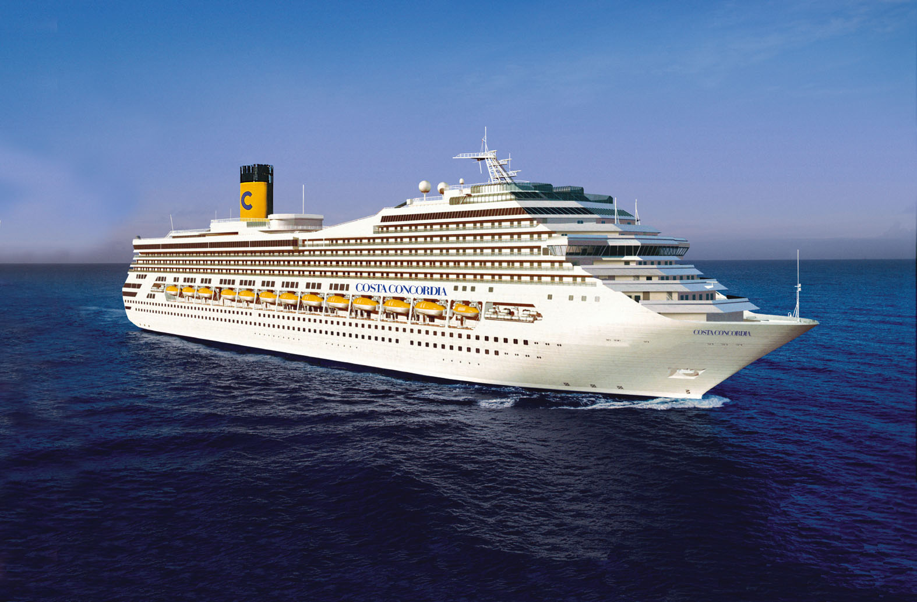

Slide 76
?
Answers
email:
gus@progress.com
danf@prodb.com

