Slide 1
Welcome to the 21st Century
Bringing Proven Applications Up To Date
Scott M. Dulecki
BravePoint

Slide 2
Agenda
Setting the Stage
Background
Learnings
Final Thoughts

Slide 3
Setting The Stage: Me
Scott M. Dulecki
Presenter at PCA and various user groups
Board Member, QAD Midwest Users Group
Board Member, QAD South & East Users Group
President, West Michigan Progress Users Group
Past President, VP Michigan Progress Users Group
PEG member 1998061901
Author of:
  Back to Basics: Dump and Load
  Safe Haven: Archiving in MFG/PRO
  Safe Haven: MFG/PRO Basics

Slide 4
Setting The Stage: You
Developers?
Managers?
Here for the beer?

Slide 5
Agenda
Setting the Stage
Background
Learnings
Final Thoughts

Slide 6
The Guinea Pig: The ADU
Automation/Deletion Utility
Tool used by a number of QAD customers
Developed in 1999
Originally v6-style character
Variety of Progress and QAD versions
Variety of user interfaces

Slide 7
The Challenge
Support for new QAD UI
Support for new QAD version
Why not update some of that old-style thinking and coding?
Goal: One set of code to rule them all

Slide 8
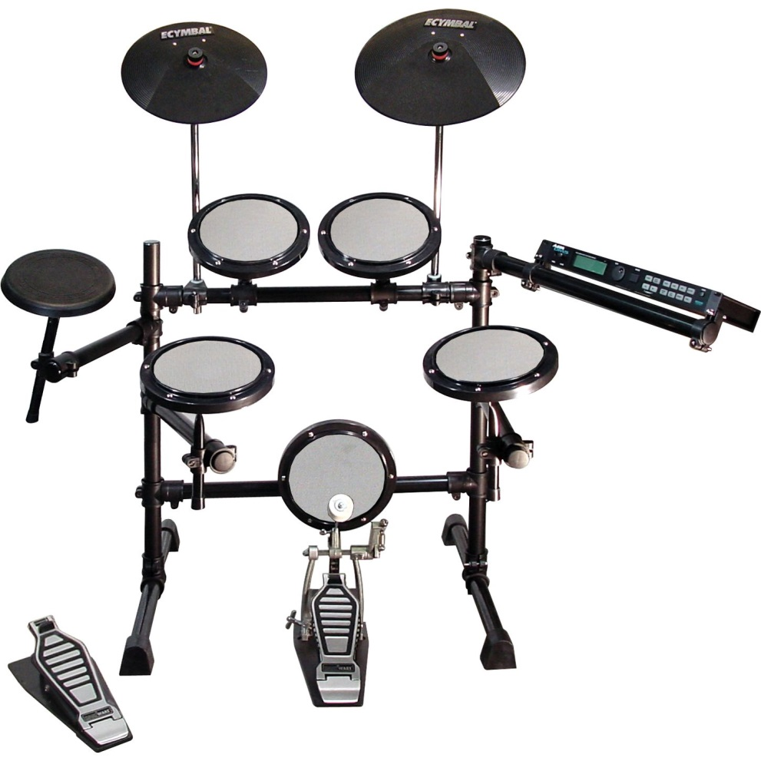
A Word About My Learning…
My electronic drum kit
Yesterday…

Slide 9
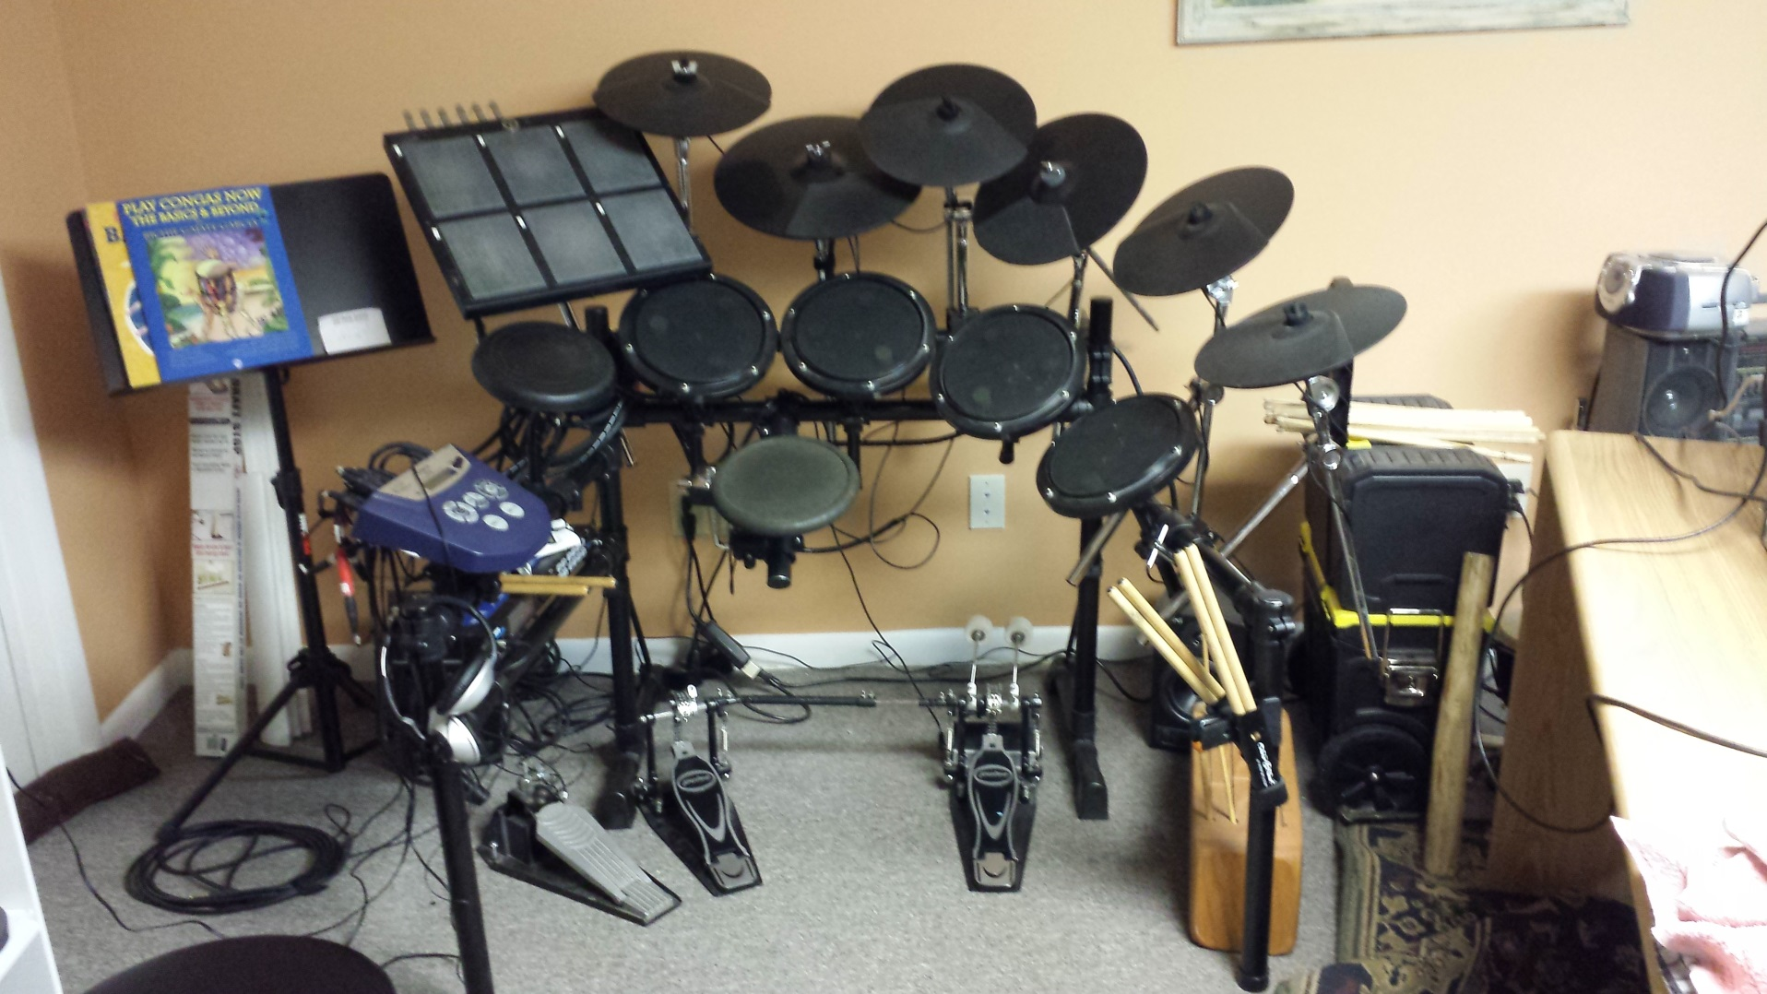
Evolution…

Slide 10
… And This Presentation
You will see…
  Yesterday
  Evolution
  Next Generation

Slide 11
Agenda
Setting the Stage
Background
Learnings
Final Thoughts

Slide 12
Learning 1: For Each
Yesterday, the mighty FOR EACH
  Powerful querying tool
  Simple automatic looping
  Bracket multiple indexes
  Conditional criteria
  Indexes fixed at compile time
    Based on all possible criteria

Slide 13
Look Familiar?
for each tr_hist where tr_hist.tr_domain = global_domain
and (tr_part = part-to-read
and (tr_site >= site and tr_site <= site1)
and (tr_effdate >= effdate and tr_effdate <= effdate1)
and (tr_date >= trdate and tr_date <= trdate1)
and (tr_nbr >= nbr and tr_nbr <= nbr1)
and (tr_so_job >= so_job)
and (tr_so_job <= so_job1 or so_job1 = "")
and (tr_type = type or type = "")
and (tr_type <> "ORD-SO" or type = "ORD-SO")
and (tr_type <> "ORD-PO" or type = "ORD-PO")
) use-index tr_part_eff no-lock
break by tr_part by tr_site
by tr_ship_type
by tr_trnbr

Slide 14
Seek the Truth
for each u1aul_log no-lock where
(IF v-Id1 = "" THEN TRUE ELSE (func_id >= v-Id1 )) and
(IF v-Id2 = hi_char THEN TRUE ELSE (func_id <= v-Id2 )) and
(IF v-log1 = 0 THEN TRUE ELSE (log_id >= v-log1 )) and
(IF v-log2 = 0 THEN TRUE ELSE (log_id <= v-log2 )) and
(IF v-Sts1 = ? THEN TRUE ELSE (run_sts >= v-Sts1 )) and
(IF v-Sts2 = hi_char THEN TRUE ELSE (run_sts <= v-Sts2 )) and
(if v-skip then not(mmessage matches "*skipped*“) else true)
break by func_Id
by log_id:

Slide 15
Evolution 1: Query
Today, the slippery QUERY
  Powerful querying tool
  Looping requires more effort
  Brackets multiple indexes
  Conditional criteria
  Indexes fixed at open time… dynamic
    Based on query prepare

Slide 16
Query Steps
Define
Create
Build
Prepare
Navigate
Stuff
Close
Delete

Slide 17
Define
define variable qdist as handle no-undo.
define variable qstring as char no-undo.
Handle allows you to grab it later
String to build up query

Slide 18
Create
create query qdist.
qdist:set-buffers(buffer tt_dist:handle).
Create an instance of the query
Link the related tables to the query

Slide 19
Build
qstring = "for each tt_dist no-lock ".
if dist_sort = true then
qstring = qstring + "by tt_reason by tt_dept".
else
qstring = qstring + "by tt_dept by tt_reason".
Build up the FOR EACH
Contingent on selection criteria
Debug Hint: DISPLAY qstring

Slide 20
Prepare
qdist:query-prepare(qstring).
qdist:query-open().
qdist:get-first().
Prepare loads the query definition
Open initializes it (and fixes indexes)
Get-first retrieves the first record

Slide 21
Navigate
do while not qdist:query-off-end:
/* stuff */
qdist:get-next().
end.
Query-off-end – end of query loop
Get-next – next record

Slide 22
Stuff
if dist_sort = true then
display tt_reason tt_dept tt_debit
tt_credit with frame d1 down.
else
display tt_dept tt_reason tt_debit
tt_credit with frame d2 down.
Whatever you need… ☺

Slide 23
Close
qdist:query-close().
Clean up after yourself
Query scoping

Slide 24
Delete
delete object qdist.
Clean up after yourself
Potential memory leak if you don’t

Slide 25
Next Generation 1: Query Handler
Coding the same thing over and over
Time to make that a generic procedure
Possibly using Tim Kuehn’s Query Manager
  OE Hive

Slide 26
Learning 2: Navigation
Up/down arrows to go between records
QAD standard:
  Editing blocks
  {mfnp.i}

Slide 27
Yesterday…
prompt-for u1auf_func_id editing:
{mfnp.i u1auf_mstr u1auf_func_id
u1auf_func_id u1auf_func_id
u1auf_func_id u1auf_func_id}
if recno <> ? then do:
/* stuff */
end.
end.

Slide 28
Evolution 2: Session Triggers
Event-driven code… what a concept!
Replace editing calls with specific actions

Slide 29
In Action
on 'down-arrow':u of inpfunc do:
find first u1auf_mstr where /*criteria */
no-lock no-error.
if available u1auf_mstr then do:
assign inpfunc = u1auf_func_id.
run display_func_info.
hide message.
end.
else do:
{mfmsg.i 20 2} /* end of file */
end.
return no-apply.
end.

Slide 30
Next Generation 2: Generic Routine
Procedure to support navigation commands
Make it persistent too…
Possibly Tim Kuehn’s Procedure Manager
  OE Hive
Or EVENT objects…

Slide 31
Learning 3: Support QAD .Net UI
ChUI dinosaurs need to evolve too
Life is easier if you follow standards

Slide 32
Learning 3: Status
Quick in-program status messages
status default “Danger, Will Robinson!”.
Easy to deploy, provide quick info
Can’t use with QAD’s .Net UI

Slide 33
Evolution 3: 8585
QAD standard message 8585
  Free-form… pass in what you want
The free-form message…
  errMsg = “Danger, Will Robinson".
  {mfmsg03.i 8585 1 errMsg """" """"}
Handles status, UI requirements

Slide 34
Next Generation 3: Own Messages
Create own set of QAD standard messages
  {mfmsg.i 9922 1} /* 9922: TBD */
Support language translation
Avoid QAD’s message number range

Slide 35
Learning 4: Message Boxes
message “Danger, Will Robinson!”
view-as alert-box.
Quick way to interrupt user
Not supported by QAD’s .Net UI

Slide 36
Evolution 4: Display Variables
def var v-form1 as char format "x(69)"
init “danger will robinson!" no-undo.
form v-form1 no-label
v-update
with frame f-form.
display v-form1 with frame f-form.
update v-update with frame f-form.

Slide 37
Next Generation 4: Generic Forms
Gotta be a better way…
Persistent form handler
Paging Mr Kuehn…

Slide 38
Learning 5: Labels and Languages
form
v-func1 colon 15
v-func2 colon 45 label “To”
with frame a.
Easy way to manage
Works… until you need another language…

Slide 39
Evolution 5: Support labels
form
v-func1 colon 15
v-func2 colon 45 label {t001.i}
with frame a.
Uses QAD internal labels
Sets groundwork for languages
  Provided you translate the labels…

Slide 40
Next Generation 5: Languages
Will be adding in language support
Handled by QAD behind the scenes

Slide 41
Learning 6: Preface
Preprocessors manage QAD versions
  &global-define web_check true
  &global-define domain_check true
Different code compiled/executed
  &IF {&domain_check} = TRUE &THEN
  /* stuff */
  &ELSE
  /* other stuff */
  &ENDIF

Slide 42
Learning 6: QAD Standard Changes
Standard Edition include
  {mfmsg.i 1 1}
  {mfdeclre.i}
Enterprise Edition include
  {us/mf/mfmsg.i 1 1}
  {us/bbi/mfdeclre.i}
All code is now in 2-character subdirectories
Affects includes, subroutine calls… everything

Slide 43
Evolution 6: Preprocessor Setup
&global-define ee_check true
&if {&ee_check} = true &then do:
&global-define usbbi "us/bbi/"
&global-define usmf "us/mf/"
end.
&else do:
&global-define usbbi
&global-define usmf
end.
&ENDIF

Slide 44
Evolution 6: Preprocessor Use
Standard Edition include
  {{&usmf}mfmsg.i 1 1}
  {{&usbbi}mfdeclre.i}
Enterprise Edition include
  {{&usmf}mfmsg.i 1 1}
  {{&usbbi}mfdeclre.i}

Slide 45
Next Generation 6: Preprocessors
Don’t know yet…

Slide 46
Learning 7: Database Layout
1999… multi-volume DBs were optional
b .
d "Schema Area":6,32 .

Slide 47
Evolution 7: Type II Storage Areas
b .
d "Schema Area":6,64;1 .
d "Static Index Area":7,256;1 . f 256
d "Static Index Area":7,256;1 .
d "Static Data Area":8,256;1 . f 512
d "Static Data Area":8,256;1 .
d "Log Index Area":9,256;1 . f 256
d "Log Index Area":9,256;1 .
d "Log Data Area":10,128;1 . f 2048
d "Log Data Area":10,128;1 .

Slide 48
Next Generation 7: Storage Areas
Really use Type II SA
Horizontal partitions?
Further breakdown?
We’ll see…

Slide 49
Questions Before Final Thoughts?
?

Slide 50
Agenda
Setting the Stage
Background
Learnings
Final Thoughts

Slide 51
Mission Status
P
P
Support for new QAD UI?
Support for new QAD version?
Update some of that old-style thinking and coding?
One set of code to rule them all?
Mission accomplished?
P
P
P
Q

Slide 52
Future Learnings
Web interaction
Mobile interface
Improve browses
Add truer .Net functionality
Whatever Progress comes up with next

Slide 53
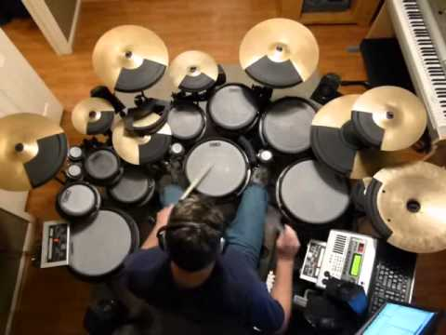
Next Generation: My Drum Set

Slide 54
For Further Information
For a copy of this presentation, leave me your business card with “Century” on it
Scott M Dulecki
BravePoint
616/481-4313
sdulecki@bravepoint.com

