Slide 1

Progress .NET, Not Progress GUI for .NET
Pug Challenge Americas 2014 - Westford
Presented by: Tom Bergman
Tom.Bergman@WoltersKluwer.com

Slide 2
.Net Framework – What is it?
http://msdn.microsoft.com/en-us/library/gg145045(v=vs.110).aspx
The .NET Framework class library is a library of classes, interfaces, and value types that provide access to system functionality. It is the foundation on which .NET Framework applications, components, and controls are built.
Windows only
In this presentation we will discuss methods primarily from the following namespaces
  System.Data
  System.Net
  System.IO
  System.Math
  System.Diagnostics
  System.DirectoryServices
  System.Drawing
  System.DateTime
  System.Text
  System.Web

Slide 3
Progress and .NET
Progress provides a “Bridge” into the .NET Common Language Runtime (CLR)
Originally intended just for UI design
Available since V10.2B
Only Prowin32.exe in 10.2B
Prowin32.exe, _Progres.exe, _Proapsv.exe all work in V11+
Developer Studio supports code completion for .NET classes
The Developer Studio Class Browser is also very useful

Slide 4
Data Mapping
By and large, Progress will map data to and from the .Net world automatically
System.String, System.DateTime, System.Double etc. can be directly assigned to Character, Date-Time and Decimal Progress variables
Binary data in .NET is often represented in memory as a System.Byte[].
Binary data in Progress is represented in memory as a MEMPTR
.NET write to a file, then COPY-LOB from file to Progress? – Not optimal
We need a means to change a System.Byte[] to a MEMPTR and back without writing a file.
ByteArrayToMemptr and MemptrToByteArray are two methods I’ll be using in a class I’ve named PugUtil. I use these in some of the demos.

Slide 5
The USING statement
Acts kind of like PROPATH does to access your Progress source
I find that while it saves a lot of typing, there’s a little less readability
These two code fragments behave exactly the same
USING System.*.
METHOD PUBLIC DECIMAL GetLeftBaseRadianAngle( ):
DEFINE VARIABLE sinX AS DECIMAL NO-UNDO.
sinX = GetHeight() / m_leftLeg.
RETURN Math:Round(Math:Asin(sinX),2).
END METHOD.
METHOD PUBLIC DECIMAL GetLeftBaseRadianAngle( ):
DEFINE VARIABLE sinX AS DECIMAL NO-UNDO.
sinX = GetHeight() / m_leftLeg.
RETURN System.Math:Round(System.Math:Asin(sinX),2).
END METHOD.

Slide 6
Translating from C#
The online examples in C# are probably the easiest to translate into Progress
Progress uses the Colon character to reference methods, properties etc. The name of the Class uses periods just like .NET
public double GetLeftBaseRadianAngle()
{
double sinX = GetHeight()/m_leftLeg;
return System.Math.Round(System.Math.Asin(sinX),2);
}
METHOD PUBLIC DECIMAL GetLeftBaseRadianAngle():
DEFINE VARIABLE sinX AS DECIMAL NO-UNDO.
sinX = GetHeight() / m_leftLeg.
RETURN System.Math:Round(System.Math:Asin(sinX),2).
END METHOD.

Slide 7
More translations
The other c# “using” syntax
Two things are illustrated here, The using syntax and an extension class.
The using syntax limits the scope and causes the object to be disposed at the end of the block. This may be required before the class actually performs the desired action.
This is not really a full substitute for what “using” does. It does not limit the scope and the dispose will not happen if an error occurs.
using (ZipArchive archive = ZipFile.Open(zipPath, ZipArchiveMode.Update))
{
archive.CreateEntryFromFile(newFile, "NewEntry.txt");
}
DEFINE VARIABLE archive AS ZipArchive.
archive = ZipFile:Open(zipPath, ZipArchieMode:Update).
ZipFileExtensions:CreateEntryFromFile(archive, newFile,“NewEntry.Txt").
archive:Dispose().

Slide 8
The c# foreach statement
There is no language statement in Progress that’s like the c# foreach.
Used to iterate through collections.
Foreach.i from Mike at Consultingwerk Ltd. is a great substitute
foreach(CompilerError CompErr in results.Errors) {
// Do something with the CompErr object
}
{foreach.i CompilerError CompErr in results:Errors}
/* Do something with the CompErr object*/
End.

Slide 9
Casting
When translating C# code, you’ll often see syntax that changes one object type to another type. This is called “Casting”
Progress uses the CAST function to do this
The objects must have an inheritance relationship
HttpWebRequest myHttpWebRequest = (HttpWebRequest)WebRequest.Create(url);
or
HttpWebRequest myHttpWebRequest = WebRequest.Create(url) as HttpWebRequest;
DEFINE VARIABLE myHttpWebRequest AS HttpWebRequest.
myHttpWebRequest = CAST(WebRequest:Create(url), HttpWebRequest).

Slide 10
Enumerations
Similar to named constants but checked at compile time
Progress can access .NET enumerations just like C# when you need to use an enumeration as a parameter to a method.
If you need to do more with enumerations, you need to use the Progress EnumHelper class.
Allows equality comparison as well as Add, And, Complement, IsGreater, Xor etc.
TempImage.Save(pFileName, ImageFormat.Tiff)
TempImage:Save(pFileName, ImageFormat:Tiff)
if response.StatusCode==HttpStatusCode.NotFound
IF Progress.Util.EnumHelper:AreEqual(response:StatusCode, HttpStatusCode:NotFound)

Slide 11
Case Sensitivity
This will compile
This will not
When in doubt, check for proper case.
USING MindFusion.Diagramming.*.
DEFINE VARIABLE myDiagram AS Diagram.
USING MindFusion.Diagramming.*.
DEFINE VARIABLE myDiagram AS diagram.

Slide 12
Progress Keywords
Some .Net class names conflict with Progress keywords
You need to use the full namespace name to reference a class like this.
This won’t compile
This will compile
USING System.Drawing.*.
SomeObject:Color = Color:Red.
SomeObject:Color = System.Drawing.Color:Red.

Slide 13
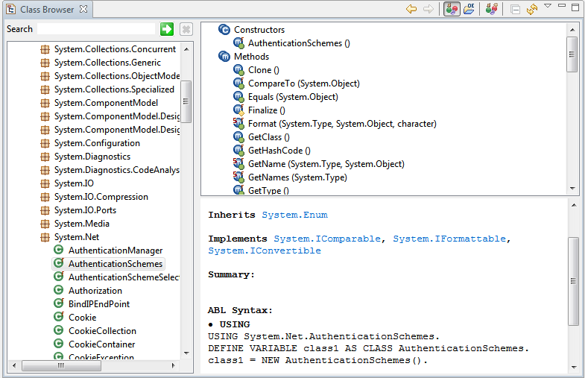
The Class Browser

Slide 14
The assemblies.xml file
In a brand new Workspace or Project, there is no assemblies.xml file
You can use any of the .NET classes you can see using the Class Browser
If you want to use classes you don’t see in the Class Browser, you need to add references to assemblies.xml (but there is no assemblies.xml file)
If you create a form and add a control, an assemblies.xml will be automatically generated. Or you can create one using the Assembly References choice under the OpenEdge Tools menu choice
Many of the example I’ll show required this to work.

Slide 15
Other Resources
Progress GUI for .NET Programming manual
Progress GUI for .NET Mapping Reference
Google (Example: “.Net Delete a file”)
MSDN

Slide 16
Now the Demos
Code is not intended to represent “Best Practices”
No more slides

Slide 17
Programs in Demo
SystemMath.p
  Illustrates the use of the System.Math class. Shows a RoundUp function, calculates the volume of a sphere and calculates the hypotenuse and the angles of a right triangle.
getTimeZone.p
  Uses System.Timezone to determine if it’s daylight time and then to display the proper name of the current timezone.
RegularExpressions.p
  Uses System.Text.RegularExpressions.Regex to perform a validation on an email address be seeing if it mathes a regular expression.
ZipDemo.p
  Uses System.IO.Compression and System.IO to first delete and create folder. Then creates a zip file from the content of a directory. It then extracts that zip file to another directory.
  It creates a new zip file and adds files one at a time. It then reads through the files in this zip file.
SystemIOPath.p
  Shows example of some of the file attributes available like the extension of a file, the generation of a temp file name etc.
  Also shows getting the size of a file. Progress FILE-INFO fails to do this with files over 2gb.

Slide 18
Programs in Demo, continued
ProcessDemo.p
  Uses System.Diagnostics.Process to get a list of all running processes, looks for a process with a particular name, then kills it.
HttpUtilityDemo.p
  Uses System.Web.HttpUtility to UrlEncode and UrlDecode a strimg. Shows how to parse a Name-Value pair list.
ParseDates.p
  Shows use of the System.DateTime.TryParse() method to get date values from a variety of character strings in various formats.
CheckCredentials.p
  Uses System.DirectoryServices and System.DirectoryServices.AccountManagement to validate user credentials against a local machine of an Active Directory server.
GetActiveDirProp.p
  Shows how to read Active Directory properties for a user.

Slide 19
Programs in Demo, continued
SQLDemo1.p
  Shows how to use the System.Data and Sytem.Data.SqlClient classes to read data from a SQL Database and create temp-table records.
SQLDemo2.p
  While the end result is similar to the above program, this demo shows reading data from a SQL database into a dynamically created Progress dataset. Illustrates that it’s possible to have a method that takes a SQL query and returns a Progress dataset with no manual definitions of tables or fields.
WebClientDemo1
  Shows basic use of the System.Net.Webclient class to make an http query and retrieve xml. Also shows basic use of System.Xml to parse values from the XML using Xpath expressions.
WebClientDemo2
  Uses the WebClient to download a file from a URL. Shows easier way to build query string. Shows use of System.Diagnostics.Process:Start to open a file in the default application.
WebClientDemo3
  Uses the Web Client to make a SOAP request. Illustrates how to do an Http POST and add headers. Demonstrates error handling and the retrieval of SOAP faults or other data returned when an error occurs.

Slide 20
Programs in Demo, continued
WebClientDemo4
  Illustrates possible encoding issues when using the WebClient. Shows a method of getting UTF-8 data into a LONGCHAR even if –cpinternal not set to UTF-8.
ExchangeAppt.p
  Creates an Appointment using the Microsoft Exchange Web Services API. Outlook is not required to use this API.
DemoCompression.w
  Requires the Sports 2000 database with an extra field added to the customer table named “blobfield”. Illustrates the use of the supplied PugUtil class to read and write compressed data to the database.
ImageResizeReformat.p
  Uses the supplied ImageUtil class to open an image and save it in several different jpeg qualities, and resize the image. Also shows how to retrieve and or add the image to a database field without a temporary file.
CSharpCompiler.w
  Written in Progress, this .w allows you to write, syntax check and compile C# code. Has no known practical purpose except to illustrate how deep the .Net framework goes.

