Slide 1
Database Storage for Dummies
Adam Backman
adam@wss.com
President – White Star Software, LLC

Slide 2
Introduction
Why is database storage important?
OpenEdge considerations
What is RAID?
Hardware vs. Software RAID
How to buy disk capacity
Hardware options
Wrap up

Slide 3
About the speaker
President – White Star Software
  Serving the Progress community since 1985
  Consulting
    Application support (design, build, review, …)
    Administration (Database, operating system, storage)
  Training (Application and administration)
Vice President – DBAppraise
  Simplifying the task of monitoring and managing the worlds best business applications
  Remote management of your OpenEdge environment by the worlds best OpenEdge administrators

Slide 4
Why is storage so important?
Storage Goals
  Reliability
    Protection of your data from data loss
  Availability
    Data is available to the users
  Performance
    Uniform application response time under varying workloads
  These different goals tend to work against each other

Slide 5
Why is storage so important?
Everything starts on the disk
When tuning, it is the second most likely cause for performance issues after application code
Disk is an order of magnitude slower than memory
Performance tuning is a process of pushing the bottleneck to the fastest resource
Network Disk Memory CPU

Slide 6
OpenEdge Considerations
Type II storage area
Database block size
Records per block
Before image cluster size
After image I/O

Slide 7
Records Type I Storage Areas
Data blocks are social
  They allow data from any table in the area to be stored within a single block
  Index blocks only contain data for a single index
Data and index blocks can be tightly interleaved potentially causing scatter

Slide 8
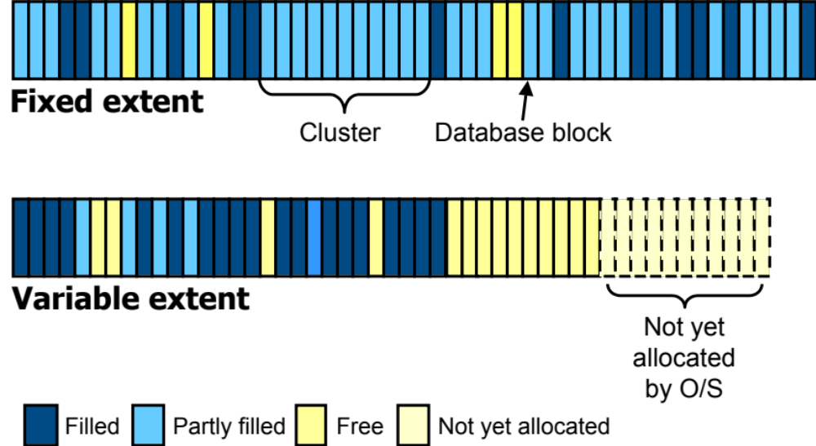
Database Blocks
Notes:
Notes:

Slide 9
Type II Storage Areas
Data is clustered
Clustering improves performance
  Better proximity of data
  Less disk head movement
  Able to take advantage of read ahead algorithms
Performance increase has been tested and proven to be (nearly) universal
Dump and load or table/index move required to move from type I to type II areas

Slide 10
Type II Storage Areas
Data is clustered together
A cluster will only contain records from a single table
A cluster can contain 8, 64 or 512 blocks
This helps performance as data scatter is reduced
Disk arrays have a feature called read-ahead that really improves efficiency with type II areas
Notes:
Records/Block Blocks/Cluster Min records
---------------------------+----------------------------------+--------------------------------
32 | 8 | 256
32 | 64 | 2048
32 | 512 | 16384
---------------------------+----------------------------------+--------------------------------
64 | 8 | 512
64 | 64 | 4096
64 | 512 | 32768
---------------------------+----------------------------------+--------------------------------
128 | 8 | 1024
128 | 64 | 8192
128 | 512 | 65536
---------------------------+----------------------------------+--------------------------------
256 | 8 | 2048
256 | 64 | 16384
256 | 512 | 131072

Slide 11
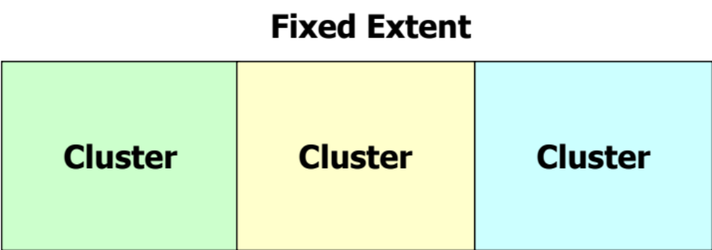
Type II Clusters
Customer
Order
Order Line
Notes:
Notes:
Each cluster will only contain one type of object (table, index)

Slide 12
Storage Areas Compared
Type I
Type II
Data Block
Data Block
Index Block
Data Block
Data Block
Data Block
Index Block
Index Block
Data Block
Index Block
Data Block
Data Block
Data Block
Data Block
Data Block
Data Block
Data Block
Data Block
Index Block
Index Block
Cluster

Slide 13
Importance of database block size
OpenEdge® default block size is still 1kb
Larger block allow for more records or index entries per physical operation
Matching operating system and database block sizes improves efficiency
  Generally 8k block size is best for most
  4k is best for Windows servers
Larger blocks *may* require a higher records per block setting

Slide 14
Records per block setting
Each area can have a different setting
Default is 64, this is generally too low for 8k blocks
Calculation:
  Database-block-size/(Mean-record-size + 20) = Maximum-Rec/block
  20 is the approximate overhead per record
  Records per block setting should equal the next HIGHER binary number between 1 and 256
Set too low and you waste space and reduce the efficiency of every read operation
Set too high and run the risk of record fragmentation

Slide 15
Example: Records /Block
Mean record size = 90
Add 20 bytes for overhead (90 + 20 = 110)
Divide product into database blocksize
  Example: 8192 ÷ 110 = 74.47
Choose next higher binary number 128
Default records per block is 64
Notes:
Notes:
If you choose the next higher binary number for records per block you ensure that your blocks will be full. Choosing the next lower number would use all of the “slots” before filling the block. This would waste space (empty portion of block could not be used) and reduce performance (a request would get only 64 records when it could get 74 in the case above)

Slide 16
Before Image Cluster Size
One the best ways to improve OLTP performance
Default has been increased to 512k but in most cases a setting above 4096k (4MB) is more appropriate
BI cluster size determines the amount of transactional (create, update, delete) work that is done between checkpoints
The goal is to have 120 seconds between checkpoints at you busiest update time of the day

Slide 17
After Image affect on I/O decisions
After Imaging provides an extra level of data protection in case of media loss
Everyone should be using after imaging
After image files should be isolated from the rest of the database
  Best case: different physical hardware
  Usual scenario: Different file system
Writes to this file have the potential to be expensive

Slide 18
What RAID really means
Most commonly used RAID levels:
RAID 0: This level is also called striping.
RAID 1: This is referred to as mirroring.
RAID 5: Most controversial RAID level
RAID 10: This is mirroring and striping. Also known as RAID 0 + 1 (OpenEdge preferred)

Slide 19
Raid 0: Striping
Disk 1
Disk 2
Disk 3
Disk
Array
Stripes 1, 4, …
Stripes 2, 5, …
Stripes 3, 6, …
Stripe 1
Stripe 2
Stripe 3
Stripe 4 ...
Volume Group

Slide 20
RAID 0: Striping (cont.)
Good for read and write I/O performance
No failover protection
lower data reliability (1 fails they all fail)

Slide 21
What is Stripe Width?
Also called chunk size
Stripe width is the amount of data put on a physical volume before moving to the next disk in the set
128k is a good stripe width for 8k block size databases but performance has been proven to increase with even larger stripe widths (upto and including 2MB tested)

Slide 22
RAID 1: Mirroring
Disk 1
Disk 2
Primary
Parity 1
Parity 2
Parity

Slide 23
RAID 1: Mirroring (cont.)
OK for read and write applications
Good failover protection
High data reliability
Most expensive in terms of hardware

Slide 24
RAID 5: Poor man’s mirroring
User information is striped
Parity information is striped with user info
  Write primary data
  Calculate parity
  Write parity
Good for read intensive applications
Poor performance for writes after cache is exhausted
Single disk failure is protected but performance will suffer

Slide 25
RAID 10: Mirroring and Striping
Ideal for both read, write or mixed applications
High level of data reliability though not as high as RAID 1 due to striping
Just as expensive as RAID 1
Generally, the recommended RAID level for most OpenEdge applications

Slide 26
RAID 10 vs. RAID 5 cache fill rate
fillTime = cacheSize / (requestRate – serviceRate)
  4 disks
  RAID10 vs RAID5
  4KB db blocks
  4GB RAM cache (1048576 blocks)
Typical Production DB Example:
  4GB / ( 200 io/sec – 800 io/sec ) = cache doesn’t fill!
Heavy Update Production DB Example:
  4GB / ( 1200 io/sec – 800 io/sec ) = 2621 sec. (≈ 44 min.) (RAID10)
    4GB / ( 1200 io/sec – 200 io/sec ) = 1049 sec. (≈ 17 min.) (RAID5)
Maintenance Example:
  4GB / ( 5000 io/sec – 3200 io/sec ) = 583 sec. (≈ 10 min.) (RAID10)
  4GB / ( 5000 io/sec – 200 io/sec ) = 218 sec (≈ 4 min.) (RAID5)

Slide 27
Hardware vs. Software RAID
Software RAID
  Uses primary CPU resources
  Less scalable
  Generally less expensive
Hardware RAID
  The preferred option
  Dedicated resources (memory and CPU) for storage
  Much greater scalability
  More expensive up front but you pay once and reap the benefits for the life of the hardware

Slide 28
Buying Disks
Buy small disks (individual drives)
  Each disk regardless of it’s size is capable of doing approximately the same number of I/Os per second
Buy fast disks
  Slow disk = slow performance
Buy reliable disks
Buy many disks
  The outer portion of the disk is up to 20% faster than the inner portion of the disk
Try to leave room for inexpensive growth
  Upgrades tend to be more expensive

Slide 29
Buying Disk Arrays
Considerations Include:
    Reliability
    Features (remote mirroring, software, …)
    Storage capacity
    Throughput capacity
    Support capacity
    Replacement/upgrade path

Slide 30
Hardware options
Many excellent options for all size operations
Small to medium scale
  iSCSI
  Low cost
  General availability components (SAS, SCSI, non-fibre channel)
Medium to large scale
  SAN
  mid-range cost (fibre channel drives, Switches, …)
  Good scalability
Enterprise scale
  Fibre throughout the array
  Nearly unlimited scalability

Slide 31
Hardware Examples – Architecture
Direct Attached Storage
  SAS and SATA drives
  No dedicated array cache
  Single path
iSCSI
  SAS, SATA and fibre channel drives
  Limited array cache
  Multi-path
SAN
  Fibre channel drives
  Multi-path throughout the array

Slide 32
Network Attached Storage (NAS)
The most well known NAS company is NetApp
NAS devices are great for file storage
NetApp even calls their device a “filer”
These are NOT good devices for databases due to the file vs. block nature of the storage

Slide 33
Hardware options – Upgrade Path
Few people consider the replacement of their storage when first making the array purchase
Replacement is still the way that most small to medium size systems are upgraded
In-place upgrades are that require downtime or reconfiguration are the hallmark of midrange arrays
Zero downtime in-place upgrades are now the norm in enterprise arrays.

Slide 34
Hardware Examples
Equilogic – Great availability, reasonable pricing
EMC VNXe – Lower end EMC versus VMAX
HP EVA – Super ease of use, self tuning
Hitachi Data Systems – Ultra scalable
IBM XIV – Commodity hardware, enterprise features
FusionIO – Ultra fast but VERY expensive and mostly unproven technology

Slide 35
Points to Remember
Disks are a good place to put money in the hardware acquisition process
Take advantage by optimizing your database storage
  Type II
  Database block size
  BI cluster size
  Isolating After Image extents
Buy what you need but remember that you may need to upgrade so buy with growth in mind
People generally overbuy CPU capacity and under buy disk throughput capacity

Slide 36

Questions

Slide 37
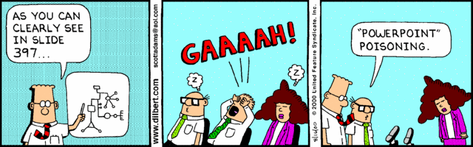
Thank you for your time!

