Slide 1
RDBMS Progress, Oracle and SQL Server in relationship with
Big Brother/Big Data
Notes:
I will not talk about languages, i.e. 4GL vs PL/SQL vs T-SQL

Slide 2
Dmitri Levin
Work with Progress since 1992
Work with Oracle since 2003
MS SQL Server – not much
Microsoft Certified Professional (SQL-2012)
Oracle Certified Associate (11g)
Progress – not certified ☺

Slide 3











Relational Databases
Big Data / NoSQL
( humongous )
Notes:
MongoDB=Craigslist, Ebay
Cassandra=facebook

Slide 4
NoSQL Types
Key-value store | Amazon DynamoDB, Oracle NoSQL
Column Store | Cassandra, Hbase, BigTable
Document databases | MongoDB (JSON)
Graph stores | Neo4j, HyperGraphDB
Notes:
Key-value stores are the simplest NoSQL databases. Every single item in the database is stored as an attribute name (or "key"), together with its value.
Wide-column stores are optimized for queries over large datasets.
Graph stores are used to store information about networks, such as social connections.

Slide 5
BigData ≈ Kind of
“proutil db –C load –i”
A top speed load
No durability

Slide 6
 | RDBMS | BigData
Relational | Yes | No
Basic unit | Row | Document
Schema | Yes | No
Notes:
BigData= a lot of data streaming at top speed, no updates, only reads.

Slide 7
RDBMS | NoSQL
Row | Document
Document
{ “name” : “Dmitri” , “last name” : “levin”, “date of birth” : 04/13/64 }
Document
{ “name” : “Dmitri” , “name” : “John” }

Slide 8
RDBMS | NoSQL
Row | Document
Table | Collection
Collection of Documents
{ “name” : “Dmitri” , “lname” : “levin”, “dob” : 04/13/64 }
{ “name” : “John” , “lname” : “Doe”}
{ “foo” : 3 }

Slide 9
RDBMS | NoSQL
Database | Database
Table | Collection
Row | Document
Column | Field=key-value pair
Index | Index
Primary Key | _id field

Slide 10
RDBMS | NoSQL
Database
Database
Table
Collection
Row
Document
Row
Document
Table
Collection
Row
Document
Row
Document

Slide 11

 | RDBMS | BigData
Relational | Yes | No
Basic unit | Row | Document
Schema | Yes | No
(NoSQL)
Scaling | Up | Out
$$

Slide 12
Shard
Partitioning
Sharding
Shard_1
Shard_2
Partition_1
Partition_2

Slide 13
DR with Sharding
A
B
C
Shard_1
Shard_2
Shard_3
Shard_1
Shard_2
Shard_3

Slide 14
 | RDBMS | BigData
Relational | Yes | No
Basic unit | Row | Document
Schema | Yes | No
Scaling | Up | Out
Normalization | Yes | No
Referential Integrity | Yes | No
Transactions/Durability | Yes | No
Row Locks | Yes | No
Joins | Yes | No
(NoSQL)
$$
Notes:
No Transactions, i.e. “Fire and forget” vs “Safe” mode. Be default “Fire and forget”.
No unique indexes.

Slide 15
Examples
Progress | mongoDB
Create Customer. Assign name = "Lift Line Skiing" country = “USA” address = “276 North Street” city = ” Boston” state = ” MA” postal-Code = 02114. | db.customer.insert( {name: "Lift Line Skiing", country: “USA”, address: “276 North Street” City:” Boston” State:” MA” Postal-Code:02114} );

Slide 16
Examples
Progress | mongoDB
For each Customer no-lock: Display Cust-Num name country address city state Postal-Code. | db.customer.find();
1 Lift Line Skiing USA 276 North Street Boston MA 02114 | { _id: ObjectID("509a8fb2f3f4948bd2f983a0"), name: "Lift Line Skiing", country: “USA”, address: “276 North Street” City: ”Boston” State: ”MA” Postal-Code: 02114}
Find first customer no-lock. | db.customer.findOne();

Slide 17
Examples
Update
db.customer.update({Cust-Num: 1}, {new-document});
Delete
db.customer.remove({Cust-Num: 1});
Delete everything
db.customer.remove();

Slide 18
Examples
db.customer.find({Cust-Num: 1});
{“cust-num”: 1, “name” : “Dmitri”}
Update
db.customer.update({Cust-Num: 1}, {‘$Set’ {‘Age’: 50}});
{“cust-num”: 1, “name” : “Dmitri”, “age”: 50}

Slide 19
CRUD
Create
Read
Update
Delete
More Examples
http://try.mongodb.org

Slide 20
Where it is used
Healthcare
Retail
Security (NSA)
Emergency Management (FAA)
Social Media

Slide 21
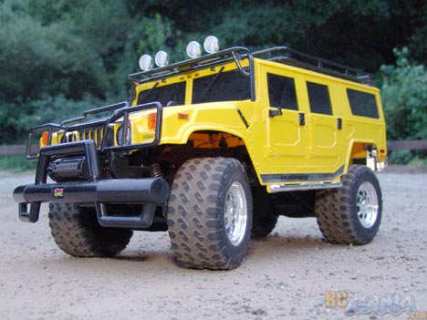


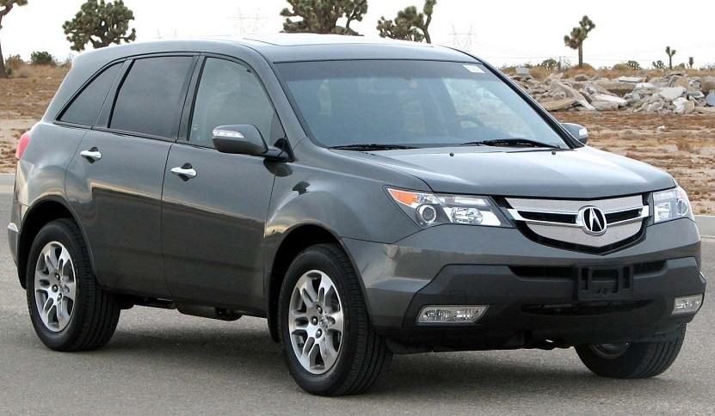
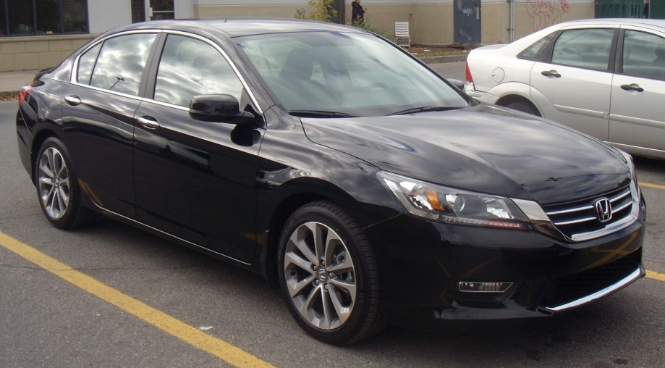

Slide 22
RDBMS
NewSQL
NoSQL
Oracle
???
MongoDB
Notes:
NewSQL is a class of modern RDBMS that seek to provide the same scalable performance of NoSQL systems for online transaction processing (read-write) workloads while still maintaining the ACID guarantees of a traditional database system.

Slide 23








NewSQL
MongoDB
General Purpose
In-memory Databases
Notes:
NewSQL is a class of modern RDBMS that seek to provide the same scalable performance of NoSQL systems for online transaction processing (read-write) workloads while still maintaining the ACID guarantees of a traditional database system.

Slide 24
That is all about NO SQL

Slide 25
Progress, Oracle and SQL Server
Notes:
I will not talk about languages, i.e. 4GL vs PL/SQL vs T-SQL

Slide 26
Instance
Background Processes
APW
BIW
AIW
WDOG
Shared memory
Sports.db
Sports.bi
Sports.lg

Slide 27
Progress v10
Oracle11g
MS SQL Server
Instance
Instance
Instance
Database
Database
Database
Schema
Schema
Schema
Schema
Schema
Schema
Database
Schema

Slide 28
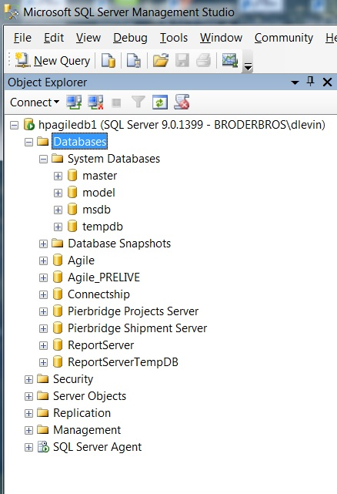
System Databases
User Databases

Slide 29
Progress v11
Oracle12c
MS SQL Server
Instance
Container DB
Instance
Database
Plugable DB
Database
Schema
Schema
Schema
Tenant
Schema
Schema
Tenant
Plugable DB
Database
Backup
Tenant
Schema
Schema

Slide 30
Physical Structure (data files)
Progress |  | Oracle |  | MS SQL Server
Database File | sports.db | Control File(s) | control01.ctl | N/A, master db
Structure file | sports.st | N/A |  | N/A
System Area | sports.d1 | System Tablespace | system.dbf | Primary datafile .mdf
D Files | area.d | Datafiles | tablespace.dbf | Secondary datafile .ndf
Before-Image File + After-Image File | sports.b1 + sports.a1 | Undo tablespace + Redo Log | undotbs.dbf + redo01.log | Log files .ldf
Copy of After-Image File | sports.date_time_etc | Archive Log | sports.date_time_etc
Log File | sports.lg | Alert Log | alert_sports.log
Parameter File | sports.pf | pfile (or spfile) | initsports.ora
Notes:
Progress and Oracle are quite different in transaction processing. No direct map of .bi and .ai
Alert Log: All startup parameter, but no user connect/disconnect

Slide 31
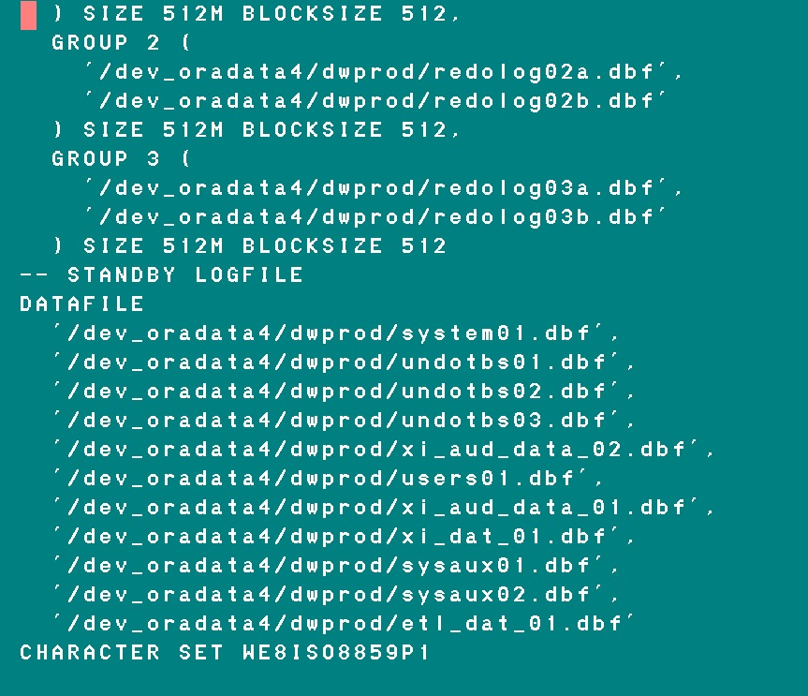
SQL> ALTER DATABASE BACKUP CONTROLFILE TO TRACE;

Slide 32
Progress = _DbStatus-LastTran
(Last Transaction Number) or promon 7
Oracle = SCN
(System Change Number)
SQL Server = LCN
(Log Change Number)

Slide 33
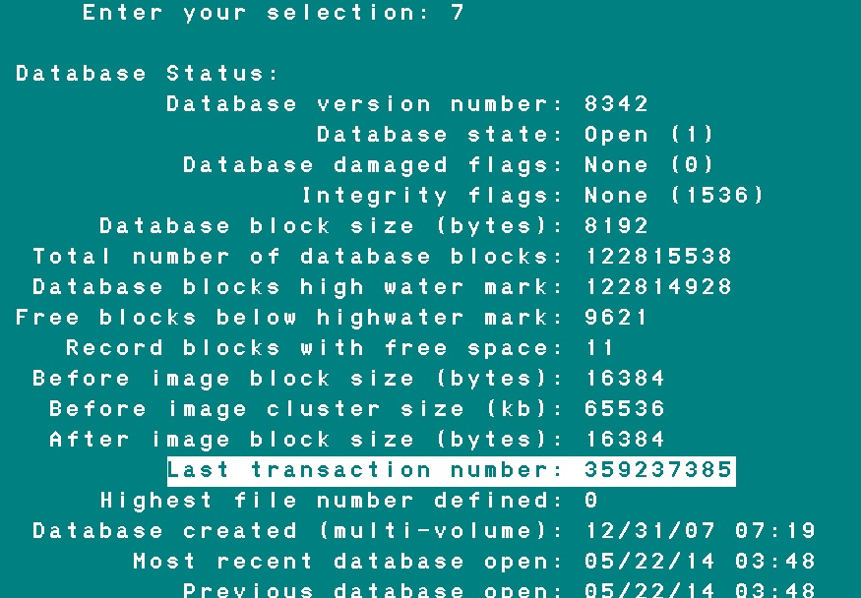
Last Transaction Number

Slide 34
Progress _DbStatus-LastTran
rfutil db-name -C roll forward
[ endtime yyyy:mm:dd:hh:mm:ss |
endtrans transaction-number ]
Oracle SCN
SQL> RECOVER DATABASE UNTIL TIME sysdate-1;
SQL> RECOVER DATABASE UNTIL SCN 1234567;
SQL Server LCN
RESTORE LOG db_name FROM DISK = 'C:\file.TRN'
WITH RECOVERY, STOPAT = 'Mar 23, 2009 05:31:00 PM'
RESTORE LOG db_name FROM DISK = 'C:\file.TRN'
WITH RECOVERY, STOPATMARK = 'lsn:lsn_number'

Slide 35
Physical Structure (data files)
Progress |  | Oracle |  | MS SQL Server
Database File | sports.db | Control File(s) | control01.ctl | N/A, master db
Structure file | sports.st | N/A |  | N/A
System Area | sports.d1 | System Tablespace | system.dbf | Primary datafile .mdf
D Files | area.d | Datafiles | tablespace.dbf | Secondary datafile .ndf
Before-Image File + After-Image File | sports.b1 + sports.a1 | Undo tablespace + Redo Log | undotbs.dbf + redo01.log | Log files .ldf
Copy of After-Image File | sports.date_time_etc | Archive Log | sports.date_time_etc
Log File | sports.lg | Alert Log | alert_sports.log | Error Log (ERRORLOG)
Parameter File | sports.pf | pfile (or spfile) | initsports.ora | Registry
Notes:
Progress and Oracle are quite different in transaction processing. No direct map of .bi and .ai
Oracle alert Log: All startup parameter, but no user connect/disconnect
SQL Server keeps by default 6 ERRORLOGs: ERRORLOG, ERRORLOG.1, etc.

Slide 36
.mdf, .ndf, .ldf
.mdf, .ldf

Slide 37
Physical Structure (data files)
Progress |  | Oracle |  | MS SQL Server
Database File | sports.db | Control File(s) | control01.ctl | N/A, master db
Structure file | sports.st | N/A |  | N/A
System Area | sports.d1 | System Tablespace | system.dbf | Primary datafile .mdf
D Files | area.d | Datafiles | tablespace.dbf | Secondary datafile .ndf
Before-Image File + After-Image File | sports.b1 + sports.a1 | Undo tablespace + Redo Log | undotbs.dbf + redo01.log | Log files .ldf
Copy of After-Image File | sports.date_time_etc | Archive Log | sports.date_time_etc
Log File | sports.lg | Alert Log | alert_sports.log | Error Log (ERRORLOG)
Parameter File | sports.pf | pfile (or spfile) | initsports.ora | Registry
Notes:
Progress and Oracle are quite different in transaction processing. No direct map of .bi and .ai
Oracle alert Log: All startup parameter, but no user connect/disconnect
SQL Server keeps by default 6 ERRORLOGs: ERRORLOG, ERRORLOG.1, etc.

Slide 38
Progress
Oracle
MS SQL Server
Instance
Container DB
Instance
Database
Before-image
After-image
Redo Log
Undo Tablespace
Transaction Log
Database
Transaction Log

Slide 39
Progress
Oracle
MS SQL Server
PROD
With After-images
W/O After-images
ARCHIVELOG Mode
NOARCHIVELOG Mode
FULL Recovery Model
SIMPLE Recovery Model
Bulk-logged Recovery Model
DEV

Slide 40
Physical Structure (data files)
Progress |  | Oracle |  | MS SQL Server
Database File | sports.db | Control File(s) | control01.ctl | N/A, master db
Structure file | sports.st | N/A |  | N/A
System Area | sports.d1 | System Tablespace | system.dbf | Primary datafile .mdf
D Files | area.d | Datafiles | tablespace.dbf | Secondary datafile .ndf
Before-Image File + After-Image File | sports.b1 + sports.a1 | Undo tablespace + Redo Log | undotbs.dbf + redo01.log | Log files .ldf
Copy of After-Image File | sports.date_time_etc | Archive Log | sports.date_time_etc
Log File | sports.lg | Alert Log | alert_sports.log | Error Log (ERRORLOG)
Parameter File | sports.pf | pfile (or spfile) | initsports.ora | Registry
Notes:
Progress and Oracle are quite different in transaction processing. No direct map of .bi and .ai
Oracle alert Log: All startup parameter, but no user connect/disconnect
SQL Server keeps by default 6 ERRORLOGs: ERRORLOG, ERRORLOG.1, etc.
C:\Program Files\Microsoft SQL Server\MSSQL.n\MSSQL\LOG\ERRORLOG

Slide 41
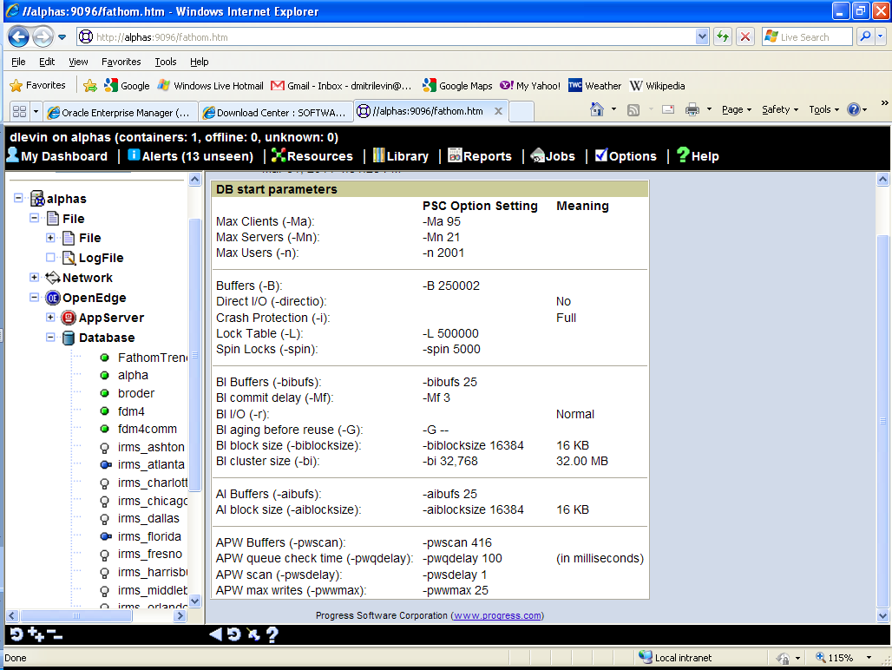
Notes:
proutil db-name -C increaseto -B n -L n -bibufs n -aibufs n

Slide 42
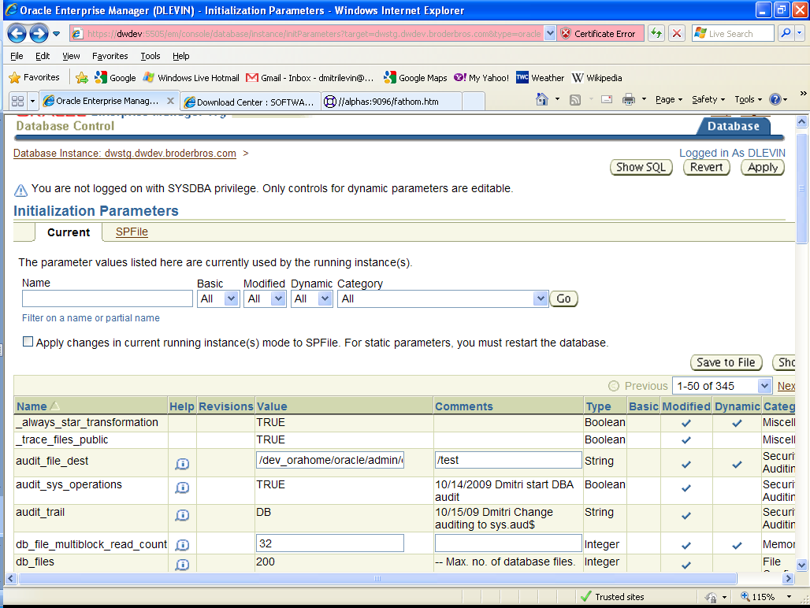
OEM parameters
Notes:
Static and dynamic parameters

Slide 43
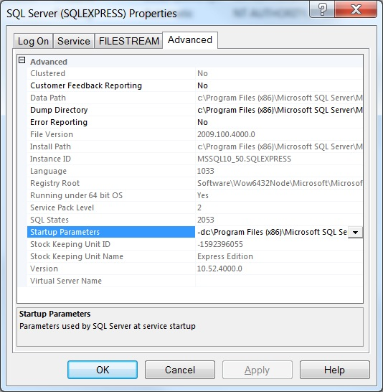

Slide 44
Logical Structure
Progress | Oracle | MS SQL Server
Area | Tablespace | Filegroup
System Area | System Tablespace | Primary Filegroup
Object | Segment | N/A
Cluster 8,64,512 | Extent system managed | Extent 8 pages
Block 1,2,4 or 8K | Block 2,4,8,16,32 or 64K | Page 8K

Slide 45
Background Processes/Threads
Progress | Oracle | description | SQL Server threads
APW | DBWn | Database Writer | Lazywriter
BIW, AIW | LGWR | Log Writer | Log Writer
AIMGT | ARCn | Archive Process | N/A
WDOG | PMON | Process Monitor | SQLOS
 | SMON | System Monitor | Database Cleanup Database Shrinking
 | CKPT | Checkpoint process | Database Checkpoint
 |  | Many other …. 80 at least
Notes:
Log Writer, like BIW is only one.

Slide 46
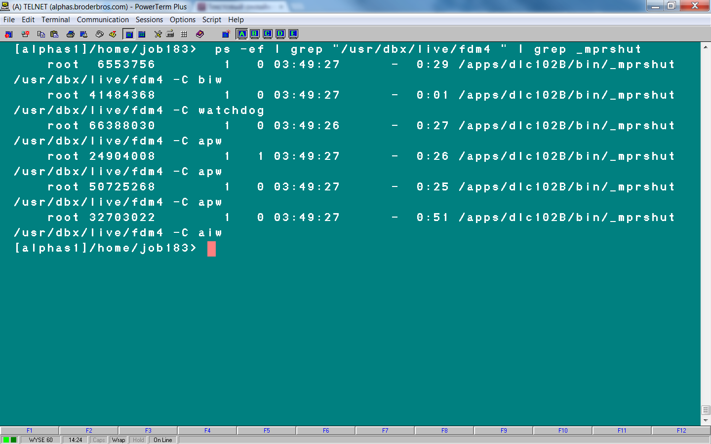
Progress: ps –ef | grep db_name| grep _mprshut

Slide 47
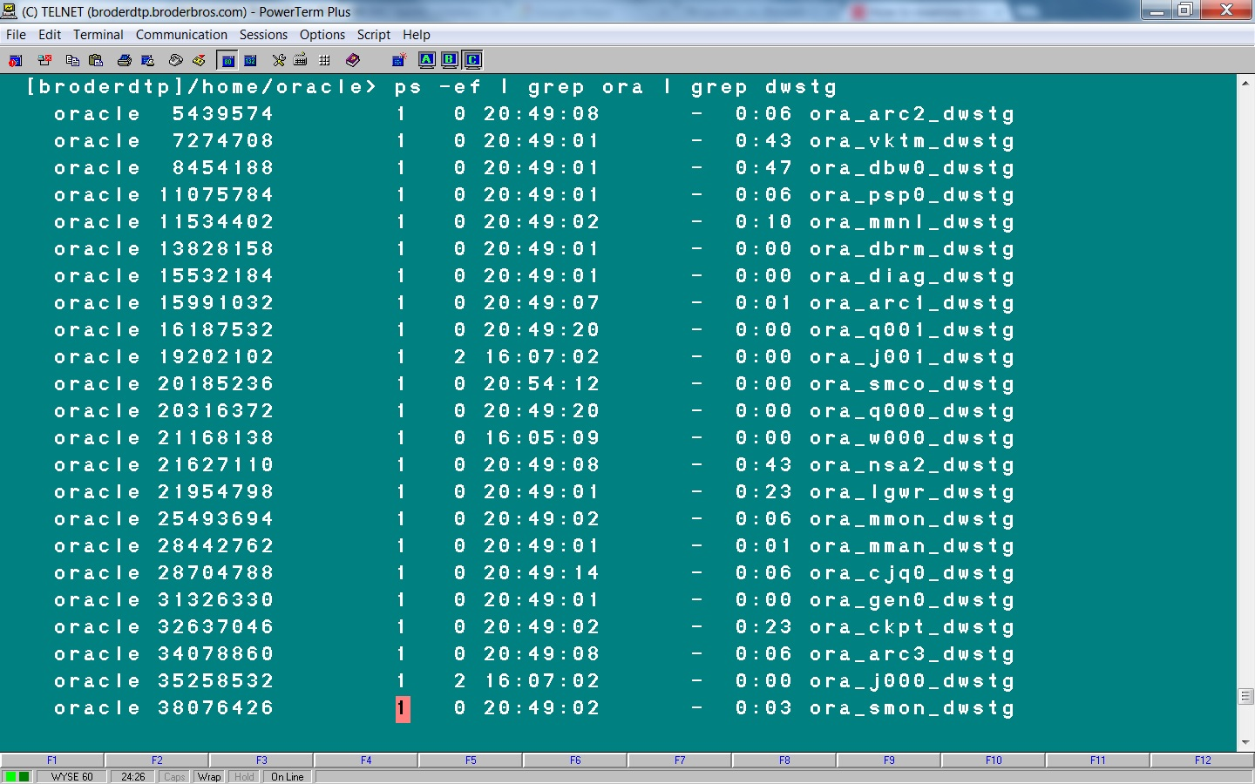
Oracle: ps –ef | grep ora

Slide 48
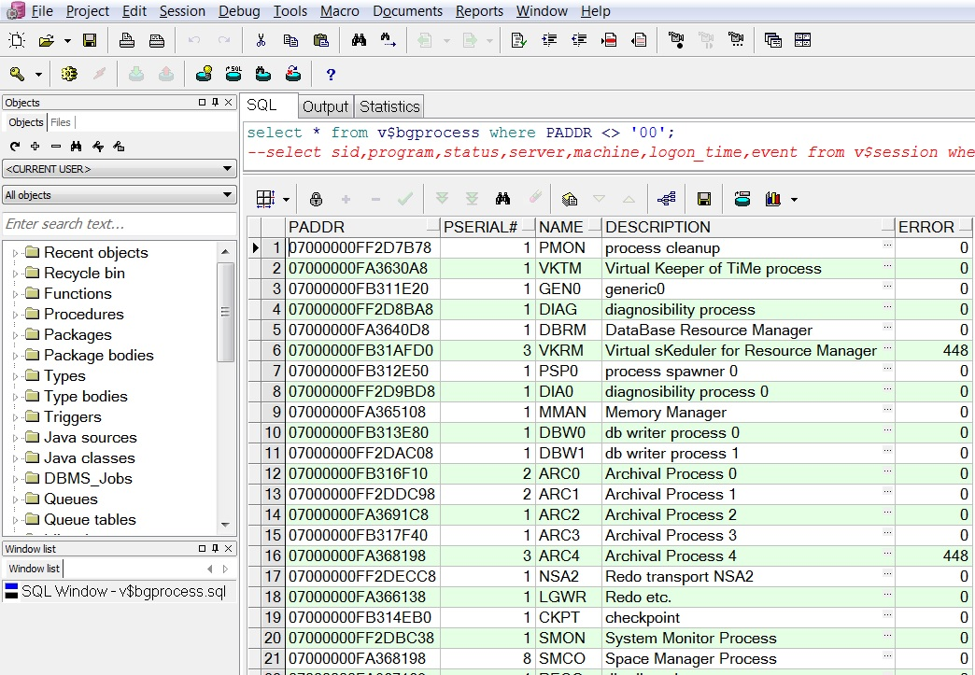
Oracle: select * from v$bgprocess;

Slide 49
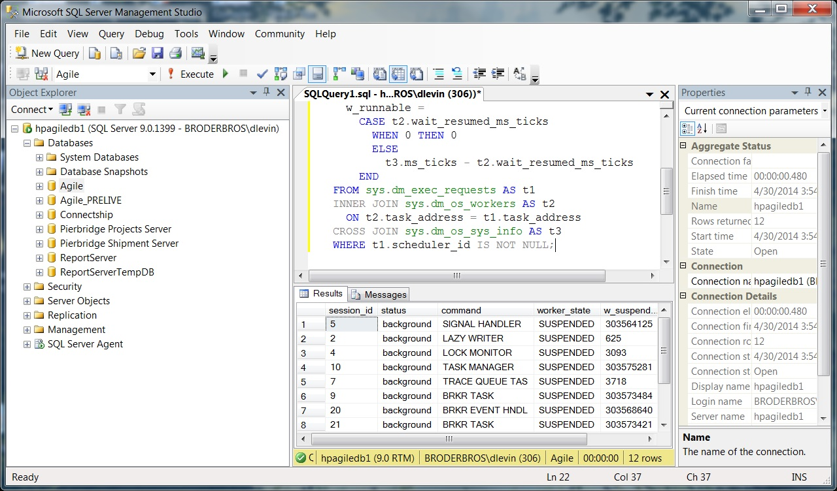
SQL Server: select * from sys.dm_os_workers;

Slide 50
Meta-schema and VST
Progress Meta-schema tables -80 < _file-number < 0
Progress VST _file-number < -16384
Progress Table | Oracle View | SQL Server
_Area | DBA_TABLESPACES | sys.filegroups
_AreaExtent | DBA_DATA_FILES | sys.master_files
_StorageObject | DBA_OBJECTS | sys.objects
_File | DBA_TABLES | sys.tables
_Field | DBA_TAB_COLUMNS | sys.columns
_Index | DBA_INDEXES | sys.indexes
_Index-field | DBA_IND_COLUMNS | sys.index_columns
_Sequence | DBA_SEQUENCES | sys.sequences
Notes:
Every Progress table has _file record
Every Oracle view has DBA_VIEW record

Slide 51
VST/ Dynamic Performance/Management Views
Progress | Oracle | SQL Server
Virtual System Tables | Dynamic Performance Views Or V$ ( Vee dollar) Views | Dynamic Management Views
_Connect | v$session, v$process | sys.dm_exec_sessions, sys.dm_exec_connections
_DbStatus | v$instance, v$sysstat | sys.dm_os_performance_counters
_Trans | v$transaction | sys.dm_tran_active_transactions
_Lock | v$lock | sys.dm_tran_locks
_Latch | v$latch | sys.dm_os_latch_stats
_AreaStatus | v$tablespace | sys.data_spaces
_Filelist | v$datafile | sys.dm_db_file_space_usage
_Startup (some) | v$parameter | sys.dm_server_registry

Slide 52
Supplied Test Databases
Progress
Oracle
MS SQL Server
Sports2000
HR
AdventureWorks2012

Slide 53
Partitioning Types
Progress | Oracle | MS SQL Server
List | List | List
Range | Range | Range
 | Hash
Sub-partitioning | Composite
Composite

Slide 54
Data Protection
Backup
Replication
Clustering
Flashback

Slide 55
Backup
Progress and SQL Server – simple | Oracle RMAN – More complicated
probkup sports file_name
BACKUP DATABASE AdventureWorks TO DISK file_name WITH FORMAT;
All databases : Online and Offline (Hot and Cold)
All databases: Complete and Incremental/Differential
Oracle and SQL Server | could be Full and Partial (some tablespaces or filegroups)
SQL Server BACKUP LOG AdventureWorks TO DISK | Log backup
Notes:
Log backup necessary in Full Recovery Model

Slide 56
Compressed Backup
900 GB Progress DB makes about 750 GB probkup
1.4 TB Oracle DB makes either 1.2 TB regular backup or
250 GB RMAN compressed backup (BZIP2 is default).
Compressed backup could be done in SQL Server.
Notes:
With compress backup CPU usage increases and I/O decreases. So it could be faster or slower then regular one.

Slide 57
Replication
OE Replication | Synchronous
 | Asynchronous
Source
Target
Oracle 12c
Far Sync DB

Slide 58
Progress
Oracle RAC
Active - Passive
Active – Active
Server 1 Memory
Apw, Biw, Aiw, Wdog
Server 2
Server 1 Memory
DBWn, LGWR ARCn, SMON
Server 2 Memory
DBWn, LGWR ARCn, SMON
DB

Slide 59
Cluster db 2
Progress
Oracle RAC
Server 1
Server 2 Memory
Apw, Biw, Aiw, Wdog
Server 1
Server 2 Memory
DBWn, LGWR ARCn, SMON

Slide 60
Flashback
Flashback Database
Flashback Table
Flashback Drop
Flashback Query
Flashback Version Query
Flashback Transaction Query
Notes:
Six types of Flashback in 10g. They are designed to fix human errors.

Slide 61
Flashback Database
Oracle Flashback DB:
SQL> flashback database to timestamp sysdate-1;
SQL> flashback database to SCN 1234567;
Oracle Flashback Query:
SQL> select * from table_name
as of timestamp systimestamp - interval ‘30' minute;
SQL Server -- Create database snapshot
CREATE DATABASE AdventureWorks_dbss1ON
( NAME = AdventureWorks_Data, FILENAME =
'C:\AdventureWorks_data_1.ss' )
AS SNAPSHOT OF AdventureWorks;
GO

Slide 62
Connecting to a database
Progress | Client Server -db db_name -H host -S service
 | Shared memory -db /full_path/db-name
Oracle | Listener
MS SQL Server | Login, Password
 | Windows credentials
Notes:
When listener is down existing users will be fine. New users will not be able to connect.
Server, Listener port, db name

Slide 63
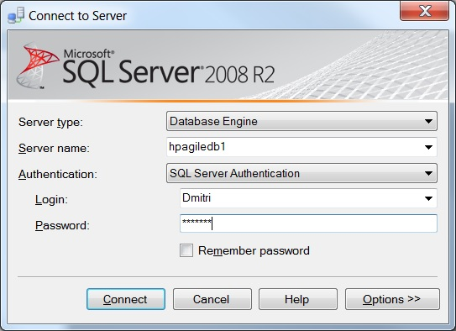

Slide 64
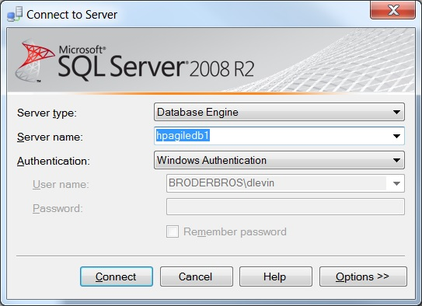

Slide 65
Connecting to a database
S
-H host –S service1
SID
Host:port:SID
-H host –S service2
Host:port:SID2
SID2
Listener
Port 1521

Slide 66
Shutdown
Unconditional Shutdown
Emergency Shutdown
Shutdown Normal
Shutdown Transactional
Shutdown Immediate
Shutdown Abort

Slide 67
Startup
Shared Memory
Background Proc
Closed | Closed
 | Nomount mode
 | Mount mode
Open | Open
←Prorest
init*.ora
←Restore
.ctl

Slide 68

Questions
Web page | www.proora.com
Email | d_levin@hotmail.com

